Slide 1
The Liberty Protection Safeguards
Tim Spencer-Lane
November 2021

Slide 2
What on earth has happened to the LPS Code & regulations?

Slide 3

Adverse possession
LPS basic principles
Deprivation of liberty is everyone’s business
Moving consideration to the frontline
No more court authorisations

Slide 4
Authorising arrangements
Arrangements can be authorised for enabling the care or treatment of a person (aged 16+) that give rise to a deprivation of liberty
can be in any setting & multiple settings
can include means & manner of transport
Notes:
4

Slide 5
Who is the responsible body?
if arrangements mainly carried out in an NHS hospital, the relevant NHS trust
if arrangements mainly carried out in an independent hospital , a local authority
If arrangements are mainly via CHC, the CCG
otherwise, a local authority (in broad terms, the authority meeting the person’s needs or in whose area the arrangements are mainly taking place)
Notes:
5

Slide 6
The 3 assessments
Capacity assessment
person lacks capacity to consent to the arrangements
Medical assessment
person has a mental disorder
Necessary & proportionate assessment
necessary to prevent harm to person, & proportionate to likelihood & seriousness of such harm

Slide 7
Adverse possession
Pre-authorisation review
No objections
Review on the papers
Objection or independent hospital
AMCP reviews the case
Undertaken by senior manager?
meets person & consults others
Pre-authorisation reviewer cannot be involved in person’s day-to-day care or providing any treatment

Slide 8
Key safeguards
rights to information
duty to provide care plan (authorisation record)
rights to regular reviews
rights to IMCA or appropriate person
rights of legal challenge to the Court of Protection
duty on CQC to monitor & report on the LPS
Notes:
8

Slide 9
Interim & emergency DoL
No more urgent authorisations
Instead, decision makers can deprive the person of liberty pending the responsible body decision
DoL must be necessary to deliver life-sustaining treatment or carry out a vital act
No statutory time limits (but Code??)
Notes:
9

Slide 10
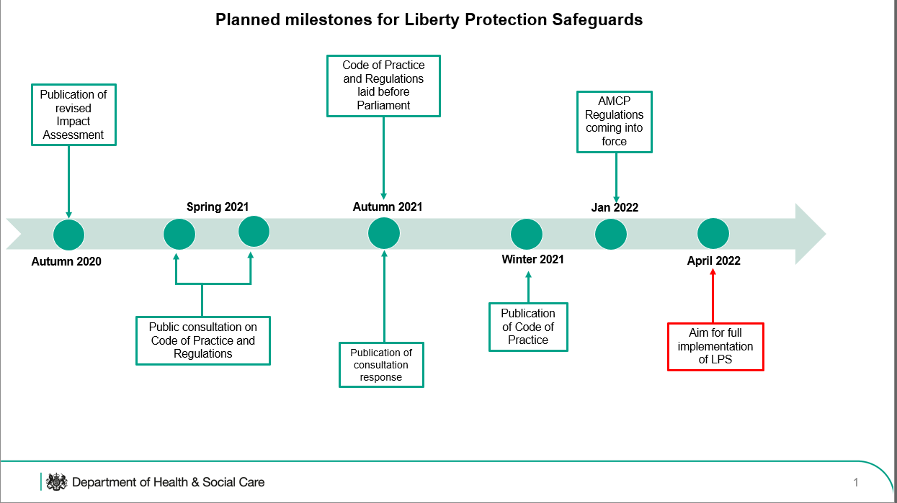

Slide 11
Regulations
Commencement and Transitional
Independent Mental Capacity Advocate regulations
Approved Mental Capacity Professional regulations
Assessments and Connection to a Care Home
Monitoring and Reporting
Consequential

Slide 12
Adverse possession
LPS Code of Practice
there will be a single Code for MCA & LPS
must be laid in Parliament & subject to the negative procedure
status: must be followed unless there are cogent reasons not to (Munjaz (2005))
must be reviewed after 3 years & then every 5 years

Slide 13
Adverse possession
Transitional arrangements
Commencement & transitional regulations
No new DoLS after April 2022
Existing DoLS will continue until they expire (inc urgent authorisations)
Court of Protection cases (eg ‘Re X’) will need to be transferred to a responsible body

Slide 14
Adverse possession
Other law reform developments
Health & Care Bill proposes to abolish CCGs & replace with integrated care systems (ICS)
Mental Health Bill due to be introduced in this Parliament
Government confirmed that Wessely proposal for the MHA interface will not be implemented
Introduction of a cap on care costs in Oct 2023

Slide 15
Thank you for listening
My contact details
t.spencer-lane@sgul.kingston.ac.uk

