Slide 1
Developing your role as a Ward Manager: A Lived Experience
Liam Button RN
Charge Nurse
Royal Cornwall Hospitals NHS Foundation Trust

Slide 2
The Aim
To share my experiences
To share what I have learned
To show you what is most important to me

Slide 3
What I wish I had known
Always be kind/stick to your morals
You are accountable but NOT to blame
People, people, people
Prioritise and execute

Slide 4
Tips and advice for aspiring Ward Managers
The importance of communication
Reflect
Clinical governance

Slide 5
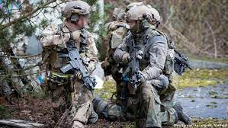
Leading by Example

Slide 6
The highs and lows of the role
The ‘rollercoaster’
Balance

Slide 7
Challenges of leading through Covid
Fear
Bravery
Recovery

Slide 8
Thank you for your time.
Recommended reading:
Dare to Lead – Brene Brown
Turn the Ship Around – David Marquet
Extreme Ownserhsip – Jock Willink
The Dichotomy of Leadership – Jocko Willink
The Little Book of Stoicism – Jonas Salzgeber

