Slide 1
Developing the role of the Nursing Associate
9 March 2021
David Melia
Director of Nursing and Quality/Deputy Chief Executive
The Mid Yorkshire Hospitals NHS Trust

Slide 2
Developing the role of the
Nursing Associate
9th March 2021
David Melia
Director of Nursing & Quality/Deputy Chief Executive
The Mid Yorkshire Hospitals NHS Trust

Slide 3
Topics to consider
Regulation of the Nursing Associates role
Developing the Nursing Associates standards
Delegation and accountability implications
I’ve been given the most exciting opening topic…..

Slide 4
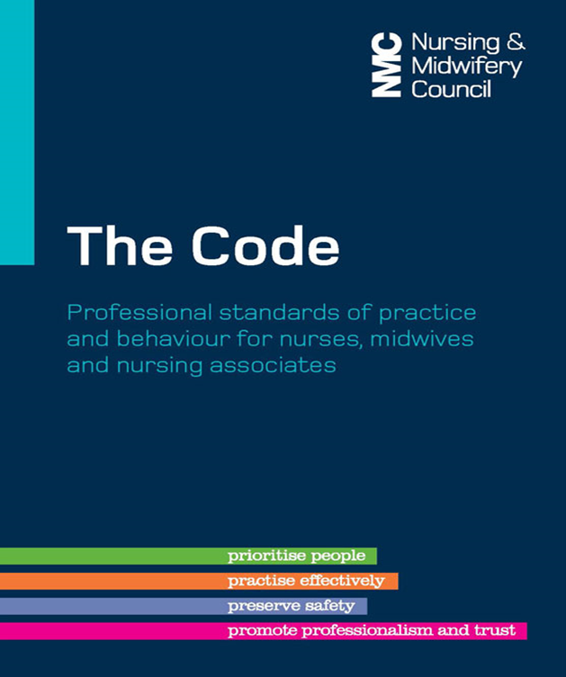
Regulation
Regulation – NAR section of the NMC Register
“It is against the law to claim to be, or to practise as, a nurse or midwife in the UK, or as a nursing associate in England, if you are not on the relevant part of our register”
“Nurses, midwives and nursing associates uphold the Code within the limits of their competence”
“Nurses, midwives and nursing associates are expected to work within the limits of their competence, which may extend beyond the standards they demonstrated in order to join the register”

Slide 5
The four many principles of ‘The Code’
Prioritise people
Practise effectively
Preserve safety
Promote professionalism and trust

Slide 6
Developing Standards
Standards of proficiency for nursing associates - published 10 October 2018
Nursing Associates (NA) are a new profession, accountable for their practice
Once they are practising, NS can undertake further education & training enhancing their competence as other registered professionals routinely do
The roles played by nursing associates will vary from setting to setting, depending on local clinical frameworks, and it may also be shaped by national guidance

Slide 7
Delegation and Accountability
11 Be accountable for your decisions to delegate tasks and duties to other people
To achieve this, you must:
11.1 only delegate tasks and duties that are within the other person’s scope of competence, making sure that they fully understand your instructions
11.2 make sure that everyone you delegate tasks to is adequately supervised and supported so they can provide safe and compassionate care
11.3 confirm that the outcome of any task you have delegated to someone else meets the required standard
Preserve Safety
“You make sure that patient and public safety is not affected. You work within the limits of your competence, exercising your professional ‘duty of candour’ and raising concerns immediately whenever you come across situations that put patients or public safety at risk. You take necessary action to deal with any concerns where appropriate”

Slide 8

That’s now – today is about………

