Slide 1
The loss of a young person through suicide
Robert & Lotte Stringer

Slide 2
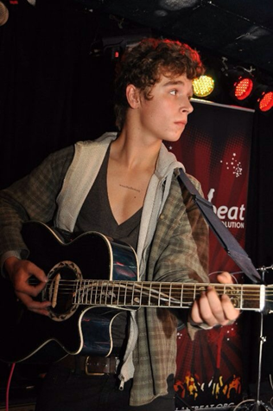
HecTalks
Hector was a normal chap
He had many friends
He was sociable
He did “over think” things
He did self harm
His suicide was completely out of the blue
It was intensely shocking to his family and friends
We have all spent time wondering how we could have prevented it

Slide 4
What do we do at Hector's House?
What do we do at Hector's House?
We....
- Visit schools & organisations to provide mental health education
- Raise vital awareness about mental health and suicide stigma
- Signpost and give support each person who reaches out to us

Slide 5
Bereavement and Complicated Grief

Slide 6
Why is death by suicide different?
•The grief is often far more intense, and there is often a lack of ‘closure’
•It is often sudden and “unexpected” effect of PTSD on survivors
•People bereaved may look for ‘answers’ and try to find reasons the person took their life
•Some people may feel there is a stigma associated with death by suicide
•The bereaved are more likely to become socially isolated
Post Traumatic Growth

Slide 7
Spotting the signs
When eat move love doesn’t work..
S
leep Disturbance
I
solation
G
iving away possessions
N
o interest in anything
S
peaking of no future

Slide 8
What could be improved to support families and young people?

Slide 9
For those bereaved by suicide – liaison team to signpost to specific support and continued monitoring of the family and friends (PTSD) – Signposting for example to Help is at Hand, SOBS, Cruse, Samaritans, Papyrus, CALM and post-vention support for the family and community – “at risk” groups
To know that it is possible to keep living and there is hope for the future
To stop suicide in young people
Education for parents, teachers, coaches etc in mental health and what to look out for, including self harm, drugs, alcohol, changes in behaviour, isolation, signs of depression or acute depression.
Learning how to talk to and listen to young people, give them the time.
If something develops or someone asks for help, get it immediately especially in young men otherwise you will lose trust.
Education in terms of effect of social media and internet on young people.
Teach people to self monitor and understanding stacking, day to day adaptability and resilience, “tools in the box”

Slide 10
10 years on...
How has mental health changed?
10 years on...
How has mental health changed?
It's been 10 years since we lost Hector to suicide. These are the changes we have noticed in mental health awareness and services since 2011 - and what we still need to improve.

Slide 11
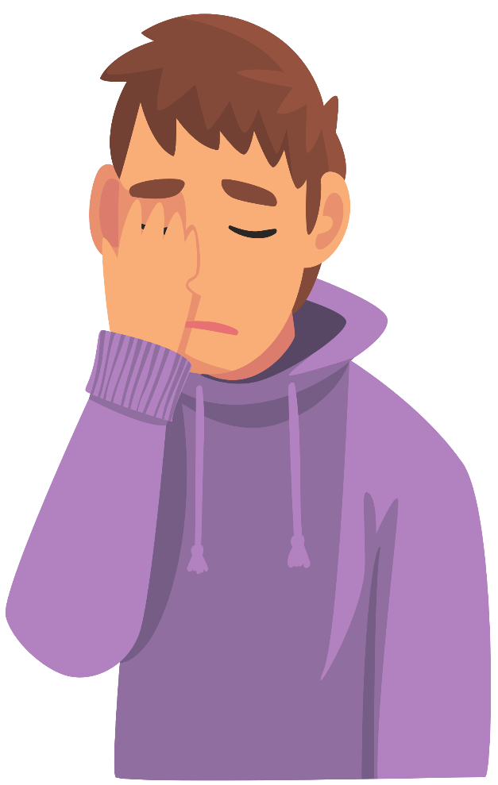
Stigma
Stigma
It seems easier to talk about our mental health problems. There is certainly less of a taboo around feeling low or needing help. We are having more open conversations, seeing more in the media about mental health and campaigns like Time to Change are helping to lessen the stigma around these conversations.
However
We still have a long way to go. Especially for men - the stigma of being strong and not allowing our men to be sensitive is costing lives. Therapy, medication and diagnosis still carries shame - this needs to be worked on, too.

Slide 12
Reporting
Reporting
Unfortunately, there have been a number of high profile suicides in the last 10 years. We are noticing a change in how these deaths have been reported on. The shame and stigma has subsided, words like commit suicide have been used less - and we are seeing more empathy from the public’s reaction.
However
The media have such an important role in reporting suicides responsibly. Including suicide method, glamourising the incident, delving into the cause or insinuating its part of a ‘cluster suicide’ can have a deep affect on vulnerable people. Charities are working closely with the media to ensure safe reporting is being carried out. (See Samaritans guide for more).

Slide 13
Social Media & Technology
Social Media & Technology
It’s difficult to talk about mental health in the past 10 years without mentioning the boom in popularity of social media. We are accessing it at a younger age, we have it 24/7 in our hands. The social comparison we do in our heads, the anxiety it can cause, the information we are exposed to and the potential relentless abuse we are open to is no doubt a factor of mental health issues we’ve seen in the past decade. We are always close to or on a screen nowadays, which is taking its toll.
However
It’s not all bad. Our smart phones give us access to support and information we would have struggled to access before. New apps like ‘Stay Alive’ are helping to save lives. With social media comes connections to others (albeit via a screen) - and if we follow inspiring accounts, find helplines or information on dealing with issues like low moods and anxiety, this can be really reassuring. We have the potential to develop communities to feel less alone in our feelings. Shameless plug - go follow @hectorshere on Instagram!

Slide 14
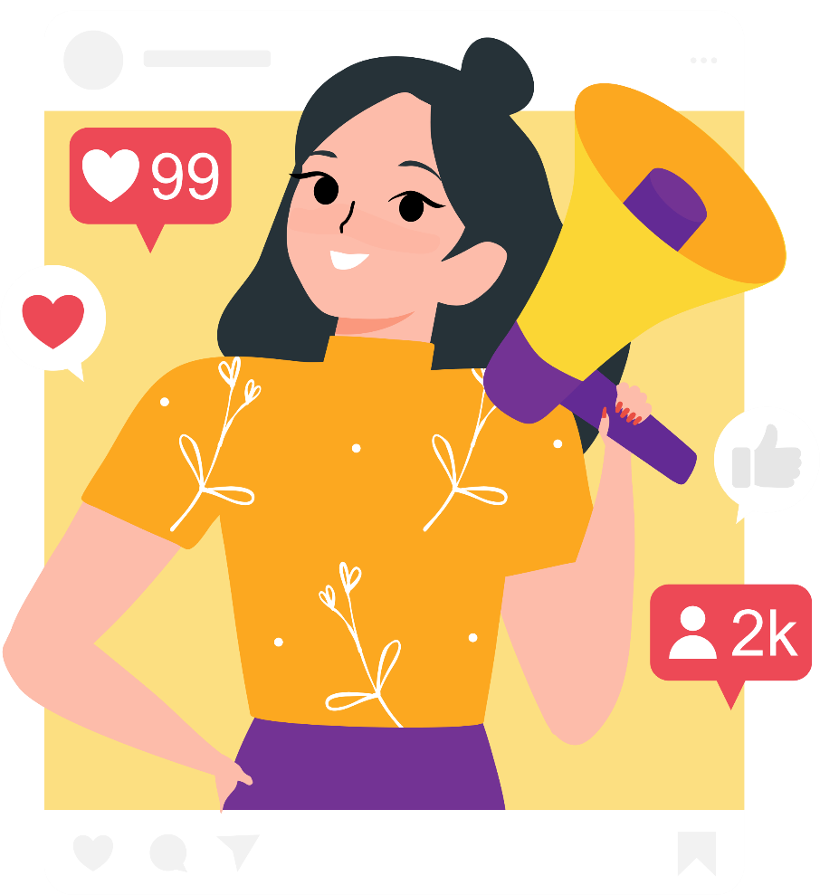
Representation
Representation
We’ve never had more of an insight to the lives of the rich and famous. Whilst this can be damaging for our young people to be exposed to, it’s also been admirable to see more and more celebrities opening up about their mental health. When we see a high profile person talk about their experiences with anxiety, it helps us feel more ‘normal’ and like we are not the only ones.
However
There needs to be support in place for that person and those who get in touch, as we know first hand how vulnerable it can make you. When a celebrity speaks out about a mental health condition, it would be wonderful to see them in partnership with a charity or cause so signposting and support can be available. It’s also common for the most high risk people to remain silent about their issues, so as encouraged as we are - there is a long way to go.

Slide 15
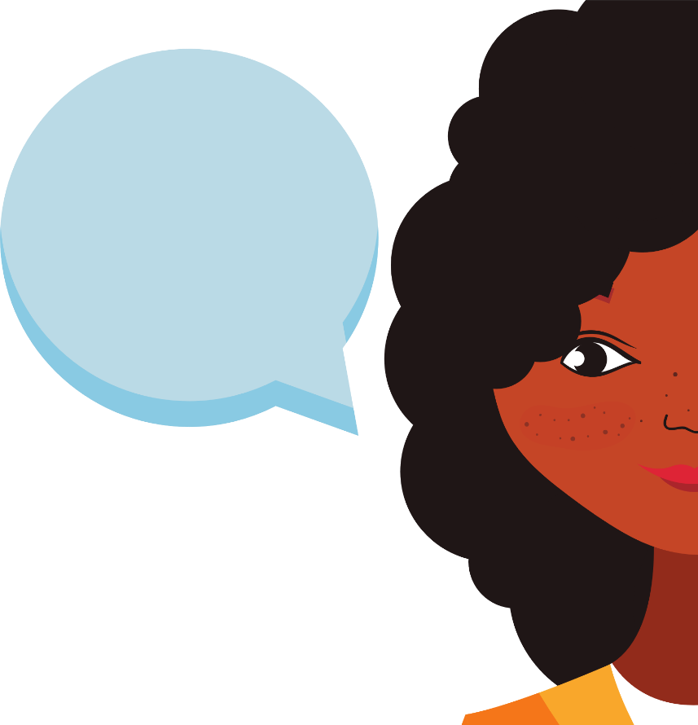
Language
Language
We’ve touched on the language used by the media changing for the good, but we are also noticing in our daily lives, we are more attune to the words we are using to describe ourselves and situations. It’s no longer acceptable to say Commit suicide - this makes it seem like it was a crime, thus adding to the stigma. ‘Don’t be gay’ is used less frequently thanks to the amazing work by the LGBTQ+ community, which implies sensitivity or feelings (particularly in males) is something that should make you question your sexuality or masculinity.
However
How often have you heard yourself or others say the following: He needs to man up, I’m just a bit OCD like that, She’s crazy, If I have to listen to her bang on about it again I’ll kill myself, Cheer up love might never happen, They’re schizo, You’re so over sensitive… Would you say that about a physical illness? These can all contribute to the shame and stigma of mental health conditions - be mindful, be gentle with yourself, and don’t be afraid to call out yourself or others to help the cause.

Slide 16
Support and Services
Support and Services
We have, unfortunately, been in this industry for 10 years following the death by suicide of our beloved Hector. Since we’ve started, the amount of support available has grown phenomenally. We now have IAPT - a self referral tool by the NHS for therapy. We have text HECTOR to 85258 for instant support. We have apps, websites, resources - the list goes on. It means that each person who comes to us for help gets tailored, instant support that’s right for them.
However
We find that men only make up to 36% of those who access services. Not all these services are available to young people, and with so many options available it can be daunting for a person who is at crisis point to know where to turn to. We are doing everything we can to ensure we simplify the process, and make signposting clear, easy and accessible.

Slide 18
Stay in touch!
@hectorshere
@lottelilibet_therapy
@househectors
Hector’s House
www.hectorshouse.org.uk
hihector@hectorshouse.org.uk
lotte@hectorshouse.org.uk

