Slide 1
The End of Life Needs of people with Heart Disease A holistic overview….. Jan 2022
Dr Ros Taylor MBE

Slide 2
We find ourselves
on different
sides of a line that
no-one drew…
Leonard Cohen
Notes:
Competition between organisations and specialities
Need a holistic vision of systems as well as patient

Slide 4
failure

Slide 5
Colleen McIlvennan
Larry Allen
BMJ
2016

Slide 6
Despite advances in cardiac therapy, heart failure remains
a progressive, highly symptomatic, and deadly disease that places great demands on patients, caregivers, and healthcare systems

Slide 7
Fatigue
Anorexia
Nausea
Pain
Breathlessness
Oedema
Anxiety
Depression

Slide 8
Sound familiar ?

Slide 9
community services are fragmented
certain

Slide 10
family structures are changing
certain

Slide 11
Changing family structures
Notes:
"Grandparents now provide support to a third of working mothers so a forum to discuss the many and varied grandparenting issues that arise with other grandparents should be invaluable”.
Justine Roberts Founder & CEO of Mumsnet

Slide 12
loneliness is increasing
certain

Slide 13
illness trajectories are becoming less certain
certain

Slide 14
not enough people are planning ahead
certain

Slide 15
baby boomers like certainty and control
certain

Slide 16
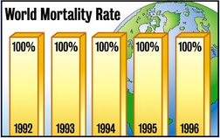

Slide 17
numbers of people needing palliative care
certain

Slide 19
independence symptom control 24/7 responsive co-ordination good ending
certain…what matters..

Slide 20
new conversations
and
new actions

Slide 21
MANAGING
SUFFERING &
UNCERTAINTY
Notes:
Watch your timing! Allocate a time for each slide and stick to it so as to keep track of your presentation and avoid speaking too much.

Slide 22
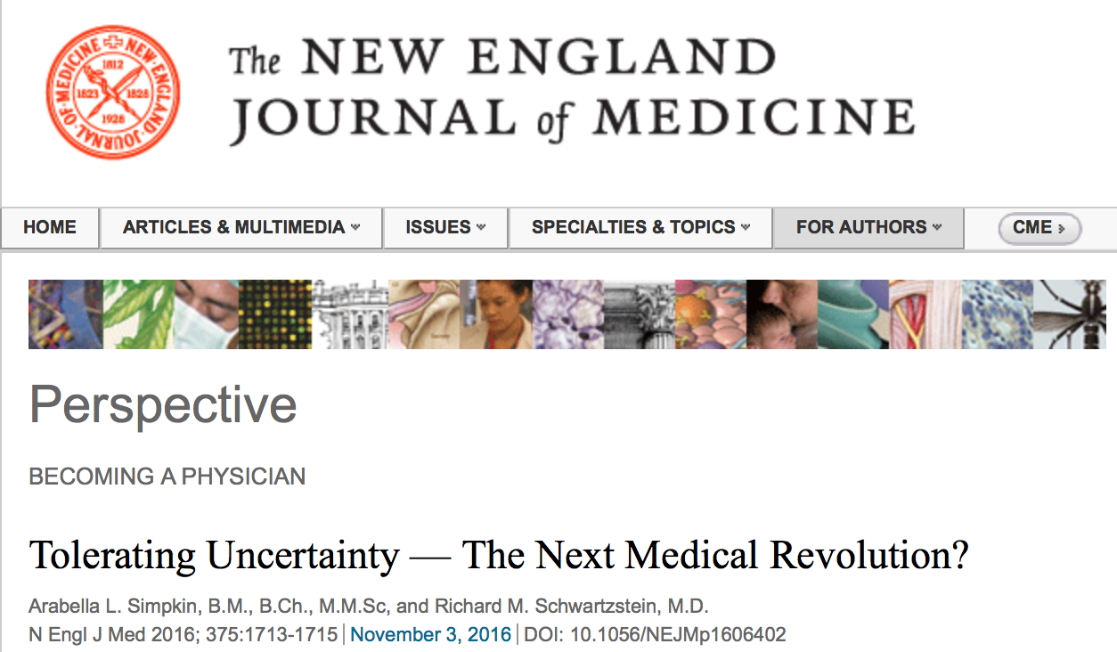

Slide 23
safe in uncertainty
uncertainty…..
Barry Mason
Notes:
Safer – planning, coordinating

Slide 24
medicine is doing too much….
certain

Slide 25
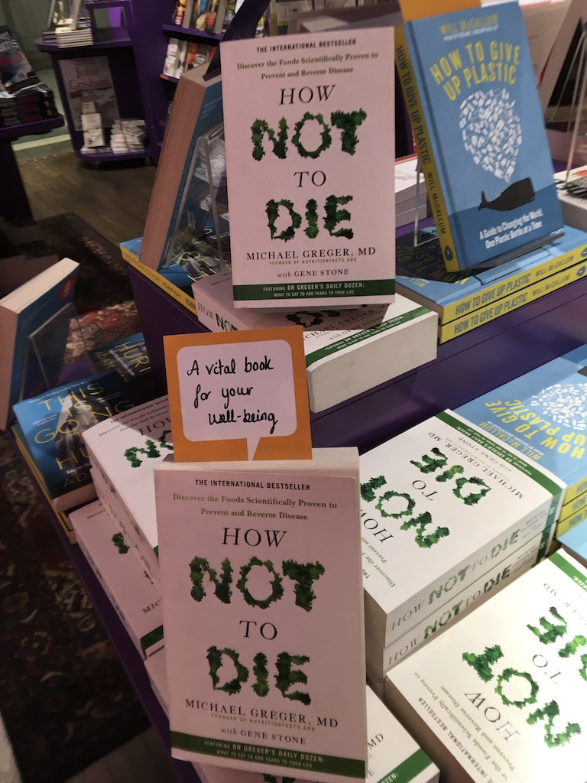
Notes:
Book shop last week

Slide 26
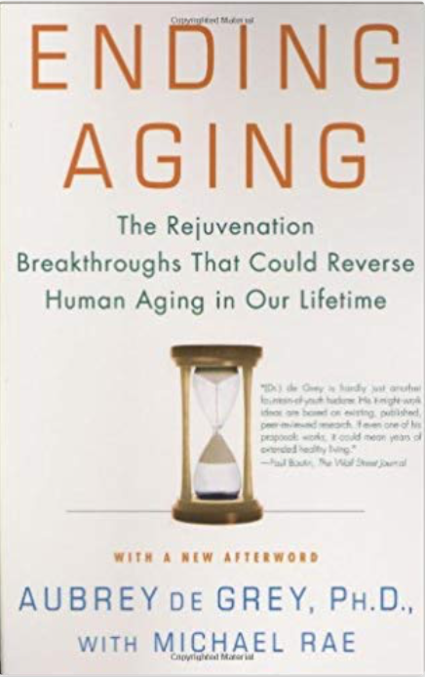
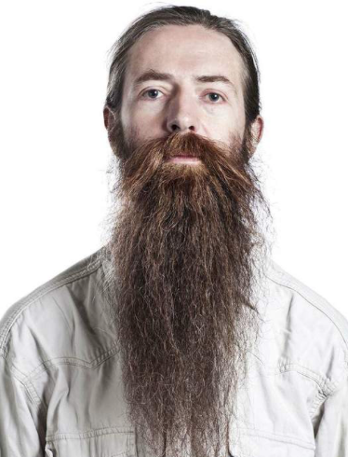

Slide 27
‘In hospital, you can only die when medical staff declare you can die….’
Bostanci 2015

Slide 28
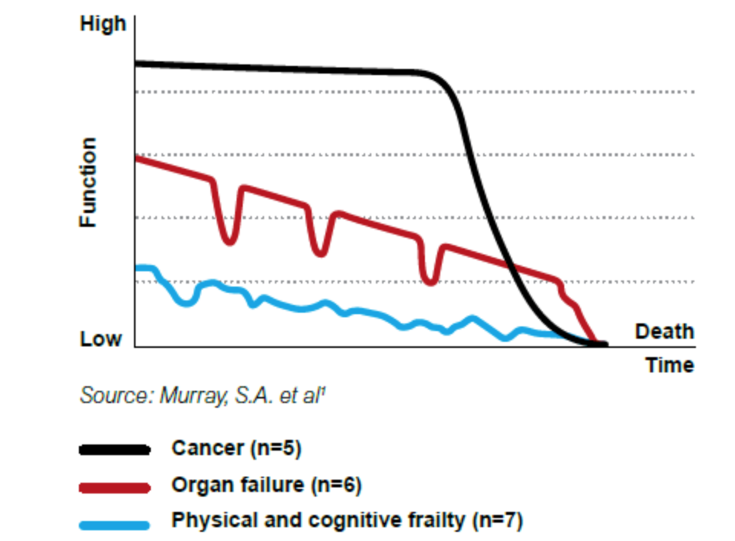
event-centred care?

Slide 29
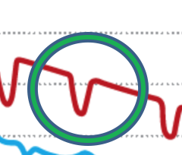
event-centred care?
Treat each event as a discrete reversible episode without taking into account trajectory
RESCUE

Slide 30
Preoccupation with the body …..ignores the mind …..deserts the spirit
medicine today
Notes:
A challenge

Slide 31
event-centred care
organ-centred care
patient-centred care
person-centred care
Notes:
Is person-centred care enough

Slide 32
what matters to you if time is short?
goals of care conversations

Slide 34
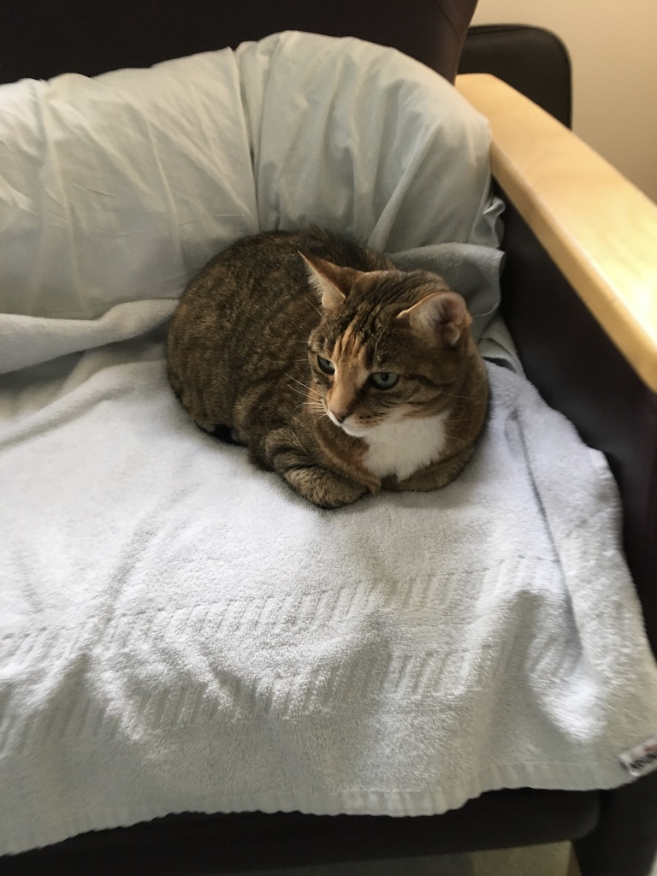
Notes:
Rebecca and peanut

Slide 35
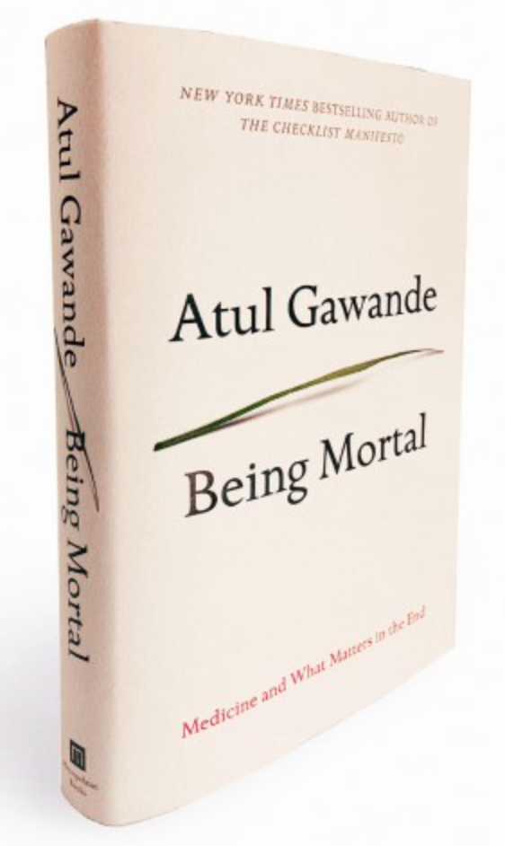
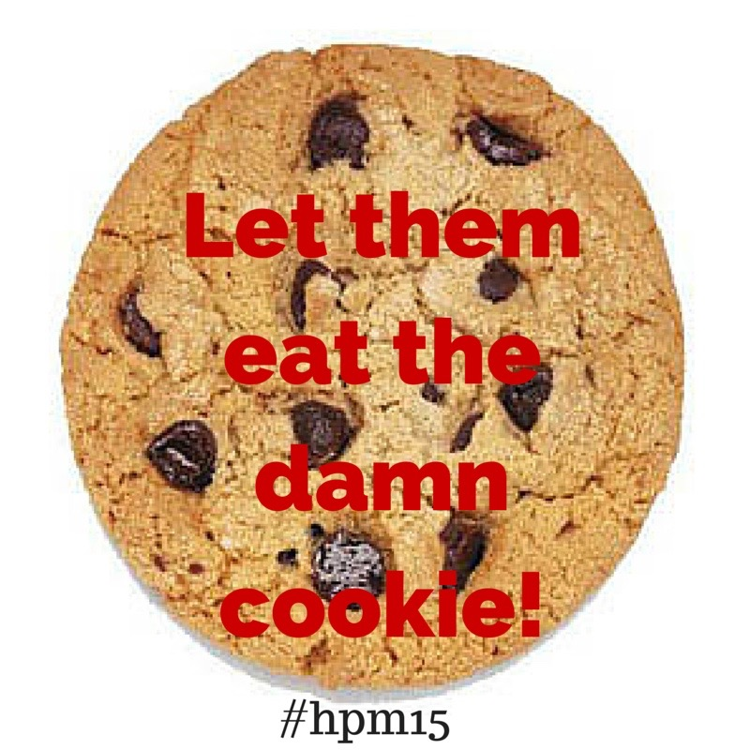

Slide 36
Advance care planning
ACP can enhance hope
rather than diminish it
Unaddressed fears about the future
and a lack of preparation are threats
to hope

Slide 37
Talking about death doesn’t kill you….. It may make your wishes more likely to happen….
Background

Slide 38
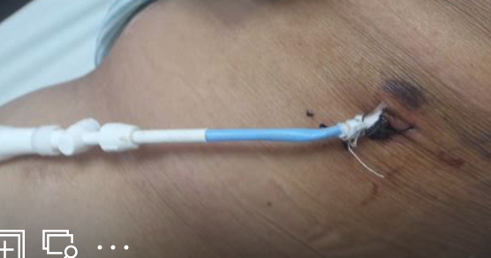
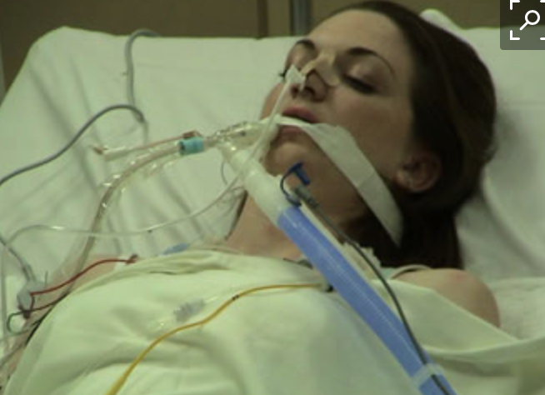
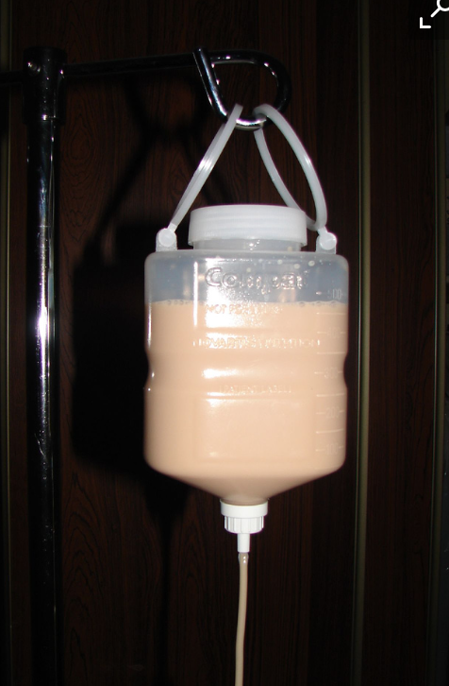
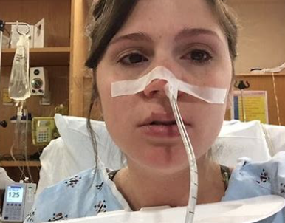
My mothers ACP
No tubes
Notes:
Conversations with individuals

Slide 40
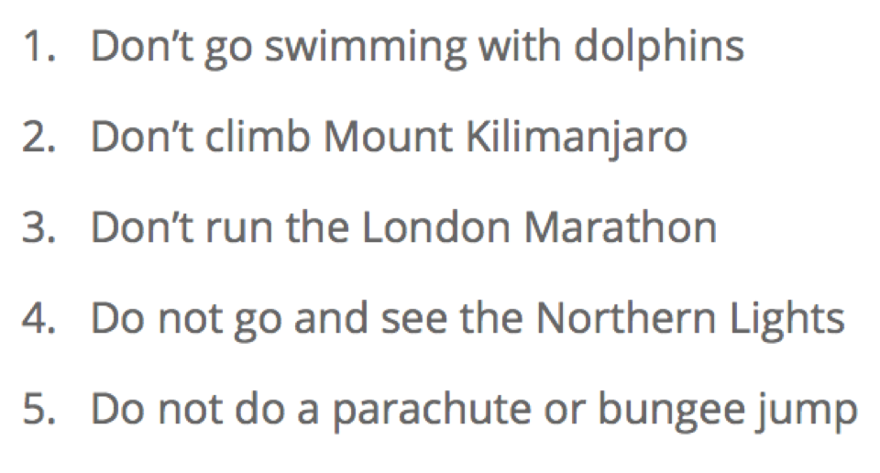
Fuckit List
http://www.whothehelldoeshethinkheis.com/

Slide 41
Better anticipation
We can see the future…..

Slide 42
Dr Kieran Sweeney
a hesitation to be brave….

Slide 43
Dirty words in palliative care !
Hospice
Morphine
Palliative
Death

Slide 45
Prognostic awareness
Understanding likely illness trajectory
Allows goals and conversations
Patients and families don’t know unless you tell them!
J.Temel

Slide 46
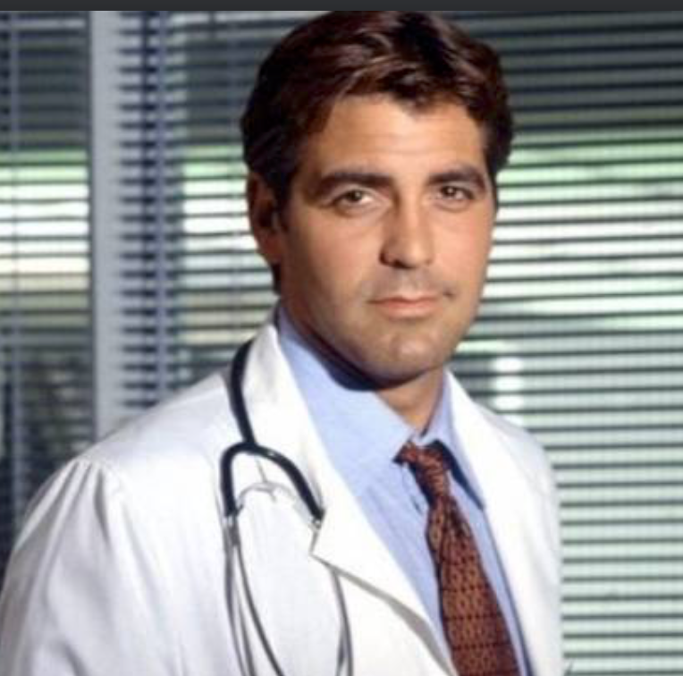
how likely is CPR to work?
75%
46%

Slide 47
earlier palliative care means better quality of life for longer
certain
Notes:
But a study in UK in 2017 showed average involvement of hospice/palliative care was 6 weeks – for many just last days
Longer for cancer and younger, very short if old and frail

Slide 48
J. Temel trial
Early palliative care for lung cancer
Quality of life improved
Mood improved
Hospice referral increased
Less chemo in final months
Refer 6 months before death
Temel J. New Eng J Medicine 2010

Slide 49
Summary
1000’s patients with advanced Ca
Improvement in:
Symptoms and quality of life
Depression
Less aggressive care
? Increased survival

Slide 50
That’s the research…..
But what is the reality ?

Slide 51
November 2016
Data from 64 Hospices
42372 deaths

Slide 52
Non-cancer
Cancer
53 days
= 7+ weeks
27 days
= 3+ weeks
DEATH
90 80 70 60 50 40 30 20 10 0
Did diagnosis make a difference ?

Slide 53
Key results
Shorter duration of
palliative care as you get older
Non-cancer – half the number
of days as cancer
Variation by location

Slide 54
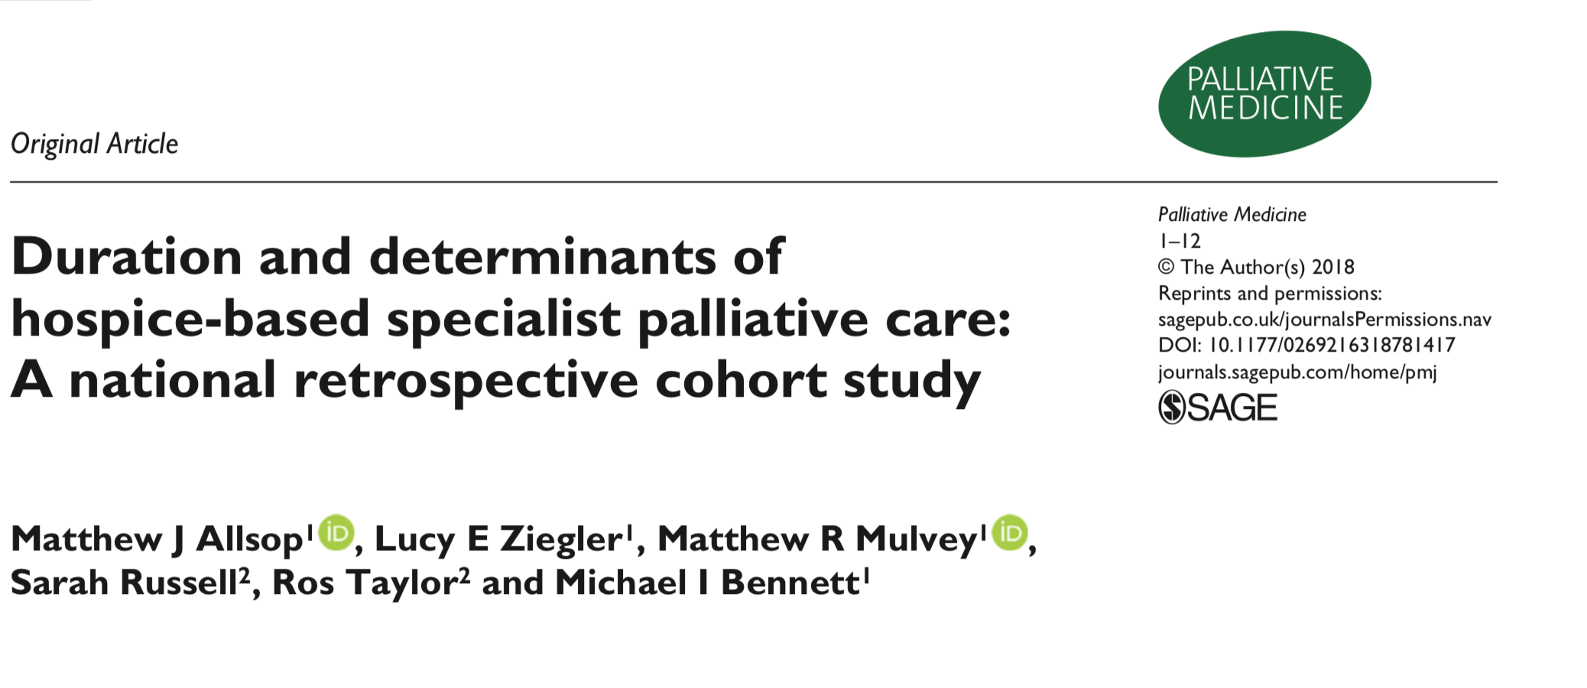
Allsop M. Palliative Medicine 2018

Slide 55
Clinician barriers to referral
Fear of upsetting patients
Uncertain trajectory
Not wanting to abandon them
Don’t understand the benefits of palliative care
Siloed care
Overlay of comorbidity & frailty

Slide 56
Patient barriers to referral
Lack of awareness about palliative care and what it can offer
Reluctance to accept that disease is progressing
Family pressure to ‘fight on’

Slide 57
Triggers for referral

Slide 58
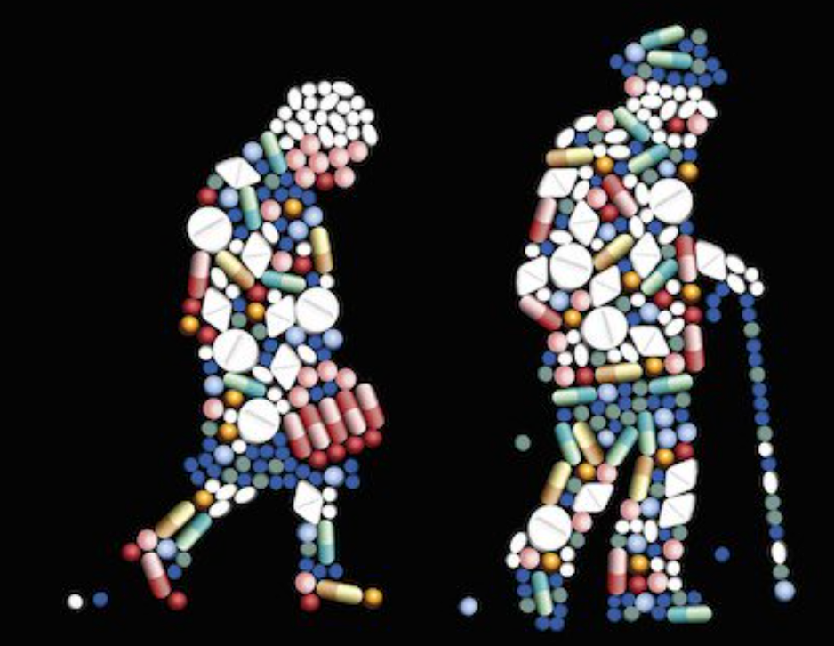

Slide 59
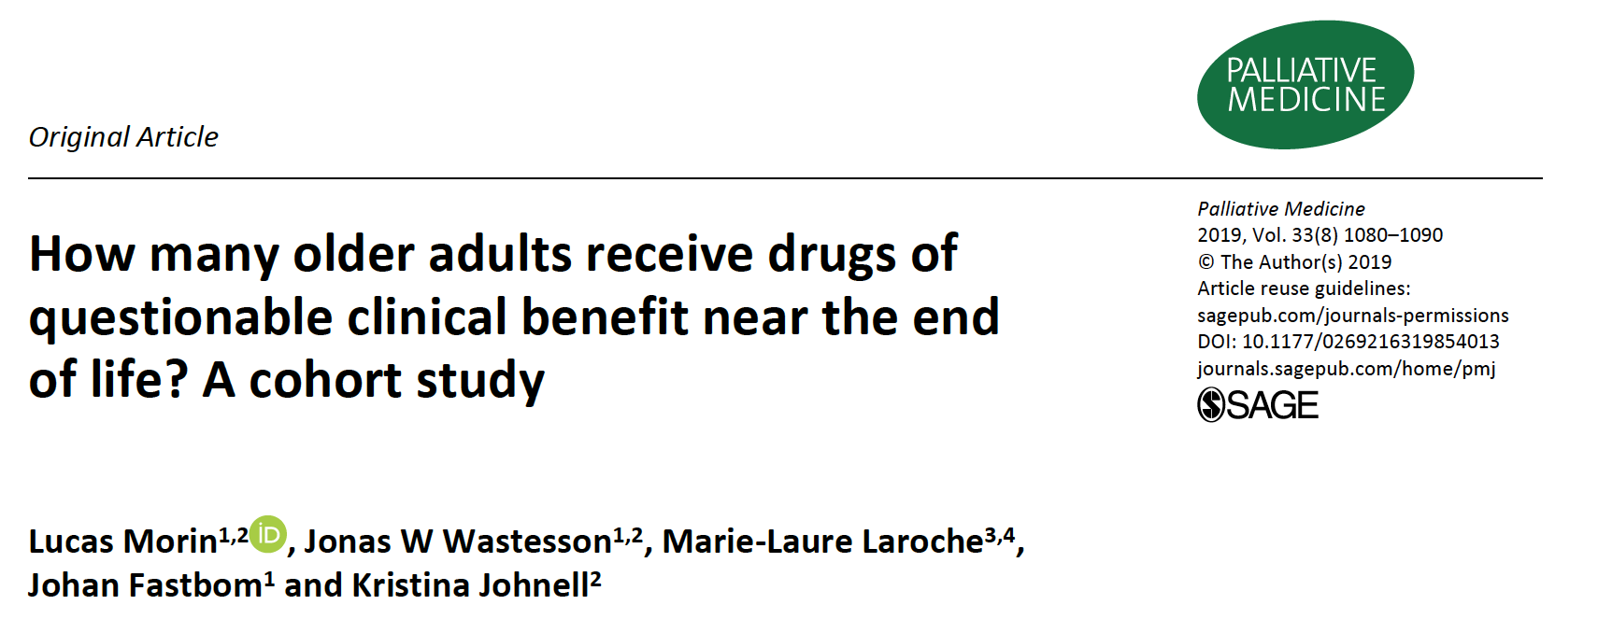
Lucas
Morin

Slide 60
opioids

Slide 61
8760 hours
Notes:
In a year
60 hours face to face with a health professional
On your own for 8000 hours

Slide 62
8760 hours
Nurse
Alone
Alone
John
Dr
Family
Nurse
Friend
Family
Alone
Friend
Abel J. Compassionate community networks: supporting home dying.
BMJ Supportive and Palliative Care 2011; 1:129-133
Notes:
Green and red blobs

Slide 63
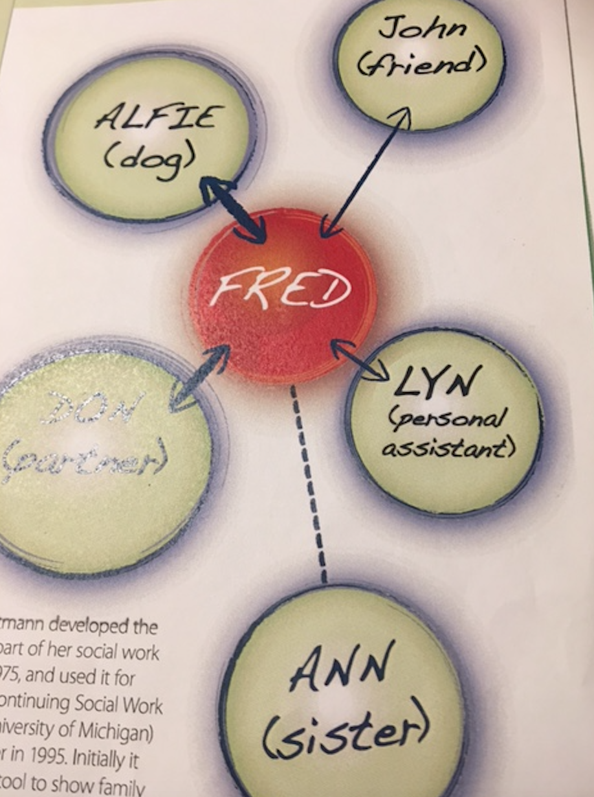
family-centred care
Who
matters to you?

Slide 64
ask about networks….
what would it take to support you to be cared for at home…. and what can your family, friends and community bring to that?

Slide 65
Social
network
Professional
network
Patient network
Notes:
Most important – unite the 2 networks we exist in

Slide 66
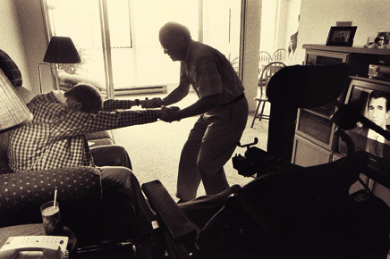

Slide 67
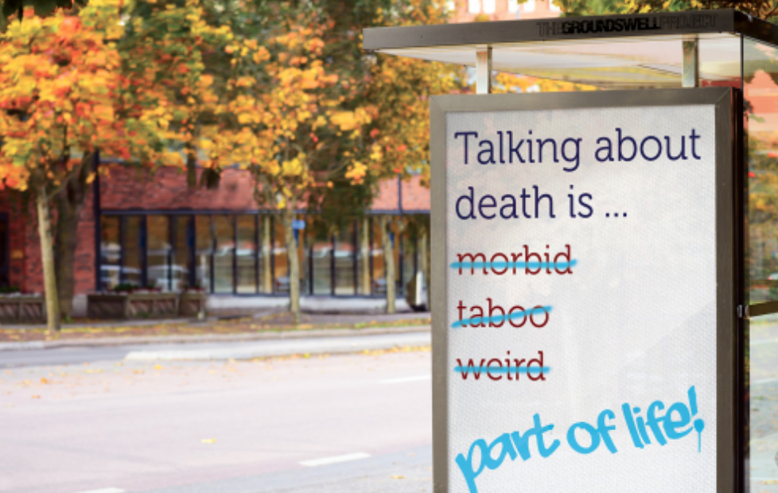
Notes:
Conversations with society

Slide 68
people are anxious about dying
certain

Slide 69
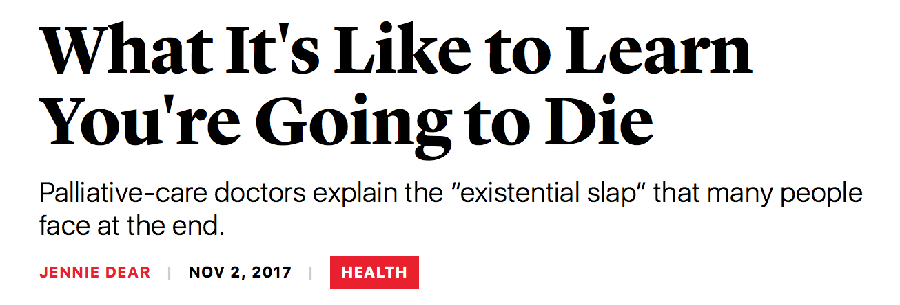
the existential slap….
Challenge No 1.
The Atlantic

Slide 70
death anxiety in NYC after 9/11
interpersonal communication….
is a means of
reducing existential terror
Yum Y. & Schenk-Hamlin W.
Journal of Social Psychology 2005 145:265-286

Slide 71
managing death anxiety
Promote connection
Self-esteem
+
=
Death Anxiety
Notes:
This is what hospice and palliative care do

Slide 72
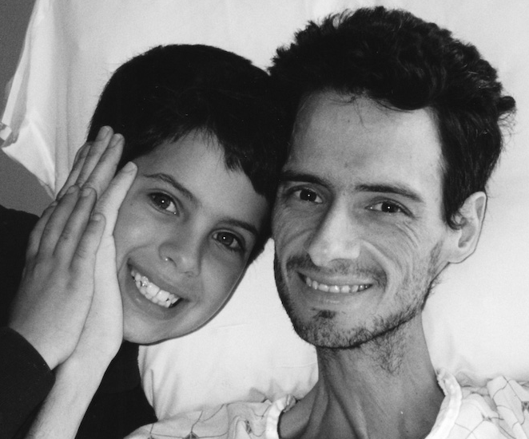
managing death anxiety
BUILD SELF ESTEEM
and CONNECTION
Notes:
Is this how pall care works
Hospices are the catalyst for kindness – join the dots that already exist

Slide 73
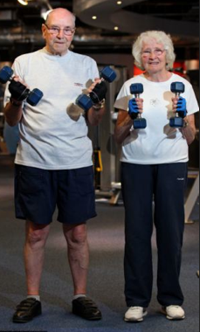
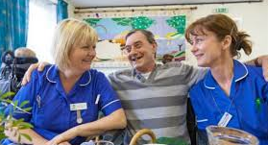
Palliative rehabilitation & social prescribing
Dependency
Self-management

Slide 74
Too few
Too late

Slide 75
How to support more people
Critical points on journey
Light touch support between
Collaborate
Coach carers
Information
Understand the meds

Slide 76
event-centred care
organ-centred care
patient-centred care
person-centred care
family-centred care
relationship-centred care
network-centred care
Notes:
There are no easy
answers –
but there are
simple answers!

Slide 77
how people die remains in the memory of those who live on Dame Cicely Saunders

Slide 79
MANAGING
SUFFERING &
UNCERTAINTY
Notes:
Watch your timing! Allocate a time for each slide and stick to it so as to keep track of your presentation and avoid speaking too much.

Slide 80
reducing uncertainty
talk about the future
document wishes & share them
what matters & who can help?
train carers in radical ways
stay connected and coordinated
be less risk averse !
Notes:
Control what you can
Family structures changing
Community services fragmented
24/7 care
Whatsapp

Slide 81
pumpingmarvellous.org

Slide 82
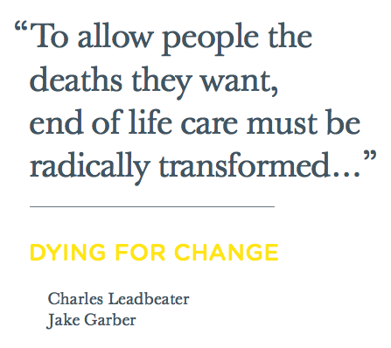
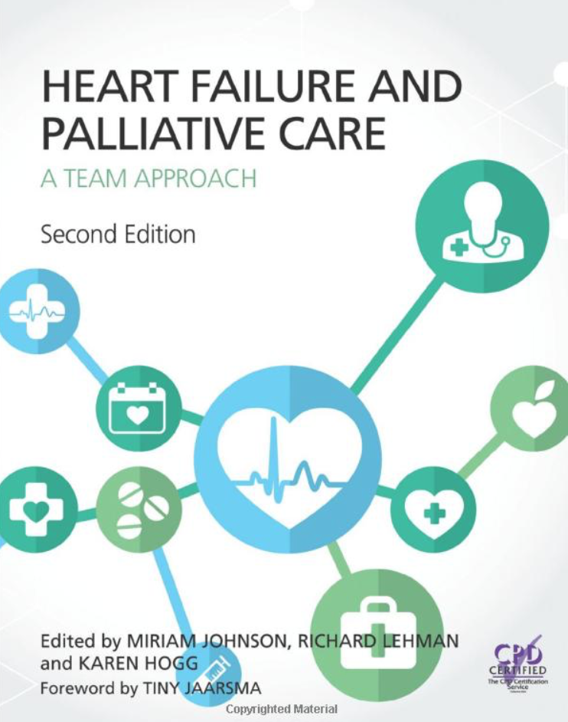
2010

Slide 83
Dance me through the panic till I’m gathered safely in…
Leonard Cohen
Notes:
Finish with my hero

Slide 85
TODAY !
Integration
Triggers for early referral
Managing the meds
Carers support
Last weeks, last days
Examples of great practice

