Slide 1
Improving patient safety: Reducing falls Carrie Tyler Falls Improvement Specialist Practitioner Mid & South Essex NHS Foundation Trust

Slide 2
Prevention pre fall
Falls Prevention has a specific NICE guidance which tells us to undertake the multifactorial assessment , NICE CG 161 Falls in Older People
This requires all patients aged over 65 years to have a multifactorial falls risk assessment. With clinical judgement for patients aged over 50 years

Slide 3
Other useful national guidance :
NICE CG 109 – Transient Loss of consciousness in adults and younger people
NICE 103 – Delirium
NICE 176 – Head Injury
NICE 146 – Fragility Fracture
NICE QS 86 – Falls in older people

Slide 4
In-patient data
Falls in hospitals are the most commonly reported patient safety incident with more than 240,000 reported in acute and mental health trusts in England & Wales
RCP, 2015, Falling Standards broken promises

Slide 5
The Impact of In-patient Falls
Nearly 100,000 patients suffer bruises, grazes, lacerations or more serious injuries
Over 800 hip fractures and around 600 other fractures are reported each year.
130 deaths associated with falls in hospital were also reported
The cost of treating falls in hospitals in the UK has been estimated at between £15 million and £87 million per year
NRLS 2014

Slide 6
Covid 19 – wider impact
The older adults in the UK were advised to shield from March 2020
A publication called “Wider impacts of COVID-19 on physical activity, deconditioning and falls in older adults” was released by Public Health England in August 2021, this analysis the effect of shielding

Slide 7
Predictions- falls increase
110,000 more older people will fall per year, an increase of 3.9%
The total number of falls for males could increase by 124,000, an increase of 6.3%
The total number of falls for females could increase by 130,000 an increase of 4.4%

Slide 8
Prediction – financial cost
For each year that the lower levels of strength and balance activity observed during the pandemic persist, there is projected to be an additional cost to the health and social care system as a result of the change in predicted related falls of £211 million (incurred over a 2 and half year period)

Slide 9
Individual Data
Use your own data to benchmark yourself, it’s not a competition
Be aware of in-patient differences between areas
Covid 19 has changed a lot of previous data and is not comparible

Slide 10
Local Prevalence
Broomfield data evidences that falls rates for night & day were 50:50 pre covid.
During 2020-1 year that changed to 68% of falls at night
Now in Q2 2021/2 there has been a change in the percentages to 47% at night and 53% during the day
So what has changed?

Slide 11
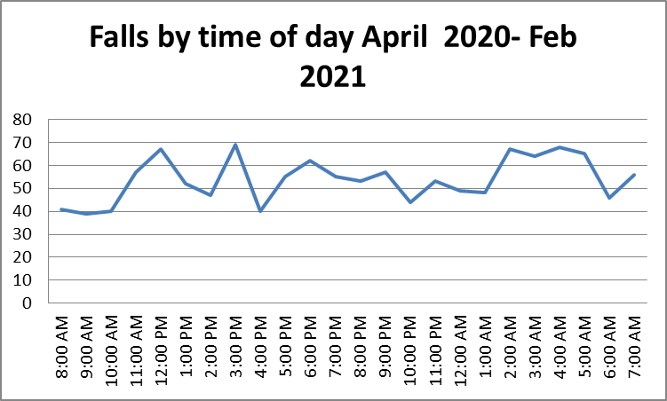

Slide 12
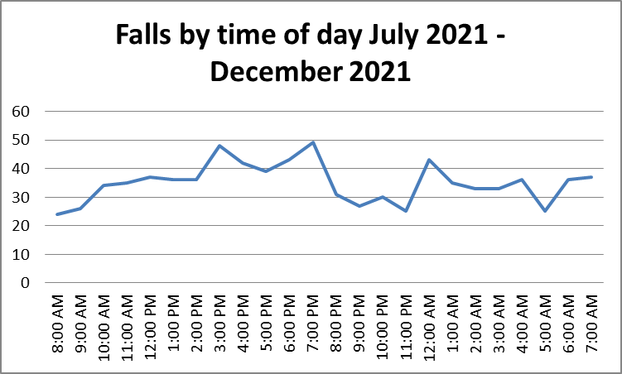

Slide 13
Variants
Covid +/- hypoxia
Climatic such as temperature
Outlier
Unplanned environmental changes, such as emergencies, other patients, new admissions
Locum/agency staffing
Greenwich Mean Time V British Summer Time ( falls used to be 30% less in the summer), longer nights in the winter

Slide 14
Ward patterns
Staffing levels
Break times
Drug rounds
Layout of the area
Lighting
Shift times

Slide 15
Causal Attribution & Falls
Attribution theory involves trying to understand and explain the causes of behaviour we observe in others
Example – incident report state patient slipped whilst using the bottle at the bedside 04.00 hours
This is where a robust SBAR reporting and questioning system pulls out vital information

Slide 16
Toileting & Use of Bathrooms
One of the biggest motivators for patients to walk on the wards
Are they visible and accessible?
Have you chairs outside for a tired patient to wait their turn on?
Has an OT checked out the environment for how easily a patient can wash/shower/get dressed/toilet
Dignified Throne ( specific falls & toileting audit) surveyed staff & patients
Can be a big part of avoiding deconditioning

Slide 17
Shared Characteristics - Toilets
More falls in the toilets during the day, mainly the patients will have do not have cognitive impairment
Low impulsivity displayed by patients
Poor room layout & lack of furniture
Poorly placed bins
Lack of perching stools/clothing hooks
Patients do not perceive any greater risk at night or day
Most common trigger to mobilise

Slide 18
Toilet/bathroom falls data
Pre covid | Q1 2021/22
65% of falls had a toileting factor | 37%
20% of falls within toilet/bathroom | 14%

Slide 19
Pre covid | Q1 2021/2
80% of falls are unwitnessed | 82% of falls are unwitnessed
65% falls are by the bed side | 73% falls are by the bed side
55% of patients were confused at the point of falling | 51% of patients were confused at the point of falling
5% falls with a one to one present | 3% falls with a one to one present
2% of falls result in a fall with serious harm | 2% of falls result in a fall with serious harm
30% had a bed/ward transfer in the previous 24 hours | 31% had a bed/ward transfer in the previous 24 hours
75% had a known history of falling | 60% had a known history of falling
41% of falls were caused by multiple fallers | 49% of falls were caused by multiple fallers

Slide 20
Q2 & Q3 data
The reporting parameters changed and some data was no longer captured. 14% of the falls reported had gaps in reporting
Unwitnessed falls – 75%
Cognitive impairment – 35%
One to one enhanced supervision - ↓1%
Bed space changed within 24 hours of the fall- 18% recorded could be up to 32%
Toileting factors involved – 27%

Slide 21
Previous patient shared characteristics who fell in the ward
Aged over 80
Diagnosed dementia
Fell by the bedside
Had a history of falls

Slide 22
Now
Evidence of deconditioning i.e falls in toilets
More patients experiencing delirium
Increase in violence and aggression
No difference in the features of falls between the day and the night
Locations have not changed
Although over 65 years of age, much younger than pre covid, with higher Rockwood scores than previously anticipated. I believe this is due to deconditioning

Slide 23
Common Root Causes
Multifactorial causes :
Sarcopaenia
Clinical Frailty
Change of Environment
Multiple bed moves
Lack of insight to current mobility
High impulsivity
Covid hypoxia

Slide 24
Low Rise Beds
Good for non walking patients who have failed the bed rail safety assessment
Can cause falls in mobile older patients as the bed is too low for access and egress
Consider how the height that the patient is lying at changes their eyeline and size perception

Slide 25
Falls Alarms in the acute setting
Very weak evidence to prevent falls
Need to be quiet/silent or very disruptive to all patients
A noisy alarm can cause falls for patients living with dementia, as could divide the attention required to stand/balance with ill-being
The alarm will function well as an automatic call bell

Slide 26
Ambient Lighting
Lots of additional lighting available :
Plug in low level lights
Press touch
Motion activated
Rope lighting to highlight around toilet doors
Rope lighting behind hand rails in corridors

Slide 27
Night Time Seating Stations
Nurses stations are not always best placed to allow staff to be near their patients at night
Fold away tables
Night time stations allow staff to unobtrusively be near their allocated patients at night
Can be wall mounted swing up tables

Slide 28
Break out seating areas
Not all patients will sleep at night
Break out seating areas provide a safe place for the patient to sit and an opportunity for staff to be able to spend time and assist the patient to achieve well being

Slide 29
Use of Fish Eye Mirror
Also called convex, security and panoramic mirrors
The mirror is designed to create a wide angle of view
If the building design has awkward corners, these can be used

Slide 30
Sleep deprivation
Hyperactive delirium can cause hyper vigilance , so placing a patient at risk of falls/ confusion by the nurses station increases this
Noises are hard to filter out
Together this will cause ill-being with all the risks of dehydration, falls, medication non-compliance to name some
Side rooms provide a therapeutic spaces for these patients

Slide 31
Sharing evidence and Root Cause Analysis Findings

Slide 32
Post Fall
NICE QS 86 – Falls in Older People, Updated 2017
Statement 4 – Checks for injury post fall
Statement 5 – Safe manual handling after in-patient fall
Statement 6 – Medical Examination after an in-patient fall

Slide 33
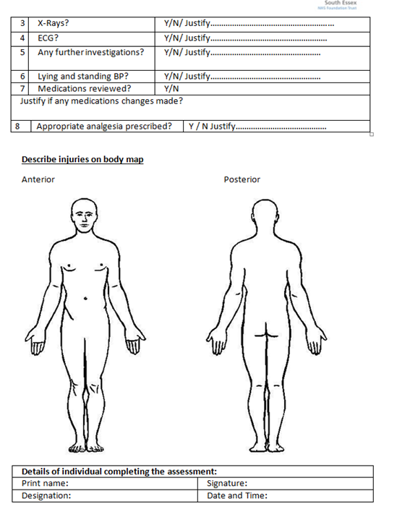
Post falls proforma

Slide 34
Falls Simulation
RCA identified that documented primary & secondary survey were inadequate or a
Falls simulation trains staff to be able:
undertake primary survey
identify suspected injury
choose correct floor retrieval
Follow SBAR process for on-call team
Understand crisis language & human factors

Slide 35
SBAR
Consider if a template may help junior or less confident staff retrieval and expected outcomes have been written for:
Suspected # hip
Suspected head injury
No head injury – new confusion ( delirium)
No injury ( up to 12 hours to review)
Full thickness skin tear

Slide 36
Safe Floor Retrieval
Flat floor retrieval needs to be made available for any suspected hip or spinal fracture
Out of hours teams need to be able to gain access to this equipment within an acceptable time frame, so staff are not pressured into a unsafe retrieval method

Slide 37
Delirium
#icanpreventdelirium can be shared for all ward staff
The more delirium is addressed during the day the more settled the patient at night
We are successfully using Bright Light therapy for patient with delirium in the day , 2 sessions a day for patients with a positive 4AT
Aromatherapy is used from late afternoon

Slide 39
Unnecessary Bed Moves
Local RCA is identifying older patients with serious harm falls have had multiple bed moves
Literature states unnecessary bed moves increase LOS
Patient flow requires bed moves, and the patient needs to be in the right bed.
Avoid the unnecessary bed moves wherever possible
Avoid late night bed moves, as staff cannot orientate the patient as effectively

Slide 40
Human Factors
Understanding falls prevention needs to also include understanding how human factors affect culture and practice
To consider:
Post fall the patient is often attended by an ad hoc team
Actions can be led by the burden of responsibility felt by staff to “protect” patients

Slide 41
Conclusion
Understanding who is at risk of falls
Consider the environmental impact from night to day
Practice with teams post fall care

Slide 42
Thank you
carrie.tyler@nhs.net

