Slide 1
Working with primary care to support for patient out of hours
Dr Chris Campbell
BMBS FRCGP MClinEd MAcadMedEd
Portfolio General Practitioner

Slide 2
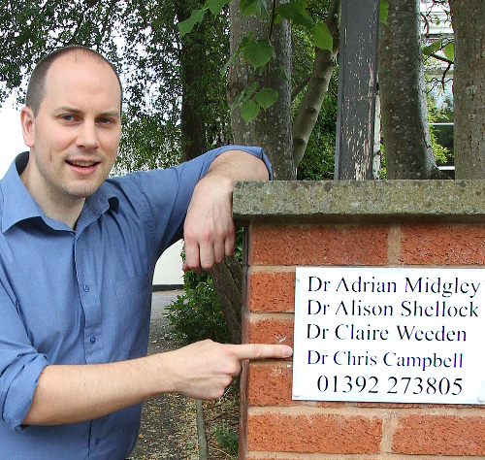
About me…
Peninsula Medical School (2008)
GP Partner & Trainer ISCA Medical Practice, Exeter
Associate Medical Director, Devon Doctors IUCS
Head of BMBS Admissions, Exeter Medical School
CQC Specialist Advisor
DOIs
On average I work 1-2 nights/week

Slide 3
Aims & Objectives
Working across organisations to improve out of hours support
Avoiding hospital admissions
Our experiences

Slide 4
Background
GP Surgeries open Monday – Friday
Core hours 0800am – 1830pm
Closed weekends & bank holidays
111
OOH Cooperatives
Extended & Improved access
Via PCNs?

Slide 5
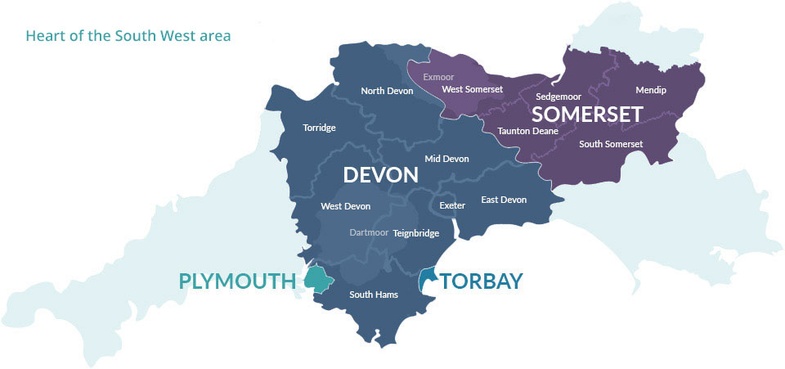
Devon Doctors
Devon - 1.2 million
Somerset – 800,000
Devon 2590 square miles
Somerset 1610 square miles

Slide 6
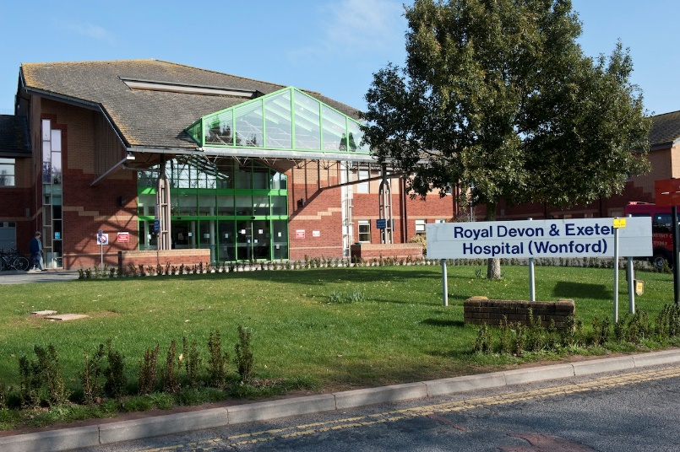
Overnight
Devon
4 Treatment Centres
1 Triage Doctor
Somerset
3 Treatment Centres
Home Visiting Paramedic
Elsewhere in UK
Very similar set ups
Patient management:
Advice
Treatment Centres
Home Visits

Slide 7
Background
Patients call 111
NHS Pathways
Module 0
Pathways
Dispositions / Dx Code
Interactive Voice Responses (IVRs)
Triaged by clinician either advised, TC or visit

Slide 8
Dispositions
Ambulance
Self Care Advice
Contact Primary Care
Attend MIU / Emergency Department
Dental Services
Etc
Within 1, 2, 4, 8, 12, 24, 72 hrs etc

Slide 9
111 Online

Slide 10
111 Online
Soft launch
Not publicised by some CCG or NHS England (yet)
Linked to DOS

Slide 11
Reducing going towards hospital
ED Revalidations
Ambulance Revalidations
Dedicated lines
Palliative care
HCP to HCP
Paramedic lines

Slide 12
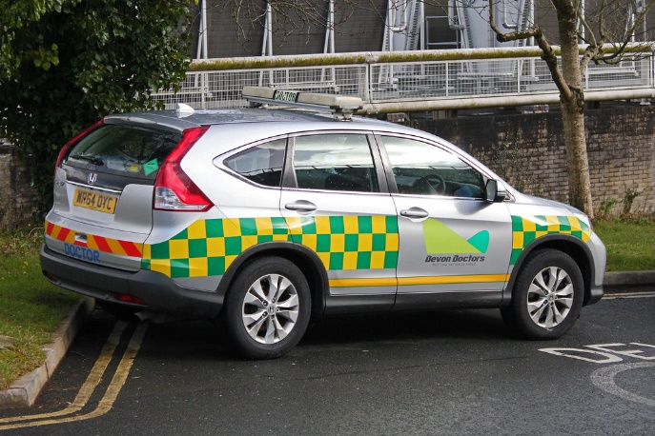
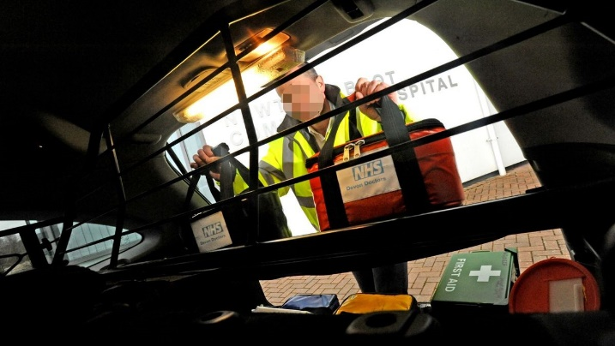
Resources
JIC / EOL Medications
POCT
First responders
Toughbooks
Sepsis kits
Diagnostic equipment
Emergency equipment
Medication
Administration
Catheters, dressings etc

Slide 13
Who & why we visit
Acutely unwell
EoL / palliative Care
Death verification
Nursing procedures
Welfare visits
Socially housebound
Safeguarding
Community Hospitals

Slide 14
Considerations
What will a visit achieve?
Would another HCP be more appropriate?
What resources are available?
Where is the visit?

Slide 15
Avoiding Admissions
Ambulatory care
Local pathways
Community Hospitals
Follow-ups
Rapid specialist advice (SpR vs F2)
Timely review
Next day admissions
Safety netting

Slide 16
Things the hospital could to do help reduce overnight admissions from primary care
Receiving of the admission
Abnormal test results processed in working hours
Approachable & available specialists
Daytime admission / SDEC
Overnight discharges
OPEL status communicated / A&E targets
Community mental health support
Shared risk

Slide 17
What primary care can do to improve / reduce admissions at night
Seeing the patient face to face
Admission under specialists vs A&E
Rapid HCP advice
Hold risk for next day management / review
Trial of treatment
Repeat abnormal bloods
Speak to specialists
Feedback Feedback Feedback

Slide 18
Case Study
Miss J 27yr old missed period 2 weeks ago
LIF tenderness, dull ache for 48hrs
PMH Chlamydia
Seen by OOH GP
O/e Tender LIF, P80, BP 124/70, RR14
Abdo tender LIF
Urine BhCG +ve, Trace leucs
Discussed with gynae reg, as stable kept at home overnight
Emergency appt at 9am the next day
Safetynetted if worse to attend gynae ward stat

Slide 19
Any Questions?

