Slide 1
Maintaining Competency in Non-medical Prescribing
Kirsty Fishburn Programme Director for Mental Health and Module Lead for Nurses NMP.

Slide 2
Aims of this session
How do we improve prescribing practice?
How we maintain our own competency – using the RPS Framework?
Tools to help - SWOT, RAG Rating (others are out there)
Developing skills and recognising own limitations
What does the new DPP Framework mean? Impact on prescribing future
Reassessing our Competence and Confidence.
Ensuing our skills are updated and fit for practice.

Slide 3
How do we deem someone is competent?
By observation of practice
Through intuition
Continuous assessment
Collecting evidence to meet specific outcomes
How many of you have peer review of your clinical practice?

Slide 4
How to assess competency
Let’s start at the beginning…….
What do you think competency is?

Slide 5
Competency - what is it? -
“A competency is a quality or characteristic of a person that is related to effective performance. Competencies can be described as a combination of knowledge, skills, motives and personal traits. Competencies help individuals and their organisations look at how they do their jobs” (Royal Pharmaceutical Society - A Competency Framework for all Prescribers)

Slide 6
What is competence ?
“ The combination of skills, knowledge and attitudes, values and technical abilities that underpin safe and effective practice and intension”
NMC identifies four sets of competencies:
Professional values
Communication and interpersonal skills
Nursing practice and decision-making
Leadership and management.

Slide 7
What helps us develop our prescribing practice?

Slide 8
New Frameworks and Standards
NMC Standards
RPS A Competency Framework for all Prescribers
Designated Prescribing Practitioner Framework
…….. Lots of change to keep up to date with

Slide 10
Underpinning Rationale…
The prescribing competency framework can be used by any prescriber at any point in their career to underpin professional responsibility for prescribing.
Development of competencies should therefore help individuals to continually improve their performance and to work more effectively.
If acquired and maintained, the prescribing competencies in this framework, will help healthcare professionals to be safe, effective prescribers who are able to support patients to get the best outcomes from their medicines

Slide 11
What does it say for maintaining competence and developing skills?
Prescribers identify strengths and areas for development through self-assessment, appraisal
Keeps up to date with emerging safety concerns related to prescribing.
Accepts personal responsibility for prescribing and understands the legal and ethical implications.
Works within the NHS/organisational/regulatory and other codes of conduct when interacting with the pharmaceutical industry.
Reflects on own and others prescribing practice, and acts upon feedback and discussion.
Negotiates the appropriate level of support and supervision for role as a prescriber.

Slide 12
Key Areas….
The Consultation (1-6)
Assess the patient – history taking – full holistic assessment - Consider the options – differential diagnosis – Reach a shared decision – make a prescribing decision (Prescribe it) – nonpharmacological options – provide information – manage expectations – monitor and review – efficacy – further referral.
Prescribing Governance (6-10)
Prescribe safely – Prescribe professionally – Improve prescribing practice – Prescribe as part of a team.

Slide 14
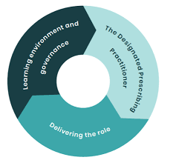

Slide 15
Underpinning Rationale…
Professional regulatory changes in 2018/19 have enabled some non-medical prescribers (NMPs) to take on this designated practitioner role for the Period of Learning in Practice PLP, in addition to Designated Medical Practitioners (DMPs) continuing to carry out this role.
In 2005, the National Prescribing Centre (NPC) published A guide to help doctors prepare for and carry out the role of designated medical practitioner, which outlined eligibility criteria and a set of broad competency areas for the DMP role. Following the recent regulatory changes, there is now a need for guidance to reflect the expansion of this role to include NMPs.

Slide 16
How does this help to maintain and develop prescribing practice…?
This competency framework has been developed to underpin quality in training in practice, a critical aspect of non-medical prescribing training to which the DPP role is central. It supports prescribers to be effective DPPs able to optimise learning and assessment in practice; working with academic partners to ensure the safety and quality of future NMPs.
It has been developed for multi-professional use and provides the opportunity to bring prescribing professions together to ensure consistency in the competencies required of all healthcare professionals carrying out the same role.

Slide 17
3 Main Areas…
The Designated Prescribing Practitioner:
Personal characteristics; Professional skills and knowledge; Teaching and training skills.
Delivering the role:
Working in partnership; Prioritising patient care; Developing in the role.
Learning environment and Governance:
Learning environment; Governance.

Slide 18
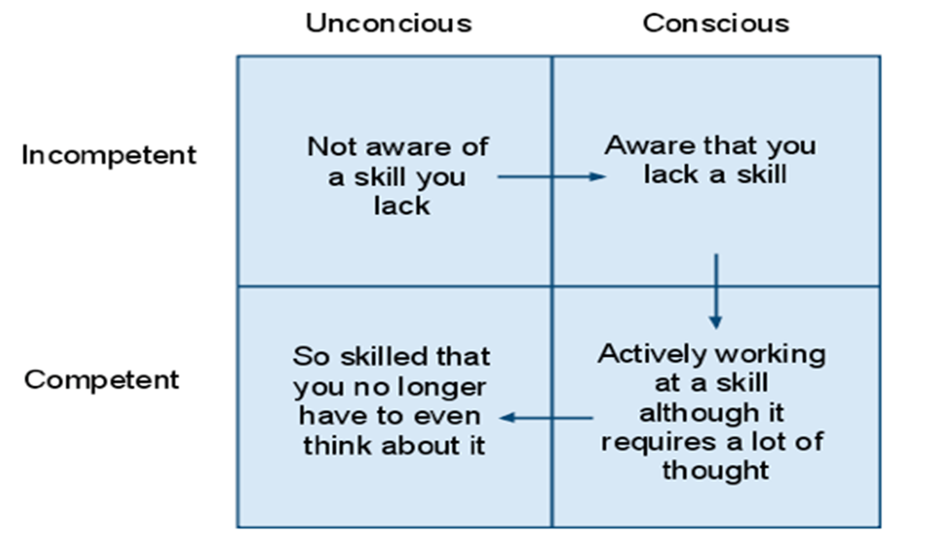

Slide 19
How do you measure competence?
How can you IMPROVE competence ?
How can you IMPROVE performance?
By observation of practice
Through intuition
Continuous assessment
Collecting evidence to meet specific outcomes

Slide 21
Thinking of difficult areas….
Pharmacology
Decision Making
Co-morbidity
Drug Interactions
……… Making a plan, developing, improvement!

Slide 22
Measuring ‘competence’ – Benner
Frameworks – Benner’s old novice to expert and more recent move to developing clinical wisdom.
Novice - Advanced beginner - Competent -Proficient – Expert
Then from expert – evolves ‘wisdom’ - expert professionals apply scientific knowledge, professional experience, and a careful attention to each patient's changing condition to underpin excellent care.
Within our area of competence

Slide 23
How do we know we are competent?
Case based discussions
Reflecting same domains of delivery of patient care and problem solving, through discussion with a clinical ‘mentor’ – DMP, PA, PS, DPP.
360* peer review – Faculty Membership
Feedback gathered by the NMP , from managers, peers , patients and any significant others and related to same domains of delivery of patient care and problem solving.
Further Training, Education and Research.
The ability to say NO!

Slide 24
Keeping up to date
Sign up for alerts – but keep them relevant and READ THEM!
Supervision with an NMP, DPP and Medical Prescriber
Schedule in 1 hour per month to have a browse…?
Attend CPD events
Link in with other organisation, Trusts, Charities and HEI’s
Attend networks, forums. Conferences…. where time and finances allow.

Slide 25
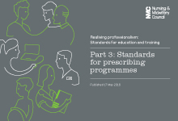
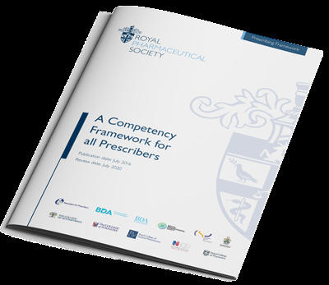
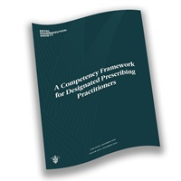
Always something new…
NMC Standards
RPS Framework
MHRA
NICE

Slide 26
…Thanks
Any Questions…
Kirsty Fishburn
Email: K.Fishburn@hull.ac.uk
Twitter: @spiderlegsmooni

Slide 27
References
Benner, P. (2001) From novice to expert: excellence and power in clinical nursing practice : Commemorative Edition. London : Addison-Wesley.
Bloom, B. (1956) Taxonomy of Educational Objectives: The classification of educational goals Handbook One: Cognitive Domain. London : Longman.
Caddye, W.S. & St. Clair-Jones, A. (2015) Reaccreditation of non-medical prescribers: maintaining competence. British Journal of Nursing, 24 (12), 640-643.
Davis, T., Thoong, H., Kelsey, A. & Makin, G. (2013) Categorising paediatric prescribing errors by junior doctors through prescribing competency assessment: does assessment reflect actual practice? European Journal of Clinical Pharmacology, 69 (5), 1163-1166.
Earle, E.A., Taylor, J., Peet, M. & Grant, G. (2011) Nurse prescribing in specialist mental health (Part 1): the views and experiences of practising and non-practising nurse prescribers and service users. Journal of Psychiatric & Mental Health Nursing, 18 (3), 189-197.
Herklots, A., Baileff, A. & Latter, S. (2015) Community matrons' experience as independent prescribers. British Journal of Community Nursing, 20 (5), 217-223.
Klein, T. & Kaplan, L. (2010) Prescribing competencies for advanced practice registered nurses. Journal for Nurse Practitioners, 6 (2), 115-122.
Klein, T.A. (2012) Implementing autonomous clinical nurse specialist prescriptive authority: a competency-based transition model. Clinical Nurse Specialist: The Journal for Advanced Nursing Practice, 26 (5), 254-262.

Slide 28
References
Latter, S. (2008) Safety and quality in independent prescribing: an evidence review. Nurse Prescribing, 6 (2), 59-66.
Latter, S., Maben, J., Myall, M. & Young, A. (2007) Evaluating nurse prescribers' education and continuing professional development for independent prescribing practice: findings from a national survey in England. Nurse Education Today, 27 (7), 685-696.
McCormick, E. & Downer, F. (2012) Students' perceptions of learning in practice for NMPs. Nurse Prescribing, 10 (2), 85-90.
McEwan, A. & Taylor, D. (2007) Assessing practice through portfolio learning. Journal of Community Nursing, 21 (8), 4-6.
National Institute for Health and Care Excellence. Medicines optimisation: the safe and effective use of medicines to enable the best possible outcomes. March 2015. https://www.nice.org.uk/guidance/ng5
Oldknow, H., Gilibrand, W. & Clifton, A. (2019) An exploration of why qualified mental health nurse prescribers do no prescribe. British Journal of Mental Health Nursing, vol 8, No:1. 41-48

Slide 29
References
Picton, C. & Granby, T. (2002) Maintaining and developing competencies in nurse prescribing. British Journal of Community Nursing, 7 (2), 90-93.
Ross, J. D. & Kettles, A. M. (2012) Mental health nurse independent prescribing: what are nurse prescribers’ views of the barriers to implementation? Journal of Psychiatric and Mental Health Nursing, 2012, 19, 916–932
Ross, J. D. (2015) Mental health nurse prescribing: the emerging impact. Journal of Psychiatric and Mental Health Nursing, 22, 529–542
Royal Pharmaceutical Society (2019) A Competency Framework for Designated Prescribing Practitioners. Accessed online https://www.rpharms.com/Portals/0/RPS%20document%20library/Open%20access/Professional%20standards/DPP%20Framework/DPP%20competency%20framework%20Dec%202019.pdf
Royal College of Pharmacists (2016) A Competency Framework for all Prescribers. Accessed online https://www.rpharms.com/Portals/0/RPS%20document%20library/Open%20access/Professional%20standards/Prescribing%20competency%20framework/prescribing-competency-framework.pdf?ver=2019-02-13-163215-030
Shah, C. & Coyne, T. (2012) Medicines management programme for non-medical prescribers. Nursing Management - UK, 19 (8), 34-37.
Snowden, A. & Martin, C. R.. (2010) Mental health nurse prescribing: a difﬁcult pill to swallow? Journal of Psychiatric and Mental Health Nursing, 17, 543–553

