Slide 1


Mortality Governance:
Meeting the national Guidance on Learning from Deaths and the National Mortality Review Programme
Mr Gabriel Sayer
Associate Medical Director and Lead for Learning from Mortality

Slide 2

Aims
Implementing national learning from deaths framework
The introduction and role of medical examiners
Developing good mortality governance locally
Examples of how we have used mortality governance for QIP
Serious Incidents, LfD and Covid 19
Sharing deaths between providers: challenges and information governance.

Slide 3
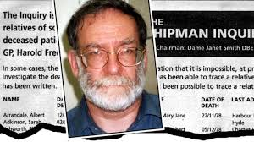
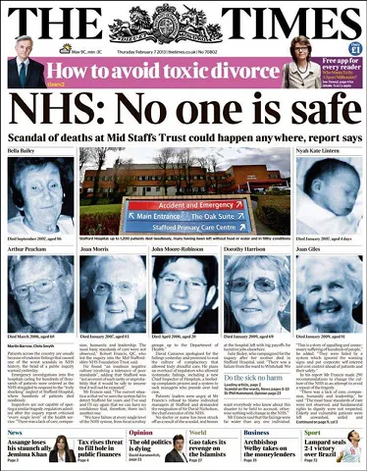
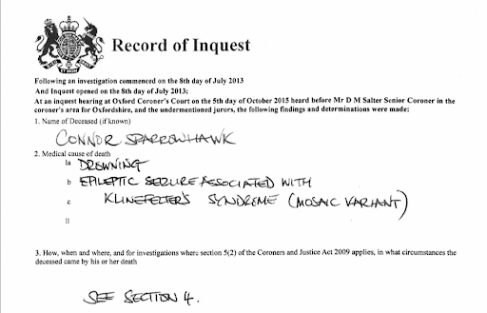
Why?
Notes:
Harold shipman found guilty of murder of 15 patients. Overall 218 potential victims identified….. Identified by coroner concerned abut high death rates of his patients. Mid staffs failure of regulators to spot poor care. Focussed on reaching FT status (cost savings) 500 excess deaths. CS died in a bath after being left alone. Southern

Slide 4
What do we have to do?
Learning from Deaths framework (NQB 2017) to learn and continually improve the quality of care provided to all patients
Have a trust approved learning from deaths policy
Information on deaths should be published in the quarter after that in which the death occurred.

Slide 5
What information do we need to publish quarterly?
number of deaths in your institutions care
number of deaths subject to case record review
number of deaths investigated as an SI
number of deaths that were reviewed/investigated and as a result considered more likely than not to be due to problems in care
themes and issues identified from review and investigation (including examples of good practice)
actions taken in response

Slide 6
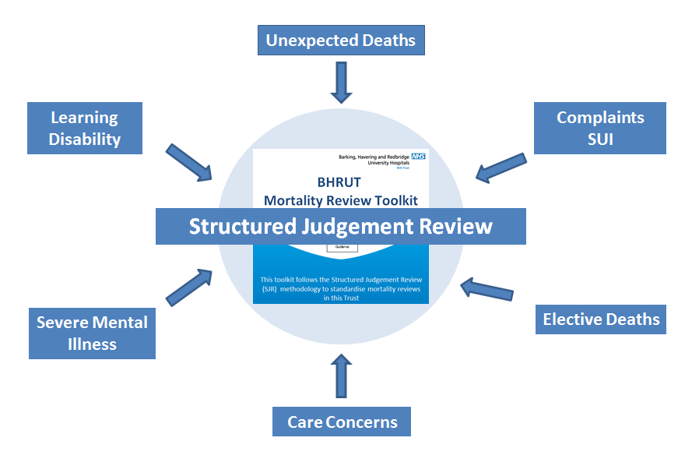
What records do you need to review?
Mandatory reviews
Requested reviews
Advisable reviews
Desirable reviews

Slide 7
Mandatory Reviews?
Deaths demonstrating a problem in care delivery as identified by your mortality review process
Deaths of people with a learning disability
Deaths of people with severe mental illness
Infant or child deaths
Stillbirths
Maternal deaths.

Slide 8
Requested Reviews
National Mortality Outlier Status- CQC
National Audits
Local concerns
  Complaints
  Medical examiner or equivalent
  Disputes

Slide 9
Advisable reviews
Service concerns
Trends towards increasing mortality

Slide 10
Desirable Reviews
Areas with good learning
Exceptionally good or poor quality practice

Slide 11
Medical Examiner Role
Various models
Pure ME role supported by bereavement officers
ME and ME officers doing screening
Should not report to trust but should link to your mortality review service

Slide 12
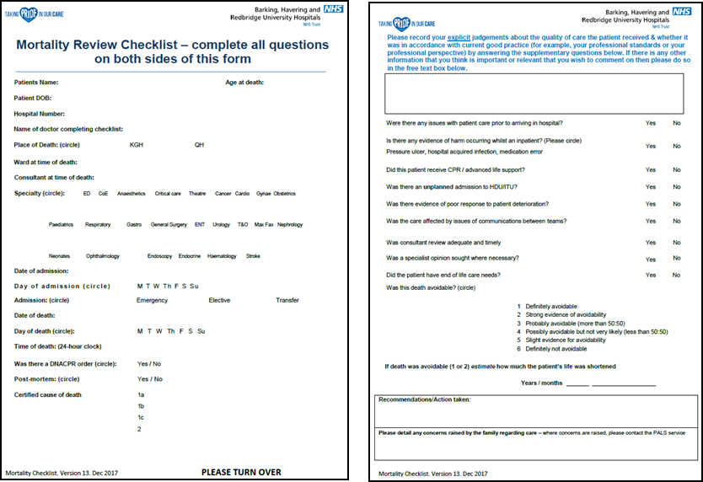
Who does the reviews?
First line checklist review and ME reviews
Second line is local faculty reviews
Third line is Mortality review faculty

Slide 13
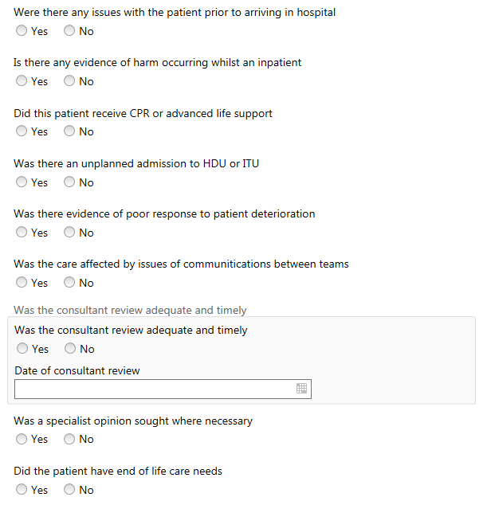
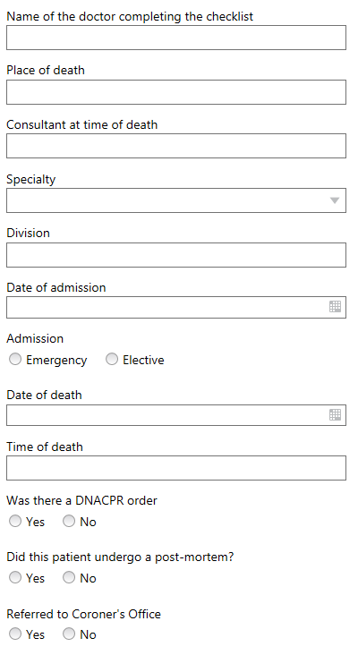
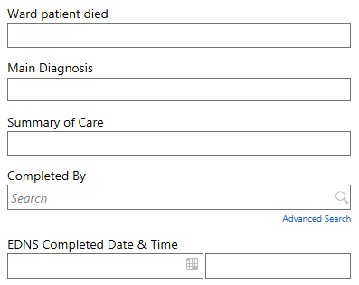
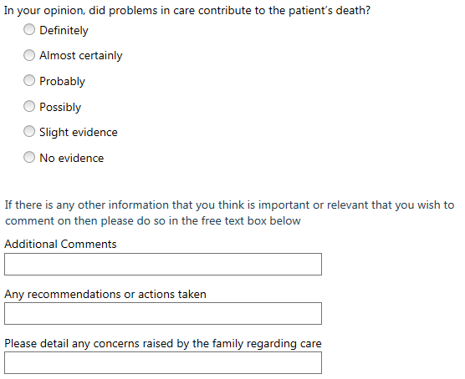
Electronic Death Notification Summary
An electronic form which poses different questions around problems in care has been created to replace the current Checklist proforma
The resulting notification of death is sent to a patient’s GP

Slide 14
Checklists & Structured Judgement Reviews - Correlation
Cases where problems in care were judged to contribute to patient death by SJR & their checklist information
Cases where death was judged to be avoidable by Mortality Checklist Review & their SJR outcome

Slide 15
Mortality Faculty
Lead for Mortality and Learning from deaths (2p.a.)
BHRUT has a core faculty of SJR reviewers who are job planned to provide monthly capacity for central reviews (4 p.a.s)
Had admin support
Monthly meetings

Slide 16



The Mortality Faculty
The Mortality Lead directs the Mortality Faculty’s ‘Learning from Deaths’ strategy
The Mortality Faculty also delivers the mandatory mortality reviews from ‘learning from deaths’, e.g. patients with learning disabilities and high-risk groups
There is a central faculty of mortality reviewers who undertake SJRs when problems are identified through the Checklist
A faculty of junior doctor mortality reviewers – who will use the SJR as part of Quality Improvement projects – is in development
Mortality reviews have proved particularly helpful where a concern is raised about the care of a patient or how they died, as they can be used to improve the quality and nature of discussions at round table meetings

Slide 17
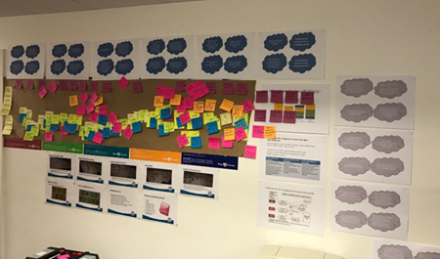
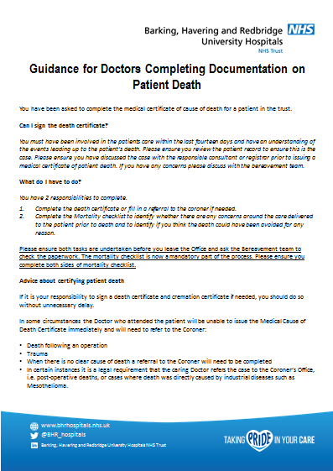
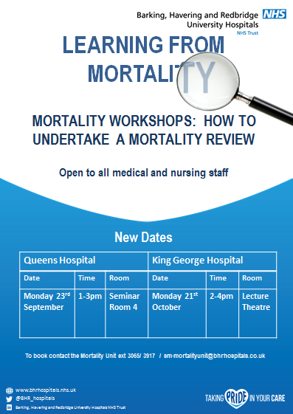
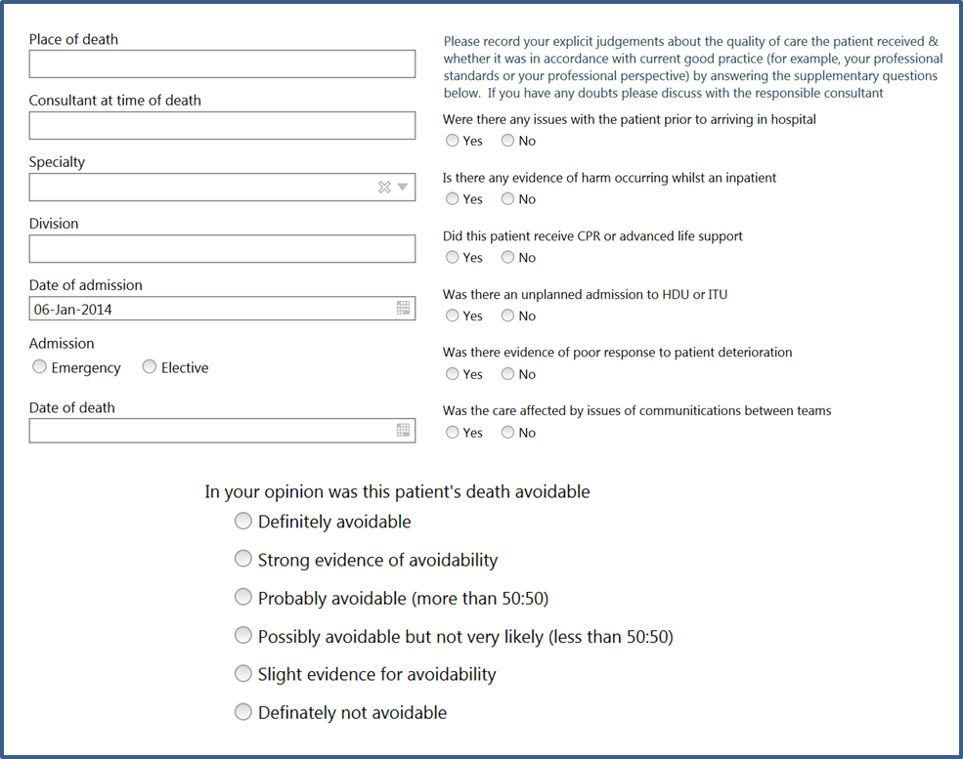


Outputs of mortality faculty at BHRUT

Slide 18
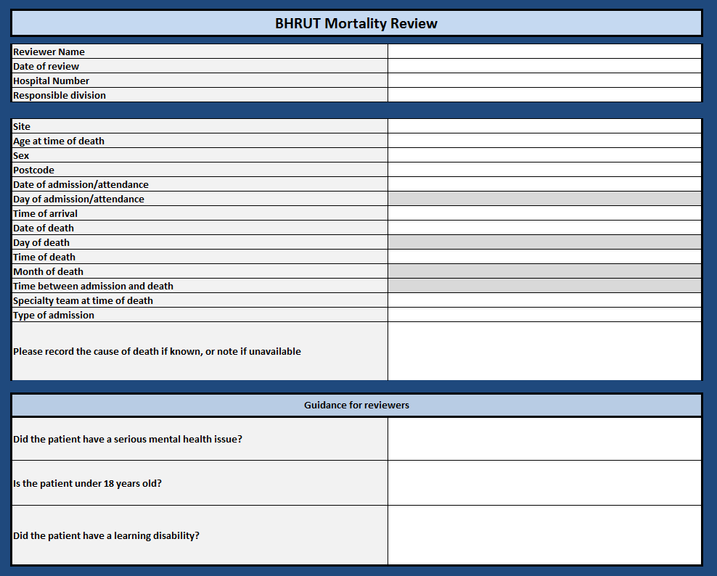

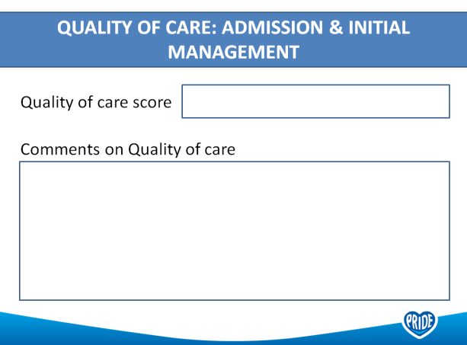
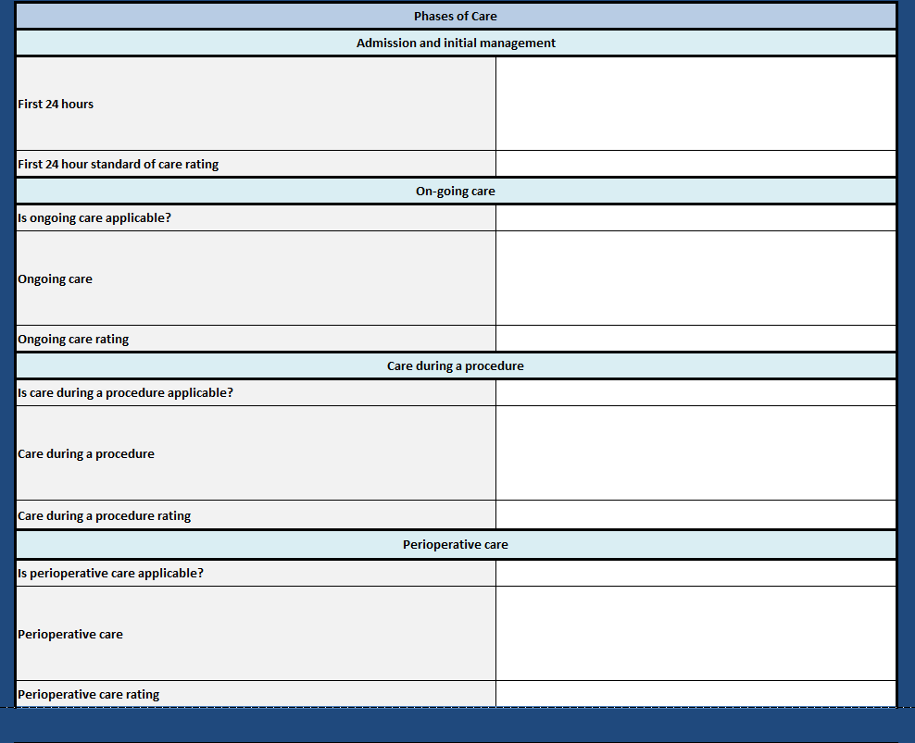
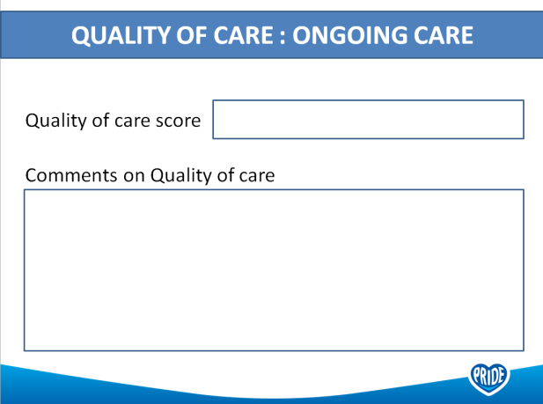
BHRUT Mortality Review Toolkit
We have developed a local tool for mortality reviews which asks for a summary and a rating for each of the stages of care.
In addition we have developed a template that enables presentation of the patient at local mortality meetings.
Testing is being undertaken by the Trust’s FY1s.

Slide 19

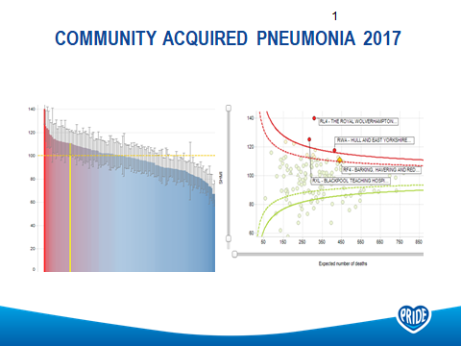
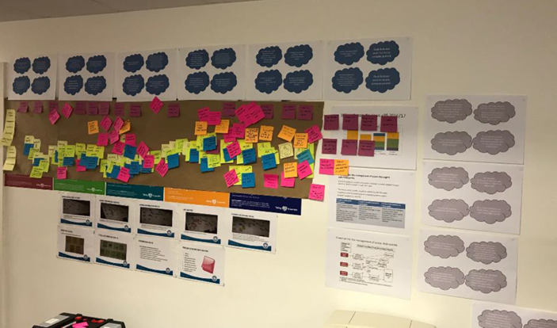
Quality Improvement Projects
When BHRUT was identified as an outlier for mortality in patients with pneumonia and in patients with biliary sepsis, the faculty undertook mortality reviews in these specific areas
The faculty engaged with the clinical teams responsible for the care of these patients to undertake SJRs and develop a Quality Improvement strategy based on their learning
These mortality reviews were used to inform and develop a new biliary sepsis pathway and management strategy
The ability to reach all specialities with complex pathways remains a challenge, but the use of the SJR highlights the ongoing need for improving management strategies
Biliary sepsis quality improvement workshop

Slide 20
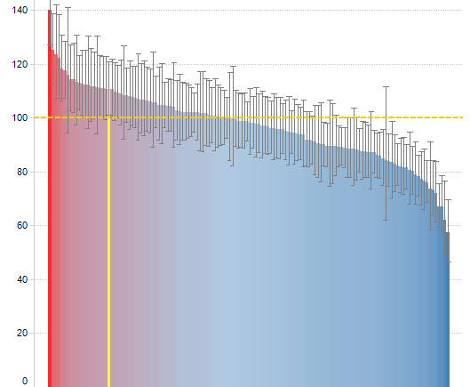
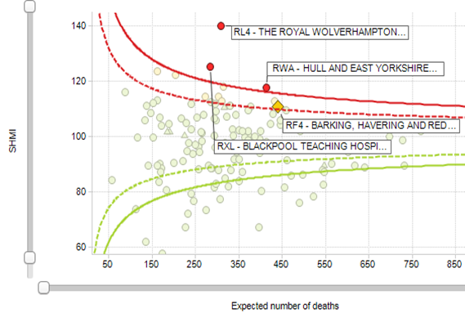
Community acquired Pneumonia 2017

Slide 21
Focussed review of pneumonia mortality 2018
Divisional HSMR outliers:
Pneumonia
Spec Med HSMR: 105.27
9 excess deaths
177 expected
186 Observed
Acute Medicine HSMR:118.25
25 excess deaths
139 expected
164 Observed

Slide 22
Mortality reviews and Pneumonia
We have now undertaken two cycles of mortality reviews
2017
    we identified a significant proportion of patients being wrongly coded with pneumonia as a cause of death.
    particular a high volume of frail elderly patients from neighbouring nursing homes were being transferred to the hospital in the late stages of the life.
2019
    focussed more on the quality of care. Case note reviews of 27 patients were undertaken by acute care physicians.

Slide 23
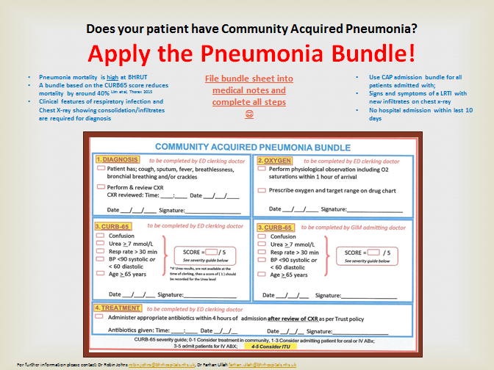
2017 review
Implemented assessment proforma for pneumonia
Mandatory training for management of pneumonia
Clinical lead for pneumonia

Slide 24
2019 pneumonia review
Supported our local teams to undertake the clinical reviews.
Used SJR methodology to identify problems in care
Review of all patient deaths in one month period

Slide 25
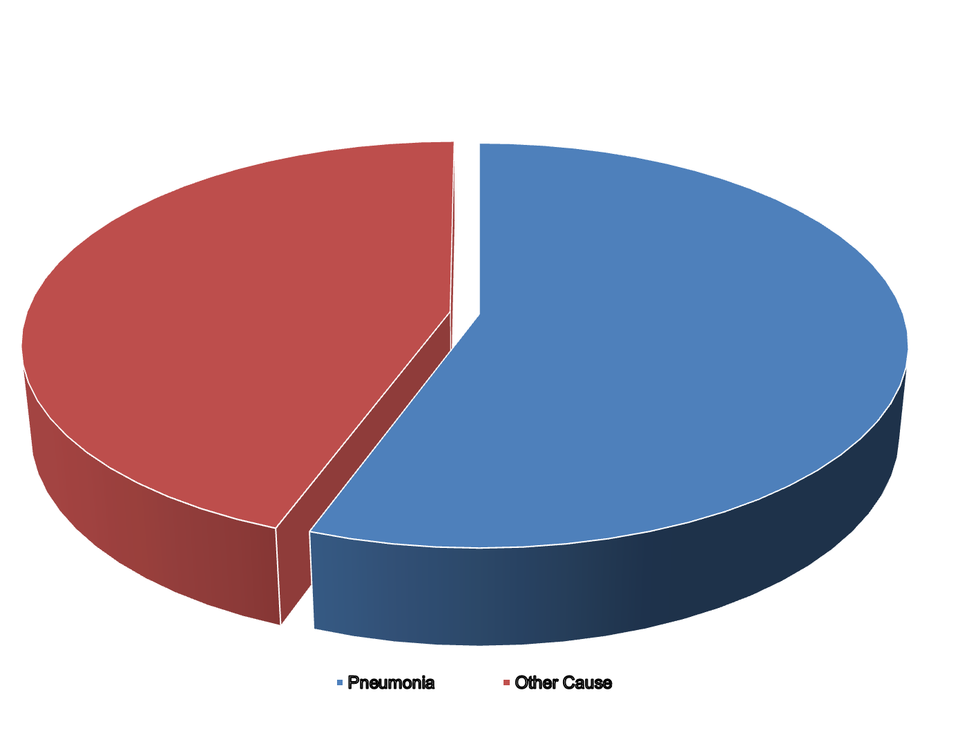
Cause of death

Slide 26
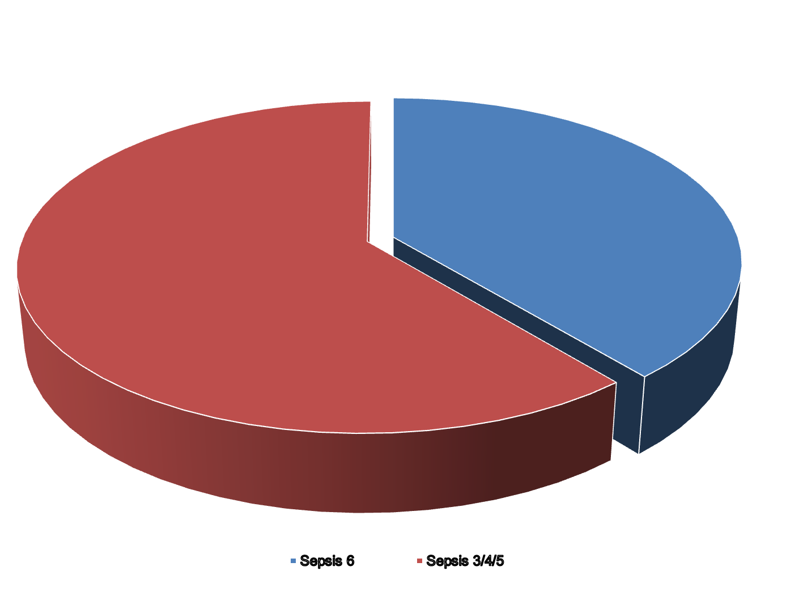
Sepsis bundle

Slide 27
Conclusions
15 people (55.55%) out of 27 died of Pneumonia
Only 6 patients out of 15 had documented CURB65 score
Only 7 patients out of 18 patients had Sepsis 6 Bundle completed and followed. (38.88%).

Slide 28
PNEUMONIA actions 2018-20
Focussed training on sepsis 5 in ED and MRU
Sepsis 6 and CURB 65 compliance assessed on Consultant ward round
Re-design of current medical clerking Proforma to include SEPSIS 6 and CURB65 tools
Focussed teaching and education on diagnosis and management of pneumonia

Slide 29
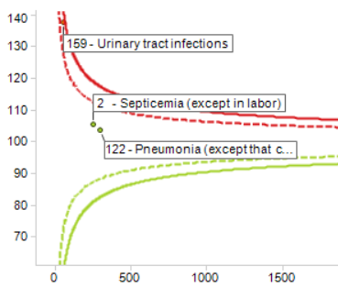
Summary
Supported learning from mortality reviews has lead to greater understanding of the department issues and ownership of the management of pneumonia within the department.

Slide 30
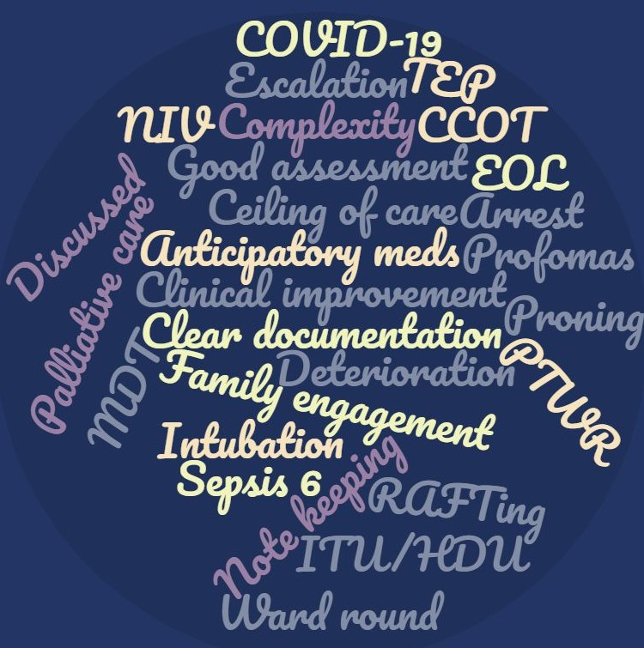
Mortality reviews: learning from deaths during Covid
Doreen Kageha, supported by junior doctor mortality faculty

Slide 31
Aims
This is a review of mortality assessments undertaken during the height of the covid-19 pandemic, specifically March to May 2020
A look at the common themes highlighted
Summary of the key learning points

Slide 32
Comparison with pre-covid data
The faculty undertook 255 reviews between this March and May 2020.
Comparison versus the pre-covid December- February 2019 64
This comparison is based on the quality of ratings provided by reviewers, with the scores categories being: very poor, poor, adequate, good and excellent.
Average of total scores
Improvement of 3.04 to 3.77, noted in the average rating scores recorded over the 2 periods
Average scores Dec 2019-Feb 2020 | Average scores March-May 2020
3.04 | 3.77

Slide 33
Comparison with pre-covid data
Dec 2019-Feb 2020 | March 2020-May 2020
Very poor= 0.5% | Very poor = 0.3%
Poor= 19% | Poor =2%
Adequate= 32% | Adequate = 17%
Good= 43% | Good= 62%
Excellent= 6% | Excellent= 19%
Percentage quality of care scores
Improvement all of the parameters

Slide 34
Judgement reviewer statements- ‘poor & very poor’
Poor record keeping
Failure to act on deteriorating patient in absence of TEP/DNAR
Decline recognised but no EOL care plan
No evidence of discussion re TEP or involvement of MDT to advise
Cardiac arrest call in a patient who had a CFS 6/7 multiple comorbidities and failure to escalate
No senior review of high EWS
Family update not documented

Slide 35
Judgement reviewer statements: ‘good & excellent’
Evidence of excellent care throughout
Speciality input as needed
Sepsis 6 completed within 1 hr of admission
Seen by CCOT on decline. Escalated to ITU timely
Good daily reviews and use of proforma. Reviewed with robust action plan
Seen by A and E/Medics with timely review and escalation decision making
Daily review and attention to detail by consultant/team
Deterioration communicated to family. Regular family updates
Rationale and explanation of EOLC given
Timely initiation of EOL pathway
Early recognition of need for palliation

Slide 36
Common themes
From the poor and very poor reviews
  lack of focus on TEP including EOL/ceiling of care/appropriate escalation contributed to lower scores
Strong evidence of cross speciality input with more mention of speciality involvement in patient care, particularly: the respiratory, ITU/HDU and palliative care teams
Evidence of early family involvement in a patient’s care, including some shared decision was associated with good care
Good EOL care was highlighted as an important factor in provision of good quality patient care

Slide 37
Summary
Clear improvement in quality of care provided to patients at BHRUT during covid-19, as reflected by the average and individual quality scores
Key aspects including:
  clear treatment escalation/ceiling of care plans including end of life
  family engagement and communication
  Specialist input

Slide 38
More recent issues: From wave2/3
Failure to consider other diagnoses
  Can you really feel those pulses
  Have we undertaken the tests proposed by our colleagues
  Have we looked at the results of tests proposed by our colleagues
  Have we acted on the results of tests.
Patients with Learning difficulties
Referral to coroners and completing of death certificates

Slide 39
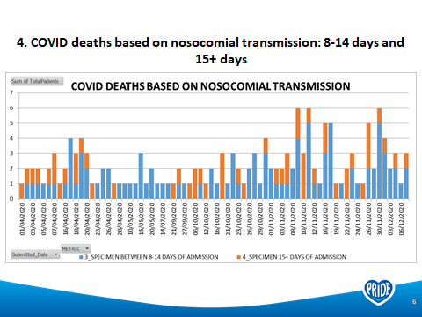
Nosocomial Infections

Slide 40
Sharing deaths between providers
ME role joint appointments
Knowing who to speak to in other organisations.
Agreed purpose

Slide 41
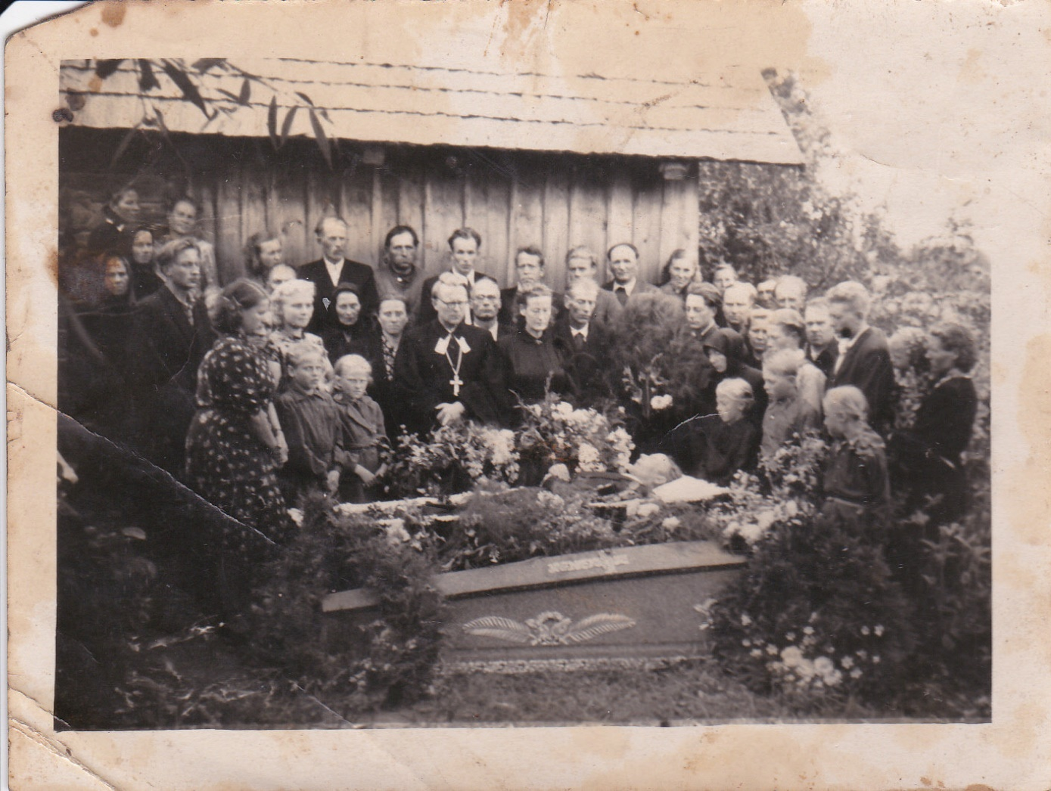
Involving relatives in mortality review process.

