Slide 1

Difficult and ethical issues for Caldicott Guardians in practice
Dr. Sarah Aylett
Consultant Paediatric Neurologist and Caldicott Guardian

Slide 2
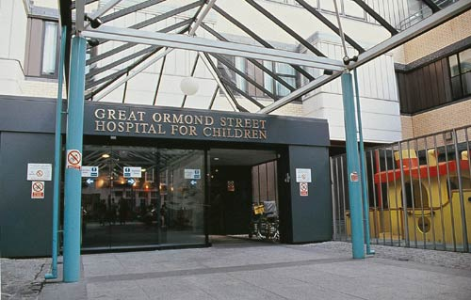
Background
Tertiary children’s hospital
Multiple specialist teams
Sharing of healthcare information with many secondary level services
Rare disorders
Active research environment

Slide 3

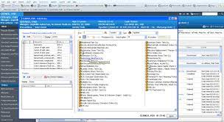
Electronic patient records (EPR)
Challenges
Modifying the system to meet the needs of paediatrics and specialities
Transfer of paper and existing electronic health records
Determining levels of access and training
Ensuring security of the system
Maintaining confidentiality
Opportunities/benefits
Improved access to the patient record
Improved communication amongst teams
Improved governance of records
Remote access for staff
Patient access

Slide 4
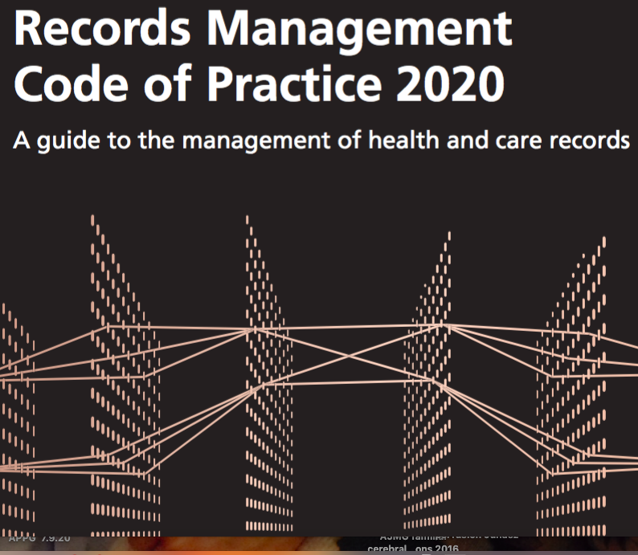


Medical records-retention and destruction- photos, media or archived records
Old records, radiology, videos and other media
Consider in relation to GDPR and requirements under the Data protection Act

Slide 5

Electronic patient records
The MyGOSH portal enables children, young people and families to have access to specific parts of the electronic patient record.
MyGOSH will let you:
Ask for changes to medical appointments – such as cancelling or booking an appointment
Look at the health summary – this is taken from your electronic patient record so is always up to date
Communicate securely with the medical team
From 12 years of age, may access jointly with parents
From 16 years of age, young person can access and determine who else has access

Slide 6

Medical records and information sharing

Slide 7
Caldicott oversight for the use of personal data in children and young people
  Medical records and information sharing
  Use of email
  Police requests
  Audit projects that cross organisational boundaries/national audits
  Teaching, where discussion or presentation of a case with particular features or history could reasonably be said to make the patient or family identifiable to others
  Research projects
  Publication of materials that identify patients
  Passing data to embassies and other organisations involved in the management of private patients

Slide 8
Uses of patient personal data and consent
Uses of patient personal data for the purpose of direct clinical care, safeguarding and the wellbeing of children
Consent is not needed for sharing children’s information that is necessary for a medical purpose with:
The Trust clinical teams involved with the care of the patient
The patient’s:
School or local education authority
GP
Dentist
Local paediatrician
Local CAMHS
Social workers

Slide 9


Consent with increasing capacity
Consent sought for a child from a family can not be relied upon once the child has reached 16 years of age
Consent must be re-sought from the patient when they reach the age/capacity to consent for themselves

Slide 10
Required disclosures of Personal Patient Data
The Trust may be required to disclose data, regardless of a patient’s or families wishes, because of specific statutory or legal requirements:
Notification of a known or suspected communicable disease
Disclosures to courts or in connection with litigation
Disclosures to statutory/regulatory bodies including CQC
Notification of a death
Social workers: staff must take great care in assessing the necessity of disclosing data to social services
Any safeguarding and child protections concerns must be shared without delay and referred to the trust Safeguarding team
Notes:
Advice should be sought
from the Trust’s legal team and data protection officer; In these cases the Trust will endeavour to inform the patient or family where appropriate, although disclosure may be necessary by law in any case:

Slide 11
Working with families
Consent is not necessary for any of the above described sharing for children
Best practice to inform the patient/family in advance of such sharing
It helps manage expectations and allows families to work with staff on practical matters such as a change of school
Where there are child protection concerns and informing the parents may place the child at further risk of harm, it is not required to inform parents
Where risk of harm is not the case, staff should inform families that they are making a referral to social work.

Slide 12
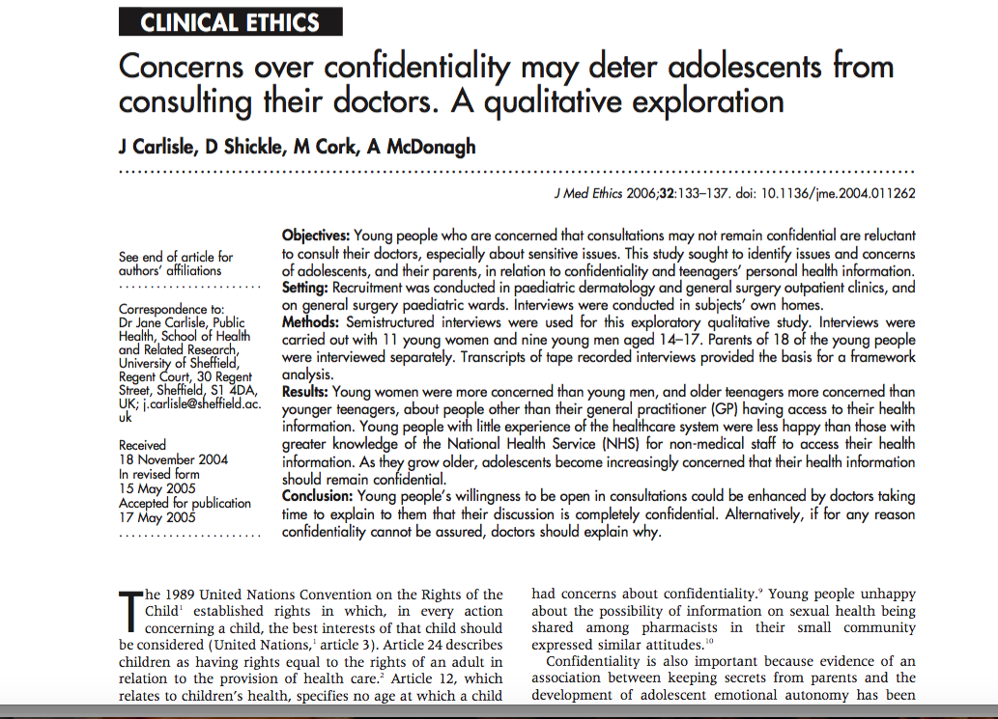
Title
Subtitle
The child first and always

Slide 13

Aim: to explore the views of young people and their parents on a young person’s right to privacy in relation to health information
Recruitment 20 young people (YP) age 14-17 years with experience of healthcare services in paediatric outpatients and general surgery paediatric wards
Qualitative analysis of semi-structured interviews of YP and parents
Notes:
86% of adolescents would normally seek health care from the GP- falls to 57% if the problem was related to pregnancy, HIV, or substance misuse. 25% would forgo health care if they had concerns about confidentiality

Slide 14
Concern about people other than their general practitioner (GP) having access to their health information:
Young women were more concerned than young men
Older teenagers more concerned than younger teenagers
Young people with little experience of the healthcare system were less happy than those with greater knowledge of the National Health Service (NHS) for non-medical staff to access their health information
As they age, adolescents become increasingly concerned that their health information should remain confidential

Slide 15
Non disclosure to children young people and maintaining confidentiality
Case discussion
Anna aged 15 years has maternally acquired HIV
Treated with antiretroviral treatment from birth
She has no regular contact with her biological mother who is an iv drug user
Maternal aunt has parental responsibility via the Court
Maternal aunt has strong Christian beliefs
She has refused information to be given to Anna about her diagnosis
Her behaviour is intimidating to staff
Each invitation to meet with the Social Work team has been declined
Has threatened legal action if there is disclosure to Anna
She will tell her when she is 18 years old

Slide 16
Police requests

Slide 17

Research

Slide 18
Common issues
Anonymised data- how, by whom and whether truly anonymised?
Does the consent process ensure re-consent when the YP has capacity?
Patient information and consent
Rare disorders- possible identification with data collection or publication
Multicentre studies- data transfer and security of storage
Data sharing agreement
IG and IT involvement

Slide 19
Research and National Audits
Paediatric National Audits
Maternal, Newborn and Infant Clinical Outcome Review Programme
National Cardiac Arrest Audit (NCAA)
National Audit of Cardiac Rhythm Management (CRM)
National Congenital Heart Disease (CHD)
National Paediatric Diabetes Audit (NPDA)
Paediatric Intensive Care Audit Network (PICANet)
Serious Hazards of Transfusion (SHOT)
UK Cystic Fibrosis Registry
Learning Disabilities Mortality Review Programme (LeDeR)

Slide 20
Sharing personal information for National Audits
Where consent is judged not to be practicable then an exemption under Section 251 of the NHS Act 2006 must be obtained.
The confidentiality advisory group (CAG) approve under section 251 of the NHS Act 2006- which sets aside the common law duty of confidence for defined medical purposes-can then disclose confidential patient data
National data opt out is now from March 2022
Caldicott Principle 8: Inform patients and service users about how their confidential information is used
Notes:
Confidentiality advisory group (CAG) approve under section 251 of the NHS Act 2006- sets aside the common law duty of confidence for defined medical purposes. Can disclose confidential patient data.
National data opt out now from March 2022.

Slide 21
Big Data Health Research

Slide 22
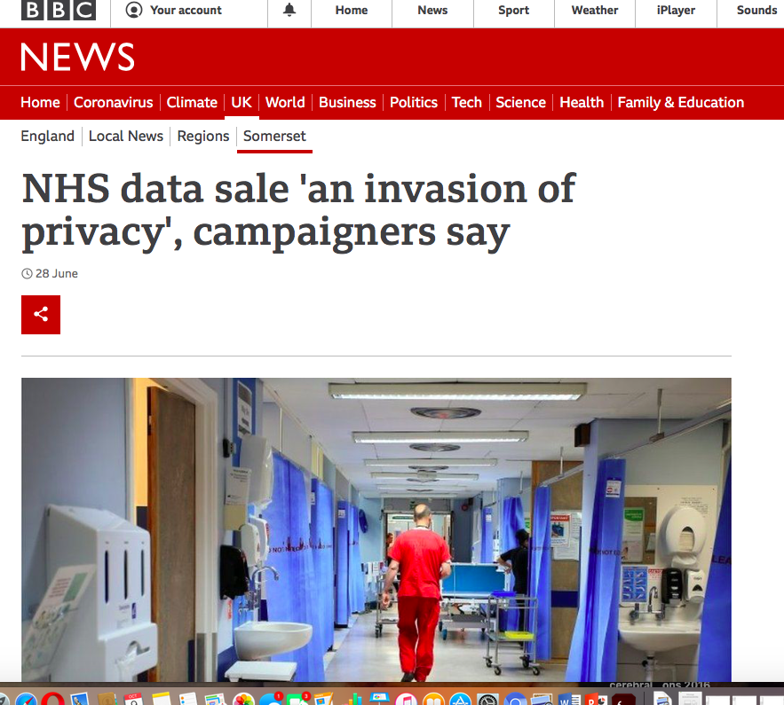

NHS health data: fighting for your right to be heard
17.03.2021
Foxglove and openDemocracy are fighting for your right to have a say about data deals between the NHS and Big Tech.
The future of our NHS is being written now. Will it be a future where shady Silicon Valley tech companies like Palantir are let in through the backdoor? Or will it be one where public health data is properly managed and used as a public asset for public good?

Slide 23
Sensyne Health and Somerset NHS Foundation Trust sign Strategic Research Agreement
Non-exclusive agreement covers a total of 1.1 million anonymised patient records and brings total number of records available to Sensyne for research to over 5.6 million
Enables the ethical application of clinical artificial intelligence research on anonymised patient data to improve patient care and accelerate research into new medicines
Somerset NHS Foundation Trust receives equity stake in Sensyne Health plc and will receive IT research funding and a share of revenues
BBC November 2020

Slide 24
Big data health research
Advance precision medicine benefits-
Disease aetiology
Treatments
Disease management
Health expenditure
Commercial asset of NHS data- £5 billion/year
-4.6 billion benefit through cost savings/improved outcomes

Slide 25
Issues for data sharing with commercial companies
Public Trust
Confidence in systems
-Transparency
-accountability
-Representation
-Clear purpose
Assurance about health data will be used
Data sharing agreement
Method of consent for identifiable data
Mackenzie Graham J Med Ethics 30 Jul 2021

Slide 26
Social purpose
As well as a commercial purpose, companies have a role in advancing goals of society
Social role of individuals to contribute to functioning of the health system
Utilitarian argument for the use of health data
Individual rights to confidentiality and privacy upheld in law and are reflected in the Caldicott principles
Mackenzie Graham J Med Ethics 30 Jul 2021

Slide 27
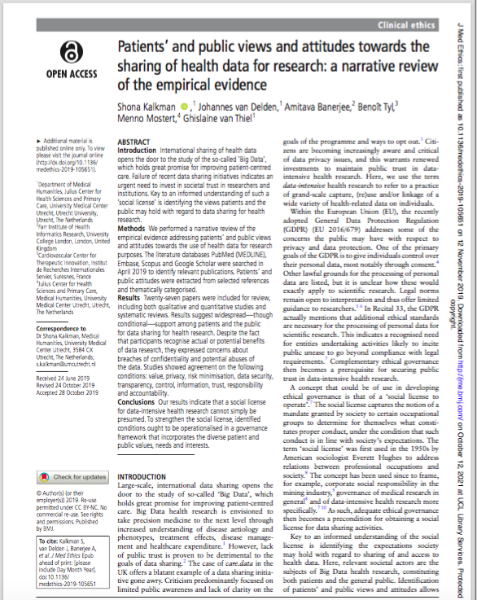
Patients’ and public views and attitudes towards the sharing of health data for research

Slide 28
Patients’ and public views and attitudes towards the sharing of health data for research
Narrative review of 27 papers from 2009-19
Performed an up-to- date narrative review of both quantitative and qualitative studies to explore predominant patient and public views and attitudes towards data sharing for health research.
Social license’ to operate- a mandate granted by society for occupational groups to determine conduct provided this reflects society's expectations
Need to identify patients’ and public’s views about sharing access to health data
Notes:
The social license captures the notion of a mandate granted by society to certain occupational groups to determine for themselves what consti- tutes proper conduct, under the condition that such conduct is in line with society’s expectations. We identified 27 papers for review, including 12 survey or questionnaire studies (quantitative), 8 interview or focus group studies (qualitative), 1 mixed methods study and 6 systematic reviews

Slide 29
Willingness to share data for health research
Widespread support for the sharing of data for health research internationally and in multicentre studies
93% of a sample of UK citizens with Parkinson’s disease (n=306) were willing to share their data
Recognised the benefits of storing electronic health information
(55%) of a sample of older Swiss citizens (n=40) were in favour of placing genetic data at disposal for research
50% of the members of the Citizens Council of (NICE) said they would have no concerns about NICE using anonymised data derived from personal care records to evaluate treatments

Slide 30
Motivations to share data
Contributing to advancements in healthcare, returning incurred benefits of the NHS and the hope of future personal health benefits
Sharing data for ‘the common good’ or ‘the greater good’ was identified as one of the most prevalent motivations
Patients with rare disease were also motivated by ‘great hope and trust’ in the development of international databases for health research

Slide 31
Perceived risks of data sharing
Breaches of confidentiality
Commercial use and potential abuse of the data
Risk of re-identification
Concerns about a party's competence in keeping data secure
Concerns that personal information could be mined from genomic data
Data ‘falling into the wrong hands’, e.g insurance companies
Health data being ‘stolen by hackers’
The NICE Citizens Council expressed concerns about the potential for data to be sold to other organisations and used for profit and for purposes other than research
The Citizens Council also highlighted the need for transparency about how data are used

Slide 32
Issues
Social value
Data security
Transparency
Accountability
Incorporate the diverse patient and public values, needs and interests of different patients

Slide 33
Summary
The role of the Caldicott Guardian in paediatrics involves many different aspects of oversight and advice
The rapid increase in the electronic use of data brings ethical and practical challenges and opportunities
It is important to work closely with IG and the DPO
Importance of holding the best interest of the child and young person central to the role
Challenges in ensuring young people are involved in their health data with increasing maturity

