Slide 1


Delirium
Prevention
@DeliriumKrish
@Fix_psych

Slide 2
Dr M S Krishnan FRCPsych
Consultant in Old Age & Liaison Psychiatry
Senior Clinical Director
TEWV NHS Foundation Trust
Chair, Faculty of Old Age Psychiatry @RCPsych
Associate Dean, Regional Delirium Lead HEE NE
Dr Eleni Fixter MRCPsych
Consultant in Old Age
Trust Doctor Tutor
Delirium Pathway Lead
TEWV NHS Foundation Trust

Slide 3
Plan of the Talk
Delirium
Delirium and COVID-19
Key steps you can take to prevent/reduce risk of some one developing delirium
Resources

Slide 4
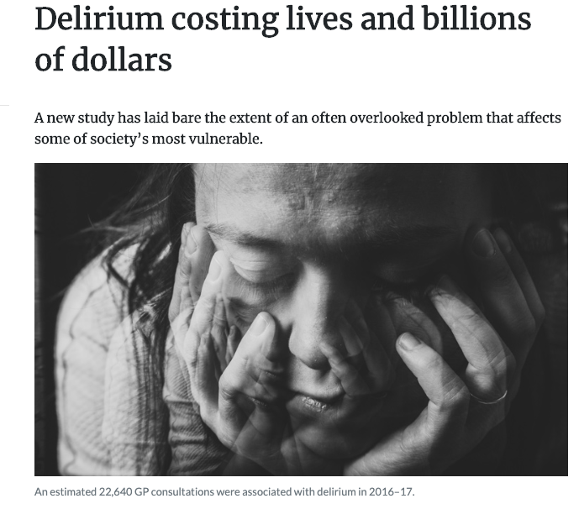
News Flash

Slide 5
What is Delirium
Delirium is an acute onset syndrome with disturbance in
attention, awareness and cognition
There is normally an underlying cause
COVID-19 COULD BE ONE

Slide 6
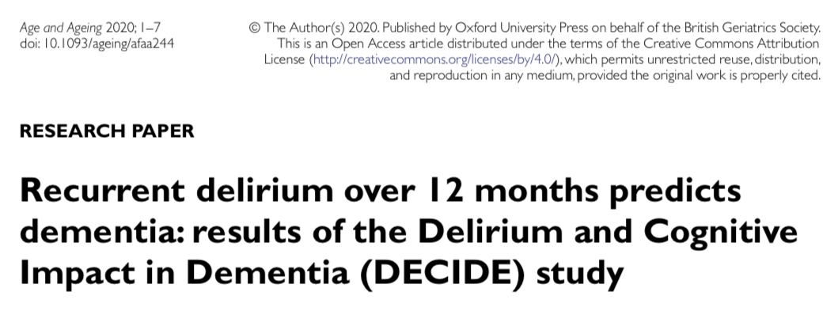
Why we need to know about delirium?
Delirium increases risk of future cognitive decline.
Longer duration, more severe delirium and more episodes of delirium were associated with worse cognitive outcomes.
Delirium may be a potentially modifiable risk factor for dementia.

Slide 7
Some Statistics
20% of older adults presenting to hospital have delirium
  Higher percentage in elderly wards and ICU
20% mortality (in 3 months)
Worsens existing dementia
  8 fold increase in development of dementia in 2yr

Slide 8
Burden
Delirium Occurrence has not changed over 4 decade 1980- 2019 (23%) Davies et al (2019)
Clearly indicates a need for preventative strategies = Risk Reduction

Slide 9
Vulnerability
Precipitant
High
Major Event
Dementia
Meningitis, sepsis
Multi-morbidity
Surgery
Fall and Fracture
Sensory Impairments
Dehydration
Polypharmacy
Urinary Catheter
Healthy and Fit
Hypnotic Tablet
Low
Minor Event
Multifactorial Model for Delirium (from Inouye 2006)
Notes:
9

Slide 10
Risk Factors
COVID-19
Age
Frailty
Cognitive impairment
Visual impairment
Hearing impairment
Medical comorbidity
Polypharmacy

Slide 11


Delirium – Diagnosis

Slide 12
Diagnosis – Always clinical
No tool is diagnostic
There are approximately 59 tools for various settings
In older adults some tools may be difficult to administer
  Sensory impairment
  dementia
  Pain/anxiety

Slide 13
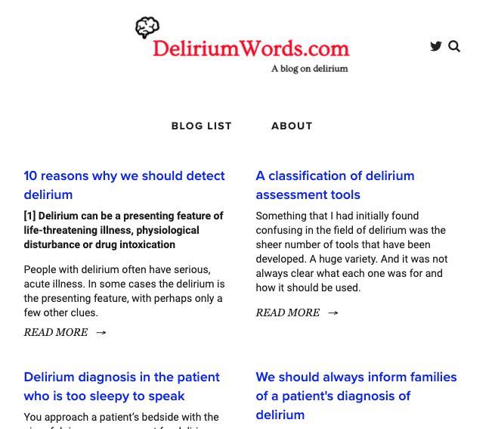
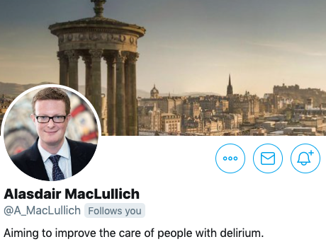
Tools
SQiD
4AT
CAM
………

Slide 14
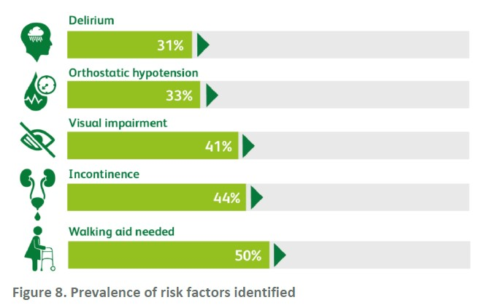
Detecting Delirium – We need more

Slide 15
Delirium – Management

Slide 16
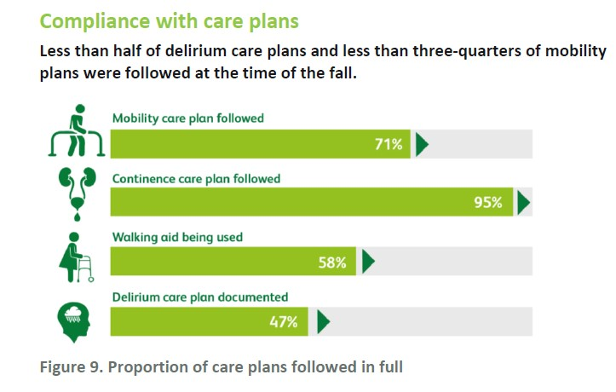

Slide 17

Principles of Delirium Management
Early Detection
Non-Pharmacological management
Medication carefully considered
Education
Prevention/ Risk Reduction

Slide 18
Non-Pharmacological
Good light
Glasses and hearing aid
Distraction
Minimise noise
Consistent communication
Early mobilisation

Slide 19
Pharmacological
Medicine optimisation
Deprescribing
Consider drug interaction with antiviral
Avoid Polypharmacy
Anticholinergic burden

Slide 20

Risk
Need
Side-effects
Chemical Restraint

Slide 21
Benzodiazepines
No Role for Benzodiazepine in the management of Delirium, can worsen the symptoms
Some indication for management of agitation in Dementia with Lewy bodies, Parkinson's disease with Dementia
Where antipsychotic medication are contraindicated - may be a role with caution
Midazolam - End of life severe agitation

Slide 22

Awareness
Skills
Knowledge

Slide 23
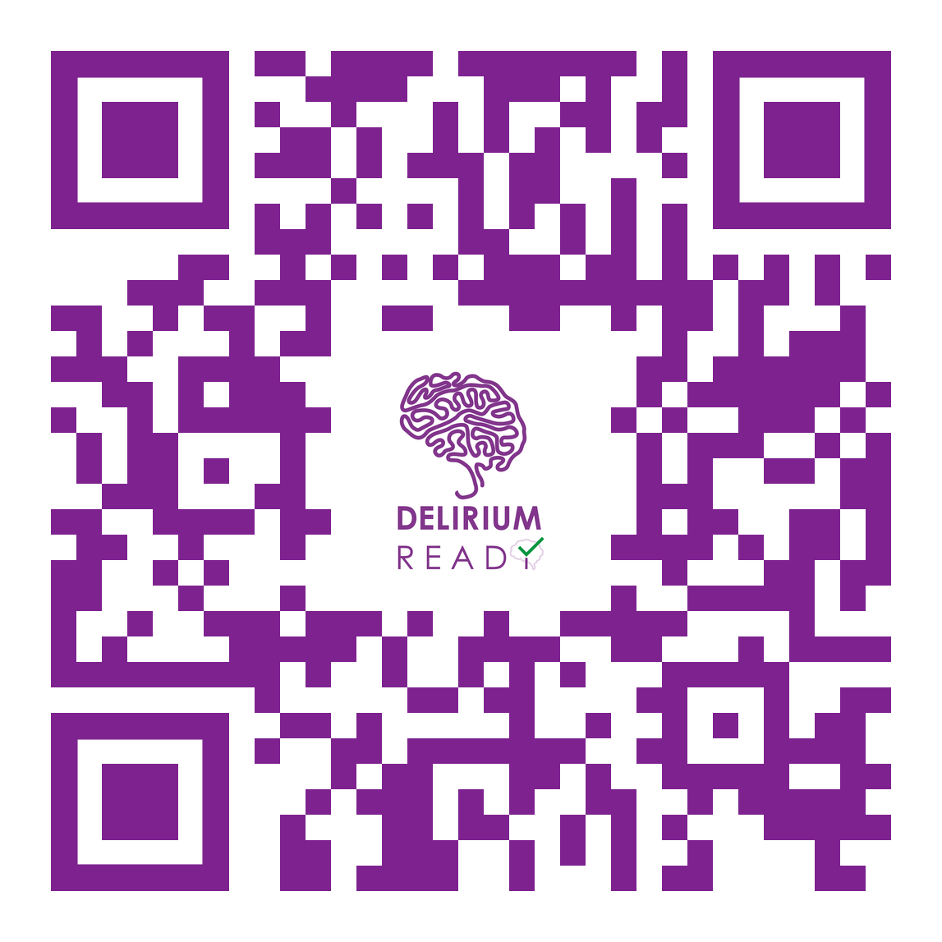
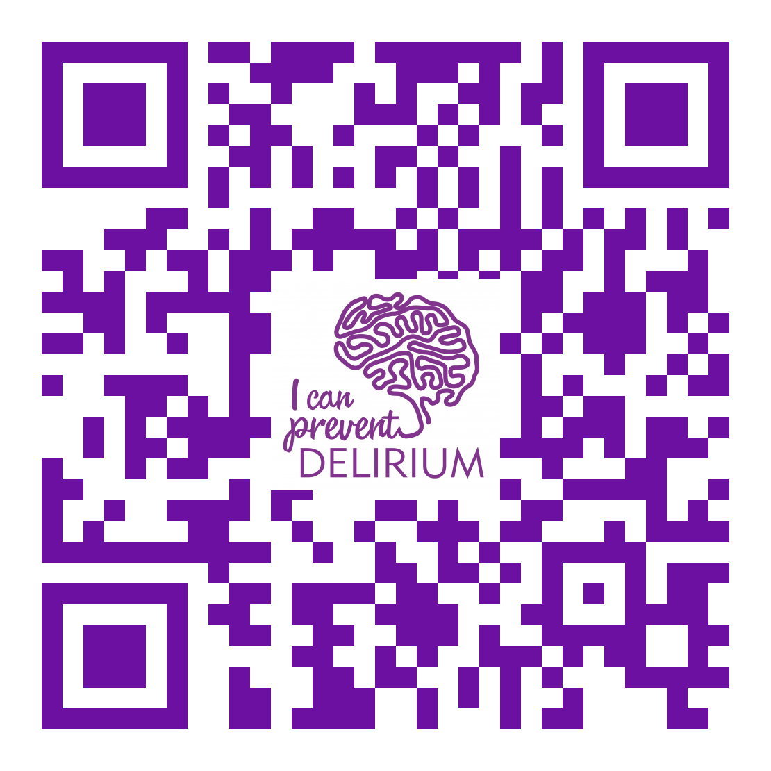
Delirium Educational Videos
https://youtu.be/2Hg1VP-Enw4
https://youtu.be/BPfZgBmcQB8

Slide 24
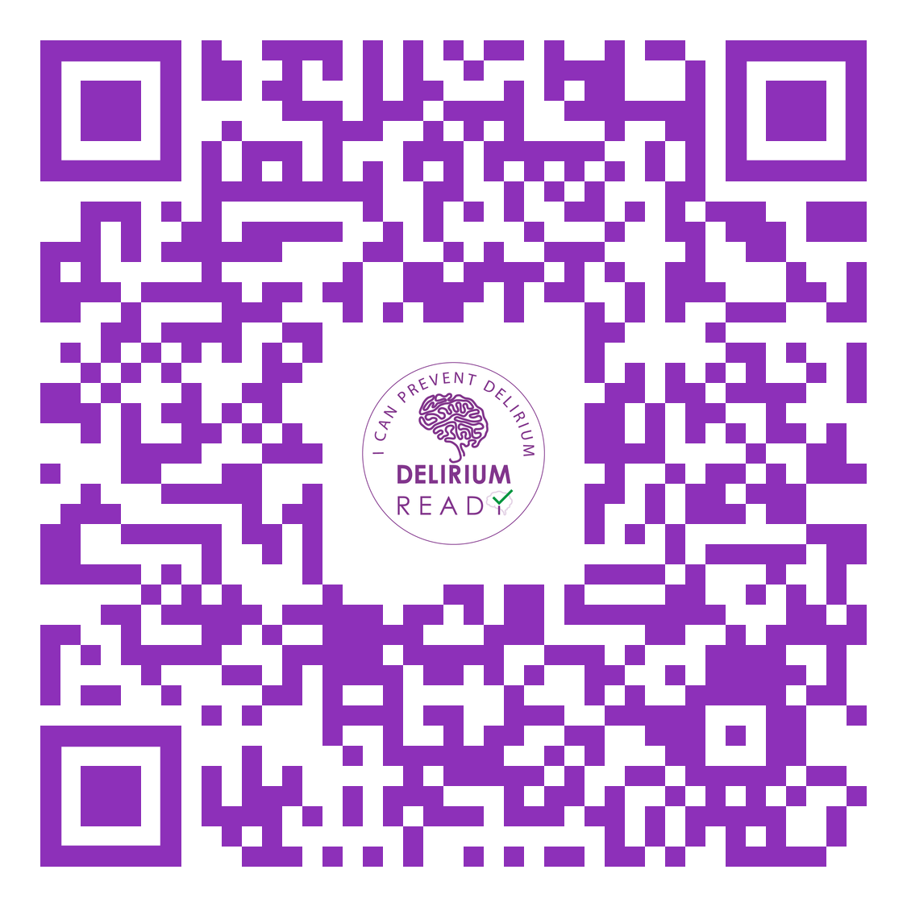

We have launched a Delirium Wheel app for care homes
iOS or Google Play store

Slide 25
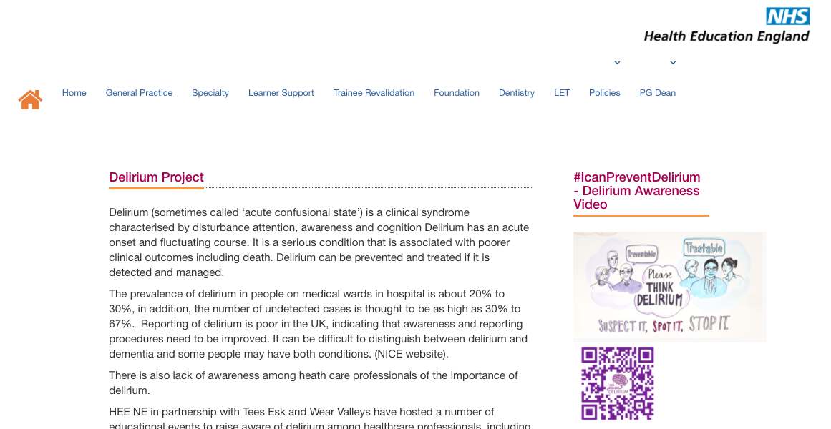
Resources
Google – HEE NE Delirium

Slide 26
Take Home….
Delirium can be prevented / Risk Reduction
Try non-pharmacological approach before considering any medications
Delirium is a risk factor for Dementia and please do not forget delirium superimposed dementia
Be mindful of presentation with COVID
Delirium is everybody’s Business

Slide 27

Thank You
@DeliriumKrish
@charliemacksey

Slide 28
Are you?
@DeliriumKrish
@Fix_psych

Slide 29

#WDAD2022
@DeliriumKrish@Fix_psych

