Slide 1




Reducing harm from falls:
Focusing on inpatient falls resulting in hip fracture
Presenter: Lucy Winstanley
Helen Dockerill
West Suffolk NHS Foundation Trust

Slide 2

Objectives
Harm from inpatient falls: reviewing data
Reporting and investigation of inpatient falls – changes with the introduction of PSIRF
Participation in the national audit of inpatient falls at a local level
Falls investigation: learning from falls
Implementation of safety improvement practice

Slide 3

Our story - WSFT falls position
December 2021 data
Total trust falls figure – 92
Of these 92 falls 77 occurred in acute beds and 15 occurring in community beds
13 patients were classed as frequent fallers – 10 fell twice and 3 three times during the reporting month
Year to date data
The average number of falls per month is 75, including acute and community beds

Slide 4
Case Study
Fall with fractured neck of femur
What happened?
Admission with back pain and urinary incontinence
Treatment given for UTI
Declined to mobilise due to back pain and feeling unwell
Mobilised with a frame and supervision and completed stairs assessment
Discharge planned for the afternoon
Unwitnessed fall within the bay and sustained a fractured neck of femur.
Why did it happen?
Background of dementia
Patient awareness that not at home and wanting to return home
Deconditioning
Reduced insight into abilities
Call buzzer not used
Staff attending to another patient and not in the bay when patient mobilised
Bed space has reduced visibility from ward corridor

Slide 5
Case Study
What have we learned?
Patient awareness and understanding of discussions and discharge plans
Manual Handling technique to assist patient off the floor
Lying/ standing blood pressure
What are we doing about it?
Education to staff ensuring close observation when patient sat out for first time
Identifying how we support patients unable to use call bell system
Education to staff regarding the covid curtains being rolled up between bed spaces
What did we do well?
Documentation regarding post fall assessment and patient refusing observations, patient monitored closely for any other signs of deterioration

Slide 6
Impact of falls within the hospital setting
Impact of a fall to the patient, family and to the staff
Falls prevention continues to be a priority at WSFT
Emotional distress
Reduced mobility
Low self esteem
Loss of confidence
Pain
Additional burden
Injury

Slide 7
National Patient Safety Strategy
Three strategic aims
INSIGHT - improving understanding of safety by drawing intelligence from multiple sources of patient safety information
INVOLVEMNT - equipping patients, staff and partners with the skills and opportunities to improve patient safety throughout the whole system
IMPROVEMENT - designing and supporting programmes that deliver effective and sustainable change in the most important areas

Slide 8
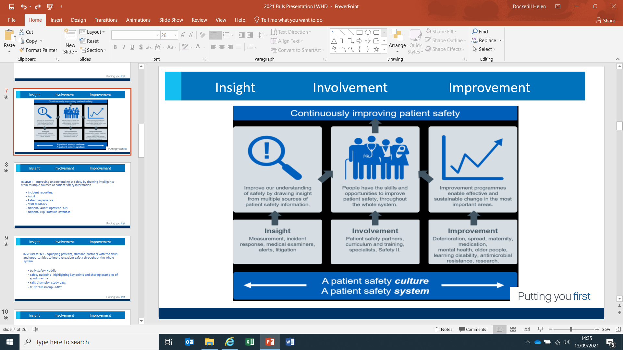
Insight Involvement Improvement
INSIGHT
  Incidents
  Greatix
  Complaints
  Staff feedback
  Safety Dashboard
  National Audit Inpatient Falls
  National Hip Database
  Daily falls reviews

Slide 9

Insight Involvement Improvement
INVOLVEMENT
  Daily Safety Huddle
  Safety Bulletins –highlighting key points
  and sharing examples of good practise
  Falls Champion study days
  Trust Falls Group – MDT
  Engagement with the patient/ family

Slide 10
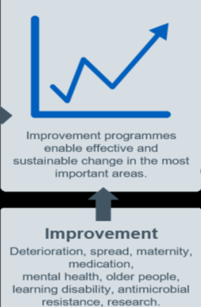
Insight Involvement Improvement
IMPROVEMENT
  NAIF –pilot of the new process including
  hot debriefs and after action reviews
  Continuous review of falls to identify themes
  Monthly quick wins
  Targeted QI approach, use of Life QI

Slide 11
Patient Safety Incident Response Framework
Key part of the NHS patient Safety Strategy
Aim to help the NHS to improve its understanding of safety by drawing insight from patient safety incidents.
Early adopter site
Opportunity to use alternative method to safety investigation
Collaborated with the National Audit Inpatient Falls for investigating inpatient falls with ‘hot debrief’ and ‘After Action Reviews’.

Slide 12
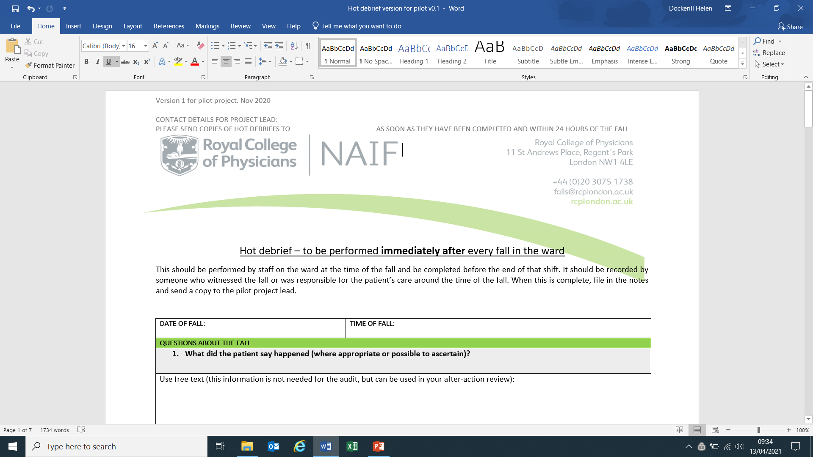
Hot Debrief

Slide 13
Hot Debrief
To ensure the patient and those involved in the patient’s care are given the opportunity to provide their account of the fall.
To collect the information about the circumstances surrounding the fall to inform the after-action review.
To improve record keeping relating to the fall
To support data collection for the National Audit of inpatient Falls for falls that lead to hip fracture (NAIF)

Slide 14
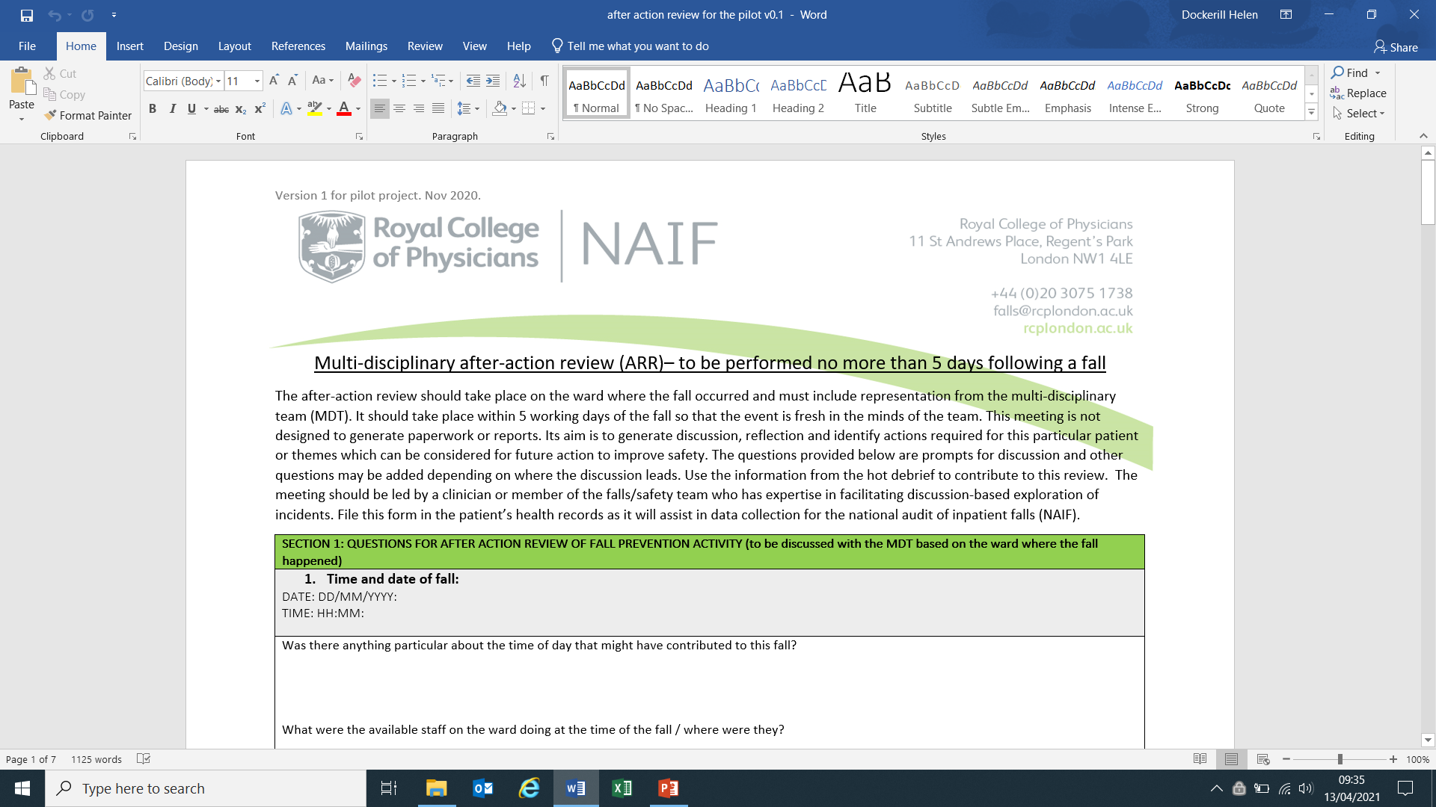
After Action Review

Slide 15
After Action Review
For the multi-disciplinary team to participate in open discussion about the circumstances leading to and the management of the fall.
To develop insights into how patient safety might be improved as a result of the discussion.
To share the outcome of discussions more widely to allow others within the organisation to benefit from the insights.
To be used to identify patterns that might require further investigation and provide an information base to support a PSII

Slide 16
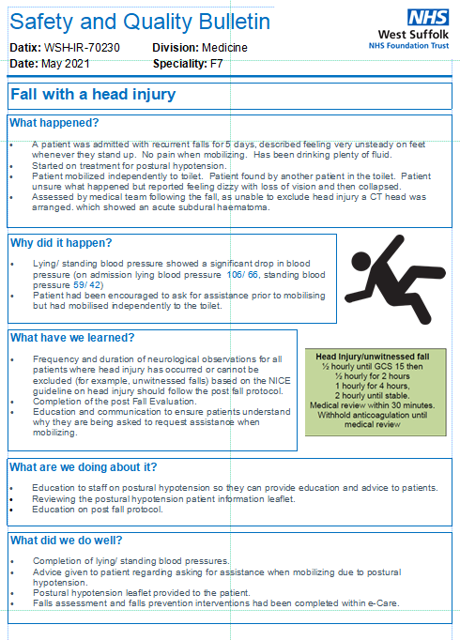
Safety Bulletins

Slide 17
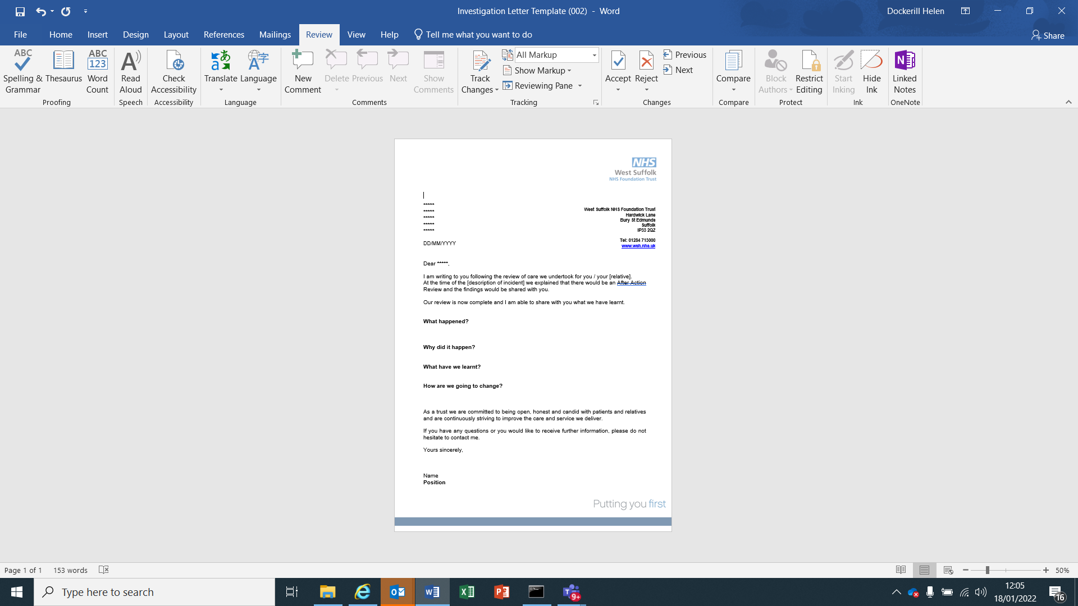
What happened?
How did it happen?
How are we going to change?
Investigation Findings Letter

Slide 18
Evaluation – Local and National
LOCAL
  Earlier identification of learning outcomes
  Earlier identification of themes across falls and therefore improvement plans to address these
  Opportunity for MDT involvement
NATIONAL
  Participated in national evaluation
  Awaiting results

Slide 19
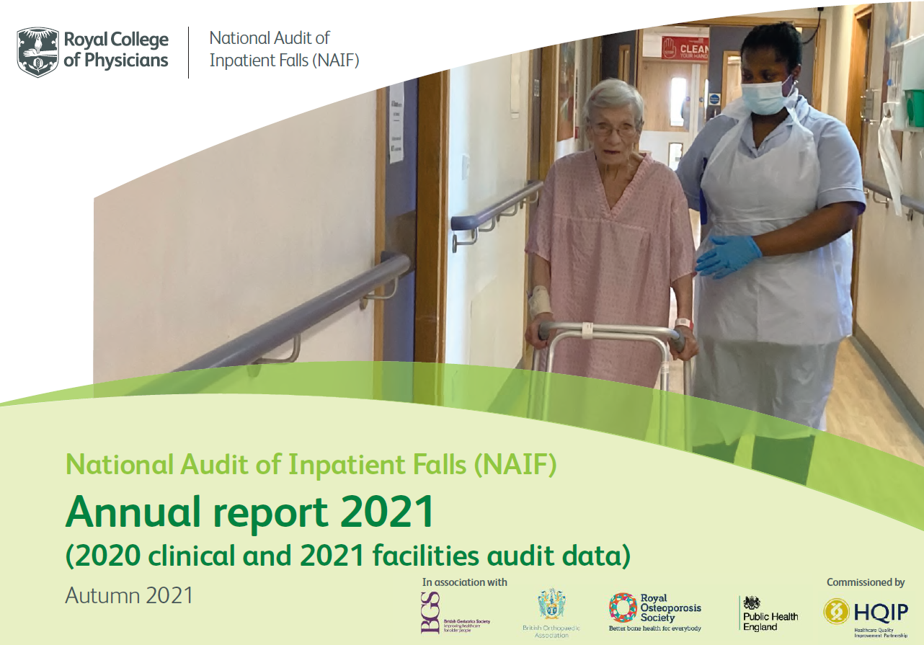
Learning from the national audit of inpatient falls at a local level

Slide 20
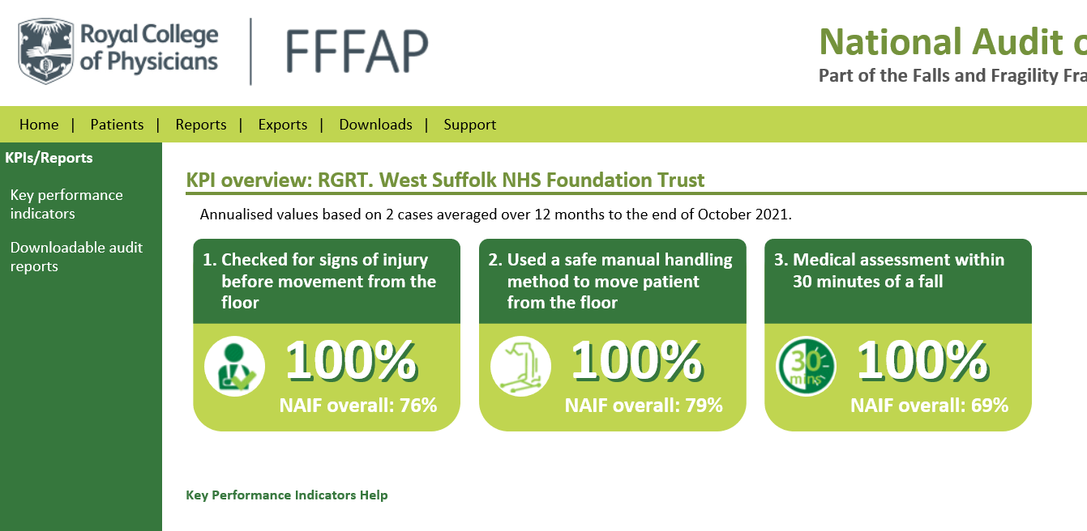
Learning from the national audit of inpatient falls at a local level

Slide 21
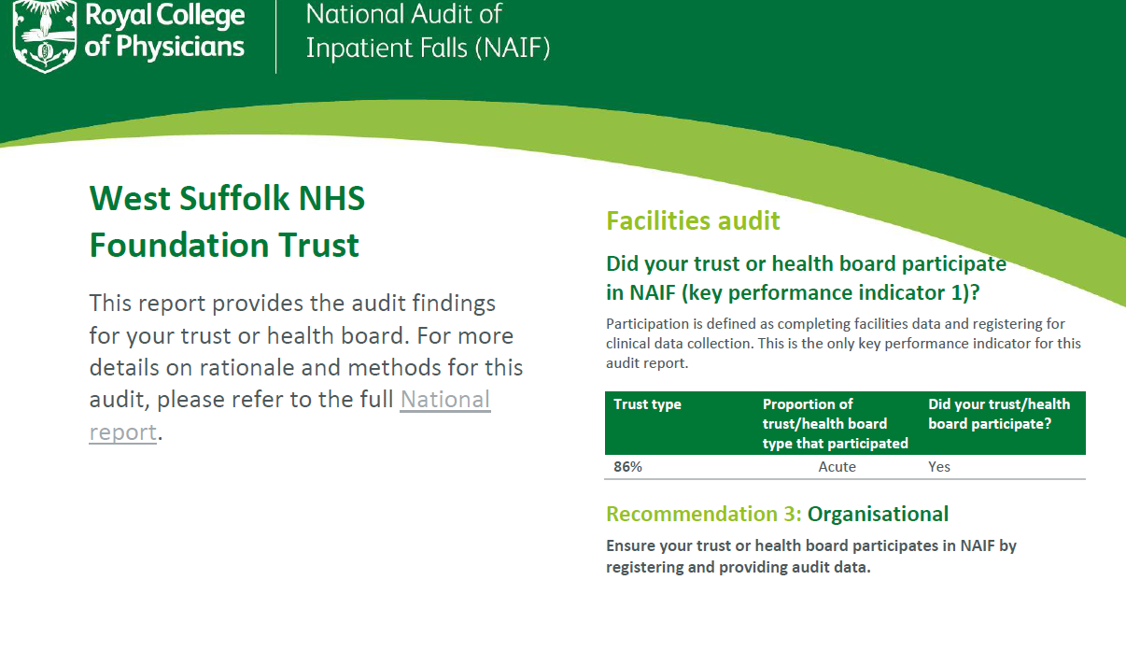
Learning from the national audit of inpatient falls at a local level

Slide 22
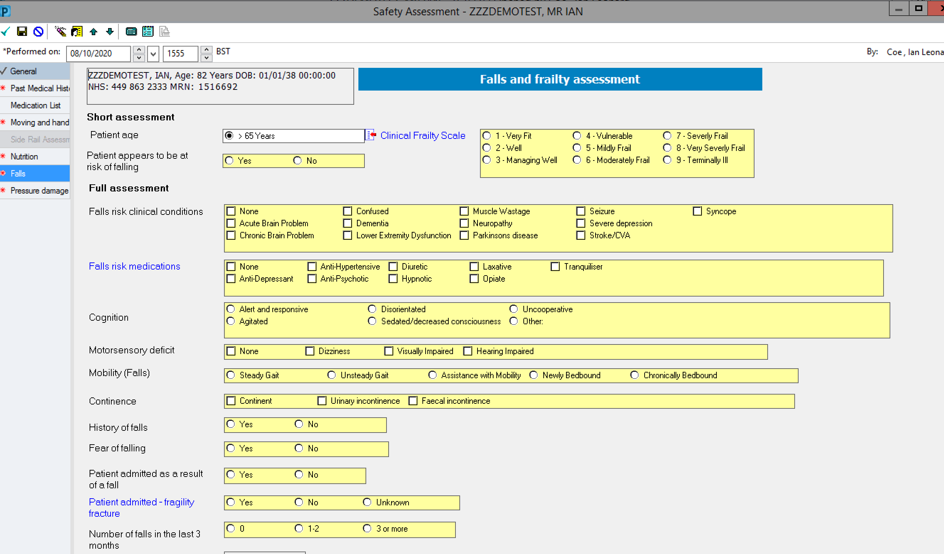
Multi factorial falls assessment
All adult in-patients are assessed for risk of falls as part of the Safety Assessment documentation:

Slide 23
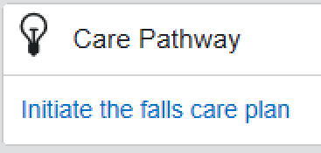
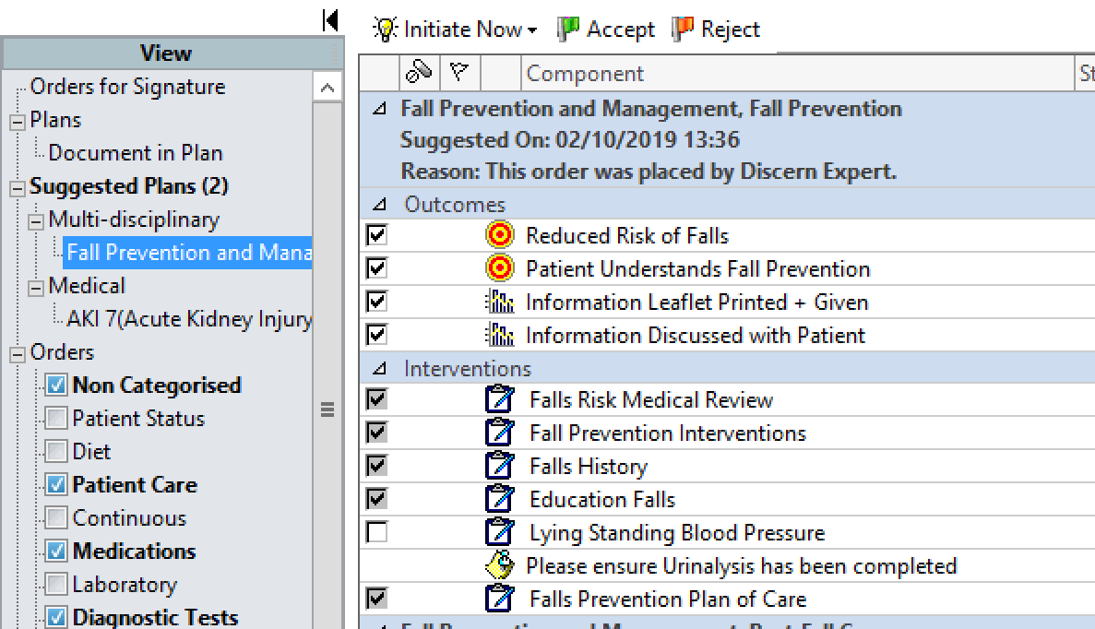
Falls care plan
If indicated, the nursing staff will be reminded to start the corresponding falls prevention care plan:

Slide 24
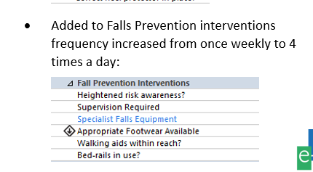
Falls Prevention Interventions
Falls Prevention Interventions changed to four times a day

Slide 25
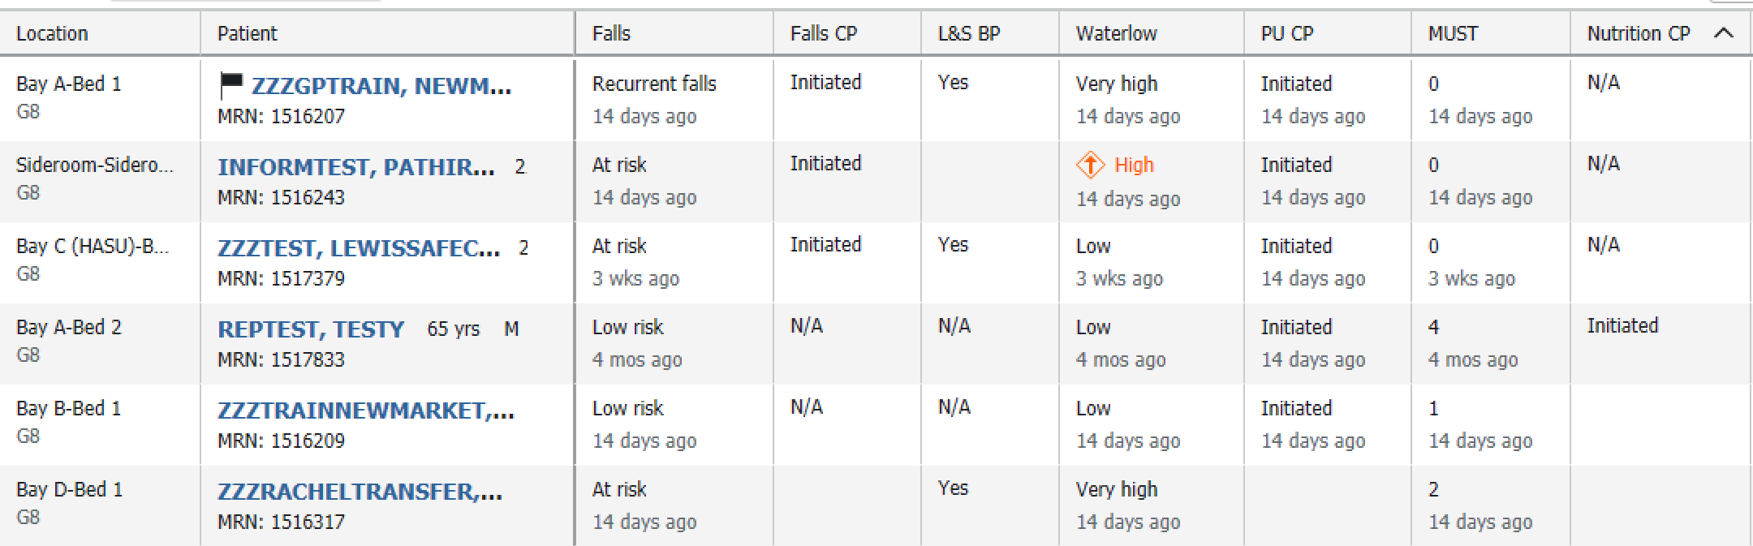
Safety assessment dashboard
Completion details relating to assessment and care-planning can be viewed on the Safety assessment details dashboard:
Blank spaces on the dashboard indicate incompletion (new):

Slide 26
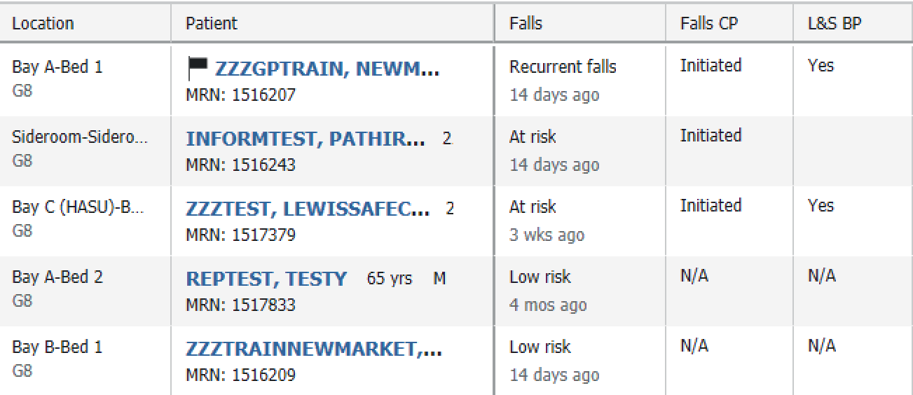
Lying & Standing BP
A reminder to record a Lying and standing BP is generated automatically for all adult in-patients over 65 years old on admission.
Completion of at least one standing blood pressure (or not) is displayed on the safety dashboard (new).

Slide 27
Safety Huddle Example
Datix ref | Emergency Department | 09/10/20 | None (no harm caused) | Slips, Trips or Falls Involving Patients | Patient fall from height e.g. bed, chair etc | I have gone to the room to take obs, found the patient on the floor very confused and cannula removed. Covered in diarrhoea. no apparent injuries, does not know how he ended up on the floor | cleaned him and took obs, got back on to the bed, doctor has seen re cannulated twice in both ACFS hartmanns given tilted bed NIC aware outreach aware and will come to see suggested to move to resus but doctor happy to keep him in cubicle six | fall
Datix ref | G3 - Endocrine and General Medicine | 12/10/20 | Negligible (minimal injury requiring no treatment) | Slips, Trips or Falls Involving Patients | Patient fall from height e.g. bed, chair etc | Patient fell during the night. Patient got out of bed to go to the toilet with a walking stick, the stick got stuck on the curtain and patient fell onto his knees, banging his head on the wall. | Patient assisted to his feet to sit on his bed. Patient insisted on walking to the toilet. Observations and neuro obs done. Doctor informed to review. Patient assisted back to bed and given some bottles. Asked patient to use the call system if needed to get out of bed in future. | none

Slide 28
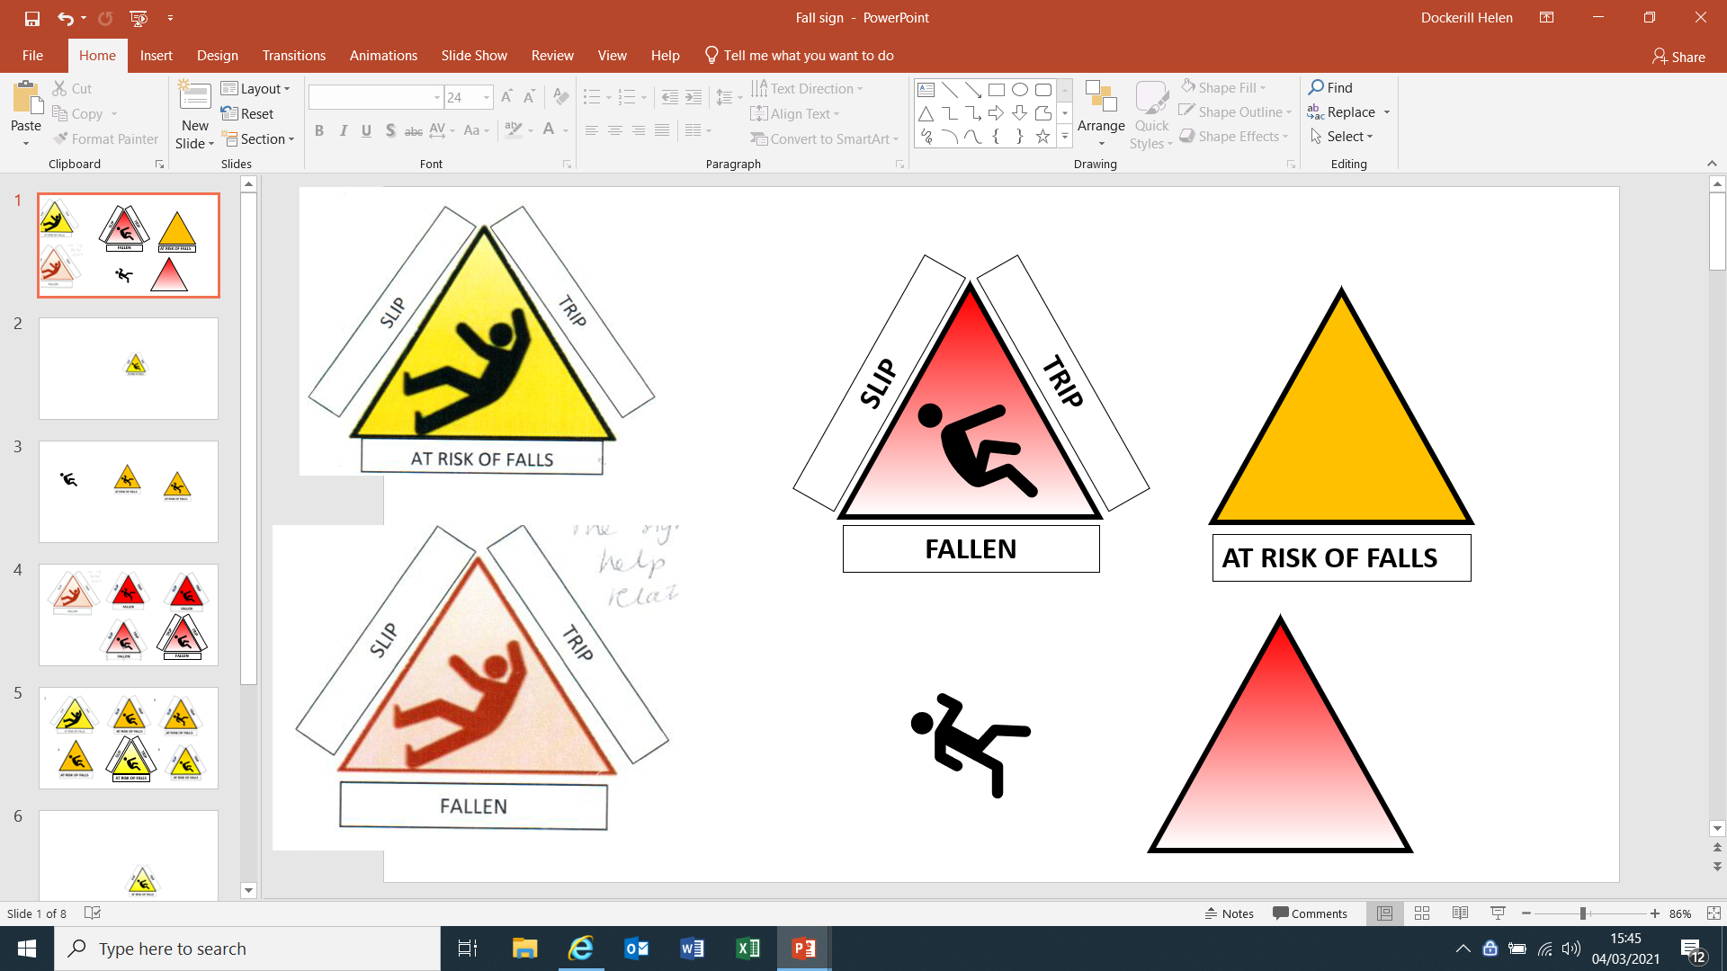
Frequent Fallers
Escalated at safety huddle to matron of the area
Ensuring all falls prevention strategies are in place
Communication within the MDT to ensure frequent fallers identified
Patient and environmental safety reviews

Slide 29
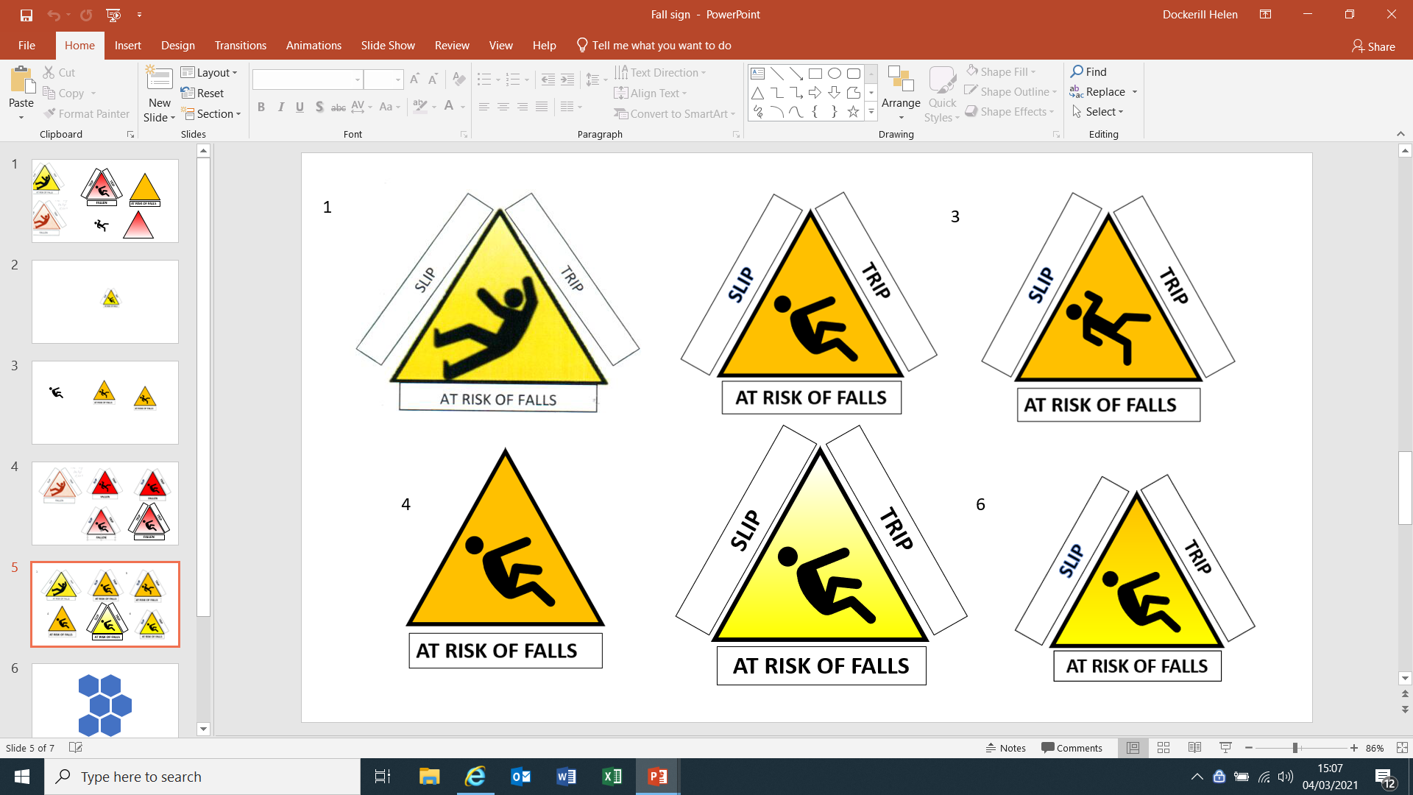
Continuous Improvement
Falls improvement Plan
Falling man symbol
Monthly lying/standing blood pressure
audits with feedback to the wards
Assistive technology –bed/ chair sensor mats
Falls Awareness Week
Call Don’t Fall posters
Safety Bulletins following a fall to highlight
learning to all staff

Slide 30
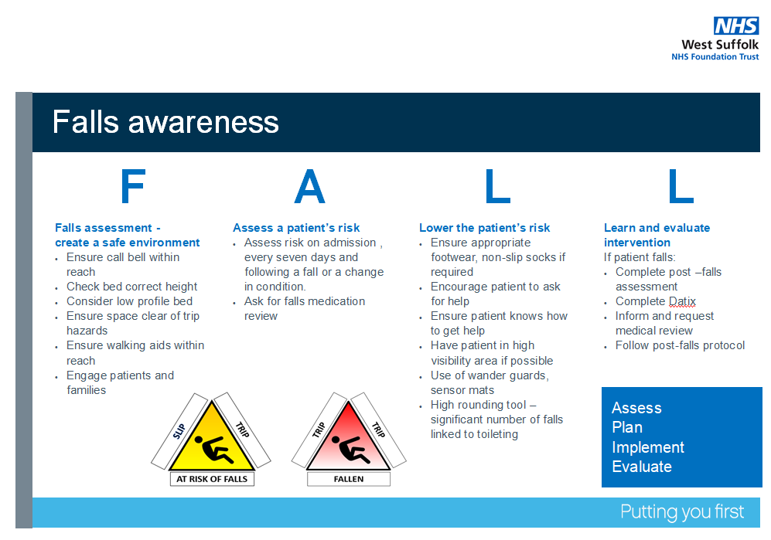

Slide 31
Impact of Covid and Covid Recovery reocvery
Impacted on some of the improvement plans
Increased number of patients not being visible to ward staff due to bay curtains
Reduced opportunity for patients to mobilise within hospital environment risking further deconditioning
Impact due to no visiting
Education virtual rather than face-to-face
Falls champion day on hold

Slide 32
Our take home messages
Trust focus on falls but accept there is still lots to do!
Insight
Invest in Falls - Trust Falls role
Utilising different investigation methods to learn
Involvement
Trust falls group with MDT input and Executive sponsor
Falls champions
Improvement
Qi projects
Frequent fallers
Deconditioning games

Slide 33

Thank you for listening.
Any Questions?

