Slide 1

Non-medical prescribing in end of life care in the community
Nigel Dodds
Consultant Nurse

Slide 2
We will cover
(Some of the) Issues around anticipatory prescribing in end of life care in the community
A focus on an audit of our practice
Learning and support for non-medical prescribers at St Christopher’s

Slide 3
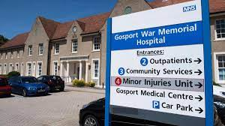
Safer anticipatory prescribing of injectable medications for symptom control in end of life care
Some recent relevant evidence…

Slide 4
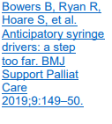
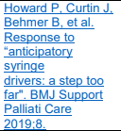
Safer anticipatory prescribing of injectable medications for symptom control in end of life care
Gosport enquiry – highlighting the potential dangers of prescribing ‘anticipatory syringe pumps’
Gosport enquiry does not fit with palliative care practice, focus on a hospital rehab unit
However has highlighted an issue we must consider – inappropriate medicines and doses being prescribed for someone before they need it
Bowers et al (2019) have advised against ‘Anticipatory syringe drivers’ - starting syringe drivers requires skilled planning and conversations, and we are not able to for see what person’s needs will be. CSCIs should be prescribed by the prescriber seeing the person
Howard et al (2019) have argued against this: EOL is foreseeable, and unambiguous + medication choices and doses unlikely to change from when PRN charts are written + starting a CSCI leads to on-going review

Slide 5
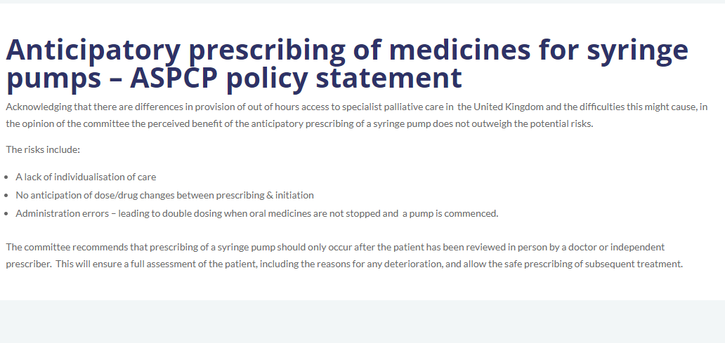

The Association of Supportive and Palliative Care Pharmacy (ASPCP) (2020)
Notes:
The Association of Supportive and Palliative Care Pharmacy (ASPCP) in a statement (opens a new page) dated August 7th 2020 acknowledged the differences in provision of out-ofhours access to specialist palliative care in the UK and the difficulties this might cause, in particular rapid access to injectable medications for symptom control. However, in the opinion of the committee, the perceived benefit of prescribing syringe pumps in anticipation of need does not outweigh the potential risks – these being a lack of individualisation of care, no anticipation of dose/drug changes between prescribing and initiation, and administration errors – for example, leading to double dosing when oral medicines are not stopped and a pump is commenced. The committee recommended that prescribing of a syringe pump should only occur after the patient has been reviewed in person by a doctor or independent prescriber. This would ensure a full assessment of the patient, including the reasons for any deterioration, and allow the safe prescribing of subsequent treatment.

Slide 6
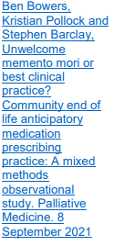
Bowers et al (2021)
Mixed methods study looking at EOLC anticipatory prescribing in the community
High volume of anticipatory prescribing
Observed frequent standard regimes and dosages – not person-centred
Often prescribed a long time in advance – even up to a year ahead
Observations that systems for good clinical governance not always in place to support safe prescribing when MAAR charts and medicines for anticipatory needs in place

Slide 7
Background to our audit
Anticipatory prescribing of injectable medications at EOL for community patients is good practice to achieve timely symptom control
We need to review and ensure anticipatory prescribing is individualised
There is a significant cost/time investment in organising anticipatory medications
It is currently unclear how many of these are used/wasted in our community population
Retrospect audit to evaluate baseline with aim to establish evidence based prescribing

Slide 8

Our steps so far…
Joint retrospective audit
 | Local NHS Trust | STCH
Looking at: | Anticipatory charts Prescribing practices Case note review | Anticipatory charts Prescribing practices Case note review
Written by: | Acute palliative care team | STCH team
For which patients? | Discharged from X to community for EOLC | Community patients (all 5 CCGs: Croydon, LSL, Bromley)
Time period | 3 months last year

Slide 9
Aims
Questions we were trying to answer:
What does our current anticipatory prescribing look like?
Are we achieving good symptom control?
Are MAAR charts being written in time?
Are we prescribing appropriate medicines/doses/ranges?
Are MAAR charts frequently needing to be re-written?
Are there training needs?
What does our dispensing cost us?
Are the drugs being used?
How can we improve current practice?

Slide 10

3. STCH AUDIT METHOD:
Number of patients with anticipatory charts written
cancer | 40
dementia | 15
frailty | 6
HF/COPD | 11
MND | 2
Other | 2
Bromley/BCC
= 73
28
66% male
Median age 80 (41 – 107)
Croydon = 62
Every 3rd patient reviewed in detail
25
<65 | 13
65-74 | 13
75-84 | 21
>85 | 29
LSL = 70
23
Total : 76 patients
Quiz Q: What percentage of anticipatory charts were written by doctors vs nurses?

Slide 11
3. AUDIT DATA:
6%
Nurses Doctors
55% 45%

Slide 12
Analgesia
3. AUDIT DATA:
% of
patients
Background opioid
* Morphine and Oxycodone total dose in 24 hours (including M/R and CSCI preparations)

Slide 13
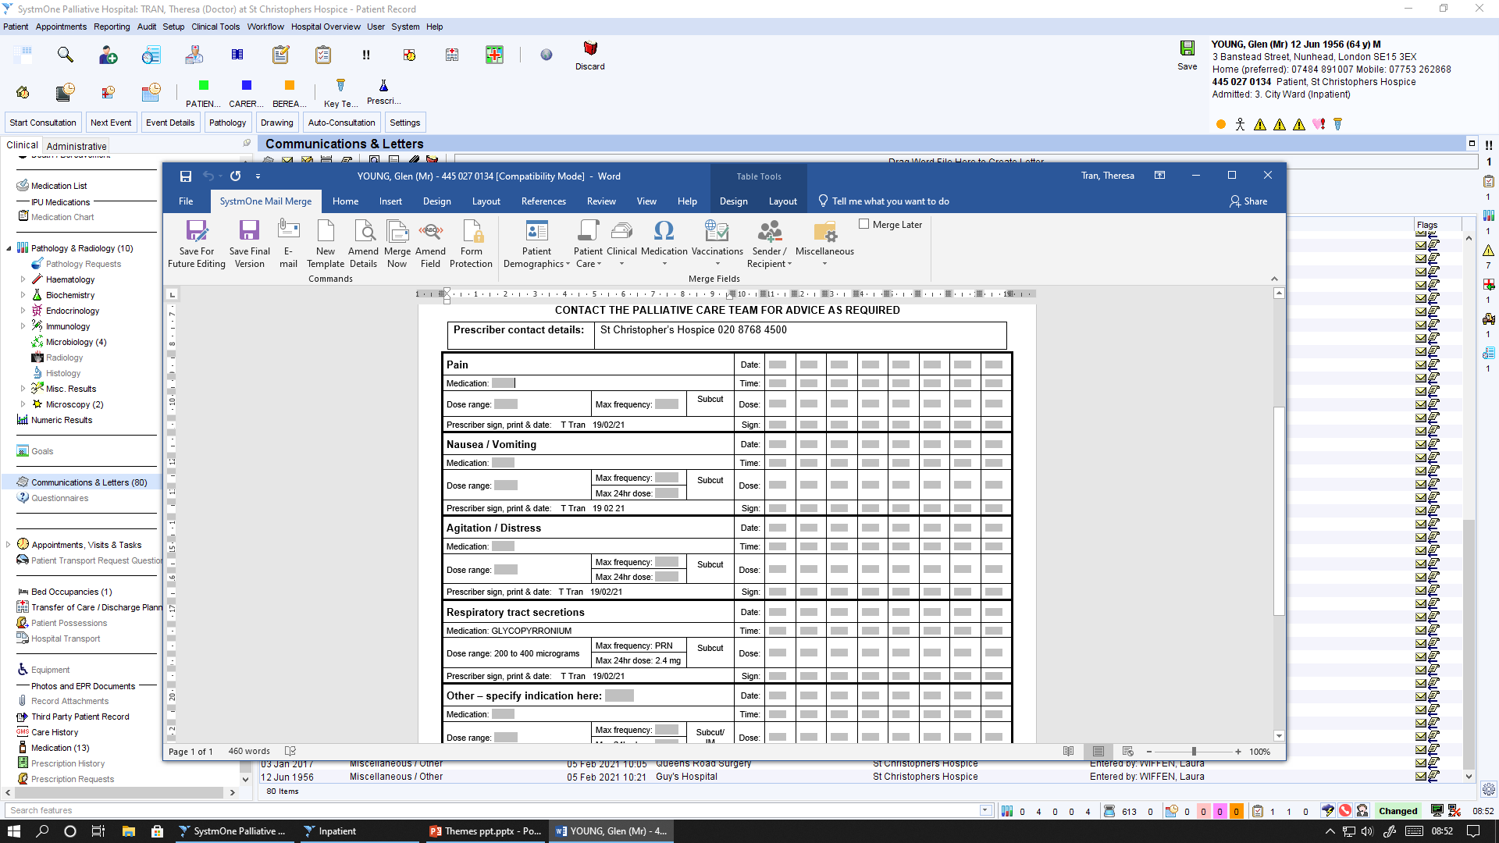
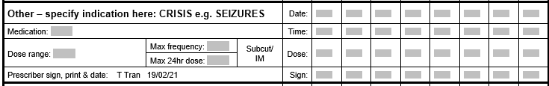
4. GENERAL THEMES:
Chart issues
Not always a max PRN frequency or max 24 hrs
Restrictive dose ranges → re-written
Charts not written in full → later re-written
  Hospital charts incomplete → re-written
  Charts not rewritten when background opioid increased
  Uncertainty around seizure management + doses
  Chart written ?too late
  LAS referred a patient unwell, dying, to remain home – charts weren’t done until patient became symptomatic the day before she then died

Slide 14
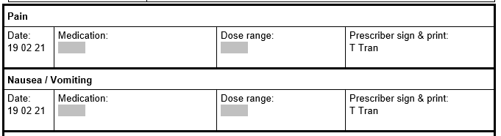
4. GENERAL THEMES:
Morphine
Doses/drugs given
2 mg – 5 mg
  PRN doses too small?
  Doses given not proportionate to the problem
  Stats given which are low in comparison to background
  Stats given because they are lowest end of the PRN chart (2 mg) despite CSCI 30 mg
Morphine
  Reluctance to use adequate dose haloperidol or midazolam
  Stats being given but not incorporated into the CSCI
10 mg – 30 mg
A lot of these are training/confidence issues

Slide 15
6. COSTINGS:
Not needing stats – 36%
Given stats – 64%
Quiz Q: Of those with anticipatory charts, how many were actually given stats?
NB: this may be an under-estimate as we don’t have access to the district nursing notes
Quiz Q: Of those given stats, what was given least often?
Analgesia?
Anti-emetic?
Anti-secretory?
Sedation?
analgesia | 40 | 53%
antiemetic | 12 | 16%
antisecretory | 18 | 24%
sedation | 31 | 41%

Slide 16
6. COSTINGS:
analgesia | 40 | 53%
antiemetic | 12 | 16%
antisecretory | 18 | 24%
sedation | 31 | 41%
PRN
Pain | Morphine | 46 | 61%
 | Oxycodone | 26 | 34%
 | Alfentanil | 4 | 5%
Anti-emetic | Haloperidol | 67 | 88%
 | Cyclizine | 9 | 12%
Secretions | Glyco | 74 | 97%
 | Hyoscine | 1 | 1%
 | None | 1 | 1%
Sedation | Midazolam | 75 | 99%
 | None | 1 | 1%
Quiz Q: Can we save some money here with our dispensing?

Slide 17

Quiz Q: What is the most expensive anti-emetic?
Haloperidol
5 mg/1ml
Cyclizine
50 mg/1ml
Ondansetron
4 mg/2ml
Metoclopramide
10 mg/2ml
Levomepromazine
25 mg/1 ml
£33.60
£14.36
£1.80
£1.44
£7.49

Slide 18
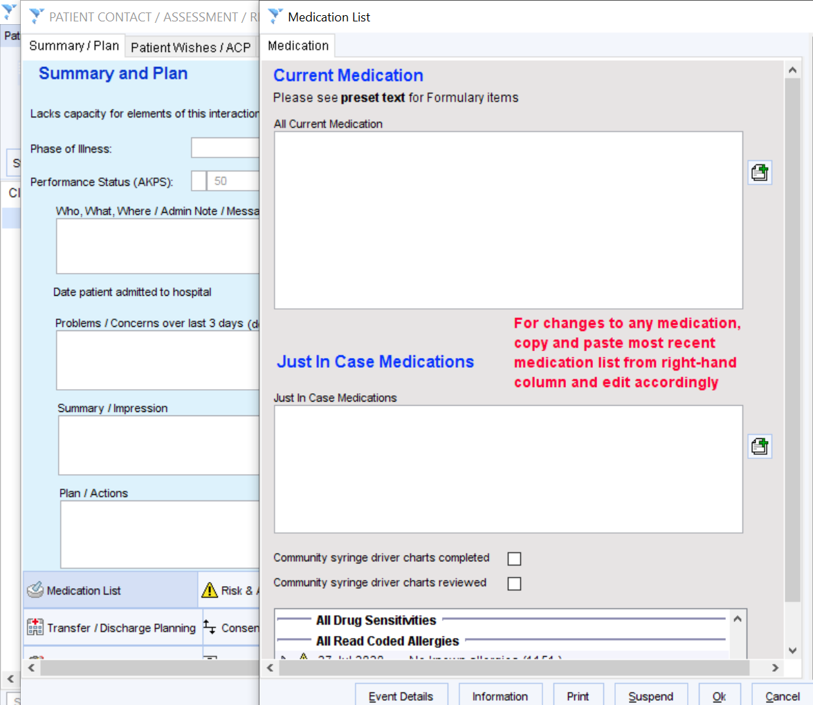

NB:
Likely an under-estimation of cost/waste – we only looked at 1/3 patients
Under-estimation of numbers – used code from S1 (tick box for JIC) to identify these patients
Quiz Q: What do you think each anti-emetic costs?
Most people get haloperidol
Only ~16% use it
e.g. For 100 patients all dispensed haloperidol |  |  | COST £3360
Only 16% use it |  |  | £537.6
Wasted drug/money |  |  | WASTED £2822.4
Haloperidol
5 mg/1ml
£33.60

Slide 19

6. COSTINGS:
The average JIC box meds dispensing (of morphine, glyco, midazolam and haloperidol) costs:
?could we dispense less often
JIC
Being more selective re: who we give it to - criteria for dispensing
OR we take them out and sign them back in if not needed?
Can we accurately predict who will need the meds urgently?
Are community set up to dispense quickly?
£51.67 PER PATIENT
Not needing stats – 36%
Given stats – 64%
?could we dispense only 5 instead of 10 ampoules
Won’t we need more boxes, more labelling?
Any other ideas/solutions?
?could we replace one drug for another e.g. replace haloperidol with levomepromazine
Can we save money here whilst maintaining efficacy, safety and reduce drug wastage?
Are they equivalent swaps? How do we measure the impact?

Slide 20
Some learning
Need to individualise prescribing
Training and support needed for large group of prescribers
Updating our guidance: St Christopher's | Resources for Professionals - St Christopher's (stchristophers.org.uk)
We need to support generalists to prescribe more, and upskill in writing MAAR charts
Linking in with SEL workstream

Slide 21
Led us to updating our guidance
St Christopher's | Resources for Professionals - St Christopher's (stchristophers.org.uk)

Slide 22
SE London….
Collaborative approach involving acute, primary, and third sector organisations – working together to review practice around anticipatory prescribing
Already highlighted practices which create concerns:
Around the evidence
Access to medications
Access to skilled professionals to prescribe and administer medications
Concerns around non-prescribers writing charts

Slide 23

Moving on….

Slide 24
Supporting non-medical prescribing at St Christopher’s
St Christopher’s have had a framework for non-medical prescribing since 2007
Now have 21 nurses who are non-medical prescribers
Historically, annual study day
Now monthly joint prescribers group
National (international) on-line Community of Practice

Slide 25
Monthly prescribers meeting
Expectation all prescribers (and those in training) will attend
Review individuals prescribing data from FP10s
Update around policy, guidance etc
Case study review (template)– doctor and nurse
Feeds into out Medicines Optimisation Group
(feeds into Quality and Governance Committee)

Slide 26
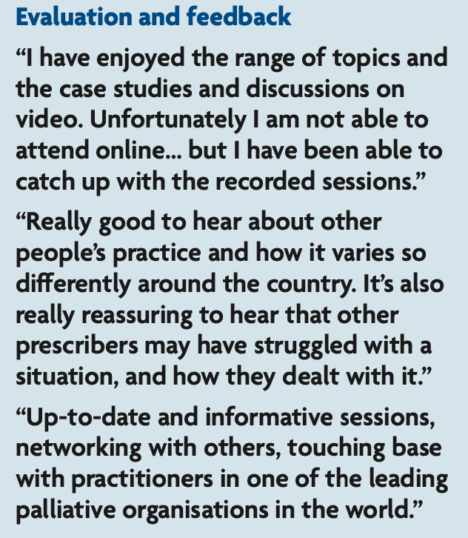
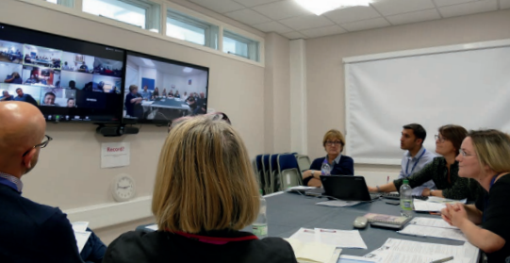
Non-medical prescribers Community of Practice
Developed quickly in 2020 in response to COVID pandemic
Led to monthly session – generally a didactic approach
12 sessions, with a focus on symptom management
Well evaluated…..

Slide 27
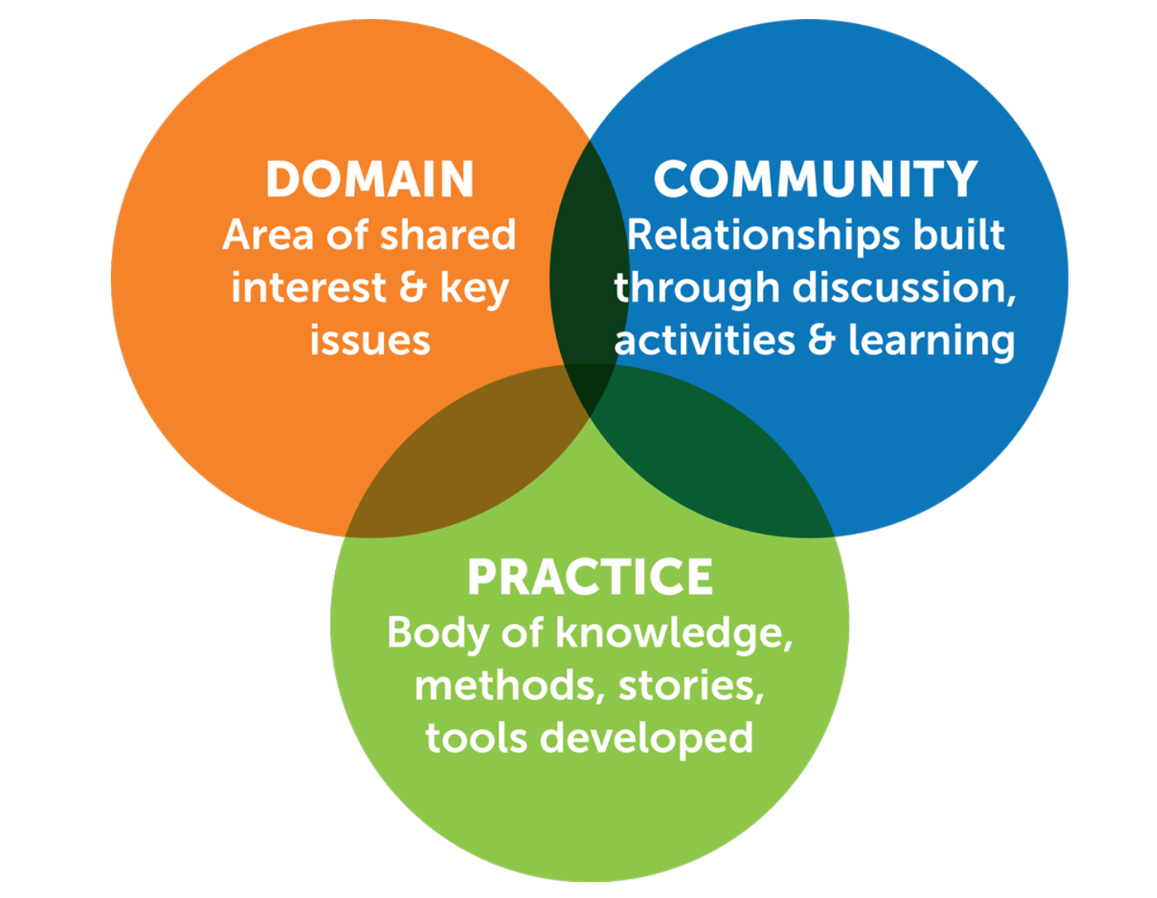
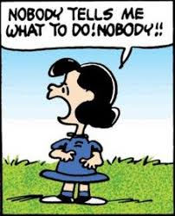
Community of Practice – REBOOT!

Slide 28
St Christopher’s CARE Community of Practice
Monthly learning supported by:
‘Curriculum’ co-created
Bi-monthly on-line session: case studies, group work, discussion
Bi-monthly input using Moodle, for journal review, discussion, activities

Slide 29

Join us….
https://www.stchristophers.org.uk/course/non-medical-prescribers-community

Slide 30
Summary
Reviewing our practice at St Christopher’s is proving to be a useful process
Connecting with others to do this is helpful
Increasing learning opportunities and addressing governance issues provides clinician support, safety and oversight

Slide 31
Nigel Dodds (Consultant Nurse) n.dodds@stchristophers.org.uk

