Slide 1
Nurse Prescribing Leadership & Advanced Nursing Roles
Heather Randle, Professional Lead for Education and Primary Care

Slide 2
Plan for today
Where are the standards for advanced roles and nursing within speciality
Recognition of advanced practice
Implications for nurse prescribers
The challenges of Covid-19
Enhanced practice and implications for NMPs
What support do nurse prescribers need at each stage of their prescribing journey
Ensuring nurse prescribing practice is integral to service development

Slide 3
Where are the standards for advanced roles and nursing within speciality
NMC Standards for medicines management (2007) withdrawn January 2019
RCN worked closely with the NMC and other organisations including the Royal Pharmaceutical Society to review currently available documents and develop new guidelines
Several publications were reviewed and news ones developed including
A Competency Framework for all Prescribers (RPS)
Guidance on Prescribing, Dispensing, Supplying and Administration of Medicines (RCN & RPS)
Professional guidance on the administration of medicines in healthcare settings (RCN & RPS)
Medicines Management: An overview for nursing (RCN)
All should be supported by local guidance
Medicines management | Clinical topics | Royal College of Nursing (rcn.org.uk)

Slide 4
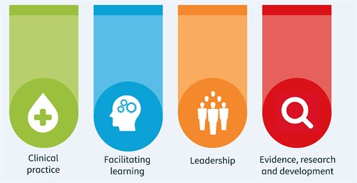
Recognition of advanced practice
Advanced practice is defined as:
A level of practice, rather than a type of practice.
Advanced Nurse Practitioners are educated at Masters Level in clinical practice
Assessed as competent in practice using their expert clinical knowledge and skills
Freedom and authority to act, making autonomous decisions in the assessment, diagnosis and treatment of patients
Four Pillars of advanced practice
Advanced practice standards | Royal College of
Nursing (rcn.org.uk)

Slide 5
RCN Advanced Practice Standards
Registered nurses working at this advanced level must meet the following standards. They must:
have an active registration with the NMC
practice within the four pillars
have a Job Plan that demonstrates advanced nursing practice and has equity with peers working at this level
be educated to Masters level
be an independent prescriber
meet NMC revalidation requirements
demonstrate autonomous evidence
www.rcn.org.uk/professional-development/advanced-practice-standards

Slide 6
Credentialing: Why are we doing this work?
Nurse - formal recognition of advanced level of practice and creation of advanced career pathway
Profession –
build upon the reputation of the nursing profession as a continuously improving and high quality service
Drive up standards of practice and skills of nursing profession
Employer - assurance of the advanced level of practice of nursing staff
Public - confidence and assurance in the continuing development, capability and professionalism of their nurses
Notes:
Nurse
Formal external recognition of ability to practice at an advanced level
Kudos – public recognition of ability to practice at advanced level
Career development, ongoing CPD and support from RCN
Portable kite mark of quality
Patients & Public
- Assurance in quality of care being delivered
Nursing profession
- Beginning of regulation of advanced practice
Organisations
Kite mark for services led by Credentialed ALNs
Cost – credentialed nurse working in advanced role

Slide 7
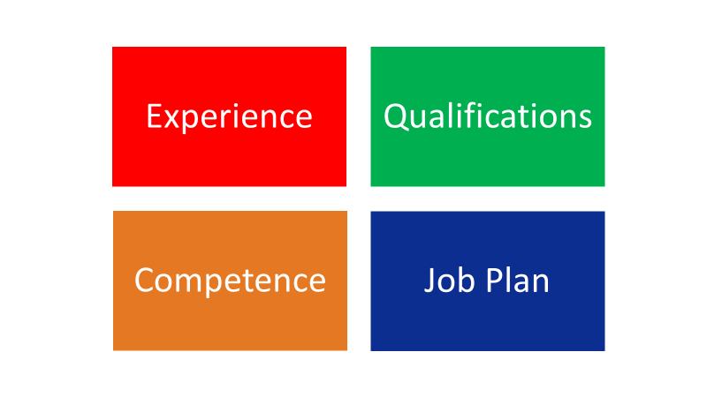
Criteria for the credential
Relevant Masters degree.
Clinical examination/ diagnostic qualification.
Prescribing rights.
Experience and competence mapped against the 4 pillars of advanced practice.
Job plan and clinical reference.
Evidence of advanced level CPD over previous 3 years.

Slide 8
Advanced Level Nursing Practice
Credentialing Models
A
RCN Accredited Msc Advanced Practice
B
Msc Advanced Practice
C
Other clinical masters + Health Assessment & Prescribing
D
Experience+ Health assessment + prescribing + assignment

Slide 9
What do nurses get?
Named on a public facing directory maintained by the RCN
Clinical governance & recognition of level
Access to education resources e.g. webinars
Research opportunities
A certificate showing achievement of the credential
Uniform badge - RCN ALNP

Slide 10
Enhanced Practice
Advanced Clinical Practice
Advanced role
Knowledge and skills to an advanced level of practice
Manage the whole episode of a patient’s clinical care, from the time they first present, through to the end of the episode
Expertise and skills to demonstrate leadership within their teams
Multi-professional framework ensures national consistency and understanding about what the ACP role is
Enhanced Practice
The ECP is an extended role rather than an advanced role
ECPs work at an enhanced level of practice with specific knowledge and skills in a field of expertise
Work as part of the MDT in a range of settings- hospital, community and general practice
They manage a discrete aspect of a patient’s care within their current level of practice, which will be particular to a specific context

Slide 11
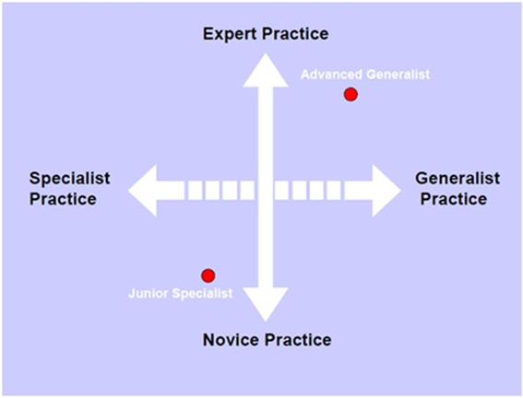
Career Pathways
Clinical Director
Clinical Lead
Consultant
Advanced Practice
Enhanced Practice
https://www.rcn.org.uk/professional-development/your-career
Registered

Slide 12
Scope of Prescribing Practice
To be a prescriber means to have the legal authority to issue prescriptions. In practice, prescribing is a complex clinical skill
Prescribe within your own scope of practice
Recognise the limits of own knowledge and skill
Provide evidence of CPD in prescribing
Regularly audit and ensure peer review of practice
Have the required training, knowledge, skills and experience to deliver these activities lawfully, safely and effectively
Appropriate indemnity cover for their prescribing role
Scope of practice informed by regulatory standards, the professional body’s position, employer guidance, guidance from other relevant organisations and the individual’s professional judgement
Prescribing defined as part of your role and included in your job description or job role

Slide 13
Advanced Level Nursing Practice and care of Pregnant and Postnatal Women
New guidance from the RCN may 2021 including scenarios in practice
NMC Code and Standards to support practice
Care of the pregnant woman is the domain of the midwife and medical practitioner and all pregnant women should have a named midwifery throughout their pregnancy
However this is not in isolation from other healthcare professionals
Understand your own role, limits and boundaries
Work Collaboratively to support best practice
Use professional judgement based on best available evidence (NICE)
Good practice to have pre-agreed guidelines/ pathways
Clear process to escalate/ refer to the most appropriate professional
Useful distinction may be whether the condition is related to the pregnancy or not
Always consider the possible impact on the pregnancy and the fetus
Midwifery/ obstetric team are available 24 hours a day
Care of Pregnant and Postnatal Women| Royal College of Nursing (rcn.org.uk)

Slide 14
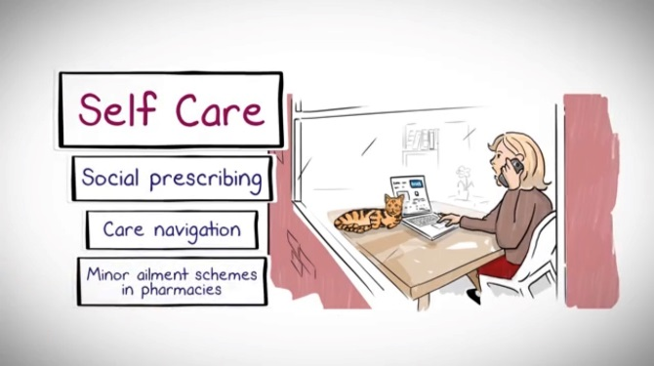
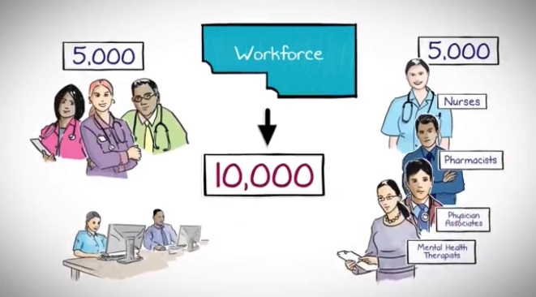
Professional Leadership
Patients
Patient Participation Groups
Staffing
Service provision
CPD
Development of e-learning, modules, career pathways
Attracting the newly qualified
Generation Y
Realising the NHS Long Term Plan
Review of Primary Care Workforce
Inspections/ audits/ governance
Developing Compassionate Leaders
ICS & Primary Care Networks- hub and spoke placements
Engagement in change
Education
Promotion Campaign
Harnessing the power of data and technology
Portfolio careers
Self Care
Career progression

Slide 15
Professional Leadership
Many opportunities to provide nursing and clinical leadership
Integration and Innovation: working together to improve health and social care for all (Policy Paper February 2021) – legislative proposals for the Health and Care Bill that build on the NHS Long Term Plan
Integrated Community Systems- bringing together organisations to redesign care and improve population health
ICS are enabler of change, PCNs make it happen
Primary Care Networks – small enough to continue to provide personalised care but large enough to be resilient (30,000- 50,000 patients)
RCN influencing to ensure that a there is a nurse at executive level through RCN Workforce Standards

Slide 16
Strategic Leadership
Listening to and supporting the membership
Realising the Long-Term Plan- current funding review
Influencing next steps
Workforce Standards
Working with other royal colleges, royal pharmaceutical society, Forums and RCN membership
Credentialing

Slide 17
Designated Prescriber Practitioner
‘Oversee, support and assess the competence of non-medical prescribing trainees, in collaboration with academic and workplace partners, during the period of learning in practice’
Regulatory changes in 2019 mean experienced NMPs of any professional background
Similar to the Designated Medical Practitioner
Evolving role of advanced practice
The Designated Prescriber Practitioner Framework is designed to empower DPPs in their role
Supported by a Competency framework for all Prescribers
RPS & RCN virtual event: Becoming a Designated Prescriber Practitioner 23rd March 1pm- 5pm

Slide 18
Prescribing Safely under Covid-19
During Covid-19 we have seen an increased need for remote prescribing
Have a clear process the same as when you see a patient face to face
Use of additional skills
Option for Video consultation, Photos etc.
If you are unable to assess the patient adequately arrange face to face
Peer review of consultations and prescribing
Clear safety netting
COVID-19 Remote prescribing | Medicines Management | Royal College of Nursing (rcn.org.uk)
What will the model look like moving forward?

Slide 19
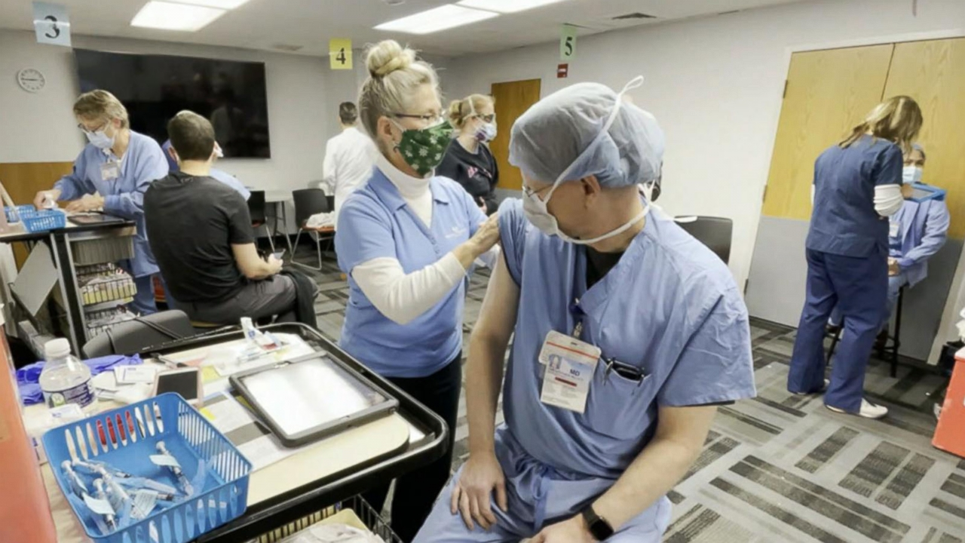
The challenges of Covid-19
Safety when consulting remotely
Changes to practice
Poor understand of the disease process
Patients reluctant to be seen face to face
Physical and psychological barriers to care
Unprecedented demand
Patients not wanting to be a burden
Vaccination programmes- National
protocol, PGDs, PSDs
What does normal look like?

Slide 20
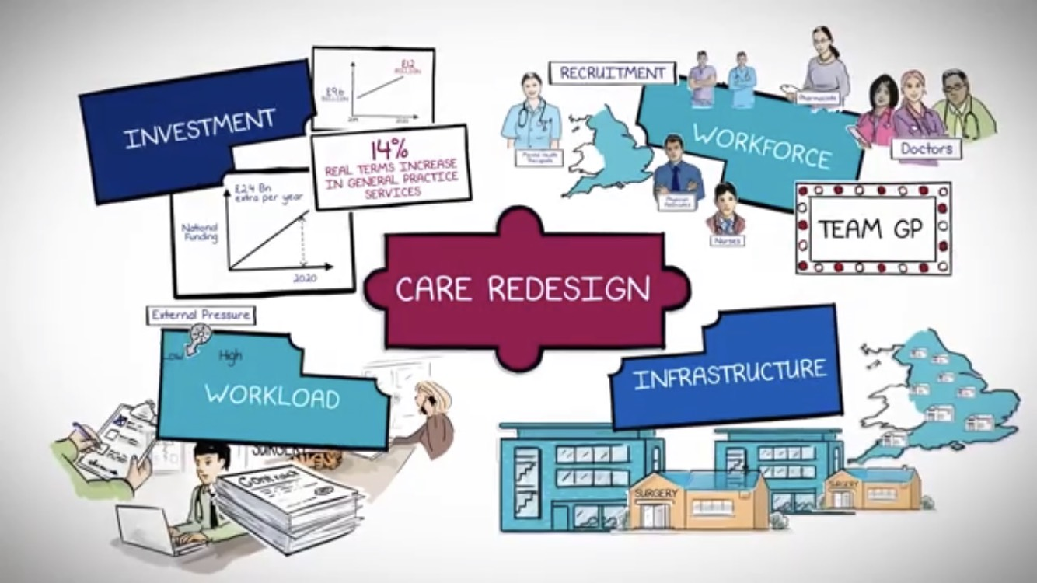
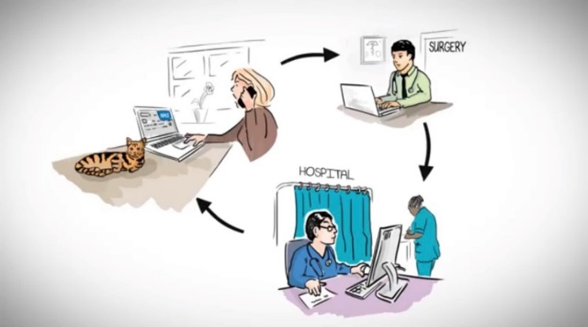
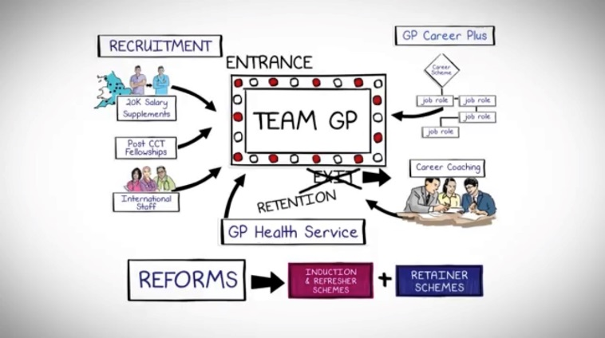
Career Redesign
Primary Care Networks
Technology
Career Pathways/ Recruitment

Slide 21
Nursing Workforce Standards
'Evidence shows that having the right numbers of nursing staff, with the right skills, in the right place, at the right time improves health outcomes, the quality of care delivered, and patient safety’
Should be used alongside established practice or setting specific guidance
Used by nurse leaders, regulators and those responsible for funding and planning
RCN Workforce Standards | Publications | Royal College of Nursing

Slide 22
Education learning and development strategy
This Education, Learning and Development Strategy meets our Royal Charter mandate of ‘promote the science and art of nursing and education and training in the profession of nursing’.
Supports a culture of life long learning
Based on collaboration with members
Transforming Culture together
Education learning and development strategy | Professional Development | Royal College of Nursing (rcn.org.uk)

Slide 23
In Summary
Executive level leadership is essential to the continue progression of nursing
Advanced practice clinicians are well placed to provide that leadership
Standards and guidance exists to support prescribing in practice
Opportunities exist to frame the prescribing role through the DPP
There is a role for both advanced and enhanced clinical practice

Slide 24
Further information
The credentialing team at:
credentialing@rcn.org.uk
Register your interest:
rcn.org.uk/credentialing

Slide 25
Thank you and Questions

