Slide 1
Working with and Involving Families following Serious Incidents
Julian Hendy

Slide 2
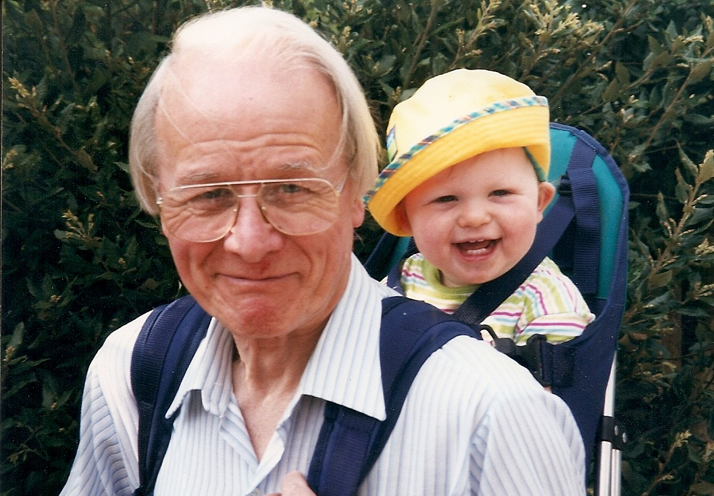
Notes:
Not just statistics – affects families and whole communities

Slide 3
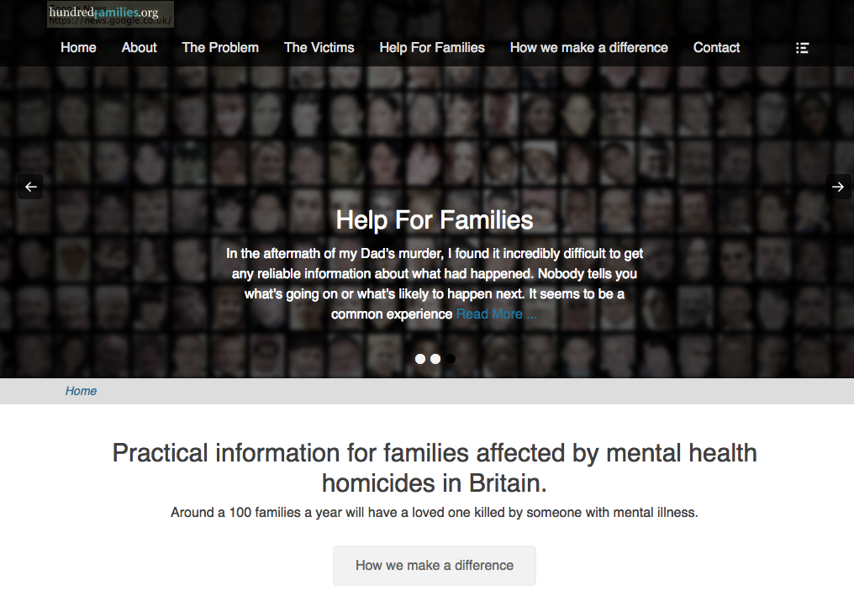
Notes:
What Hundredfamilies does
Support, Information and advocacy for Families
Advice and Information for Professionals (onlt national repository for homicide inquiry reports)
Campaigning for change

Slide 4
Support and advocate for families
Work with the NHS and others to prevent further tragedies
Provide evidence and training to influence change

Slide 5
NHS England - Independent Investigations 2018-19 Annual Report
93
121
111
Notes:
Published July 2020 - Page 6 –
England only – Scotland Wales & NI extra
Now numbers considerably worse since Covid

Slide 6
BJP - July 2020
Notes:
Flynn, S., Ibrahim, S., Kapur, N., Appleby, L., & Shaw, J. (2020). Mental disorder in people convicted of homicide: Long-term national trends in rates and court outcome.
The British Journal of Psychiatry, 1-7. doi:10.1192/bjp.2020.94

Slide 7
Most victims are Families and Friends
“Perpetrators’ mental health was mentioned in 65% of DHRs; 49% of perpetrators had a mental health diagnosis. Healthcare services in particular, mental health services, were most likely to be involved with perpetrators.”
Notes:
Published March 2020 - Analysed 141 domestic homicide reviews (DHRs) in England and Wales.
https://onlinelibrary.wiley.com/doi/abs/10.1111/hsc.12881

Slide 8
People or Process ?
2013/29555 | 2017/14144 | 2011/13432 | 2019/14670 | 2014/42532 | 2018/23654
2012/18752 | 2016/18500 | 2012/16046 | 2014/42181 | 2014/25273 | 2017/15717
2011/17106 | 2013/28276 | 2016/18856 | 2018/951 | 2015/14132 | 2019/4407
2014/10128 | 2017/15440 | 2015/23056 | 2018/18636 | 2015/37663 | 2018/16725
2013/3454 | 2016/32823 | 2016/22096 | 2014/39959 | 2013/33945 | 2020/484
2013/14158 | 2016/19955 | 2017/7489 | 2014/24147 | 2014/2927 | 2017/26924
2012/15116 | 2018/19290 | 2014/22374 | 2016/17208 | 2014/31324 | 2019/12699
2013/23705 | 2019/4055 | 2014/29627 | 2017/29685 | 2014/626 | 2017/6089
2014/20490 | 2019/13411 | 2017/13260 | 2017/18462 | 2015/24621 | 2017/13849
2012/25285 | 2017/32700 | 2015/11584 | 2017/9654 | 2016/6113 | 2014/26905
2014/29533 | 2014/17675 | 2016/21910 | 2018/4054 | 2016/15284 | 2013/3454
2014/40060 | 2015/36282 | 2021/11335 | 2021/14665 | 2019/359 | 2020/19195
Notes:
NHS Steis numbers of patient homicides

Slide 9
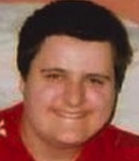
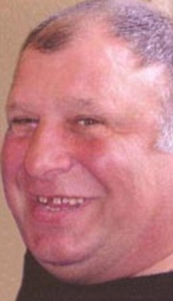
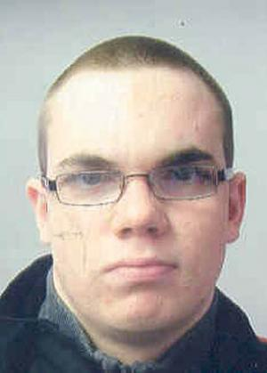
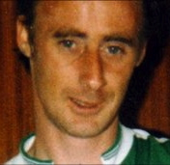
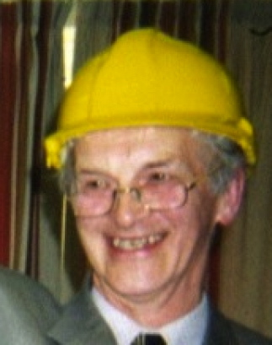
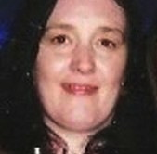
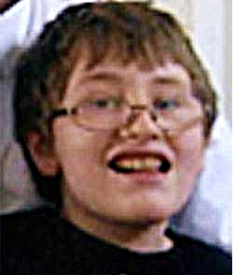
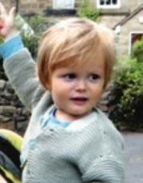
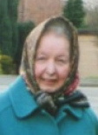
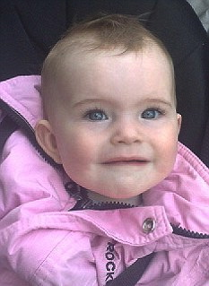
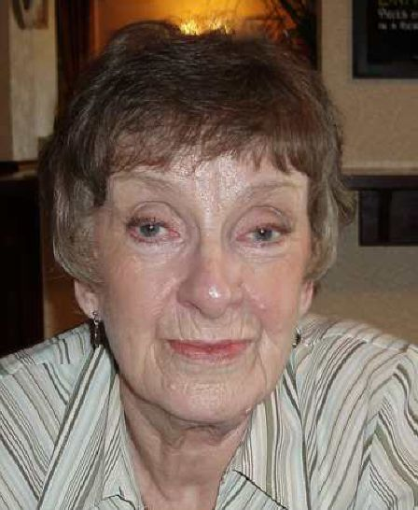
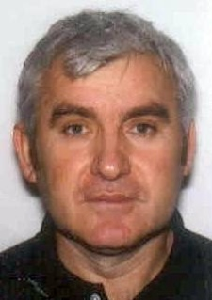
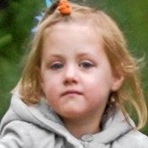
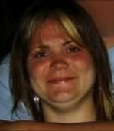
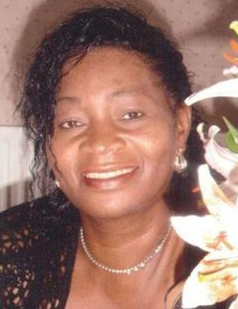
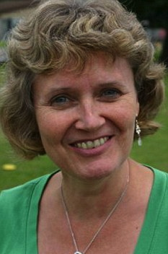
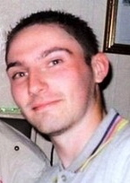
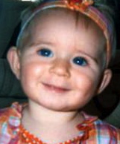
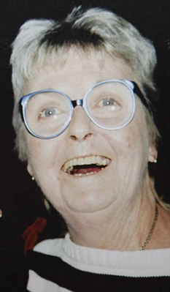
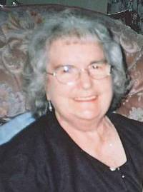
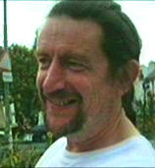
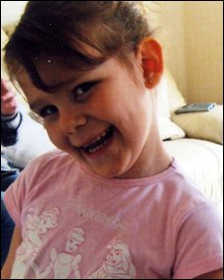
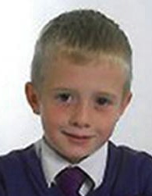
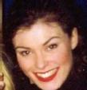
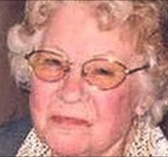
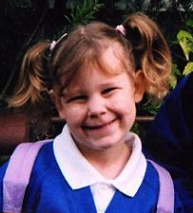
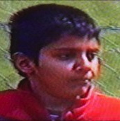
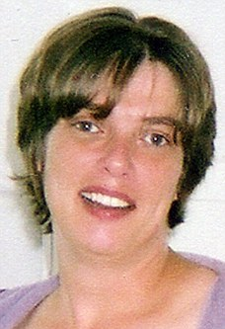
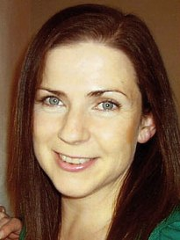
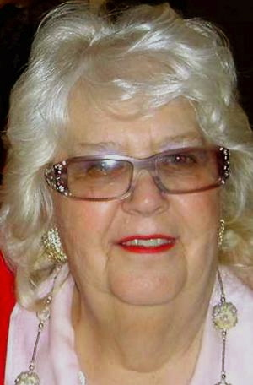
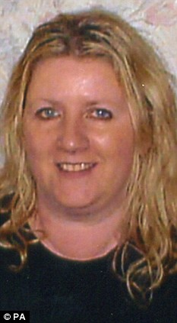
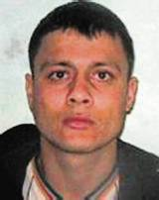
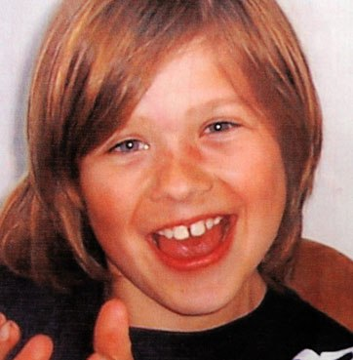
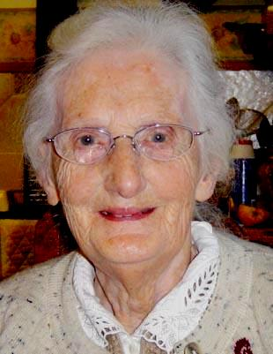
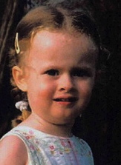
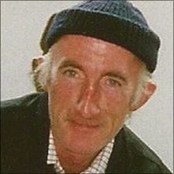
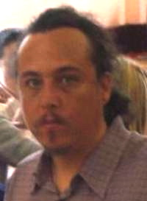
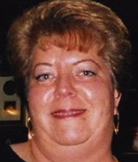
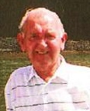
Notes:
Some recent homicide victims, large numbers of kids, elderly and some other mental health patients

Slide 10
Effects on Families after Homicide
All report some adverse physical/mental health problems
High rates of depression and PTSD
High rates of drug & alcohol problems
Huge financial pressures -
High rates of relationship or family breakdown
25% have to move home and/or lose their jobs
Effects persist for years
Notes:
Largest ever UK survey of 400 families bereaved by murder & manslaughter
Source: Office of the Victims Commissioner, Louise Casey CB, Review into the Needs of Families Bereaved by Homicide, London, July 2011
http://www.justice.gov.uk/downloads/news/press-releases/victims-com/review-needs-of-families-bereaved-by-homicide.pdf ;
Zinzow, February 2009 - J Trauma Stress - Losing a Loved One to Homicide: Prevalence and Mental Health Correlates in a National Sample of Young Adults
Managing the impact of violence on mental health, including among witnesses and those affected by homicide: position statement, Royal College of Psychiatrists, 2012
http://www.rcpsych.ac.uk/pdf/PS01_2012.pdf

Slide 11
Notes:
Daily Mirror - 17 July 2021, Emma Blood

Slide 12
Victims & MH Homicides
Criminal Justice System
Health Service

Slide 13
Criminal Process
Who did it?
What should happen to them?

Slide 15
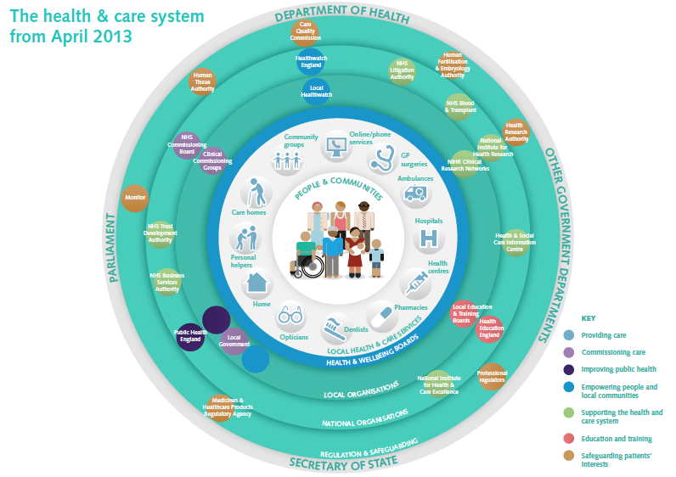
Notes:
SOURCE : http://www.nhs.uk/NHSEngland/thenhs/about/Pages/nhsstructure.aspx

Slide 16
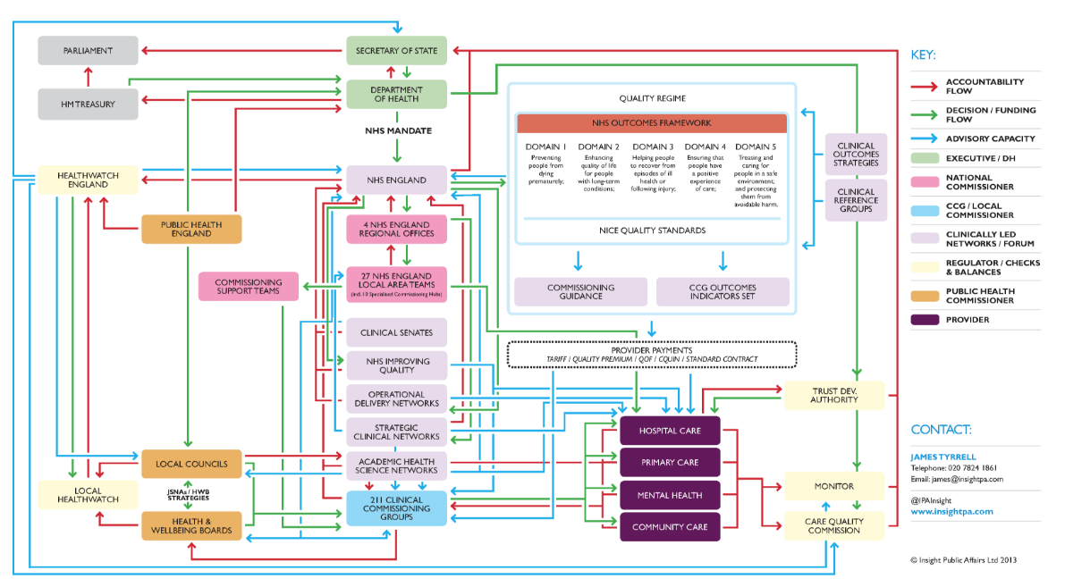
Notes:
Source : Insight public affairs
http://insightpublicaffairs.com/wp-content/uploads/2013/04/2013-NHS-Structure.png

Slide 17
What do families want?

Slide 18
Apology & Accountability
Recognition & Respect
Effective learning

Slide 19
Apologies
“Saying sorry is always the right thing to do.
It is not an admission of legal liability.
It’s the first step to learning from what happened and preventing it recurring.”
Notes:
https://resolution.nhs.uk/wp-content/uploads/2018/09/NHS-Resolution-Saying-Sorry.pdf

Slide 20
Notes:
Dec 2017
https://www.cqc.org.uk/sites/default/files/20161213-learning-candour-accountability-full-report.pdf

Slide 21
Families have poor experience of reviews and investigations –
Not always treated with kindness, respect & sensitivity

Slide 22
Harry Morris
Notes:
June 2011 – Anthony Ogburn killed Harry Morris
Manslughter - diminished responsibility

Slide 23
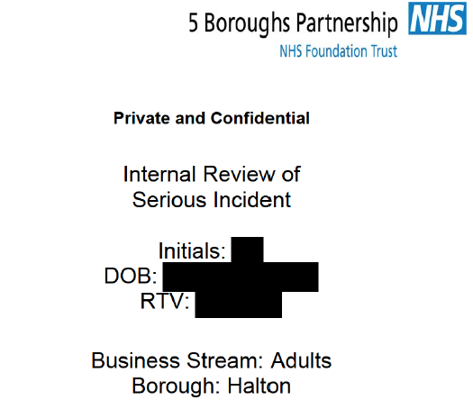

Slide 25
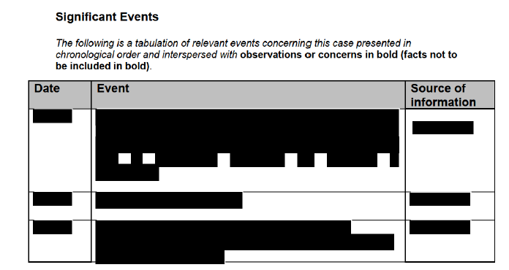

Slide 26
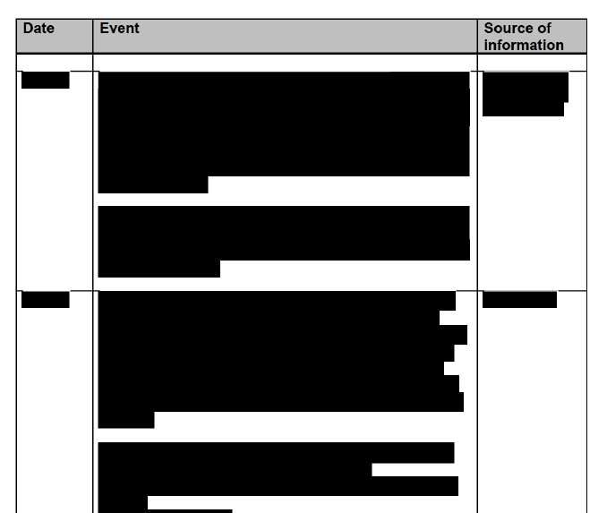

Slide 28
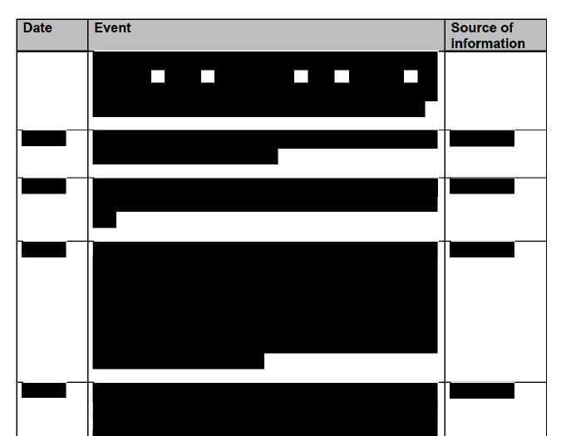

Slide 29
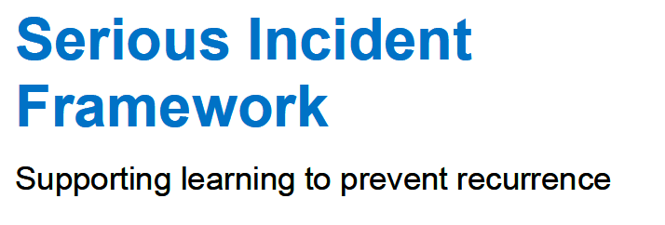
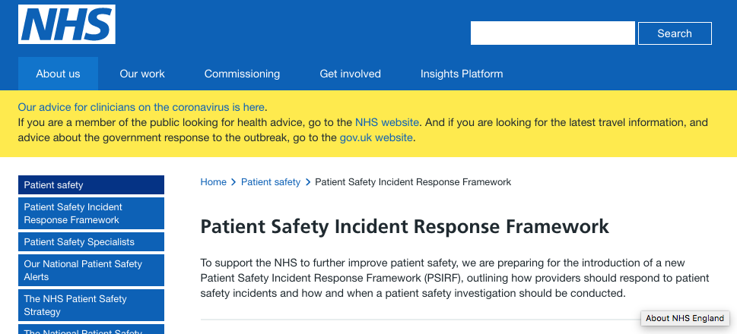

Slide 30
NHS Serious Incident Framework
Highlights “the importance of working in an open, honest and transparent way where patients, victims and their families are put at the centre of the process”
The needs of those affected should be the primary concern of those involved in the investigation of serious incidents.
Patients and their families/carers and victims’ families must be involved and supported throughout the investigation process.

Slide 31
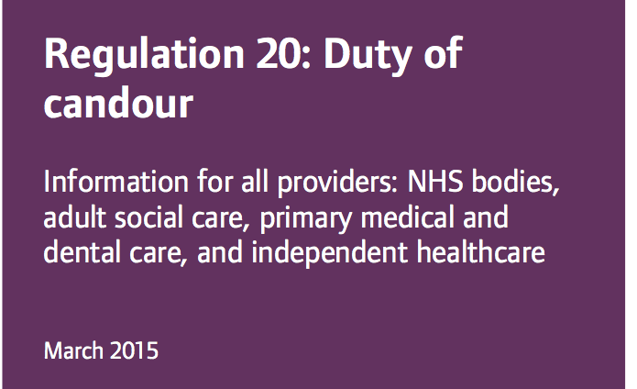
Notes:
https://www.cqc.org.uk/sites/default/files/20150327_duty_of_candour_guidance_final.pdf

Slide 32
Duty Of Candour
Providers have to act in an open and transparent way with relevant persons in relation to care and treatment provided.
Tell the relevant person, in person, as soon as reasonably practicable after becoming aware that a notifiable safety incident has occurred, and provide support to them in relation to the incident.
Provide an account of the incident which, to the best of the provider’s knowledge, is true of all the facts the body knows about the incident as at the date of the notification.
Notes:
CQC requirement – CQC regulation 20
https://www.cqc.org.uk/guidance-providers/regulations-enforcement/regulation-20-duty-candour

Slide 33
Open, truthful, timely and clear
Families receive the information they need
Notes:
Truthful, timely and clear
Families receive the information they need

Slide 34
Other routes
Coroner’s Inquest
Disclosure of reports to ‘Interested Persons’ – includes families
Legal claim
Disclosure of relevant documents under ‘Discovery’

Slide 35
What can happen when there’s poor
family engagement?

Slide 39
How can better
family engagement benefit Mental Health Services?

Slide 40
Listening to friends & families
Families know stuff
(not necessarily in the medical records)
They can tell you what you don’t know, what you are missing.
Manages expectations & reputations
Keeps people safe.

Slide 41
Theodore Johnson
Notes:
Theodore Johnson
Killed first wife Yvonne Johnson in1981 – battered and threw her off a ninth floor balcony – claimed provocation
Killed second wife, Yvonne Bennett in 1993 – strangled here with a belt - manslaughter diminished responsibility
2016 killed third partner, Angela Best, – beat her with a claw hammer & strangled with dressing gown cord

Slide 42
Self-reporting isn’t always accurate or safe
“Studies in the USA show that rates of violence by psychiatric patients may rise threefold if self-report is supplemented by official records and by the account of a key informant.”
Practical application of structured risk assessment
Tony Maden
BJP Vol 178 Issue 5 May 2001 p 479

Slide 43
Some tips for better
family engagement

Slide 44
Establish Early Contact
Establish early contact with families
Write to them saying
Sorry
Investigate / Improve
Dedicated contact
Don’t be afraid to make the first move
Follow up

Slide 45
Don’t forget -
Not everyone can read and write well.
Check ability to understand
Don’t use jargon
Notes:
Remember ‘My mum’ test
MoJ – gov.uk website writes for a reading age of 12

Slide 46
Family Liaison Officers
Facilitate contact after Serious Incidents
Part of Investigation? (Police model)
Need dedicated time and resources
At least two needed

Slide 47
Learn effectively (Change doesn’t end with an Action plan)

Slide 48
Engaging with families
Meets your statutory obligations
Shows you care
Makes for better investigations
Helps avoid litigation & hostile press coverage
Right thing to do

Slide 49
Some Resources
Notes:
https://www.england.nhs.uk/london/wp-content/uploads/sites/8/2019/08/Information-for-Mental-Health-Providers_V4.0.pdf
https://www.england.nhs.uk/london/our-work/mhsupport/

Slide 50
Julian Hendy
www.hundredfamilies.org
Julian.hendy@btinternet.com
@hundredfamilies

