Slide 1
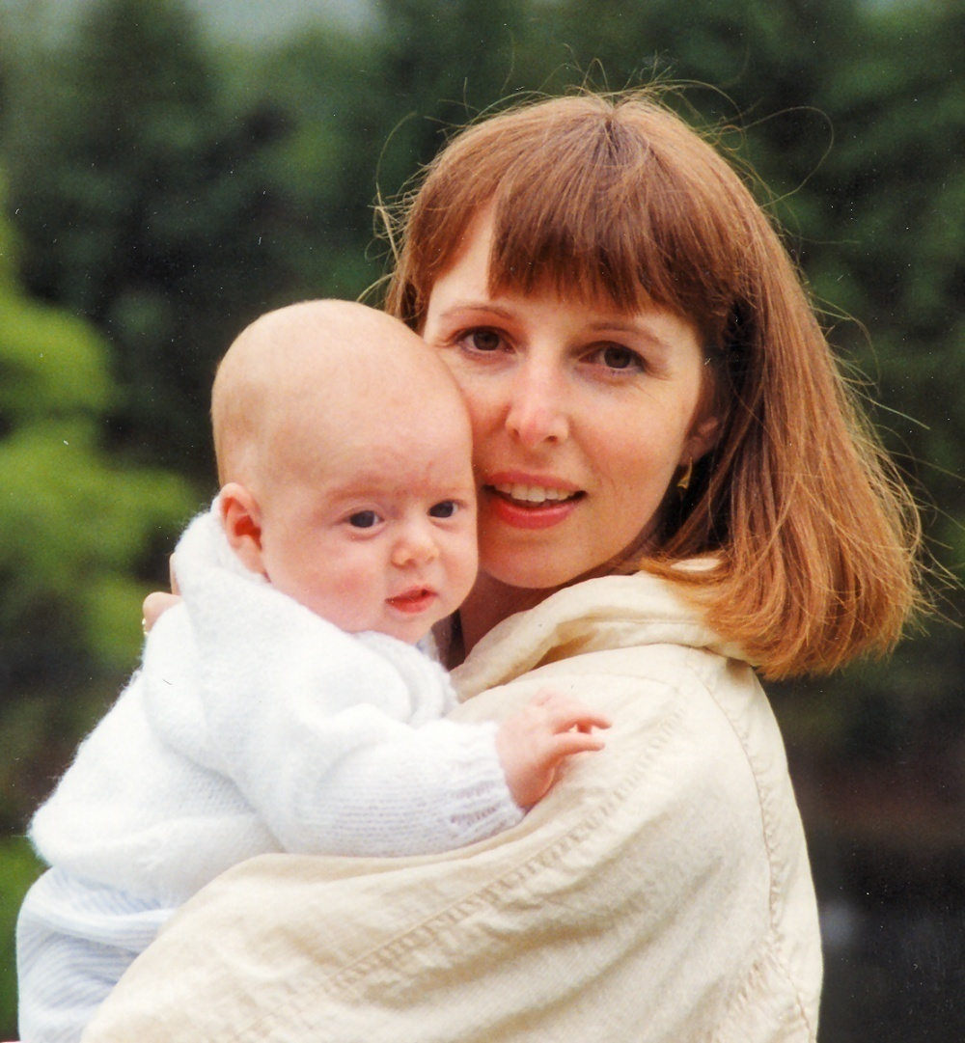
Perinatal Mental Illness:
What it feels like to be in crisis and what helped me to keep on living

Slide 2
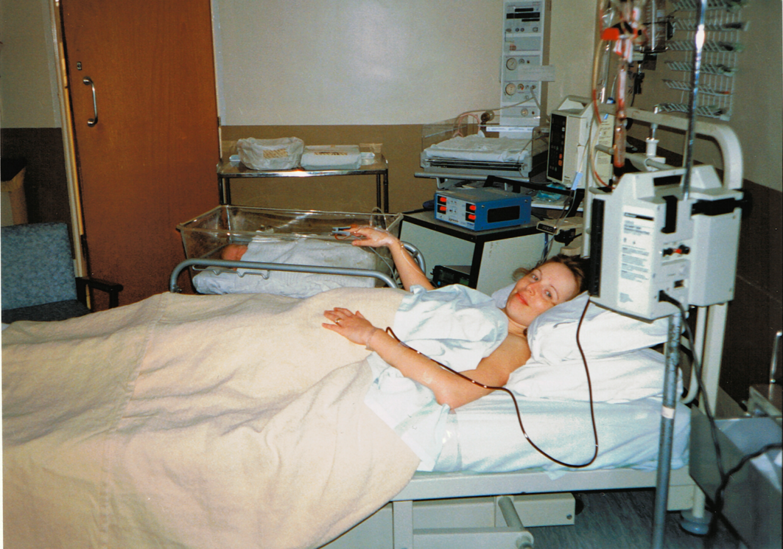

Slide 3
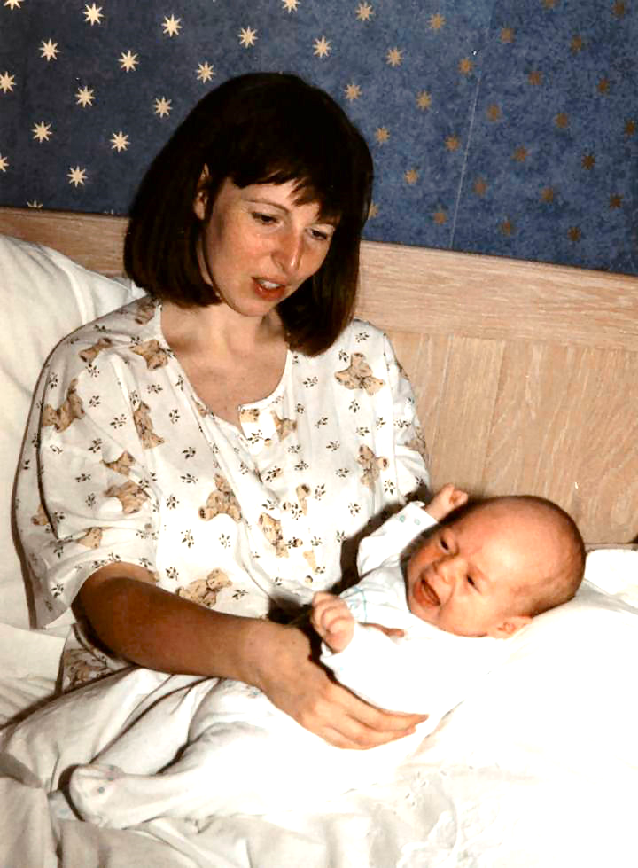
Exhausted
Lonely
Aggressive
Irrational
Nervous energy
Emotional

Slide 4
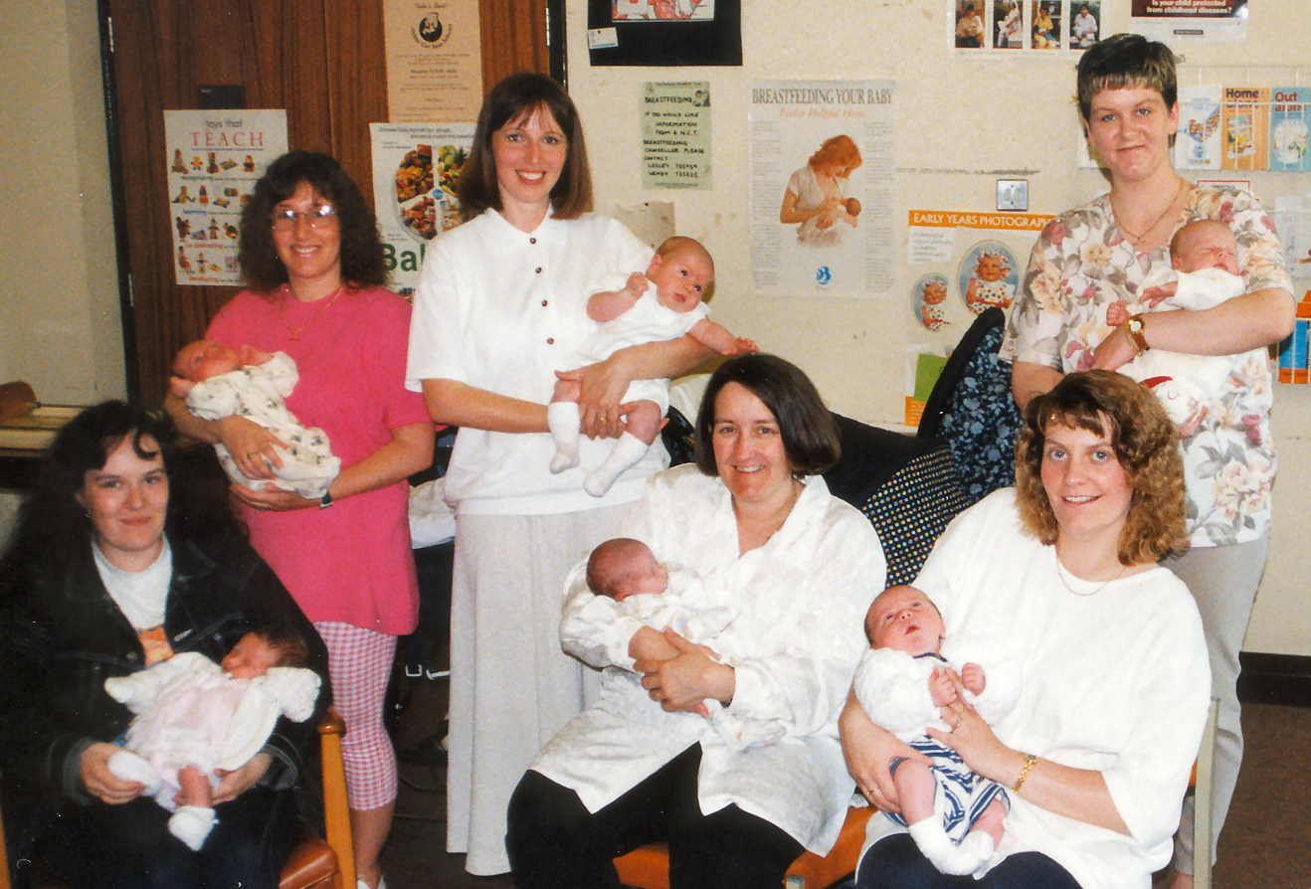
Why does everyone else seem to cope?

Slide 5
Thanks to instagram.com/anna_kanyuk and instagram.com/knee_deep_in_life for this video

Slide 6
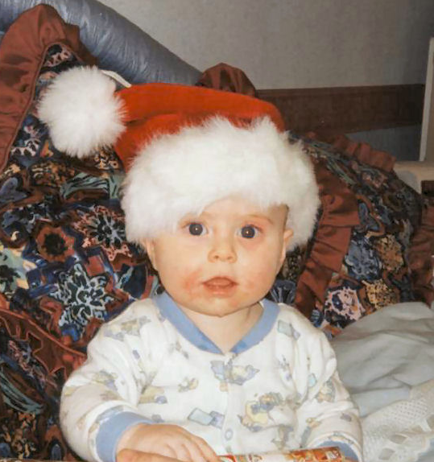
Where’s my Mum?

Slide 7
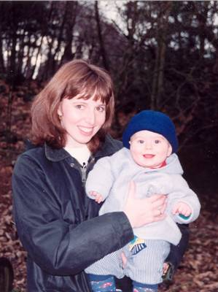
An in-patient!

Slide 8
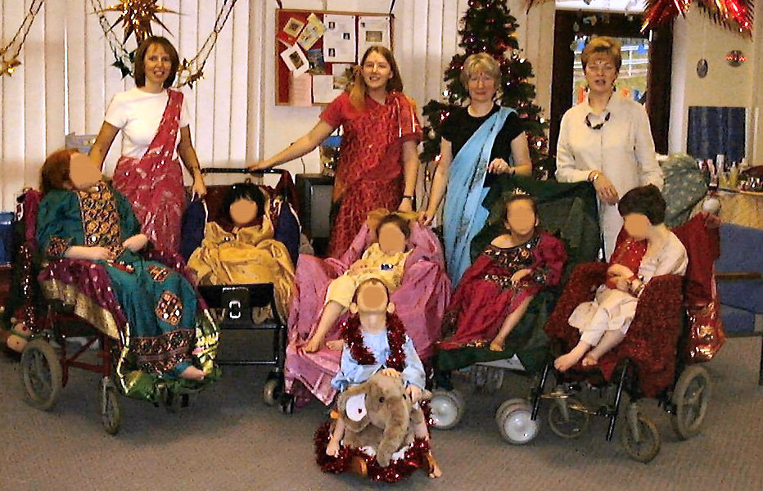
Back to life ….

Slide 9
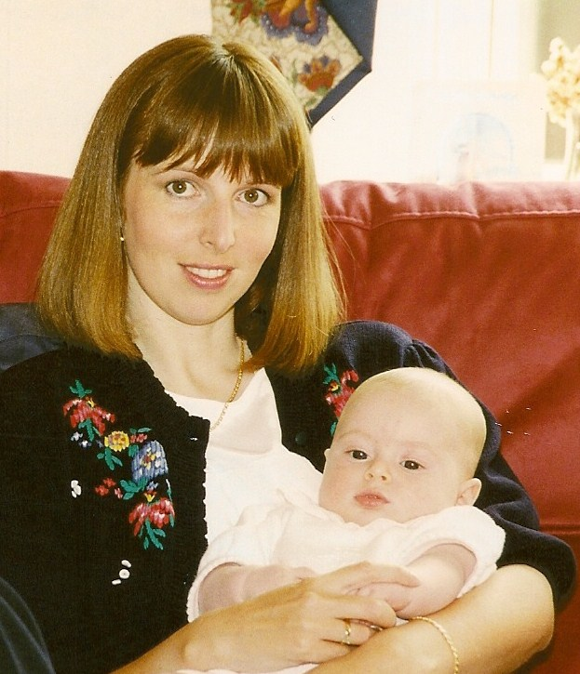
Empathetic HCPs
Time & patience
ECT
Family and friends
Being in hospital
Occupational Health
My son
Exercise
What helped?

Slide 10
Non-empathetic HCPs
Communication
Sleep deprivation
Financial pressure
My ‘dishonesty’
Ignorance
My
personality
Stigma
What hindered?

Slide 11
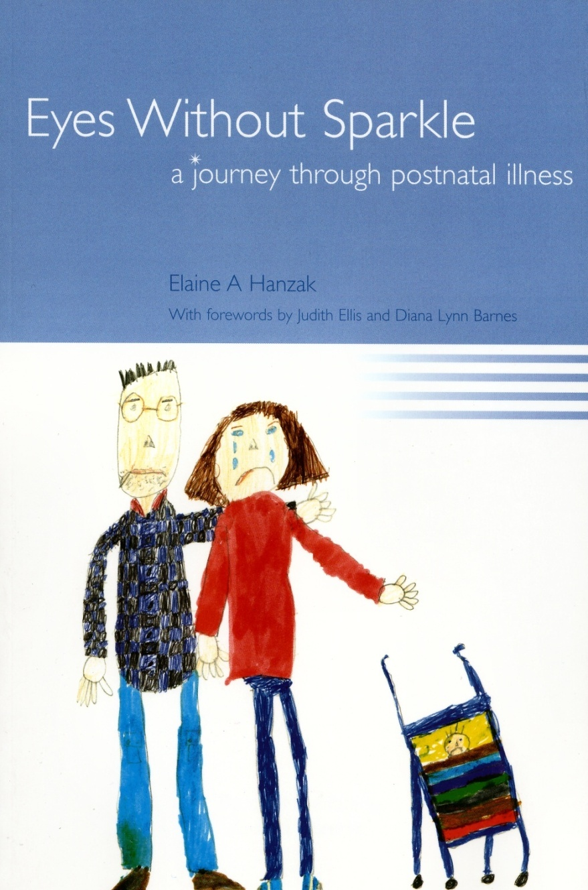
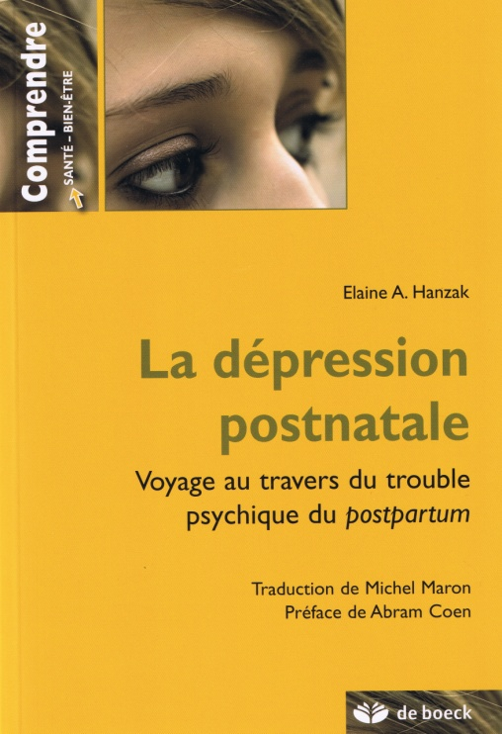

Slide 12
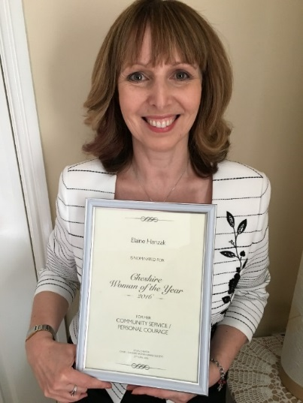

Slide 13
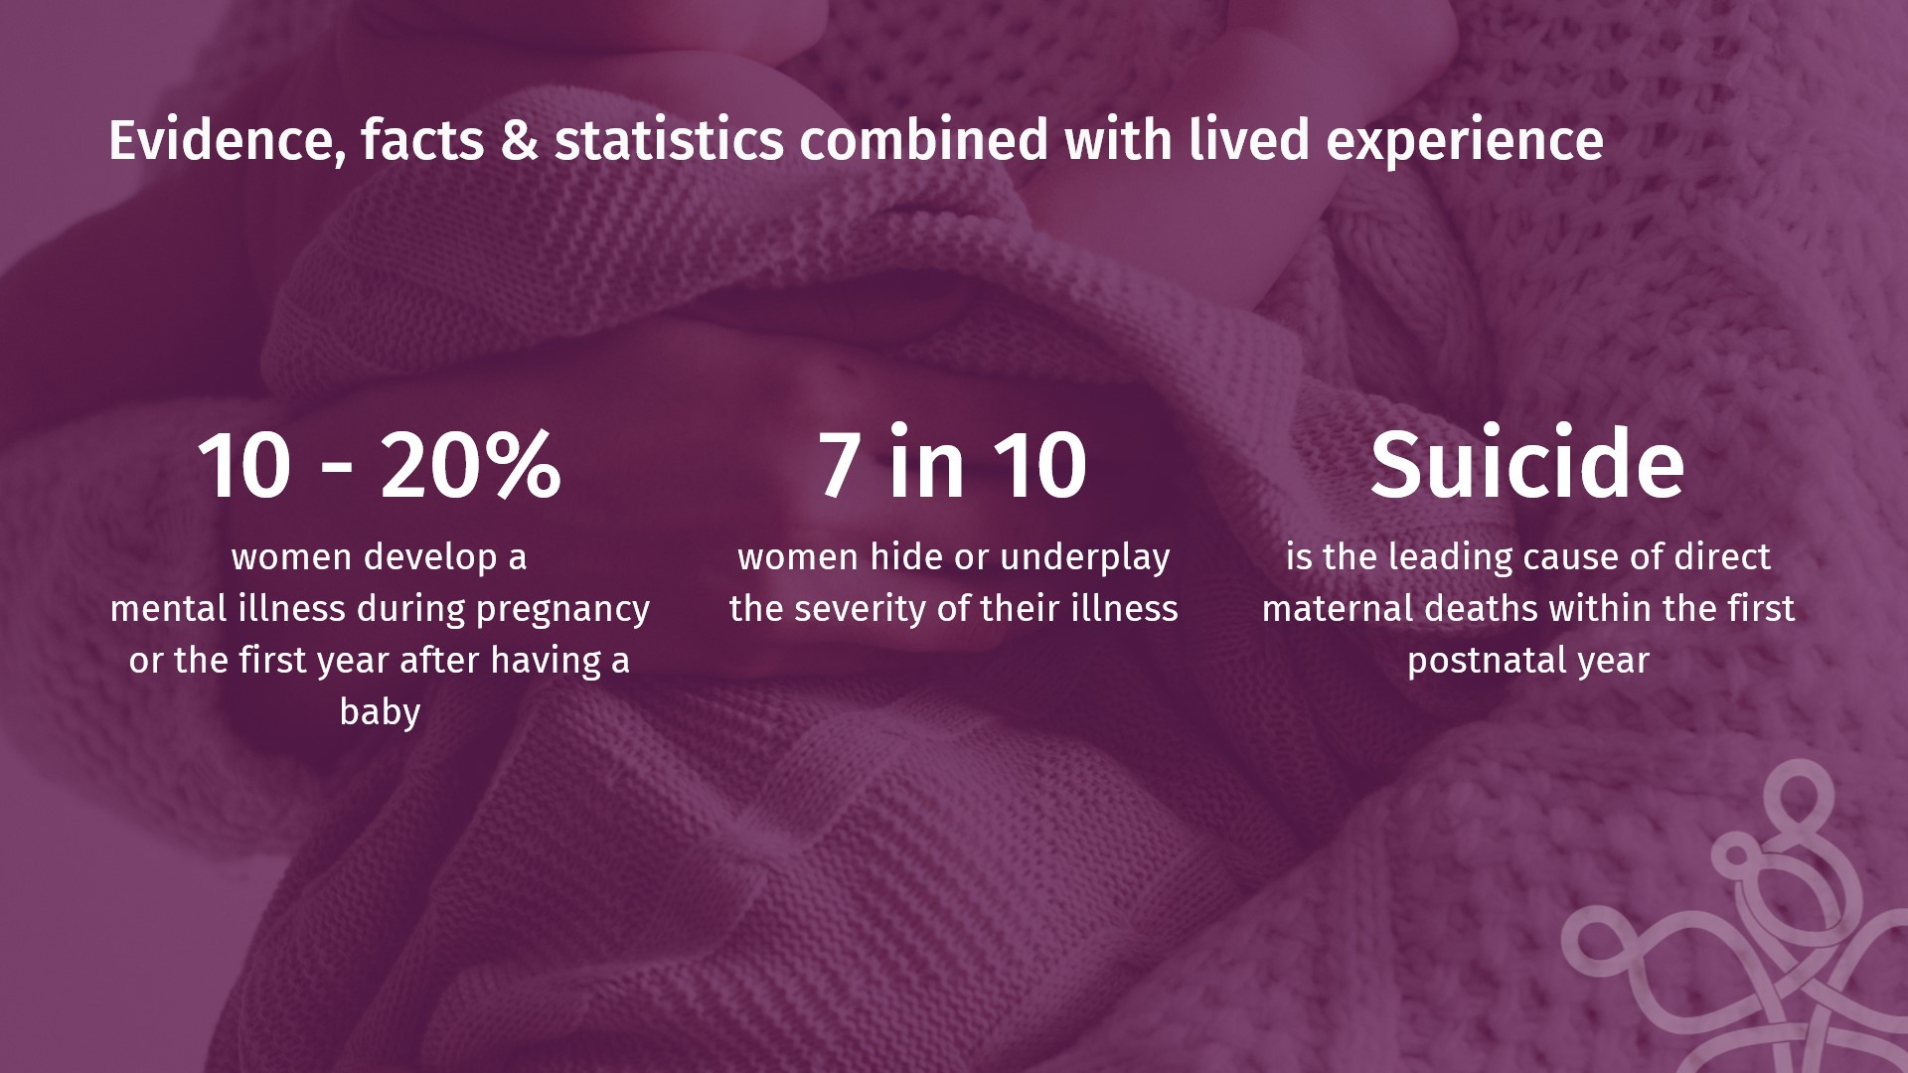

Slide 14
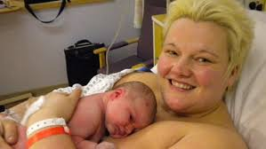
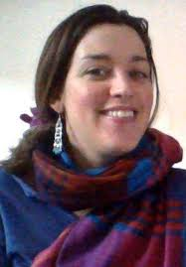
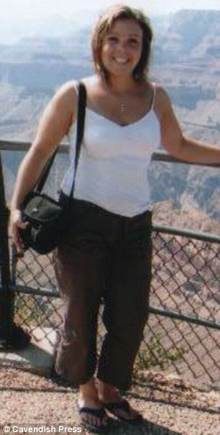
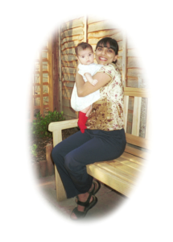
Let’s enable their silent screams to be heard…
Notes:
Claire Peake, 39 – school teacher – hung herself like scene from Officer & Gentlemen
Joe Bingley, nurse – jumped in front of a train
Charlotte Bevan + daughter – jumped off Avon Gorge in Bristol
Dr Daksha Emson & Freya – stabbed and set fire
In the words of Daksha Emson’s husband on what would have been his daughter’s 18th Birthday – ‘Let’s enable their silent screams to be finally heard’.

Slide 15
COVID-19
Useful links
Notes:
https://maternalmentalhealthalliance.org/
https://ihv.org.uk/our-work/our-work-in-mental-health/resources-for-families/?highlight=perinatal
https://parentinfantfoundation.org.uk/1001-days/
https://marcesociety.com/
https://path-perinatal.eu/

Slide 16
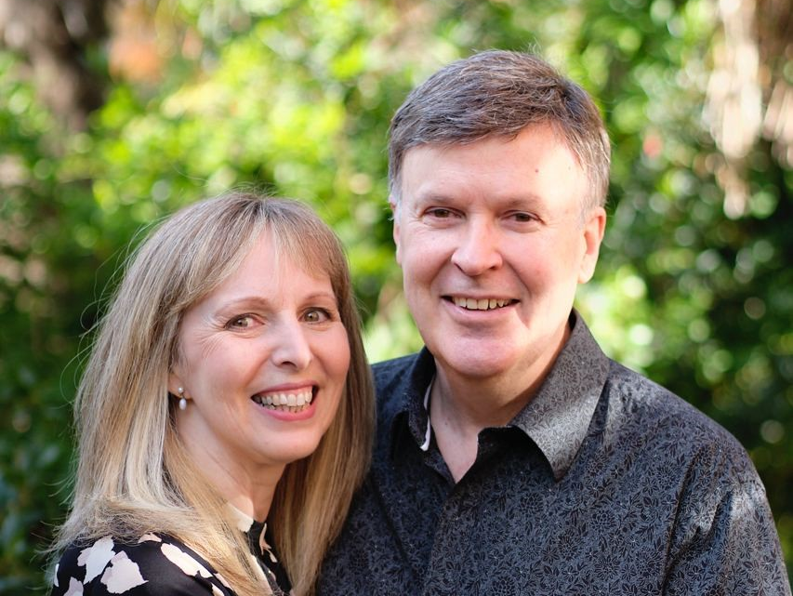
COVID-19
Covid-19 & Long Covid
Notes:
https://maternalmentalhealthalliance.org/mmhpandemic/

Slide 17
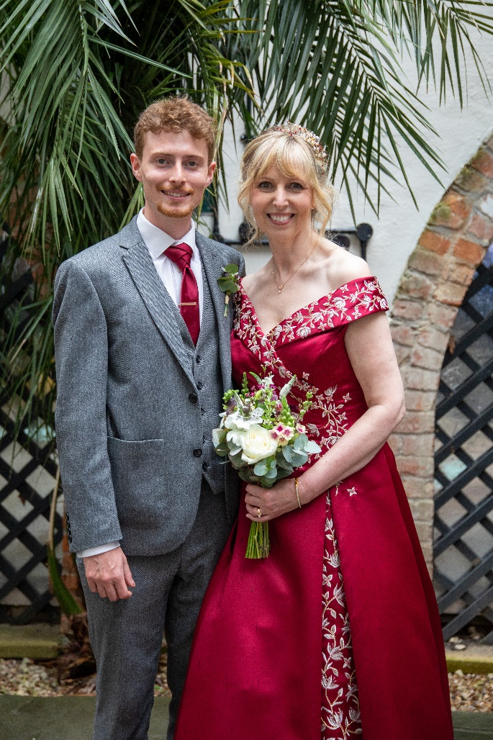
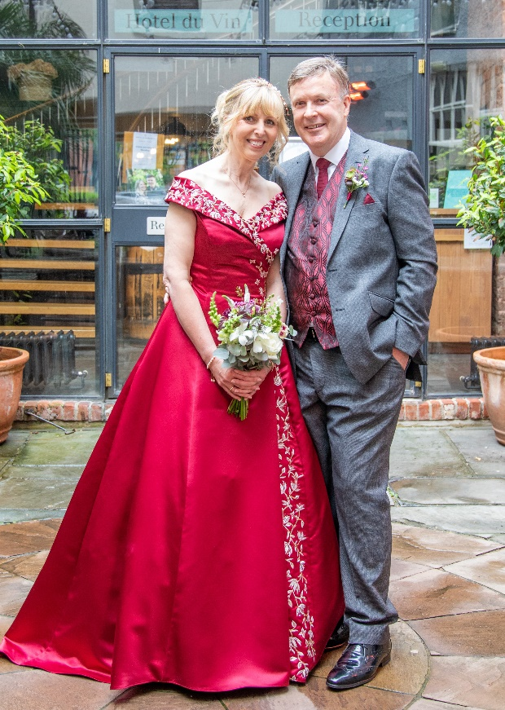
Gratitude

Slide 18
COVID-19
Questions?

