Slide 1

Understanding Quality Metrics for Quality Assurance
Natasha Goswell
System Director of Nursing and Professional Practice
Torbay and South Devon NHS Foundation Trust

Slide 2
Overview and Aims
Aim to inform of our experience of devising and delivering a quality assurance accreditation scheme
How we chose, set up and developed our quality metrics and the monitoring framework
We describe what an accredited ward looks like, the benefits of an accredited ward and its impact
Inform how we set up shared governance and its relationship with ward accreditation
The key themes from our experiences to date

Slide 3
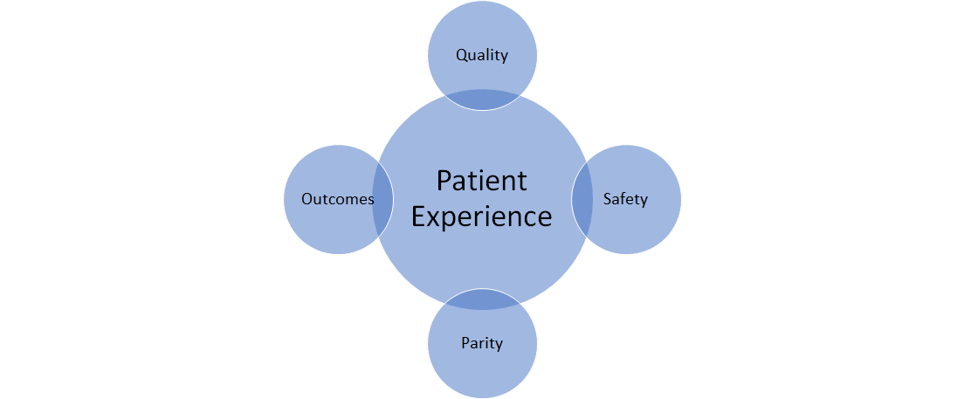

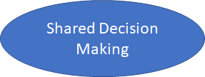
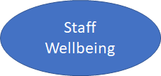

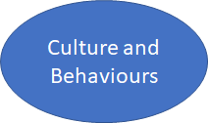

What is Ward Accreditation at Torbay?

Slide 4

What Does This Mean To Our Staff?
Ward Accreditation is designed to support nurses in practice to understand how they deliver care, identify what works well and where further improvements are needed.
Providing meaningful information for ward teams to monitor their progress
Creating constructive conversations to enhance the teamwork around improvement
  Recognising and rewarding success
By promoting a culture that supports and motivates staff to engage in continuous improvement. Ward managers can deliver local quality improvement initiatives with their teams on their wards and ensure that patients always receive quality care

Slide 5
Devising and Delivering a Quality Assurance Accreditation Framework
Nov 2019
Torbay chosen as 1 of 14 Trusts nationally to undertake Pathway to Excellence accreditation
Feb 2020
March 2020
Gap analysis indicated fundamentals of ward assurance and shared decision making needed greater focus
April – July 2020
Principles of assurance frameworks for Ward Accreditation and Shared Governance designed and agreed
Pathway programme on hold
July 2020
November 2020
February 2020
August – October 2020
Pathway to Excellence Organisation Culture and Behaviours Survey undertaken
7 inpatient wards accredited
DAISY Staff Recognition Awards launched
Shared governance pilot programme roll out

Slide 6










Developing Our Quality Metrics

Slide 7

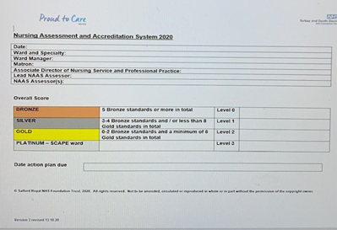
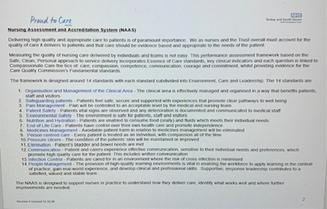
Developing Our Quality Metrics
Developed in consultation with Ward Managers, Lead for Pharmacy, Freedom to Speak Up Guardian, Pathway to Excellence Lead Nurse and System Director of Nursing
Adaptation of the Salford National Accredidation Scheme Standards included Torbay specific elements

Slide 8

What Do We Assess?
Standards and 216 Key lines of enquiry
Observations of care
50% of patient notes reviewed
Patient conversations
Review of patient feedback
Discussions with patients on the wards at time of assessment of area
Whole day assessment with the assessment team attending morning handover and safety briefing
Assessment
medicines management, lunchtime and care interactions as appropriate
Documentation review
Staff Conversations
Medical, nurisng and AHP notes reviewed
Discusssions with Staff on shift
Staff complaints, grievances
Desktop review of quality and safety, workforce key performance indicators
Formal meeting with the Ward manger for intial feedback from the observations

Slide 9
What Do The Standards Include?
Organisation and Management of the Clinical Area
Safeguarding patients
Pain Management
Patient Safety
Environmental Safety
Nutrition and Hydration
End of Life Care
8. Medicines Management​
9. Person centred care​
10. Pressure Ulcers​
11. Elimination​
12. Communication​
13. Infection Control​
14.People Management

Slide 10

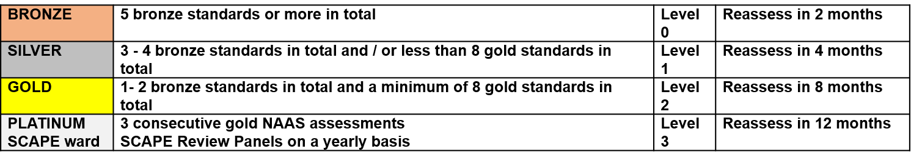
Ward Does Feedback To The Wards
Look Like?
Date: August 4th 2020
Ward and Specialty: Dart Ward, Totnes Hospital - Rehabilitation
Ward Manager: Allie Taylor
Matron: Tracey Cunningham
Associate Director of Nursing Service and Professional Practice: Rhoda Allison
Lead NAAS Assessor: Katy Sorrell
NAAS Assessor(s): Corrine Jackson
Overall Score

Slide 11
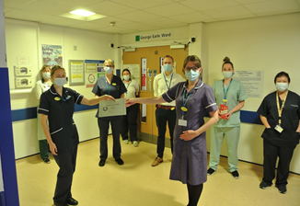
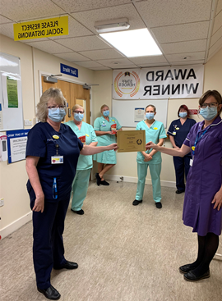
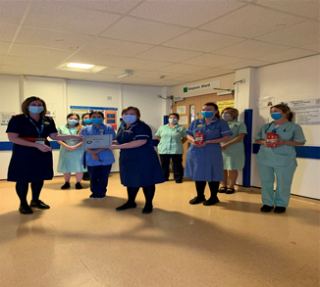
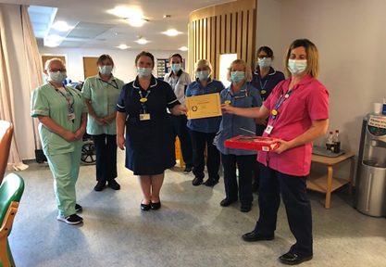
What Does An Accredited Ward
Look Like?
Ward Manager of Teign Ward at Newton Abbot Community Hospital, said: “Ward accreditation is a reflection on the high standard of care the staff provide to our patients. Teign Ward staff are very proud of the care they deliver on a daily basis and I am extremely proud to be part of such a fantastic dedicated team.”

Slide 12
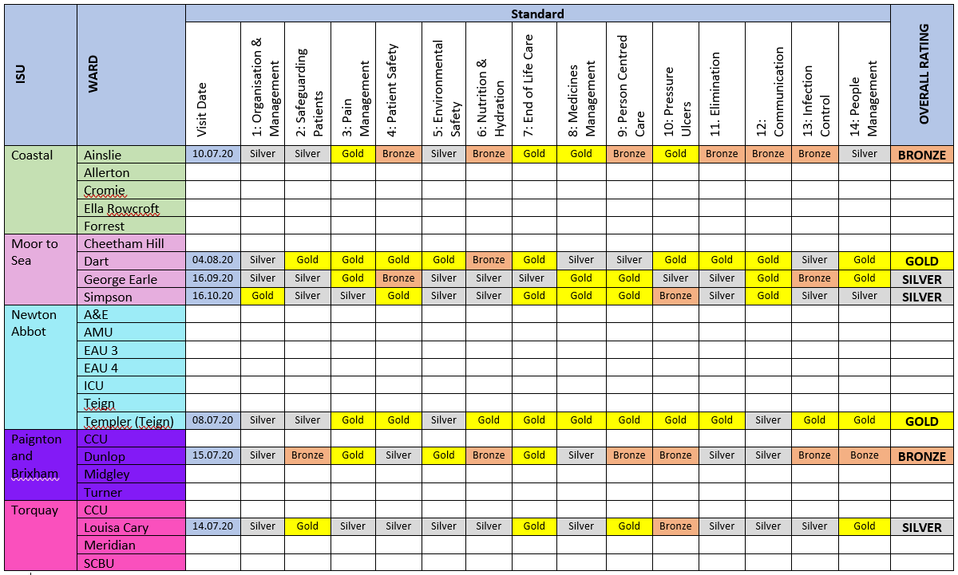
What Does An Accredited Ward
Look Like?
Heat Map
Improvement Plan
Trust Priorities
CQC KLOE's

Slide 13






Benefits of Ward Accreditation
Trust wide areas for organisational focus i.e (Nutrition)
Staff development programme – Band 6 and 7 nursing and midwifery staff are part of the ward accreditation assessment team, enabling shared practice and organisational awareness
Engagement with process and improvement plans by ward manager, their team, matron and Associate Director of Nurisng
We have learned that the standards are an iterative process
•Development of a ‘Heat Map’
healthy competition between wards
•Showcase for exemplary practice at ward level as well as across wards (End of life care)
Development of ‘Care to Chair’ and CQC assurance frameworks

Slide 14
What Does Shared Governance Mean
At Torbay?
Staff are given protected time to have a collective ownership to develop and improve practice and it places staff at the centre of the decision-making process
Listening to the voices of patients, colleagues and managers
Using research and quality improvement to formulate a strategy for improvement and implementing change
Improving upon an aspect of the work environment that needs developing
Flattening the hierarchy
Encouraging personal and professional development whilst focusing on improving patient safety, experience and staff experience
‘Nurses and Midwives directly leading change in their practice areas’

Slide 15
What Does Shared Governance
Mean in practice ?
Significant shift in culture and practice
Empowering and enabling front line staff to have their say and shape decisions
Commitment to hearing the Voice of Nursing and Midwifery
Committed to a Multi professional approach/Voice and creating a culture of shared decision making
Primary goal is to optimise the participation of nursing and midwifery and other key professionals in the decision-making process
Aim to generate consensus in professional practice matters.
We wish to offer staff at all levels the opportunity to participate in planning, implementing, evaluating, and revising nursing practice.
Trusts who have implemented Shared Governance systems have reported a significant focus on solutions instead of problems as well as a cultural shift towards innovation and action.

Slide 16


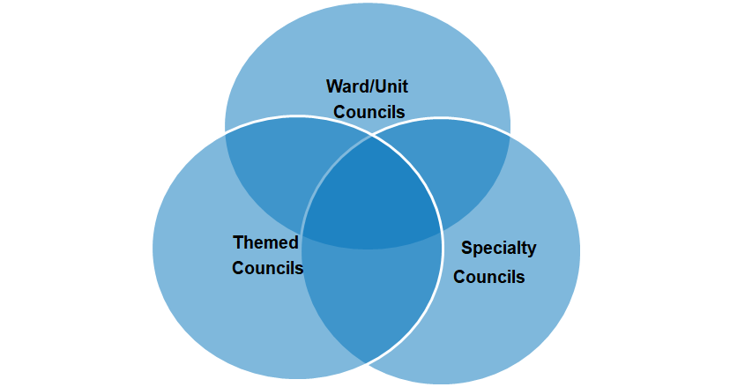






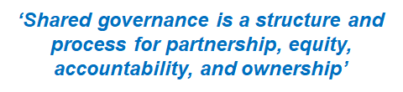
Shared Governance Council Modelling
Corporate
Councils

Slide 17

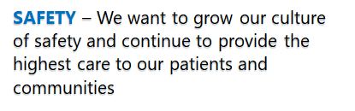



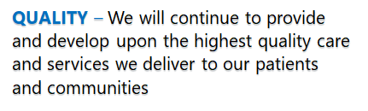

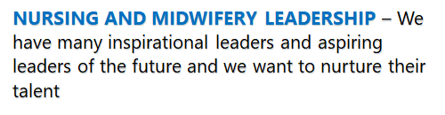

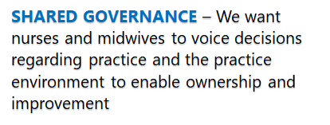

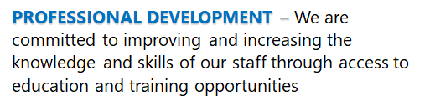
What The Professional Voice Means
At Torbay

Slide 18
Key Themes From Our Experience
Engagement
Training and Education
Organisational quality improvement priorities
Standardisation
Leadership

Slide 19



Slide 20
REFERENCES
Guanci G. Feel the Pull. Minneapolis, MN: Creative Health Care Management, Inc.; 2016.
Robert N, Finlayson S. Fundamentals of Magnet(R) Toolkit. Silver Spring, MD: American Nurses Association; 2015.
Beglinger JE, Hauge B, Krause S, Ziebarth 2011 L:Shaping future nurse leaders through shared governance. Nurs Clin North Am. 2011;46(1):129-135.
4. Newman KP. Transforming organizational culture through nursing shared governance. Nurs Clin North Am. 2011;46(1):45-58.
Hess, Jr., Robert G 2004: From bedside to boardroom - nursing shared governance. Source: Online Journal of Issues in Nursing . 2004, Vol. 9 Issue 1, p95-106. 12p.Author(s): Interdisciplinary Shared Decision-Making: Taking Shared Governance to the Next Level Golanowski, Marie MS, RN, CNAA; Beaudry, Diane PhD, RN; Kurz, Lynne MS, RD; Laffey, William J. BS, MBA; Hook, Mary L. MS, APRN, BC Author Information- Pub Nursing Administration Quarterly: October-December 2007 - Volume 31 - Issue 4 - p 341-353
Maiju Kyytsönen, Marco Tomietto, Moona Huhtakangas, Outi Kanste 2020: Research on hospital-based shared governance: a scoping review. Pub International Journal of Health Governance ISSN: 2059-4631 Publication date: 7 July 2020

