Slide 1
Putting safety, quality improvement and experience at the core of what we do in the NHS: Co-Producing Improvements with People with Lived Experience
Thursday 10th February 2022
Cristina.serrao@nhs.net @acserrao76
Helen.lee12@nhs.net @helenlee321_lee
#ExpOfCare #AlwaysEvents #Coproduction #wmty #LivedExperience
Notes:
Introduce yourself like a native American:
#hellomynameis…..
Share something about you & your life
Share what brought you here today & what matters to you

Slide 2
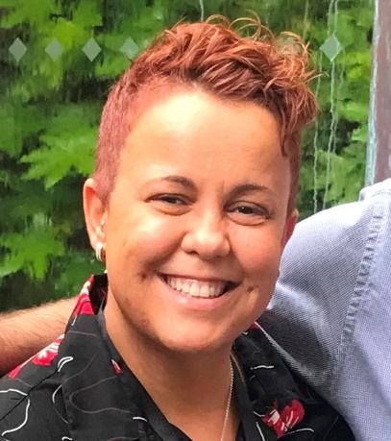


Welcome
Cristina Serrão & Helen Lee
Experience of Care Team
NHS England and NHS Improvement
Cristina.serrao@nhs.net @acserrao76
Helen.lee12@nhs.net @helenlee321_lee
#ExpOfCare #AlwaysEvents
#Coproduction #wmty #LivedExperience

Slide 3

3 words to describe what coproduction means to you……
Please type them into your chat box

Slide 4
Rate yourself how well do you coproduce?
I don’t work this way at all
Excellent – do it all the time!
On a scale of 0-10…Share your number in the chat box

Slide 5
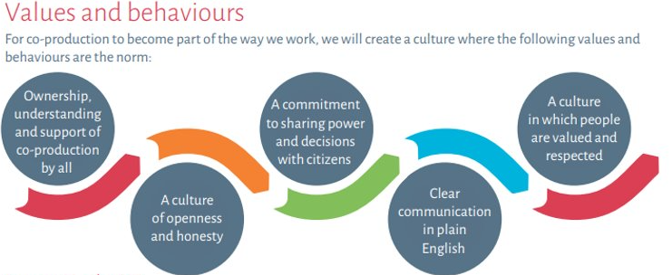
What is meant by the term co-production?
"Co-production is a way of working that involves people who use health and care services, carers and communities in equal partnership; and which engages groups of people at the earliest stages of service design, development & evaluation.
Co-production acknowledges that people with ‘lived experience’ of a particular condition are often best placed to advise on what support and services will make a positive difference to their lives. Done well, co-production helps to ground discussions in reality, & to maintain a person-centred perspective. Co-production is part of a range of approaches that includes citizen involvement, participation, engagement & consultation.”
A model for co-production: NHS England and NHS Improvement and Coalition for Personalised Care (formerly Coalition for Collaborative Care) (2020)

Slide 6

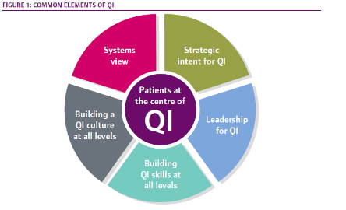
https://www.cqc.org.uk/sites/default/files/20180911_QI_hospitals_FINAL.pdf
Putting the patient at the centre of QI – the QI journey sharpens the focus on delivering high-quality patient care and aligning improvement activity to outcomes and experience for patients. To deliver this, patients must be involved and enabled as true and equal partners for QI.

Slide 7
Co-production in our learning from the pandemic response
The COVID-19 pandemic was a catalyst that sparked new partnerships, accelerated research, and increased the speed at which innovations were adopted across the health and social care system.
The Accelerated Access Collaborative (AAC) and the Beneficial Changes Network (BCN) commissioned Frontier Economics, Kaleidoscope Health and Care, and RAND Europe, to conduct an independent review to help learn lessons from this period and recommend how potentially beneficial changes can become day to day practice.
It was conducted between October and December 2020, and involved a range of lived experience voices and over 80 stakeholder organisations.
The number one critical ingredient for change was co-production.
A paper went to the Quality and Innovation Committee at NHSE/I in March 2021 and there is now work to co-produce how we bring this recommendation to light and shift the culture of the way we work to ensure it is co-production as default.
Access the full report here and see more information on the following slide.
Click here to join in the discussion on the Beneficial Changes FutureNHS site

Slide 8
‘Co-production as default’: a critical ingredient for change in implementing COVID-19 related beneficial changes and recovery
Critical ingredients for change
1. | Co-Production as Default
2. | Prioritise reducing inequalities
3. | Leadership for innovation
4. | Innovation-Friendly Environment
What did we say needs to be done to implement the co-production as default:
Work with system partners to place co-production – including people with relevant lived experience – at the centre of how the health and care system learns and embeds change from the response to COVID-19.
In local services, in ICSs and nationally, we will transform our ways of working so that we are able to demonstrate that we:
• Always start from what matters most to people who use and work in services
• Work with people who have relevant lived experience (patients, service users, unpaid carers and people in paid lived experience roles) and with staff, in everything we do to directly connect with multiple and diverse voices
• Build equal and reciprocal partnerships with people who have relevant lived experience, and staff, including with those from

Slide 9
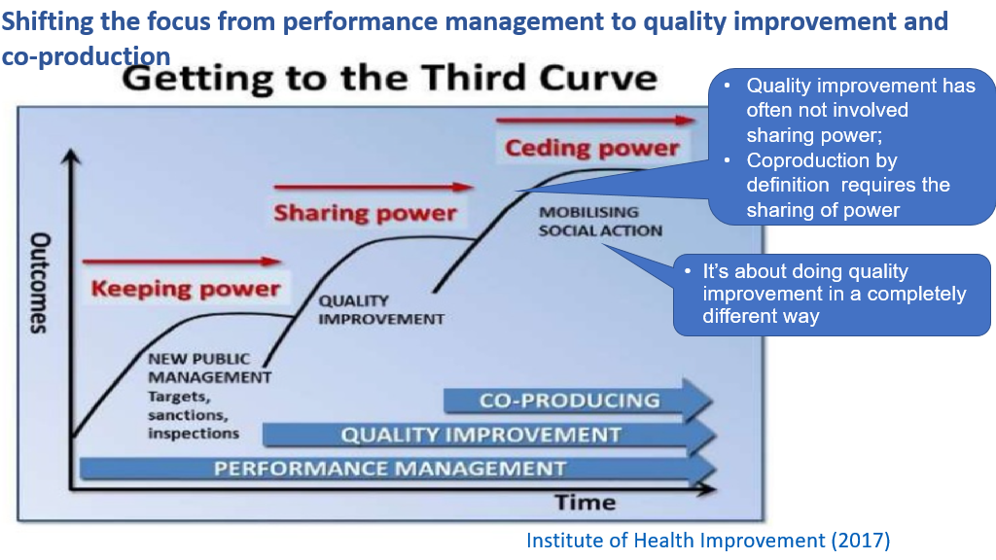

Slide 10
Our vision…..
We have taken the previous slide and re-worked it to better illustrate the aim is to improve experiences of care by co-producing quality improvements together, within a quality assurance system
Quality Assurance (system)
Where the
magic
happens
Co-production
Quality
Improvement
Our shared goal - Improved experience of care
Notes:
We have taken the previous slide and re-worked it to better illustrate the aim is to improve experiences of care by co-producing quality improvements together, within a quality assurance system

Slide 11
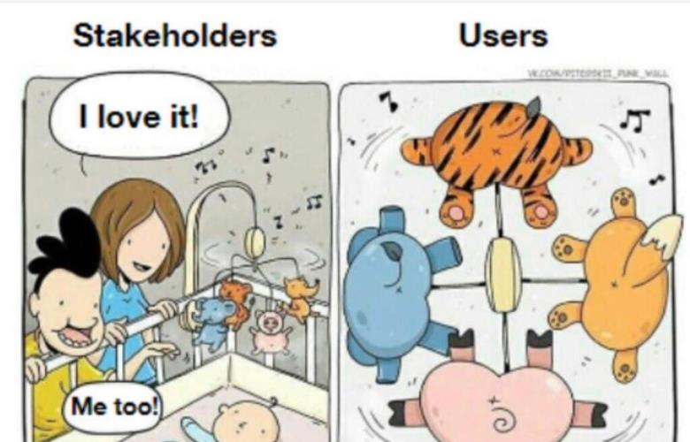


Slide 12
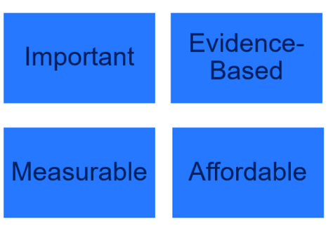
Always Events®
Criteria
NHS England, Picker Institute Europe and the Institute for Healthcare Improvement (IHI) piloted and tested the Always Events® framework
Created guidelines and a toolkit for implementing Always Events within the NHS in England.
Now over 135 sites – in a range of settings. Now beginning in Primary and social care and across integrated care system footprint
IHI encourages us to think of it as an Always experience not just a one off Always Event
It’s a promise to partner with people using services so things that are important happen consistently and always.

Slide 13

Always Events®
Always Events® are defined as “those aspects of the patient and family experience that should always occur when patients interact with healthcare professionals and the delivery system.”
Always Events is a trade marked product owned by the Institute of Healthcare Improvement. It was originally developed by the Picker Institute Inc in the USA
Always Events

Slide 14
Co-Design an Always Event®
Reliably Implement
Standard Work Over Time
Understand “What Matters to Patients?” in the Pilot Unit or Program
PLAN
Communicate Standard Work Processes
Use Process Measures to Assess Progress
Create a Vision for the AE and Develop an Aim Statement
Event
DO
Always
Implement Standard Work
Generate and Test Specific Change Ideas to Address What Matters
STUDY/ACT
Observe & Redesign Standard Work as Needed to Increase Reliability
Specify Details of Successful Changes for The Always Event
Notes:
Understand “What Matters?” – themes from patient stories; themes from surveys, complaints and negative patient experiences; focus group
Test the components and composite of the Always Event
Standard Work: specify the process clearly -- who, what, when, where, how
Observation: identify defects and redesign processes to mitigate failures

Slide 15

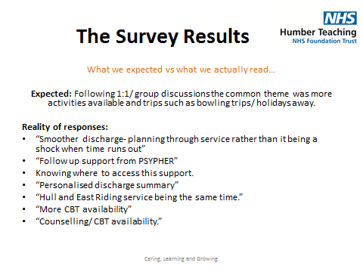
Video on Humber Teaching NHS FT talking about Always Events

Slide 16
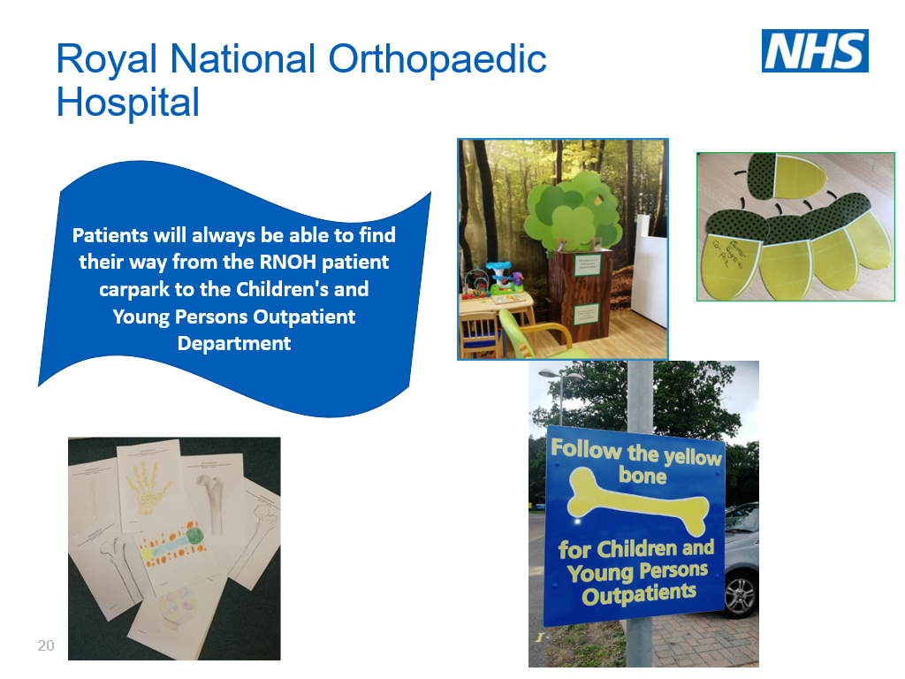

Slide 17
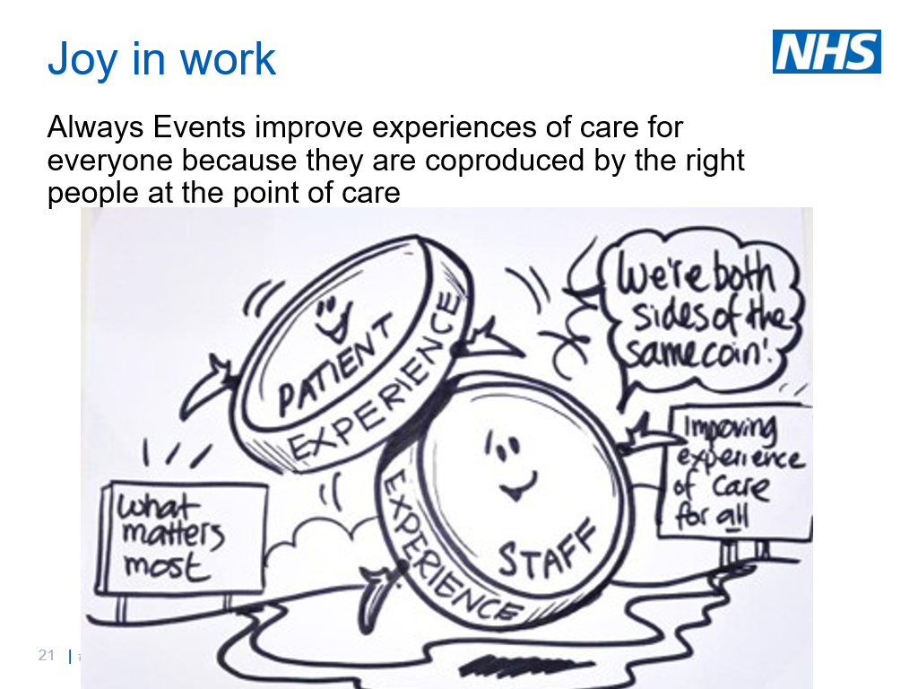

Slide 18


Slide 19
