Slide 1
Victim Support: effective sexual abuse pathways during and beyond Covid-19

Slide 2
What you can expect from this session
What is the Rape Crisis network
The impact of Covid-19 on Rape Crisis service users and workers.
Demand on specialist community-based sexual violence and abuse services.
Funding and commissioning landscape of sexual violence and abuse services.

Slide 3
The Rape Crisis network
39 member services across England & Wales
All adhere to the Rape Crisis National Service Standards
The RCNSS are acknowledged by the Care Quality Commission as successfully aligned with their Key Lines of Enquiry for Healthcare and Social Care Services
Rape Crisis services offer specialist counselling and advocacy (including ISVA) services to all survivors of all forms of sexual violence and abuse.

Slide 4
The impact of Covid-19 on Rape Crisis service users and workers

Slide 5
Case study of a survivor, “B”
Impact of lockdown and changing parental/childcare responsibilities, including education
Anxiety and depression
Survivors supporting survivors

Slide 6
Case study of a Rape Crisis worker
Illness and bereavements
Failings of the criminal justice system
Stress and vicarious trauma

Slide 7
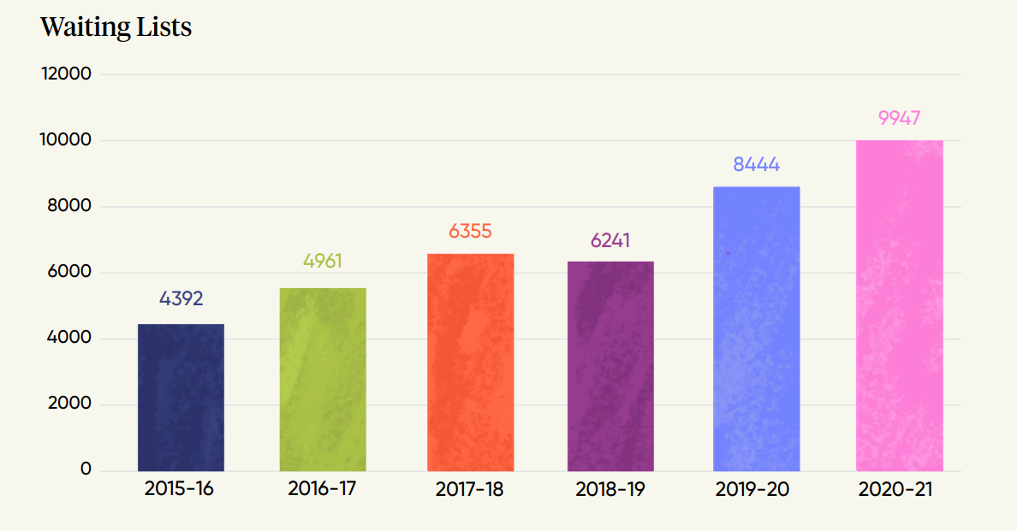
Demand for Rape Crisis services

Slide 8
Rape Crisis response

Slide 10
Obstacles on the referral pathways
Rape Crisis Centre managers

Slide 11
Key asks we make to improve referral pathways for survivors of sexual violence and abuse
Local and regional health trusts and commissioners need to recognise the specialism of sexual violence and abuse services, and recognise them as centres of wellbeing.
CCGs and ICSs must appropriately fund specialist Rape Crisis Centres to help reduce the waiting times of specialist sexual violence and abuse services.
Department for Health and Social Care must work with other Government departments and commission Rape Crisis services at a national level and create a ring-fenced fund for specialist sexual violence and abuse services.
Specialist support must not depend on whether someone reports to the police – everyone should get the support they need, when they need it.

Slide 12
Any questions?
Find out more
Website: www.rapecrisis.org.uk
Email: amelia@rapecrisis.org.uk
Follow us on social media
Twitter: @RapeCrisisEandW
Facebook: @rapecrisiseandw
Instagram: rapecrisisew

