Slide 1
Reducing and Managing Catheter Related Bloodstream Infection
Valya Weston - National IPC Improvement Lead
#ImproveIPC

Slide 2
National Drivers
NHS Long Term Plan
‘As medicine advances, health needs change and society develops, the NHS has to continually move forward so that in 10 years time we have a service fit for the future. The NHS Long Term Plan is drawn up by frontline staff, patient groups, and national experts to be ambitious but realistic.’

Slide 3
National Drivers
Tackling antimicrobial resistance 2019–2024. The UK’s five-year national action plan
Antimicrobial resistance (AMR) is a global problem that impacts all countries and all people, regardless of their wealth or status. The scale of the AMR threat, and the need to contain and control it, is widely acknowledged by country governments, international agencies, researchers and private companies alike.
AMR infections are estimated to cause 700,000 deaths each year globally. That figure is predicted to rise to 10 million, alongside a cumulative cost of $100 trillion, by 2050 if no action is taken.

Slide 4
National Drivers
The UK’s antimicrobial resistance five-year national action plan
Focuses on three key ways of tackling AMR:
• reducing need for, and unintentional exposure to, antimicrobials
• optimising use of antimicrobials
• investing in innovation, supply and access
These are underpinned by actions across ‘content areas’, ranging from reducing infection and strengthening stewardship to improving surveillance and boosting research.

Slide 5
Why is this important in Vascular Access?
Estimated 8.9 million Healthcare Acquired Infections (HCAI) annually (Suetens et al 2018)
Around 30% of HCAI are resistant to antibiotics (Suetens et al 2018)
Vascular Access Device - associated Blood Stream Infections are one the commonest device related HCAI and are often preventable (Quinn et al 2020)

Slide 6
Routes of Contamination
Extraluminal
Infection sources emanate from:
Patients own skin at the catheter insertion site
Evidence suggests that an extraluminal source of infection predominates in catheters placed for a shorter duration of time.

Slide 7
Routes of Contamination
Intraluminal
Infection sources emanate from:
the catheter hub,
the catheter tubing connection,
contaminated intravenous fluids.
Evidence suggests that an intraluminal source predominates with more prolonged dwell times.
Intraluminal colonisation with biofilm-producing microbes is more widespread after prolonged catheterisation.

Slide 8
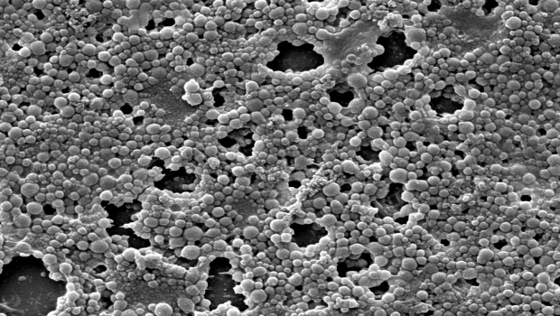
What is a Biofilm?
Biofilms are complex Microbial communities containing bacteria and/or fungi.
They can consist of a single bacterial or fungal species or more commonly they can contain multiple species.
Microrganisms synthesise and secrete a protective ‘slimy’ matrix – which attaches the biofilm firmly to living or non-living surfaces.

Slide 9
Mechanism of Survival
Bacteria and fungi want to survive. Therefore, they adapt as a form of protection.
Microbial Resistance:
Where microorganisms adapt and develop resistancy to antibiotics and other antimicrobials.
Biofilm Formation:
The formation of the biofilm acts as a barrier protecting the microorganism colony from external threats.

Slide 10
Biofilm Formation
Intravenous Catheters – when inserted may readily acquire biofilms on the inner and outer surfaces.
The longer the catheter remains in place, the greater the tendency for microorganisms to develop biofilms that result in infection.

Slide 11
Importance of Care Bundles
Plethora of evidence to demonstrate that the implementation of Care Bundles has a significant effect on reducing the risk of complications including infections.
Components:
Hand Hygiene
Aseptic Technique
Dressing changes
Assessment of function, complications and signs and symptoms of infection.
Failure to complete one of these components predisposes the patient to a BSI or other complications.
High Impact Interventions: New revised care bundles for PIVC and CVC, for insertion and care and maintenance
Notes:
HHIs – now in the process of being trialled.

Slide 12
Insertion
Infection Risk
Breaking the skin and inserting a medical device directly through the vein wall and into the blood stream.
Mitigations
Hand hygiene
Maximal barrier precautions
Skin antisepsis
Catheter site selection – avoidance of femoral site in adults
Daily review of line necessity

Slide 13
Maximal Barrier Precautions
Purpose:
To establish an aseptic barrier minimising the passage of microorganisms from non-sterile areas to sterile areas.
Principles:
Central Venous Catheter procedures should be treated as a surgical procedure
Using:
Non-sterile caps and masks
Sterile gown
Sterile gloves
Sterile full – body drapes

Slide 14
Skin Antisepsis - Insertion
The skin acts as protective barrier against bacteria and infection
The skin is punctured during Vascular access device (VAD) insertion – creating a direct entry for bacteria to ingress into the blood stream.
The chosen antiseptic should be applied to the skin in a back-and-forth grid –like pattern with friction to agitate the surface layers of the skin.
Important that the antiseptic is allowed to dry completely prior to insertion – can cause dermatitis, can inactivate the adhesive of the dressing, can increase the risk of infection due to moisture being trapped underneath the dressing.

Slide 15
Device Necessity
Daily review of Line Necessity
Most effective way to reduce the risk of catheter-related BSI, is to remove it as soon as possible. The longer the catheter remains in situ the higher the risk of infection.
Perform a daily assessment:
Is the catheter still necessary for treatment?
Can the patient be switched to peripheral or oral medications?
Are there catheter related problems?
Are there alternative therapies?
Is therapy being discontinued?
Is the patient happy with the current delivery of medications?

Slide 16
Skin Antisepsis – Dressing change
Vitally important that the skin is disinfected at each dressing change and when the skin puncture site is exposed.
Important that the antiseptic is allowed to dry completely prior to dressing application – can cause dermatitis, can inactivate the adhesive of the dressing, can increase the risk of infection due to moisture being trapped underneath the dressing.
Assessment of the skin underneath the dressing should be performed regularly – potential risk of skin injury due to age, underlying skin conditions, joint movement and/or the presence of oedema.
A risk from medical adhesive- related skin injury (MARSI) associated with the use of adhesive – based engineered stabilisation devices.

Slide 17
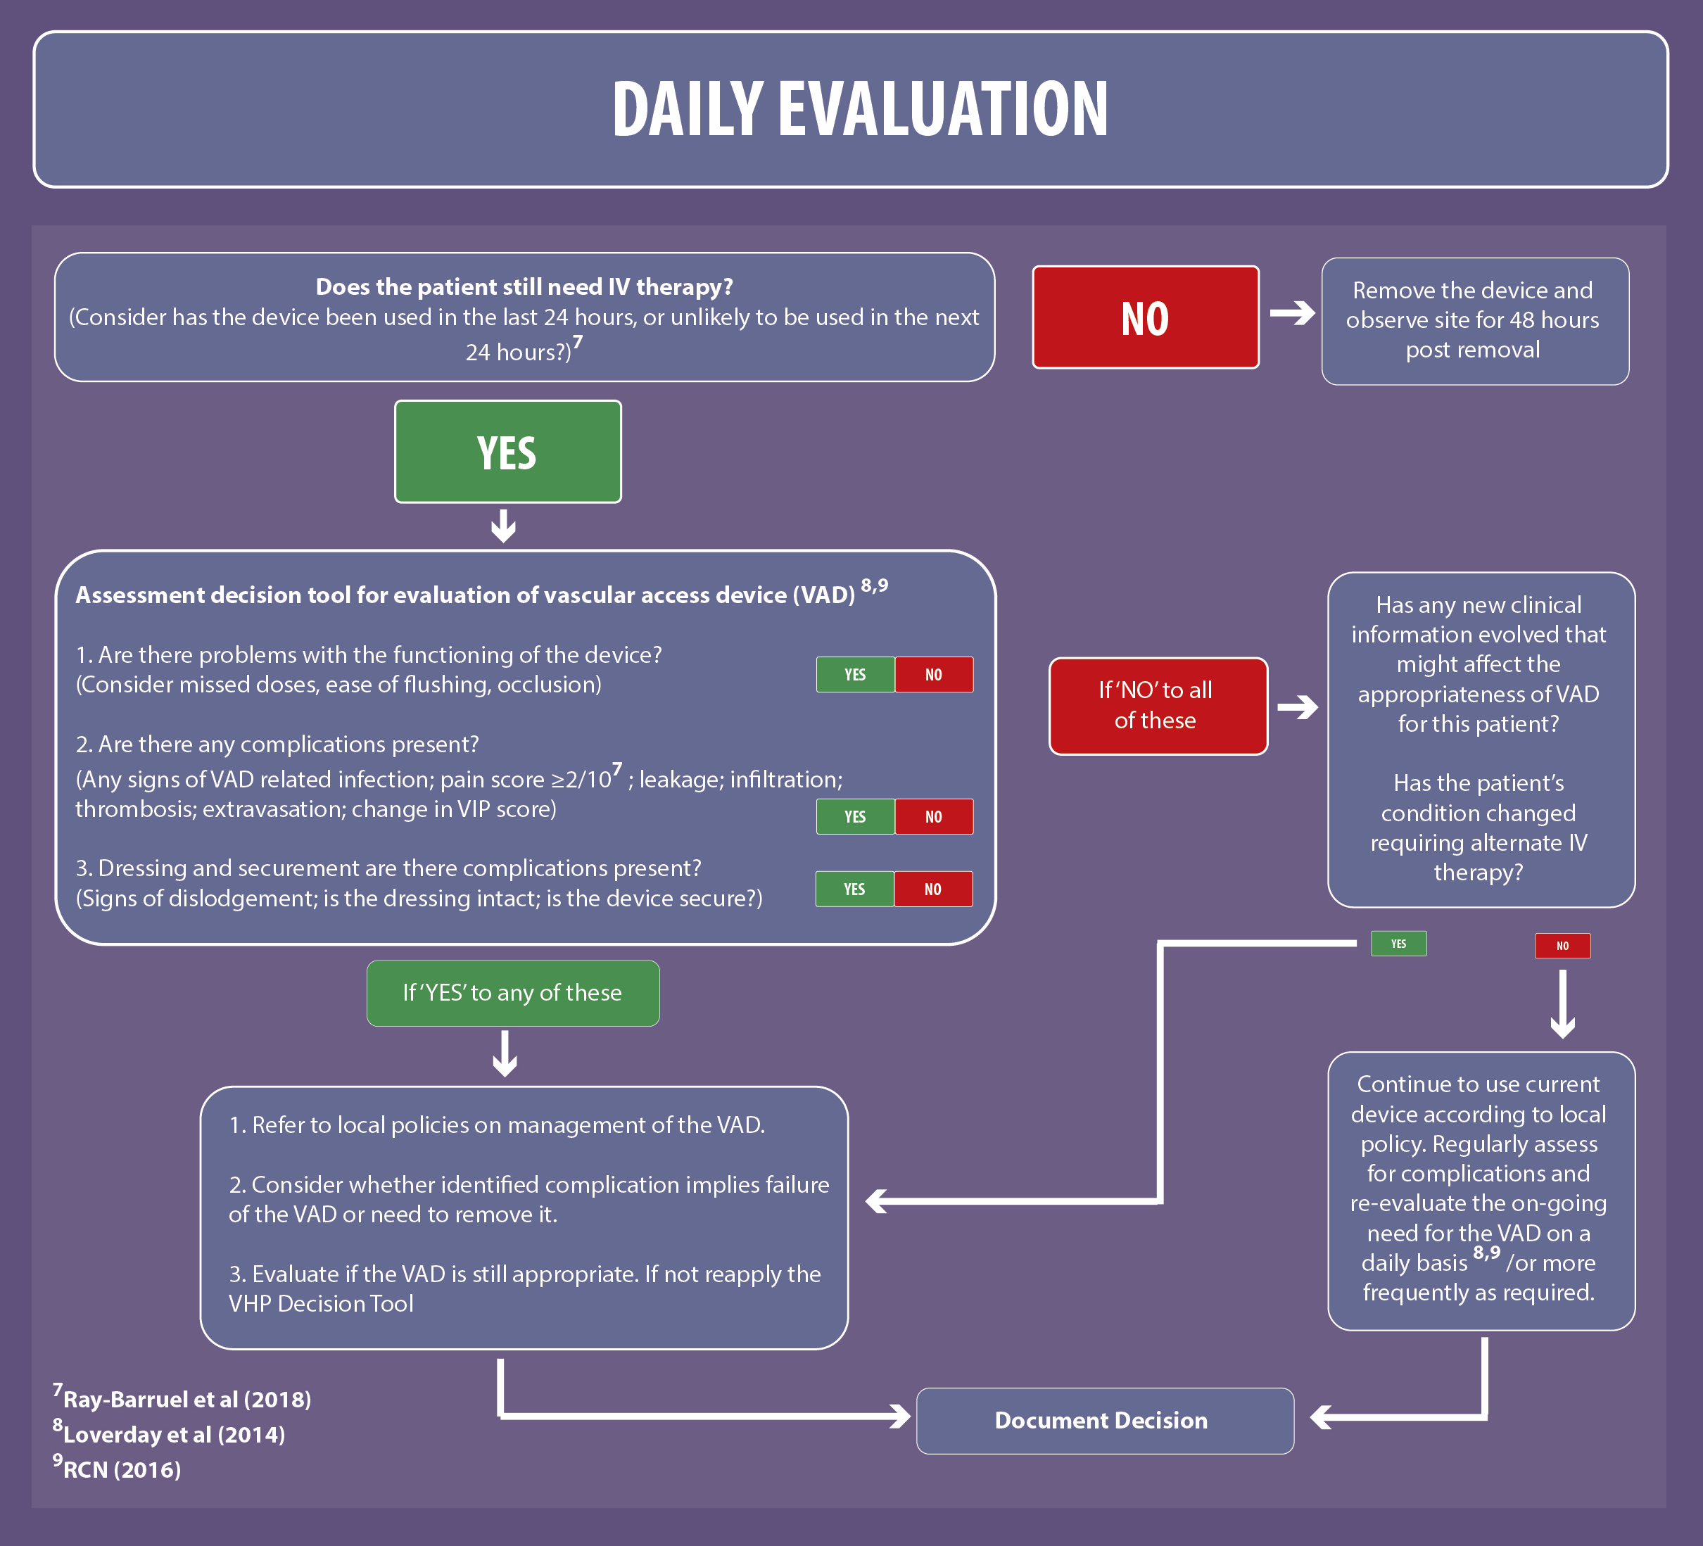
Assessment
Active process of inspecting, monitoring and evaluating a vascular access device.
Includes assessing the entire infusion system from the solution container to the VAD insertion site.
Objective is to monitor the device for:
Complications
Patency
Position
Function
Necessity

Slide 18
Assessment and Maintenance
Aims:
To prevent the interruption in treatment
To assess the patency of the VAD
To detect signs of infection or other complications at the earliest possible stage.
Components and Documentation:
Cannulation site – assessed and documented at a minimum of every shift.
Device care
Dressing changes
Methods to evaluate function prior to use
Flushing and canular length
Device necessity

Slide 19
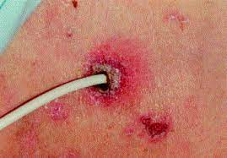
Monitoring Insertion Site
Visual inspection of the insertion site for redness, swelling and/or any signs of infection.
If possible, ask how the patient is feeling and whether they are feeling pain or discomfort at the site.
Palpation of the site for signs of tenderness, firmness, blanching, moisture , oedema or oozing.
Catheter position is checked and measured to ensure that the catheter has not migrated in or out of the cannulation site.
Upper arm can be measured when clinically indicated to assess for the presence of oedema or a DVT.

Slide 20
Dressing Adherence
Remember that once the skin is punctured the dressing is the only protective barrier keeping microorganisms from entering the body through the insertion site.
Use a transparent, permeable to water, vapour and oxygen and impermeable to microorganisms.
Ensure:
The dressing is completely intact
All edges are adhering to the skin
The dressing is clean and dry.

Slide 21
Dressing Changes
After insertion:
the transparent dressing should be secure and intact
All edges adhere to the skin
Dressing is clean and intact.
Gauze and tape can be used if there is a drainage of blood or fluid from the exit site or if the patient has profuse sweating.
Implications for changing the Dressing.
If integrity has been compromised by:
Moisture, drainage, or blood
There are signs of sheering or dislodgement
There are signs and symptoms of infection – redness, exudate or pain
.

Slide 22
Infection
All invasive devices are a known source of infection with VADs having a greater risk for BSI.
Sources include:
Practitioner’s hands – direct contact
Patient skin
Catheter hubs
Catheter tubing/giving sets
Infusates
Contamination of equipment – indirect contact

Slide 23
Phlebitis inflammation of the Vein
Types:
Chemical – associated with infusate administration or with skin antiseptics that have not been allowed to dry fully and are pulled into the vein on insertion.
Mechanical – associated with vein wall irritation caused by the catheter being too large, catheter movement or catheter material and stiffness.
Bacterial – associated with bacterial contamination or colonisation of the VAD or cannulation site.
Post – infusion – can occur up to 48hrs after removal of the device, necessitating continued observation of the site.

Slide 24
Central Vascular Access Infections
Mandatory National Surveillance of Blood Stream infections
MRSA
MSSA
Gram Negatives – Pseudomonas, Klebsiella and Ecoli
However not necessarily caused by VADs.
Central Line Associated Blood Stream Infections (CLABSI)
Defined as a laboratory-confirmed bloodstream infection not related to an infection at another site that develops within 48 hours of a central line placement.
Data Collection:
Often collected in Intensive Care Units but data not widely collected in other areas.

Slide 25
In Summary
Vascular access is an integral part of everyday healthcare. However, it is not without its complications, some of which can be life threatening.
The delivery of evidence-based care through the application of care bundles during insertion and care and maintenance can help to alleviate and/or prevent some of these complications.
This should be underpinned with providing all practitioners caring for VADs with the education and knowledge to care for the VAD and to have the confidence to identify and manage complications such as infection when they occur.
The prevention of Blood stream infections underpins the work being undertaken nationally for tackling antimicrobial resistance.

