Slide 1
Chronic Pain in Children and Young People
Nick Wilkinson
Paediatric Specialist in Rheumatology and Chronic Pain
University Hospital Wales

Slide 2
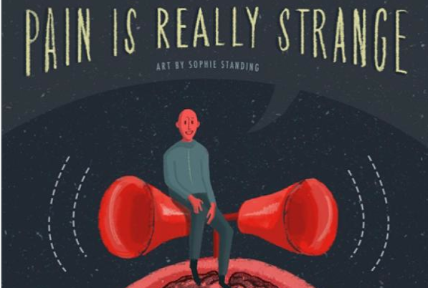
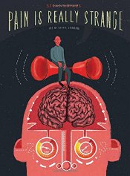

Slide 3
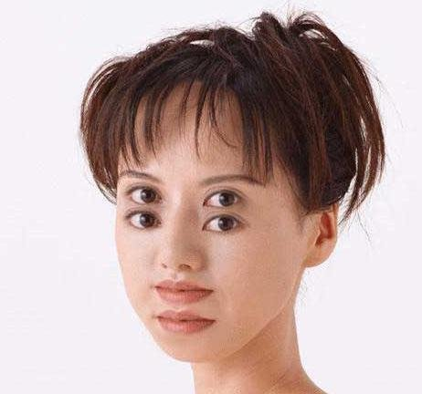

Slide 4
Objectives
Challenge assumptions about pain
  What it represents and what it does not
Explain pain processing
Discuss some of the language of pain
How to help patients with chronic pain (before it becomes disabling)

Slide 5
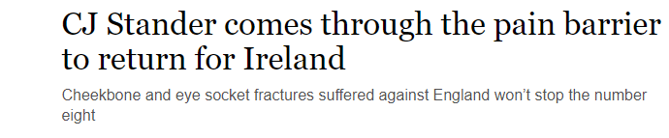
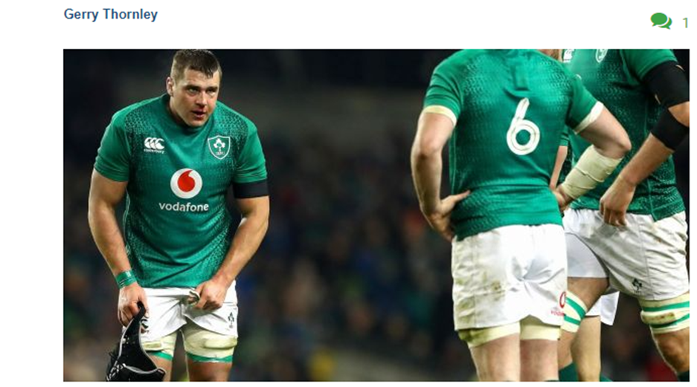


Slide 6

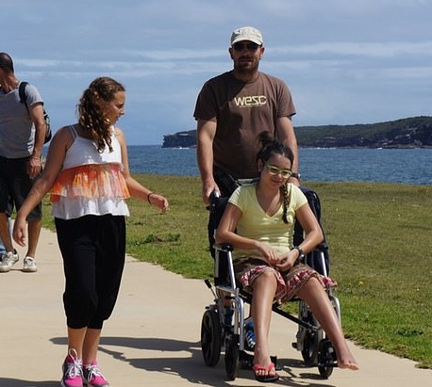
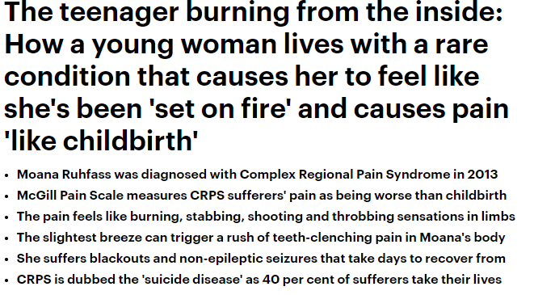

Slide 7
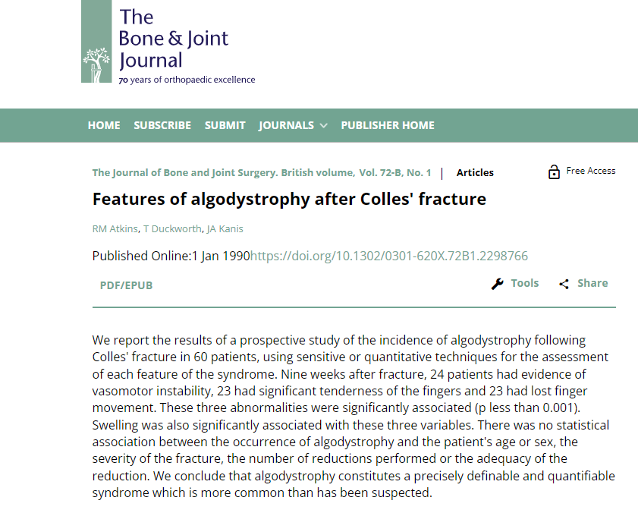

Slide 8
Prevalence of severe chronic pain in a large school population Perquin et al., 2000
Notes:
More than 5000 children, self-report data; 82 % response rate
Chronic pain: occurring weekly for more than 3 months with VAS scores above 5
Most prevalent: limb pain, headache, abdominal pain

Slide 9
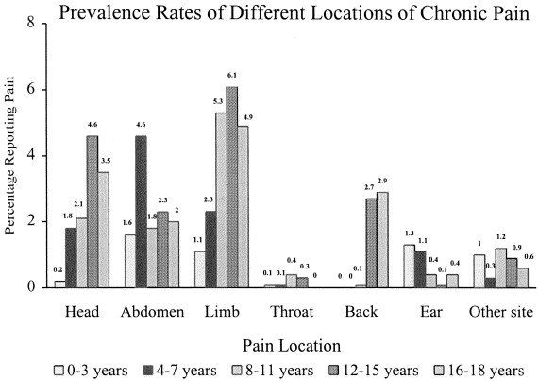
Shead 2011, J Pain
Perquin 2000, Pain

Slide 10
MSK pain in primary care
5-10 % in two other studies
Henschke 2014 BMC

Slide 12

Key points - I
Pain is common

Slide 13

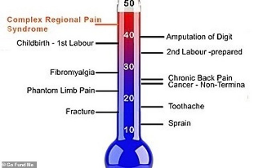
Key points - I
Pain is common
Pain score is not a marker of tissue damage
  But is of distress or threat

Slide 14
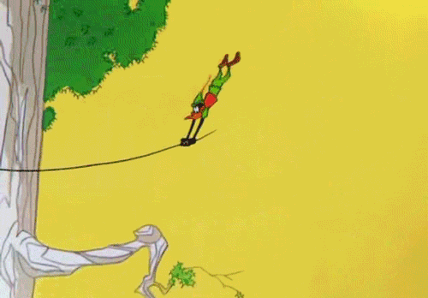
What is the point of pain?
Notes:
Evolutionary biology

Slide 15
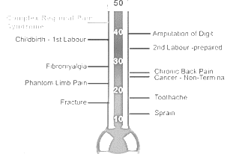
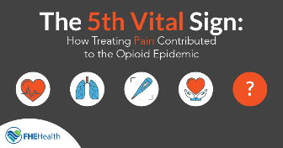
Key points - I
Pain is common
Pain score is not a marker of tissue damage
  But is of distress or threat
Pain score is entirely subjective or personal
  Comparisons between conditions is pointless
Pain is not the fifth vital sign

Slide 17
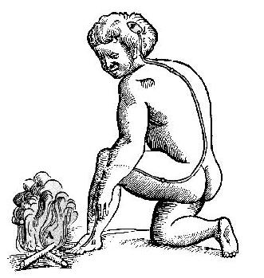
There is not a pain nerve

Slide 18
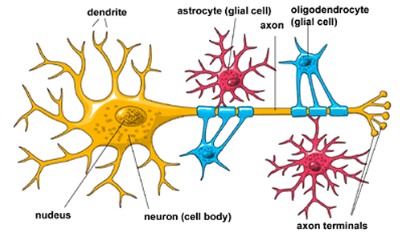
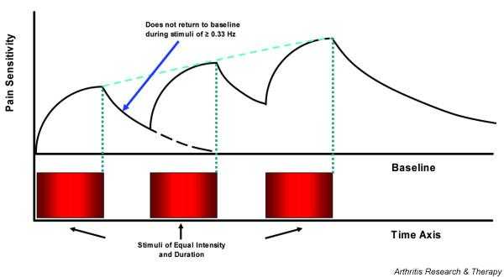
Interactions of nerves

Slide 19
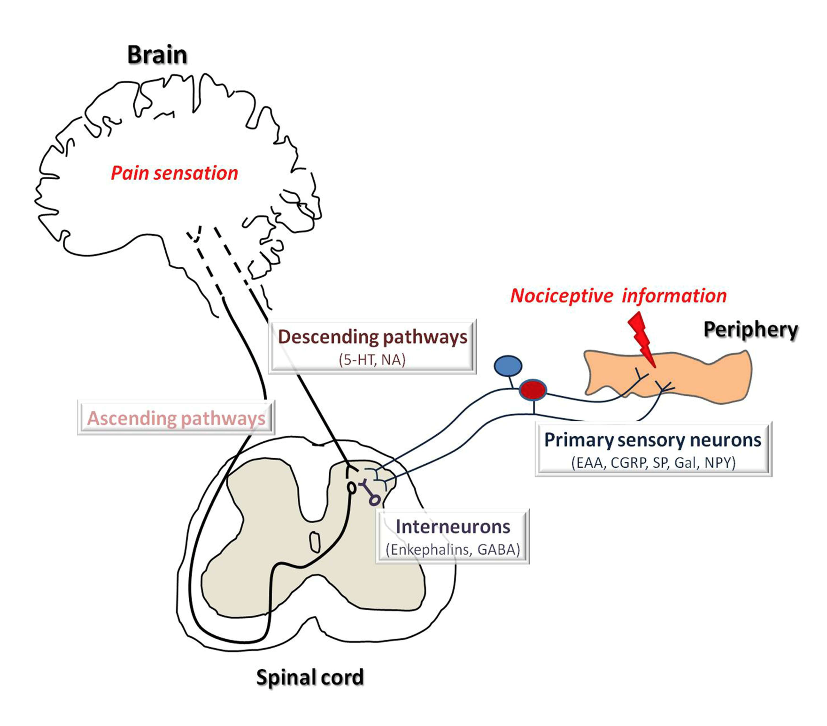

Slide 20
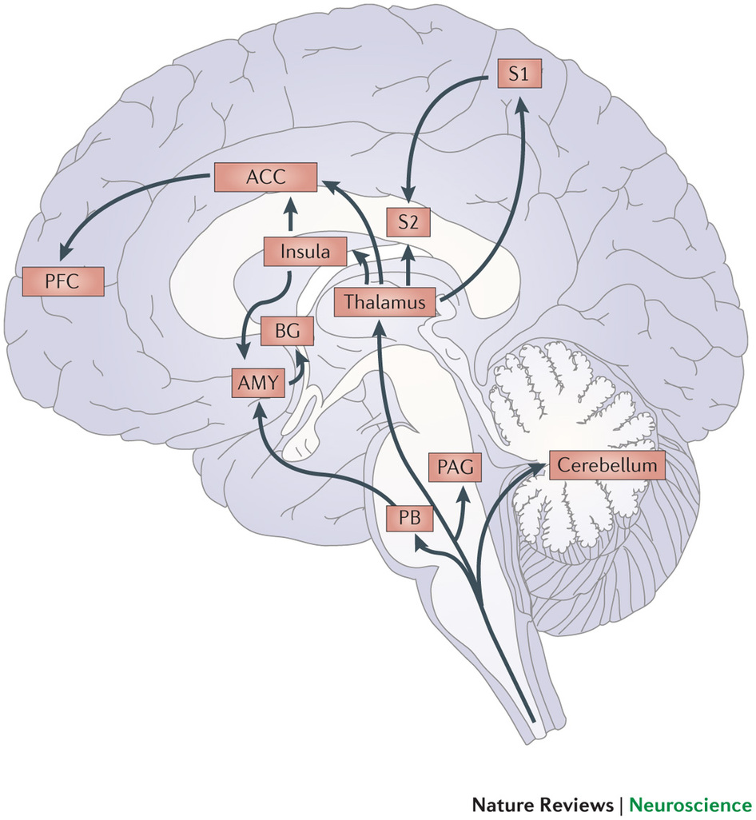
Context
Localise
Arousal
Anxiety
Expectation
Happiness
Beliefs
Expectation
Genetics
Notes:
rACC stands for Rostral Anterior Cingulate Cortex
mACC Medial

Slide 21
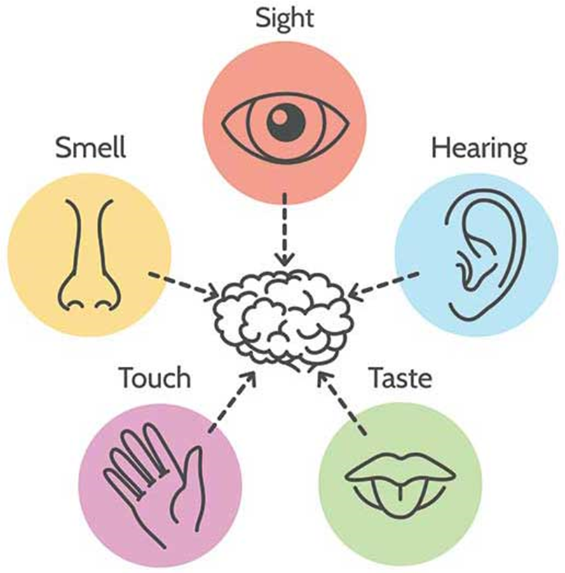
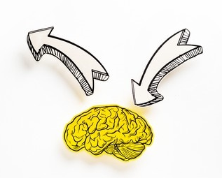

Slide 23
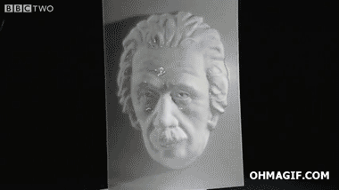

Slide 24


Slide 25
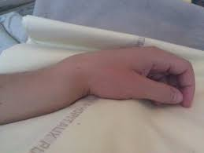

Slide 26

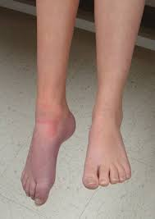
Touch
Warmth
Movement
Trust
Explanation
Goals

Slide 27
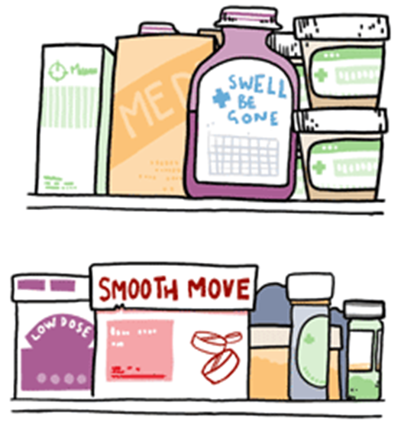
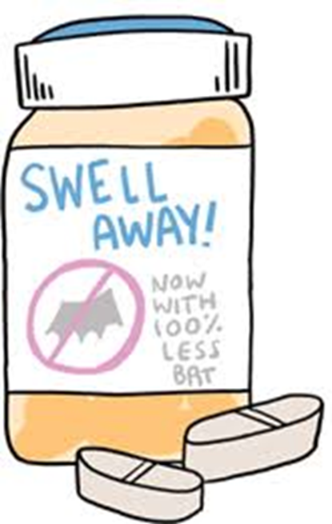
Key points - II
Be careful of a mind v body approach to pain
Pain becomes self fulfilling unless challenged
  But in the right way
The role of medication is limited

Slide 28
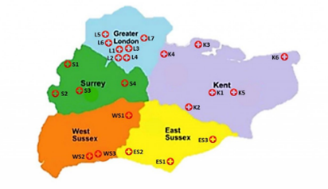
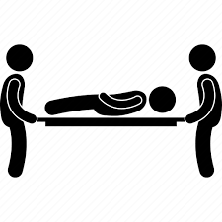
Case 2: getting it right first time
The importance of understanding and explaining pain
Ensuring a patient feels heard
Effective reassurance
Careful choice of language
Acknowledging complexity
One size does not fit all
Build a community
15yo girl – emergency referral
7mo increasing back & neck pain
Seen by 9 different teams / services
3 x MRI (and other tests)
Admitted for 10 days
  Medication
  MRI repeat
  No improvement
Referred and seen urgently

Slide 29
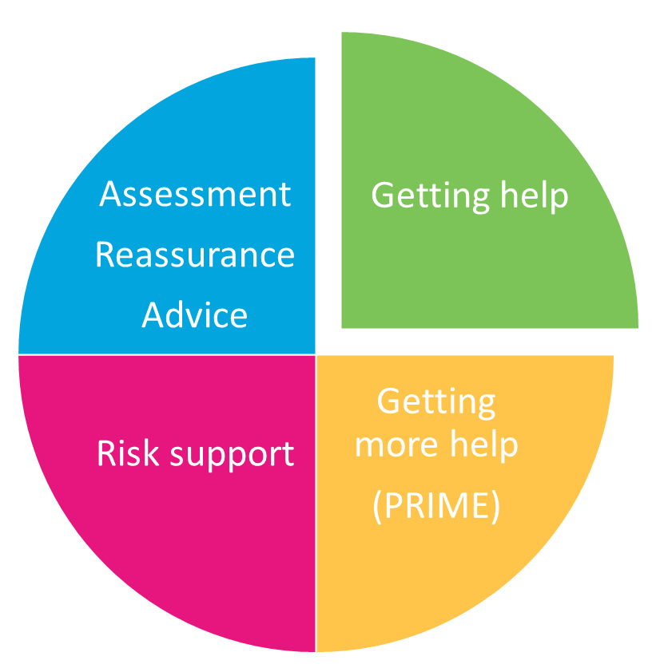
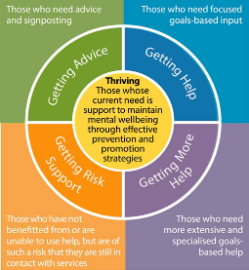
Triaged model; matching resource to need
Similar to Thrive mental health model
i-THRIVE toolkit
i-THRIVE Academy
i-THRIVE communities of practice

Slide 30
Asset based healthcare
Personal assets
Organisational processes
Community assets

Slide 31

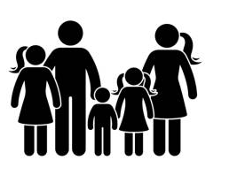
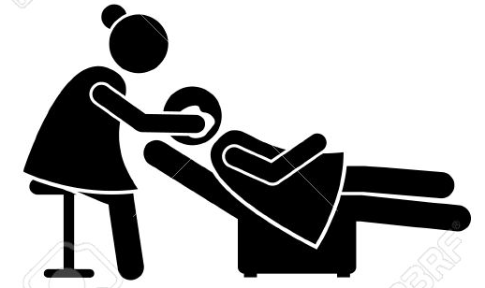

Slide 32

Regional developments
Regional connections
  >100 staff
  43 physios
Multiple strategies for
  Teaching
  Coaching
  Problem solving
= named therapists
= new therapy led pain service

Slide 34
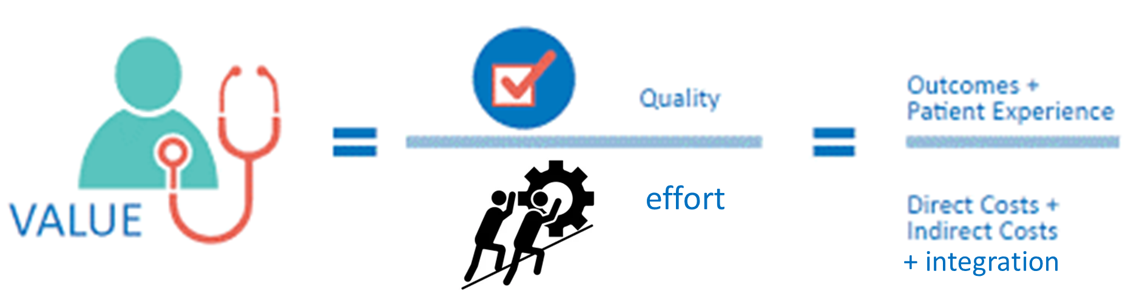
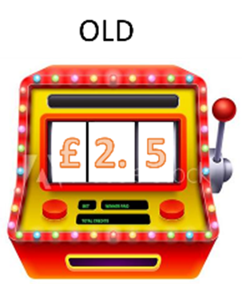

Value based healthcare
Low levels of staffing
  0.5 WTE consultant
  1 WTE physio
  1 WTE OT
  1 WTE psychologist
Reduced redundancy
  RhEvE system of care
  RhEve workshops
  RhEve regional meetings and communities of practice
Cost (millions)

Slide 35
Summary
We all have a role to play
This role needs rehearsing and developing
Not alone
  Manage as teams …. beyond organisational boundaries
  And beyond healthcare

Slide 36
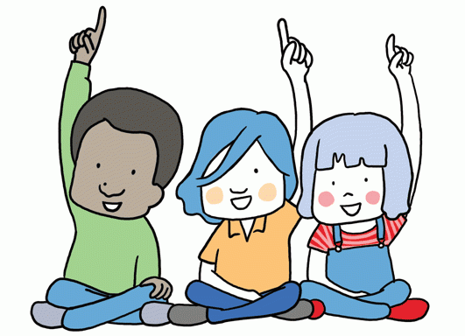

Slide 37
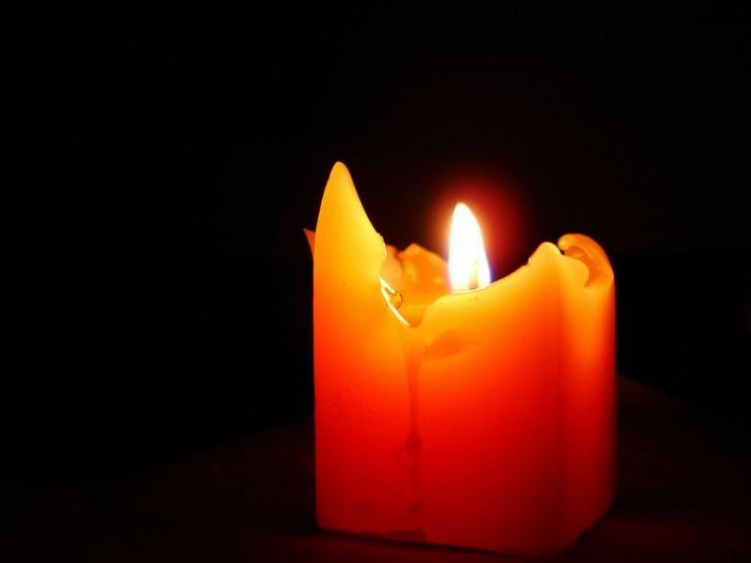

Slide 38
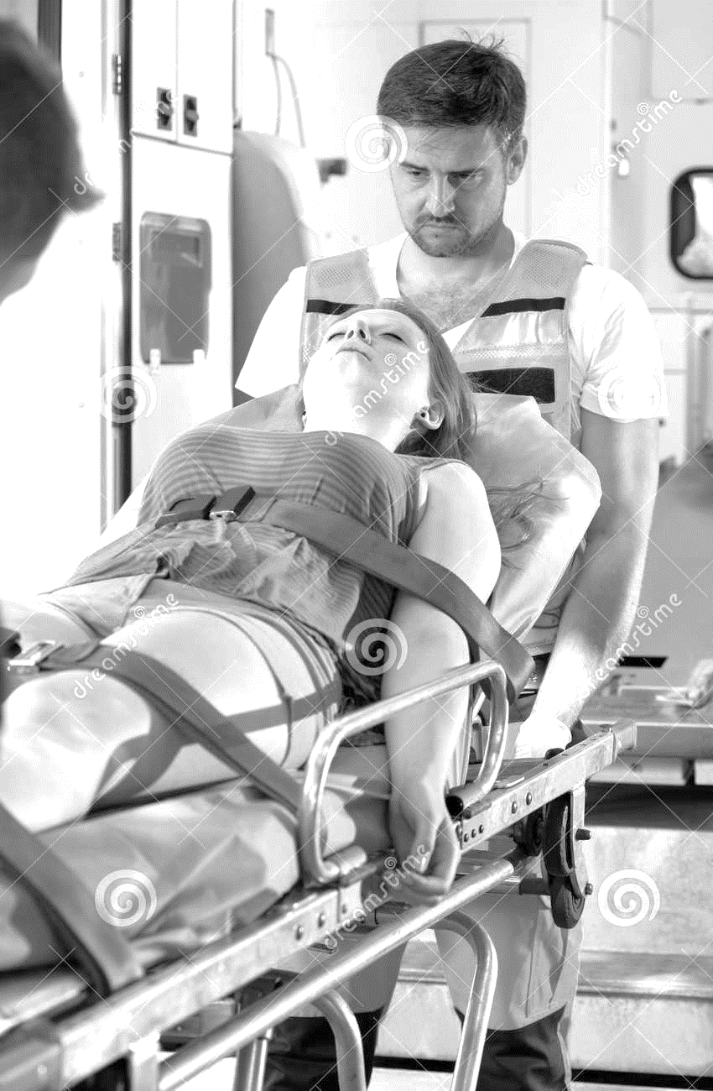

Case 2: Redundancy in current model of care
The importance of understanding and explaining pain
Ensuring a patient feels heard
Effective reassurance
Careful choice of language
Acknowledging complexity
One size does not fit all
Build a community
15yo - 7mo Hx back & neck pain
Seen by 9 different teams / services
3 x MRI (and other tests)
Admitted for 10 days
  Medication
  MRI repeat
No improvement
Referred as an emergency

