Slide 1

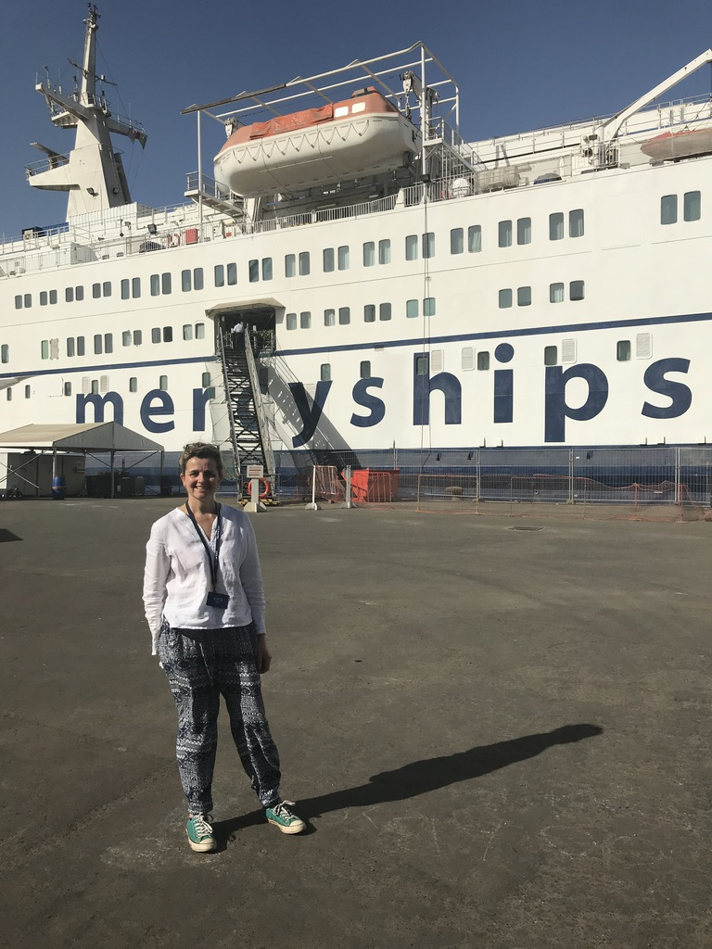
Rachel Buckingham
Children’s Orthopaedic Consultant
Oxford
(and Mercy Ships)
Notes:
Thank you to the organisers for allowing me to talk about Mercy ships, and allowing us to have a stall

Slide 2
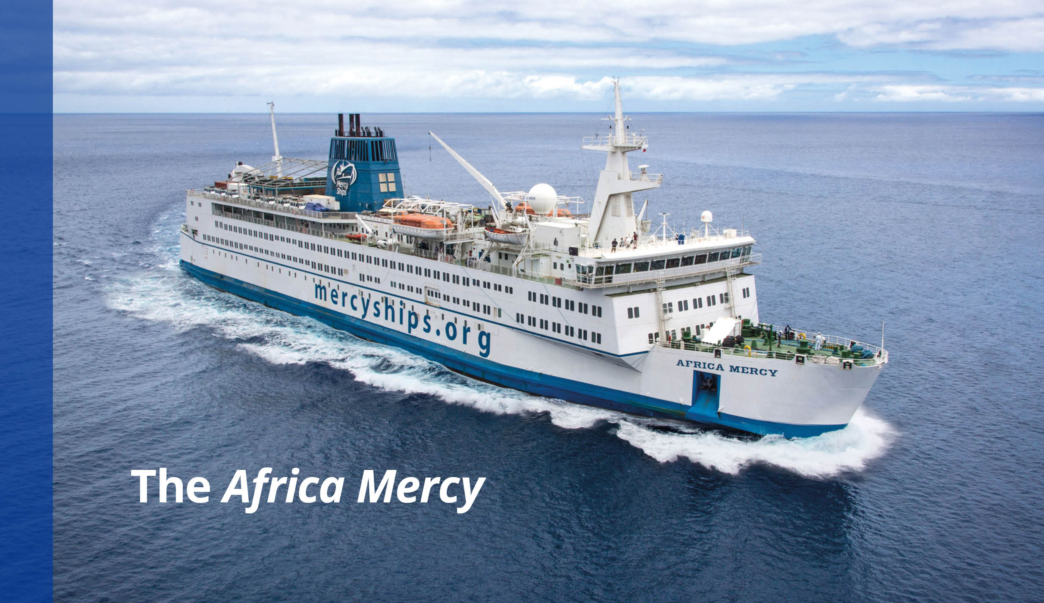
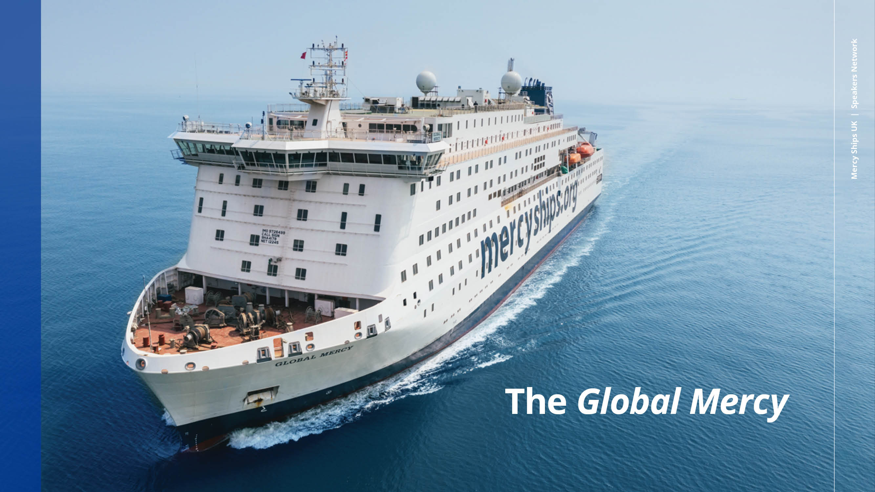
Notes:
So what is Mercy ships? Mercy ships is a Christian charitable organisation that owns the two largest non-governmental hospital ships in the world. They bring the opportunity of surgical treatment to those who would never otherwise have access to care.
Why is this necessary?

Slide 3
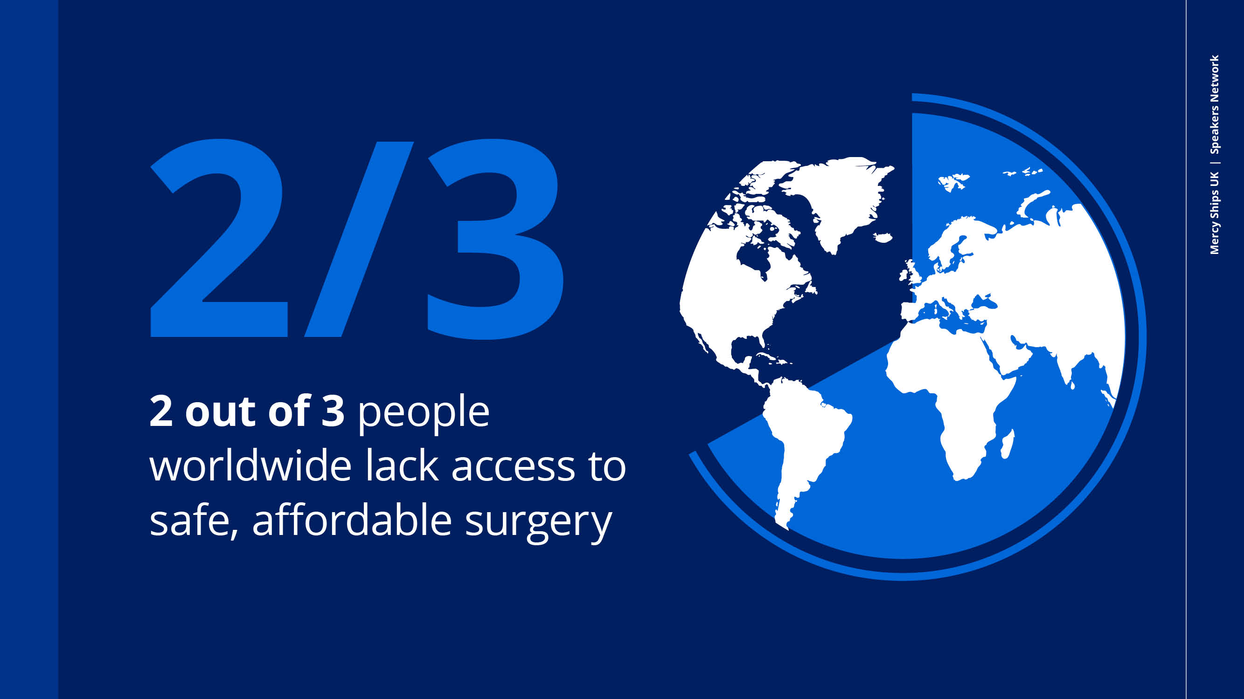
Notes:
Two out of three people on the planet , and in fact 93% in subSaharan Africa do not have access to safe, affordable surgery when they need it.

Slide 4
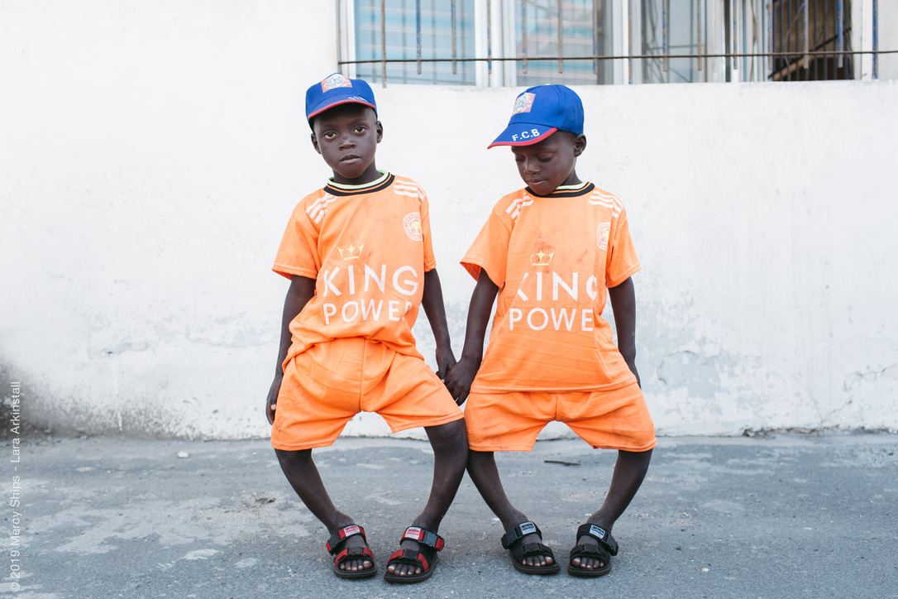
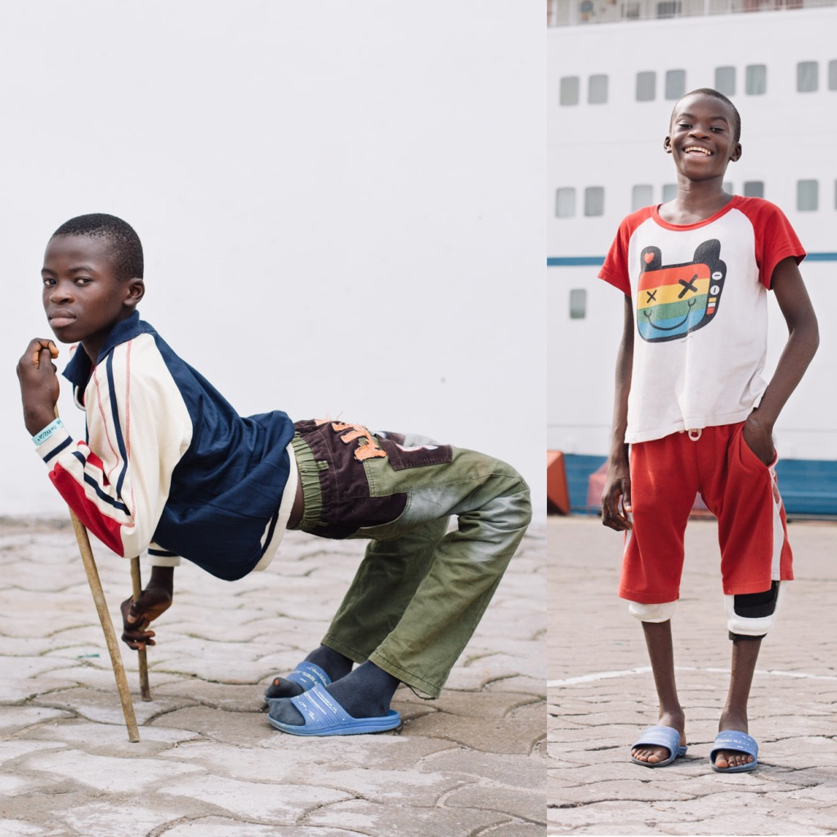
Notes:
So if you are the parents of twins Ousseynou and Assane with rickets
Or Ulrich with untreated congenital knee dislocation
And you are not able to afford treatment, then life looks pretty beak.

Slide 5
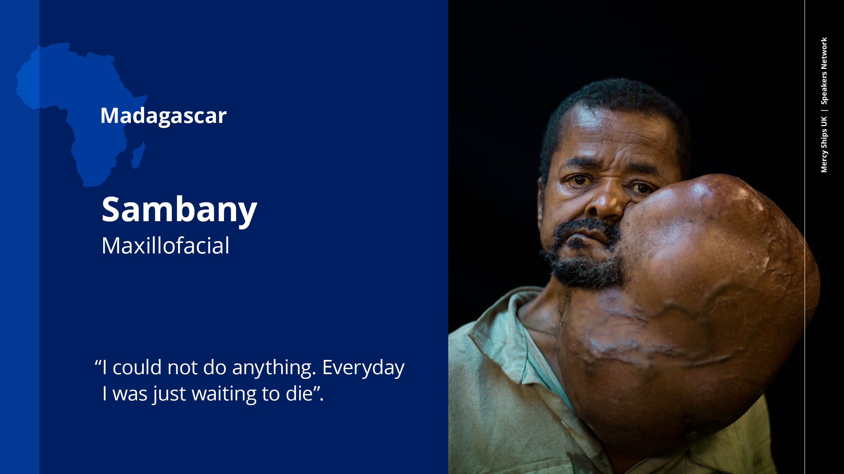
Notes:
This is Sambany. For 36 years, this tumour defined his life. He became isolated and weak, and hopelessness defined his life as he merely felt he was waiting to die.
That is until one day he heard of Mercy Ships coming to Madagascar and he was determined to seek help. It took six of his friends two days to carry Sambany from his remote village to a main road as he was two weak. He then endured the painful six-hour taxi ride to get to the dock.
He was determined to have the risky surgery, despite being told of the danger that he might not come out alive.
He responded, “I’m already a dead man.” I’ll tell you about his outcome later, but just to let you know that he had his surgery and needed 10 units of blood. There is not much storage space on a boat, so where do you think this blood came from?

Slide 6
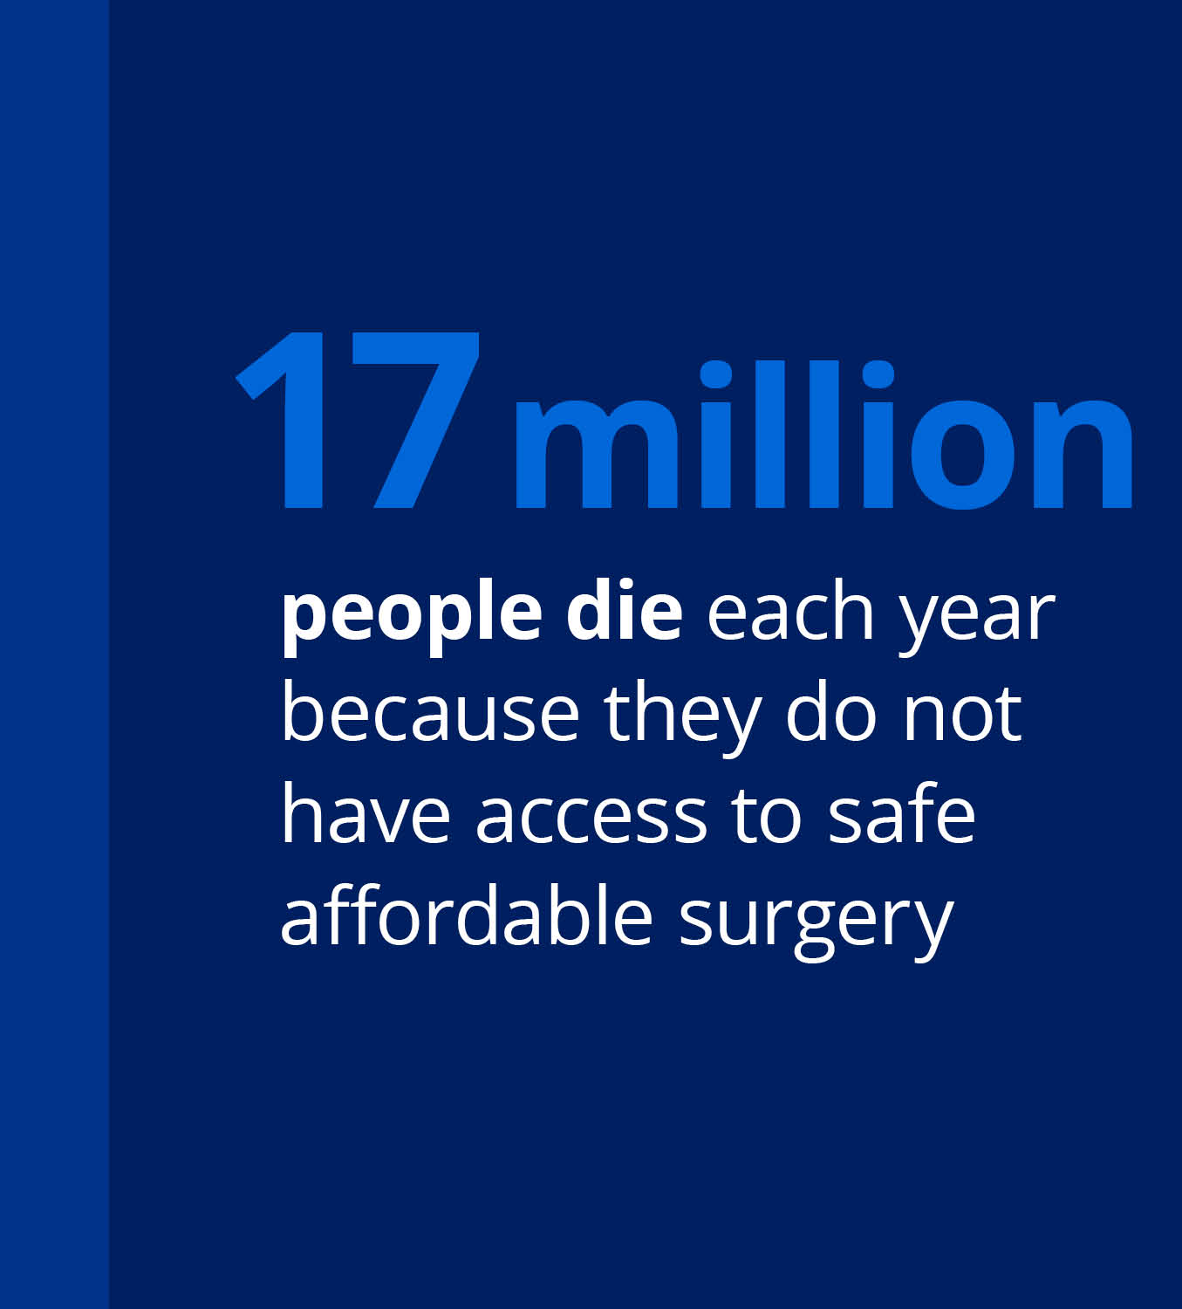
>(HIV+Malaria+ TB) x3
Notes:
Around the world 17 million people die each year because they do not have access to safe affordable surgery.
That’s more than three times the annual number of people who die from HIV, Malaria and TB combined. Around 6 million have died in two years of the Covid pandemic.
This is the global surgery crisis.

Slide 7
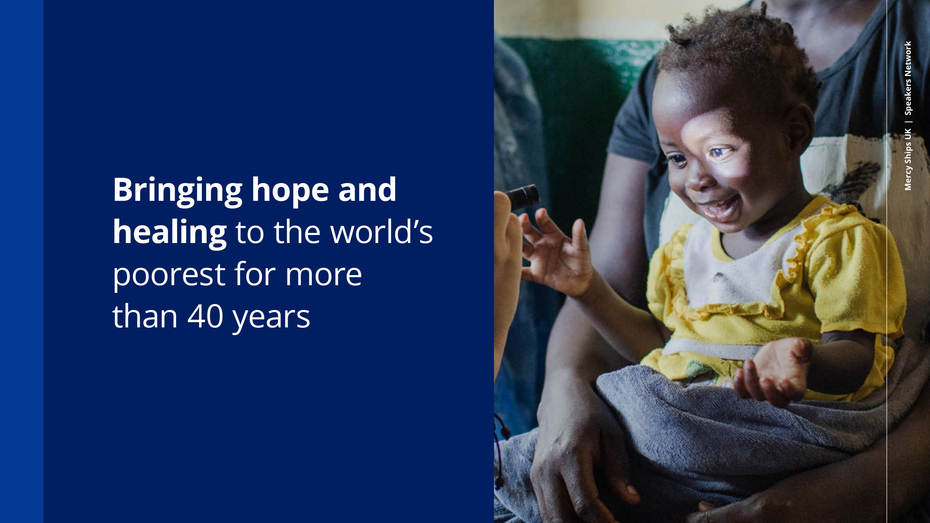
Notes:
Mercy ships has been bringing hope and healing to the worlds poorest for the past 40 years. At the invitation of the government of the host nation the ship docks for 10-12 months,
the Africa Mercy has 5 operating theatres and – a volunteer crew of 450 people who come from over 40 countries. The newest in our fleet – the Global Mercy - is even bigger with a crew of over 900, 6 theatres, a student academy and 682 seat auditorium. The staff are not paid, infact we pay our own flights and living costs when on board. Volunteers spend anywhere between 2 weeks and 30 years on board.

Slide 8
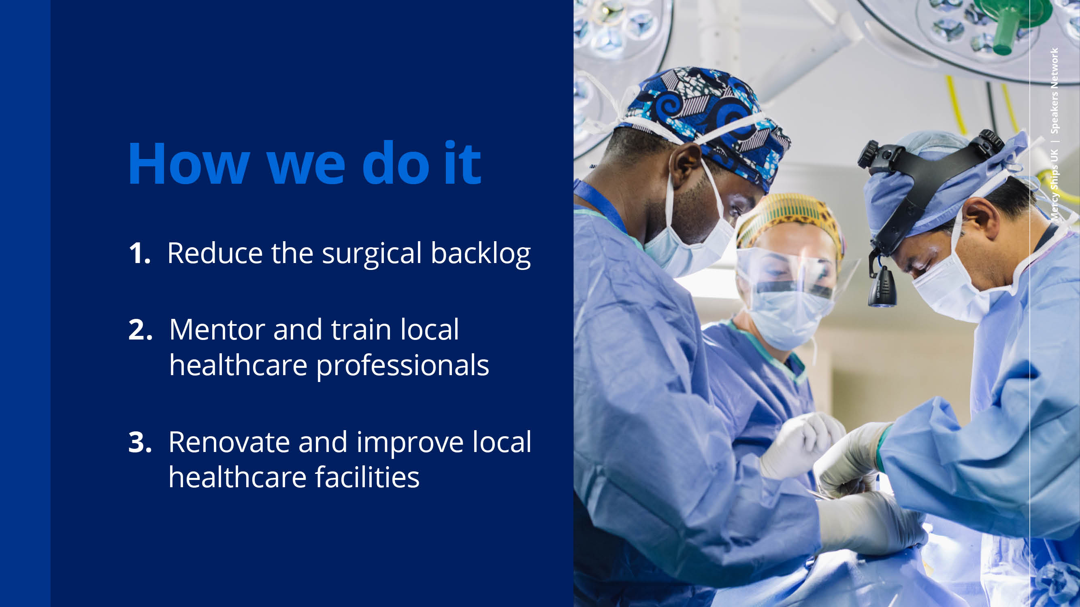
Notes:
In each country visited, the ships aim to reduce the surgical backlog, mentor and train local healthcare professionals, and renovate and improve local facilities.

Slide 9
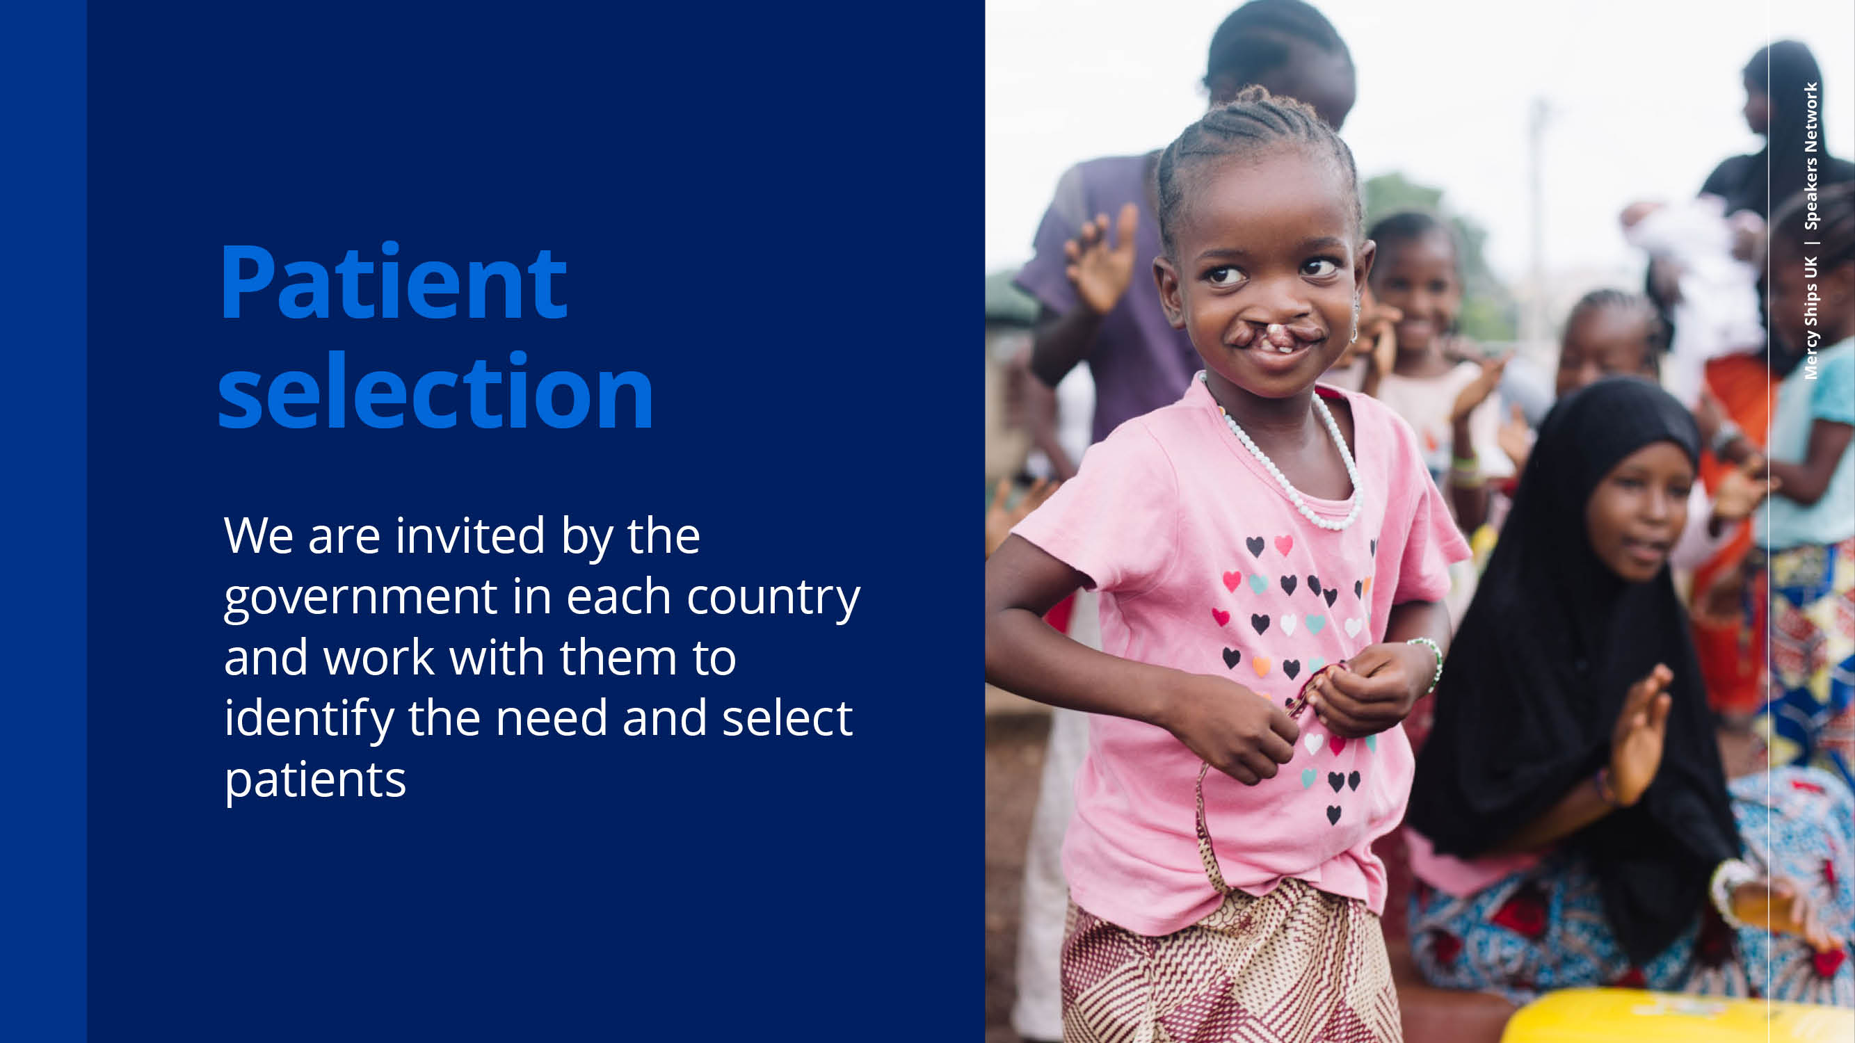
Notes:
Patient selection is crucial, and it is done in partnership with governments and partnerships on the ground and involves awareness campaigns in district health posts, health centres and regional hospitals to make sure everyone is aware of the surgical opportunities available with Mercy Ships.

Slide 10
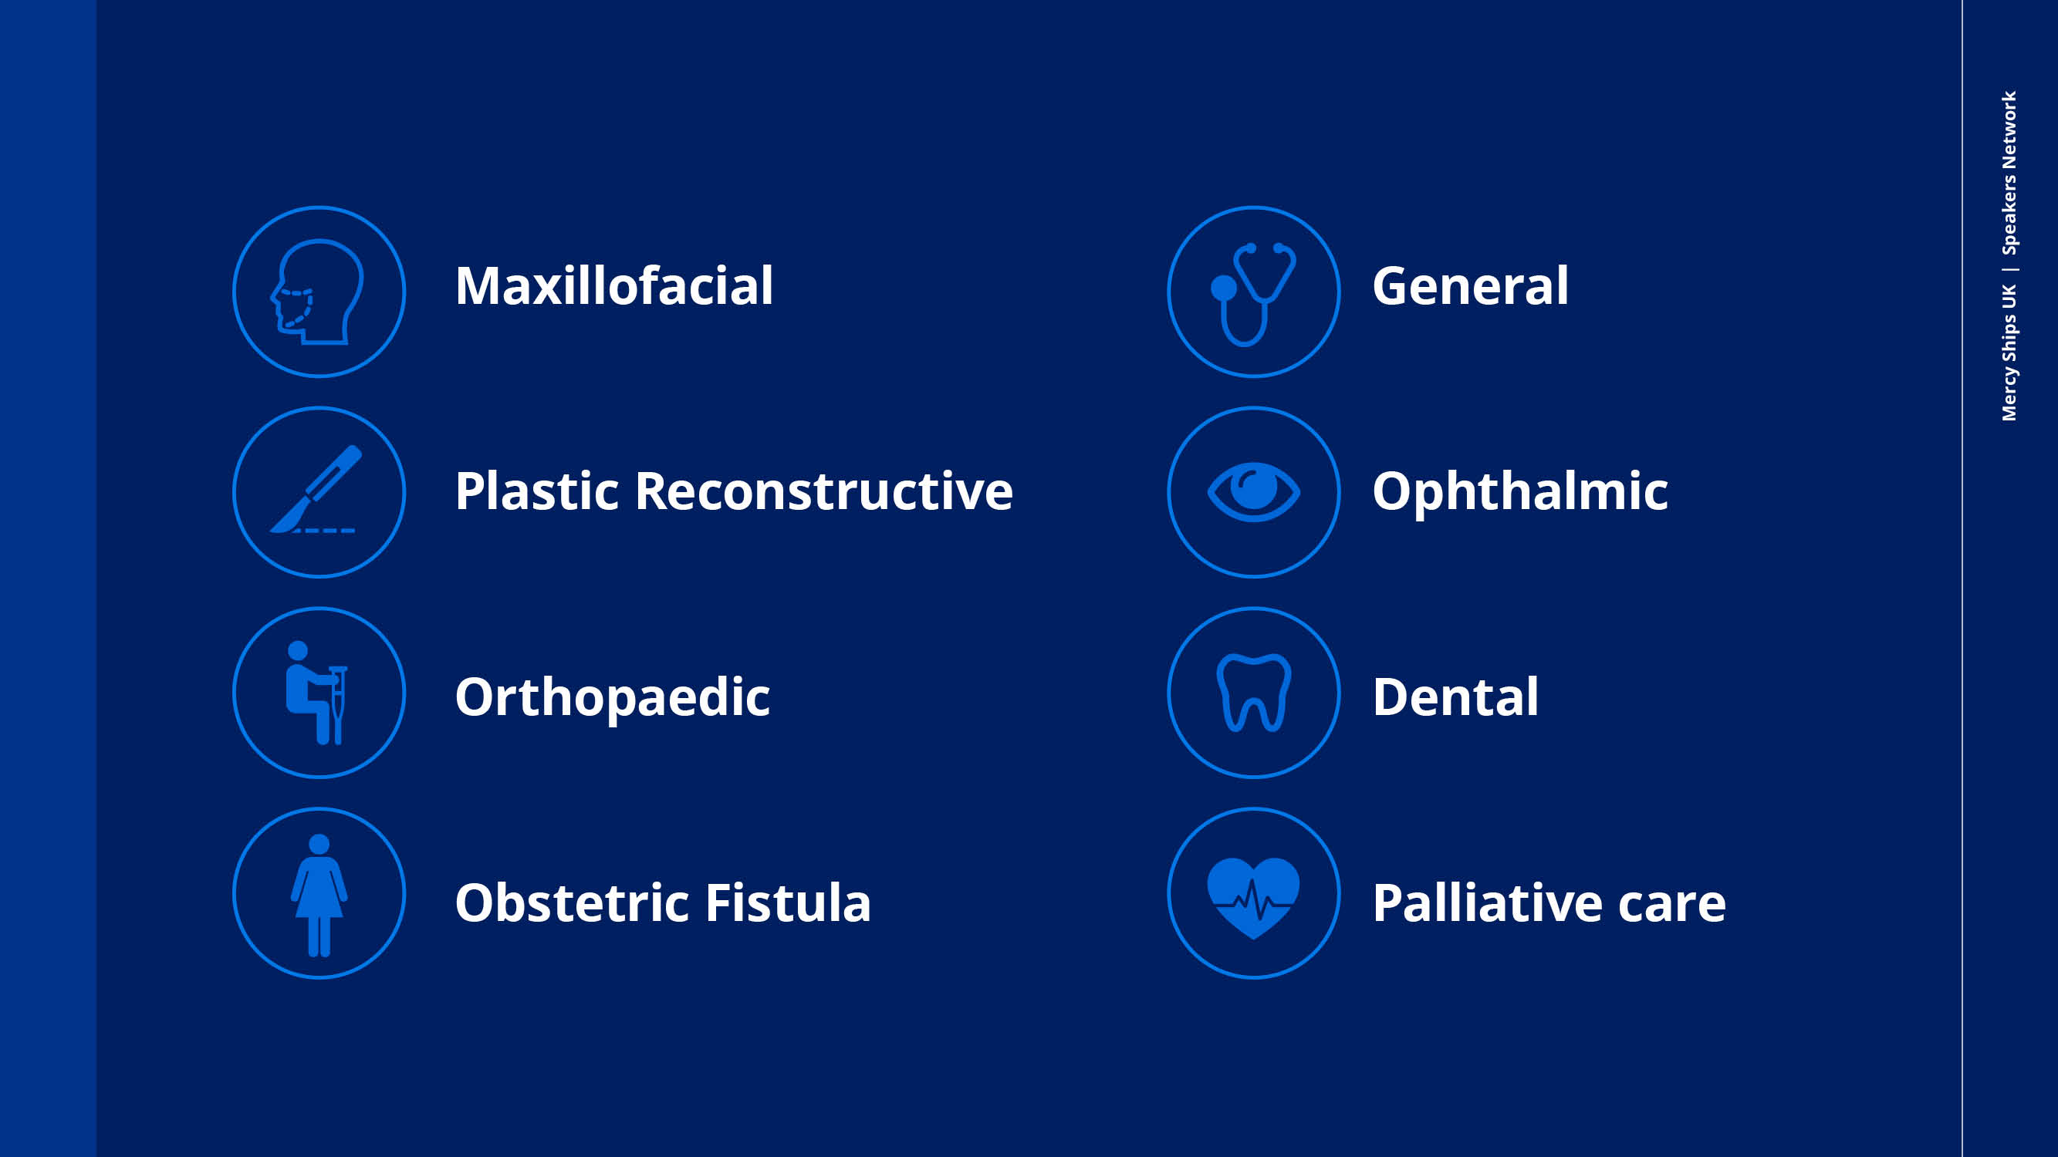
Notes:
Mercy Ships provides surgery for many conditions, and crucially it is free.

Slide 11
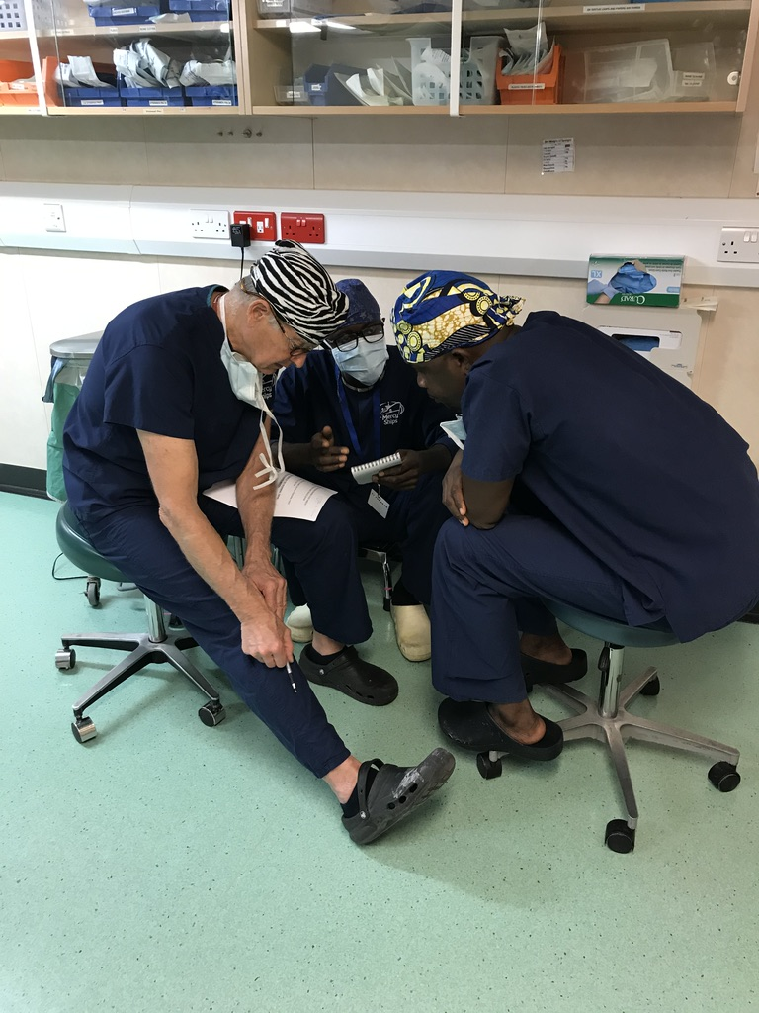
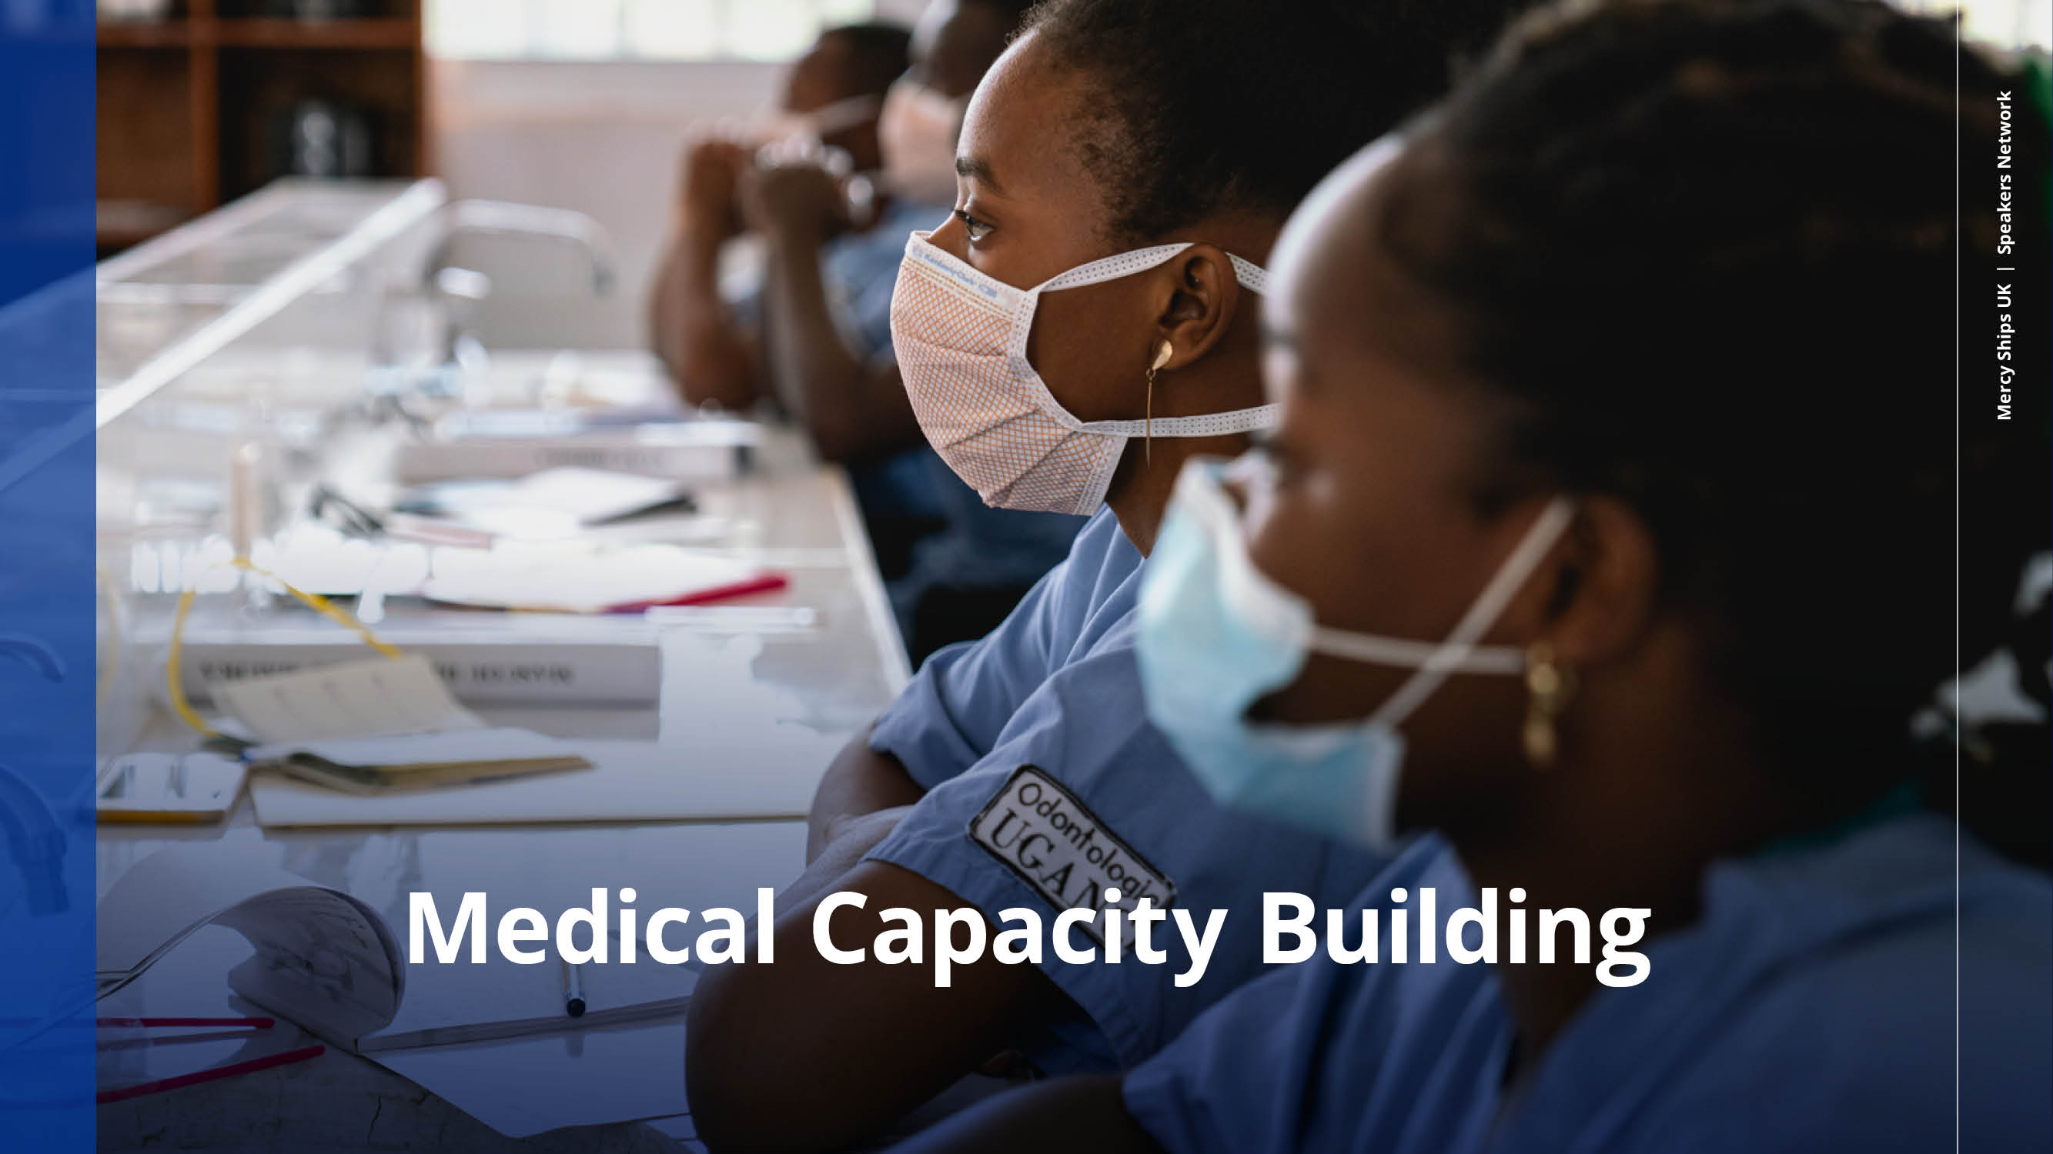
Notes:
A lot of training goes on for local healthcare professionals, both on and off the ship
Support is even given in improving nutrition through the Food for Life programme that teaches farmers sustainable farming methods so they can work to improve their country’s nutrition.

Slide 12
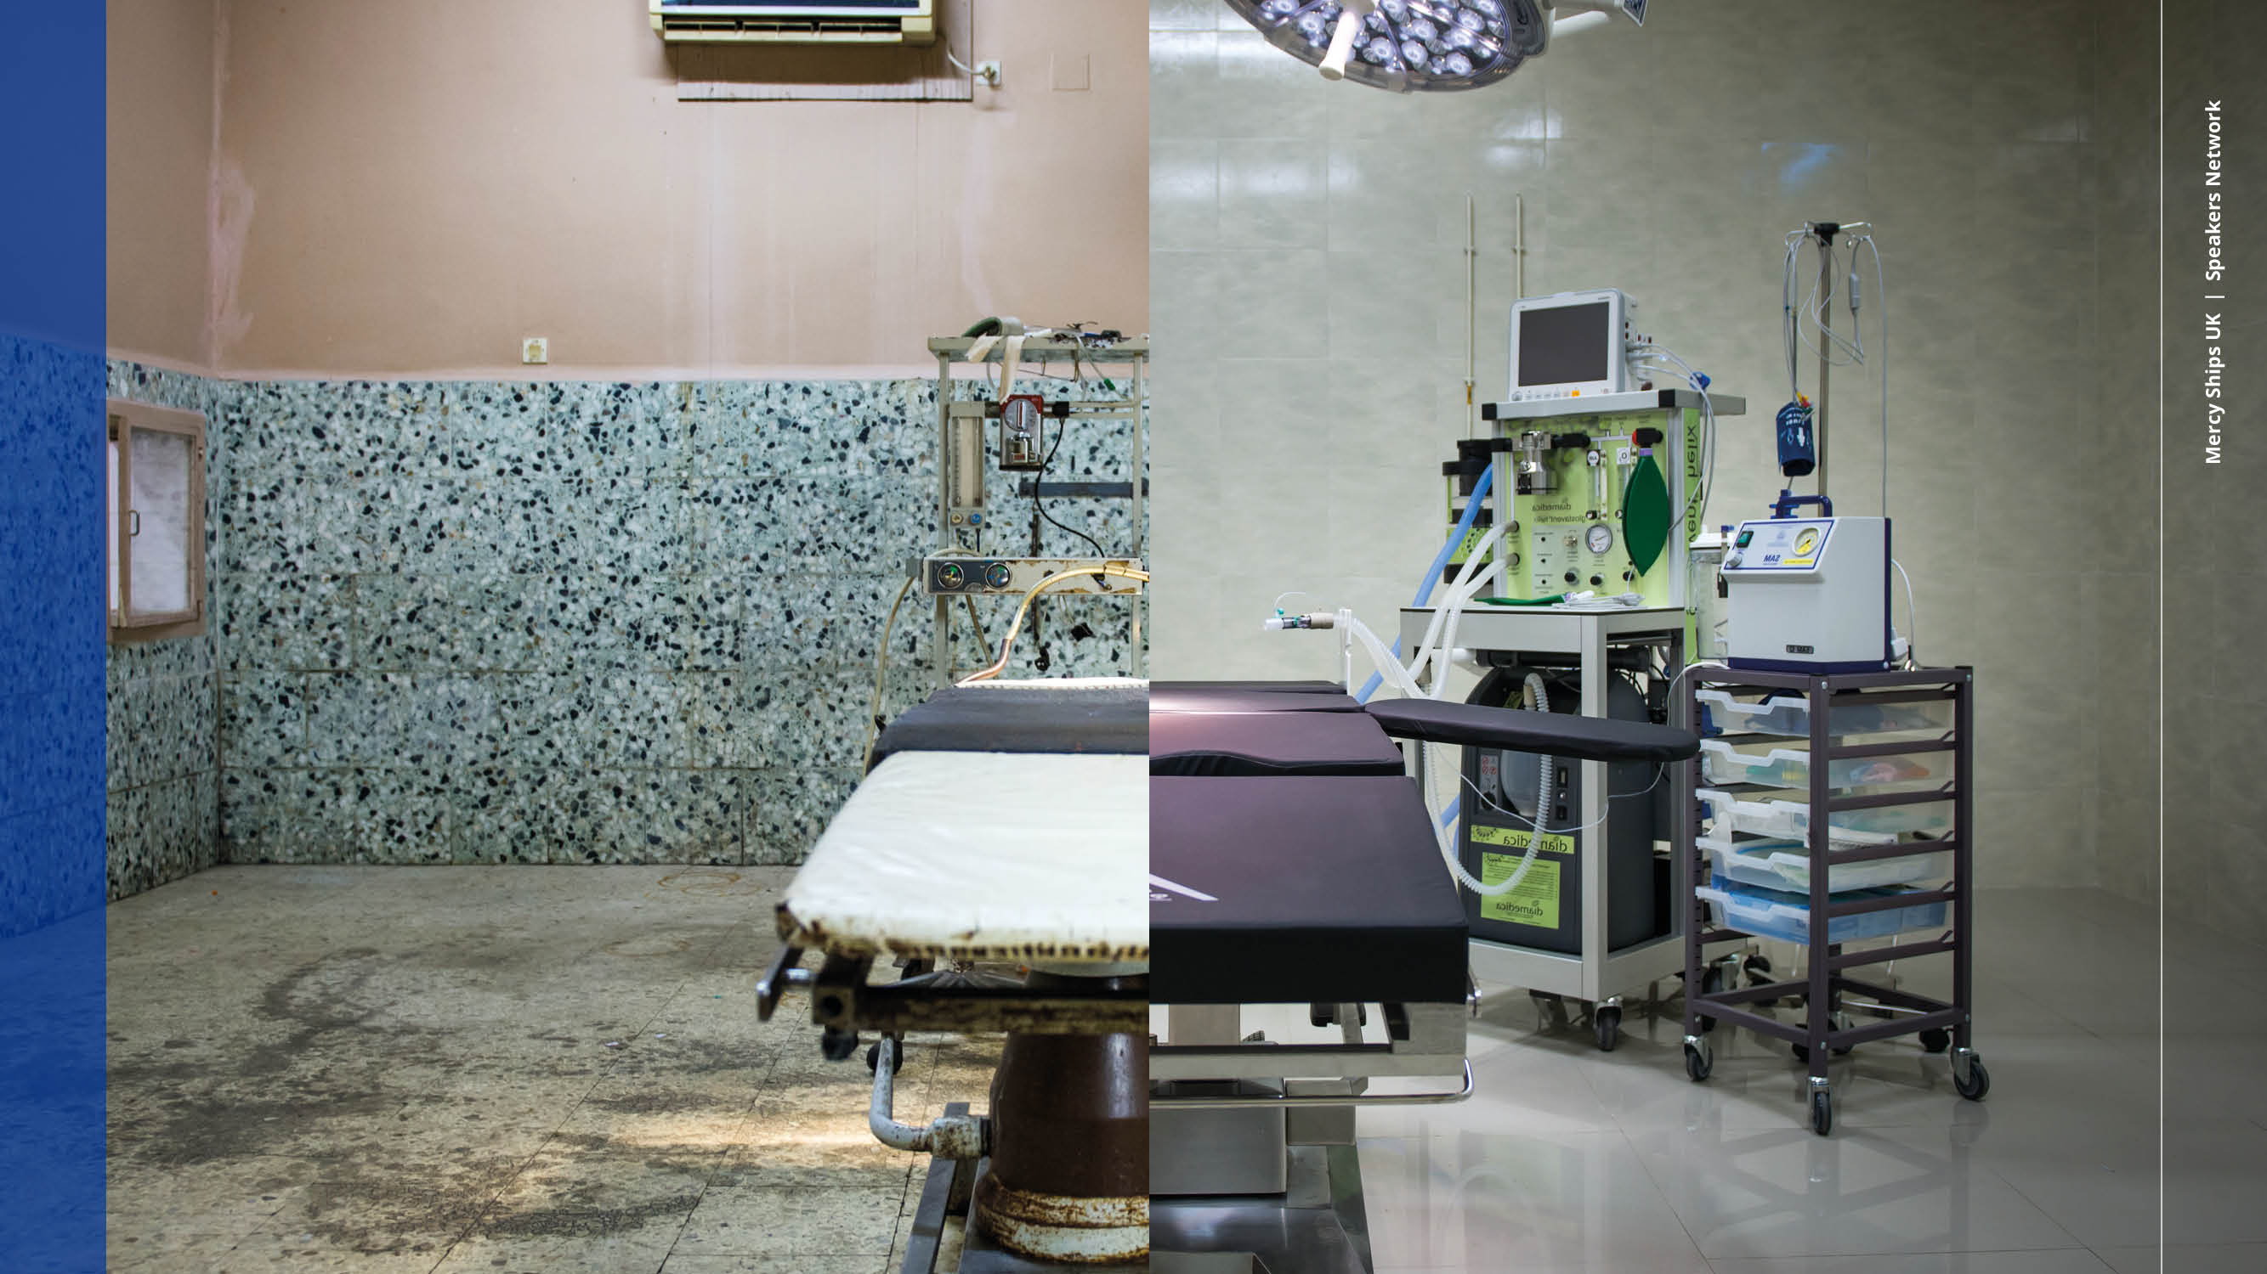
Notes:
Mercy Ships renovates local facilities like these, donates the equipment and trains local teams to use and look after it

Slide 13
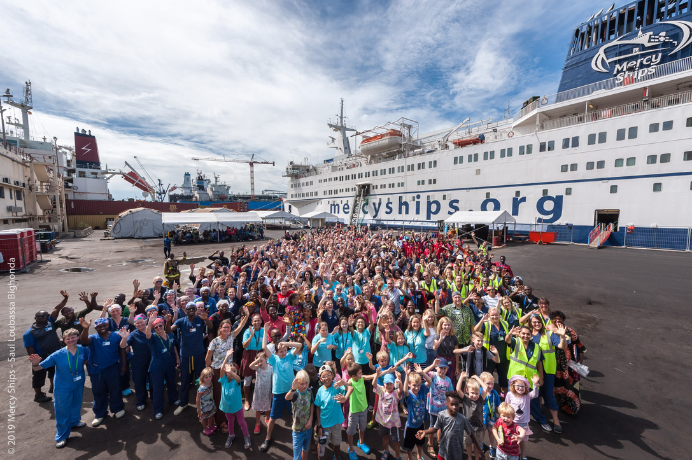
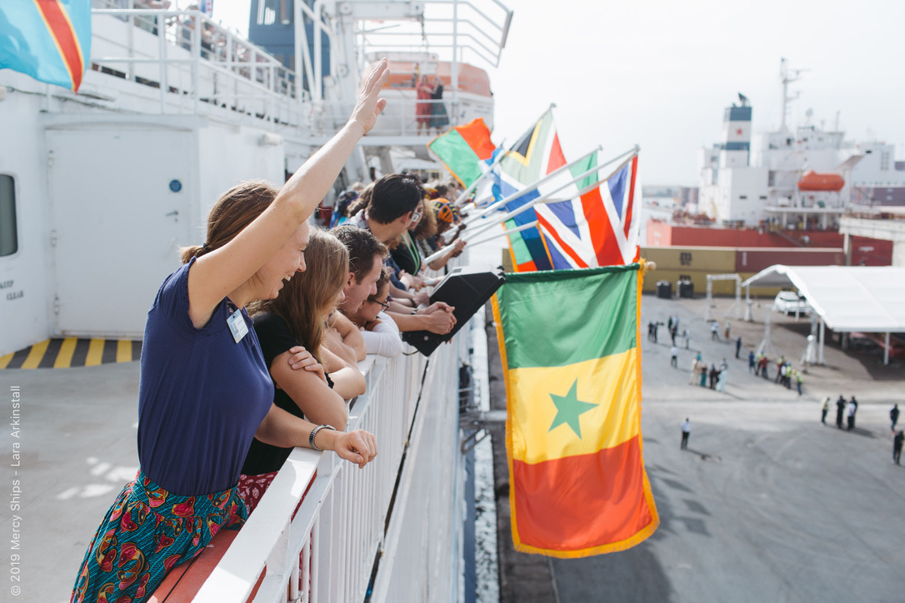
Senegal 2019
Notes:
So my first trip with Mercy ships was to Senegal in 2019 and I went for two weeks

Slide 14
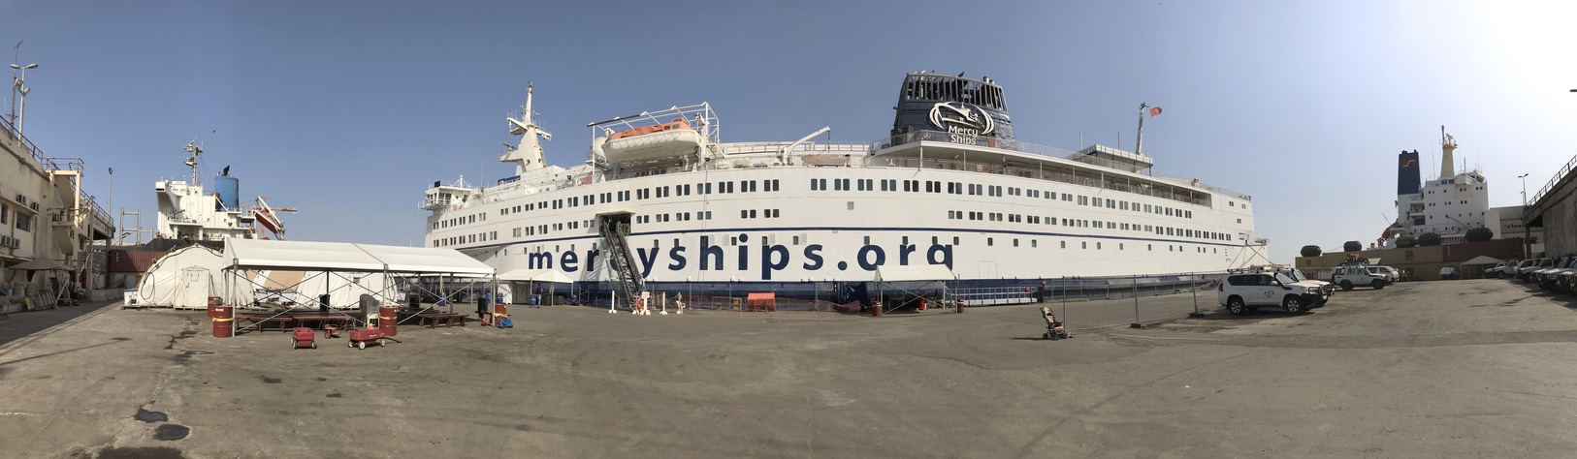
Notes:
We were docked in the port at Dakar

Slide 15
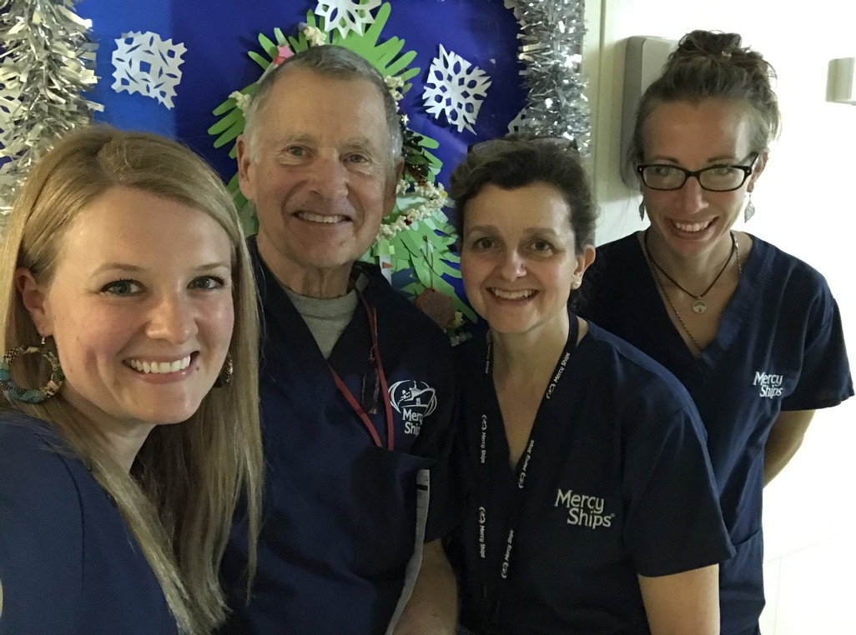
Notes:
I found myself working with an amazing team. They always put two surgeons together, and if you are new they will put you with someone who has done been before. I worked with Frank Hayden, and American surgeon with 10 years of experience working with Mercy ships.

Slide 16
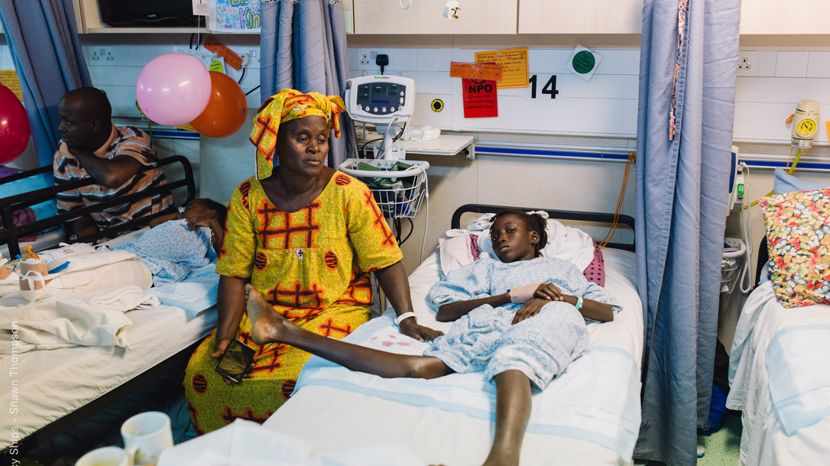
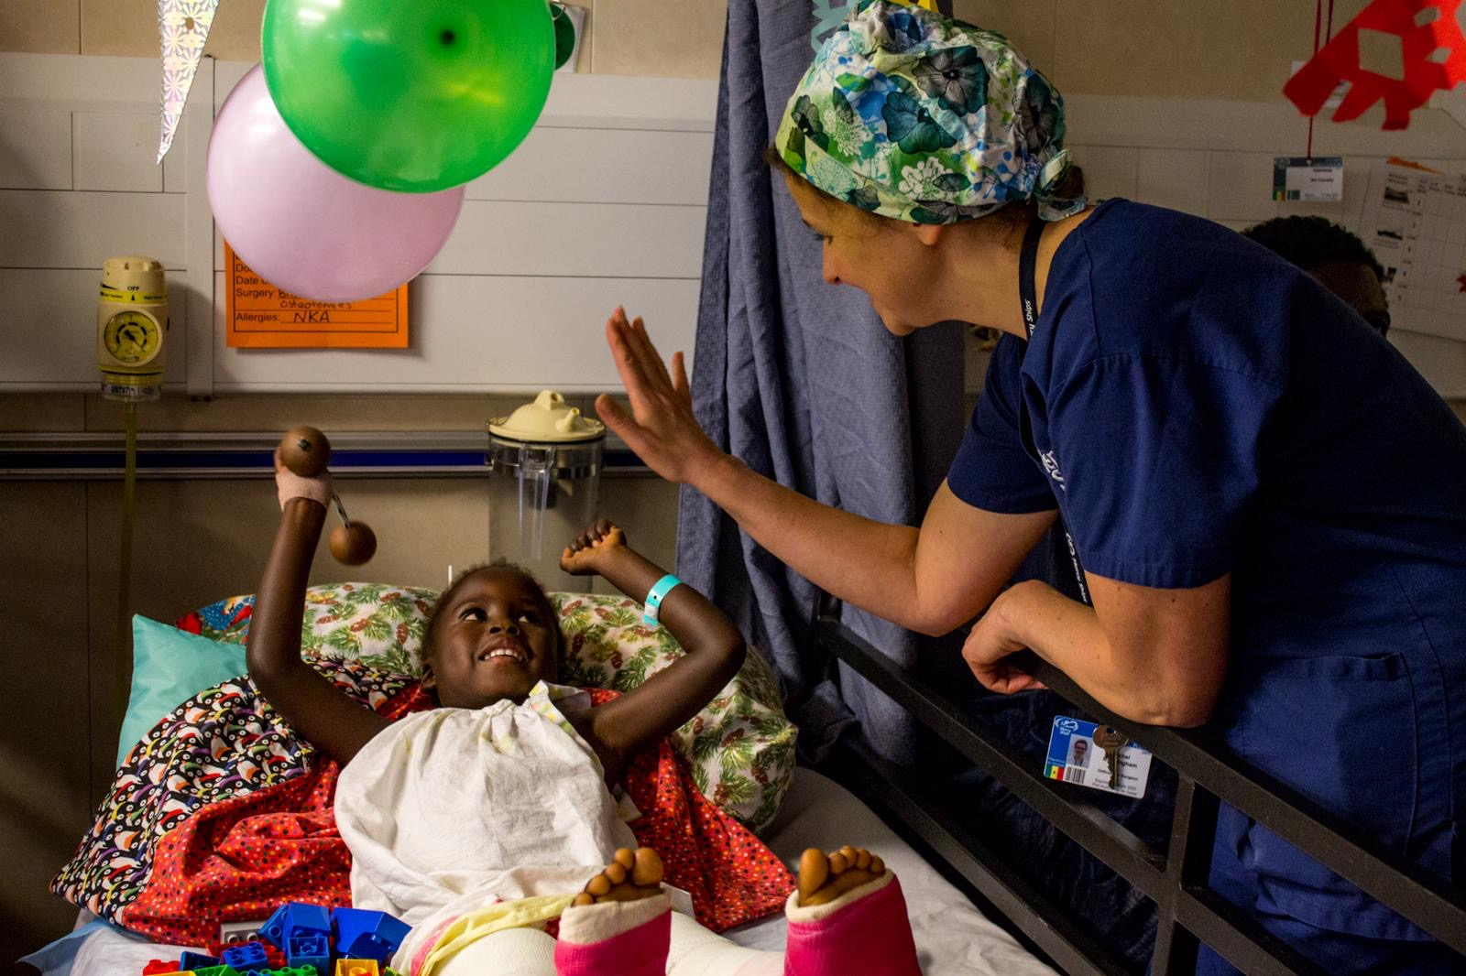
Notes:
The wards are on the portside of the ship. There is very little space between the beds and the parents sleep underneath!

Slide 17
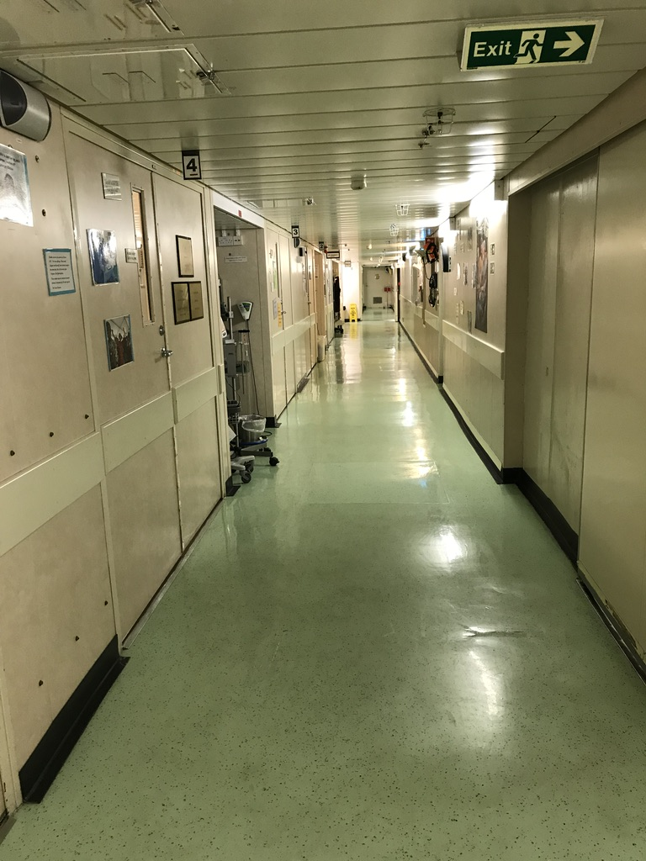
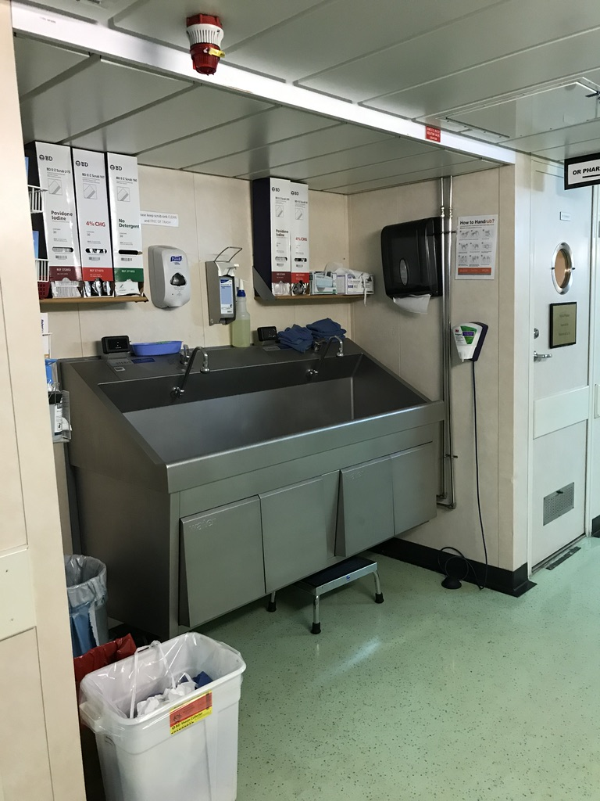
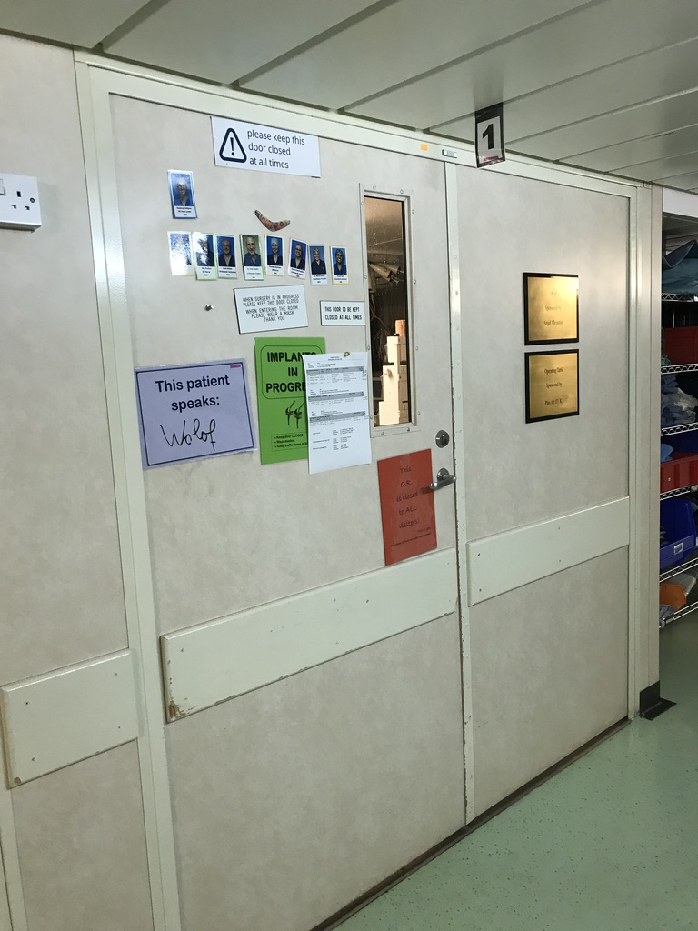
Notes:
The operating theatres, labs, and radiology are on the starboard side.

Slide 18
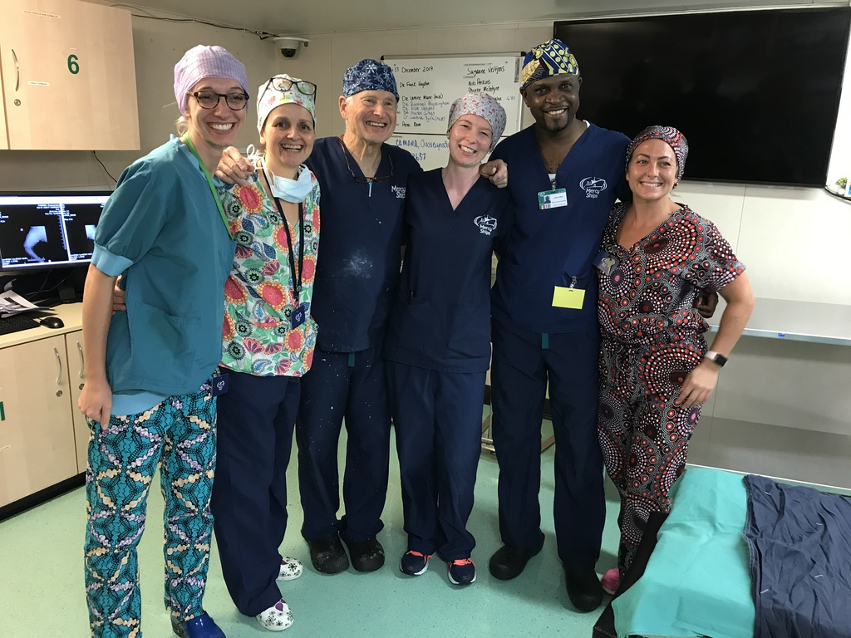
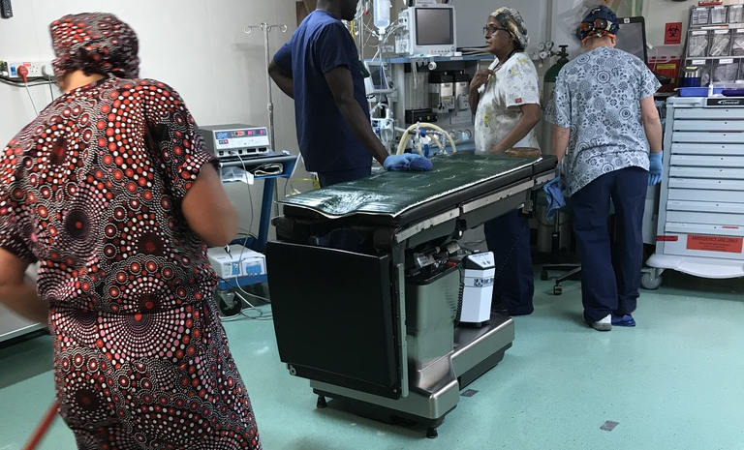
Notes:
We had an incredible team of nurses

Slide 19
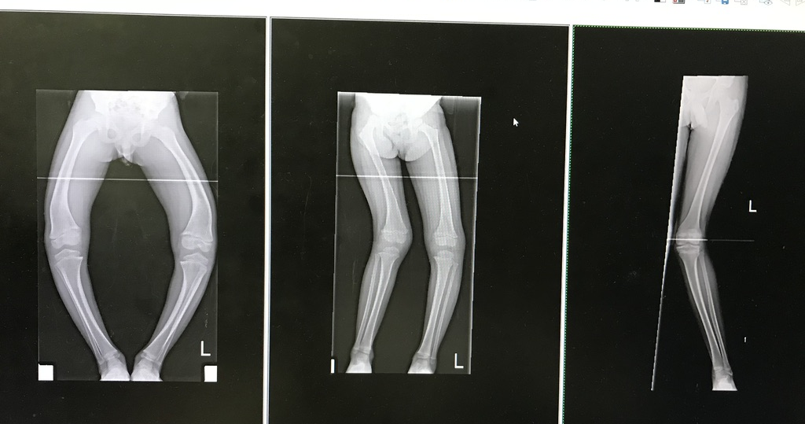
39 children in 2 weeks
Notes:
During 10 days in theatre Frank and I operated on 39 children, mostly bilateral osteotomies to correct deformities. This was the work for one day

Slide 20
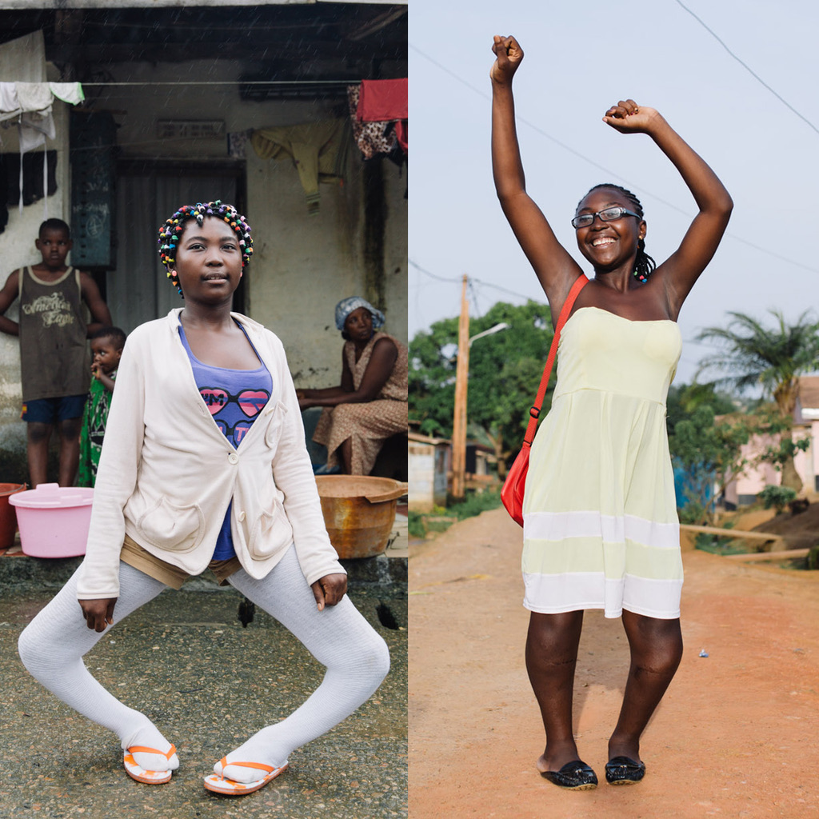
Challenges
1-shot opportunity
Only 3 month follow up
No option of future implant removal
High risk of infection
No second surgery
Opportunities
Professional team with a ‘can-do’ attitude
Very well equipped theatres
Notes:
There are big challenges to this kind of work.
You’ve basically got a 1 shot opportunity, limited follow up, high risk of infection and no option for future implant removal.
On the other hand there is an amazingly professional team of people with a real ‘can do’ attitude.
So the answer to the implant issue, is that we barely put in any metal

Slide 21
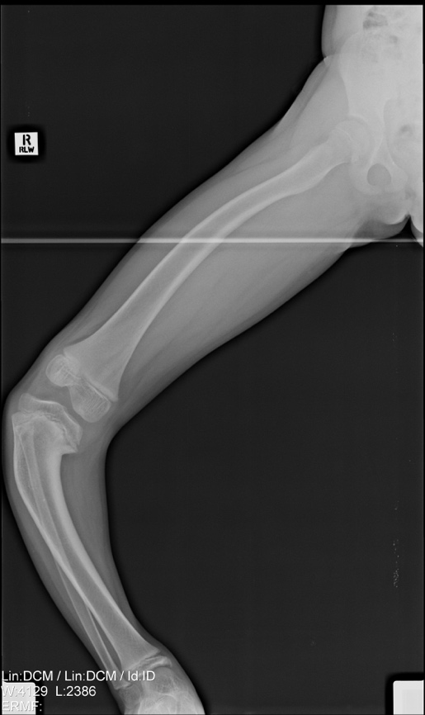
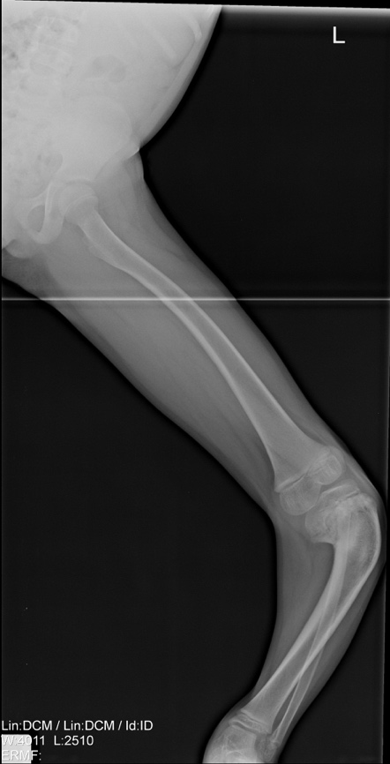
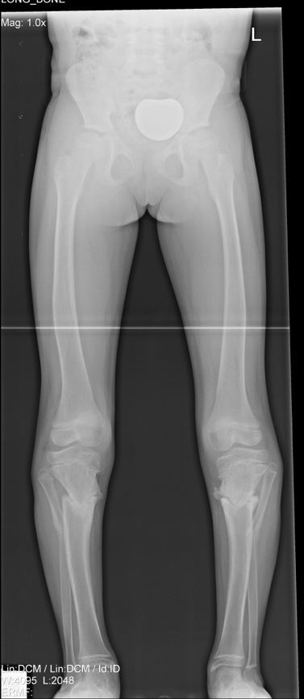
Notes:
I’m going to briefly tell you about this proximal femoral osteotomy that Frank Haden designed.

Slide 22
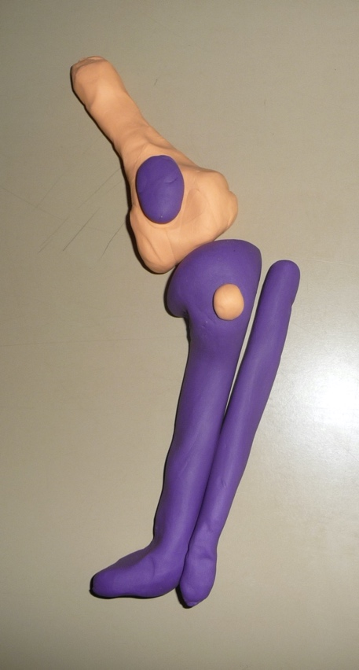
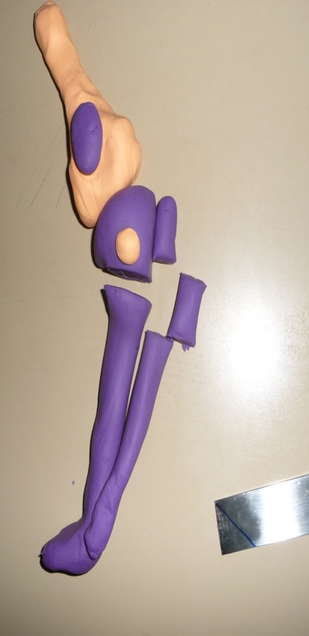
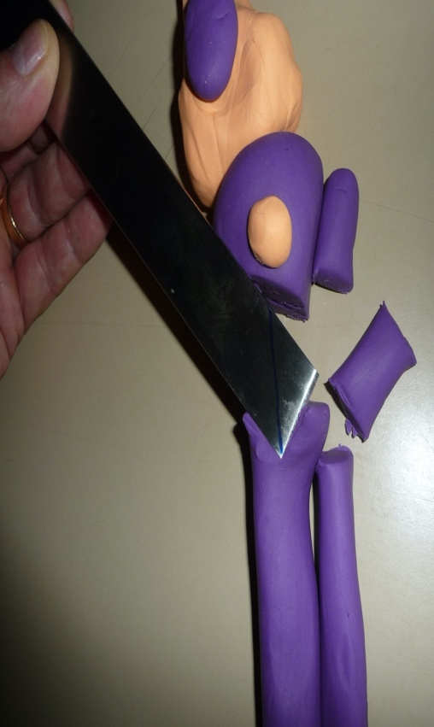
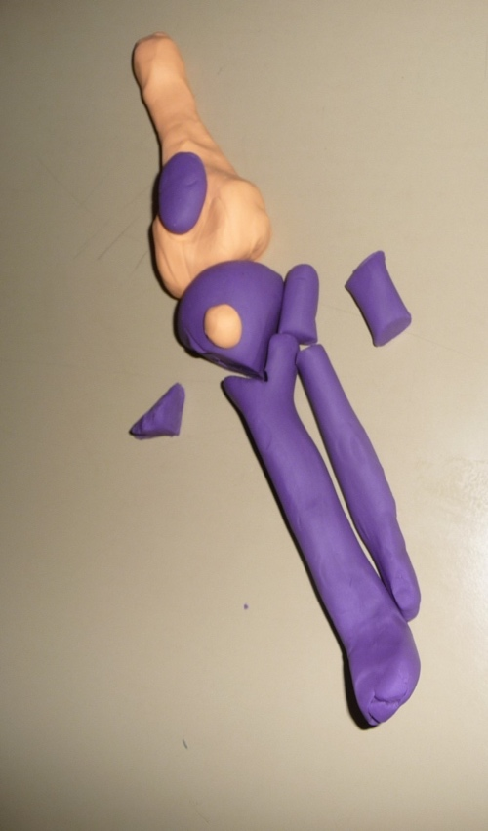
Haydon osteotomy
Notes:
So a section of fibula is removed and an osteotomy performed of the tibia. The knee is then flexed and the lower leg rotated to correct the rotation. A notch is then cut in the distal cut surface of the tibia to accept the corner of the proximal tibia which locks into position.

Slide 23
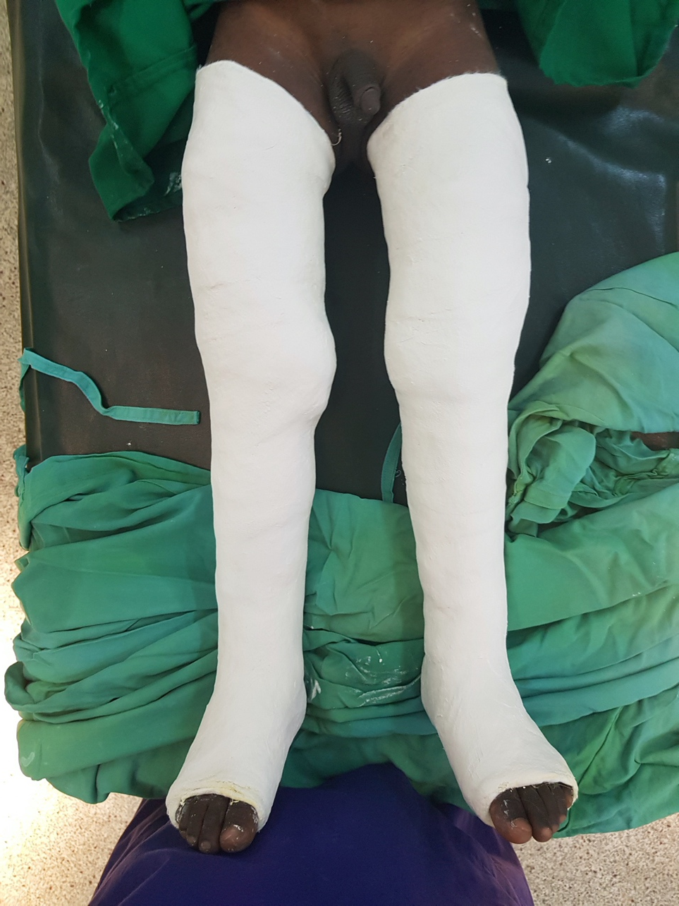
Overwrap with fiberglass after 3 to 5 days then mobilize full weight bearing
Check x-ray when weight bearing
Wedging of cast where required then re-xray
Change cast at 3 weeks and xray
Remove cast at 6 weeks if healed
Intense therapy for several weeks
Notes:
The patient is then put into long leg casts and mobilised fully weight bearing at day 3-5. long leg xrays are then taken to see if the casts need to be wedged.
Total cast time is around 6-8 weeks depending on healing. The patient is given lots of therapy, and years supply of vitamin D.

Slide 24
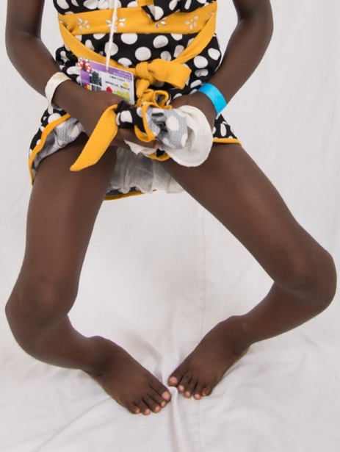
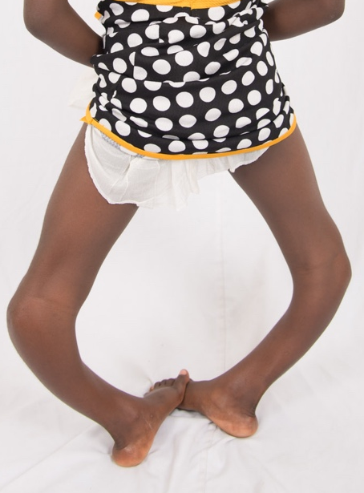
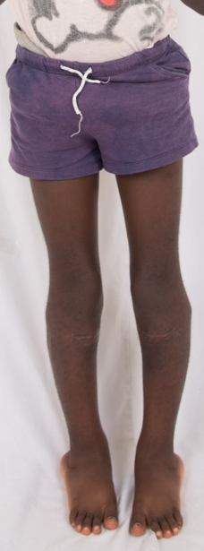
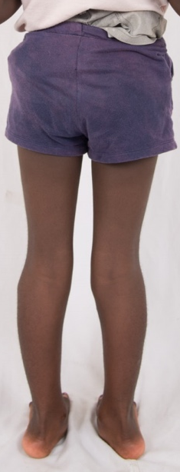
Notes:
And that’s how legs like these, become straight

Slide 25
Audit of the Hayden Osteotomy
208 tibial valgisation osteotomies were performed in 124 patients between 2013 and 2017.
mean age at time of surgery was 8.4 (2.9 to 16.9)
60 patients (48.4 %) were diagnosed with Blount´s disease, 45 (36.3 %) with rickets, 12 (9.7 %) with idiopathic genu varum and 7 (5.6 %) with diseases of another aetiology
The last long leg weight-bearing anteroposterior radiograph was taken 13.4 (5.9 to 28) weeks postoperatively
Mean preoperative mechanical tibiofemoral angle was 42.1° varus (range: 85° – 12° varus). Mean postoperative mechanical tibiofemoral angle was 4.3° varus (range: 30° varus – 13° valgus).
Notes:
An audit of 208 of the Hayden osteotomies done at an average age of 8.4, showed that 48% of patients had Blounts disease and 36% had rickets with the remaining having other aetiologies. The last radiographs were taken on average 13.4 weeks post op.
The mean pre-op mechanical tibiofemoral angle was 44 degrees varus, and post operatively it was 4.3 degrees. So there were some undercorrections,

Slide 26
Notes:
However if you start like this, then even with an undercorrection the surgery looks pretty successful!

Slide 27
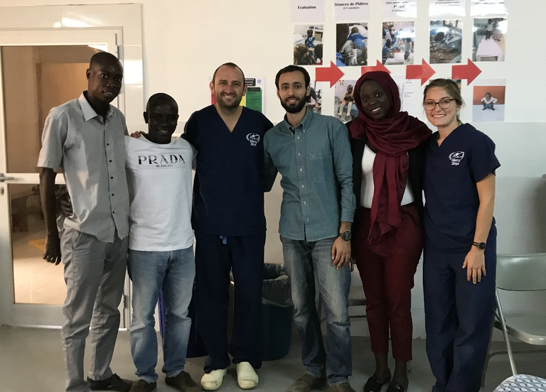
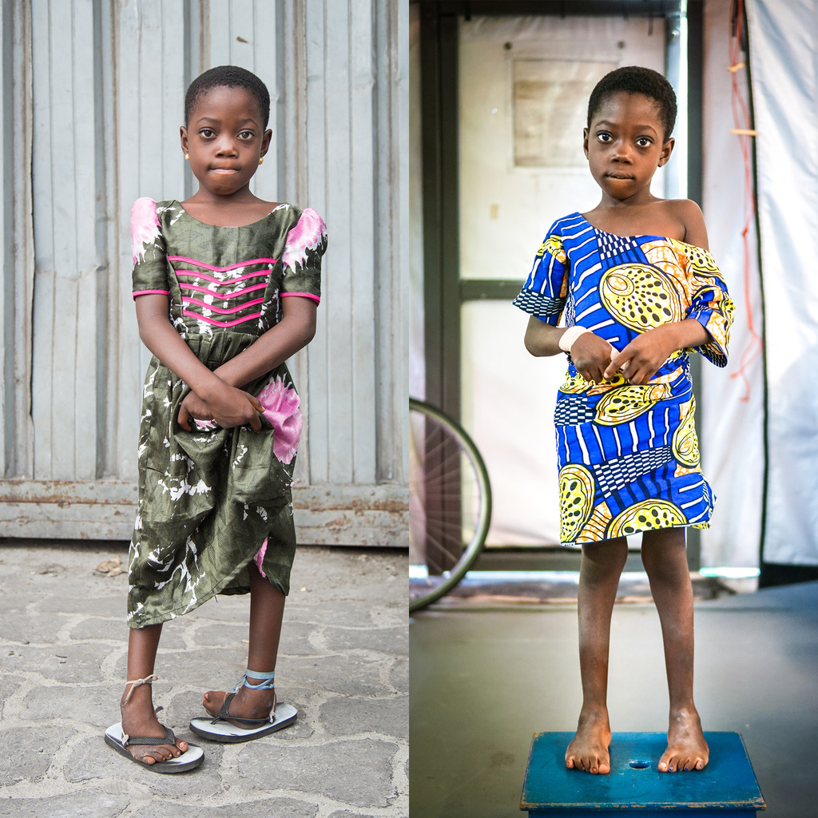
Notes:
Mercy ships also runs a comprehensive ponseti treatment program for babies and older children with training of local teams

Slide 28
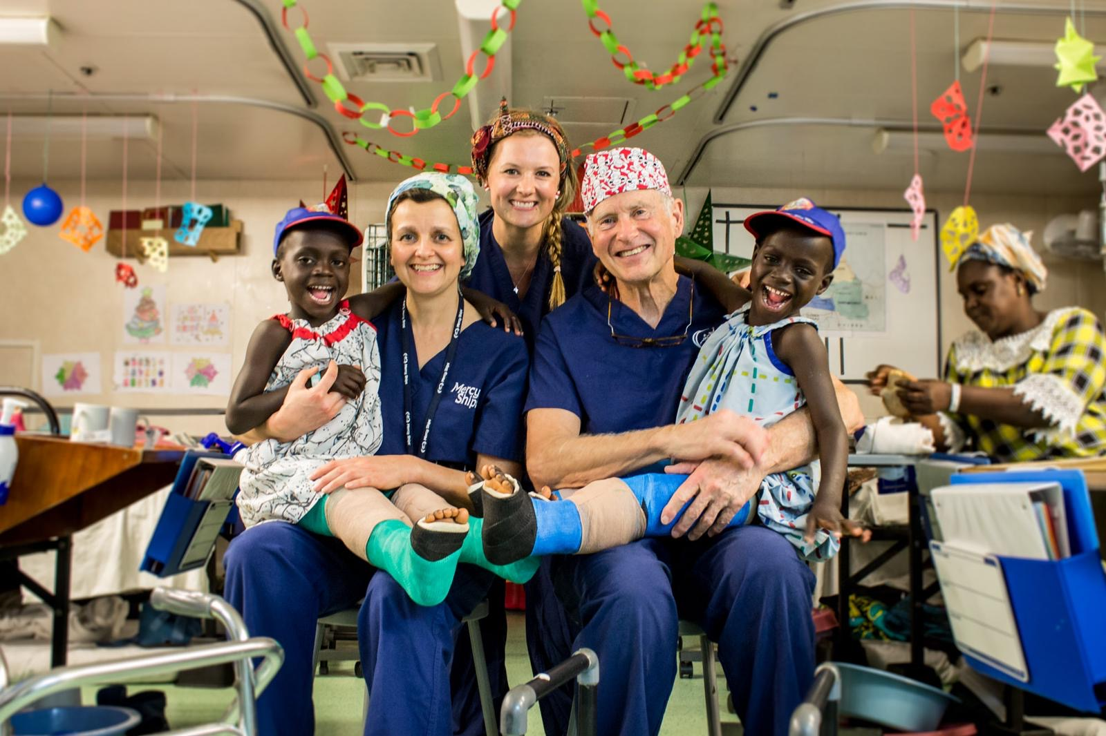
Notes:
Ousseynou and Assane, so just to show you some of the results

Slide 29
Notes:
Ulrich was able to stand upright for the first time in his life

Slide 30
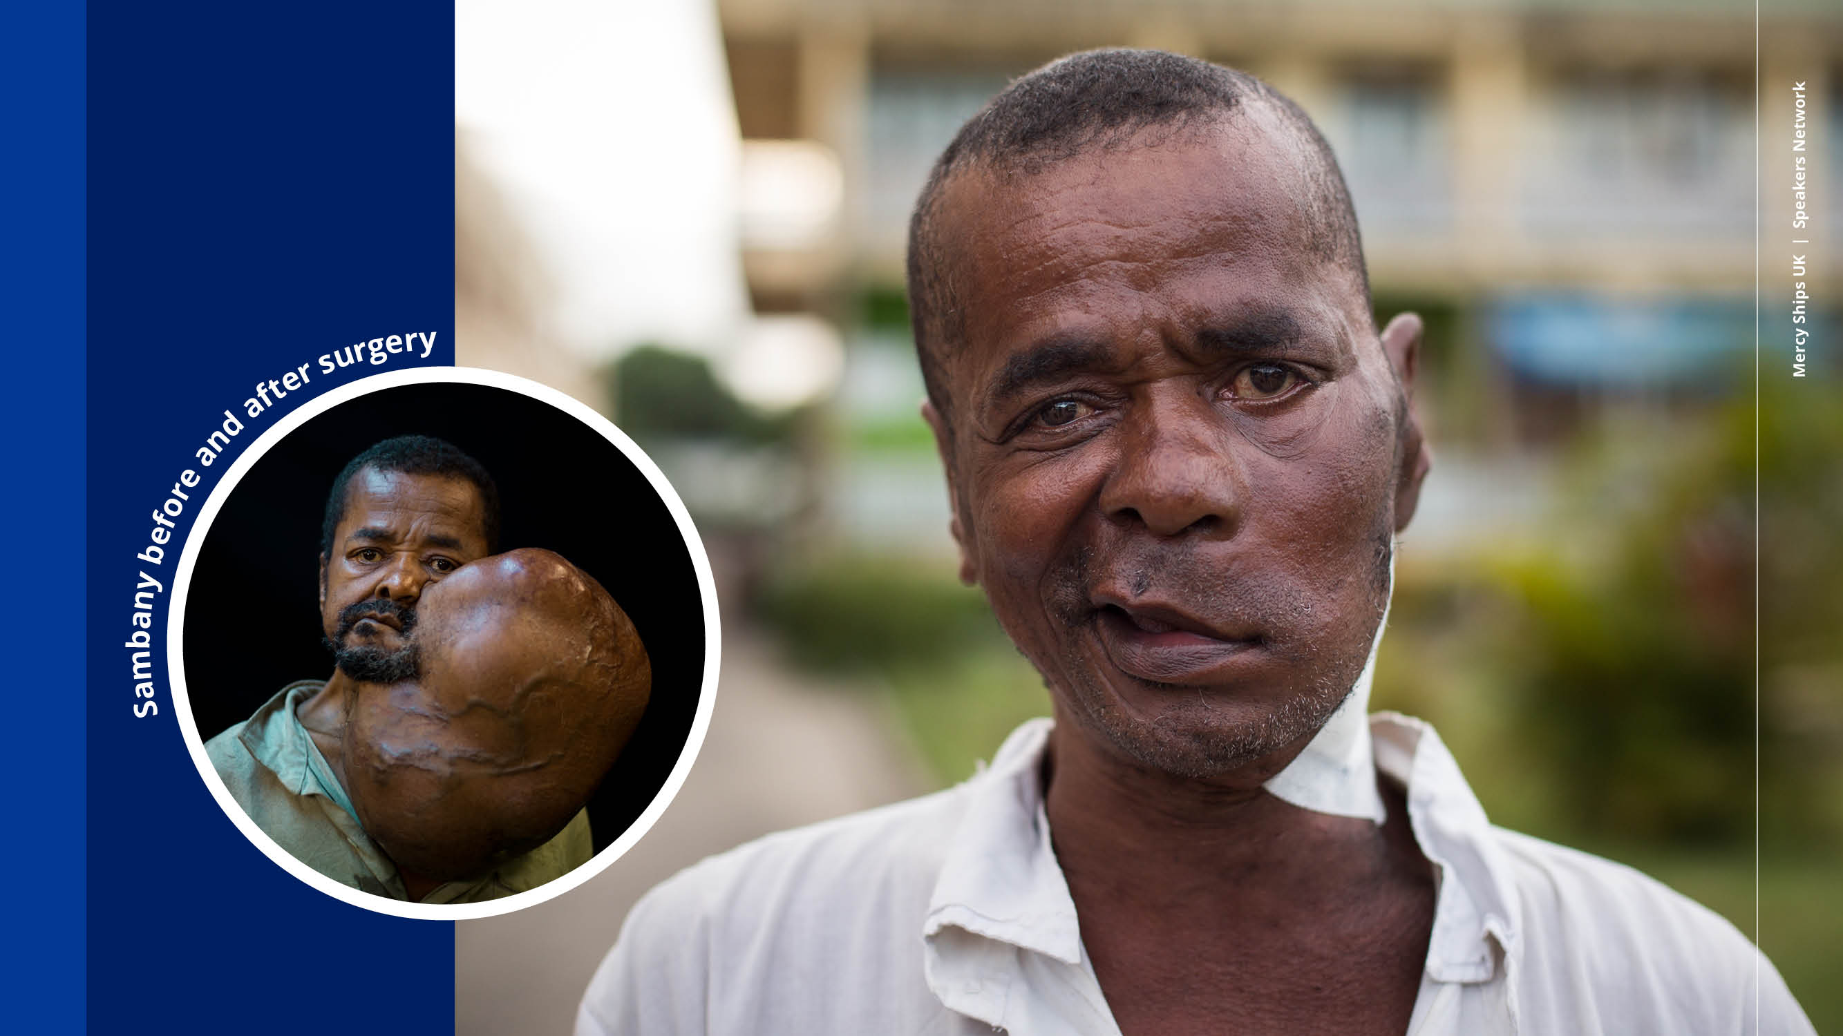
Notes:
Sambany had a 14 hour life saving operation. His 10 units of blood came from the mercy ships crew who are the walking blood bank.
He is back living happily with his wife and children who didn’t recognise him when he first returned home!

Slide 31
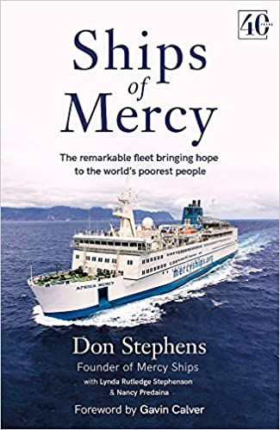
If you would like to know more….
Please visit the mercy ships stall!
http://www.mercyships.org
rachel.buckingham@ouh.nhs.uk
Notes:
I would highly recommend Mercy ships as an organisation. I’m going back to work for another 2 weeks in Senegal this summer. If you would like to know more about volunteering then do come and talk to me, I will be hanging around the mercy ships stall. If you cant volunteer but would like to donate, then visit the mercy ships website.
You may also be interested to the read the book by Mercy ships founder, Don Stephens which is a really fascinating read.

Slide 32

Notes:
Thanks for listening!

