Slide 1
How can we best support people living with and beyond cancer?
Ceinwen Giles
Founding Director
Shine Cancer Support
March 2022

Slide 2
Overview
Personal perspective on what patients need
Priorities for cancer patients
The impact of Covid-19
Supporting your patients
Notes:
Speak both as a cancer survivor and as a Director at Shine Cancer Support

Slide 3
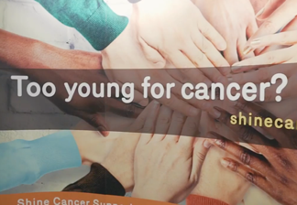
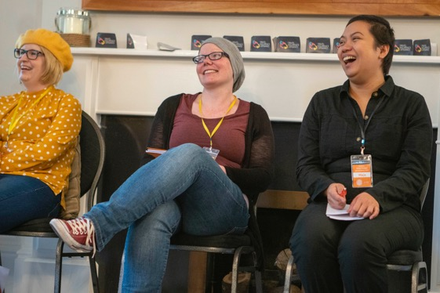
About Shine
Shine Cancer Support (reg. charity no 1146902) is the only charity in the United Kingdom that is exclusively focused on supporting people in their 20s, 30s and 40s who have had a cancer diagnosis.
Vision
We want every adult in their 20s, 30s and 40s who is diagnosed with cancer to know they’re not alone, and to have the support, knowledge, and confidence to navigate whatever cancer throws their way.
Notes:
Ceinwen

Slide 4
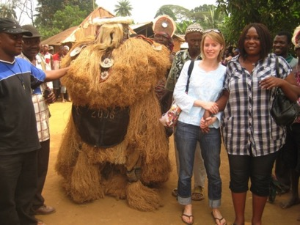
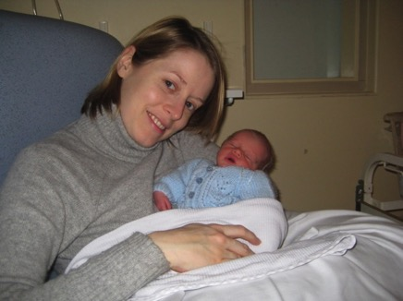
Personal Perspective

Slide 5
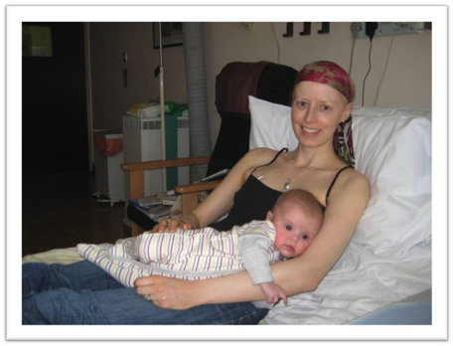
Diagnosis & treatment….
R-CODOX-M/IVAC-R as part of a Phase II clinic trial
Five months as an in-patient

Slide 6
Remission
Remission
Went back to work part-time, 7 months after treatment ended
Symptoms of post-traumatic stress disorder

Slide 7
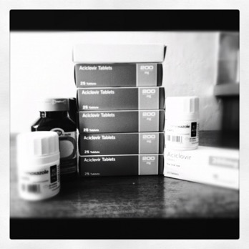
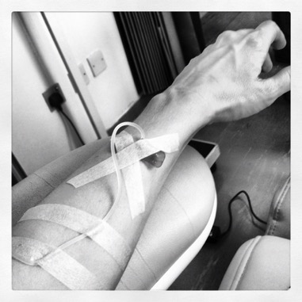
Ill again….

Slide 8
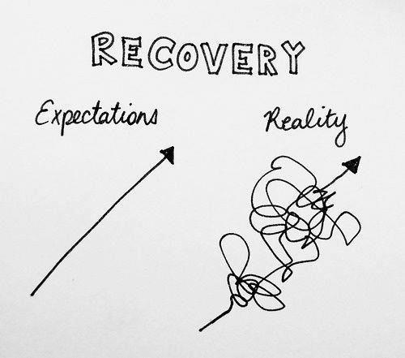

Slide 9

Imagine finding a mountain lion in your fridge…
It’s something like this: one day, you’re minding your own business, you open the fridge to get some breakfast, and OH MY GOD THERE’S A MOUNTAIN LION IN YOUR FRIDGE…
So you take off running, and the mountain lion is right behind you. …Also, for some reason, there’s someone in the crowd who’s yelling “I read that mountain lions are allergic to kale, have you tried rubbing kale on it?”
[After you’ve killed the mountain lion] all your friends come running up to you and say “that was amazing! You’re so brave, we’re so proud of you! You didn’t die! That must be a huge relief!”
Meanwhile, you blew out both your knees, you’re having an asthma attack, you twisted your ankle, and also you have been mauled by a bear. And everyone says “boy, you must be excited to walk down the mountain!” And all you can think as you stagger to your feet is “f**k this mountain, I never wanted to climb it in the first place.”

Slide 10
Priorities for cancer survivors
Between 2017 and 2019, the NCRI partnered with the James Lind Alliance to develop priorities for research in collaboration with patients and healthcare professionals. This was distilled into 10 priorities which included:
How care can be better coordinated?
What causes fatigue and how can we manage it?
Psychological impacts of cancer
Best ways to manage pain.
What lifestyle changes help with recovery and restore quality of life?
Notes:
These themes came out of work we did back in 2012 to look at the unmet needs of young adults – we had 244 people answer a survey then. We’ve just redone this with 409 respondents so we are analyzing the statistics at the moment with the help of a team at Santander.

Slide 11

Shine’s six themes
Living with uncertainty – coping with anxiety and depression
Working after cancer
Fertility
Relationships & dating
Caring for young children
Finances
Notes:
These themes came out of work we did back in 2012 to look at the unmet needs of young adults – we had 244 people answer a survey then. We’ve just redone this with 409 respondents so we are analyzing the statistics at the moment with the help of a team at Santander.

Slide 12
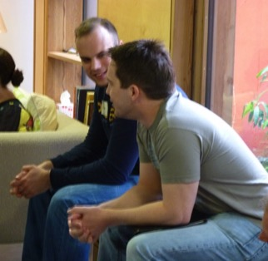
Living with uncertainty
– anxiety & depression
Younger adults with cancer tend to suffer higher rates of loneliness, isolation, depression and anxiety than their older counterparts.
However, many cancer patients experience mental ill health after a diagnosis.
50% of respondents felt that others had avoided them since their diagnosis
52% report experiencing depression
79% report experiencing anxiety.
83% felt that they had lost a sense of security in their future.
Notes:
Fatigue, sexual difficulties, poor mental health and pain all add to the difficulties of living after a cancer diagnosis (Macmillan, Cured but at What Cost?)
Heightened due to expectations – losing feeling of invincibility.
In updated Small c Survey (June 2019), 79% say they’re suffering from anxiety and 52% from depression

Slide 13
Living with uncertainty
– anxiety & depression
Uncertainty relates to many issues including:
Living in fear of a relapse and a feeling of “waiting to get ill again”
Questions relating to whether or not side effects of cancer treatment would get better over time (e.g. peripheral neuropathy)
Whether “late effects” of treatment may emerge in the future
What the impact of having cancer might be on their children or whether to have children at all.
Younger adults may have longer to live with these concerns than other older cancer patients, but levels of uncertainty can be difficult to live with, no matter what your age.
Notes:
Heightened due to expectations – losing feeling of invincibility.
Possibly not all doom and gloom = theory of post-traumatic growth. 78% think that it has helped them to recognize what is important in their life.
90% feel that cancer will always be a part of their life.

Slide 14
Cancer experiences lead to grieving
Notes:
Heightened due to expectations – losing feeling of invincibility.
Possibly not all doom and gloom = theory of post-traumatic growth. 78% think that it has helped them to recognize what is important in their life.
90% feel that cancer will always be a part of their life.

Slide 15

Living with uncertainty
– anxiety & depression
Covid-19 and associated isolation is exacerbating mental health issues.
Shine has carried out a number of surveys through the pandemic:
  53% are experiencing depression at a greater rate than before lockdown.
  63% are feeling more anxious
  55% feel that they are extremely emotionally isolated from others
  *As of May 2021, however, many of these issues continue to a greater or lesser extent.
Notes:
Fatigue, sexual difficulties, poor mental health and pain all add to the difficulties of living after a cancer diagnosis (Macmillan, Cured but at What Cost?)
Heightened due to expectations – losing feeling of invincibility.
In updated Small c Survey (June 2019), 79% say they’re suffering from anxiety and 52% from depression

Slide 16
How to support patients – living with uncertainty
People tell us that they are rarely asked how they are feeling (perhaps in a way that makes them comfortable sharing). Men in particular may need more encouragement to discuss these issues.
Support
Ask! Help to normalise feelings Recognise the value of peer support Make sure people are aware of the support that is available – but remind them of it time and again.

Slide 17

Working after cancer
Employment and careers are often negatively affected by a cancer diagnosis.
Almost 40% of people in our 2019 survey state they are unable to work in the same way as they had done before their diagnosis.
75% of those employed say their work has been negatively impacted.
Only 64% of people employed at the time of diagnosis achieve a successful and sustained return to work 2-3 years after diagnosis (Work Foundation).
Notes:
75% say that their work has been negatively affected by their diagnosis

Slide 18

Working after cancer
Many issues contribute to difficulties returning to work.
Lack of understanding from colleagues & bosses
Dealing with fatigue
Justifying on-going time-off
Many feel pressure not to “let others down” and to continue to put in very long hours.
Lack of confidence
In a 2022 survey by Working through Cancer and the Institute for Employment Studies, only 57% of those returning to work knew that they were protected by the 2010 Equality Act - meaning that a significant proportion of people are unaware of actions such as the right to request reasonable adjustments/flexible workshop.
Notes:
Work foundation 2013

Slide 19

Working after cancer
Covid-19’s impact on employment: how to return to work in different environments, and how to manage treatment, work and issues like childcare from home.
Some individuals who are clinically vulnerable still have also had to attend work, regardless of their health status/safety of the workplace;
Lack of employment protections of any kind is likely to hit the most vulnerable the hardest.
Notes:
NEIL:
Respondents to Shine’s 2019 survey listed many reasons why their work had been negatively affected.
Fatigue is a key issue here as many patients feel that their boss and colleagues do not understand how they are physically or mentally feeling or understand that fatigue is more “than just tiredness”. Many people say that they worry about justifying on-going time off, with colleagues saying things like “I thought you were finished treatment” and not having an awareness that cancer often requires long-term follow up and that side effects may need additional appointments.
A lack of confidence was mentioned by a significant proportion of respondents who also noted that they felt pressure not to let others down in their workplace. In some ways, the lack of confidence experienced by cancer patients has parallels with women returning to the workplace following a maternity leave; they have been out of the office/work place for some time, may not be fully aware of any changes, and have experienced a significant change in their life while their colleagues’ lives may have continued on as normal.
The full extent of Covid-19’s impact on employment for those with cancer is not yet known and is a developing story. Emerging issues include those patients who may find it difficult to work in people-facing jobs or environments which may not be Covid-secure enough given their underlying health. Some Shine forum members have also mentioned struggles to balance treatment, work and childcare as families are at home more meaning that there is no break in the day when they are able to rest.

Slide 20
How to support patients – working after cancer
A lot of people are told ‘Go back to work when you feel ready’ but what does that actually mean? Most people need a little more help in thinking about how and when to return to work.
Make sure that people are aware of their rights – all people diagnosed with cancer are classified as disabled for purposes of equality rights.
Support
Recognise that fatigue is a large issue in most cases Talk about how people can manage a phased return to work Discuss long term adjustments that may be made Psychological needs need to be considered – what is the main concern about returning to work?

Slide 21
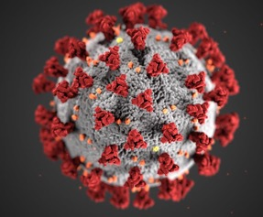
Covid’s impact on cancer patients
Covid-19 is having a wide-ranging impact on cancer and cancer treatment:
Current backlog and ‘missing patients’: significant drop off in people presenting at their GPs with suspected cancer symptoms; c.45,000 patients.
There have been interruptions to diagnostics, particularly for certain cancers – stomach cancer, lung cancer, etc.
Some patients have reported delays/interruption to their treatment although we know that the NHS is working hard to keep things on track.
Move to virtual appointments has suited some but not all and risks increasing health inequalities.
Notes:
Work foundation 2013

Slide 22
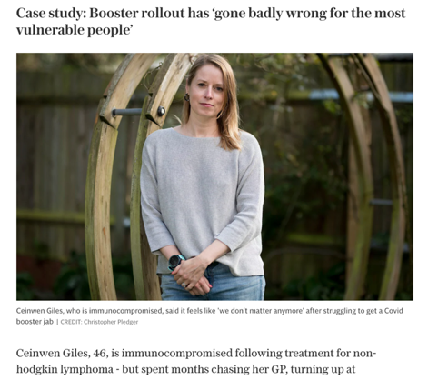
Covid’s impact on cancer patients
We also know that cancer patients are:
Experiencing increased loneliness, anxiety and depression – ”Freedom Day” and the lifting of all restrictions actually reduced freedom for some people,
  Covid more severe for patients undergoing treatment, and for patients who have or have had blood cancer – data from May 2021 to Jan 2022 shows immune compromised people account for more than 1/4 of intensive care admissions despite having three vaccines.
  Covid-19 vaccine does not work as well for people with compromised immune systems.
  Roll out of the third jab (not the booster!) and fourth jab has been very confusing for patients and healthcare professionals alike.
Notes:
Work foundation 2013

Slide 23
How Shine supports young adults with cancer
In person support & activities
Online support & information
Advocacy and training for healthcare professionals
Shine
Notes:
Peer support is a major thread throughout all of this work.

Slide 24

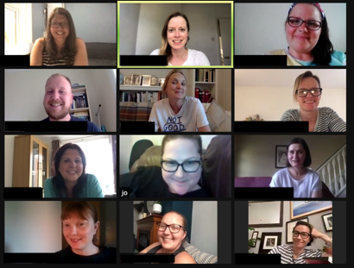
The value of peer support
  “As soon as I started attending online support groups with Shine I felt more resilient and better able to handle treatment. Connecting with other people who have had a cancer diagnosis helped me feel less afraid of everything cancer might throw at me.”
  “Thanks for giving me the space to share my experience about all the difficult things people said to me about my diagnosis. I'd felt so alone with that and had struggled to convey the impact of it when I talk to the hospital psychologist.”
  62% feel less depressed
  73% feel less stressed

Slide 25
Questions? www.shinecancersupport.org ceinwen@shinecancersupport.org

