Slide 1


Delivering an effective cancer survivorship programme
Dr Claire Taylor, MBE
Macmillan Nurse Consultant in Colorectal Cancer
London NW University Healthcare NHS Trust

Slide 2
Content
What is a cancer survivorship programme?
What makes it ‘effective’?
Developing outcome data
Best practice – seeing the positive impact

Slide 3
What is a cancer survivorship programme?
Survivorship Programme is a service for cancer ‘patients’ and their families who have completed active treatment.
Overall intention is to meet the individual’s personalised care and support needs and..
to focus on their recovery, health and
wellbeing after cancer treatment.
Notes:
To provide information, advice and follow up care to all cancer patients and their carers who are at the end of active treatment and to enable supported self management based on individual needs and preferences and with the appropriate clinical assessment, support and treatment.
To improve health, wellbeing and quality of life for the patient.
To improve the patient’s confidence and motivation.
V

Slide 4
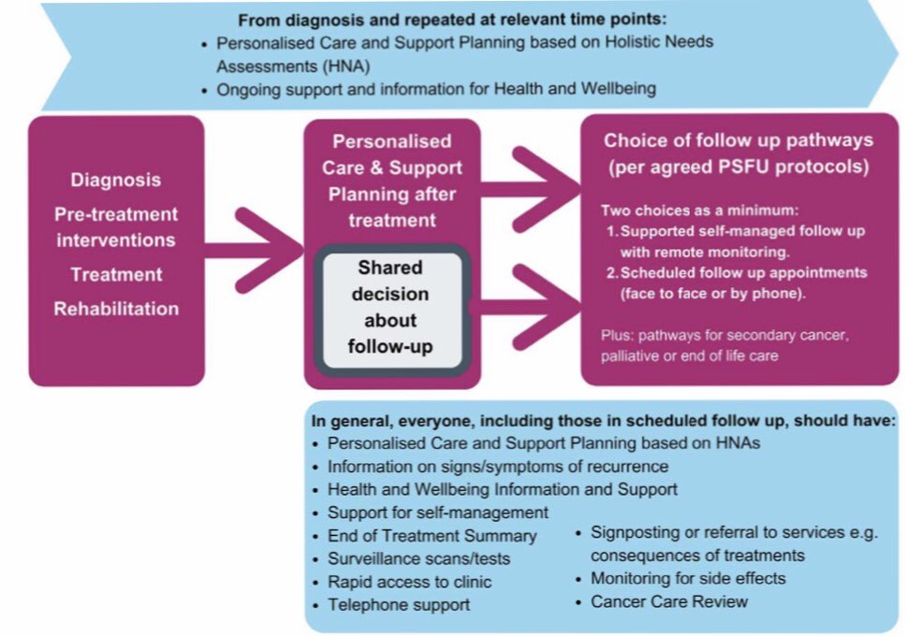

Slide 5


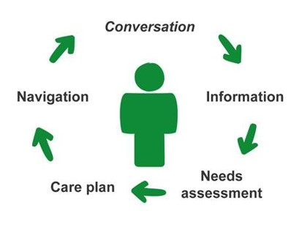
Where is it delivered?

Slide 6
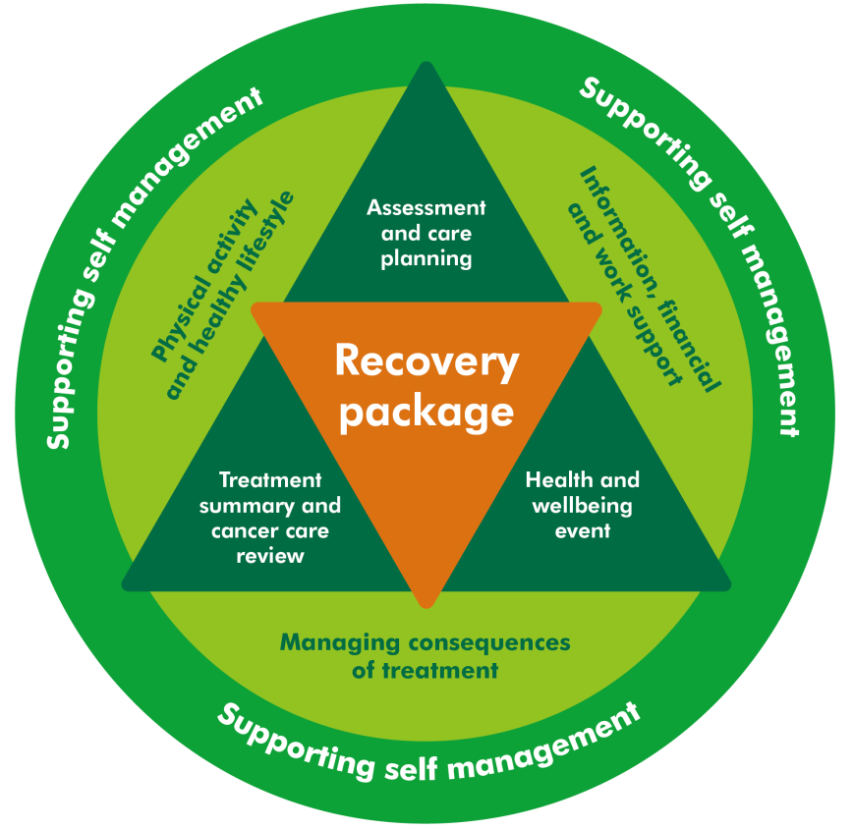
Personalised care and support
Notes:
The ‘Recovery Package’ is a combination of different interventions, which when delivered together, will greatly improve the outcomes and coordination of care for people living with and beyond cancer. These are:
Holistic Needs Assessments and care planning at key points of the care pathway,
A Treatment Summary completed at the end of each acute treatment phase, sent to patient and GP
A Cancer Care Review completed by GP or practice nurse to discuss the person's needs, and
A patient education and support event, such as Health and Wellbeing Clinics, to prepare the person for the transition to supported self management, which will include advice on healthy lifestyle and physical activity.
6

Slide 7
Notes:
The ‘Recovery Package’ is a combination of different interventions, which when delivered together, will greatly improve the outcomes and coordination of care for people living with and beyond cancer. These are:
Holistic Needs Assessments and care planning at key points of the care pathway,
A Treatment Summary completed at the end of each acute treatment phase, sent to patient and GP
A Cancer Care Review completed by GP or practice nurse to discuss the person's needs, and
A patient education and support event, such as Health and Wellbeing Clinics, to prepare the person for the transition to supported self management, which will include advice on healthy lifestyle and physical activity.
7

Slide 8
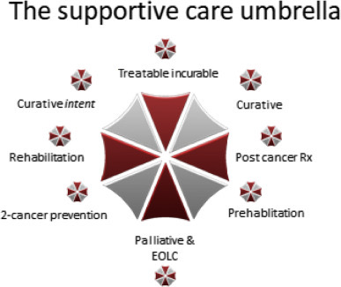
* Prehab
* Rehab
* Stratified after care
* Surveillance
* 2ndary cancer prevention
* Managing acute ttmt effects
* Managing long-term effects
* Monitoring for late effects
a
Notes:
Oncocardiologists, endocrinologists, dentists and fertility specialists are examples of the more common specialists who can contribute to providing coordinated survivorship care.

Slide 9
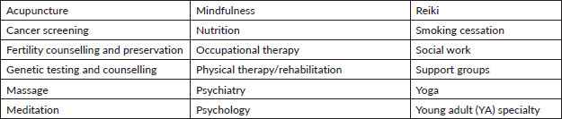
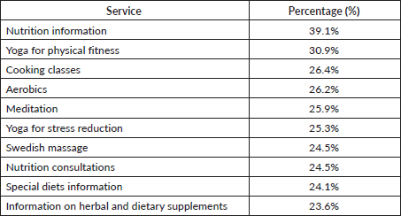
The top ten support services requested by cancer survivors.
Survey of 1,054 people LWBC
Notes:
Building a comprehensive cancer survivorship program
Tessa Flores¹, et al NY ecancer https://doi.org/10.3332/ecancer.2019.992

Slide 10
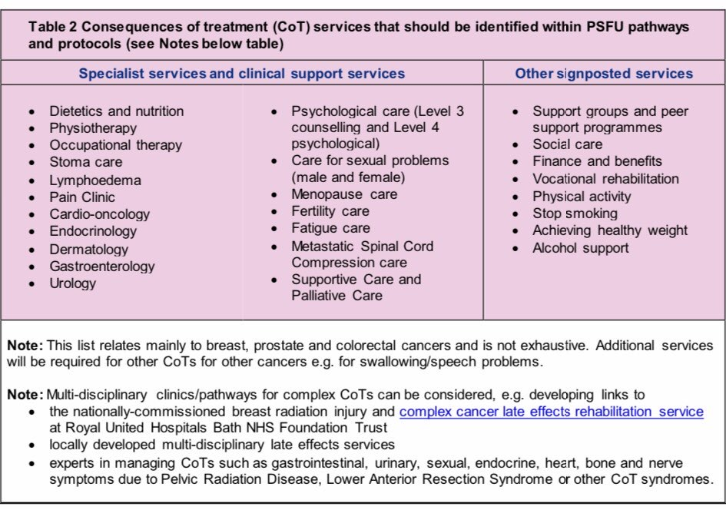
Notes:
Staggering high number of pts still suffer from significant health issues years after being declared disease free
Martina Schmidt Fatigue ESMO
2500 PTS with 15 different types of cancer, 2 yrs after cancer. 40% had fatigue that they reported as a moderate to severe burden

Slide 11
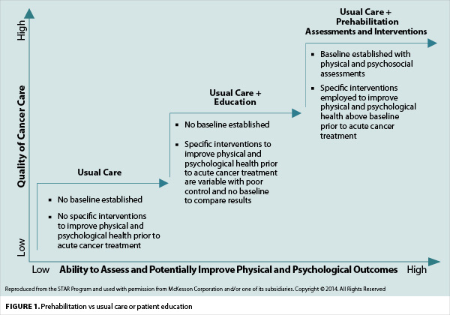
Physical activity and healthy lifestyle
- stratification
https://www.oncologynurseadvisor.com/home/hot-topics/side-effect-management/cancer-prehabilitation-one-step-toward-improved-outcomes/
Notes:
Improve physical and psychological well-being
Reduce the risk of consequences of treatment
Improve overall survival rates and reduce the risk of recurrence
Reduce the risk of co-morbidities (two or more medical conditions

Slide 12


What defines an ‘effective’ program?
Care is given in a way and place that works for that person
The care and support is tailored to that individual and those close to them
The support enables that person to manage their recovery themselves.
There is improvement in that person’s health, wellbeing and quality of life
Notes:
Choice – flexible systems
Personalised or person –centred
Enabling supported self management

Slide 13
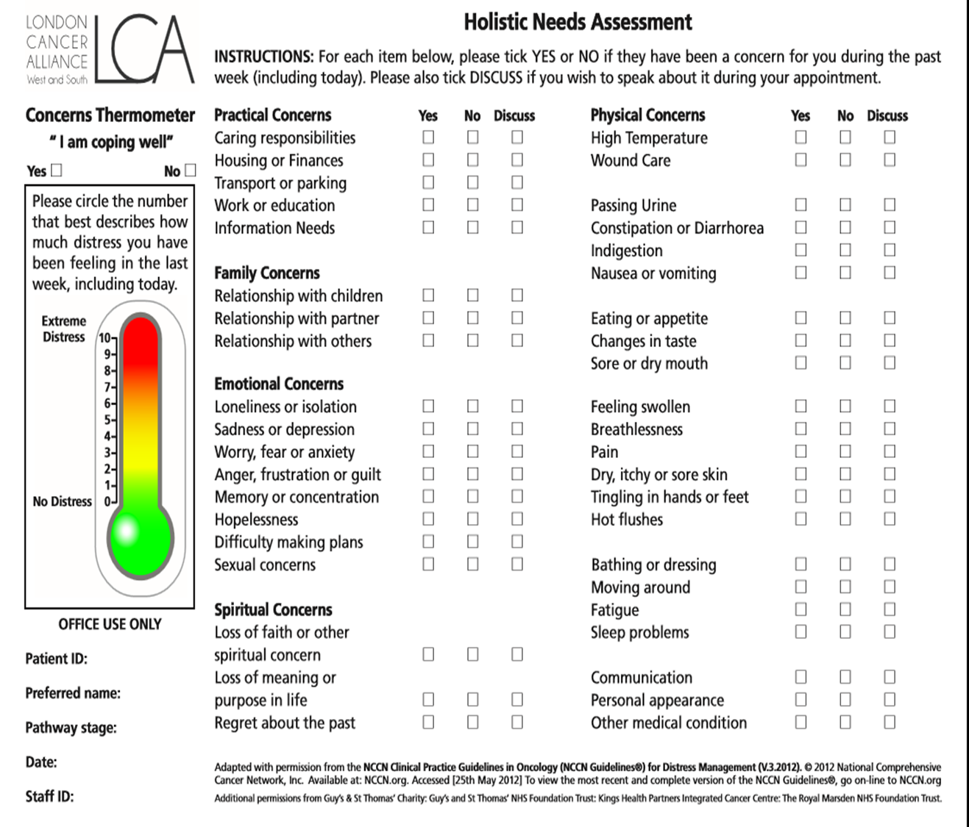
Holistic needs assessment
Notes:
Physical Symptoms
Psychological Issues
Religious and Spiritual Issues
Independence And Activity
Family and Social Issues
Treatment Issues
Personal Issues

Slide 14
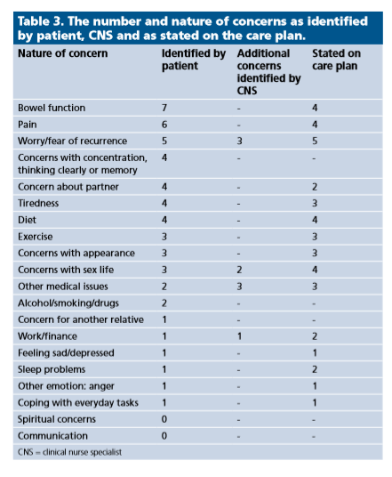
Benefits
18 CRC patients HNAs and care plans were reviewed post-treatment
CNS’ picked up nine additional concerns that had not been stated by patients on their HNA tools
Notes:
CNS’ picked up nine additional concerns that had not been stated by patients on their HNA tools. The most commonly under-reported concerns were noted to be either of a personal nature, in particular, fears of cancer recurrence (n=3) and sexual concerns (n=2), or worries that were perceived as being unrelated to cancer
It enables issues and concerns to be identified that might not otherwise be addressed in a HCP led assessment
Provides a framework for hcp

Slide 15
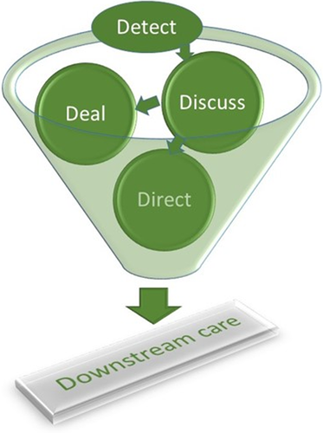
Key features
Detecting needs
Discussing and dealing with identified needs
Referrals and Signposting actions
The implementation and impact of Holistic Needs Assessments for people affected by cancer: A systematic review and thematic synthesis of the literature Young et al 2019 https://doi.org/10.1111/ecc.13087
Notes:
Post‐assessment access to, and uptake of, support services is referred to as “downstream care” (Mitchell et al., 2012

Slide 16
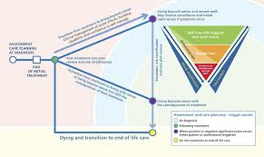
Stratifying according to what need?

Slide 17
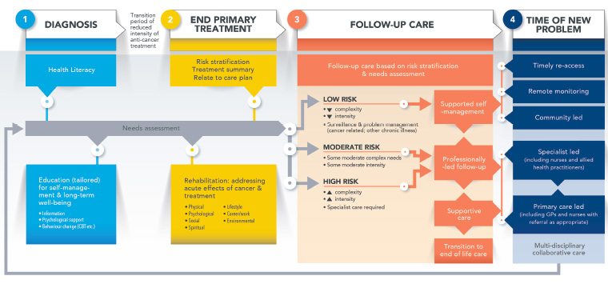
Clinical Oncology Society of Australia position statement on cancer survivorship care
Vardy et al 2019 doi: 10.31128/AJGP-07-19-4999

Slide 18
Developing outcome data
Personalised Care and Support Plans
End of Treatment Summaries
Primary Care Cancer Care Reviews
Health & Wellbeing Information and Support
Quality of life metric
Patient satisfaction
Cost-effectiveness
Sustainability

Slide 19
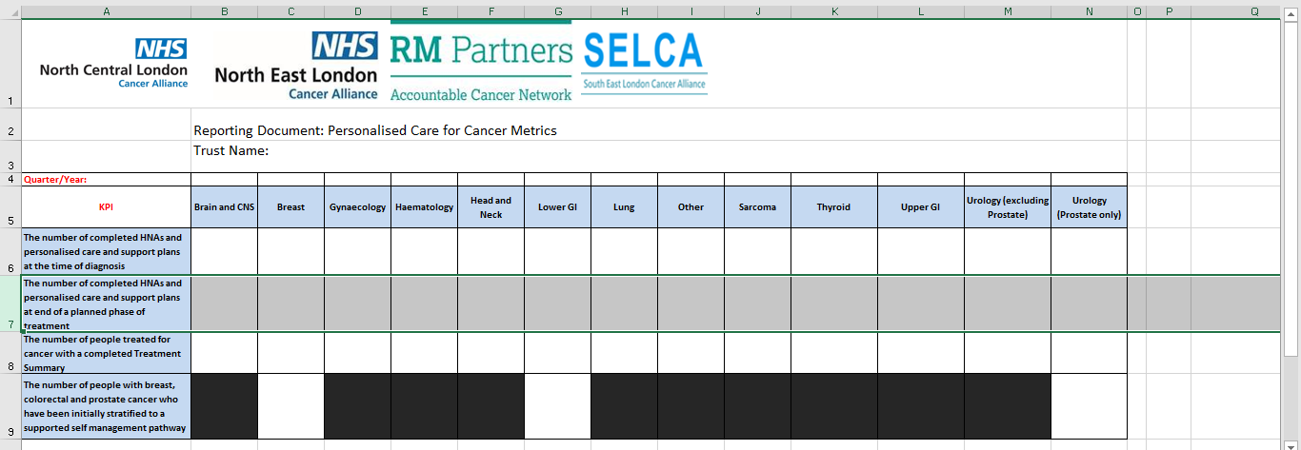
Quarterly data collected

Slide 20
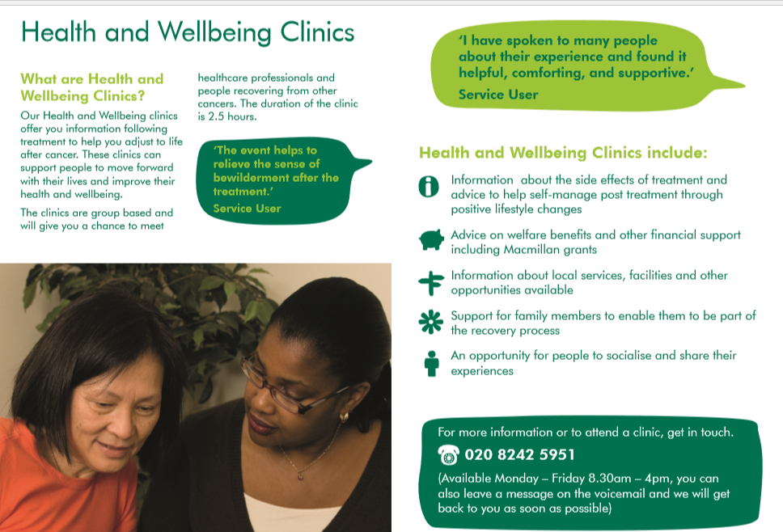

Slide 21
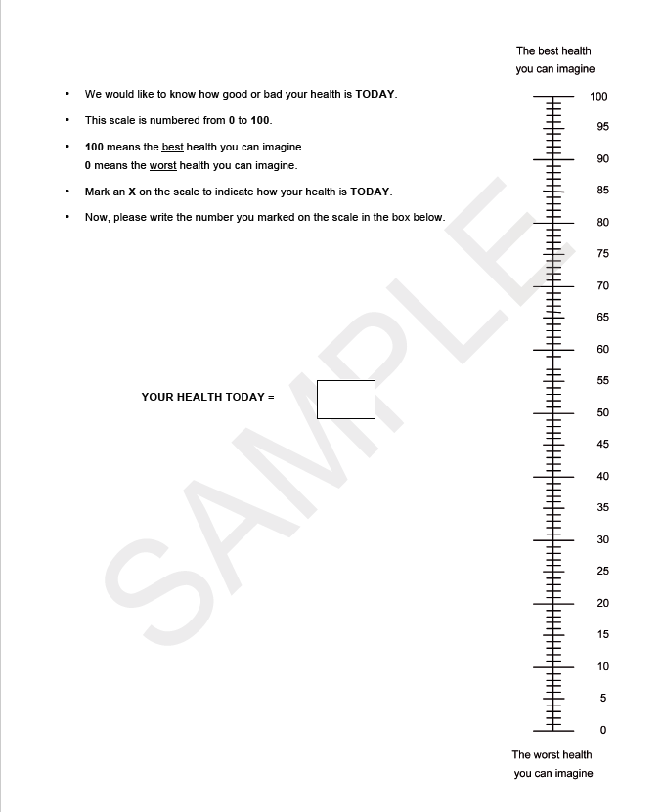
How is your health today?
Score 0-100

Slide 22
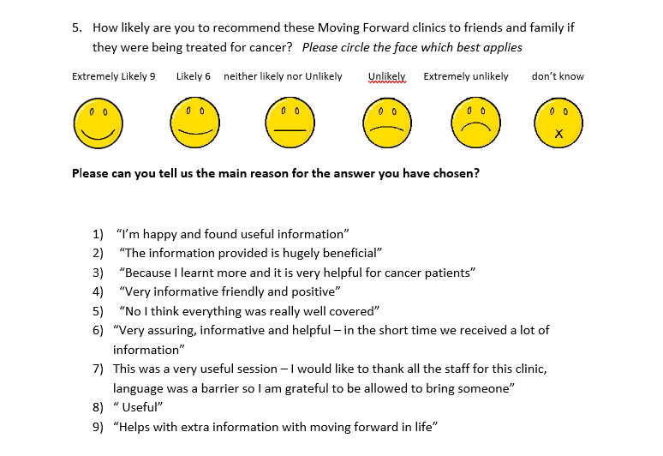
Patient feedback

Slide 23
Rehabilitation study data
Category | Outcome | What will you measure? | What data will you collect and from whom (source) | How often will you collect the information? e.g.mthly/6/12 | Who will be responsible for collecting information? | Where will this information be recorded? | What proportion of people will you collect this from and how will they be sampled?
Clinical | Preoperative pathway
 | Increased activity levels | Exercise diary (as in ABC trial, otherwise Bouchard) |  | Collected for ?3 or 7 days at initial assessment and week prior to admission
 | Improved self-efficacy | Self-efficacy for Exercise (SEE) Scale |  | Initial assessment Repeat at hospital admission
 | Optimised physical condition pre-surgery | Measures of functional capacity: Chester Step Test and/or 6MWT Duke Activity Status Index (DASI) Performance in ADLs: Barthel Index |  | Initial assessment Repeat at hospital admission
 | People feel empowered to participate | Assessment of patient knowledge, skill, and confidence for self-management via Patient Activation Measure (PAM) +/- PES (see below) |  | Initial assessment Repeat at hospital admission
 | Goal Setting | Goal attainment Scale (GAS) |  | Initial assessment Repeat at hospital admission if there were goals limited to pre-op
 | ?Frailty Score | Rockford

Slide 24
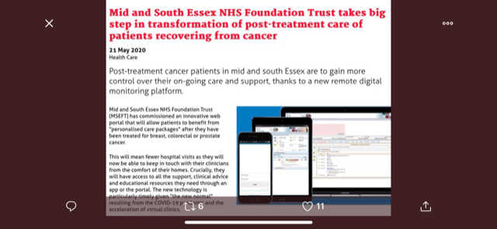
Digital solutions

Slide 25
My medical record
A digital model of FU care for men LWBC prostate cancer @Southampton
The pioneering development gives men access to view their PSA blood test results as soon as they are uploaded by the lab, as well as complete assessments, view patient information and message their clinical team – removing the need for routine appointments unless essential.
They take part in a HWB workshop & are given a dedicated support worker.
The study ran for three years and involved 2,675 men and 250 workshops, showed that outcomes were the same or even better for men than traditional follow-up care, with lower per patient costs.
Follow-up care after treatment for prostate cancer: evaluation of a supported self-management and remote surveillance programme. Frankland et al 2019 doi.org/10.1186/s12885-019-5561-0
Notes:
Following the success of My medical record, a personal online health record developed at University Hospital Southampton, it was adapted in partnership with the TrueNTH programme, a global initiative led by the Movember Foundation, to improve critical areas of prostate cancer care.
As part of a national trial funded by Prostate Cancer UK, the self-management model was introduced at UHS and four other hospital trusts across the country, with its implementation evaluated by the University of Southampton.
Although clinical teams initially had concerns about patients having access to results before clinicians had assessed them, the project showed men were not adversely affected even if their test results were abnormal.

Slide 26
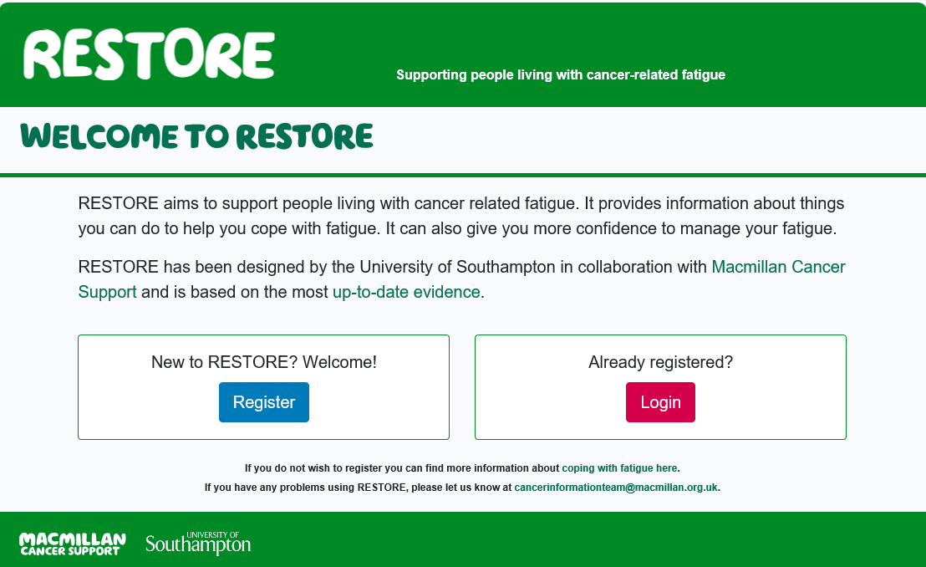
Online tool to help manage fatigue www.macmillanrestore.org.uk

Slide 27
Lessons learnt - 1
Engage with patients and family/friends
Work with all the MDT
Good leadership - vital
Be realistic about what is needed for any service improvement – how, when, who, where.
Pilot - in the right team!
Sell the idea of benefits to staff and patients
Funding opportunities
Work with outside agencies/voluntary sector/existing cancer services staff
Evaluate – audit/patient experience
Keep the momentum up – keep on key agenda’s
Challenge current practice and be brave to make change!

Slide 28
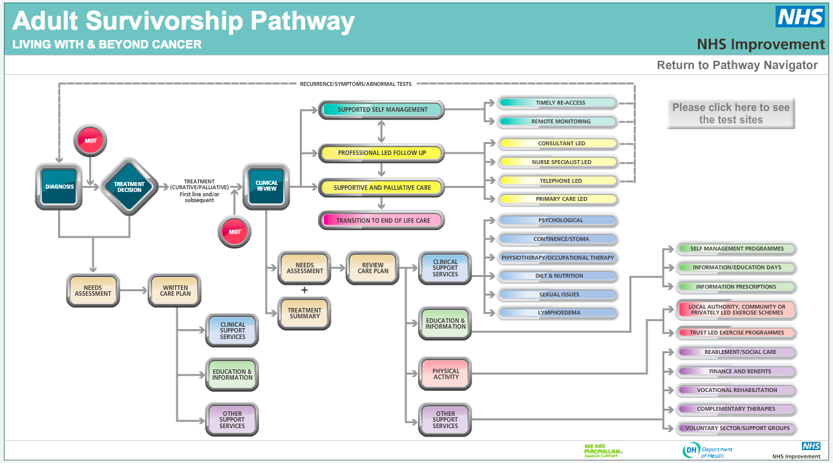
Integration within the cancer care pathway - 2
Health & Well-being + Cancer Care Review
HNA
HNA
Manage any
consequences
Treatment summary

Slide 29

Build a winning team - 3
Macmillan Consequences of Cancer Treatment collaborative (Macmillan CCaT)

Slide 30
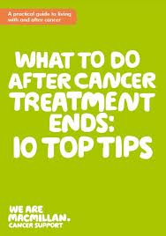
Helping people help themselves - 4
Discuss your needs and develop a care plan
Ask about a treatment summary
Find your main contact
Be aware of any post-treatment symptoms
Get support with day to day concerns
Talk about how you feel
Try to lead a healthier life style
Know what to look out for
Be aware of your own health
Share your experiences (Booklet MAC13615)

Slide 31
Key points
Requires a multidisciplinary, systematic approach to deliver coordinated and integrated survivor-centred care for all individuals from the time of diagnosis in partnership with primary care providers.
Stratified pathways of care should be based on the needs and risk factors of the individual, treatment sequelae, existing comorbidities and capacity to self-manage.

Slide 32
Key points 2
The survivorship care plan requires regular review and update to document main concerns & agreed actions.
Survivors require equitable access to services in a timely manner, while minimising unnecessary use of healthcare services and resources.
Survivorship care should support wellness, healthy lifestyle and primary and secondary prevention.

Slide 33


Thank you
claire_taylor22

