Slide 1
Deliv Supporting people living with and beyond cancer during Covid-19
Nikki Cannon
Transformation Lead Personalised Care & Survivorship
Guy’s and St Thomas NHS Trust
Notes:
Good morning and thankyou for giving me the opportunity to share with you some of the work we have done at GSTT NHS Trust in London to support cancer patients through the covid-19 pandemic
My name is Nikki Cannon and I am the Transformation lead for Personalised care and Cancer Survivorship
I’d like to thank my colleagues Liz Graham and Jess and Macmillan cancer support

Slide 2
The impact of Covid-19 on cancer survivorship. Understanding what matters to people. Supporting people who are shielding and isolated. Developing services for cancer survivors during the pandemic.
What we will cover today

Slide 3
March 2020- Covid- 19 – the challenge
March 2020- huge reduction in patients physically attending- 70 % of all appointments moved to remote.
Patients - Increased anxiety delayed treatment, isolation from family and friends.
HCP- Reduced capacity, increased anxiety about patient wellbeing.
Personalised care & support planning (HNA) rates falling
Reduced/redirected resources limiting potential solutions
@nikkicannon50

Slide 4
The Solution – SMS Text Message HNA
Clinical teams upload patients to MyCarePlan via a spreadsheet
Text message is dispatched or scheduled by PCC team
Patient can complete their HNA at a time that suits them best
If uncompleted after 5 days, a reminder text message is sent
If uncompleted after 10 days, a phone call should be made
Once completed, email received to confirm HNA submitted
Care plans can be completed face to face, or over the phone
@nikkicannon50
Notes:
As a response to this we developed a process where a patient can receive a text massage and link to complete there HNA at home and then receive a follow up care planning conversation
Using existing systems and technology – text for appointment reminders and pt experience surveys.
Able to expedite GDPR (data agreement)
Text message is received with a link to My CarePlan and 6 digit passcode
Patients log in using pass code and DOB
Pts consent to data agreement which allows anonymised data to be shared with MCS
Patients can select any number of concerns across 5 domains (emotional, family, physical, practical, diagnosis & treatment, spiritual & religios) and rate the level of concern from 1 to 10 and can also select information needs
If pts email address is entered the pt can access completed care plan (s)
Once submitted the HCP that set up the assessment will be notified and can arrange a FU care planning conversation.
If not completed in 5 days a reminder text is sent

Slide 5
Notes:
CNS : enter patients into a spreadsheet (shown below), upload directly to MyCarePlan. it sets up all of the patients with an assessment at the same time.
From new diagnosis/first treat clinic, collate a list of patients that have agreed to receive HNA by text message
Complete spreadsheet ‘MyCarePlan Upload BLANK.xlsx’, filling in NHS Number, Hospital Number, First Name, Last Name, Date of Birth, and Tumour Group for each patient.
Save file in .CSV format.
Log in to http://mycareplan.co.uk, and click ‘Set Up Assessment’ > ‘Upload CSV’ > ‘Choose File’
Inform AOS Coordinator and Patient Experience Lead that this has been completed
My team: Open ‘Remote HNA List.xlsx’ (S:\CancerProgramme\07_Patient Centred Care\Survivorship\HNA reporting\Remote HNA Messaging\Remote HNA List.xlsx)
Extract ‘Assessment Report’ from MyCarePlan, Year to Date
Copy all data into ‘Assessment Data’ tab on Remote HNA List spreadsheet
Enter hospital numbers of new patients on eHNA tab for current quarter
Copy formulae from above cells (columns B-F, I-O) to automatically populate patient information
Copy new hospital numbers into ‘PIMS Check.xlsm’, and run extraction by ‘Trust Number’. (S:\CancerProgramme\07_Patient Centred Care\Survivorship\HNA reporting\Remote HNA Messaging\PIMS Check.xlsm)
Remove any patients if ‘DOD’ returns a date. Patient is deceased.
Returning to ‘Remote HNA List.xlsx’, copy corresponding patient ‘Primary’ and ‘Secondary’ phone numbers into eHNA tab for current quarter. Do not use ‘next of kin’ phone numbers.
Cleanse and format data using find and replace and filter tools, until all numbers in ‘Primary’ column are formatted in a ‘+447#########’ format.
For patients that do not have a mobile number on record, check Mosaiq notes for mobile number, otherwise refer back to CNS team to retrieve mobile number of follow up patient via the phone.
Copy new data from columns A-G of eHNA tab into ‘MessageBird Output’ tab, pasting as values only.
Right click ‘MessageBird Output’ tab > ‘Move or Copy’ > tick ‘Create a Copy’ > ‘To book: (new book)’ > OK
In new book, highlight column ‘I’ and delete column.
Save as ‘Remote HNA Export.xlsx’, overwriting previous copy.
Log into https://sms.drdoctor.co.uk and add contacts
To add new contacts click ‘Contacts’ > ‘Add contact’ > ‘Choose File’
Select ‘Remote HNA Export.xlsx’
Under ‘Add to Group’, select ‘Group name is a column in the file’ > ‘Next’
Configure as follows, and then click ‘Next’ once complete
Hospital Number = ‘Custom 1’
First Name = ‘Name’
Last Name = ‘Surname’
Passcode = ‘Custom 2’
Target Completion Date = ‘Custom 3’
Tumour Group = ‘Custom 4’
Phone Number = ‘Telephone Number’
Tumour Group & Date = ‘Group’
Send SMS to patients
To send text message, click ‘SMS’ > ‘Campaign Builder’
Select Template > ‘HNA Invitation’ (or ‘HNA Reminder’ if reminder message) > ‘Next’
Enter ‘Originator’ as ‘GuysCancer’
Click ‘+ Groups from Phone Book’ > Search for new group using group name set up in previous step (e.g ‘Gynae Jan 1’) > ‘Add’ > ‘Next’
Check preview message is correct > ‘Send’ (or ‘Schedule’, as below)
Aim to send message between 11am – 2pm. If outside of this time-frame, consider scheduling for between these times later on the same day, or on the following day if already passed.
On ‘Contacts’ Tab, search for group name > click ellipses > Export
Copy rows from exported spreadsheet into ‘Messaged Patients’ tab on Remote HNA List.xlsx
Remove list of patients from ‘MessageBird Export’ tab
Take care not to delete formulae from columns H and I
Save Spreadsheet, and inform CNS team that messages sent.

Slide 6
1.
HNA Completion Analysis
Data through 31st August 2021

Slide 7
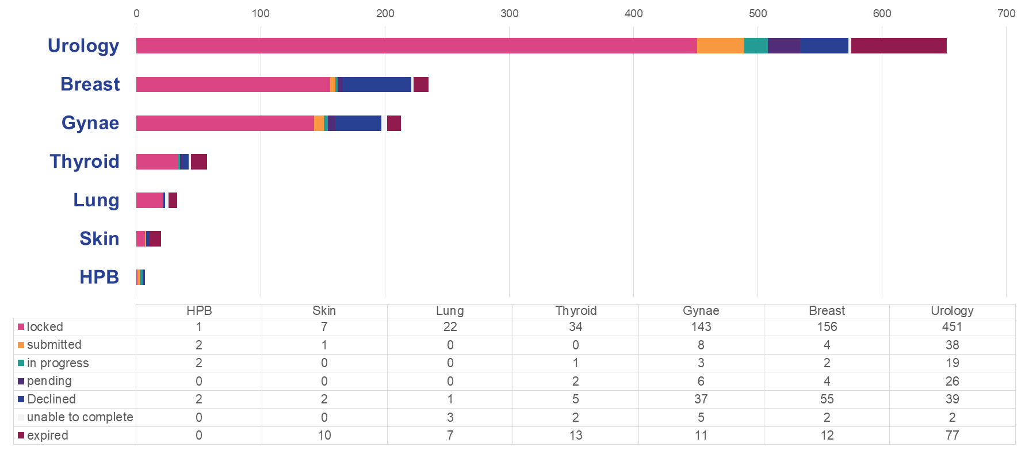
Text Message HNA Completion
Urology includes Prostate, Renal and Testes Skin includes Lymphoma, Melanoma, and Non-Melanoma
Notes:
Since rolling out the Text Message HNA in April 2020, over 1200 HNAs have been sent to patients via SMS.
Of these, 75% have been completed by patients across 11 tumour groups
In 2021, HNAs offered by text message currently make up about 30% of all HNAs offered within the trust

Slide 8
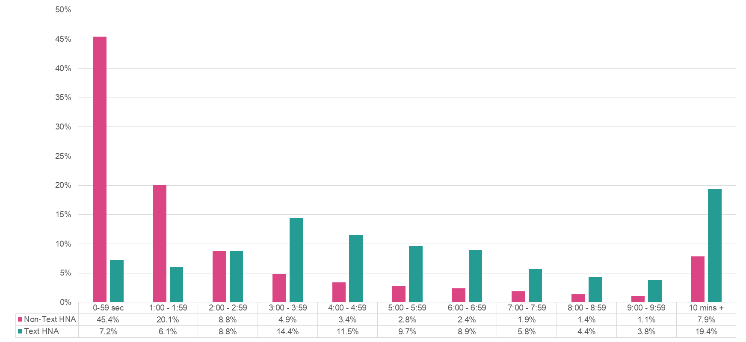
HNA Duration: Non-Text vs Text Message HNA
Notes:
65.5% of Non-Text Message HNAs offered within the trust between are completed in under 2 minutes, compared to 86.7% of Text Message HNAs taking patients over 2 minutes when completed independently.
When offered HNA by other means, patients may not be given enough time to complete HNA
When offered HNA by other means, patients may not be given enough time to complete HNA

Slide 9
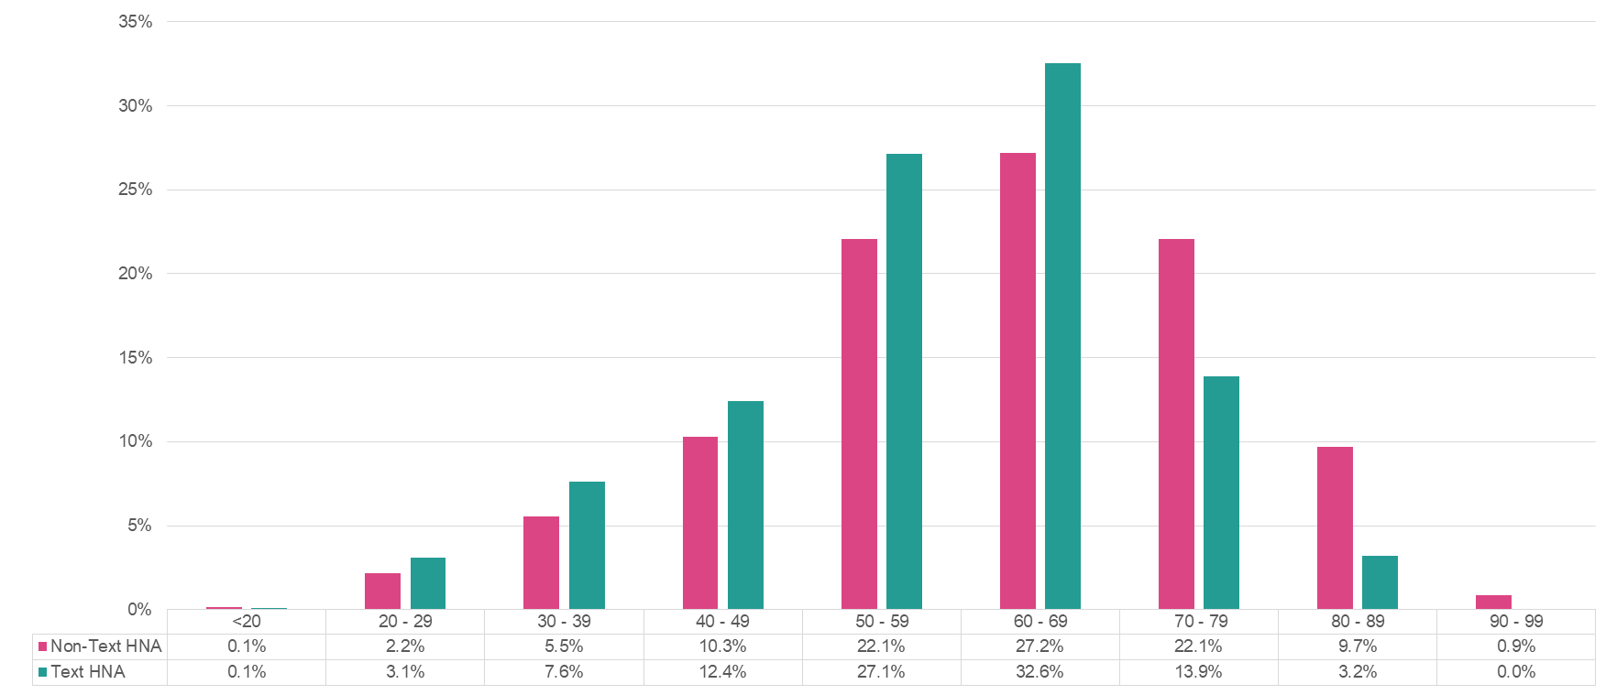
HNA Completion (Age): Non-Text vs Text Message HNA
Notes:
Age distribution for HNAs completed by text message appears to skew towards younger patients, compared to HNAs offered by other means, which skew towards older patients.
This could also be a result of a perception bias when offering the HNA to patients, teams may be more reluctant to offer HNA to older patients

Slide 10
HNA Completion (Ethnicity): Non-Text vs Text Message HNA
31% of all patients with assessments set up on MCP have the ethnicity field blank

Slide 11
HNA Completion Summary
65.5% of Non-Text Message HNAs offered within the trust between are completed in under 2 minutes, compared to 86.7% of Text Message HNAs taking patients over 2 minutes when completed independently.
When offered HNA by other means, patients may not be given enough time to complete HNA
Age distribution for HNAs completed by text message appears to skew towards younger patients, compared to HNAs offered by other means, which skew towards older patients.
This could also be a result of a perception bias when offering the HNA to patients, teams may be more reluctant to offer HNA to older patients.
Decline rate of HNAs across both text message and non-text message sits at around 12%.
Overall HNA rates increased from 68% March 2020 to 80% December 2020.

Slide 12
2.
Concerns Analysis
Data through 31st August 2021

Slide 13
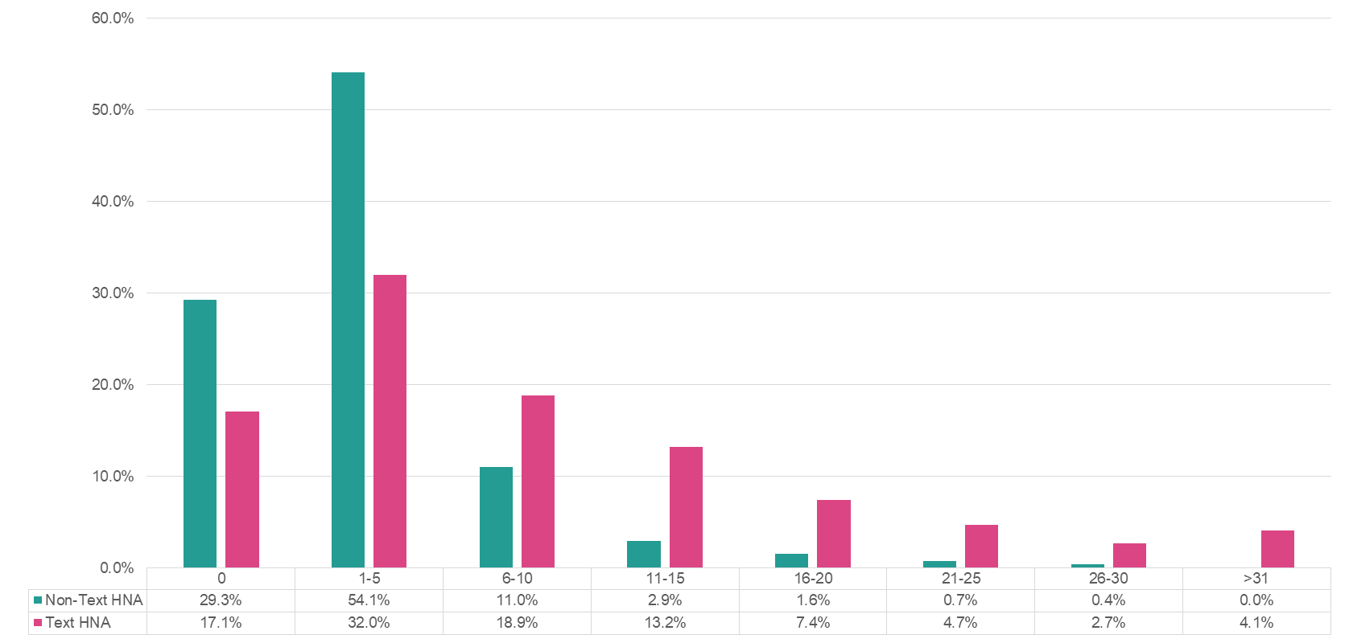
Number of Concerns Raised
Notes:
On average, HNAs offered by text raise a higher number of concerns and information needs compared to those not offered by text.
29% of HNAs not offered by text message raised nil concerns, a percentage almost halved to 17% in HNAs offered by text.

Slide 14
Concern Domains
Clinical Concerns |  | Holistic Concerns
Physical concerns | Questions about Dx, Tx, or Effects | Emotional concerns | Family concerns | Practical concerns | Spiritual or religious concerns | Information Needs
Breathing difficulties | Questions about Diagnosis, Treatment or Effects | Anger or frustration | Children | Difficulty making plans | Faith or spirituality | Complementary therapies
Changes in weight |  | Guilt | Other relatives or friends | Grocery shopping | Feeling at odds with my culture, beliefs or values | Diet and nutrition
Constipation |  | Hopelessness | Partner | Housing | Meaning or purpose of life | Exercise and activity
Cough |  | Independence | Person who I look after | Laundry or housework |  | Health and wellbeing
Diarrhoea |  | Loneliness or isolation | Person who looks after me | Money or finance |  | Making a will or legal advice
Dry, itchy or sore skin |  | Loss of interest in activities |  | My medication |  | Managing my symptoms
Eating, appetite or taste |  | Regret about the past |  | Pets |  | Patient or carer's support groups
High temperature or fever |  | Sadness or depression |  | Preparing meals or drinks |  | Planning for my future priorities
Hot flushes or sweating |  | Thinking about the future |  | Problems with alcohol or drugs |  | Sun protection
Indigestion |  | Unable to express feelings |  | Smoking cessation
Memory or concentration |  | Uncertainty |  | Taking care of others
Moving around (walking) |  | Worry, fear or anxiety |  | Talking or being understood
My appearance |  |  |  | Transport or parking
Nausea or vomiting |  |  |  | Travel
Other medical conditions |  |  |  | Washing and dressing
Pain or discomfort |  |  |  | Work or education
Passing urine
Sex, intimacy or fertility
Sight or hearing
Sleep problems
Sore or dry mouth, or ulcers
Speech or voice problems
Swallowing
Swelling
Tingling in hands or feet
Tired, exhausted or fatigued
Wound care

Slide 15
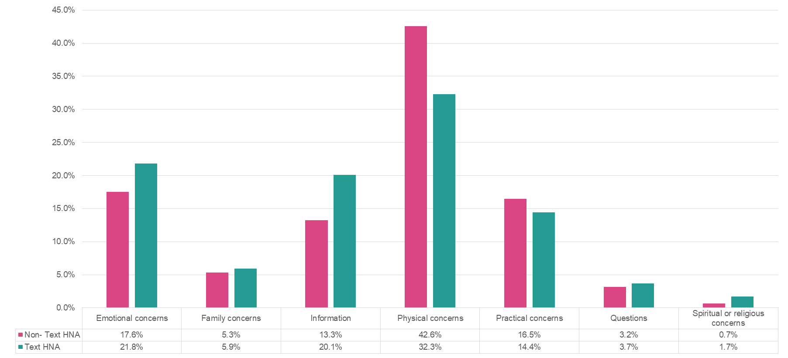
Concerns Raised per Domain

Slide 16
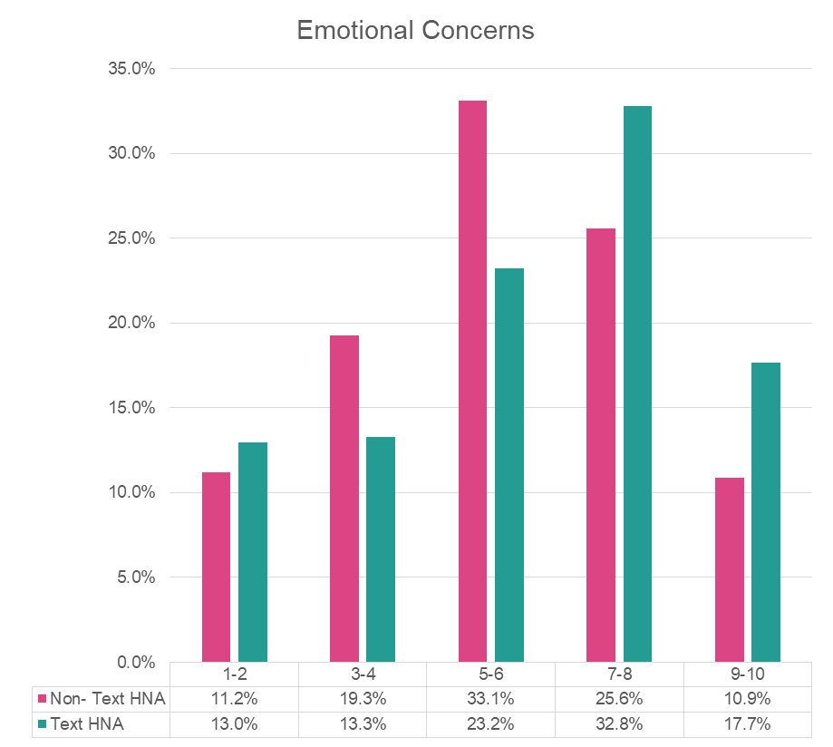
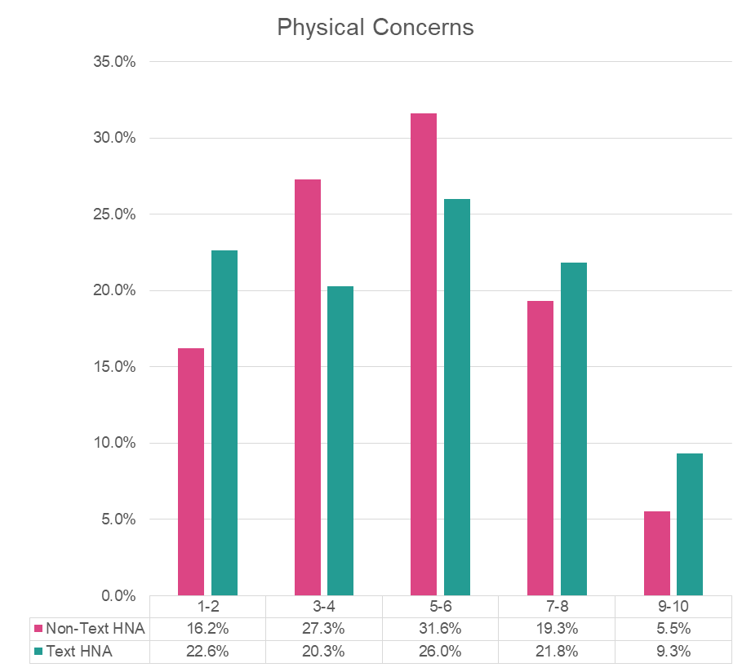
Average Concern Scoring across Concern Domains
Low: Scores of 1 to 3 Mid: Scores of 4 to 6 High: Scores of 7 to 10
Notes:
Emotional Concerns raised by Text HNA are about 1.5 times as likely to be scored between 7 and 10 compared to those raised during a HNA offered by other means.
Emotional Concerns make up an extra 4.2% of concerns raised when offered via text message compared to those offered by other means.

Slide 17
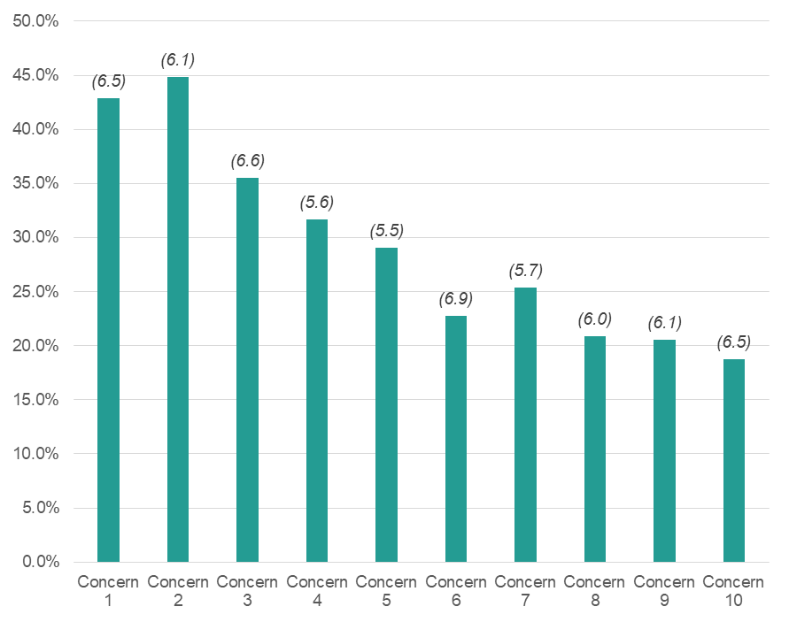
Text HNA Concerns Raised
Top 10 Concerns
% of Patients Raising Concern & Average Score
Rank | Concern
1 | Thinking about the future
2 | Worry, fear or anxiety
3 | Uncertainty
4 | Tired, exhausted or fatigued
5 | Sleep problems
6 | Money or finance
7 | Pain or discomfort
8 | Sadness or depression
9 | Partner
10 | Work or education
(n) = Average Score
Data from 651completed eHNA assessments between 1st September 2020 and 31th August 2021, offered by SMS and with at least one concern raised
Notes:
‘Worry, fear or anxiety’ is the top concern raised across both modes of HNA delivery.
45% of patients completing a text HNA raised this as a concern, with an average score of 6.1, compared to 23% of patients completing a HNA by other means, with an average score or 5.7

Slide 18
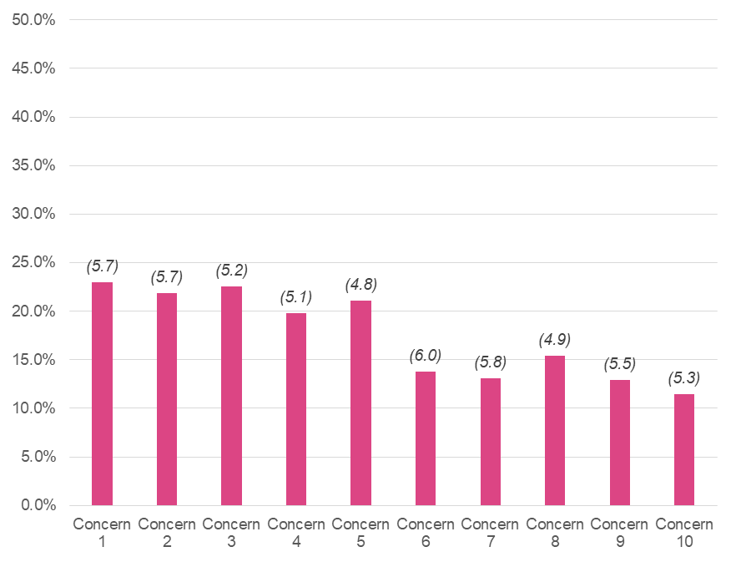
Non-Text HNA Concerns Raised
Top 10 Concerns
% of Patients Raising Concern & Average Score
Rank | Concern
1 | Worry, fear or anxiety
2 | Money or finance
3 | Pain or discomfort
4 | Tired, exhausted or fatigued
5 | Eating, appetite or taste
6 | Uncertainty
7 | Thinking about the future
8 | Changes in weight
9 | Moving around (walking)
10 | Breathing difficulties
(n) = Average Score
Data from 1592 completed eHNA assessments between 1st September 2020 and 31th August 2021, not offered by SMS and with at least one concern raised
Notes:
‘Worry, fear or anxiety’ is the top concern raised across both modes of HNA delivery.
45% of patients completing a text HNA raised this as a concern, with an average score of 6.1, compared to 23% of patients completing a HNA by other means, with an average score or 5.7

Slide 19
Concerns Analysis Summary
On average, HNAs offered by text raise a higher number of concerns and information needs compared to those not offered by text.
29% of HNAs not offered by text message raised nil concerns, a percentage almost halved to 17% in HNAs offered by text.
Emotional Concerns raised by Text HNA are about 1.5 times as likely to be scored between 7 and 10 compared to those raised during a HNA offered by other means.
Emotional Concerns make up an extra 4.2% of concerns raised when offered via text message compared to those offered by other means.
‘Worry, fear or anxiety’ is the top concern raised across both modes of HNA delivery.
45% of patients completing a text HNA raised this as a concern, with an average score of 6.1, compared to 23% of patients completing a HNA by other means, with an average score or 5.7

Slide 20
Patient welfare calls- Wave two:- February 2021
Patients referred by CNS, AHP or self
Receive call from Cancer Support Worker
Protocol and FAQs provided to respond to common queries ( eg. Vaccine)
Initial call undertaken, notes recorded in EPR and feedback to initial referrer
Clinical issues referred to CNS
Over 60 patient received a call
Average time 10-15 min
Most patients received a single call.
Patients welcomed calls reported feeling reassured, pleased, minor queries answered
Notes:
As a result of the findings it was clear that patients needed additional support , with clinical resources being scarce we worked with out team of Macmillan cancer support workers to implement patient welfare calls.

Slide 21
Next Steps
PCSP (HNA) offered by text message now make up 30% of all HNAs offered within the trust.
Since rolling out the Text Message HNA in April 2020, over 1700 HNAs have been sent to patients via SMS with a 75 % positive response rate.
A valuable additional tool in the delivery of personalised cancer care.
A number of areas for further investigation in terms of quality and impact of PSCP.
Highlighted need to provide additional support to patients.
Thank you
Notes:
Covid -19 has had a major impact on the delivery of personalised cancer care.
Need to look to innovative solutions to provide the support needed
Overall HNA rates increased from 68% March 2020 to 80% December 2020.

