Slide 1


Delirium - Prevention
Transforming Acute care of Older Adults with Frailty
@DeliriumKrish
@Fix_psych

Slide 2
Dr M S Krishnan FRCPsych
Consultant in Old Age & Liaison Psychiatry
Senior Clinical Director
TEWV NHS Foundation Trust
Chair, Faculty of Old Age Psychiatry @RCPsych
Associate Dean, Regional Delirium Lead HEE NE
Dr Eleni Fixter MRCPsych
Consultant in Old Age
Trust Doctor Tutor
Delirium Pathway Lead
TEWV NHS Foundation Trust

Slide 3
Plan of the Talk
Why we need to know about Delirium?
Delirium and COVID-19
Delirium Frailty falls
Key steps you can take to prevent/reduce risk of some one developing delirium
Resources

Slide 4
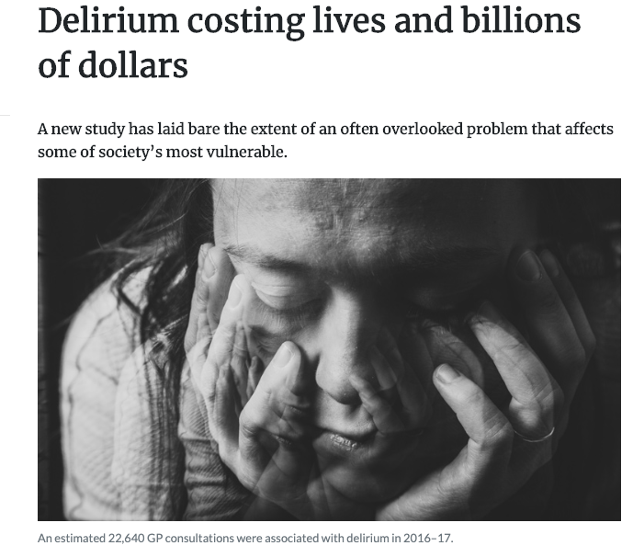
News Flash

Slide 5
What is Delirium
Delirium is an acute onset syndrome with disturbance in
attention, awareness and cognition
There is normally an underlying cause
COVID-19 COULD BE ONE

Slide 6

Increase Morbidity
Patient & Carer Distress
Why do we need to identify delirium?
20% mortality (in 3 months)
8 fold increase
of dementia in 2yr
1 in 8
cases are preventable
2 in 5 dead in 12 months
1 in 4 admissions to hospital
20% don’t go back to baseline
Notes:
Changing the mindset of ‘its ok to be a bit confused’

Slide 7
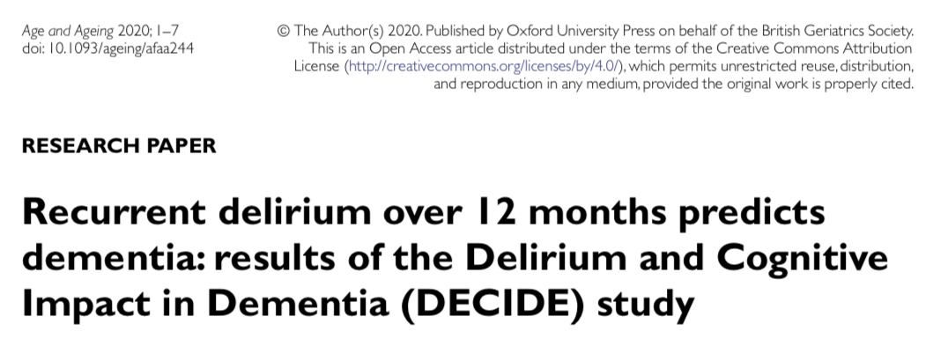
Why we need to know about delirium in Older Adults?
Delirium increases risk of future cognitive decline.
Longer duration, more severe delirium and more episodes of delirium were associated with worse cognitive outcomes.
Delirium may be a potentially modifiable risk factor for dementia.

Slide 8
Burden
Delirium Occurrence has not changed over 4 decade 1980- 2019 (23%) Davies et al (2019)
Clearly indicates a need for preventative strategies = Risk Reduction

Slide 9
Vulnerability
Precipitant
High
Major Event
Dementia
Meningitis, sepsis
Multi-morbidity
Surgery
Fall and Fracture
Sensory Impairments
Dehydration
Polypharmacy
Urinary Catheter
Healthy and Fit
Hypnotic Tablet
Low
Minor Event
Multifactorial Model for Delirium (from Inouye 2006)
Notes:
9

Slide 10
Vulnerability
Precipitant
High
Major Event
Dementia
Meningitis, sepsis
Frailty
Multi-morbidity
Surgery
COVID-19
Fall and Fracture
Sensory Impairments
Dehydration
Polypharmacy
Urinary Catheter
Healthy and Fit
Hypnotic Tablet
Low
Minor Event
Multifactorial Model for Delirium (from Inouye 2006)
Notes:
10

Slide 11
Risk Factors
COVID-19
Age
Frailty
Cognitive impairment
Visual impairment
Hearing impairment
Medical comorbidity
Polypharmacy
Frailty

Slide 12
Delirium – Frailty

Slide 13
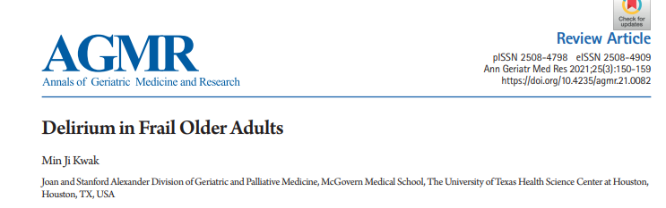
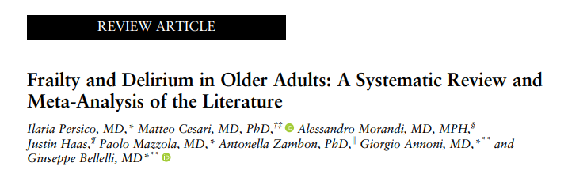
Delirium and Frailty in Older Adults
Both interlinked
Delirium can trigger/worsen frailty
Frailty is a risk factor for some one developing delirium and delayed recovery
Both can affect independent functioning at home

Slide 14


Delirium – Diagnosis

Slide 15
Diagnosis – Always clinical
No tool is diagnostic
There are approximately 59 tools for various settings
In older adults some tools may be difficult to administer
  Sensory impairment
  dementia
  Pain/anxiety

Slide 16
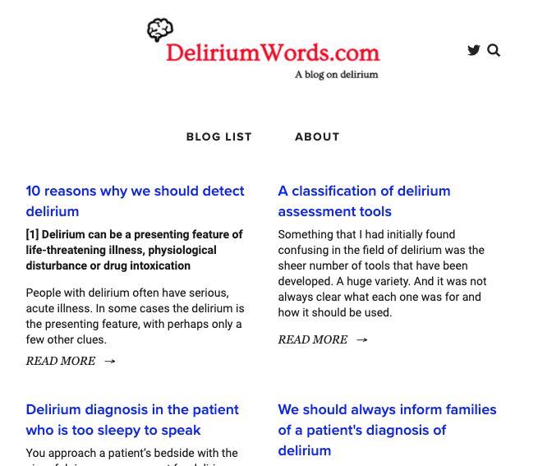
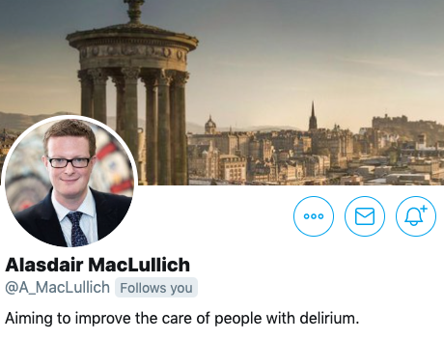
Tools
SQiD
4AT
CAM
………

Slide 17
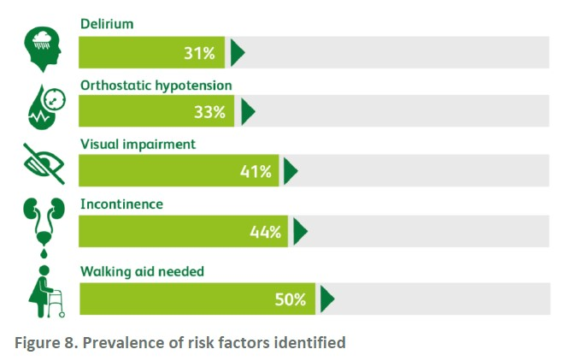
Detecting Delirium – We need more

Slide 18
Delirium – Management

Slide 19
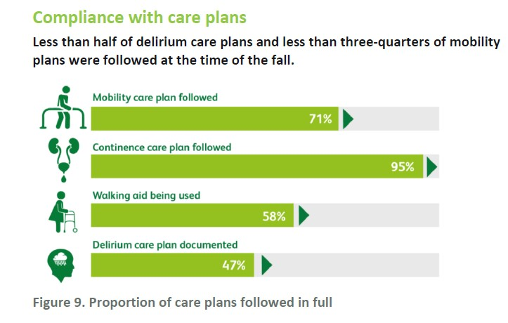

Slide 20

Principles of Delirium Management
Early Detection
Non-Pharmacological management
Medication carefully considered
Education
Prevention/ Risk Reduction

Slide 21
Non-Pharmacological
Good light
Glasses and hearing aid
Distraction
Minimise noise
Consistent communication
Early mobilisation

Slide 22
Pharmacological
Medicine optimisation
Deprescribing
Consider drug interaction with antiviral
Avoid Polypharmacy
Anticholinergic burden

Slide 23

Risk
Need
Side-effects
Chemical Restraint

Slide 24
Benzodiazepines
No Role for Benzodiazepine in the management of Delirium, can worsen the symptoms
Some indication for management of agitation in Dementia with Lewy bodies, Parkinson's disease with Dementia
Where antipsychotic medication are contraindicated - may be a role with caution
Midazolam - End of life severe agitation

Slide 25

Awareness
Skills
Knowledge

Slide 26
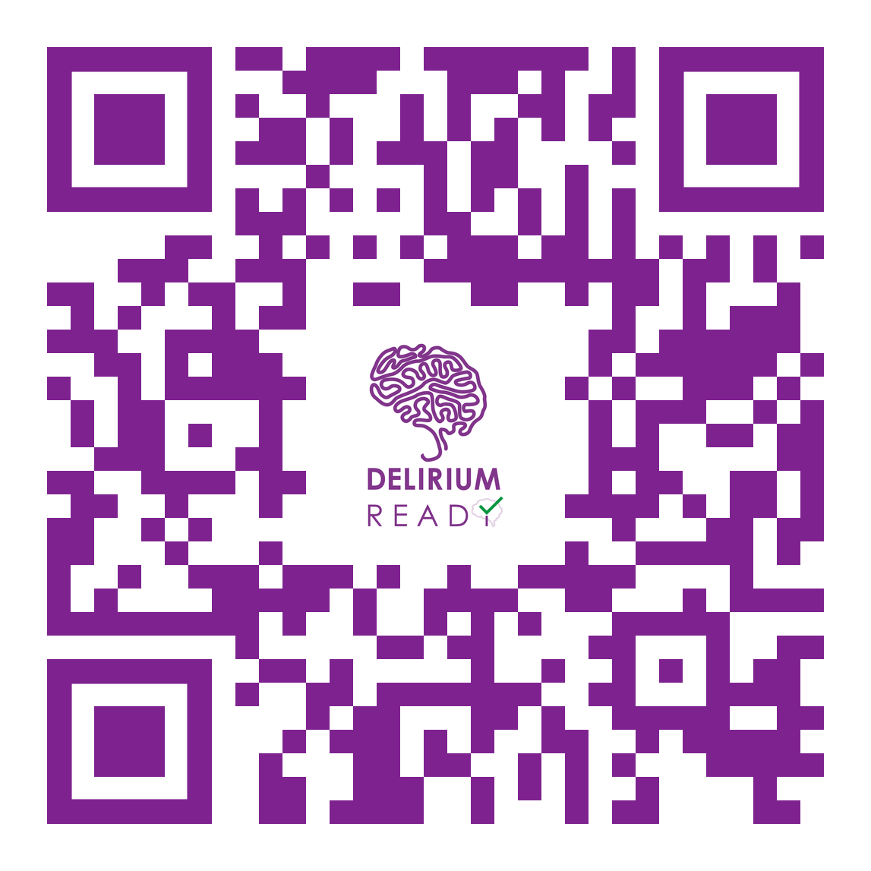
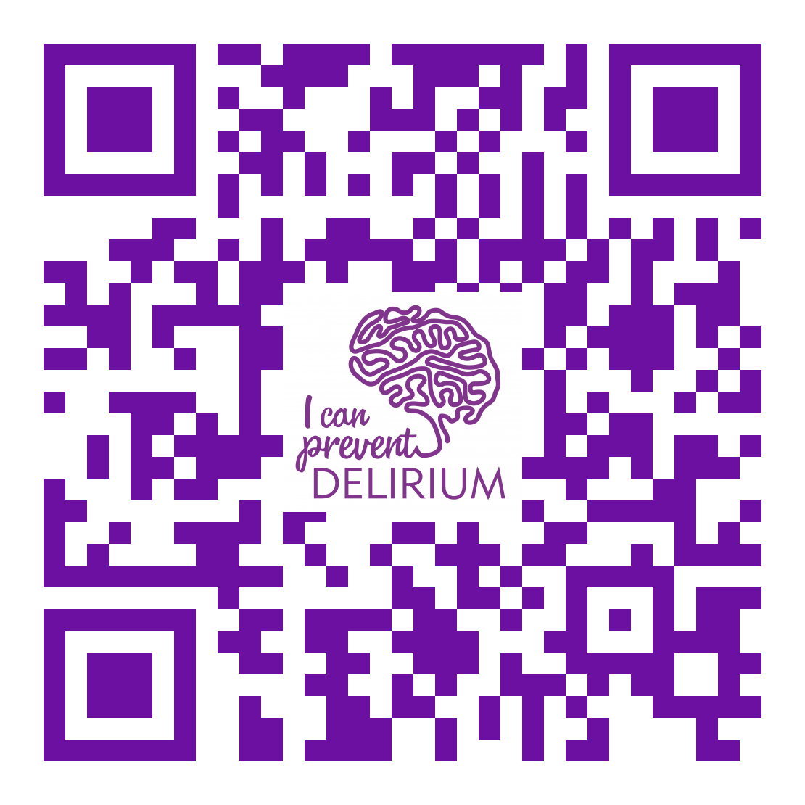
Delirium Educational Videos
https://youtu.be/2Hg1VP-Enw4
https://youtu.be/BPfZgBmcQB8

Slide 27
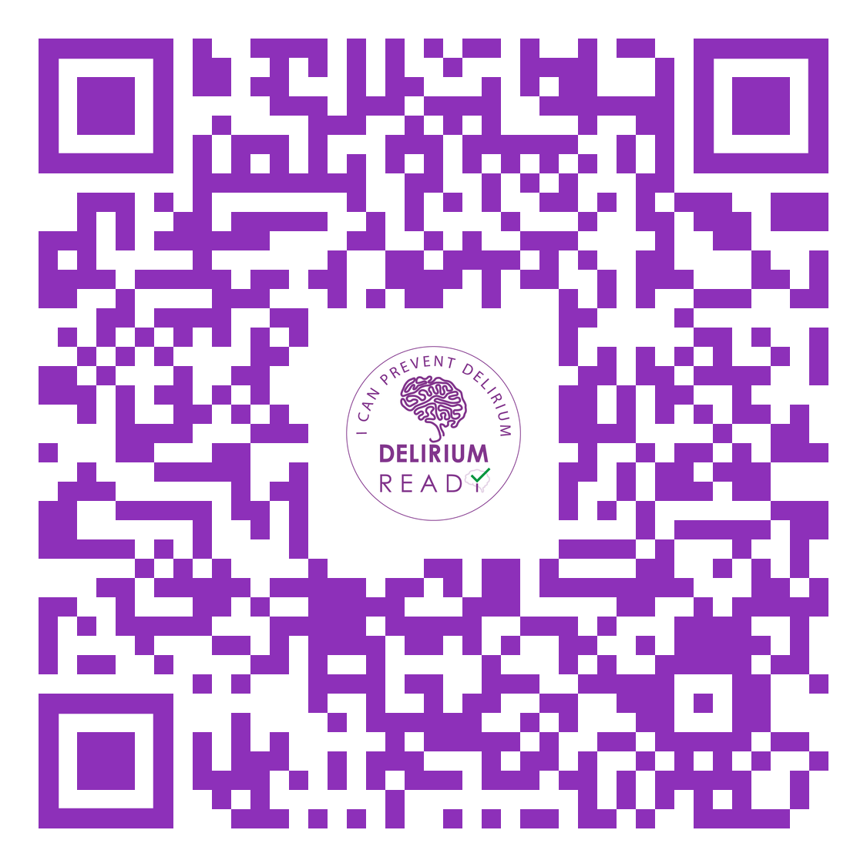

We have launched a Delirium Wheel app for care homes
iOS or Google Play store

Slide 28
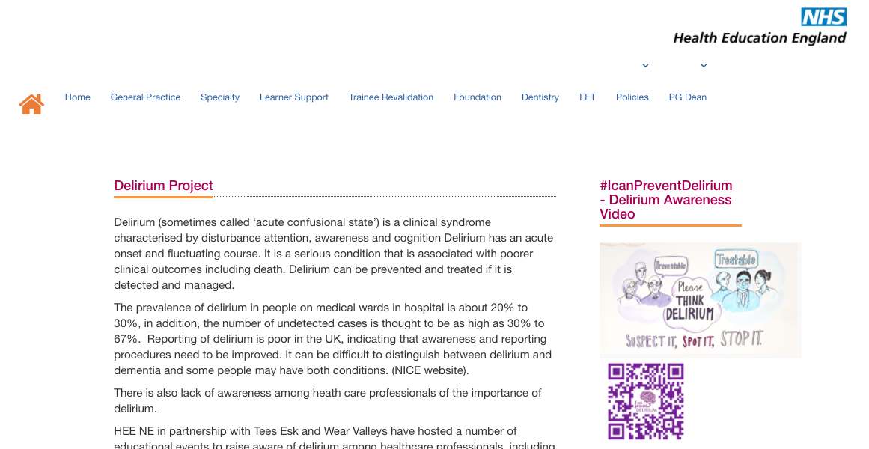
Resources
Google – HEE NE Delirium

Slide 29
Take Home….
Delirium can be prevented / Risk Reduction
Try non-pharmacological approach before considering any medications
Delirium is a risk factor for Dementia and please do not forget delirium superimposed dementia
Be mindful of presentation with COVID
Delirium is everybody’s Business

Slide 30

Thank You
@DeliriumKrish
@charliemacksey

Slide 31
Are you?
@DeliriumKrish
@Fix_psych

