Slide 1
Learning from Deaths During Covid 19
Dr Ellen Makings
Regional Medical Examiner East of England

Slide 2
The session
Brief overview of the ME system
Learning from Deaths and the ME system
How do we learn from our mortality processes
ME service in the Coronavirus pandemic
Non acute roll out of the ME service
Our experience

Slide 3

Long Term Plan/ Patient Safety Strategy
The NHS will:
adopt and promote key safety measurement principles and use culture metrics to better measure how safe it is
use new digital technologies to support learning from what does and does not go well, by replacing the National Reporting and Learning System with a new safety learning system
introduce the Patient Safety Incident Response Framework to improve the response to, and investigation of, incidents
implement a new Medical Examiner system to scrutinise deaths
improve the response to new and emerging risks, supported by the new National Patient Safety Alerts Committee
share insight from litigation to prevent harm.

Slide 4
Why we need Medical Examiners
Introduction of medical examiners is a key recommendation in several high-profile independent enquiries

Slide 5
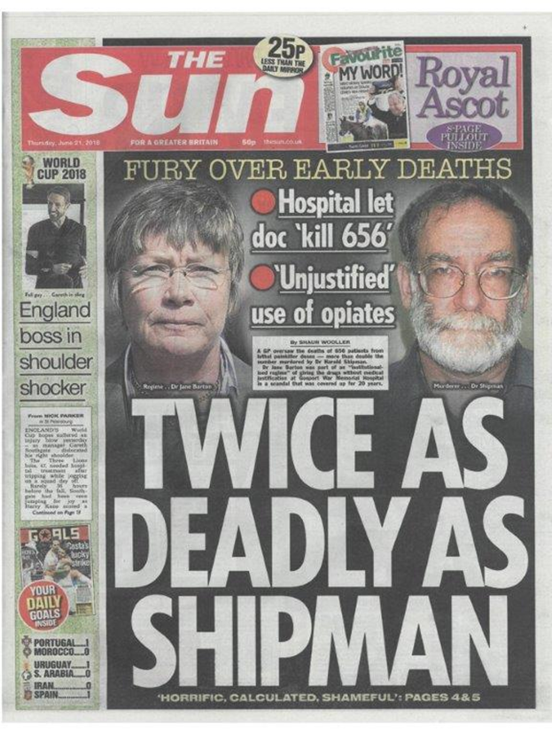
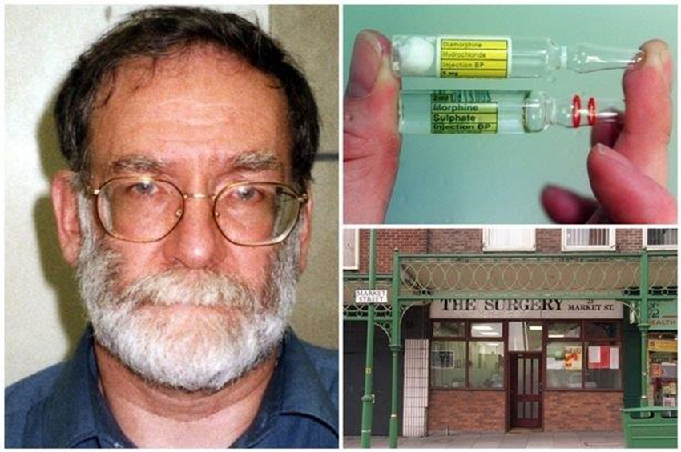
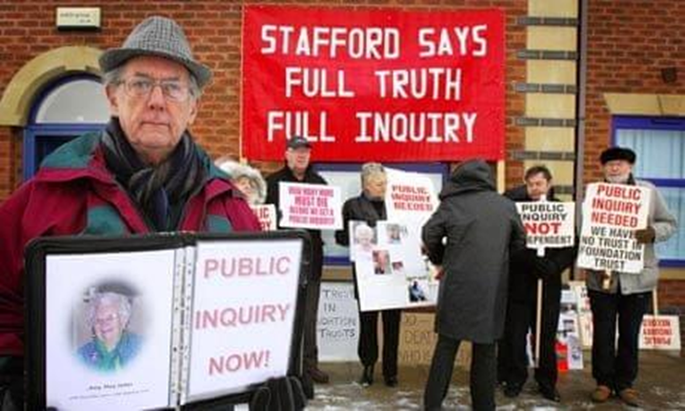
In all of these enquiries, families did not feel heard when concerns were expressed about the care their loved ones had received

Slide 6
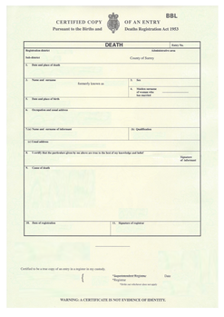
Why we need Medical Examiners
The introduction of medical examiners is designed to:
provide bereaved people with opportunities to ask questions and raise concerns
enhance safeguards for the public and healthcare providers through improved and consistent scrutiny of all non-coronial deaths
improve the quality and accuracy of medical certification of cause of death, and ensure referrals to coroners are appropriate
support local learning and improvement by identifying matters for clinical governance and related processes
align with existing mortality initiatives

Slide 7
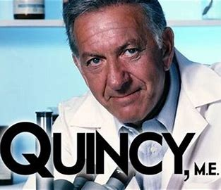
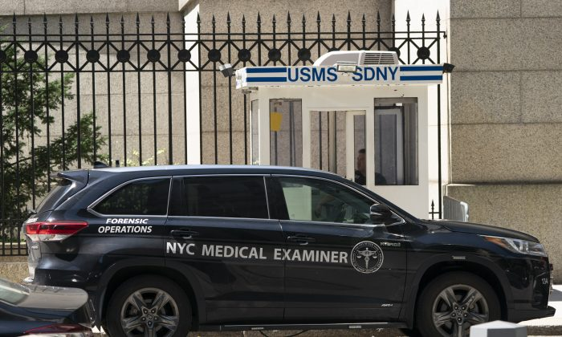
What do Medical Examiners do?
Medical examiners are specially trained senior doctors who provide independent scrutiny of deaths which are not investigated by coroners. They focus on three questions:
What do patients die from?
Accurate completion of Medical Certificate of Cause of Death (MCCD)
Does the death need reporting to the coroner?
Timely and accurate referral to the coroner
Are there any clinical governance concerns?
Early detection and notification

Slide 8
Who Can Be A Medical Examiner?
At least 5 years’ experience as a fully registered practitioner
Currently practising in England or Wales or have retired in the last 5 years
Hold a license to practise with the GMC
What training is required to become a Medical Examiner?
Up to date knowledge of medical conditions, treatment and causes of death
Knowledge of relevant legislation and processes
Knowledge of local and national clinical governance systems
Strong communication skills
Ability to work in a multi disciplinary team
26 mandatory eLfH e-learning modules (8-10 hours)
Attend face to face training day ( RCPath)

Slide 9
How do Medical Examiners work?
The role of medical examiners is to examine non-coronial deaths to:
agree the proposed cause of death with the attending doctor and the ensure accuracy of the medical certificate cause of death (MCCD)
discuss the cause of death with bereaved people or informant in lay terms and establish if they have concerns about the care that could have impacted or led to death
a medical advice resource for the local coroner
inform the selection of cases for further review under local mortality arrangements and other clinical governance procedures.

Slide 10
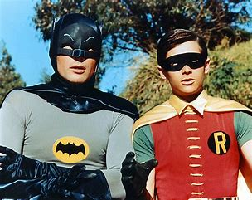
Medical Examiner offices in acute trusts
Medical Examiners
  Lead Medical Examiner
  Part time, consultants or GPs (typically 1 or 2 PAs pw)
  Online and face-to-face training
  1 WTE per 3000 annual deaths
Medical Examiner Officers
  Support medical examiners
  Will be able to provide advice on medical terminology and causes of death, and discuss these with medical staff and bereaved people
  Online and face-to-face training
  3 WTEs per 3000 annual deaths

Slide 11
Medical examiner scrutiny
25 minutes on average per case – notes scrutiny, cremation 5 papers , view body
Interaction with bereaved people
Interaction with the attending doctor who is completing MCCD
All within 24 hours of the death being notified to the medical examiner office, and records received
(2) and (3) may be delegated to a Medical Examiner Officer
The note scrutiny is described as a proportionate review

Slide 12
Medical Examiners and Learning from Deaths

Slide 13
Implementing national guidance on Learning from Deaths July 2017| page23
‘The introduction of the medical examiner’s role, expected to be in April 2019, should therefore further clarify which deaths should be reviewed under the Learning from Deaths framework. Medical examiners will be able to refer the death of any patient for review by the most appropriate provider organisation(s). This new mechanism should ensure a systematic approach to selecting deaths for review, regardless of the setting or type of care provided in the period before a patient’s death’

Slide 14
Implementing national guidance on Learning from Deaths page 24
Link with mortality rates
The Learning from Deaths work does not replace the need to consider mortality data.
Hospital standardised mortality ratio (HSMR), summary hospital-level mortality indicator (SHMI), crude mortality rates and other data are all sources of information that support trusts to understand where to focus improvement work
Mortality governance processes should consider mortality rates and the results of case record reviews and investigations as part of a single clinical governance framework. Multiple sources and types of data and information – not just limited to mortality – should be used to help a trust understand how to improve care.
Boards should be aware that their organisations can have low mortality rates and discover substantial problems in care of patients who die, or high mortality rates but relatively few identified problems in care.
Mortality rates are a statistical construct that is based solely on what is in the coded data and hence are limited in measures of acuity and pathology compared to the depth of clinical information available in case note reviews.

Slide 15
If Concerns are Raised the Medical Examiner can ……
Refer to coroner to investigate
Inform Medical Director - concerns re a Doctor’s conduct
Inform Clinical Governance of Trust or external parties – eg care home, primary care, ambulance service
Complete incident form to Serious Incident Framework
Refer case for a Structured Judgement Review
Invite ward team down to the meet the family to discuss concern
Introduce family to PALS team
Most severe
Least severe

Slide 16
Medical Examiners and Learning from Deaths
Important role in the LFD process
ME scrutiny is not a replacement for a Structured Judgement Review
ME should not carry out ME scrutiny and SJR on same patient
Role is to detect , signpost concern
Medical Examiner Officers are more likely to see emerging ‘ themes’ as they are the consistent member of the office.

Slide 17
Ensuring Learning from the Mortality Review Process and Governance
ME s are professionally accountable to National Medical Examiner via the Regional Medical Examiner
Employed by the Acute Trust Provider and should be part of the Trust Mortality Review Board
ME should report any concerns or themes that are emerging
ME should also receive feedback at this forum re cases highlighted as SI or requiring SJR.
MRG should then report to the Quality and Safety Group of the organisation
If an ME is not satisfied with the Trust’s response to a concern , the ME can raise with their Regional Medical Examiner

Slide 18
Medical Examiner Implementation

Slide 19
How we are implementing
Medical Examiners
Medical examiners form part of the DHSC’s death certification reforms programme
The Health and Care Bill includes provisions to establish the statutory medical examiner system.
Work started in 2019/20, establishing medical examiner offices on a non-statutory basis. There are now 129 medical examiner offices based in NHS acute trusts.
In June 2021, all NHS organisations were asked to start implement processes to enable medical examiner offices to provide independent scrutiny of all non-coronial deaths.

Slide 20
Medical Examiner Infrastructure

Slide 21
Implementation - progress
2019 | 2020 | 2021 | 2022
Dr Alan Fletcher appointed National Medical Examiner
NME’s good practice guidelines published
Health and Care Bill provisions for statutory medical examiners
National team established
(Policy and Programme Lead, Office Coordinator, Finance Analyst)
Medical examiner offices established in all acute trusts
National Medical Examiner’s good practice series
Regional medical examiners and regional medical examiner officers (all 0.4 FTE)
NHS healthcare providers start preparing for medical examiners to scrutinise all non-coronial deaths
Confirmed funding for medical examiner offices
RCPath has trained ~1,400 senior doctors as medical examiners

Slide 22
Medical Examiners and the Coronavirus Pandemic

Slide 23

Coronavirus Act 2020
Sections 18 + 19 look at Death Certification
‘ In the event of a severe Coronavirus outbreak, the number of deaths would increase, as would absence rates for the healthcare workforce : this would have a significant impact, and increase in pressure, on registered medical practitioners, registration services and coroners dealing with a larger than normal number of deaths to be registered

Slide 24

Medical Examiner Services During the Pandemic
As part of the response to extreme pressures caused by COVID-19, it is a local decision whether or not to suspend the ME system at a Trust.
In the emergency period, it is reasonable to deploy medical examiners and medical examiner officers according to local requirement. However, medical examiners and medical examiner officers may still support the death certification process, releasing valuable front line clinician time if needed.

Slide 25
Coronavirus easements
A Doctor can complete an MCCD if they have not known in life if the patient has been seen by a Doctor in the last 28 days or after death
The doctor knows the cause of death ‘ to the best of their knowledge and belief’

Slide 26
Coronavirus Act expires 24 th March 2022
The Coronavirus Act 2020 expires at midnight on 24 March 2022. Some changes have been retained on a permanent basis through other measures, and other processes revert to previous practice.
The following provisions are continuing after 24 March 2022:
The period before death within which a doctor completing a Medical Certificate of Cause of Death (MCCD) must have seen a deceased patient will remain 28 days (prior to the coronavirus pandemic, the limit was 14 days).
It will still be acceptable for medical practitioners to send MCCDs to registrars electronically.
The government’s intention is that the form Cremation 5 will not be re-introduced after the Coronavirus Act expires.
The following emergency provisions are changing with the expiry of the Act:
The provision temporarily allowing any medical practitioner to complete the MCCD, introduced as a temporary measure by the Coronavirus Act, will be discontinued.
Informants will have to register deaths in person, not remotely

Slide 27
Medical Examiners in Covid 19
Some ME offices suspended if staff redeployed to frontline
MOST continued to operate to maintain mortuary flow and importance of ME process.
Doctors who needed to shield were redeployed to Medical Examiner roles, online training completed prior to starting.
Doctors on the frontline did not need to come to bereavement suite, able to concentrate on their clinical duties
Support for the bereaved – VITAL – limited communications from wards. A chance to speak to a senior Doctor about what happened to their loved one.
MCCDs able to completed in a timely manner and then scanned and sent to the Registration services electronically
ME s also able to complete Cremation form 4

Slide 28
Patient Safety in Covid
Same principles apply throughout pandemic
Cases of nosocomial Covid deaths identified to be for SJR and IPC Root Cause analysis
Any concerns raised from bereaved passed on
Coroners referrals as per guidance
Where occupational exposure to Covid has led to the death of a worker.

Slide 29
Covid 19 Staff Deaths
Secretary of State for Health and Social Care requested the Medical Examiner service to review every death of a member of NHS staff or social care who died of Covid 19
To provide an independent review to determine if the person’s work brought them directly in contact with a known coronavirus hazard.
To discuss with the bereaved family if they had concerns to raise.
To ensure a Coroner referral had been made if occupation related
RME To write to the CEO of the Provider to advise if a notification to HSE under RIDDOR regulations was required.

Slide 30
Non acute roll out of Medical Examiners

Slide 31
Non acute roll out
The Government introduced the Health and Care Bill on 6 July 2021, reinforcing the Government’s commitment to introduce a statutory medical examiner system.
The Clause of the Health and Care Bill relating to medical examiners completed House of Commons report stage on 23 November 2021 and first reading in the House of Lords was on 24 November 2021.
The Health and Care Bill will amend the Coroners and Justice Act 2009 to allow NHS bodies to appoint medical examiners instead of Local Authorities in England, and Welsh NHS bodies in Wales
Subject to parliamentary process we do not expect the statutory system to be introduced before Summer 2022.

Slide 32
Operational Model
Existing Medical Examiner offices in acute Trusts are being asked to take on their local community deaths
Regional teams are aligning GP practices, Care Homes, Hospices etc with ME offices using mapping tools
Coronial boundaries being followed if possible
Offices have been recruiting ME s and MEO s to prepare for the increase in cases

Slide 33
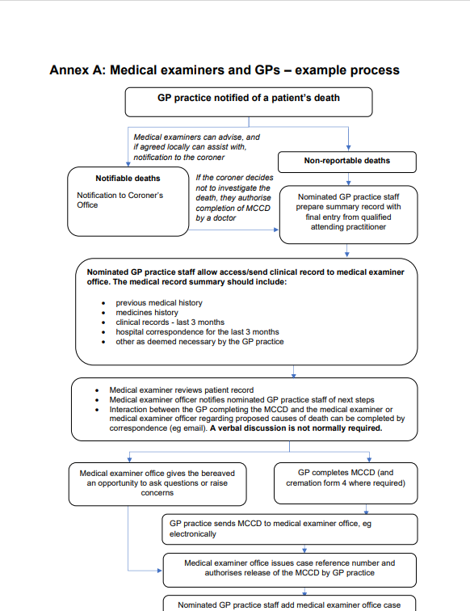
A MORE COMPLEX PROCESS…..
Process needs to work for GPs and ME office
GPs are busy people!
GP availability
Pressures of Covid, backlogs, vaccination already on primary care
Seen as extra work
Why now?
GP engagement vital
Data sharing agreements
Opt out patients

Slide 34
Data Sharing
In autumn 2020, NHS England and NHS Improvement agreed with DHSC to make a submission to the Confidentiality Advisory Group (CAG) to provide a “beyond doubt” basis for healthcare providers to share confidential patient data for medical examiner scrutiny in the non-statutory phase. This related specifically to extending medical examiner scrutiny to non-acute settings in the non-statutory phase. Details of the approved application (ref 21/CAG/0032) can be found on the Health Research Authority's website
The S251 approval from the CAG allows other healthcare organisations to share confidential patient data for medical examiner scrutiny.

Slide 35

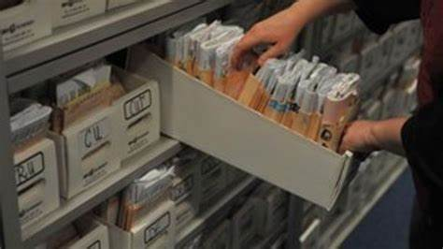


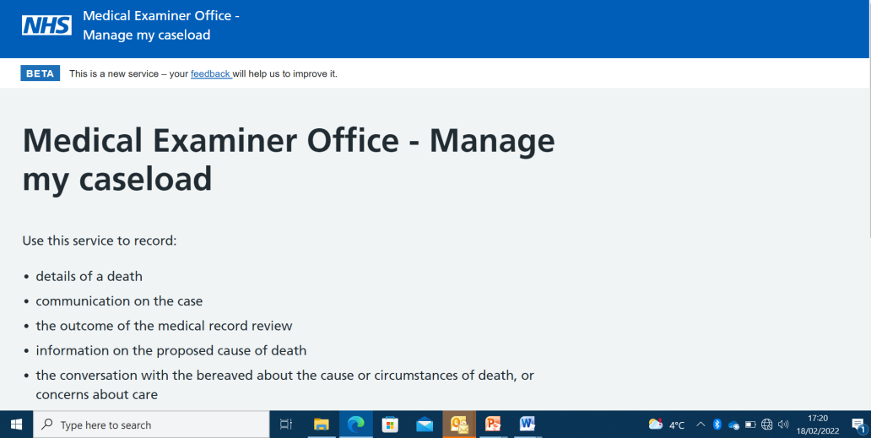

Access to GP notes

Slide 36


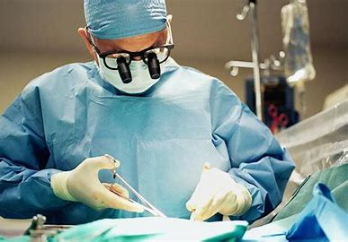
Our experience
Medical Examiner Office opened 2019
100 % Scrutiny of all in hospital deaths completed
Small number of deaths ~200/year
Good clinician engagement
Community deaths (1900) assigned to Royal Papworth ME Office
Team of 7 ME s, 2 MEOs now in place
Community roll out has started
Good working relationship with CCG and LMC
LMC Chair volunteered to be our first GP practice

Slide 37
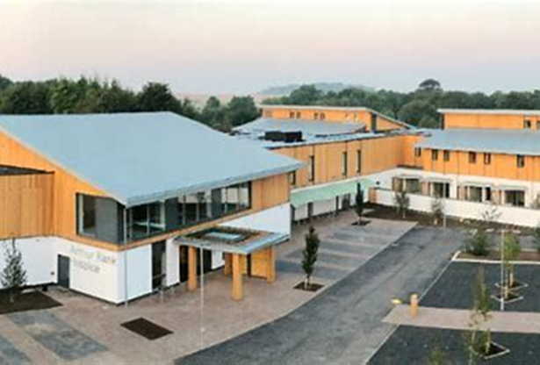
Our successes
New ME office at Arthur Rank Hospice
4 GP practices onboarded and 1 hospice
2018-19 85.2 % of all deaths referred to the Coroner ( pre ME)
2020-2021 44.5% of all deaths referred to the coroner ( post ME )
‘The excellent ME scrutiny forms and input from an ME is enabling us to deal with families better also. This is probably a value added element at our end but also for the hospital also – we have been able to say to some families in the light of the scrutiny that it is a clear post op complication etc and we have then avoided an inquest and saved a lot of clinician time.
I have the highest regard and utmost praise for the ME system and the benefits it has brought’’

Slide 38



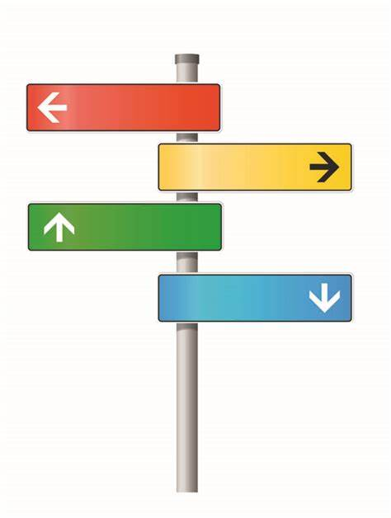
In Summary…….

Slide 39
Thank You For Your Time

