Slide 1
Improving services for people with personality problems The ICD-11 classification of personality disorder: a tortuous pathway through science, politics and stigma
Peter Tyrer, Emeritus Professor of Community Psychiatry, Imperial College, London and Consultant in Transformation Psychiatry, Lincolnshire Partnership NHS Foundation Trust, UK

Slide 2
Declaration of interest
I was the Chair of the World Health Organisation Revision Group for the Classification of Personality Disorders (2010-2017)

Slide 3
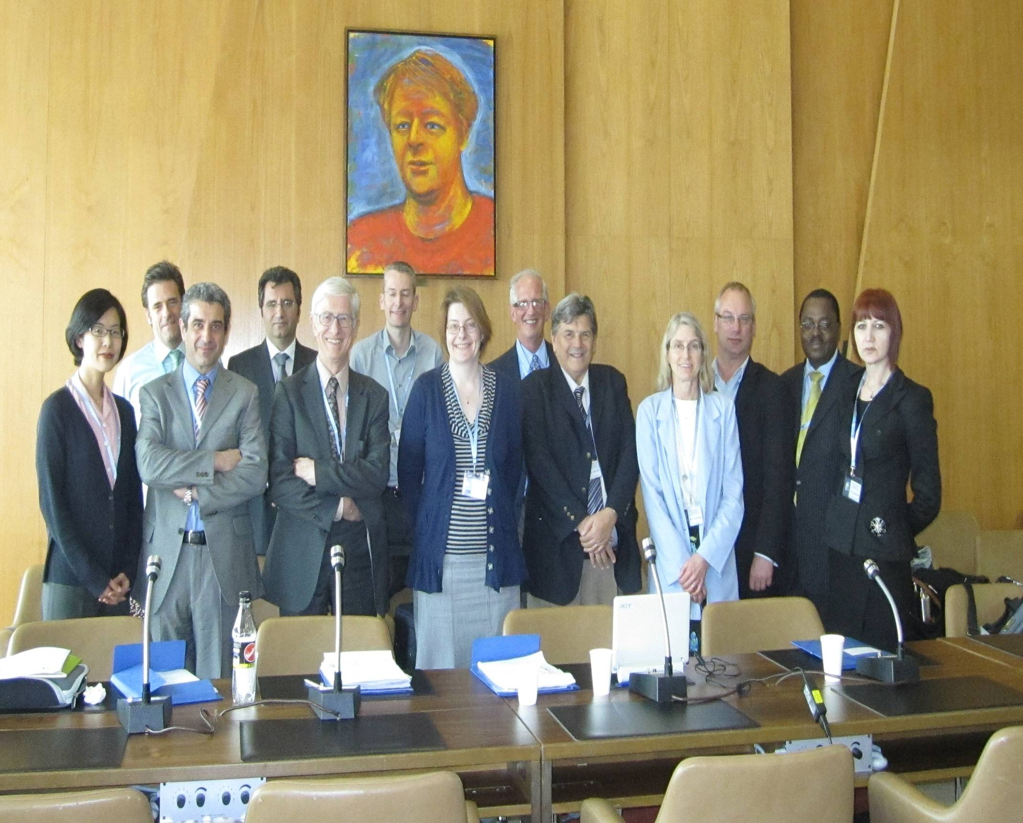
This is the ICD-11 revision group for the classification of personality disorders
Korea Switzerland Italy Iran UK UK Wales US Argentina US New Zealand Kenya Serbia

Slide 4
Three reasons why the personality disorder diagnosis is stigmatized
It is a criticism of the person
It is untreatable
3. It never gets better

Slide 5
All of these are scientifically wrong

Slide 6
1. It is a criticism of the person
It is a brief account of two central aspects – a problem in interaction with people and a somewhat distorted understanding of others
These difficulties have been present for at least two years
The criticism, if thought of in this way, is one of behaviour, not the person

Slide 7
2. It is untreatable
The common argument used here is that because basic personality is relatively unchanging the same must be true of personality disorder, so if you have this diagnosis there is nothing either you, or anybody else, can do to improve it
The latter part of this talk will show all the treatments that are available and their likely value

Slide 8
3. It never gets better
Unfortunately this has been a largely unspoken belief for nearly 100 years. It was never based on evidence.
Personality disorder is one of the most unstable diagnoses in psychiatry

Slide 9
Nottingham Study of Neurotic Disorder (1983-2020)
200 patients with common mental illness involved initially in a trial of treatments and then followed up over 30 years. Clinical symptoms and service contacts recorded on 12 occasions over 30 years; personality status assessed at baseline and at 2, 12 and 30 years. At baseline 36% had personality disorder. Personality strengths assessed at 30 years.
Main results: Those with personality disorder at baseline had worse outcome than others, took more drug treatment, had more suicidal behaviour, had more day hospital and social work involvement and more mental state pathology – but this lessened over time. Personality status fluctuated greatly over time.
Main references:
Tyrer et al (1988). Lancet, 332, 235-40 (main paper), Tyrer et al, (1990). Psychological Medicine, 20, 423-31, Tyrer et al, 1993, British Journal of Psychiatry, 162, 219-226 ; Kingdon et al, (1996) British Journal of Psychiatry, 169, 93-97. Tyrer et al, 2004, Psychological Medicine, 34: 1385-1394; Knerer et al, 2005, Acta Psychiatrica Scandinavica, 112, 224-232. Tyrer et al, 2021, Personality and Mental Health, 32-39; Yang et al (2022). Australian and New Zealand Journal of Psychiatry, 56, 260-269.
.

Slide 10
Australian and New Zealand Journal of Psychiatry, 2022: 56, 260-269.

Slide 11
Almost all of these were
patients with no personality
disorder at baseline

Slide 12
ICD-10 and DSM-IV Classification of Personality Disorders
ICD-10
DSM-5 (now DSM-IV)
Paranoid personality disorder
Schizoid personality disorder
Dissocial personality disorder
Emotionally unstable personality disorder – i. Borderline
ii. Impulsive
Histrionic personality disorder
Anxious personality disorder
Dependent personality disorder
Anankastic personality disorder
Paranoid personality disorder
Schizoid personality disorder
Schizotypal personality disorder*
Antisocial personality disorder*
Borderline personality disorder*
Histrionic personality disorder
Narcissistic personality disorder*
Avoidant personality disorder*
Dependent personality disorder
Obsessive-compulsive personality disorder*
12
These labels are primarily the legacy of one expert in 1923 (Kurt Schneider)

Slide 13
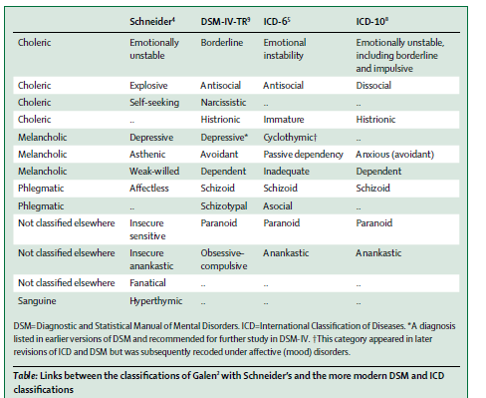
Galen
From: Tyrer P, Reed GM, & Crawford MJ (2015). Classification, assessment,
prevalence and effect of personality disorder. Lancet, 385, 717-726.

Slide 14
Better and more confident usage of diagnosis needed
7% have personality disorder in the population but only 3% have it if
they are an in-patient in a psychiatric hospital
F60 | Specific personality disorders
F61 | Mixed and other personality disorders
F63 | Habit and impulse disorders

Slide 15
Australia Gen. Psych
Notes:
Gen psych shorter stays in public, private psych hospitals (did not receive care in a specialized psych unit)
Specialized psych much longer stays in public psych hospitals, more voluntary than involuntary, younger (mostly 25-44)

Slide 16
Australia Gen. Psych
60.31 Borderline 60.9 personality disorder unspecified, 60.2 dissocial 60.7 dependent
Notes:
Gen psych shorter stays in public, private psych hospitals (did not receive care in a specialized psych unit)
Specialized psych much longer stays in public psych hospitals, more voluntary than involuntary, younger (mostly 25-44)

Slide 17
Yet we know from research data
that personality disorder is very
common in the community and in
all parts of psychiatric practice

Slide 18
Prevalence of personality disorder in different settings (research findings)
80-90% Tertiary Psychiatric Services
70-80% Prison
50-60% Enhanced Community Care
35-45% Psychiatric Outpatient
There are 600,000 people with ‘borderline pd’
In the UK, how do we manage them?
25-30% General Practice
4-10% Community

Slide 19
Phase 2. Science The ICD-11 classification attempts to rely on the scientific data underlying personality
All the evidence shows that a dimensional system is better than a categorical one; it fits in with the Big Five of normal personality variation (Openness to experience, Neuroticism, Conscientiousness, Extraversion, Agreeableness)
Such a classification on one dimension avoids comorbidity
Its sub-classification is based on five traits that are similar to the Big Five
It abolishes categories
It puts personality disorder in the spotlight, and shows how common it is

Slide 20
Everybody has to be somewhere on this spectrum of personality disturbance – and in one place only at any one time
Cut –off point
for disorder
________________
No personality personality mild personality moderate severe
dysfunction difficulty disorder personality personality
(20%) (65%) (12%) disorder disorder

Slide 21
How the diagnostic system works
Stage 1. Identification of the severity of personality disturbance (based on interpersonal social dysfunction and distortions of self-perception)
Stage 2. Qualifying the severity level with allocation of relevant domain traits

Slide 22
Trait domains
negative emotionality/negative affectivity (equivalent to ‘neurotic’ in old terminology)
detachment
anankastia
dissociality
disinhibition

Slide 23
Relationship between domain traits and severity levels
Each domain trait is a potential qualifier of each level of personality disturbance but not a diagnosis in its own right.
A domain trait cannot therefore be judged in isolation – it has to be attached to the appropriate severity level

Slide 24
Trait Domains: Negative affectivity
Negative affectivity. The core feature of the Negative Affectivity trait domain is the tendency to experience a broad range of negative emotions. Common manifestations of Negative Affectivity, not all of which may be present in a given individual at a given time, include: experiencing a broad range of negative emotions with a frequency and intensity out of proportion to the situation; emotional lability and poor emotion regulation; negativistic attitudes; low self-esteem and self-confidence; and mistrustfulness.

Slide 25
Dissocial domain trait
Dissociality. The core feature of the Dissociality trait domain is disregard for the rights and feelings of others, encompassing both self-centeredness and lack of empathy. Common manifestations of dissociality, not all of which may be present in a given individual at a given time, include: self-centeredness (e.g., sense of entitlement, expectation of others’ admiration, positive or negative attention-seeking behaviours, concern with one's own needs, desires and comfort and not those of others); and lack of empathy (i.e., indifference to whether one’s actions inconvenience hurt others, which may include being deceptive, manipulative, and exploitative of others, being mean and physically aggressive, callousness in response to others' suffering, and ruthlessness in obtaining one’s goals).

Slide 26
Anankastic domain trait
The core feature of the Anankastia trait domain is a narrow focus on one’s rigid standard of perfection and of right and wrong, and on controlling one’s own and others’ behaviour and controlling situations to ensure conformity to these standards. Common manifestations of Anankastia, not all of which may be present in a given individual at a given time, include: perfectionism (e.g., concern with social rules, obligations, and norms of right and wrong, scrupulous attention to detail, rigid, systematic, day-to-day routines, hyper-scheduling and planfulness, emphasis on organization, orderliness, and neatness); and emotional and behavioral constraint (e.g., rigid control over emotional expression, stubbornness and inflexibility, risk-avoidance, perseveration, and deliberativeness).

Slide 27
Detached domain trait
The core feature of the Detachment trait domain is the tendency to maintain interpersonal distance (social detachment) and emotional distance (emotional detachment). Common manifestations of detachment, not all of which may be present in a given individual at a given time, include: social detachment (avoidance of social interactions, lack of friendships, and avoidance of intimacy); and emotional detachment (reserve, aloofness, and limited emotional expression and experience).

Slide 28
Disinhibited domain trait
The core feature of the Disinhibition trait domain is the tendency to act rashly based on immediate external or internal stimuli (i.e., sensations, emotions, thoughts), without consideration of potential negative consequences. Common manifestations of disinhibition, not all of which may be present in a given individual at a given time, include: impulsivity; distractibility; irresponsibility; recklessness; and lack of planning.

Slide 29
How many possibilities of classifying personality disturbance (if you wish)
Combining severity and domains you have 641 different options of classifying personality
Patients classified as borderline usually have negative affective/dissocial or negative affective/disinhibited or negative affective/disinhibited/dissocial domain traits
So there is much room for variety

Slide 30
Advantages of ICD-11 proposal for treatment

Slide 31
It allows change over time to be recorded so can be linked to treatment
____________________
Mild personality Moderate
Disorder – time 2 pers dis – time 1

Slide 32
Main addition to ICD-10 definition
ICD-10 essentially confines manifestation of personality disorder to late adolescence or early adult life
ICD-11 will allow personality disorder to be diagnosed at any time in life if it has lasted for 2 years or longer
This may increase prevalence from 10% to 12%

Slide 33
Young people with personality disorder should be recognised and appropriately managed (Tyrer P (2022) Child and Adolescent Mental Health (in press))
The characteristic features of personality disorder that are found in older people are also present in young people. These features are currently not diagnosed as personality problems by most UK practitioners, through a mixture of fear and prejudice, which is used to justify this avoidant diagnostic behaviour. A simple solution is offered. State that personality function is ‘disordered’ in those who cross the threshold for diagnosis but emphasise that it is often ephemeral and can be managed.

Slide 34
Examples of where the new classification should help treatment

Slide 35
Personality difficulty
Personality difficulty refers to pronounced personality characteristics that may affect treatment or health services but do not rise to the level of severity to merit a diagnosis of personality disorder. Personality difficulty is characterized by long-standing difficulties (e.g., at least 2 years), in the individual’s way of experiencing and thinking about the self, others and the world. In contrast to personality disorders, these difficulties are manifested in cognitive and emotional experience and expression only intermittently (e.g., during times of stress) or at low intensity. The difficulties are associated with some problems in functioning but these are insufficiently severe to cause notable disruption in social, occupational, and interpersonal relationships and may be limited to specific relationships or situations.

Slide 36
How to manage personality difficulty
Be aware of settings where the patient might be at particular disadvantage (eg. High anxious predisposition with social anxiety at job interviews, undue close supervision of those who are independent). Relevant to occupational health
Help in pointing the patient to avoid settings where the negative effects of personality are shown and the positive ones may flourish

Slide 37
Mild personality disorder
All general diagnostic requirements for Personality Disorder are met. Disturbances affect some areas of personality functioning but not others (e.g., problems with self-direction in the absence of problems with stability and coherence of identity or self-worth), and may not be apparent in some contexts. There are problems in many interpersonal relationships and/or in performance of expected occupational and social roles, but some relationships are maintained and/or some roles carried out. Specific manifestations of personality disturbances are generally of mild severity. Mild personality disorder is typically not associated with substantial harm to self or others, but may be associated with substantial distress or with impairment in personal, family, social, educational, occupational or other important areas of functioning that is either limited to circumscribed areas (e.g., romantic relationships; employment) or present in more areas but milder.

Slide 38
Management of mild personality disorder
Allows different forms of management of comorbid mental (and physical) health problems to be taken into treatment decisions
Gives scope for nidotherapy and social prescribing
Takes into account the options for psychological therapy (eg, group, individual, session number)

Slide 39
Example of management of mild personality disorder
Question from Vicar who is upset about a colleague whom my wife and I have been seeing via our charity (NIDUS-UK)
‘I do need to know if R can understand social nuances or can re-learn these? As again last weekend he kept a frail 84 year old woman in the cold and rain whilst talking at her in the car park at X Garden Centre, she did not know how to say she needed to go or that she was very cold, as she wanted to be polite. She was so cold and wanted to cry when she came to the World Day of Prayer and did not warm up until late evening.
I am not sure of the work you are doing with R - that is up to you professionally - however he does need to know what is acceptable and what is not, in his approach to everyone.
I hope you can see the safeguarding issues behind this, and I pray we can move forward.’

Slide 40
Reply to vicar
Sorry to hear about this.
The situation is this:
R has a personality disorder. This is not in any way a criticism. One in ten of the population has a personality disorder but the subject is not often discussed openly as there is so much stigma attached to it (which we are trying desperately to reduce). People with personality disorders have two major problems: they have difficulties in interpersonal relationships and have distorted self-perception (ie, they do not see themselves as others see them and so make mistakes in interpreting behaviour). The best way of managing those with personality disorder is to make sure they are not in settings where their personality problems are most prominent. R’s personality problems express themselves in obsessionality (over-preoccupation with order and procedure) and detachment (a tendency to be isolated and cut off from other people). Part of the obsessional component is that he does not know when to end conversations; he adds more and more minutiae and most people who know him well have to cut him off quite bluntly to end the interview. This is precisely what the 84-year old lady should have done after being kept out in the rain. R would not mind; he is used to it.
There is no reason to sanction R in any way. He gets depressed from time to time and this aggravates his personality problems. He had similar problems at X Parish Church, again linked to these personality characteristics, but when he was allowed by David X to come to your church he achieved a position of equilibrium. He has told us that this was nidotherapy – our treatment of planned environmental change that puts people into environments where they feel secure and safe. Since David retired R has not felt secure and safe. This is not a criticism of you or anybody else, but we think that David fostered an unusual degree of acceptance, compassion and latitude that allowed R to flourish.
In our management of R by our charity, NIDUS-UK, we are following the same plan. This involves R having some time at your church but also devoting his spiritual time to another church in the Diocese where he feels wanted and accepted. Nidotherapy essentially points people to where they want to go – we only facilitate this. While he is getting more settled in this new plan he is going to have some problems along the way.

Slide 41
Nidotherapy and social prescribing
Making planned environmental changes includes social prescribing (when mild) and nidotherapy (when more severe)

Slide 42
⬅
From: Tyrer P (2018). The importance of nidotherapy and environmental change in the management of people with complex mental disorders. International Journal of Environmental Research and Public Health, 15, 972.
⬅
This is social
prescribing
⬅
⬆

⬅
This is nidotherapy

Slide 43
Moderate personality disorder
All general diagnostic requirements for personality disorder are met.
Disturbances affect multiple areas of personality functioning (e.g., identity or sense of self, ability to form intimate relationships, ability to control impulses and modulate behaviour). However, some areas of personality functioning may be relatively less affected. There are marked problems in most interpersonal relationships and the performance of most expected social and occupational roles are compromised to some degree. Relationships are likely to be characterized by conflict, avoidance, withdrawal, or extreme dependency (e.g., few friendships maintained, persistent conflict in work relationships and consequent occupational problems, romantic relationships characterized by serious disruption or inappropriate submissiveness). Specific manifestations of personality disturbance are generally of moderate severity. Moderate personality disorder is sometimes associated with harm to self or others, and is associated with marked impairment in personal, family, social, educational, occupational or other important areas of functioning, although functioning in circumscribed areas may be maintained

Slide 44
Examples of treatment for moderate personality disorder
With negative affectivity, dissociality and disinhibition (borderline 1): planned supervised intensive treatments such as DBT, MBT, STEPPS, TFT, Schema Focused Therapy, CAT, CBT (no evidence that any one is superior to another)
With negative affectivity and some disinhibition (borderline 2): shorter treatments such as Structured Psychological Support, Structured Clinical Mangement)
With anankastia and negative affectivity: CBT, Acceptance and Commitment Therapy
With detachment and anankastia: Self-help programmes, nidotherapy, occupational change
For those at risk of self-harm: promotion of personality strengths

Slide 45
 | Personality strengths: Mean ± SD
Characteristics | Forcefulness | Emotional toughness | Cautiousness | Independence | Discernment | Overall
Suicide attempts: N (30 yrs) None: 71 1-2 times: 12 3 times and more: 6 P value | 18.3±6.8 13.9±7.4 8.7±3.8 0.001 | 23.2±10.7 12.5±7.5 9.5±6.9 0.000 | 15.1±7.1 11.1±5.0 5.2±3.4 0.001 | 12.3±4.9 8.3±4.3 6.7±2.9 0.001 | 4.8±3.2 3.0±2.1 1.2±1.5 0.006 | 71.5±26.3 48.5±18.3 32.0±11.8 0.000
N: (12 yrs) None: 70 1-2 times: 13 3 times and more: 6 P value | 18.5±6.7 11.1±5.9 12.8±7.8 0.001 | 22.9±10.8 12.6±8.5 14.8±10.6 0.003 | 15.4±7.0 8.6±4.9 7.3±3.5 0.000 | 11.9±5.2 8.6±3.8 11.3±4.8 0.093 | 4.6±3.1 2.7±2.2 4.2±3.4 0.130 | 70.9±27.2 44.3±16.6 51.3±21.5 0.002
Change: N No change: 67 Increased attempts: 10 Reduced attempts: 12 P value | 18.4±6.9 12.9±7.2 12.9±6.4 0.006 | 23.2±10.9 11.9±7.7 15.3±9.2 0.001 | 15.5±6.9 9.5±6.3 8.4±4.5 0.000 | 12.2±5.1 7.0±4.1 10.9±4.1 0.009 | 4.6±3.2 2.2±2.3 4.0±2.8 0.063 | 71.5±27.2 43.0±21.5 52.3±16.7 0.001
From Yang et al, 2022. The recording of personality strengths: an analysis of the
impact of positive personality features on the long-term outcome of common
mental disorders (in press)

Slide 46
Level 4 of ICD-11 – severe personality disorder
All general diagnostic requirements for Personality Disorder are met.
There are severe disturbances in functioning of the self (e.g., sense of self may be so unstable that individuals report not having a sense of who they are or so rigid that they refuse to participate in any but an extremely narrow range of situations; self view may be characterized by self-contempt or be grandiose or highly eccentric). Problems in interpersonal functioning seriously affect virtually all relationships and the ability and willingness to perform expected social and occupational roles is absent or severely compromised. Specific manifestations of personality disturbance are severe and affect most, if not all, areas of personality functioning. Severe personality disorder is often associated with harm to self or others, and is associated with severe impairment in all or nearly all areas of life, including personal, family, social, educational, occupational, and other important areas of functioning.

Slide 47
Treatments for severe personality disorder
Sorry: Nothing to report

Slide 48
Please note this day in your diaries
May 25th is:
International Personality Spectrum Day
When we can all celebrate our diversity

Slide 49
Peter Tyrer and Roger Mulder
Personality Disorder: From Evidence to Understanding
Cambridge University Press, February 2022

Slide 50
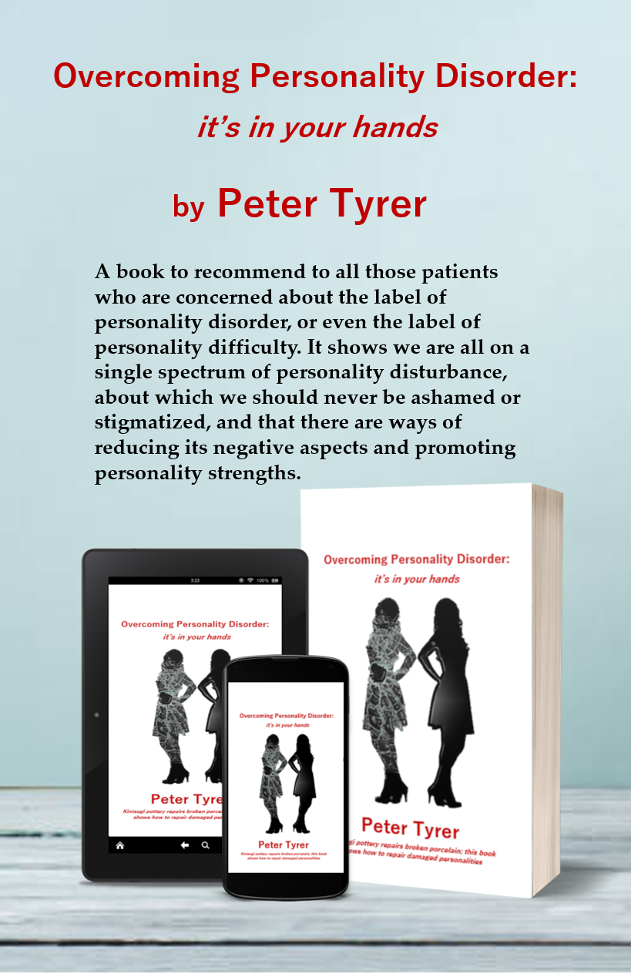

Slide 51
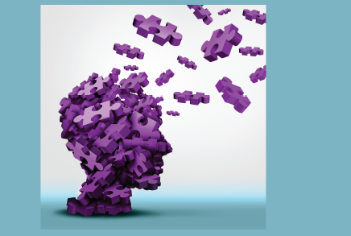
Book on nidotherapy
Was £18, now down to £12.99 - all proceeds to NIDUS-UK to promote nidotherapy
Nidotherapy: Harnessing the Environment with the Patient
Peter Tyrer and Helen Tyrer

