Slide 1

Transitional Safeguarding: Addressing the gap between child and adult safeguarding
Dr Christine Cocker
Professor in Social Work
University of East Anglia (UEA)
christine.cocker@uea.ac.uk
Notes:
Introduce selves
Refer to biographies – one children’s person; one adult person
Say we are going to draw on our experiences of discussing TS with staff and managers from all over the country from different agencies and localities.

Slide 2

Quiz: At what age?
Notes:
Can you consent to sex? 16 (but not watch sexual activity simulated on film until 18)
Are you legally accountable for a crime? 10
Can you vote? 18
Do you have to be for the Mental Capacity Act to apply? 16
Do you have to be for the mental health Act to apply? No limit – all ages
Can you drive? 17
Join the navy or air force? 15 yrs and 9 months with parents permission Airforce – 16 Navy
Get married or enter into a civil partnership? 18 or 16/17 with parental consent
Do the provisions of the Domestic Abuse Bill apply (ie you can be a victim of DA)? 16
Buy a lottery ticket? 18
Are definitions of CSE and CCE considered (18)
Get a tattoo 18
Consent to medical treatment – at any age if understand the implications but donate organs at 10

Slide 3

There’s a ‘cliff-edge’ at 18 years…
Notes:
But it starts before 18 years
Little quiz

Slide 4
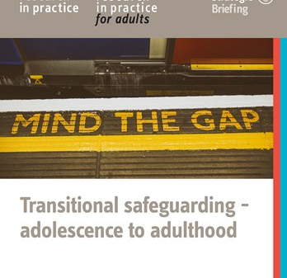
What is Transitional Safeguarding?
Transitional Safeguarding is
  “an approach to safeguarding adolescents and young adults fluidly across developmental stages which builds on the best available evidence, learns from both children’s and adult safeguarding practice and which prepares young people for their adult lives” (Holmes and Smale, 2018, p. 3).
Notes:
We have a binary safeguarding system in England. Children’s system 0-17 yrs and 364 days and then adult safeguarding system 18+. Whilst it might appear that there is only 1 day between these two systems, there is actually a cliff edge with a massive chasm between then and some of our YP fall down the gap
It is a binary system
Children’s safeguarding is designed to protect young children who experience abuse in their own homes
Systems have developed in accordance with different legislative and policy frameworks and arguably divergent conceptual frameworks.
Child’s consent is not required to initiate a safeguarding response; broadly considered essential that an adult’s consent is sought before making a safeguarding referral unless they are found to lack capacity.
Trying to fit square pegs into round holes!

Slide 5
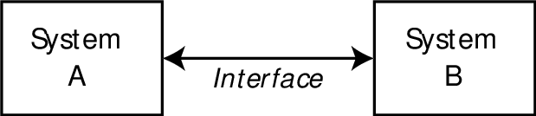

What’s wrong with the current safeguarding system?
It is a binary system
Children’s safeguarding is designed to protect young children who experience abuse in their own homes
Systems have developed in accordance with different legislative and policy frameworks and arguably divergent conceptual frameworks.
Child’s consent is not required to initiate a safeguarding response; broadly considered essential that an adult’s consent is sought before making a safeguarding referral unless they are found to lack capacity.
Trying to fit square pegs into round holes!
Notes:
So why are we arguing for a whole system change to address the shortcomings in working with young people?
This is because despite some excellent practice and innovative services, there remains for many involved in safeguarding YP a sense that we are trying to fit square pegs into round holes.
Expanding / creating new categories in the current system is unlikely to enhance effective prevention and intervention for a number of reasons:
it does not by itself increase resources and effectiveness
In the context of resource pressures, this could in fact lead to negative unintended consequences – for example, prioritising adolescents at the expense of 5-10 year olds
It places child protection as the dominant framework for addressing these risks, yet this framework was designed primarily in response to younger children facing risks from their family. In a number of ways this makes it difficult to apply effective principles for reducing adolescent risks and harms – principles explored further in this paper.
The child protection system typically relies on mechanisms which can alienate young people – for instance, routes to participation such as attending child protection meetings are intimidating (Gorin & Jobe, 2013) and may inadvertently lead to young people feeling stigmatized by their risks and problems
Adolescent agency in relation to risks makes adolescents ‘imperfect victims’ and makes addressing those risks (and their impact) a complex business. (Rees and Stein, 1999)
This is made more difficult still by working within a child protection system that is designed primarily to meet the needs of younger children maltreated within the family (Bilston, 2006)

Slide 6
Why do we need to think differently about safeguarding young people?
Adolescents may have distinct safeguarding needs, harms - and routes to protection - are often 'contextual‘ / extra-familial and are underpinned by complex social and biological drivers
Harm and its effects do not abruptly end at 18, however professional support may do
Transition to adulthood is a particularly challenging and vulnerable time, we may need care and support without having Care & Support needs™
Need to consider promoting resilience of young people and understand their changing developmental needs
There are moral and economic drivers for a reimagined safeguarding system which is contextual, transitional and relational.
P.S. Transitional Safeguarding is not a prescribed model
7
Notes:
This is described in the ‘Mind the Gap: Transitional Safeguarding – adolescence to adulthood’ RiP publication
We have a binary safeguarding system – divided into children and adult. This does not meet the needs of adolescents – e.g. the children’s safeguarding system was designed to meet the needs of younger children who experience abuse and neglect in their family home.

Slide 7
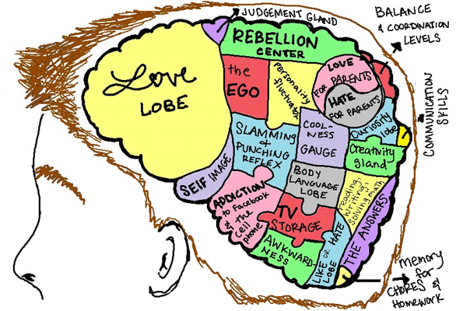
Redefining adolescence and transition
Some studies into brain development and effects on behaviour show some elements of brain growth – eg development to more mature affect regulation, social relationships and executive functioning - continue into the 20s. (Sawyer et al, 2018)
“An expanded and more inclusive definition of adolescence is essential for developmentally appropriate framing of laws, social policies, and service systems. Rather than age 10–19 years, a definition of 10–24 years corresponds more closely to adolescent growth and popular understandings of this life phase”. (Sawyer et al, 2018)
BUT biological studies to define capabilities of adolescents should be treated with caution, not misinterpreted in reductionist ways. (Moshman, 1999).
(Credit: Dez Holmes)
Notes:
Research literature from US points to an additional life stage – known as ‘emerging adulthood’.
Jeffrey Arnett - ‘having left the dependency of childhood and adolescence, and having not yet entered the enduring responsibilities that are normative in adulthood, emerging adults often explore a variety of possible life directions in love, work and world views.’ (2000, p469)
Along with adolescence and young adulthood, ‘emerging adulthood’ is also a cultural construct. Arnett (2000) argues that individual experiences are not universal because they are diverse; young people are now less limited by historical role expectations. Consequently, this period of time is characterised by ‘exploration’ and ‘freedom’ where young people can explore their identities, focus on themselves in a self-obsessed manner, experience uncertainty in many aspects of life including employment, housing, and personal/sexual relationships.

Slide 8

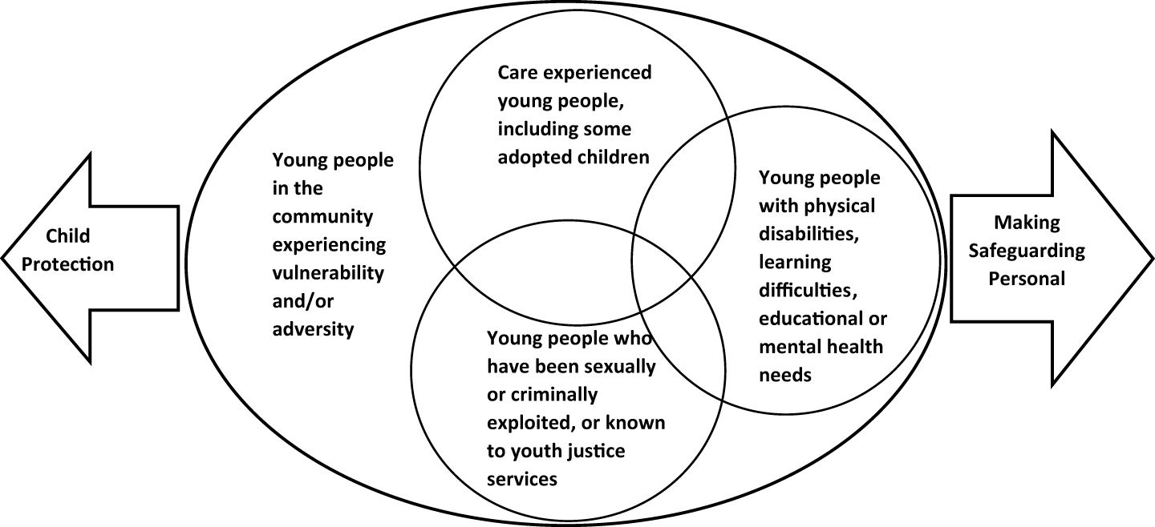
Mind the gap…
Child protection
Making Safeguarding Personal
These are the young people we know, but we need to consider those we don’t already know too
Notes:
Who are we talking about? We have found that people find this slide helpful in understanding who we are concerned about
Let’s not confuse those young people with transition needs with who we mean when we use the term ‘transitional safeguarding’ - some overlap.
Most children and young people fall off the cliff edge as approach 18 = very few will be eligible for statutory adult services
Children with health, mental health, education needs (SEND and CAMHS) i.e. commonality is that they are already known to health, education or mental health services
Children who have come into state care – Looked After Children
Children who are ‘in trouble’ – cross over with youth justice, also county lines, sexual exploitation, modern slavery
The age limits vary – legislation and policy varies
Specific groups of young people face particular challenges (for example; young people with special educational needs and disabilities (SEND), care-leavers, young carers) and many parts of the wider system have already arguably created a more fluid and transitional approach towards service provision. However, there are still problems. For example, there is a concern that young people leaving care are ‘focussed on running away from their previous experiences rather than toward new opportunities’, which is the opposite experience of most other young people who have not been in care (Tyrell and Yates, 2018, p1024). Many young people leaving care who have experienced considerable adversity in their lives view themselves as adults long before turning 18, yet do not think they have been prepared well for it (Tyrell and Yates, 2018).
These we know, then there are those we didn’t know about as children or adolescents (TH SAR)

Slide 9
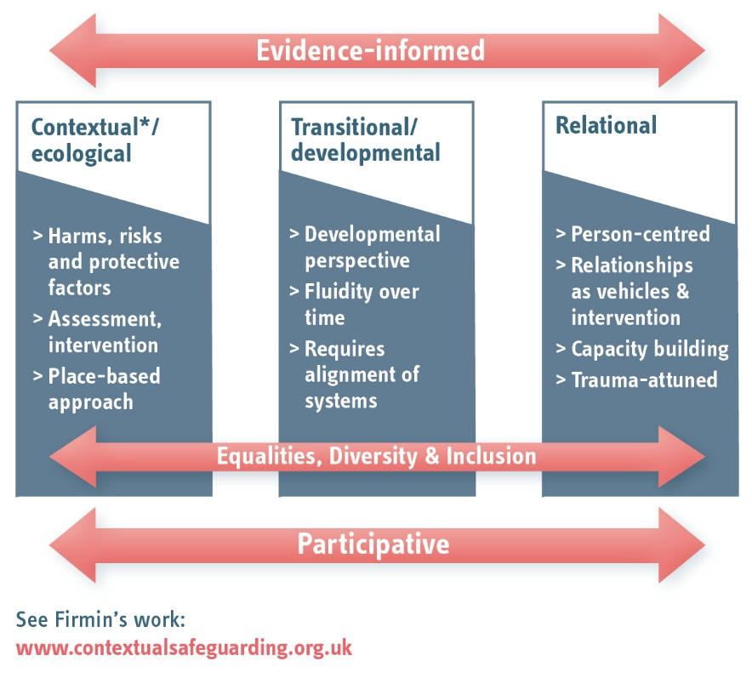
A possible framework?
Notes:
Evidence informed requires not only research literacy, but effective local analysis capacity and mechanisms for gathering and responding to expertise form those with lived experience
Poverty shown to have a strong causal effect on physical and mental health (Marmot and Bell, 2012)
Poverty linked to SE of adults; increases psychological distress and reduces opportunities for employment (Wilson and Butler, 2013)
SE can compound mental ill-health, and MH issues arising from sexual exploitation can result in diagnoses of PTSD, (Levine, 2016)
Connection between modern slavery (including forced labour, sexual exploitation and trafficking) and homelessness (bi-directional) (The Passage, 2017)
Adults with ‘multiple needs and exclusions’ experience a range of negative outcomes and are more likely to have experienced adversity in childhood (McDonagh, 2011; RiPfA, 2015)
PAUSE FOR QUESTIONS SO FAR

Slide 10
Developments in Transitional Safeguarding
Policy
Publications
Research
Awareness raising
Multi-agency training
Service innovation
Community of Practice
Safeguarding Adults Reviews
Notes:
What had happened over the last 2 years

Slide 11
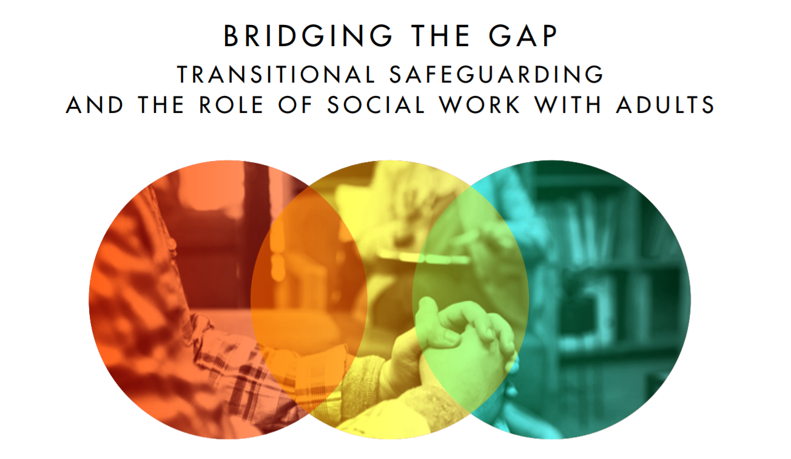
Developments in Transitional Safeguarding
Chief Social Worker for Adults Knowledge Briefing
Notes:
Policy input
Chief social worker (adults) brought partners together
Dez author
Also BASW, NWG, ADASS, LGA and others
This briefing is designed for all those involved in safeguarding adults, from frontline practitioners to senior leaders and has a particular focus on the role of social work with adults
This launched a number of months ago – we had over 680 people at the event from across the country.

Slide 12
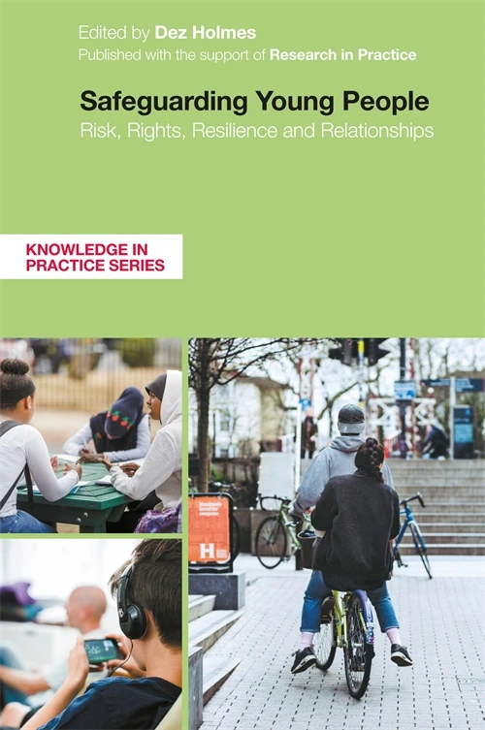



Developments: Publications and Research
Journal articles; British Journal of Social Work; Journal of Adult Protection; Practice Special Issue
Book edited by Dez Holmes on adolescent safeguarding (2022)
Book on Transitional Safeguarding due 2023
Innovate research project, University of Sussex (ESRC funded)

Slide 13

Developments: raising the profile, skilling up staff and leading change
Awareness raising through conferences, workshops and other events
Multi-agency training - Responding to local need
Service innovation – localities are reviewing and improving their ‘offers’ to young people.
Community of Practice on Transitional Safeguarding – set up by Research in Practice.
Developing a TS Framework for Good Practice for use in SARs
Notes:
See CSW briefing for examples of service innovation and Practice special issue.
No one is doing it all

Slide 14
Legal frameworks and statutory guidance
These underpin multi-agency roles and define responsibilities.
Social Services Departments came from the same roots in the 1970s, but branches have grown in different ways at different times. Divergent legal frameworks from Children Act 1989 and NHS and Community Care Act 1990.
Public enquiries, investigations, case law and ‘scandals’ affect policy
There are differences in Children and Adult services between inspection, regulation and sector led improvement and these have had a differential impact on public services.
Differences between the Department for Education, the Department of Health and Social Care, Home Office, Department of Justice: approaches; priorities; resources; affecting different sectors.
Notes:
Legal frameworks and statutory guidance development around safeguarding for children and adults are different
Both have the same starting point through from Seebohm 1968 1970s and LASSA 1970
Different timings for safeguarding developments in C&F and adults: 1970s onwards development of child protection,. 1990s beginnings of adult protection and No Secrets in 2000
Years of government enquiries into children’s cases/with death of Maria Colwell and the many public inquiries undertaken in the 80s, to adults cases e.g. most recently Winterbourne View
Regulation, inspection and sector led improvement – how we are regulated, inspected and monitored affects what we do and how. You have probably experienced different iterations of inspections and the consequences of the ‘name and shame’ approach to improvement. These have had a different cultural impact on Local Authority Children and Adults Services as well as providers
Different role of State within Children and Adults– and different impact of DFE and DHSC – CSW role enacted and supported differently sg. DfE have identified large pot of funding and a social work reform agenda, DHSC has left Lyn to influence policy through more modest means
Some examples of impact on adults and children’s social services:
Children’s legal rights are different to adults - according to age and understanding – adults according to mental capacity – some similarity but a childs ‘right’ to be safe ‘trumps’ a childs right to a family life

Slide 15
Legal frameworks - Age
Age | 15 | 16 | 17 | 18 | 19 | 20 | 21 | 22 | 23 | 24 | 25
CA1989 (looked after children)
CA1989 (CP)
CSWA2017 (looked after children)
MCA2005
MHA2007
Care Act 2014
C&FA2014 C&SA2014 (SEND)
Notes:
And yet look at this! 18 yrs isn’t the ‘cut off’ for all responsibilities of adulthood – far from it. Key message – non alignments of legal frameworks in terms of age. These are systems designed by humans, so they can be changed.
CSWA = children and social work act
C&FA = children and families act
C&SA = Care and Support Act
MCA – Mental Capacity Act DOLs – Deprivation of Liberty Safeguarding to become Liberty Protection Safeguards – LPS in April 2022
MHA Mental Health Act
Talk about powers and duties under legislation – powers provide some ‘wriggle room’ for joint working

Slide 16

Emerging messages from SARs and CSPRs
The importance of early planning and preparation for transitions / independence. A recurring theme was a lack of clarity for young people regarding their future living situation due to upcoming move or transition to adult services.
Lack of inclusion of young person’s voice when planning.
Poor multi-agency planning and communication (including organisations, regulators, providers and commissioners), in particular around:
  safeguarding concerns and disclosures
  communication when young people are placed out of area/ working across borders
  support for young people with multiple and complex needs
  assessing the mental capacity of the young person regarding specific decisions
Inappropriate responses in times of crisis.
Not understanding and utilising the young person’s support system, including peers, extended family and professional support.
Lack of understanding about complex safeguarding needs, which can be perceived as ‘lifestyle choices’ (e.g. substance misuse, alcohol misuse, CCE, CSE)
Issues regarding commissioning the right services for the young person
Notes:
Developing a Framework of best practice to be published 2022 with MPS
Increasing number of SARs regarding young people being written – Christine will be reviewing with RiP
Christine SAR to be published on TS
PAUSE FOR ANY QUESTIONS SO FAR

Slide 17
A possible framework?
Notes:
Evidence informed requires not only research literacy, but effective local analysis capacity and mechanisms for gathering and responding to expertise form those with lived experience
Poverty shown to have a strong causal effect on physical and mental health (Marmot and Bell, 2012)
Poverty linked to SE of adults; increases psychological distress and reduces opportunities for employment (Wilson and Butler, 2013)
SE can compound mental ill-health, and MH issues arising from sexual exploitation can result in diagnoses of PTSD, (Levine, 2016)
Connection between modern slavery (including forced labour, sexual exploitation and trafficking) and homelessness (bi-directional) (The Passage, 2017)
Adults with ‘multiple needs and exclusions’ experience a range of negative outcomes and are more likely to have experienced adversity in childhood (McDonagh, 2011; RiPfA, 2015)
Racism is a h

Slide 18

What do we know? National Workshops
Four national workshops held in 2019:
Participants - middle and senior managers with a specific remit for developing and leading safeguarding practice in Adult and Children’s services in Local Authorities in England.
Participants attended from 52 out of 152 Local Authorities.
33 matched pairs of Children and Adult services representatives
19 Local Authorities were represented by either someone from Adults or Children’s social services.
(Cocker, Cooper and Holmes, 2021)
Notes:
RiP commissioned us to do this work The aim was to provide an environment for middle managers to explore challenges and opportunities to safeguard young people, to understand more about evidence prompting the development of Transitional safeguarding and to think about system changes and individual changes that they could make in their roles in innovate in this areas.
Although local authority participants – similar messages in other service areas. We have done a number f other multi-agency sessions and similar messages arise.

Slide 19
Key messages from four national workshops 2019
We want to do this.
We want to innovate, and we want to be able to work better across children and adults services to minimise the ‘gap(s)’.
We recognise that as children become adults, some young people have particular support needs due to the risks in their lives, that continue during their transition into adulthood and we want to be able to support them.
Give us permission and trust us to do this.
We need you as leaders to lead us through the challenges that will arise from addressing this (e.g. please deal with the organisational and institutional barriers).
We need you to create a joint vision across the local authority, communicate it to all the staff working in that local authority, and support us to work together so we can be more effective and achieve better outcomes for these young people.
Notes:
This is what the managers said to us in terms of their ‘ask’ to senior managers. We collected these messages and presented them to senior managers – Adi and Dez spoke to ADCS national conference in 2019, and Dez has presented these findings at other conferences.

Slide 20
Key messages from four national workshops 2019
Children’s services to Adult services
How can we develop a shared culture and shared values that meet the legislative and regulatory requirements for both agencies?
If moving to a 15-25 integrated service, can we pool budgets?
How can we help you develop early help for adults/adolescents?
Adult services to Children’s services
Identify young people in transition – tell us who is coming through.
Joint work cases.
Information about adolescent development – tell us what you know, share your knowledge and listen to us about positive risk taking approaches.
You need better mental health/mental capacity literacy – we can help with this.
Notes:
This is LA information only.
During the national workshops, we enabled participants to express their ‘asks’ and ‘offers’ from their respective specialism to their counterparts. These are some examples
This wasn't an ‘us’ and ‘them’ scenario. But more a strengths based conversation about how to work better together.

Slide 21

Learning from children’s safeguarding
Contextual Safeguarding (Firmin, 2017). Taking into account the developmental changes in adolescence can lead to innovation in redesigning safeguarding services for adolescents, focusing on ‘place’ and ‘space’ in ways that recognise life span development and the extra-familial safeguarding risks for this population group.
Innovative work has developed across the 18 years-of-age ‘boundary’ regarding CCE and CSE services. However, these projects often received additional government funding, such as the expansion of the Sexual Exploitation Hub in 2015. This was developed following Newcastle’s ‘Operation Sanctuary’, a police investigation into the grooming of girls and young women in the city (Rogers, 2018).
Notes:
Assume those working with children know this, so more for those working with adults
Already mentioned Carlene Firmin’s work –
There has been some innovation work across the 18+ boundary in LAs all over the country – often with additional funding received e.g. the sexual exploitation hub in Newcastle following ‘Operation Sanctuary’.

Slide 22
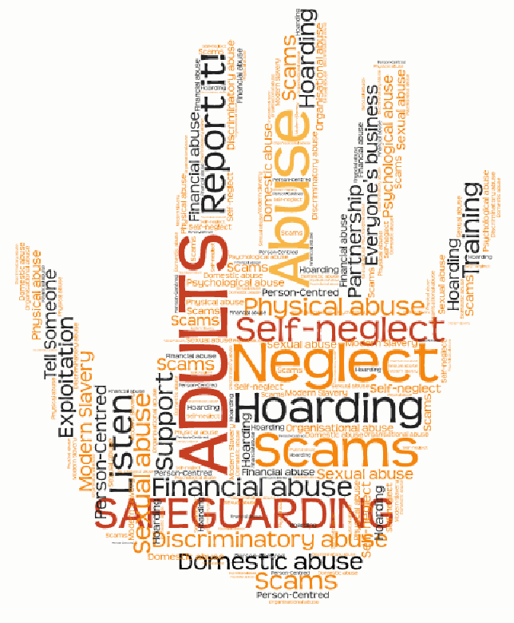
Learning from adult safeguarding
Six key principles:
  Empowerment: People being supported and encouraged to make their own decisions and informed consent.
  Prevention: It is better to take action before harm occurs.
  Proportionality: The least intrusive response appropriate to the risk presented.
  Protection: Support and representation for those in greatest need.
  Partnership: Local solutions through services working with their communities. Communities have a part to play in preventing, detecting and reporting neglect and abuse.
  Accountability: Accountability and transparency in safeguarding practice.
Notes:
We assume that those working with Adult already know this – so directed to those of you working with children – there are 6 key principles in the Care Act 2014 statutory guidance that underpin adult safeguarding.

Slide 23
Comparing key principles in children and adult safeguarding (Cocker, Cooper and Holmes, 2021a)
Safeguarding Principles for Adults (14.13 Care Act Guidance 2014) | Safeguarding Principles for Children (Children Act 1989)
Proportionality: The least intrusive response appropriate to the risk presented. | Three overarching principles: paramountcy of the welfare of the child; ‘no order’ principle – there is some cross-over with proportionality principle in adult safeguarding principles; ‘no delay’ principle. Human Rights Act 1998 requires a proportional approach when Article 8 right to private and family life is qualified. For children as well as adults, one must intervene only just as much as is necessary to achieve a safeguarding goal.
Protection: Support and representation for those in greatest need. | Protection: from serious harm (s47);
Prevention: It is better to take action before harm occurs. | Preservation: every effort should be made to preserve the child's home and family links; a duty for and provision of services to children in need (s17)).
Empowerment: People being supported and encouraged to make their own decisions and informed consent. | Participation: the views of children should be sought according to their age and understanding;
Accountability: Accountability and transparency in delivering safeguarding. | Accountability: occurs at a strategic level through Children’s Partnership arrangements
Partnership: Local solutions through services working with their communities. Communities have a part to play in preventing, detecting and reporting neglect and abuse. | Partnership: services should work in partnership with parents and others with PR
Notes:
Whilst many of the principles underlying safeguarding practice in Children’s and Adult social services are the same, there are some differences.
These differences are critical when considering how best to safeguard young people.
Firstly, the adult safeguarding principle of empowerment is central to personalisation in adult social care, and provides people with choice and control in their lives, and key to risk enablement (Department of Health, 2020). In children’s safeguarding, whilst participation is encouraged, it is with the requirement to
‘(a) ascertain the child’s wishes and feelings regarding the action to be taken with respect to him’ and
(b) give due consideration (having regard to his age and understanding) to such wishes and feelings of the child as they have been able to ascertain.’
(Children Act 1989: s. 47(5)(a)
How this is applied to practice with young people is variable. Arguably, ‘ascertain(ing) the child’s wishes and feelings’ is a diluted notion of participation. Article 12 of United Nations Convention on the Rights of the Child states this as every child having the right to express their views, feelings and wishes in all matters affecting them, and to have their views considered and taken seriously (Children and Young Peoples Commissioner Scotland, 2017). Further, practitioner assumptions can influence the amount of participation (Cossar et al., 2011). The Children Act 1989 is clear on this issue, however the implementation of this requirement is often dominated by a paternalistic approach that seeks to eradicate and avoid risk, rather than a participative approach that empowers the young person to make decisions about their own life (Tucker 2016; Diaz et al., 2019)
Secondly, proportionality is key to issues of risk management and central to the application of the Mental Capacity Act 2005. The Mental Capacity Act 2005 applies to young people 16 years old and over. In both legal frameworks for children and adults, intervention should only be as much as is necessary to achieve a safeguarding goal. The State must be able to justify intervention. However, whilst in adult safeguarding, proportionality equates to the least intrusive response appropriate to the risk presented, in children’s safeguarding, the argument for proportionality is spread across a number of pieces of legislation. The Children Act 1989 has as its key principle, ‘the welfare of the child’, which includes the ‘no order’ principle. This has a broader application than proportionality in decision-making in child protection, and unlike adult safeguarding, it is not based solely on the child or adolescent’s expressed wishes, even when the adolescent is over 16 and has mental capacity. There are tensions in the intersection of these legislation (Children Act 1989; Mental Capacity Act 2005), which are explored further below. In addition, the Human Rights Act 1998 requires a proportional approach, but the Article 8 right to private and family life is a qualified right, meaning that it can be interfered with in order to protect the rights of another or the wider public interest (Brammer, 2015).
Thirdly, accountability exists at strategic levels across both children and adult partnerships (Children and Social Work Act 2017; Care and Support Statutory Guidance 2020) but not at a practice level in Children’s services. At a practice level, the way ‘accountability’ is understood by practitioners differs. The ‘I’ statement for the ‘accountability’ principle in adult safeguarding posits: ‘I understand the role of everyone involved in my life and so do they.’ Whilst good practice would determine that routine sharing of information about all aspects of the safeguarding process should be undertaken by practitioners with the young people involved, this does not always occur. Young people should be involved in developing appropriate safeguarding responses to the risks in their lives: these should be personalised and outcome focused, in keeping with MSP (Lawson, 2017). There is evidence that the involvement of young people has considerable value for child protection services and the young people themselves (Cossar et al, 2011; Jobe and Gorin 2012, Warrington, 2016).
As reflected in the conversations between Children’s and Adult social services at the workshops, participants recognised that developing a transitional safeguarding approach involved improving their understanding of these differences. Developing a safeguarding response for young people that better reflected the six key principles from adult safeguarding, adopting a ‘making safeguarding personal for young people’ approach, might provide the necessary link from one safeguarding system to another. This would draw on the safeguarding expertise of Adult services colleagues, alongside the adolescent development knowledge of Children’s services colleagues. The biggest challenge is to involve young people as key stakeholders in developing appropriate safeguarding responses. This is both at the individual practice level and at service design level.

Slide 24

Making Safeguarding Personal
An ‘approach’ to safeguarding adults which is personalised and outcome focused, improves quality of life, achieves both wellbeing and safety.
The safeguarding process is driven by the person’s wishes and feelings about what they want to happen and how to keep themselves safe, aiming for resolution and recovery.
It was ‘best practice’ before the Care Act 2014, and became part of the formal guidance under the Care Act 2014.
Notes:
For those who don’t know what MSP is – this is directly more at colleagues working with children
An approach – not a ‘model’ or ‘method’ and fundamentally about culture change
May be helpful when working with young people approaching adulthood?
Care and Support Statutory Guidance Chapter 14 para 14
Pre Care Act it was good practice. Now it is statutory – this is how we do it.

Slide 25

Examples of Innovation (Some people are doing some things but no-one is doing everything)
Contextual Safeguarding and CCE/CSE initiatives e.g. Newcastle (already mentioned)
Complex Safeguarding (Greater Manchester)
Special Issue – Practice Journal published Feb 2022
  Havering – Transitions Panel, a new multi-agency planning forum,
  The Cocoon, a new ‘one-stop shop’ onsite multi-agency service provision for care-experienced people
  Norfolk – ‘Preparing for Adult Life’ service
  Hackney – setting up adolescent safeguarding service
  Bath and North East Somerset – merged governance arrangements for the Children’s Partnership, Safeguarding Adults Board and Community Safety Partnership
Chief Social Worker for Adults Transitional Safeguarding guidance document was published in 2021
https://assets.publishing.service.gov.uk/government/uploads/system/uploads/attachment_data/file/990426/dhsc_transitional_safeguarding_report_bridging_the_gap_web.pdf
Notes:
Some examples from workshops
No one is doing it all

Slide 26

Further reading
Cocker, C., Cooper, A., and Holmes, D. (2021) Transitional Safeguarding: Transforming how adolescents and young adults are safeguarded. British Journal of Social Work
Cocker, C., Cooper, A, Holmes D, and Bateman F. (2021a) Transitional Safeguarding: Presenting the case for developing Making Safeguarding Personal for Young People in England. Journal of Adult Protection
Firmin, C, Horan, J. Holmes, D and Hopper, G. (2019) Safeguarding during adolescence– the relationship between Contextual Safeguarding, Complex Safeguarding and Transitional Safeguarding. Dartington, Research in Practice
Holmes, D. and Smale, E. (2018) Mind the Gap: Transitional Safeguarding – Adolescence to Adulthood. Dartington, Research in Practice
Holmes, D. (2021) Bridging the Gap: Transitional Safeguarding and the role of social work with adults. London, Chief Social Work Office for Adults/DHSC. Available at: https://assets.publishing.service.gov.uk/government/uploads/system/uploads/attachment_data/file/990426/dhsc_transitional_safeguarding_report_bridging_the_gap_web.pdf
Notes:
Thank you for your participation

