Slide 1
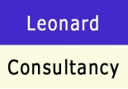
Adolescent Safeguarding and Harmful Sexual Behaviour
Marcella Leonard
@leonardconsult

Slide 2
Remember
Child development is a fluid process and we have reason to believe behaviours will be responsive to intervention during childhood and adolescence
“It is easier to build strong children than to repair broken men” Fredrick Douglas 1818-1895

Slide 3
All studies undertaken in respect of young people who have engaged in HSB are a highly diverse group in terms of their backgrounds, age of onset, the type of behaviour, who their victims were, their learning abilities, gender, ethnicity, and their own trauma abuse history.
Key studies are:
Finkelhor et al., 2009 (USA)
Taylor 2003 (UK)
Vizard et al., 2007 (UK)
Hackett et al., 2013 (UK)
Who engages in HSB?

Slide 4
Gender
Age
Hackett et al (2013) Study of 676 children and young people referred to UK services over 9 year period
97% were male
3% female
Hackett et al 2013 mean age of 14 years at referral
Finkelhor et al 2009 mean age of 12 years
Vizard et al 2007 mean age 13 years though onset age calculated at 9.5 years

Slide 5
Ethnicity
Attachment
Hackett et al 2013 : 93% were white, 1% black, 3% Asian and 3% mixed race
Hackett 2013 : 42% living at home, 12% with relatives, 32% Looked After / Care Order , 6% secure accommodation
Vizard 2007: 5% living at home, over half severely socially isolated
Taylor 2003: 36% educational statementing process, 44% referred professional help pre 10 years
Rich 2006, Longo et al 2013, Creeden 2013: attachment relationships as significant

Slide 6
Learning Disability
Own Abuse
Hackett et al 2013: 38% of 700 YP had learning disability
Fortune & Lambie 2004: 24 of 131 adolescents had ‘special needs’
Vizard 2007: 92% had some form of abuse
Creeden 2013: increase risk of those YP who experience adversities and prolonged stressors links to developmental damage and deficits in self- regulatory functioning and inhibitory control
Hackett 2013: two thirds were known to have experienced at least one form of abuse and 50% had been victimised

Slide 7
Victims
Taylor 2003: only 3% of 402 alleged incidents involved victim unknown to adolescent perpetrator
Hackett 2013: 75.2% abused children aged 10 years or under, 50% penetration
Vizard 2007: 93% contact sexual offences, 72% penetration
Taylor 2003: mean age victim was 8 years of age
Hackett 2013: 51% abused females only, 19% males only and 30% both

Slide 8
Relationship with the Victim
Most young people who sexually harm will harm someone who is known to them; sibling abuse often motivated by jealousy and anger (Yates et al 2012)
Ryan indicates that in 94% of cases some form of relationship and in approx 40%+ interfamily
Boys abusing in the home less likely to abuse in the community (Yates et al 2012)
We put young people in positions of power, trust and authority of other children and young people yet with adults we request vetting
Young people who sexually harm live in a young persons world

Slide 9
Radford et al, 2011
Random Study
One in 20 children (4.8%) had experienced unwanted sexual contact/ abuse
Over 90% where abused by someone they knew
More than 1 in 3 (34%) who experienced unwanted sexual contact/ abuse by an adult did not tell
4 out of 5 (82.7%) who experienced unwanted sexual contact/ abuse form a peer did not tell

Slide 10
Female Adolescents Who Sexually Harm
Under estimation in research , under reporting and denial
Majority, if not all, have been sexually harmed
Tend to suffer harm from young age
Sexual harm likely to have been repetitive and severe, more aggression used
Mental health problems
When they are named by a victim, there is a recognition of their past trauma which is not always applied to males but also within this recognition of past trauma a lack of recognition of harm and risk

Slide 11
Will they re-offend as adults?
As with other types of adolescent offending most young people once detected do not go on to offend sexually as adults; particularly with the right preventative interventions and support
Intervention needs to focus on broad-based behaviour and developmental goals, not just on preventing further sexual abuse (Hackett & Masson 2011: Boswell et al 2014)
Non- sexual offence is more common
Nisbet et al 2004: 303 adolescent males follow up of 7.3 years – 25% further sexual offence conviction before 18th birthday

Slide 12
Cont…
But many adult male sex offenders will acknowledge that they had their first deviant thoughts/ actions as an adolescent.
The best predictor of adult sex offending among young people displaying harmful sexual behaviour in adolescence is stranger victim and multiple victims Gerhold, Browne & Beckett (2007)

Slide 13
Definition
“Harmful sexual behaviour involves one or more children engaging in sexual discussions or acts that are inappropriate for their age or stage of development. These can range from using sexually explicit words and phrases to full penetrative sex with other children or adults”. ( Rich, 2011)
BUT
‘The most important thing about terminology is that accurate descriptions of the physical acts committed are used, rather than any euphemistic or jargon-ridden phrases’ (Hackett 2014)

Slide 14
Sexual Abusive Behaviour
Nature of the sexual abuse
Extent
Duration
Victim/s profile
Currency of the sexual abuse

Slide 15
Assessment of Sexual Behaviour
Legal
Illegal
Deviant

Slide 16
Consent
Equality
Coercion
Core Issues to Consider

Slide 17
3 Components of sexual desire:
Drive
Beliefs and values
Motivation

Slide 18
Charged
Convicted
Reality
Fantasy

Slide 19
What you got convicted of
What I was able to tell
What happened in the room
What you admitted to
What they heard from me
What offence criteria it met
What you pleaded to

Slide 20
The 4 stages of engaging in HSB ( adapted Finkelhor )
RISK
R
Victim Compliance
The YP gains the victim’s compliance by ‘threat/treat/coercion’
Overcoming External Barriers
I
How the YP was able to commit HSB in the environment / create opportunities to commit HSB
Overcoming Internal Barriers
S
What the yp tells themselves as to justify the HSB
Reflect / repeat
The YP reflects on their actions, recognizes they have not been caught, fantasises , repeats the HSB
K
Internal Motivation /Thoughts
The young person thinks about sexual behaviour influenced by own experiences

Slide 21
Almond et al 2006
3 Distinct Groupings of Young People who commit Harmful Sexual Behaviour
Abused : confused re sexuality and sexual attraction, focus on situational and personal factors to reduce reoffending
Delinquent : HSB as part of general criminality , need to target individual, family
and social influences as well as drug / alcohol
Impaired: ADHD, LD, emotional, behavioural, psychological & physical difficulties

Slide 22
Understanding Why?
These are the general areas which must be covered prior to discussing the sexual abusive behaviour to enable the beginning of analysis when move to discuss the more challenging topic
Forensic History
Physical and Mental Health
Convictions
Charges
Criminal Justice
Involvement
Psychosexual History
Physical health
Mental health
Pre disclosure and post
Alcohol and Substance use
Coping Strategies
Education and Employment
Formal and informal sex education
Relationship History
Current relationship
5
Education history
Cognitive Functioning
Relationships with peers, teachers
Employment History
Relationships with colleagues
4
Early Childhood
Parents
Attachments
Exposure to ACEs
Siblings
Relationships
Supports
Insight into offending behaviour
3
2
1

Slide 23
Early Childhood History through a Trauma Informed Lens
The aim is to analyse the experience the young person has had and how these experiences have influenced their emotional development, their attitudes, beliefs, their attachments, sense of belonging and of being loved and cared for.
Early Childhood History
Stage 1
What type of parenting experience have they had e.g. caring, consistent, supportive, positive regard for each other, respect or have they had inconsistent parenting with exposure to significant adversities, such as domestic abuse, alcohol/ drug use, criminality, mental health problems, parental absence.
Stage 2
In considering the parenting experience this will have a direct influence on the attachment style of the person. Childhood attachment style will have a direct impact on their adult attachment and ability to relate to others
Parenting
Attachments
Exposure to ACEs
Stage 4
Stage 3
What is their relationship with their siblings, do they ‘fit’ with them in terms of achievements or are they seen as ‘black sheep’, are their siblings supportive, positive influences and what are their attitudes towards the sexual abusive behaviour
Consideration of the type of adversities the person was exposed to either by or within the family system or external to this. How did the person cope with these adversities, were they aware of their impact, what has been the impact of these experiences on their perception of and with others.
Siblings
Relationships / Supports
Insight into Abusive Behaviour

Slide 24
Education and Employment
After school, consider 3rd level education, employment, any authority issues, suspensions, attitudes, current employment
C
The aim is to consider how the young person has cognitively developed, how they progressed through education from both a conforming perspective, social perspective in terms of peers/relationships, belonging and from school to employment and their sense of achievement and purpose. Or if significant sexual / physical behavioural problems were evident at an early stage and impacted on education and employment.
B
What schools did they attend after primary, any behavioural difficulties, how did they progress, friendships, sports, social clubs
What primary school did the person attend, how did they progress, did they make friends, any difficulties with teachers, learning , consider multiple changes, bullying, learning difficulties or any concerning sexual / physical behaviours
A

Slide 25
Mental and Physical Health
Aim is to consider has the young person’s physical / mental health had a role in their abusive behaviour , what role , if any, did alcohol / drugs play and what is their health currently
Consider pre the allegations coming to light
Consider the impact of ACE’s , early childhood experiences
Impact of physical health on self perception , abilities and relationships
Impact of mental health
Coping strategies
Use of alcohol
Use of substances
Impact of above on psychosexual functioning

Slide 26



Sex education
Peer Influenced
Relationship History
Psychosexual History
Aim is to analyse how the young person received their sex education, was this formal, informal, peer influenced inappropriate, abusive, how has that affected their relationships, sexual behaviour and current relationship.

Slide 27
Forensic History
Aim is to consider whether the young person has a pattern of antisocial / criminality and breaking of societal boundaries and rules or if this is their first time to be involved with the criminal justice processes
Any previous criminal justice involvement
How long has their criminal behaviour been present
Have they received significant consequences previously
Or is this their first time to come to police attention
Family attitudes and experience with criminal justice

Slide 28
Key Questions
What is the behaviour, is it sexual?
Is the behaviour age appropriate?
Is there risk to self and / or others?
What is the risk
Who is at risk
Can the risk be managed
Who can manage the risk
What education / intervention for the YP and their family / school/ employment is required to reduce the risk and its management
What needs to happen immediately, short term and long term

Slide 29
Established by practitioners for practitioners
Multi professional
Aim :
to provide quality, effective assessment and intervention models
for practitioners in health, education, criminal justice, social care
working with children and adolescents and their Harmful
Sexual Behaviour
AIM
Introduction to AIM

Slide 30
AIM
Review of AIM2 , practitioner , trainer and agency feedback
The changing nature of HSB including technology
Having a ‘developmentally informed’ model of assessment
The static labelling of young person Low, Medium or High
Review of AIM2

Slide 31
Seek to understand the HSB within the wider functioning /experiences of the young person
Analyse the profile of the young person considering all their life domains
Gaining a profile of the young person to identify the specific areas for safety planning and interventions
Review the AIM3 profile after intervention to assess progress and continue to target specific areas through bespoke , individualized interventions
Gender neutral and able to be used with race / culture allowing for unique considerations within items
AIM
Core Principles of AIM3

Slide 32
Sexual / non sexual / self regulation
Developmental / Environment / Family
External Factors
Who does young person pose a risk to, when is this more likely and what can assist in reducing this likelihood

Slide 33

Observation
Experience
Knowledge
Peer influenced
Learning difficulties

Slide 34
What might the HSB mean for the Young Person?
Curiosity / exploration
Sexual / sensations pleasure
Learnt behaviour
Emotional management
Revenge / grievance
Needs being met
Peer acceptance

Slide 35

Understanding the YP and their pathway
Recognises the origins of why a person commits sexual abusive behaviour often lies in their own life experiences
Recognises the need to see beyond the behaviour to understand what needs the behavior meets for the person
To understand what support systems are influencing the person both positively and negatively to assist the person from committing further sexual abuse
Relying solely on static determinations of low, medium and high risk provide minimal assistance to child protection decision making in terms of working in partnership with the family in recognizing change due to age, maturity, environmental and societal influences
It informs the identification of individualized interventions for the person rather than generic programmes

Slide 36
HACKETT (Continuum of Young People’s Sexual Behaviours ) 2010
Normal
Developmentally expected
Socially accepted
Inappropriate
Single instances of inappropriate sexual behaviour
Socially acceptable behavior within peer group
Problematic
Problematic and concerning behaviours
May include levels of compulsivity
Consensual, mutual, reciprocal
Context for behavior may be inappropriate
Generally consensual and reciprocal
Developmentally unusual and socially unexpected
No overt elements of victimisiation
Consent issues may be unclear
May lack reciprocity or equal power
Abusive
Victimising intent or outcome
Includes misuse of power
Coercion and force to ensure victim compliance
Intrusive
Informed consent lacking or not able to be freely given by victim
May include elements of expressive violence
Violent
Physically violent sexual abuse
Highly intrusive
Instrumental violence which is physiologically and / or sexually arousing to the perpetrator
Sadism

Slide 37
AIM
Gender
Age and Onset
Ethnicity
Attachment Histories
Learning Disability
Trauma / abuse History
Developmental
Victims
AIM3 Practice Considerations

Slide 38
AIM3 DOMAINS
Sexual Behaviour
Non Sexual Behaviour
Developmental
Environmental / Family
Self Regulation
Young
Person
AIM

Slide 39
AIM3 Model of Assessment
Items
Factors
Domains
AIM3 Profile Graph
AIM

Slide 40
AIM
Notes:
Trainers explain the end result of the AIM3 assessment model in the graph
Red immediate safety / protection action needed

Slide 41
AIM3 DOMAINS AND FACTORS
Domain 2
Non Sexual Behaviour
Factor 1: Non-Sexual Criminality
Domain 3
Developmental
Factor 1: Trauma and Victimisation
Domain 4
Environmental
Factor 1: Stability and Safety
Domain 5
Self Regulation
Domain 1
Sexual Behaviour
Factor 1: Nature of the Harmful Sexual Behaviour
Factor 2: Onset and extent of Harmful Sexual Behaviour
Factor 3: Victim Characteristics
Factor 4: Sexual Aggression and Regulation
Factor 5: Sexual Knowledge, Attitudes and Interests
Factor 3: Alcohol and Drugs
Factor 4: General Behaviour
Factor 5: Mental health and Well-being
Factor 2: Non – Sexual Aggression and Anti – Social Behaviour
Factor 2: Childhood and Adolescent Adversity
Factor 3: Attachment
Factor 4: Family Functioning
Factor 5: Intellectual and Emotional Functioning
Factor 2: Parental / Carer Supervision
Factor 3: Relationships
Factor 4: Peer Group
Factor 5: Education, Employment and Leisure
Factor 1: Responsibility
Factor 2: Motivation and Engagement
Factor 3: Future Perspective
Factor 4: Problem Solving
Factor 5: Social Competence
AIM

Slide 42
AIM3
Intervention
AIM3 Review
Progress Review
AIM3 Reviewed

Slide 43

Assessing HSB through a Trauma Lens

Slide 44
AIM3 DOMAINS AND FACTORS
Domain 2
Non Sexual Behaviour
Factor 1: Non-Sexual Criminality
Domain 3
Developmental
Factor 1: Trauma and Victimisation
Domain 4
Environmental
Factor 1: Stability and Safety
Domain 5
Self Regulation
Domain 1
Sexual Behaviour
Factor 1: Nature of the Harmful Sexual Behaviour
Factor 2: Onset and extent of Harmful Sexual Behaviour
Factor 3: Victim Characteristics
Factor 4: Sexual Aggression and Regulation
Factor 5: Sexual Knowledge, Attitudes and Interests
Factor 3: Alcohol and Drugs
Factor 4: General Behaviour
Factor 5: Mental health and Well-being
Factor 2: Non – Sexual Aggression and Anti – Social Behaviour
Factor 2: Childhood and Adolescent Adversity
Factor 3: Attachment
Factor 4: Family Functioning
Factor 5: Intellectual and Emotional Functioning
Factor 2: Parental / Carer Supervision
Factor 3: Relationships
Factor 4: Peer Group
Factor 5: Education, Employment and Leisure
Factor 1: Responsibility
Factor 2: Motivation and Engagement
Factor 3: Future Perspective
Factor 4: Problem Solving
Factor 5: Social Competence
AIM

Slide 45
How do we Safeguard?
AIM
To enhance understanding of the family / Carer system response to Harmful Sexual Behaviours
Objectives
To consider the impact within the family system when HSB occurs
To consider the family system dynamics when sibling HSB occurs
To gain further insight to the assessment of ability to supervise and protect
To have an overview of the CASP-R framework of supervision and protection

Slide 46


Slide 47
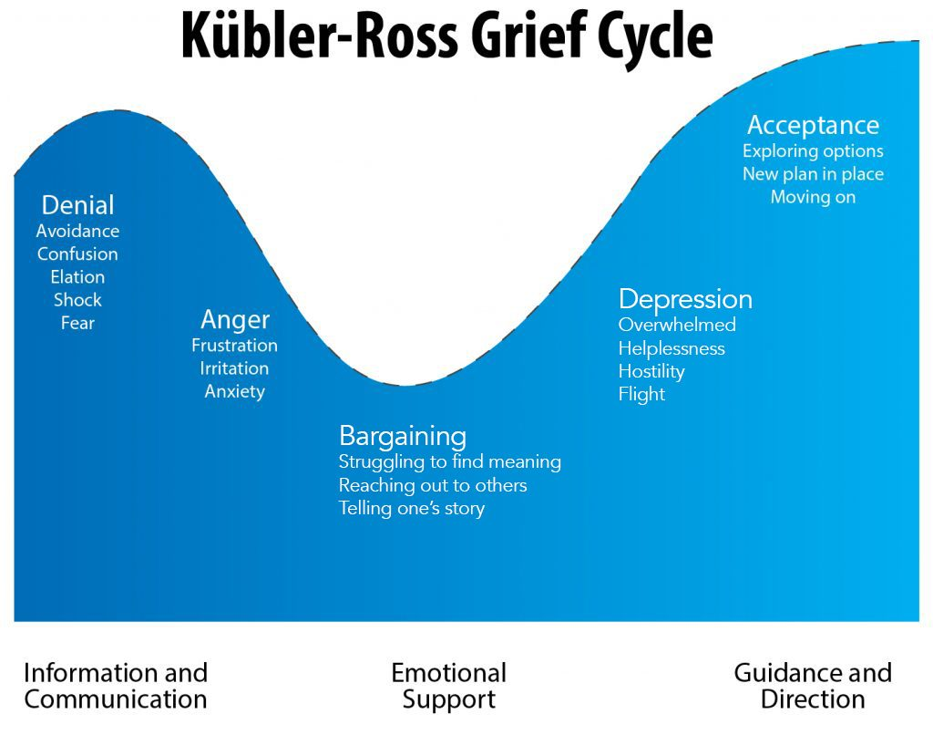

Slide 48

A young person is part of a system and therefore all assessments and assessment and intervention must be in conjunction with the young person and their family system
Notes:
.

Slide 49
Assessing Capacity and Ability
Although responsibility for an individual’s abusive behaviour should always remain with that person it has long been accepted that positive, protective parenting plays a crucial role in keeping children safe from victimisation.
Well-informed assessments concerning the ability of a non–abusing parent or a proposed carer (PC) to keep a child or children safe from a person of concern (POC) are essential to making appropriate decisions family constitution.
Yet, the determination of a non-abusing parent’s capacity to protect a child from a risk or a concern relating to sexual abuse has been incredibly challenging for practitioners to conclude upon with any objective defensibility.
Assessments models to date are largely based on an acceptance of the concerns and an ability to parent.
They failed to consider specific issues relevant to the dynamics of child sexual abuse, including the primary carer’s suitability to hold the person of concern accountable for their behaviour and supervise their interaction with a child/ren effectively.

Slide 50
So what is the CASP-R?
The Capacity and Ability to Supervise- Risk (CASP-R) is a structured professional judgement framework (SPJ) which assists practitioners in assessing not only whether the parent/carer can protect the child but, critically do they have the capacity to supervise the risks posed by the person of concern.
Structured professional judgments (SPJ) are universally recognised as an effective way to improve the quality and transparency of professional decision making.
SPJ instruments draw together factors for which there is relevant research evidence and allows practitioners to analyse an individual’s circumstances against such evidence in order to reach an overall conclusion in a defensible and standardised way.
The CASP-R has has been developed by drawing upon relevant international research and best practice decision making in cases of family constitution when concerns exist in relation to either sexual or domestic violence.

Slide 51
Core Principles of CASP-R
Responsibility for an individual’s abusive behaviour should always remain with that person.
Decisions affecting the right to family life must not be arbitrary or discriminatory, the rationale underlying them must be clear, reasoned and reasonable.
The CASP-R aims to conclude upon a proposed carer’s (PC’s) capacity and ability to supervise a person of concern (POC).
The CASP-R is a ‘review’ model of support.
It recognises many PC’s are on a journey towards empowerment and autonomy.

Slide 52
Domain | Item
Internal Capacity | Adverse Childhood Experiences Cognitive Impairment Anti-sociality Sense of Self Relationship History
Insight of Harm | Response following disclosure Insight into person of concern Victim Insight Engagement with Safeguarding Services
Parenting Capacity | Parental Empathy Parental Authority Perception of self as parent Parenting children with additional needs
Coping Capacity | Coping & Resilience Use of positive support networks Substance Use Mental and Physical Health
CASP-R
Domains
Assessment

Slide 53
Insight of Harm
Internal Capacity
Parenting Capacity
Coping
Capacity
Parent
Partner
Protector
Supervisor

Slide 54
Strength Based Analysis
Parent
Partner
Protector
Supervisor
What is needs to happen?
What is working well?
What are we worried about

Slide 55
Intervention & Safety Planning
Intervention to be tailored to the specific needs and strengths of each PC.
It should reflect the unique history, circumstances and context of each person.
The approach is collaborative and supportive to enable intuitive understanding, enhance resilience and develop autonomy of thought.
Safety planning is proportionate to the strengths and concerns.
The CASP-R is a dynamic assessment framework and must be reviewed following each significant intervention or event with the ‘capacity for role’ reviewed accordingly.

Slide 56
Safety Planning in Home
Educate everyone in the family on healthy sexual development, personal safety and warning signs of SA.
Parents need to take the lead in educating their children and talking to them about sexual development, using correct names for body parts
Set clear boundaries re. personal privacy and behaviour such as appropriate clothing, bathing, sleeping, not going into someone else’s room without consent or knocking
Boundaries need to change as the children get older
Identify safe adults and that they can talk about any issues and they can say “no” to anyone or anything that makes them feel uncomfortable
Make sure the supervising parent / carer knows the details of the HSB and can supervise the YP adequately.
Ensure that the parents know how to check internet access and history, how to access social media and apps for the same information

Slide 57
Safety Planning in School
Detail the behaviour or incident that has given rise to the concerns – what, where and when, to whom, what relationship was there between the YP involved, what was the response of the YP who initiated the HSB, what was the response of the YP’s parents, what was the impact on the other child and their parents
What are the concerns for the school?
Who could be harmed and how?
In which situations could the risk occur?
Do any other agencies have concerns about the YP?
Does the YP and / or their parents agree with the risks assessed?
What factors can reduce or increase concerns?

Slide 58
General Points to Remember
Girls, as well as boys, can be sexually aggressive and inappropriate. They are more likely to use violence, force or coercion in HSB than boys
Take a “gender neutral” view when considering Harmful Sexual Behaviour (HSB) and Childhood Sexual Exploitation (CSE)
Children can abuse power, use threats, manipulation and force and can intimidate adults
Being a victim of sexual abuse by a child can be as traumatic as being abused by an adult
Sexual pleasure and negative feelings about what they have done can reinforce the need for the HSB.

Slide 59

Key Messages
Recognise the impact on a family system where HSB has occurred
Consider the stages of grief / loss the parent/s or carer/s are going
What are the additional external influences in this family
Consider what the risk is, to whom and under what circumstances
Is there a general parenting concern?
Ensure safety planning considers the daily functioning of this family

Slide 60
Core Messages
Seek to understand the behaviour within the context of the young person’s experiences
How many ‘lenses’ and how have they informed how the young person experiences
Attachments
Emotions, positive, negative, arousal,
Intimacy, sexuality
Relationships
Self
Analysis of information to develop bespoke interventions which are fully trauma informed in their content, review and assessment.

Slide 61
Remember!!

Slide 62
Thank you
marcella@leonardconsultancy.co.uk

