Slide 1

Effective Ward Manager Developing your Ward Leadership Skills
Sally Bassett,
Chair of RCN Nurses in Management and Leadership Forum and Chair of the Chairs of RCN Forums

Slide 2
Aims for this session
Questions you might want to reflect on as we run through the session:
What does nurse leadership mean to you?
What behaviours, skills and attitudes come to mind?
Do you see yourself as a leader?
Think about what it might be like to be on the receiving end of you?
Gain an understanding of and why you need to develop your leadership practice
Identify some of the qualities and behaviours of a leader - how frameworks can help
Reflect on the role of coaching and mentoring plays in leadership
Consider the importance of conflict management for you as a leader
Discuss why an understanding of the whole organisation/system is relevant to you as a ward manager

Slide 3
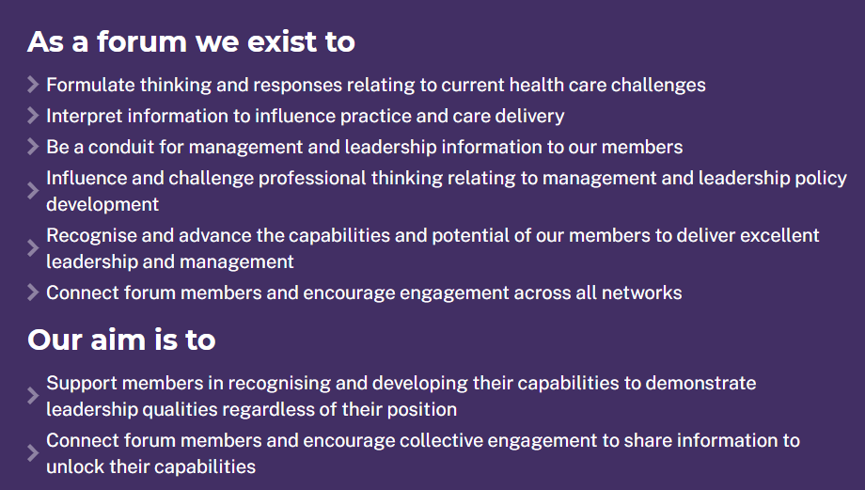
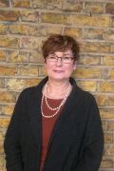

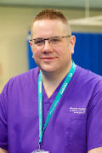
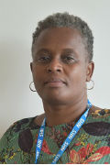

Sally Bassett RCN Chair for Nurses in Management & Leadership
Rabina Tindale

Slide 4


So what is this thing called leadership?
Leader
Ship
What’s your image and definition?

Slide 5

Rapid…

Slide 6


Slide 7

Images of leadership
Why are these people seen as leaders?
Do we assume that the term leader is synonymous with being ’good’
What does being ‘good’ (or effective?) mean?
What it is that you are trying to develop to become effective?
What does it take to be a leader?

Slide 8
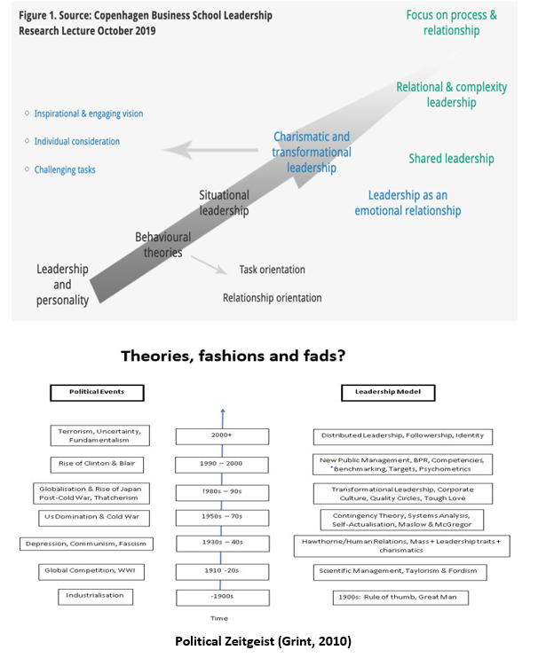
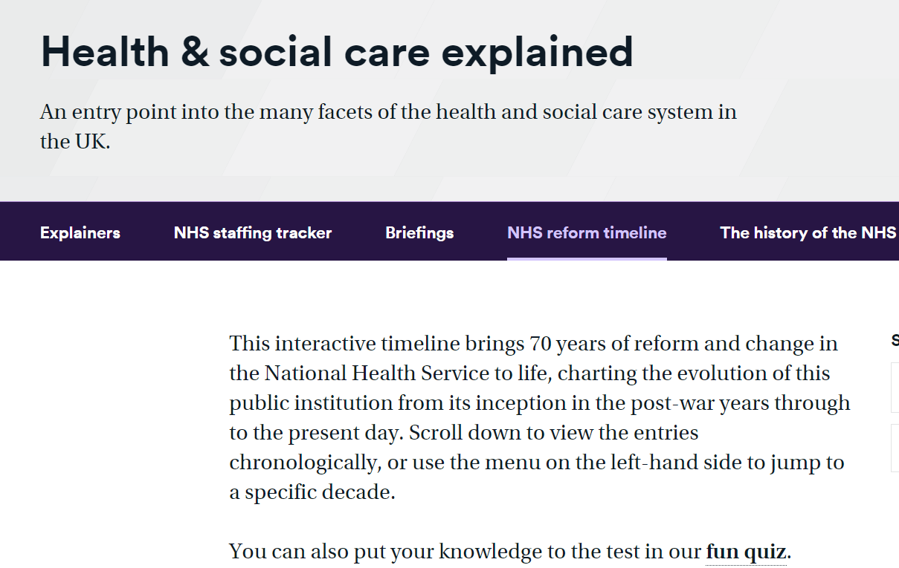
Socio-Political Context
Leadership theories, fashions and fads?
https://www.nuffieldtrust.org.uk/health-and-social-care-explained/nhs-reform-timeline/
Style and theory does it matter – Transactional, Democratic, Charismatic Transformational, Autocratic, Servant, Distributed, Laissez-faire, Silent, Pseudo Transformational, Compassionate, Congruent, authentic …
https://www.businessballs.com/leadership-styles/

Slide 9
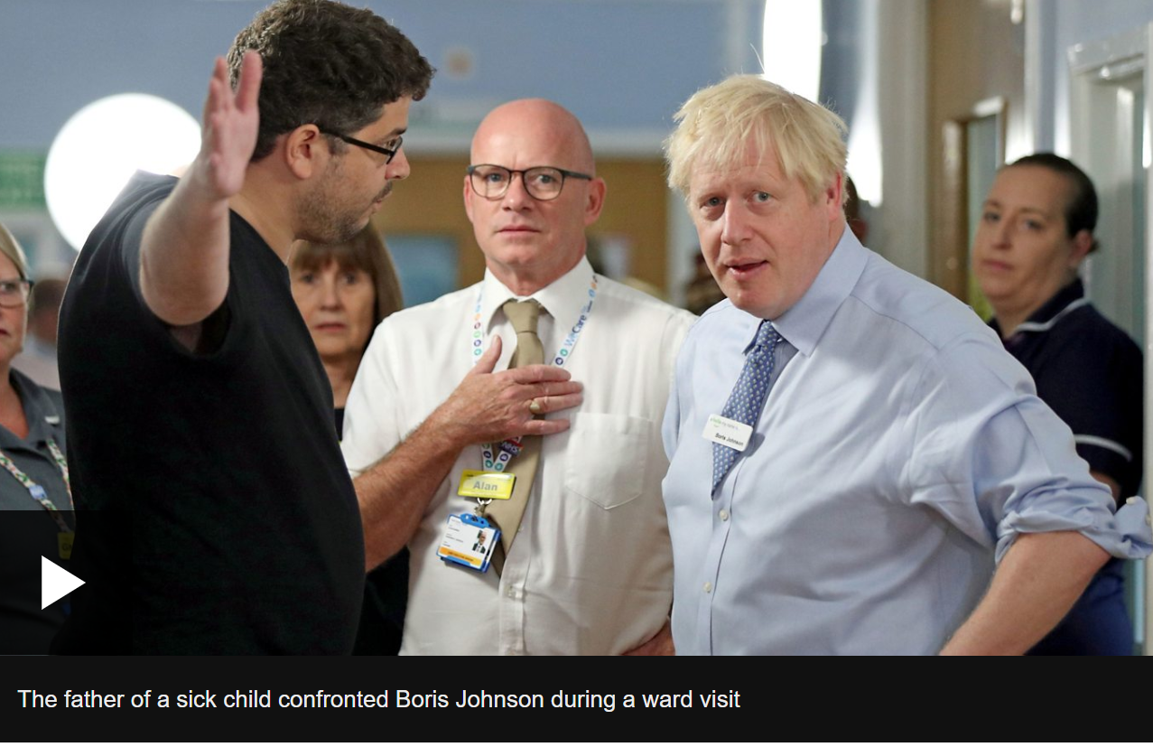
What are the basic ingredients?
Leader – the person
Leading - the process and action
Leadership - the result
Follower – the person
Following- the process and action
Followership – the result
Context – Politics, Policy, People
Relationships
Power and influence
Know why we follow some leaders and not others - Simon Sinek -Know your ‘Why’ and how to build Trust
https://www.ted.com/talks/simon_sinek_how_great_leaders_inspire_action?language=en
Theory helps explain and guide our practice
Character + Judgement = Behaviour
This is what gets the results

Slide 10

Leaders develop on 3 dimensions
Knowing is the body of knowledge that you need to lead and manage effectively – technical know-how around people management, finance, planning, operational management etc
Doing is about putting that theory into practice – the practical skills and characteristics to perform in the workplace. Practically being able to lead a team, or manage a project, not just knowing how it should be done
Being is about who/how you are – the self awareness, integrity and emotional intelligence needed to engage others and engender trust
(Institute of Leadership and Management 2010)
Moral compass – take your humanity to work with you
https://thecorporatephilosopher.org/
Your values matter
https://www.mindtools.com/pages/article/newTED_85.html

Slide 11
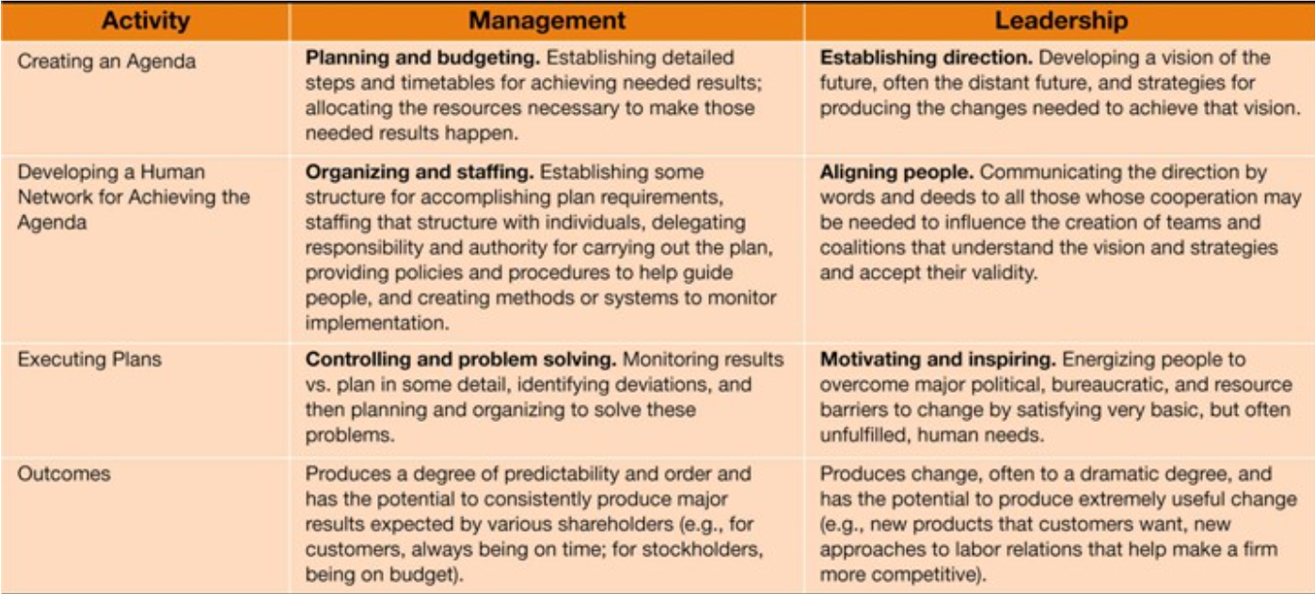

What’s the difference between
Leadership and Management?
You need both to be effective
Kotter (2001)

Slide 12



What’s the difference between
Leadership and Management?
Leadership is concerned with direction
Managemnt is concerned with delivery
Your job is to do both

Slide 13
So how can we define leadership?
Leadership is about a person who wishes to influence another (Bolden 2017) – we assume for a good end; this involves change
Leadership is a practice, it’s what happens in the everyday activities of doing your work – the evidence is drawn from many different disciplines (Iszatt- White 2020)
Leadership is the consequence of an action (leading) being taken by a person (a leader) (Grint 2010)
Leadership is constructed between a leader and a follower, without a follower there can be no leadership. Followers share the same characteristics and preferences as leaders (Kean 2011)
Followership is an underrated form of leadership; we are all followers of someone in our professional lives. As followers our leadership voice is important because we endorse the leader's action, and our feedback helps leaders to make morally good decisions (Johnson 2015)

Slide 14
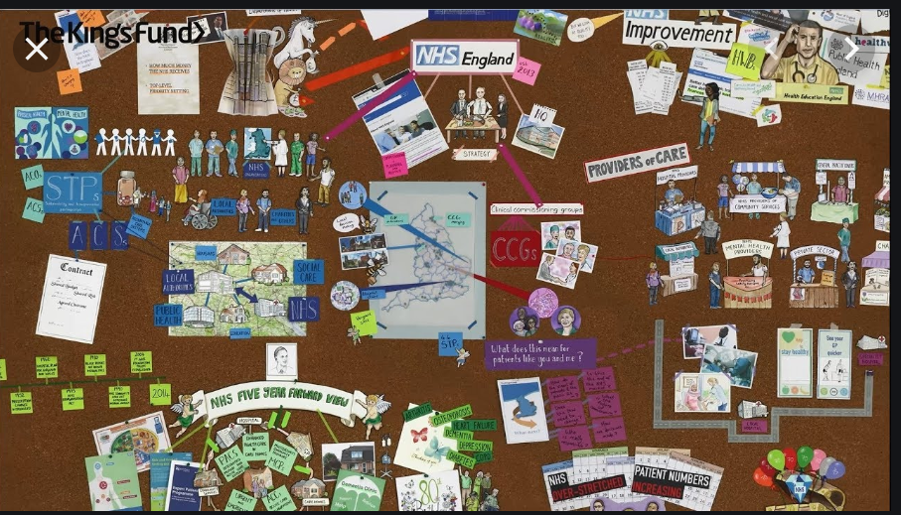
Systems, the organisations, leaders, teams and individuals - understand how they all fit together?
Understand the context
https://www.kingsfund.org.uk/audio-video/how-does-nhs-in-england-work
Politics – the distribution of scarce
resources
Big P – the policies and major decisions made by Governments / systems on how those resources will be distributed
Small p – the everyday decisions and choices we make that represent who we are, our identity, where we are from, what mattress to us, personal win’s and loses
Both involve power; health and social care and nursing are political; we deal in politics and power everyday

Slide 15
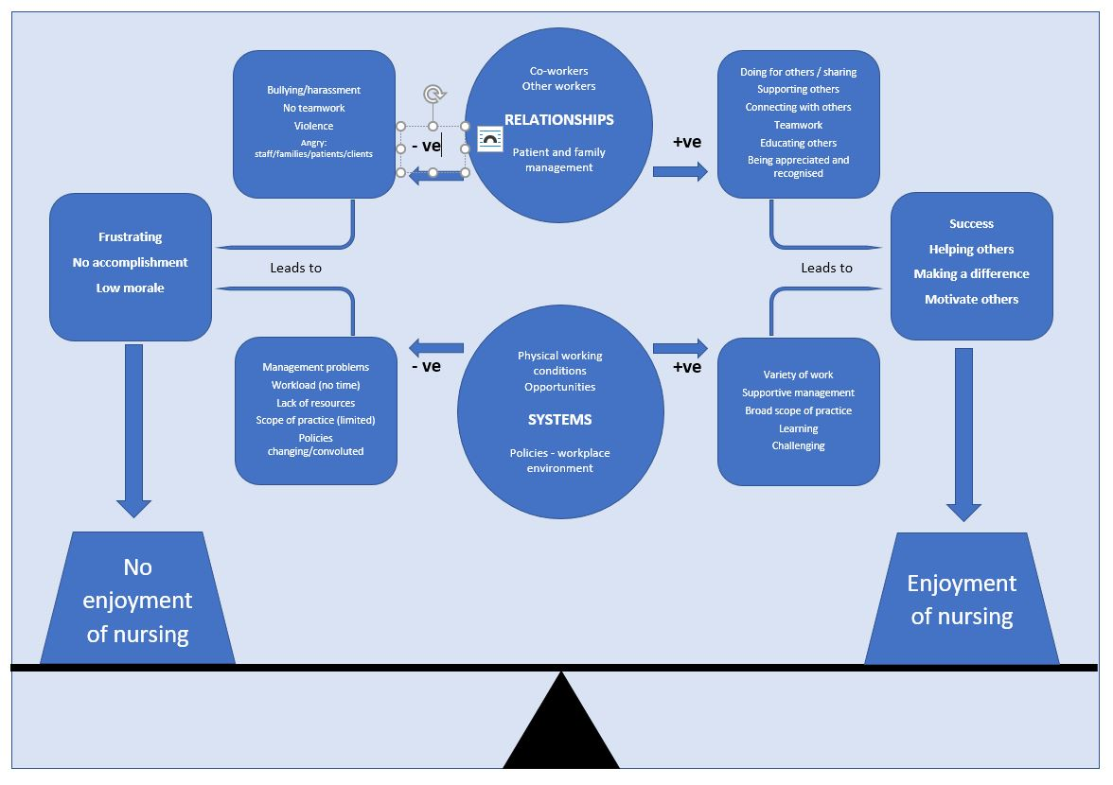
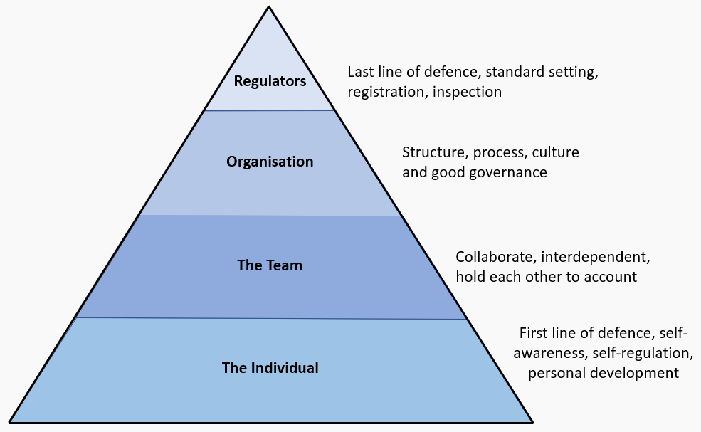
Why do we need leadership and what's the impact?
To protect the public
To keep the joy of nursing
Bassett (2020)
            Job Satisfaction and Enjoyment Balance of Systems and Relationship Model (Tarrant, 2008)

Slide 16
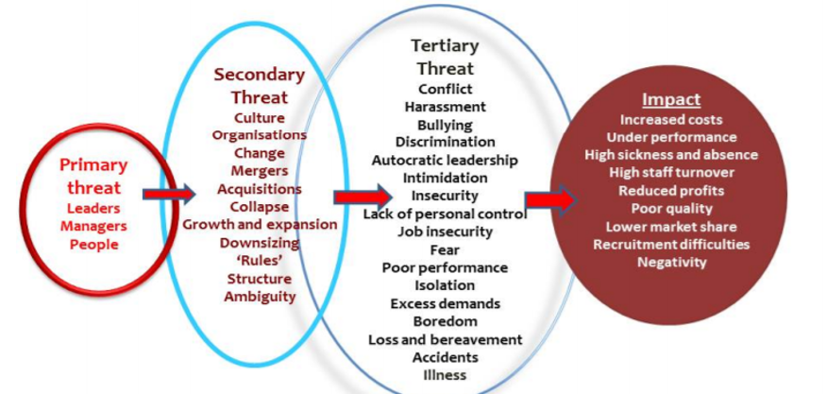
Some more things we need to know…
This is a story about 4 people named Everybody, Somebody, Anybody and Nobody – why we needs and leaders
There was an important job to be done an Everybody was asked to do it.
Everybody was sure Somebody would do it. Anybody could have done it but Nobody did it. Somebody got angry about that because it was Everybody's job.
Everybody thought Anybody could do it, but Nobody realized that Everybody wouldn't do it.
It ends up that Everybody blames Somebody when Nobody did what Anybody could have done.
Primary threat to others well being could be your leadership
Mowbray's leadership responsibility for “Mental Well-being” and personal resilience. ref

Slide 17
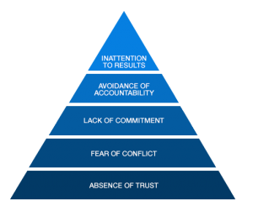

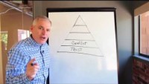
Teamworking –
The foundations are essential
Equality, Diversity and Inclusion - Learn how to be a good ally
https://www.bbc.co.uk/programmes/articles/GxjYmfnH6hbMMy26Z2yTth/how-to-be-a-good-ally
Traditional team - A team task, clear boundaries, clearly specific authority to mange work processes and membership stability over a reasonable period of time.
Hackman 2002 cited in Dawes and Hanscombe 2005 p.10
The Lencioni Effective Team Working Model ( 2005)
https://uwe-repository.worktribe.com/output/852067/inclusion-the-dna-of-leadership-and-change
Notes:
Stable team: inducted, organised pattern, projects & innovation, often context is within our control.
Stable and traditional ways of working are not responsive enough to respond well to change
Leaders need to build a way of teaming that it feels natural
Curiosity, passion & empathy
Be curious to find out what others know, what they can bring to the table, enthusiasm and willingness to make an effort
Care enough to make it work and empathy to see another's perspective
Essential for effective collaboration under pressure – refer to Code
We might not have labelled it like this before, a new way of describing it, but need to learn to work in this way.
Stable team
No time for Tuckman's (1977)
Forming
Storming
Norming
Performing
Adjourning
NMC Code Teamwork

Slide 18


Slide 19

Culture: Lowering the waterline to make it a better workplace for all
The cultural tone you tolerate
Rules, patterns, policy, formal,
organisational, regulation, explicit
Discrimination defined by the Equality Act 2010 (Direct, indirect, associative, disability discrimination, perception, harassment victimisation) Clear definition, formal process judicial and organisational remedy
Bullying is any unwanted behaviour that makes someone feel intimidated, degraded, humiliated or offended. Clear definitions, formal processes and organisational remedy e.g. grievance procedure
The conversational water line
Conversational water-line. Issues beneath the water line tend to not be discussed openly
Emotion, context, micro aggressions psychological safety, interpersonal, ambiguity
Incivility is defined as low-intensity poor behaviour characterised by rudeness and disregard for dignity with ambiguous intent to harm
Visit the Inclusion Café at the RCN
https://www.rcn.org.uk/employment-and-pay/inclusion-cafe

Slide 20
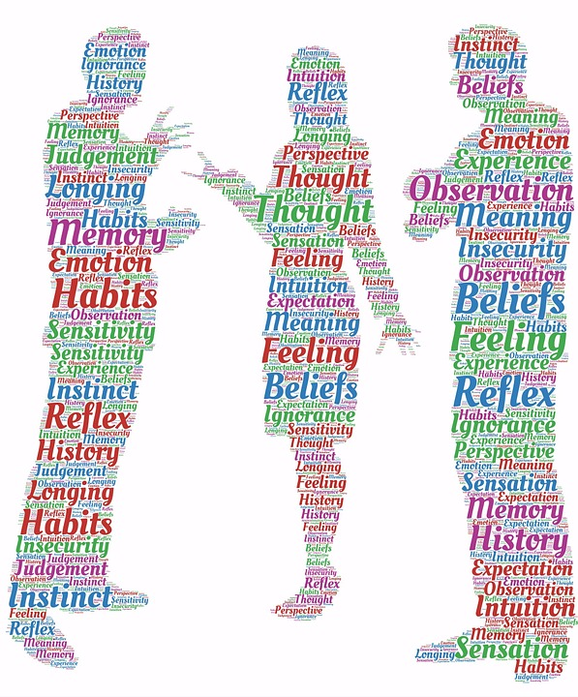
Conflicts, evidence and tools
Conflict – don’t avoid it
Conflict can occur for a number of reasons e.g.:
Competition for limited resources
Disagreement on how things should be done
Personal, self, or group interest
Tension and stress
Power and influence
Personality clash or conflict
In the literature five styles of managing conflict are identified: competition, collaboration, avoidance, accommodation, compromise. (Mullins 2010, p.102)
The ideal style is collaboration, where there is agreement from both parties and reaching consensus is important.
However, it may not always be possible to achieve this.

Slide 21
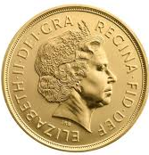
A framework for giving
constructive feedback - COIN
Context
Observation
Next Steps
Impact
(Mindtools.com, 2019)
Notes:
Spend 2 minutes with a partner to discuss how this can be used within your workplace

Slide 22
A framework for giving
constructive feedback - COIN
A framework for giving feedback
Context | The circumstances, event or issue that you want to discuss.
Observation | Specific, factual descriptions of what has happened.
Impact | How the event or issue that you're discussing affects others in your team or organization.
Next Steps | A clear agreement on the changes or improvements in behaviour or performance that you expect going forward.
(Mindtools.com, 2019)
Notes:
With your partner, spend a few minutes reflecting on an event where you have had to deliver feedback, think of how you could use this model instead of what you have previously used.

Slide 23

How to influence – reflect on your personal credibility
Some job titles give you formal authority - but it’s limited and lost when you leave
The most valuable form of authority is the power of your personal credibility (and that of the people in your team)
In what way does personal power and credibility make you a leader?
Because … speaking confidently about nursing practice, comes from our knowledge of science and art, its impact on patients and society, we make it happen everyday, others listen to us - we advocate and advise everyday. Everyday our personal credibility is in how we practice and how we talk about the nursing care we give, the contribution of nursing to health and social care policy
Our influences and impact on others is in our everyday actions demonstrating our leadership
Our identity as a nurse encompasses being a leader – our identity is rightly as nurse leaders
Reflect
Notes:
attribute to QuotesGram

Slide 24
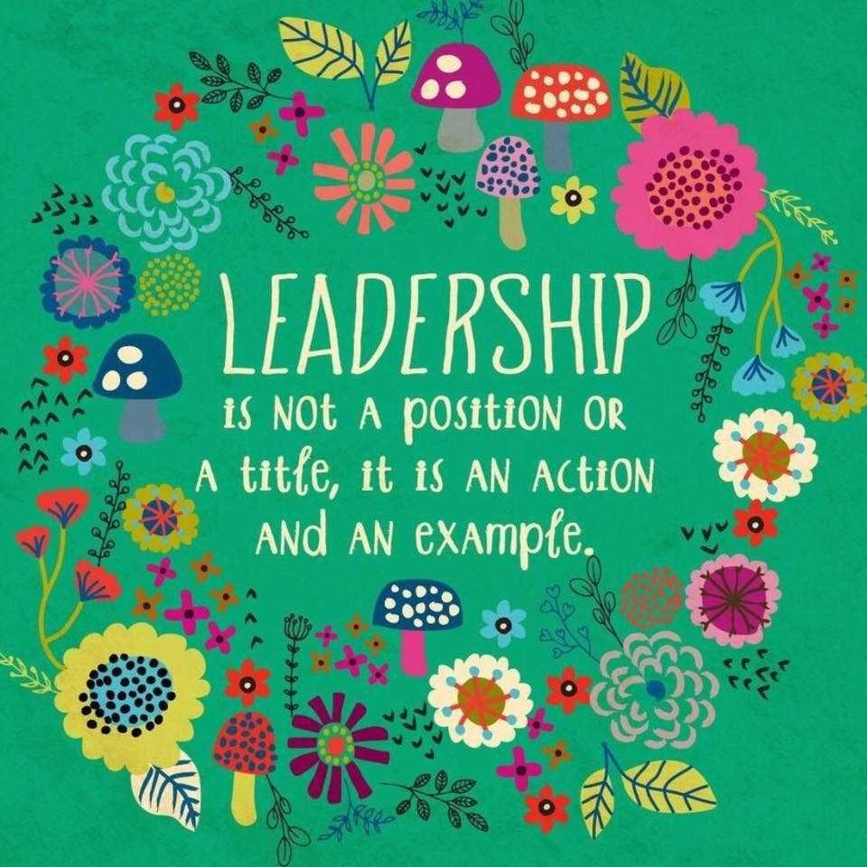
Thoughts on Influencing
The push/pull model explores the ways in which leaders exert influence to reach
organisational goals. Influence is exerted through a mixture of two different
styles. It is either forced (pushed), or encouraged (pulled).
Push method of leadership – This method is useful in times of urgency it is a good technique for safe ideas. The characteristics are leading through persuasion and assertion. Push leaders says ‘I want...’
Pull Method of leadership - This method is best used for dangerous ( novel) ideas,. It is demanding, The characteristics of leading through encouragement, and through the styles of bridging and common vision. Pull leaders say ‘We are…’
https://www.leadershipcentre.org.uk/artofchangemaking/theory/push-and-pull-influencing-style/

Slide 25

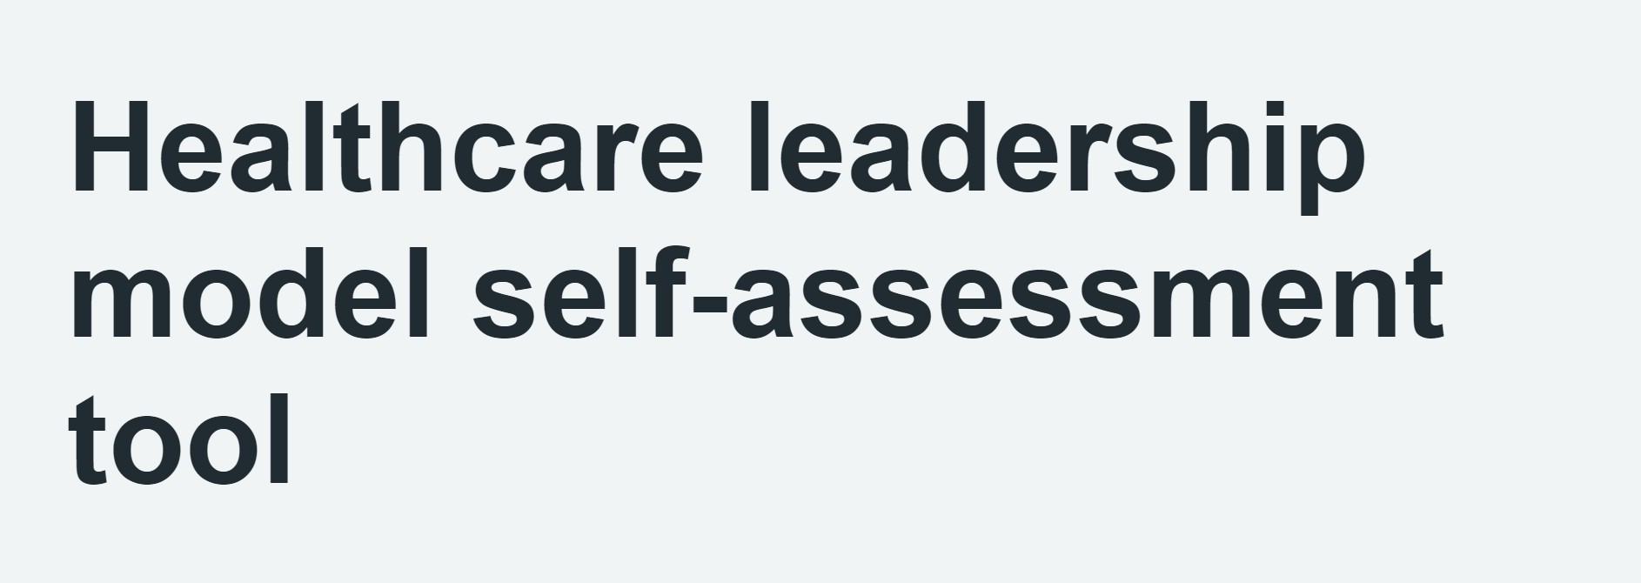
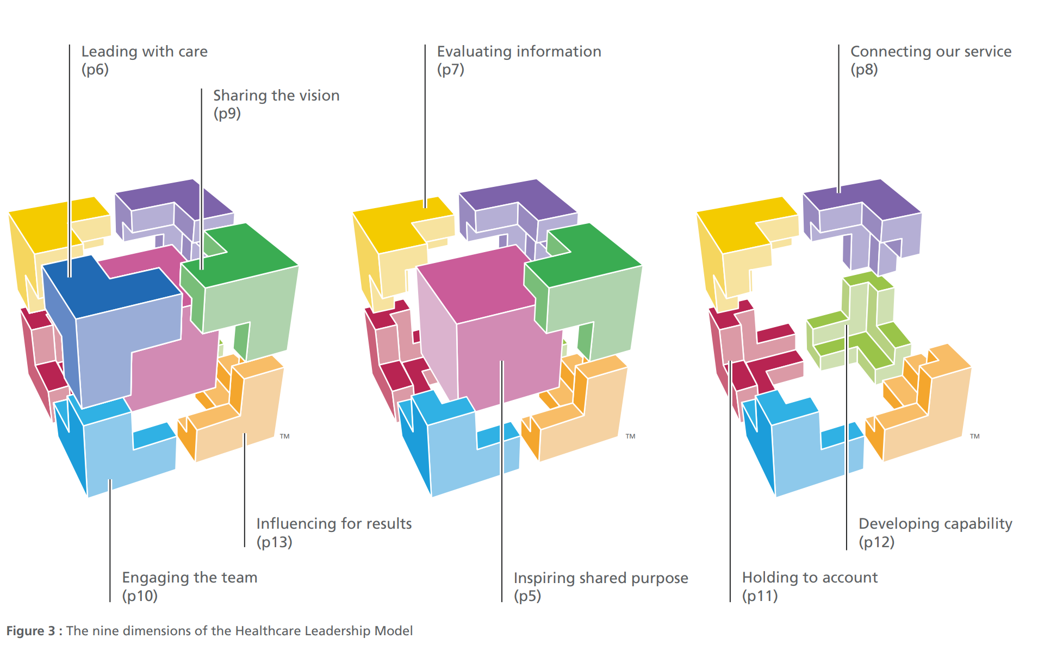
First be able to lead yourself – using a framework helps development – find your own susceptibilities and strengths
https://www.leadershipacademy.nhs.uk/resources/healthcare-leadership-model/
Inspiring a shared purpose
Leading with care
Evaluating information
Connecting our services
Sharing the vision
Engaging the team
Holding to account
Developing capability
Influencing results

Slide 26
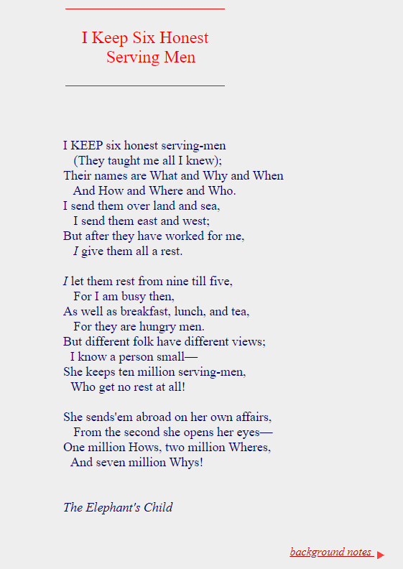
How to influence – ask good questions
Needs both critical appraisal and critical thinking -
Evaluate the information - is it evidence based, is it trustworthy, reliable, valid and useful in this situation?
So, the questions you have to ask both as a follower and as a leader are: What and why, when and how, where and who – as with anything – how you ask these and when you ask are them are important – timing is everything.

Slide 27

Ask coaching questions
I wonder if…?
I am curious about…?
Can you help me to understand…?
Can you share that perspective with me…?
I notice that…?
I understand that…?
Can you walk/talk me through your thoughts…?
Can you tell me about…?
I would like to know more about…?
When I hear/see that I am reminded of…?

Slide 28
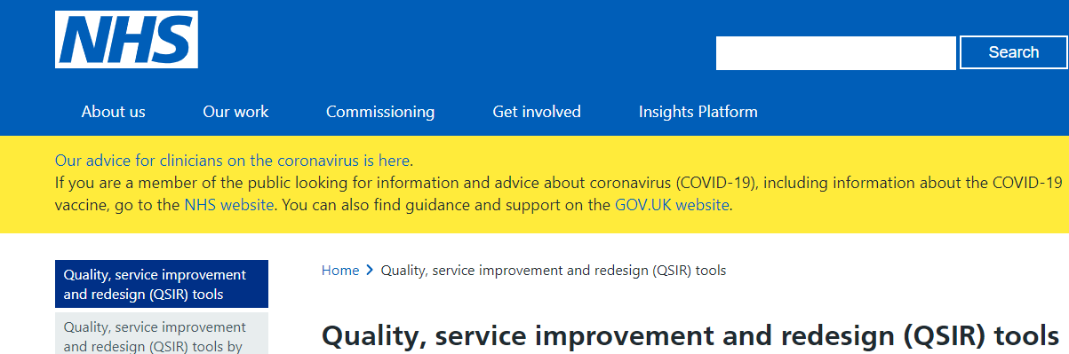
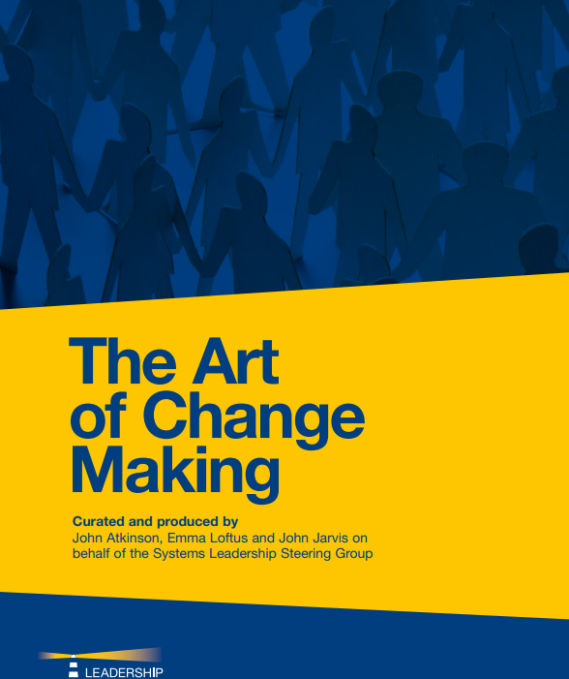
Resources to help you influence and lead change
https://www.england.nhs.uk/quality-service-improvement-and-redesign-qsir-tools/
https://www.leadershipcentre.org.uk/wp-content/uploads/2016/02/The-Art-of-Change-Making.pdf

Slide 29
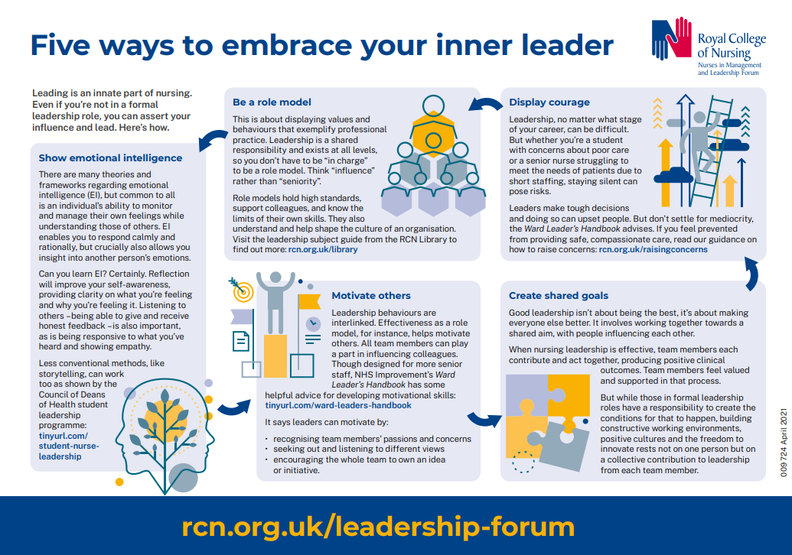

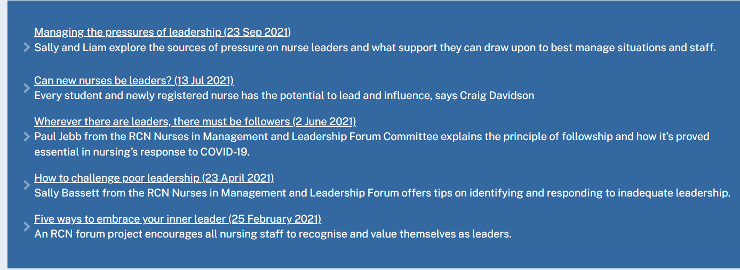
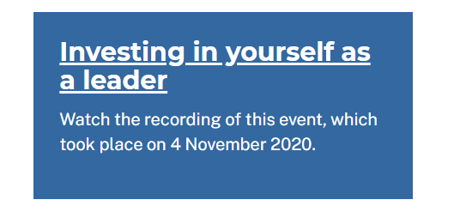
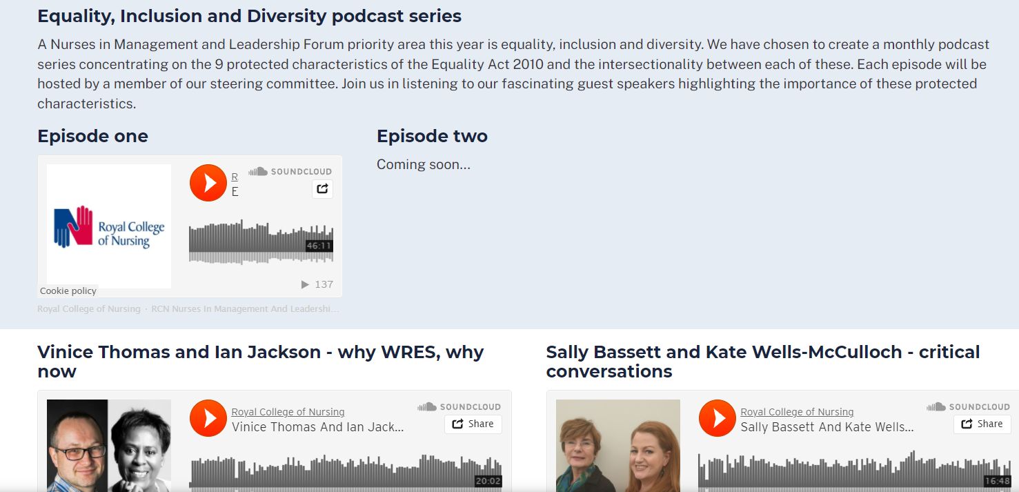

Visit our web page, join our forum! @RCNMandLForum https://www.rcn.org.uk/get-involved/forums/nurses-in-management-and-leadership-forum
https://shows.acast.com/nursing-matters-from-the-royal-college-of-nursing/episodes/why-the-rcn-forums-matter

Slide 30

NMLF Congress 2022
Learning and Well Being Events (Fringe) – 5 items
Does Imposter Syndrome affect you? Here's what you can do about it
Becoming an effective leader by developing your influencing skills
Developing Skills for Senior Nurse Leadership
In partnership with the RCN Foundation - Leadership legacies from COVID-19
Inspiring students: Our shared leadership story
Agenda – 3 items
Campaign for nursing staff with Long Covid to receive equitable and effective support
Support for introducing and embedding clinical digital leadership roles across the health and care sector
Calls on RCN Council to lobby legislators to protect the title 'Nurse' in the UK

Slide 31
Reflect as soon as you can – and carry on throughout your career – your leadership practice will depend on it!
Ask
Who do I need to Be
What do I need to Do
What do I want to Have (achieve)
Be + Do = Have

Slide 32

What leadership approach do you want to develop?
Leadership is critical for successful teams, thinking and acting critically as a team leads to success
What's the image of leadership in your head?
As a metaphor, why not lead like a goose?

Slide 34
Top Tips for Managing & Leading Yourself
• Do what fulfils you
• Build your networks
• Find a coach-mentor; be someone else's
• Invest in yourself
• Face your fears
• Try something new
• Be kind and generous

Slide 35


Slide 36
References (1):
References (1)
Blackstock, S., Salami, B. and Cummings, G. G. (2018) “Organisational Antecedents, Policy and Horizontal Violence among Nurses: An Integrative Review,” Journal of Nursing Management, 26(8), pp. 972–991. doi: 10.1111/jonm.12623.
Blackwell, S, L. (2008) From Silence to Voice: What Nurses Know and Must Communicate to the Public, Journal of Hospital Librarianship, 8:1, 129-131, DOI: 10.1080/15323260801943612
Boin, A., Overdijk, W., and Kuipers, S. (2013). Leadership in Times of Crisis: A Framework for Assessment. International Review of Public Administration. 18. 79-91. 10.1080/12294
Bolden et al. (2011) Exploring Leadership, Individual, organisational and societal
Bolden et al. (2011) Exploring Leadership, Individual, organisational and societal perspectives Oxford: Oxford University Press
Buresh, B. and Gordon, S. (2013) From Silence to Voice: What Nurses Know and Must Communicate to the Public. 3rd Edition. Cornell Press.
Bunting, M. (2020) Labour of Love: Crisis in care. Granta Books
Deitchman, D. 2013. Enhancing Crisis Leadership in Public Health emergencies. Disaster Medicine and Public Health Preparedness. 7(5):534-540.
Grint , K. (2010) Leadership: a very short introduction. Oxford University Press
Iszatt-White, M. and Saunders C. (2020) Leadership.3rd edition. Oxford University Press
Horseman, Z. Hamilton, S. Noble, H. Jones, A. Rafferty, A-M. Holloway A. Reid, J. Harris R. Smith, P. Kelly, D. (2020) Identifying the challenges and opportunities of the executive nurse director role in the UK: a scoping review. Nursing Management. doi10.7748/nm.2020.e1948 ( accessed October 22nd 2020).
IntraHealth International, Nursing Now and Johnson & Johnson 2020. Investing in the power of Nurse Leadership: What will it take? https://www.intrahealth.org/resources/investing-power-nurse-leadership-what-will-it-take
Jackson, J. Anderson, J.E. Maben, J. (2021) "What is nursing work? A meta-narrative review and integrated framework": https://www.sciencedirect.com/science/article/pii/S0020748921000870
Jones, A., Lankshear, A. and Kelly, D. (2016) “Giving Voice to Quality and Safety Matters at Board Level: A Qualitative Study of the Experiences of Executive Nurses Working in England and Wales,” International Journal of Nursing Studies, 59, pp. 169–176. doi: 10.1016/j.ijnurstu.2016.04.007.
Kean S, Haycock-Stuart E, Baggaley S, Carson M. (2011)Followers and the co-construction of leadership. J Nurs Manag. May;19(4):507-16. doi: 10.1111/j.1365-2834.2011.01227.x. Epub 2011 Apr 6. PMID: 21569147
Kelly D, Lankshear A and Jones A (2016) “Stress and Resilience in a Post-Francis World - a Qualitative Study of Executive Nurse Directors,” Journal of advanced nursing, 72(12), pp. 3160–3168. doi: 10.1111/jan.13086.
Notes:
The Power of One, The Power of Many
https://www.england.nhs.uk/improvement-hub/wp-content/uploads/sites/44/2017/11/The-Power-of-One-the-Power-of-Many.pdf

Slide 37
References (2)
Johnson, C. E. (2015) Meeting the ethical challenges of leadership : casting light or shadow. Fifth edn. Los Angeles: Sage.
NHS Institute for Innovation and Improvement. (2009). The Power of One, The Power of Many.
https://www.england.nhs.uk/improvement-hub/wp-content/uploads/sites/44/2017/11/The-Power-of-One-the-Power-of-Many.pdf accessed 2.11.20
Nursing and Midwifery Council [NMC] (2018). Future Nurse: Standards of proficiency for registered nurses. London: NMC. Available from: https://www.nmc.org.uk/standards/standards-for-nurses/standards-of-proficiency-for-registered-nurses/
Schedlitzki, D. and Edwards, G. (2014) Studying leadership : traditional and critical approaches. London: SAGE.
Stanley, H. 2020. A concept analysis of clinical leadership in the healthcare professions and the ‘simple rules‘ for Clinical leadership Programmes in : A realist evaluation of the impact of learning and development strategies in a clinical leadership programme on workplace culture and person-centred practice (unpublished doctoral dissertation ). Canterbury Christ Church University
Stanley, D., and K., Stanley. 2017. Clinical leadership and nursing explored: a literature search. Journal of Clinical Nursing. 1-14.DOI:10.1111/jocn.14145.
Stokes-Parish J, Elliott R, Rolls K, Massey D. Angels and Heroes: The Unintended Consequence of the Hero Narrative. J Nurs Scholarsh. 2020 Aug 27:10.1111/jnu.12591. doi: 10.1111/jnu.12591. Epub ahead of print. PMID: 32856396; PMCID: PMC7461164.

Slide 38
RCN NMLF Resources (2):
Might be interesting resources
Bassett, S. and H. Stanley. 2020. COVID-19: pandemic poses tests of nursing leadership, courage and compassion. Nursing Management. https://rcni.com/nursing-management/opinion/comment/covid-19-pandemic-poses-tests-of-nursing-leadership-courage-and-compassion-160616 accessed 12.10.20
Amy Cuddy TED Talk, Fake it till you make it: https://www.youtube.com/watch?v=RVmMeMcGc0Y
Amy Cuddy TED Talk: Imposter Syndrome. https://www.youtube.com/watch?v=SqHuETdHKzQ
West, M. (2018) How Teams Improve Staff Engagement and Why it Matters. Retrieved from: https://www.youtube.com/watch?v=Gmw7EsfUfNg
Bailey, S. and West, M. (2020) Covid-19: Why Compassionate Leadership Matters in a Crisis. London: The Kings Fund. Retrieved from: tinyurl.com/KF-compassionate-lead (accessed 16.8.20 )
You can learn more about power and leadership here: https://www.mindtools.com/pages/article/newLDR_56.htm
YouTube resource: First Follower: Leadership Lessons from Dancing Guy https://youtu.be/fW8amMCVAJQ (accessed 25.8.20)
RCN suite of Leadership courses information: https://www.rcn.org.uk/professional-development/professional-services/leadership-programmes
Sinek, S. TED Talk, Start with why: How great leaders inspire action https://www.youtube.com/watch?v=u4ZoJKF_VuA
RCN Workforce Standards: Nursing Workforce Standards | Professional Development | Royal College of Nursing (rcn.org.uk)

