Slide 1

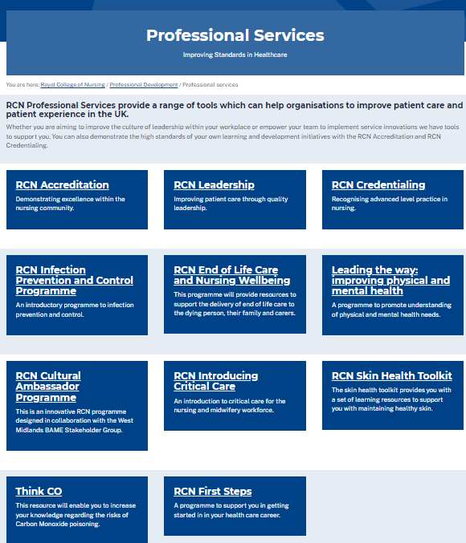
https://www.rcn.org.uk/professional-development/professional-services
@wendypresto
Ward Manager Conference
Wendy Preston RN MSc
RCN Head of Nursing Practice
Honorary Respiratory Consultant Nurse
Advanced Nurse Practitioner - OOH

Slide 2


Ward Manager – what hat’s do you wear?

Slide 3
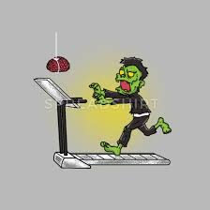





Slide 4
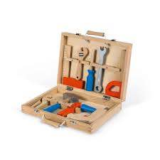

What tools do you need in your toolbox?

Slide 5


Staffing for safe and effective care?
Are you always supervisory?
…..or in the numbers often?
https://www.rcn.org.uk/news-and-events/news/uk-how-were-staffing-levels-on-your-last-shift-090322

Slide 6

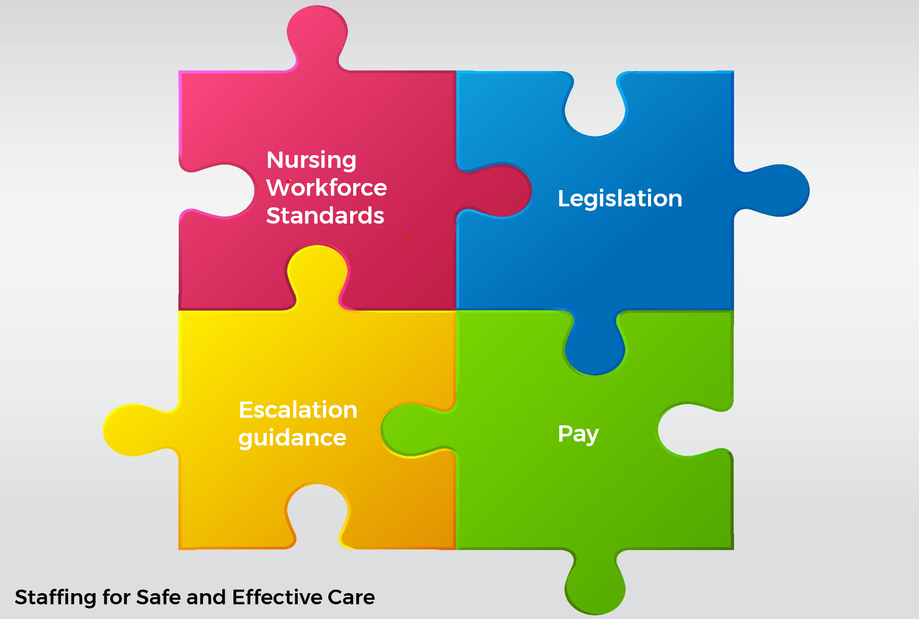
A new tool for your tool box…….
https://www.rcn.org.uk/professional-development/nursing-workforce-standards

Slide 7



About the Standards
The Standards apply across all areas of nursing and all sectors within the United Kingdom.
The Standards were co-created with expert consensus by the nursing professional body and the largest trade union for nurses.
The Standards are designed to support a safe and effective nursing workforce alongside each nation’s legislation.
The 14 Standards are grouped into 3 key themes:
  Responsibility and Accountability – 4 standards
  Clinical Leadership and Safety - 6 standards
  Health, Safety and Wellbeing - 4 standards

Slide 8
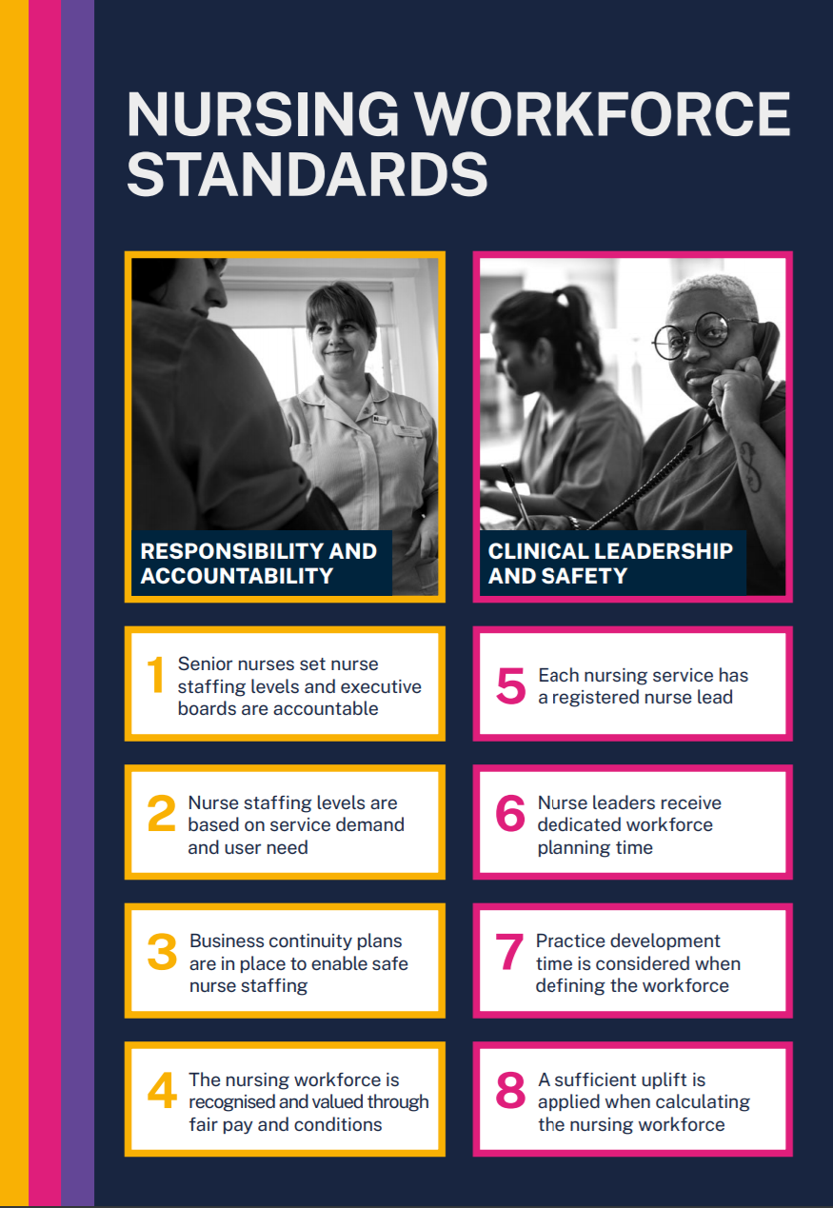
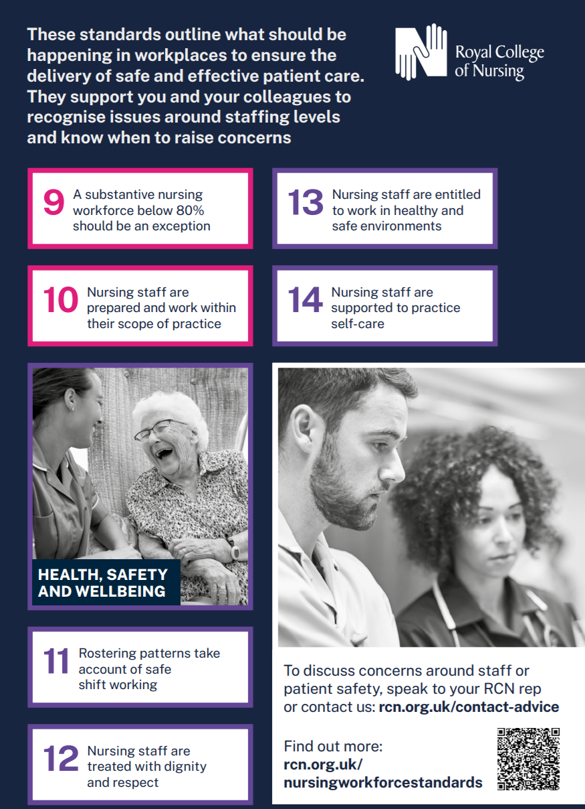

Slide 9
Registered Nurse Leadership
Standard
5
Standard
6
Examples
Registered Nurse Lead
Time & Resources to Lead
5a - Each team & service (e.g. Ward/ Community team/ Nursing Home) should have a registered nurse lead.
5b –If it is a wider MDT team and not managed by a RN then there must be a clear line to nursing leadership.
6a – Should be 100% supervisory (i.e. not planned to be in the numbers) – if not needs to be a documented exception and reported to board.
6b – list of what this resource and time is for.
6c – Role within leadership team needs to be included in job descriptions.
Notes:
DoN example

Slide 10
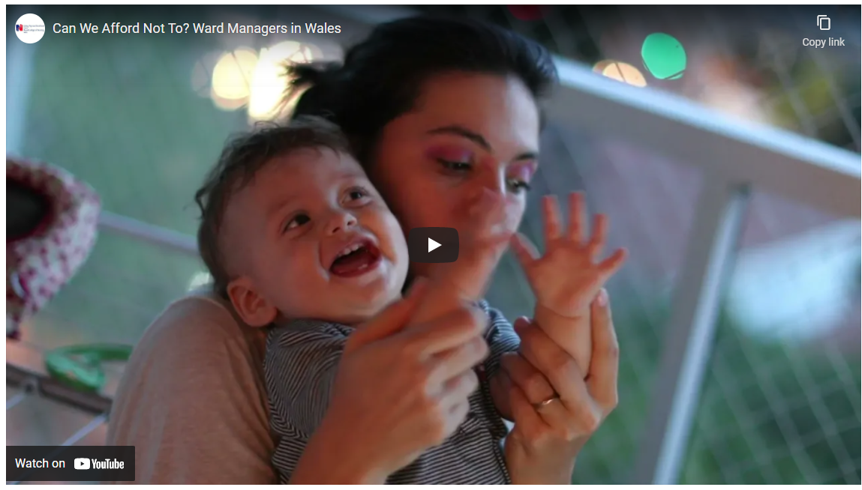
Ward Managers: The Importance of Being Supernumerary
We're excited to launch our new report and short film on ward managers in Wales: the issues they currently face, but also the impact great leadership brings in improving patient care and reducing adverse incidents.
Often responsible for around 30 patients and teams of around 40, ward managers need protected time when they aren't required to care directly for patients and can focus on managing and leading their teams. This is called being supernumerary, and it benefits both staff and patients.
This work was made possible by RCN members. Over 100 ward managers from across NHS Wales participated in three focus groups, interviews and an online survey. Their experiences and views formed the basis of our recommendations.
Full reports available at:
https://www.rcn.org.uk/wales/Get-Involved/Safe-and-Effective-Care
Video - https://youtu.be/CA7I8NcGslM

Slide 11
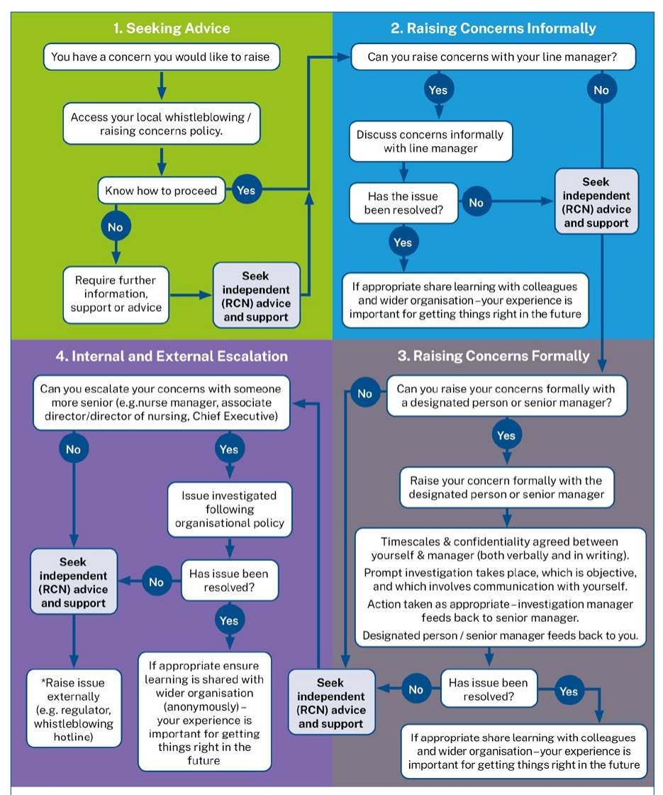
The standards complement RCN guidance published in November 2020: Raising and Escalating Concerns
View the publication
https://www.rcn.org.uk/professional-development/publications/rcn-raising-and-escalating-concerns-uk-pub-009425

Slide 12
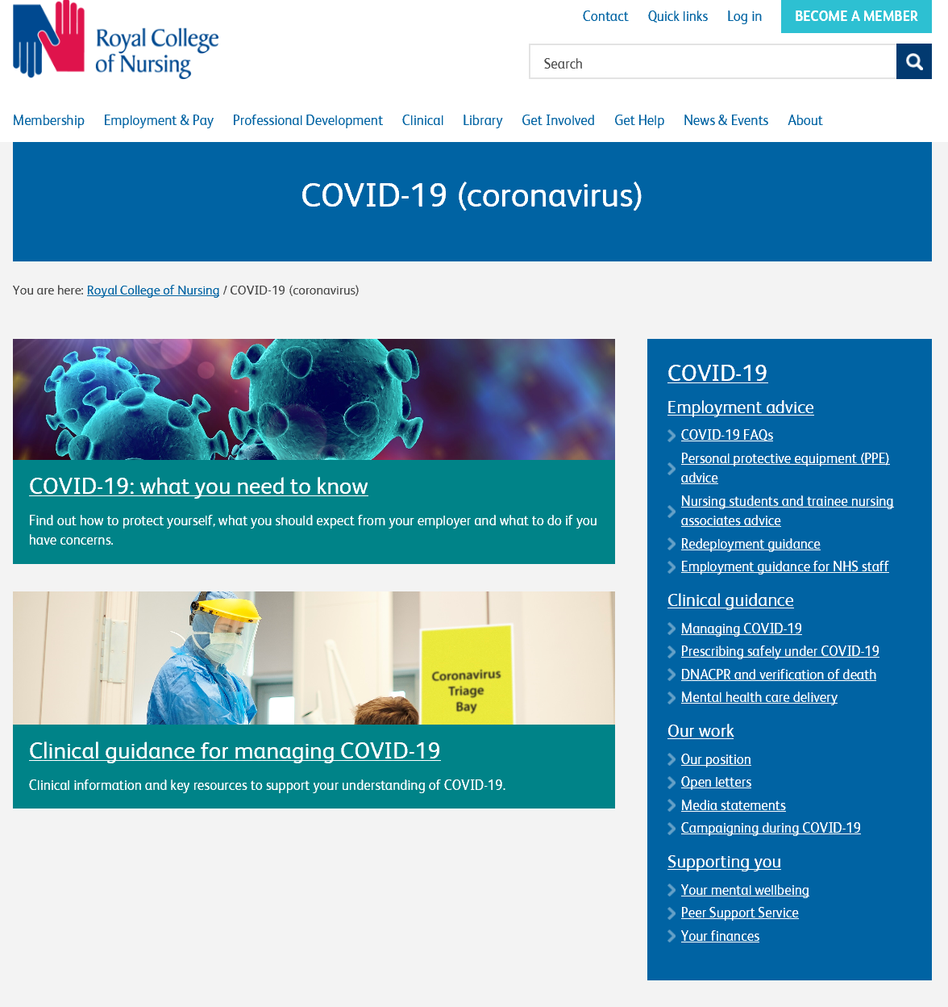
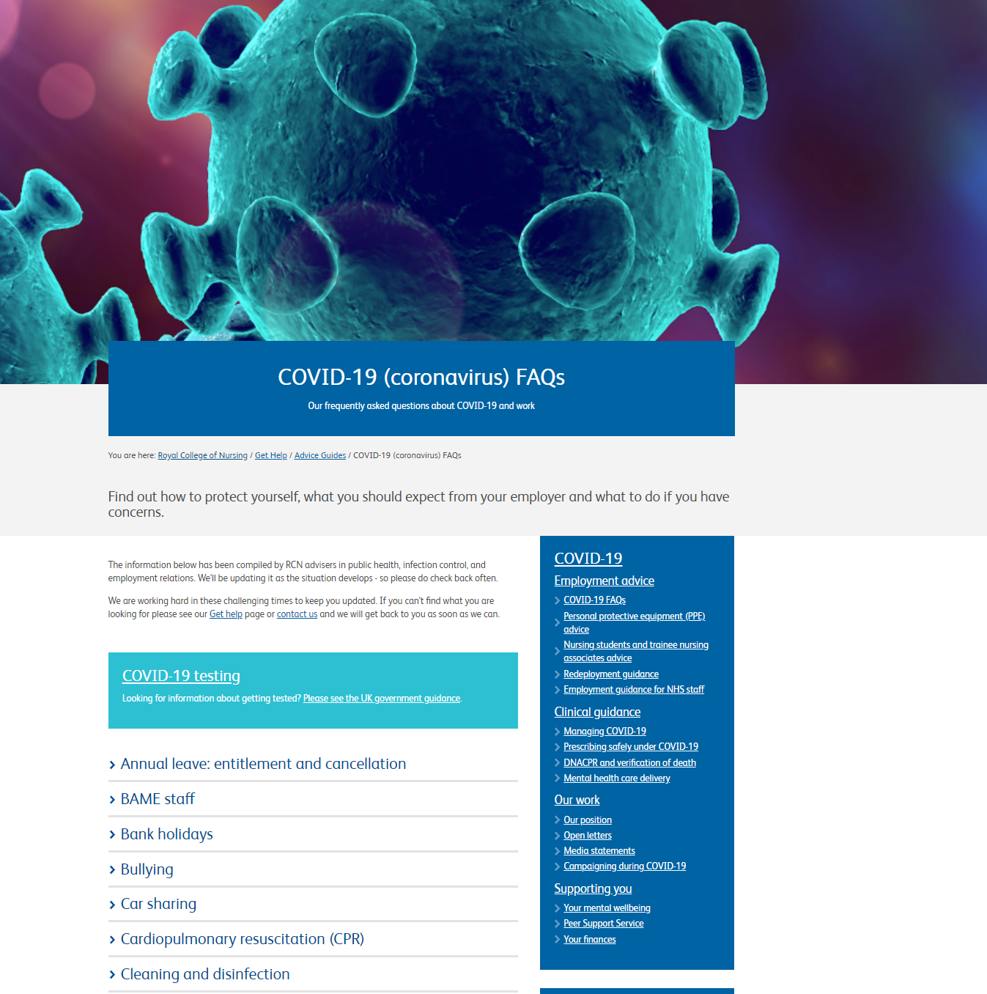
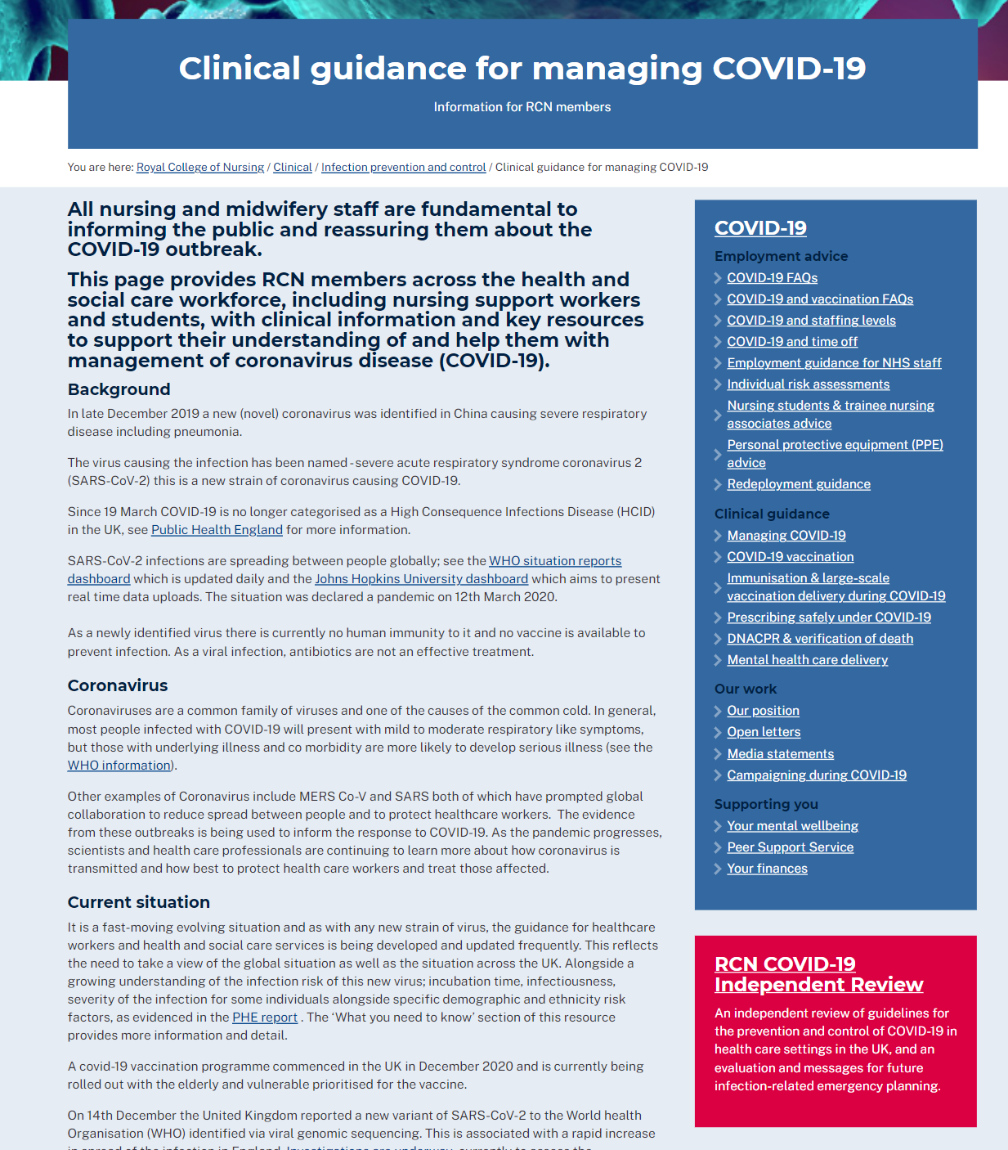
Covid 19 resources
www.rcn.org.uk/covid-19

Slide 13
Today……..for your tool box
Exciting agenda
Developing your role as a Ward Manager: A Lived Experience – Adelaide Atu
Developing your Ward leadership skills – Sally Bassett
Supporting Ward Manager to Lead through Covid-19– Sheran Oke
Driving Pride on the Wards: Delivering Ward Accreditation – Sarah Beauchamp
Supporting Nurses in difficulty & managing performance – Kelly McGovern
Leading a ward through difficult & challenging times – Edmund Tabay
Last but definitely not least is finance and budgets – David Bailey
Enjoy…..

