Slide 1
Improving information sharing whilst ensuring patient confidentiality in emergencies
Victor Inyang FRCEM, Medical Director & Caldicott Guardian

Slide 2
East Anglian Air Ambulance
CQC registered Air Ambulance charity
First mission 2001
Approximately 30,000 missions
Running cost of £14 million (raised from the local community)
Provision of PHEM (Pre-hospital Emergency Medicine) across the East of England
Physician/ Critical Care Paramedic model
24/7 Consultant cover
24/7 from the Norwich & Cambridge bases

Slide 3
EAAA Teams
Clinical
Pilots
Engagement & fundraising
Marketing & communications
Operations
Finance
Executive

Slide 4
EAAA Information Governance
SIRO (Senior Information Risk Owner)
Caldicott Guardian
Data Protection Officer
Information Governance Team
Information Sharing Agreements
Clinical Information System

Slide 5
Clinical Information System
HEMSBase
Internal access
Clinical
Non-clinical
External access
NHS Hospitals
Ambulance Trust
Safe-Guarding
HM Coroner
Police
Health & Safety Executive
Patients (Subject Access Requests)

Slide 6
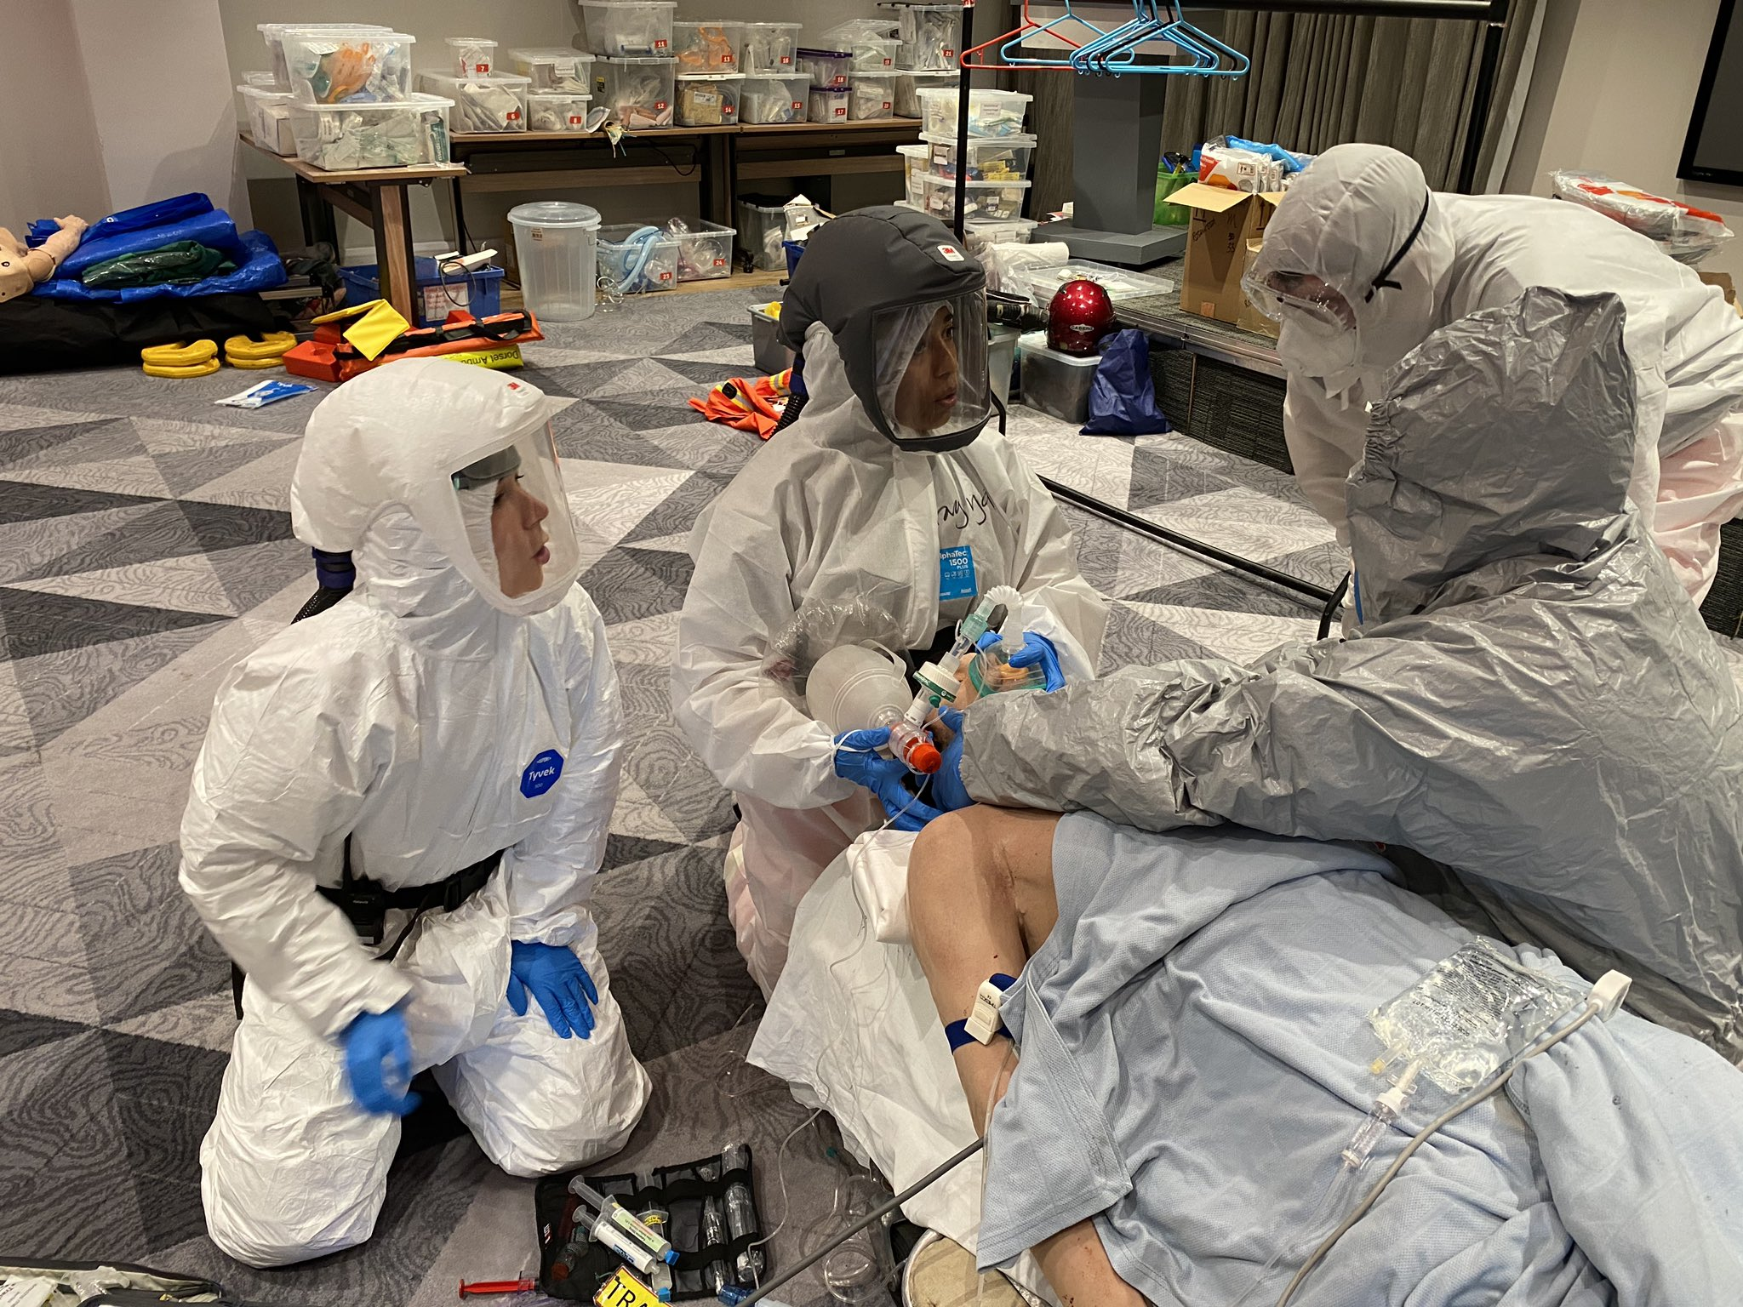
SARS-COV-2 Pandemic
Critical care transfer
Complex logistics
Patient information handled by a number of individuals
Providing updates to relatives
Press interest
COVID transfers

Slide 7
Case 1 (Police Inquiry at incident scene)
At the scene of a RTC, a police officer makes an Inquiry of the clinical condition of a pedestrian hit by a car
The clinician gives a detailed summary of each injury, including the fact that a poor outcome is expected
Based on this information the road is closed and treated as a scene of forensic interest
Within an hour the online edition of a local newspaper publishes the incident details, including the age, sex, location and location of the incident

Slide 8
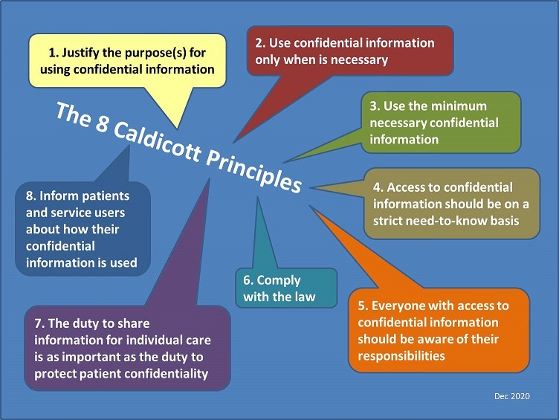

Slide 9
Case 2 (Press enquiry)
The clinical team return to base following a clinical incident at a local beach (two patients received treatment for life threatening conditions)
The reporter has called to confirm details of the incident already recorded by on-lookers and already on social media
The reporter stresses that this piece of beach is notorious with swimmers and there is a public interest to share details of the victims
The clinical politely refer the reporter to the communications team, without confirming or denying attendance at the incident

Slide 11
Case 3 (Triangulation of patient data)
A paramedic, as part of raising awareness of psychological injury amongst emergency teams, gives an interview to a national newspaper
The interview contains details of an incident attended five years previously, including the date, age of the child and location
With this information another reporter is able to identify the case and contacts the family for an interview

Slide 13
Case 4 (Clinical photography)
A PHEM doctor uses his mobile phone to take a picture of a patient’s fracture (open fracture of the proximal humerus)
This has been done to reduce repeated wound examination
The picture includes the patient’s face, who is unresponsive at the time and unable to consent
An attempt is made to share this picture with a clinician at the receiving hospital
In error, this picture is also shared with non-clinical contacts of this doctor, one of whom identifies the patient

Slide 15
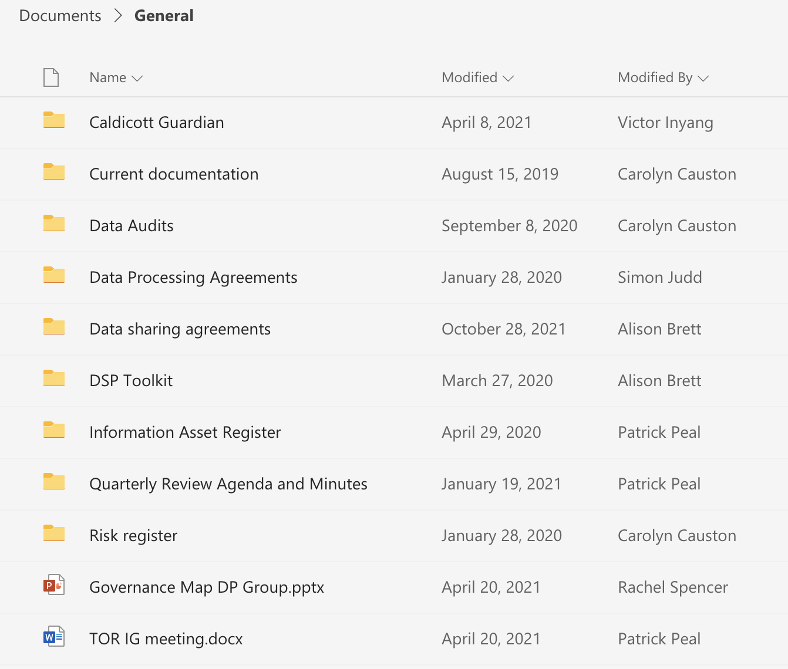
Improving Caldicott Decision making
& supporting the team
Embed Caldicott Guardian activity within IG strategy and operations
Raise awareness of the role of the Caldicott Guardian
Increase accessibility to the Caldicott Guardian
Ensure the role becomes ”business as usual”
Develop a decision making & recording tool
Mitigation to cover leave/ absence
Mandatory IG training

Slide 16
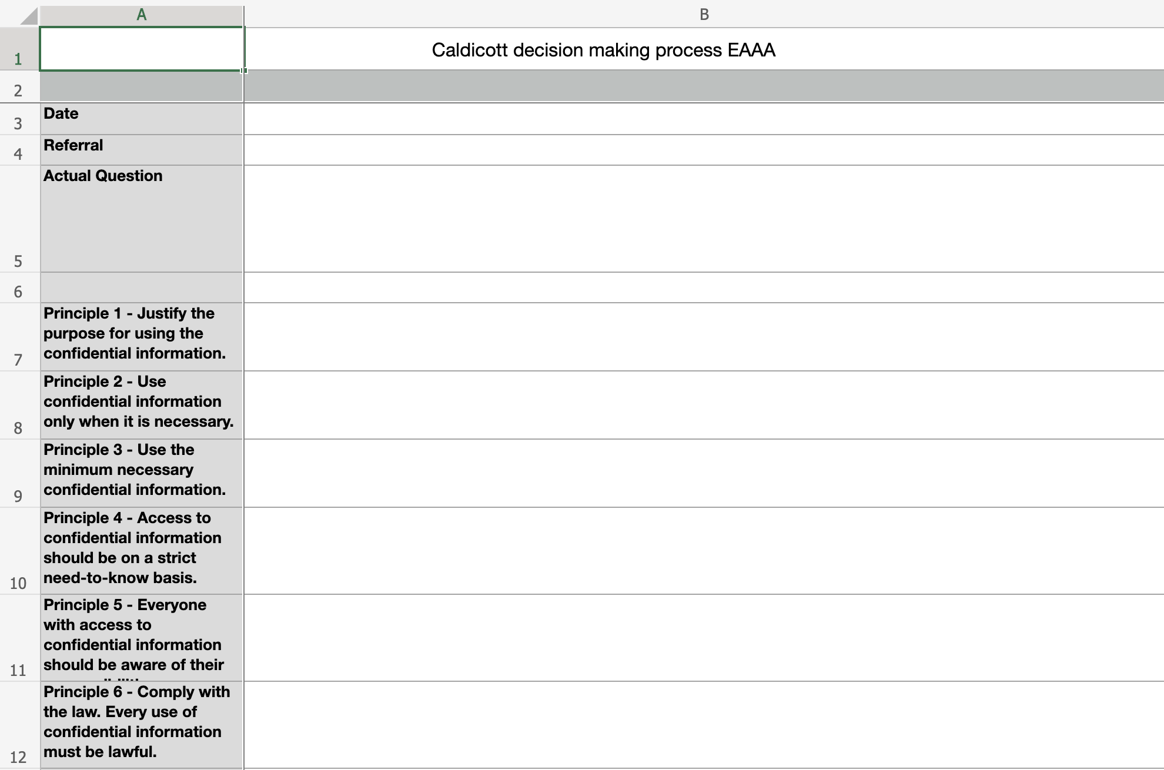
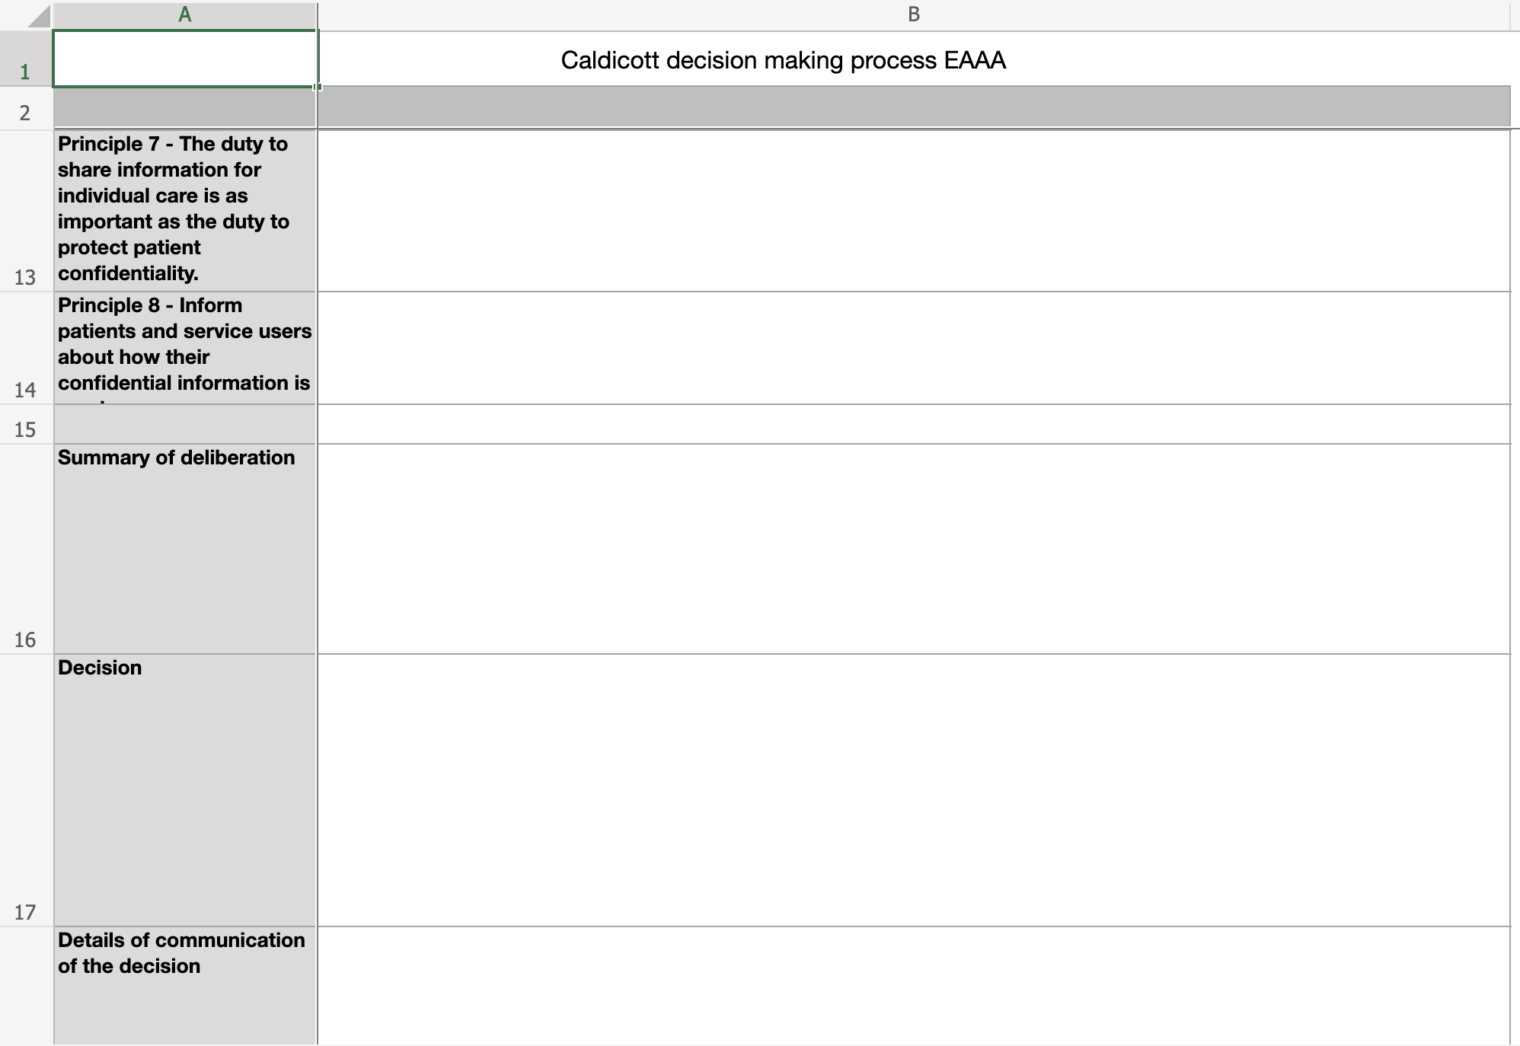
Improving Caldicott Decision making
& supporting the team

Slide 17
Summary
The Caldicott Guardian role can and should become “business as usual” within clinical teams
An approachable and therefore preventative model is preferable
  “Phone a friend” when in doubt
Education, education and more education to avoid pitfalls is key

Slide 18
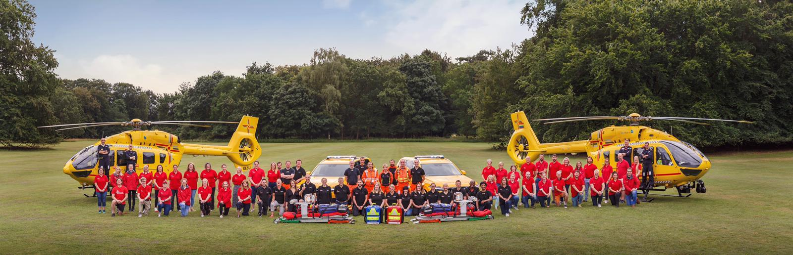
Questions

