Slide 1
Developing your skills, confidence and competence as a Non-medical Prescriber in Cardiology
Alison Pottle
Nurse Consultant in Cardiology
Royal Brompton and Harefield Hospitals -
Harefield Hospital
Part of Guy’s and St Thomas’ NHS Foundation Trust
Non-Medical Prescribing in Cardiology – April 26th, 2022, Virtual Conference

Slide 2
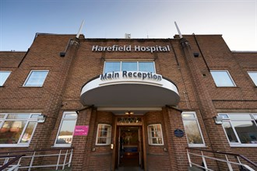

Slide 3
Overview
Background
Competence
Developing confidence
Using guidelines and ensuring prescribing is evidence-based
Keeping up to date
Ensuring you have appropriate clinical skills to prescribe
Measuring impact
Examples from my clinical practice
Adherence

Slide 4
Background
History taking, clinical assessment, diagnosis and prescribing have been seen as medical roles
Changes in ways of working by both medical and allied health professional staff have prompted nurses and AHPs to take on skills/practices they have not previously undertaken
Aim is to improve patient care and access to treatment whilst maintaining safety

Slide 5
Criteria for non medical prescribing
Right person
Competence
Confidence
Correct situation to prescribe
Cost effective
Benefit to patient care

Slide 6
Skills required to prescribe
Advanced clinical knowledge
Experience in the field
Clinical examination skills
Ability to interpret investigations
Diagnostic skills
Ability to make decisions and work autonomously
One year on the NMC Register (from January 2019)

Slide 7
Autonomous practice
‘Having the authority to make decisions and the freedom to act in accordance with one’s professional knowledge base’
(Skar, Journal of Clinical Nursing, 2010)

Slide 8
Where are we now?
A quick tour of the evidence base…
Literature is (still) scarce
Prescribing authority increases job satisfaction
Enhances relationships with patients
Improves the quality of care, more choice, more convenient
But…
Increases pressure and workload

Slide 9
Competence
What is competency?
‘Knowledge, skills, motives and personal traits’
Collins English Dictionary;
‘the condition of being capable, ability’

Slide 10
Prescribing competence
Single competency framework for all prescribers
Endorsed by professional bodies and NICE

Slide 11
Why is competency important?
Maintains standards
Measurable
Facilitates good practice
Patient safety
Organisational accountability/liability
Professional accountability

Slide 12
Developing confidence in prescribing practice
‘Self reported confidence in prescribing skills correlates poorly with assessed competence in fourth-year medical students’
(Brinkman et al 2015; Clinical Therapeutics Vol 37; e1)

Slide 13
Influences on prescribing
‘Prescribing is a complex skill that is high risk and error prone, with many factors influencing its practice, whether contextual of psychological’ (Lewis et al 2014)
Confidence
Time since qualifying
Training
Continuous practice
Multidisciplinary support
Use of formularies or guidelines

Slide 14
Confidence
Nurses – knowledge of pharmacology
Pharmacists – ability to undertake physical examination or to diagnose
(Latter et al 2012)
Prescribing can be scary!!
Practice with Patient Group Directions (PGDs) or protocols can help with preparation
Medical support – engaged DMP/DPP
Clinical supervision
Peer supervision; support from other NMPs
The role of the Trust Prescribing Lead

Slide 15
Guidelines and evidence
Practice must be evidence based¹
Numerous guidelines within cardiology – NICE², ESC³, SIGN⁴, local
Guidelines help confidence and competence
Enable the effectiveness of practice to be measured - audit
ESC, European Society of Cardiology; NICE, The National Institute for Health and Care Excellence; SIGN, Scottish Intercollegiate Guidelines Network.
1. NMC. 2015. Standards of proficiency for nurse and midwife prescribers. Available at: https://www.nmc.org.uk/globalassets/sitedocuments/standards/nmc-standards-proficiency-nurse-and-midwife-prescribers.pdf. 2. NICE CG108. Chronic heart failure in adults: management. September 2010. Available at: https://www.nice.org.uk/guidance/cg108. 3. Ponikowski et al. Eur J Heart Fail 2016;18(8):891–975. 4. SIGN 147. Management of chronic heart failure. March 2016 Available at: http://www.sign.ac.uk/pdf/SIGN147.pdf.

Slide 16
Keeping up to date
Electronic updates & alerts
Professional Journals
Clinical Supervision
Publish articles
Conference presentations
Appraisal
Study days
Local prescribing network meetings
Trust prescribing lead
Peer support and supervision
Mentoring/coaching
Short update sessions
Peer review
Informal multi-disciplinary meetings
Audit
Protected time for professional reading
Performance appraisal
Organised Prescribing courses
Critical incident analysis
Clinical visits to other professionals involved in prescribing
Drug company training sessions

Slide 17
Assessing competence
How can this be measured?
Competency statements
Performance review
DMP/DPP discussion
Audit

Slide 18
Non medical prescribers annual declaration of competence
Area to self-certify | YES / NO | Comments / Evidence/ Action to be undertaken if required
Reviewed Scope in line with current role and responsibilities |  | Scope extension required?
Circumstances impacting upon prescribing practice over past year discussed and addressed with line manager and/or DMP, practice supervisor and/or NMP Lead e.g.long-term sickness, maternity leave, change in role |  | If circumstances have not been discussed or addressed an action plan is required.
Participated in prescribing related CPD activities e.g. in-house forums, presentations, conference attendance, literature read or reviewed, attended medicines related committee
Applied professionalism to all aspects of practice in line with professional code, standards and guidance
Received clinical supervision or opportunities to reflect in relation to prescribing / opportunities to discuss prescribing decision making
Participated in clinical audit, quality improvement or service development activities relating to prescribing area
I have reviewed my learning and development needs against the ten dimensions of the RPS Competency Framework for all Prescribers (2016) and I have documented one example below per competency dimension as evidence of competence and/or areas for development. I have reflected on one of these competencies for discussion with my DMP/ Peer Equivalent NMP
The Consultation | 1.Assess the patient | Evidence of competence / Areas for development
 | 2.Consider the options | Evidence of competence / Areas for development:
 | 3. Reach a shared decision | Evidence of competence / Areas for development
 | 4. Prescribe | Evidence of competence / Areas for development

Slide 19
Prescribing Governance | 5. Provide information | Evidence of competence / Areas for development
 | 6. Monitor & Review | Evidence of competence / Areas for development
 | 7. Prescribing safely | Evidence of competence / Areas for development
 | 8. Prescribe professionally | Evidence of competence / Areas for development
 | 9. Improve prescribing practice | Evidence of competence / Areas for development
 | 10. Prescribe as part of a team | Evidence of competence / Areas for development
Declaration
My job description includes a prescribing statement
I have read the Royal Pharmaceutical Society (RPS) publication ‘A Competency Framework for all Prescribers 2016’
I have reviewed my competence and accurately reflected on my on-going development needs
I have discussed this declaration and my reflection with my DMP or peer equivalent non-medical prescriber or practice assessor
I will discuss this declaration at my annual appraisal
I have the knowledge and skills to safely prescribe within the level of my experience and competence, and I will act in accordance with the professional and ethical frameworks described by my professional body
I have read the RBHT Non-Medical Prescribing Policy
I have attended the mandatory minimum of 50% of in house forums / CPD sessions
Prescribers Signature:
Date:
DMP or Peer Name and Signature:
Date:
Acknowledged by Line Manager:
Line Managers Printed Name:
Line Managers Signature:
Date:

Slide 20
Is non medical prescribing necessary?
Evidence supports non medical prescribing^{1,2}
Need to prescribe enough to keep skills up to date³
Cost implication³
1. Hacking & Taylor. 2010. An Evaluation of the Scope and Practice of Non-Medical Prescribing in the North West. NHS, North West. Available at: (17) (PDF) An evaluation of the scope and practice of Non Medical Prescribing in the North West For NHS North West (researchgate.net) 2. Scrafton et al. J Clin Nurs.2012;21(13–14):2044–2053. 3. NMC. 2015. Standards of proficiency for nurse and midwife prescribers. Available at: https://www.nmc.org.uk/globalassets/sitedocuments/standards/nmc-standards-proficiency-nurse-and-midwife-prescribers.pdf. URLs last accessed: April 2022.

Slide 21
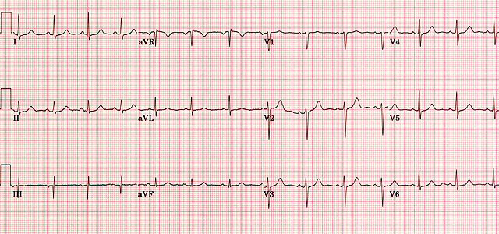
Developing clinical skills
Physical examination
History taking
Requesting and interpretation of investigations
Making/receiving referrals
Diagnostic skills
Managing patient caseloads
Prescribing medicines and treatments
Running clinics
C.N.O. 10 key roles for nurses
The NHS Plan (July 2000) www.nhs.uk/nationalplan

Slide 22
Measuring impact
Don’t need to justify role
Audit measures benefit of non medical prescribing
Adherence to guidelines can be measured
Evidence for expansion in non medical prescribing

Slide 23
Audit
Ward Round 2021
No. | Date | Hospital No | Procedure urgency | Procedure | First operator | Second operator | Medication changes | Drugs changed | Discussed with medical staff | Reason for discussion | Other referral | Discharge today | Data exported to Info Flex | Notes
e.g. | 01-Jan-15 | 15/00125 | Primary | Primary PCI | MM | Rob | Yes | Ramipril | Yes | In AF | FH Screening | Yes | Yes | See diary
1 | 07-Jan-21 | 4152191 | Primary | Primary PCI | GR | Nishan | No |  | No |  | FH Screening | Yes | No
2 | 11-Jan-21 | 4152577 | Primary | Primary PCI | GR | Nishan | Yes |  | No |  | No | No | No | See diary for meds
3 | 11-Jan-21 | 4152581 | Primary | Primary PCI | RS | Nishan | Yes |  | No |  | No | No | No | See diary for meds
4 | 11-Jan-21 | 4152572 | Primary | Primary PCI | RS | Nishan | Yes |  | No |  | No | No | No
5 | 11-Jan-21 | 4152574 | Primary | Primary PCI | GR | Nikhil | Yes |  | No |  | No | No | No
6 | 13-Jan-21 | 4152700 | Primary | Primary PCI | TK | None | Yes | NRT | No |  | No | Yes | No
7 | 13-Jan-21 | 4152718 | Primary | Angiogram | GR | None | No |  | No |  | No | No | N/A
8 | 18-Jan-21 | 4153195 | Primary | Primary PCI | TK | None | Yes |  | Yes | AF management | No | No | No | See diary for meds
9 | 18-Jan-21 | 4153207 | Primary | Primary PCI | MCD | None | Yes | áLansoprazole to 30mg | Yes | Bystander disease | No | No | No
10 | 19-Jan-21 | 4153195 | Primary | Primary PCI | TK | None | No |  | No |  | No | No | No
11 | 19-Jan-21 | 4152718 | Primary | Primary PCI | RS | Asrar | Yes | Stop Nicorandil | No |  | No | Yes | No
12 | 19-Jan-21 | 4153194 | Primary | Primary PCI | De Silva | Naeema | No |  | No |  | No | Yes | Yes
13 | 19-Jan-21 | 4153221 | Primary | Primary PCI | MCD | None | Yes | Stop Amlodipine | No |  | No | No | No
14 | 26-Jan-21 | 4153832 | Primary | Primary PCI | WM | Nishan | Yes |  | Yes | Raised WCC | No | No | No
15 | 26-Jan-21 | 4153824 | Primary | Primary PCI | VP | Jiliu | Yes | áRamipril to 5mg od | No |  | No | Yes | No
16 | 04-Feb-21 | 4102903 | Elective | Elective PCI | TK | Nishan | No |  | No |  | Other | Yes | No | U/S groin
17 | 04-Feb-21 | 13/08348 | Primary | Primary PCI | TK | Savvas | Yes | Regular meds | No |  | No | No | No
18 | 15-Feb-21 | 4155720 | Primary | Primary PCI | RS | Nishan | No |  | No |  | No | Yes | No
19 | 17-Feb-21 | 4155874 | Primary | Primary PCI | TK |  | Yes |  | No |  | No | Yes | No | See diary for meds
20 | 18-Feb-21 | 4156011 | Primary | Primary PCI | WM | Naeema | Yes |  | No |  | No | Yes | No | See diary for meds
21 | 18-Feb-21 | 4155985 | Primary | Primary PCI | RS | Nishan | Yes | Lansoprazole 30mg od | No |  | No | Yes | No
22 | 18-Feb-21 | 4156088 | Primary | Primary PCI | WM | Nishan | No |  | No |  | No | No | No
23 | 19-Feb-21 | 4145480 | Primary | Primary PCI | Naeema | Maria | Yes |  | No |  | No | No | No | See diary for meds
24 | 19-Feb-21 | Y98-04530 | Primary | Primary PCI | WM | Nishan | No |  | No |  | No | No | No
25 | 19-Feb-21 | 4156088 | Primary | Primary PCI | WM | Nishan | Yes |  | No |  | No | Yes | No | See diary for meds
26 | 22-Feb-21 | 4080765 | Primary | Primary PCI | GR | Maria | Yes | âBisoprolol to 1.25mg | No |  | No | Yes | No
27 | 22-Feb-21 | 13/18372 | Primary | Primary PCI | GR | Maria | No |  | No |  | No | Yes | No
28 | 22-Feb-21 | 4156270 | Primary | Primary PCI | RS | Naeema | Yes | âAtorvastatin to 40mg | No |  | No | No | No
29 | 23-Feb-21 | 14/12145 | Primary | Primary PCI | VP | Maria | Yes |  | No |  | No | No | No | See diary for meds
30 | 23-Feb-21 | 4156191 | Primary | Primary PCI | TK | CI | Yes |  | No |  | No | Yes | No | See diary for meds
31 | 23-Feb-21 | 4146357 | Primary | Primary PCI | VP | Naeema | Yes |  | No |  | No | No | No | See diary for meds
32 | 23-Feb-21 | Y98-04530 | Primary | Primary PCI | WM | Naeema | No |  | No |  | No | No | No
33 | 25-Feb-21 | Y95-00156 | Primary | Primary PCI | GR | Nishan | Yes | âAtorvastatin to 40mg | No |  | No | No | No
34 | 25-Feb-21 | 4156548 | Primary | Primary PCI | GR | Nishan | Yes | áRamipril to 5mg od | No |  | No | Yes | No
35 | 25-Feb-21 | 4156603 | Primary | Primary PCI | TK | None | Yes | NRT | No |  | FH Screening | No | No

Slide 24
My prescribing story
PGDs
Qualified as non medical prescriber 2005
Initially supplementary prescribing
Independent prescribing

Slide 25
My prescribing practice
Rapid Access Chest Pain Clinic
Ward rounds
Preadmission clinics
Post PCI clinics
Day case unit
Lipoprotein apheresis unit
Other outpatient clinics

Slide 26
My prescribing in 2021
Prescribing for 55 patients

Slide 27
Rapid Access Chest Pain Clinic
Rapid access clinic for patients with possible angina
Patients seen within 2 weeks of referral
Nurse-led clinic – myself and Clinical Nurse Specialists
3 clinics per week – Monday (am and pm) and Friday
Maximum 14 patients seen each week

Slide 28
Prescribing in the RACPC
Prescribing for 24 patients

Slide 29
Case study
43 year-old male
2 month history of central chest pain which occurs every time he walks
Associated with breathlessness and sweating
Relieved by rest
Typical story for angina

Slide 30
Case study
Risk factors for CAD:
Ex smoker – stopped 6 months ago
Raised cholesterol (TC 5.97mmol/L)
(Psoriasis)
No family history of heart disease
CXR – normal
CT coronary angiogram carried out in the clinic
Significant stenosis in the right coronary artery, plaque disease in the left coronary artery

Slide 31
Case study
Prescribed:
Aspirin 75mg od
Atorvastatin 20mg od
Bisoprolol 1.25mg od
GTN spray
Admitted for angiogram – PCI to RCA

Slide 32
Benefits
Timely prescribing of essential medication
Patient safety/reassurance
Symptom management
Evidence based prescribing

Slide 33
Ward rounds
Year | March 2010-April 2011 | April 2011-March 2012 | 2012 | 2013 | 2014 | 2015 | 2016 | 2017 | 2018 | 2019 | 2020 | 2021
No of patients reviewed | 1070 | 833 | 807 | 669 | 591 | 459 | 548 | 325 | 269 | 91 | 206 | 216
CNS |  |  |  |  |  |  |  | 112 | 136
Total |  |  |  |  |  |  |  | 427 | 405

Slide 34
Number of patients who had changes to medication
Total of 258 changes made for 143 patients

Slide 35
Main changes to medication
Drug | New prescription | Dose titrated ↑ | Dose titrated ↓ | Stat dose | Drug stopped
ACEi | 6 | 23 | 5 | 1
Bisoprolol | 5 | 7 | 10 | 7 | 1
Atorvastatin | 1 | 4 | 7
Enoxaparin | 1 |  |  |  | 9
GTN spray | 34
NRT | 23
Lansoprazole | 19 | 2 |  |  | 2
Change Ticagrelor to Clopidogrel | 4
Ezetimibe | 21
Change Clopidogrel to Ticagrelor | 5
Regular meds | 4

Slide 36
Benefits of nurse led ward round
Optimisation of evidence based secondary prevention medication post PPCI can be successfully performed by health care professionals trained as NMPs
This ensures that patients are receiving maximum tolerated doses of secondary prevention medication on discharge from hospital in accordance with the Trust guideline for the management of patients post PPCI, NICE and European Society of Cardiology guidelines
Further titration to target doses is often required in primary care

Slide 37
Impact on my role
Autonomy
Facilitates total patient management
Affect on workload
Improvement in knowledge

Slide 38
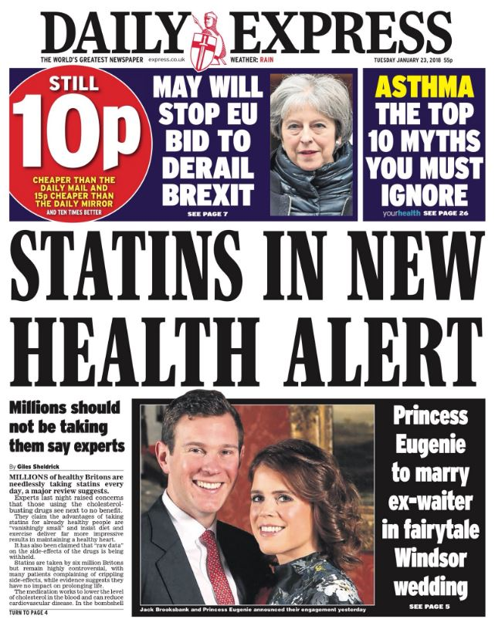
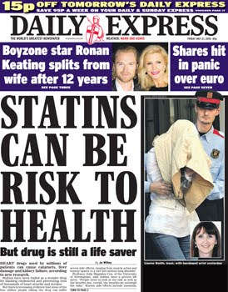
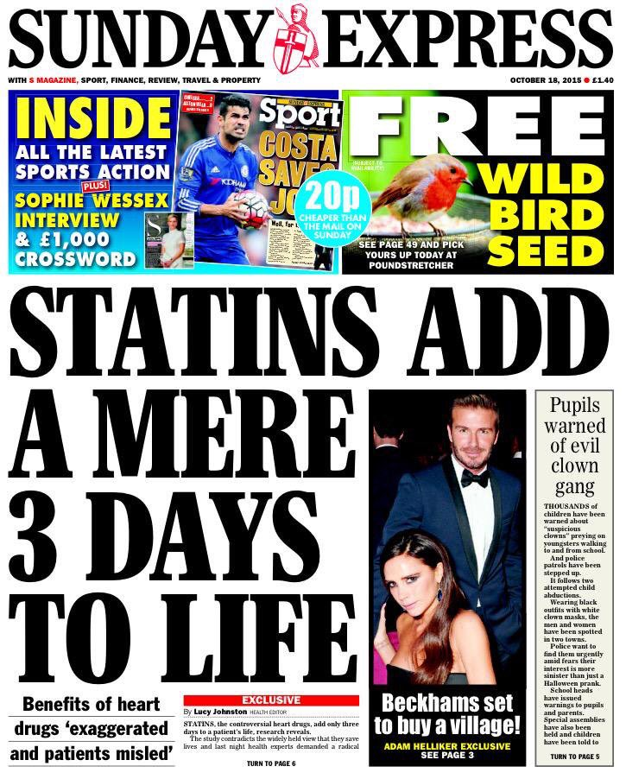
Medicines adherence
Drugs will only work if they are taken!
Informing and empowering
Patients believe what they read in the newspapers
Must take patients view into account
Need to dispel myths and untruths
Partnership between the prescriber and the patient

Slide 39
Conclusion
Non medical prescribing improves the quality of care given to patients by a variety of nurses and AHPs
Facilitates running of a seamless service
Quality and safety need to be maintained and monitored
Limitations of non medical prescribing must be appreciated by all involved to protect patient safety

Slide 40
a.pottle@rbht.nhs.uk

