Slide 1
Non Medical Prescribing in Cardiology Strategy and Governance
Jan Keenan
Consultant Nurse Cardiology
Non-Medical Prescribing Lead
Oxford University Hospitals NHS Foundation Trust
Jan.keenan@ouh.nhs.uk

Slide 2
Strategy and Governance
Ensuring effective governance of prescribing practice in Cardiology
Evaluating where prescribing could improve care for your patients
Developing a new service and working differently during Covid-19
How coronavirus can interact with heart medication
Issues and challenges around prescribing in cardiology

Slide 3
Ensuring effective governance of prescribing practice in Cardiology

Slide 4
Clinical governance
"A framework through which NHS organisations are accountable for continually improving the quality of their services and safeguarding high standards of care by creating an environment in which excellence in clinical care will flourish."
Scally G and Donaldson L (1998) Clinical governance and the drive for quality improvement in the new NHS in England
BMJ 317(1750): pp61-65
Key themes:
Patient focus - how services are based on patient needs
Information focus - how information is used
Quality improvement - how standards are reviewed and attained
Leadership - how improvement efforts are planned
Staff focus- how staff are developed
https://www.rcn.org.uk/clinical-topics/Clinical-governance

Slide 5
Patient focus – Non Medical Prescribing
Service design
Reviewing roles or the sequence in which actions occur
Changing who can prescribe, what and how? Accessibility to treatment
The care environment; improve dignity or provide better control over a situation
Offering the patient the opportunity to be a partner in their care; focus on shared decision making, ‘treat the patient not the condition?’
Process design; meal times, drug rounds, or the patient pathway
Reviewing roles, or the sequence in which actions occur
Putting the skills the patient needs, where they are needed
Continuous feedback to improve systems and processes
How we use continuous feedback to improve how we perform
Auditing prescribing practice; feedback from patients, colleagues
Participatory health and patient activation
a person provider partnership based on mutually acknowledged expertise. Patient activation describes the knowledge, skills and confidence a person has in managing their own health
Shared decision making

Slide 6
Information focus – Non-Medical Prescribing
How information is used, or accessed?
Patient and clinician access to information – smart phones, portable technology
Personalised or precision medicine-application of emergent technologies
Treatment guidelines
Electronic guidelines
Electronic health records
Mobile technology
Digital development
Social innovations
"patients are in control of the information they need to improve their health and wellbeing and NHS information systems are designed to support clinicians and other front-line staff to deliver safe, high quality care to their patients“
DH (2012) The power of information

Slide 7
Quality Improvement – Non Medical Prescribing
Timely – reducing waits and delays
Access to treatment
Effective - providing services based on evidence and which produce a clear benefit
Right treatment, right patient
Person-centred - establishing a partnership between practitioners and patients to ensure care respects patients’ needs and preferences
Using feedback from patients
Efficient – avoiding waste
De-prescribing / reviewing medication; use and adherence
Equitable - providing care that does not vary in quality because of a person’s characteristics
And accepting risk varies depending on some of those characteristics
Safe - avoiding harm to patients from care that is intended to help them
Safety-net, ongoing review

Slide 8
Leadership focus – Non Medical Prescribing
Leaders are critical in shaping organisational culture
Leadership styles contribute to team cohesion, lower stress, and higher empowerment and self-efficacy
Nurses prefer managers who are participative, facilitative, and emotionally intelligent
Leadership is a predictor of quality outcomes in health care settings
Authentic leaders offer good role models consistent with values and vision for health care. They offer individualised consideration of staff, provide motivation and stimulate of creativity and innovation.

Slide 9
Non-medical prescribing leadership
The Non-Medical Prescribing Lead advocates and facilitates
Recognition of the benefits to patients of non-medical prescribing
Identification of a range of clinical areas where patients could benefit
Highlighting that such developments need to be service driven and Divisions and Directorates are key to including non-medical prescribing in business plans and identifying areas where service re-engineering should support non-medical prescribing.
Identification of ways to support and sustain the transition of staff to advanced roles and developing the services they provide
Continuing Professional Development opportunities both within the Trust and externally

Slide 10
Staff Focus – Non Medical Prescribing
‘When staff are positive about levels of support this can lead to improved patient satisfaction, health outcomes, and ratings of quality of care, as well as reduced staff absenteeism and turnover’
Aiken (2012) Patient safety, satisfaction, and quality of hospital care: cross sectional surveys of nurses and patients in 12 countries in Europe and the United States. BMJ 344; e1717

Slide 11
Selecting the right people
Advanced practice trajectory
Clinical skills
Taking a history
Making a diagnosis
Meeting patient need
Meeting service need
Good support and supervision
Professional requirements to take on prescribing
Indemnity

Slide 12
Evaluating where prescribing could improve care for your patients

Slide 13
Nurse prescribing was a logical response to an identified health need….
Gould and Bain (2022) Principles and Practice of Nurse Prescribing
Access to treatment
Timeliness of treatment

Slide 14
Outreach
ACS
Chest pain pathway
Monitoring and maintaining treatment
Follow-up – PCI
Arrhythmia
Heart Failure
End of Life Care
Congenital heart disease
Inpatient pathway, discharge
Pre-admission
Cardiac rehabilitation

Slide 15
How coronavirus can interact with heart medication

Slide 16
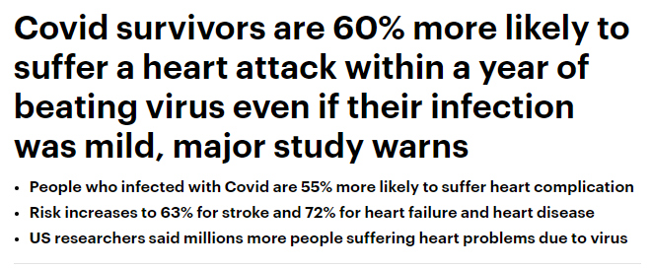
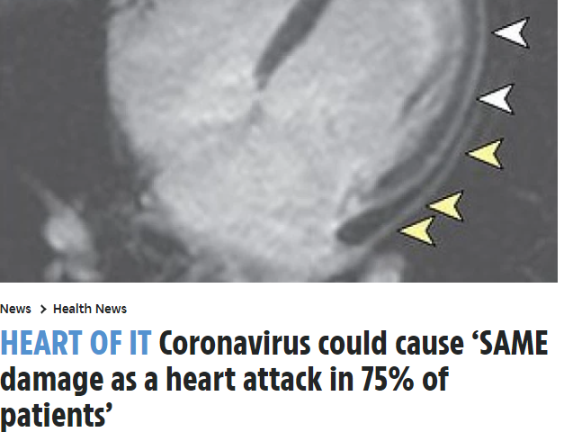

Slide 17
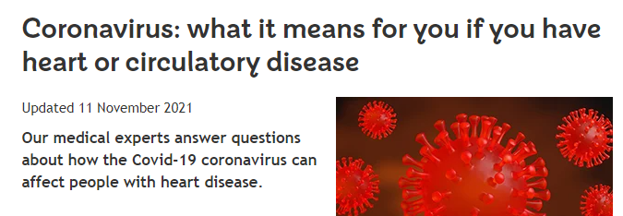
Cardiac effects of the virus
Possibly linked to endothelial damage & inflammation
Coagulopathy – DVT, PE
Covid toe
Heart rate, palpitations, PAF
Myocarditis
Pericarditis
Takotsubo
https://www.escardio.org/Education/COVID-19-and-Cardiology
https://www.bhf.org.uk/informationsupport/heart-matters-magazine/news/coronavirus-and-your-health#:~:text=Anyone%20with%20a%20heart%20condition,high%20risk%20(vulnerable)

Slide 18
Issues and challenges around prescribing in cardiology

Slide 19
Current issues and challenges
Pandemic related:
Reduced capacity
Do we investigate more if we telephone?
Telephone and remote consultations
https://www.nmc.org.uk/globalassets/sitedocuments/other-publications/high-level-principles-for-remote-prescribing-.pdf
https://www.gmc-uk.org/ethical-guidance/learning-materials/remote-prescribing-high-level-principles
https://www.rpharms.com/resources/pharmacy-guides/coronavirus-covid-19/clinical-resources-during-covid-19/upskilling-during-covid-19/remote-consultations

Slide 20
Thank you for listening
Jan.Keenan@ouh.nhs.uk

