Slide 1
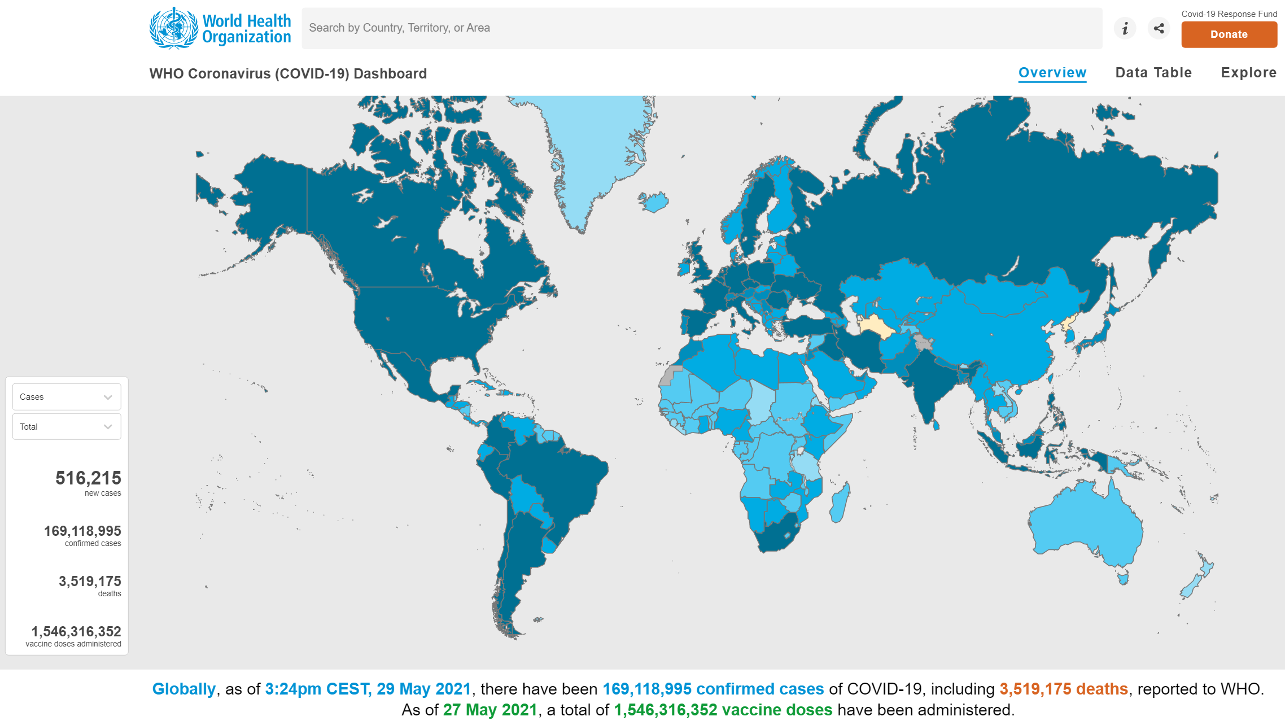
COVID-19: Recommendations for Surgery Outlook for day case emergency surgery
By:
Justin Kua
NIAA HSRC Clinical Research Fellow
MPhil/PhD Student at UCL

Slide 2
Conflicts of interest
None to declare.

Slide 3
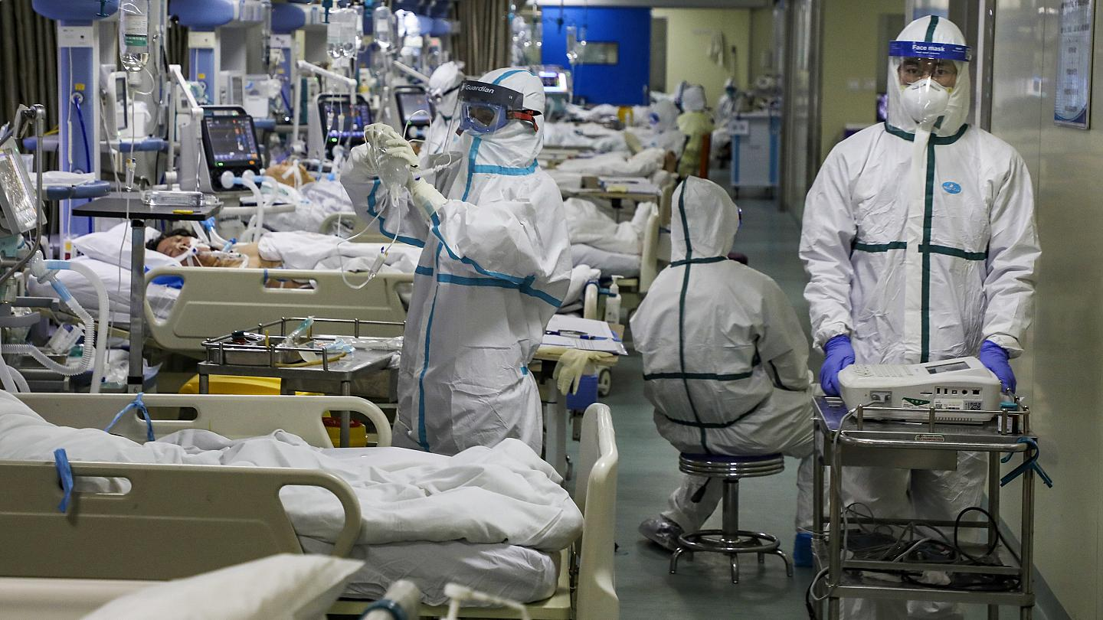
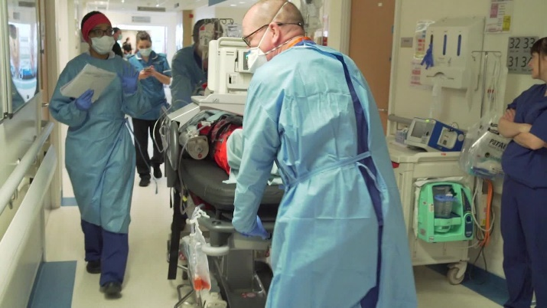
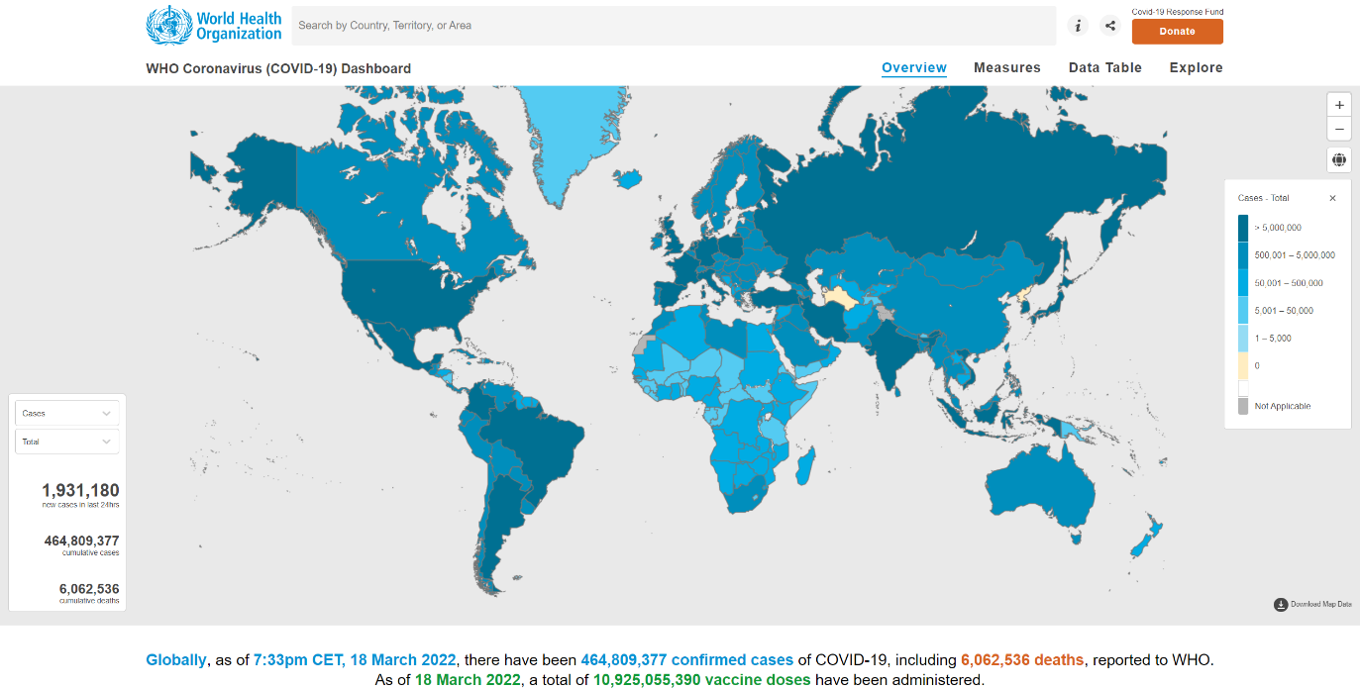
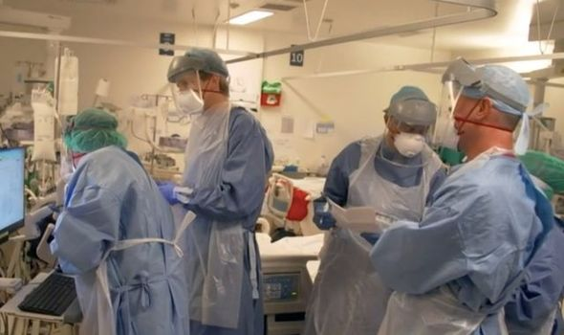

Slide 5
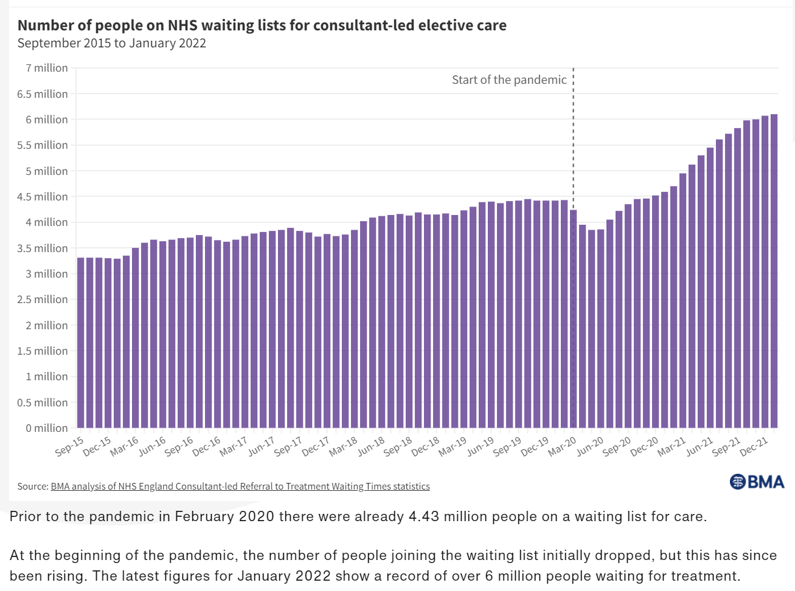

Slide 7
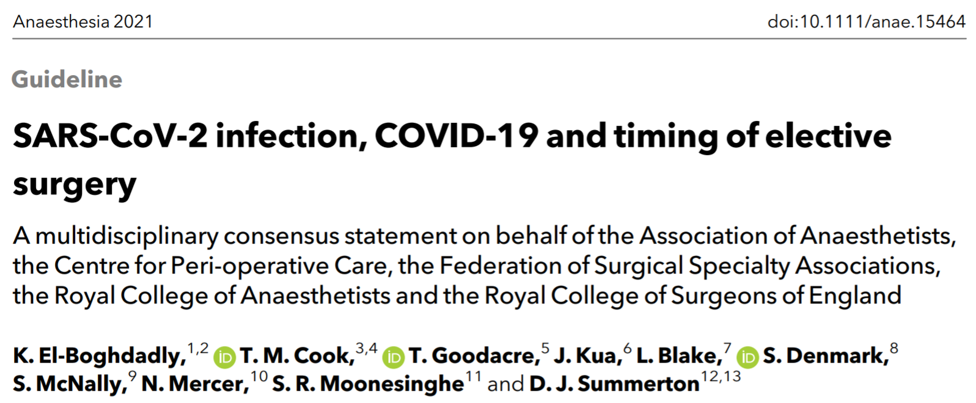

Slide 8
‘New Normal’
‘Acute COVID-19’
‘Post-COVID-19’

Slide 9
‘New Normal’
COVID-free
Fully vaccinated
LOWEST risk
‘Acute COVID-19’
‘Post-COVID-19’

Slide 10
‘New Normal’
COVID-free
Fully vaccinated
LOWEST risk
‘Acute COVID-19’
Positive for SARS-CoV-2 via RT-PCR or antigen testing
+/- Symptoms
HIGHEST risk
‘Post-COVID-19’

Slide 11
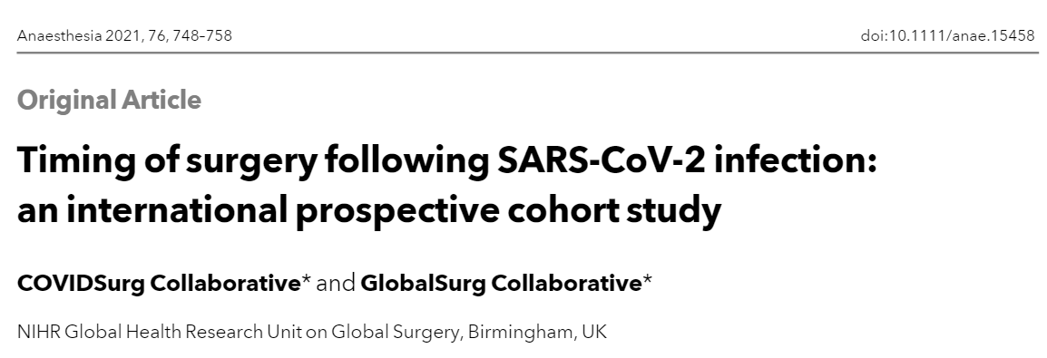
COVIDSurg Collaborative & GlobalSurg Collaborative, 2021

Slide 12
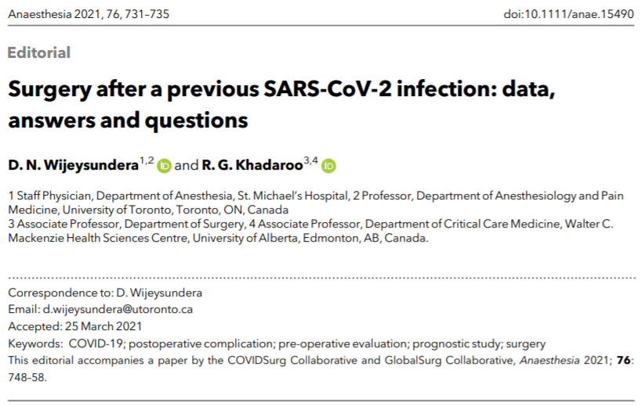
Wijeysundera & Khadaroo, 2021

Slide 13
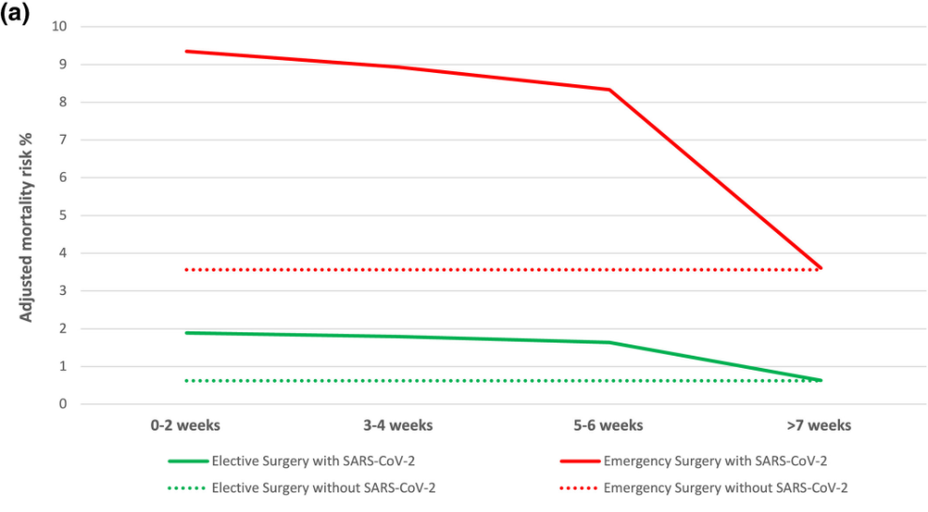
Wijeysundera & Khadaroo, 2021

Slide 14
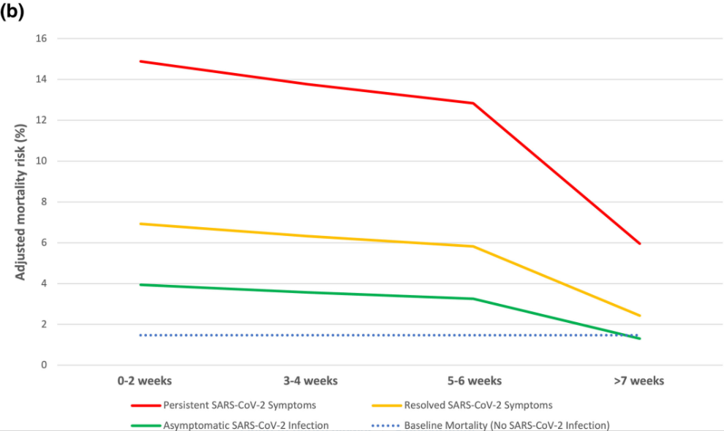
Persistent Symptoms
Resolved Symptoms
No Symptoms
Wijeysundera & Khadaroo, 2021

Slide 15
‘New Normal’
COVID-free
Fully vaccinated
LOWEST risk
‘Acute COVID-19’
Positive for SARS-CoV-2 via RT-PCR or antigen testing
+/- Symptoms
HIGHEST risk
‘Post-COVID-19’

Slide 16
‘New Normal’
COVID-free
Fully vaccinated
LOWEST risk
‘Acute COVID-19’
Positive for SARS-CoV-2 via RT-PCR or antigen testing
+/- Symptoms
HIGHEST risk
‘Post-COVID-19’
Previous COVID-19 infection
+/- Symptoms
? ’Long Covid’
INTERMEDIATE risk

Slide 17
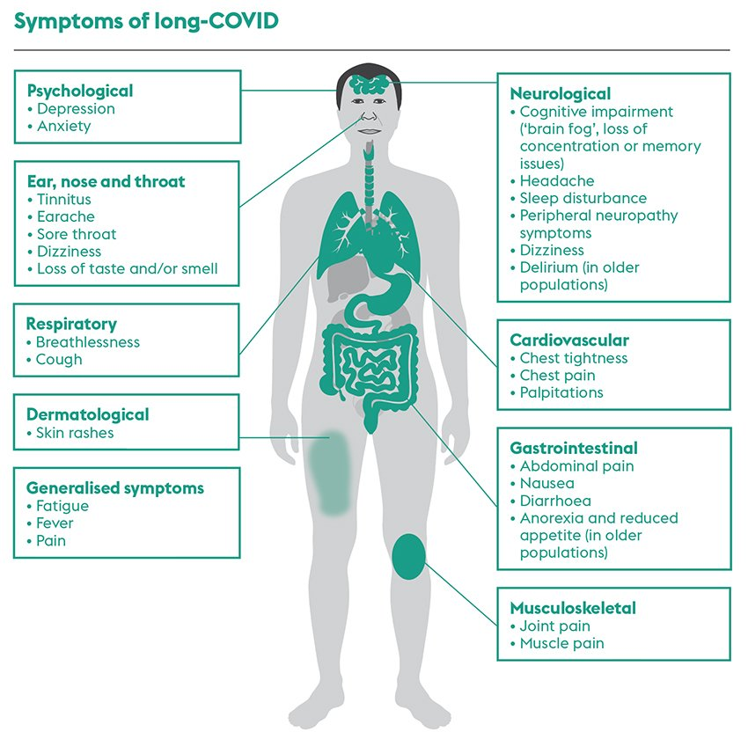
Evans, 2021

Slide 18
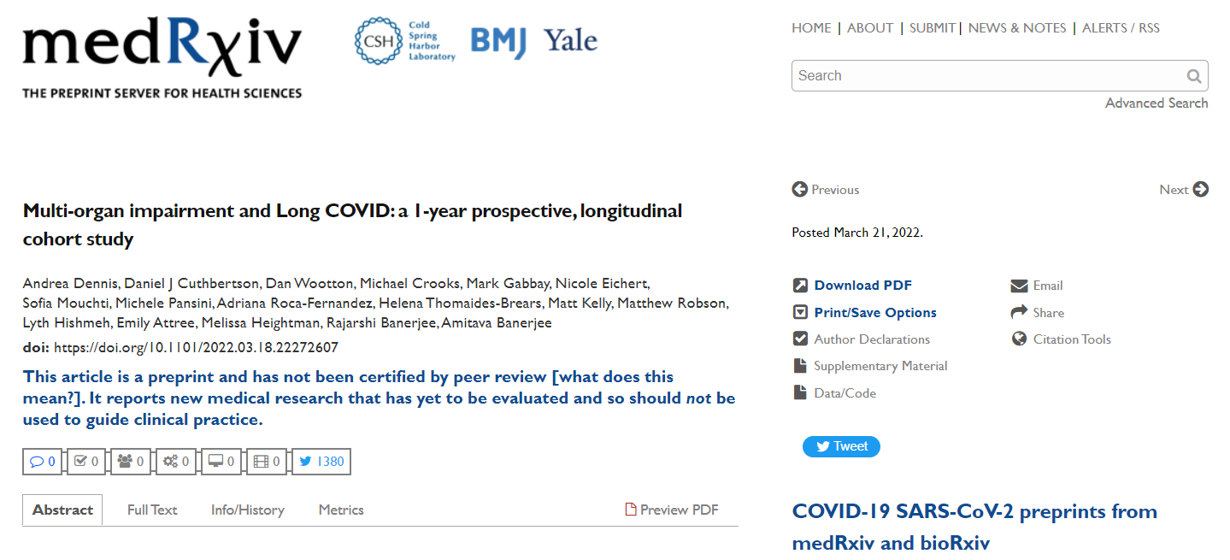

Slide 19
‘New Normal’
COVID-free
Fully vaccinated
LOWEST risk
‘Acute COVID-19’
Positive for SARS-CoV-2 via RT-PCR or antigen testing
+/- Symptoms
HIGHEST risk
‘Post-COVID-19’
Previous COVID-19 infection
+/- Symptoms
? ’Long Covid’
INTERMEDIATE risk

Slide 20
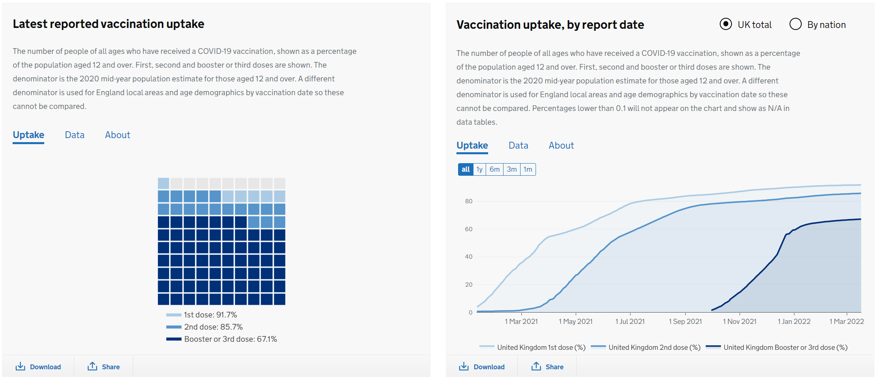

Slide 22
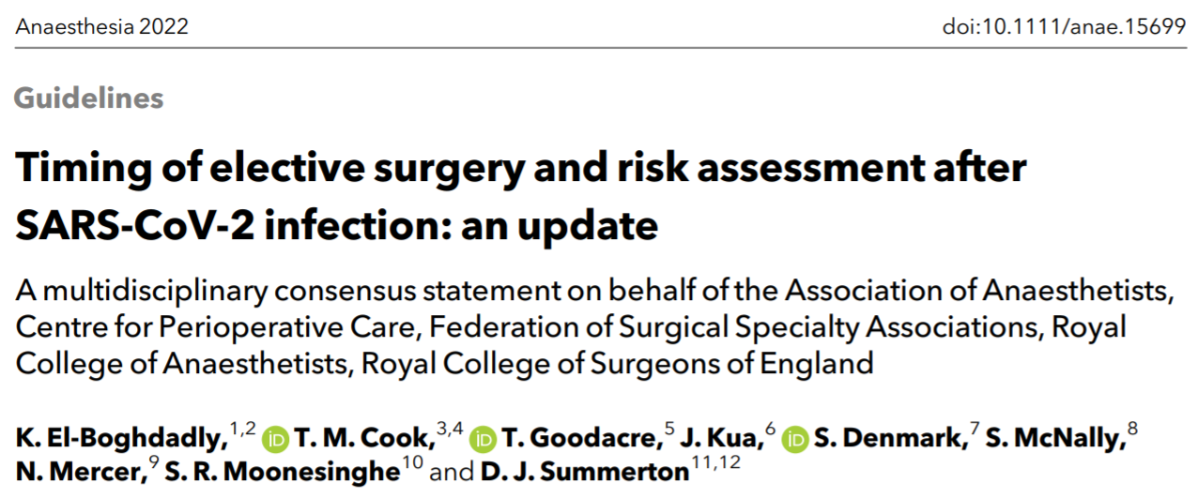

Slide 23
Recommendation 1:
There is currently no evidence on peri-operative outcomes after SARS-CoV-2 vaccination and the omicron variant. Therefore, previous recommendations that, where possible, patients should avoid elective surgery within 7 weeks of SARS-CoV-2 infection remain, unless the benefits of doing so exceed the risk of waiting. We recommend individualised risk assessment for patients with
elective surgery planned within 7 weeks of SARS-CoV-2 infection.

Slide 24
Recommendation 2:
Surgical patients should have received pre-operative COVID-19 vaccination, with three doses wherever possible, with the last dose at least 2 weeks before surgery.

Slide 25
Recommendation 5:
Elective surgery should not take place within 10 days of diagnosis of SARS-CoV-2 infection, predominantly because the patient may be infectious, which is a risk to surgical pathways, staff and other patients.

Slide 26
Recommendation 9:
In patients with recent or peri-operative SARS-CoV-2 infection, avoidance of general anaesthesia in favour of local or regional anaesthetic techniques should be considered.

Slide 27
Recommendation 10:
Rather than emphasising timing alone, we emphasise:
timing,
assessment of baseline and increased risk,
and shared decision-making.

Slide 28
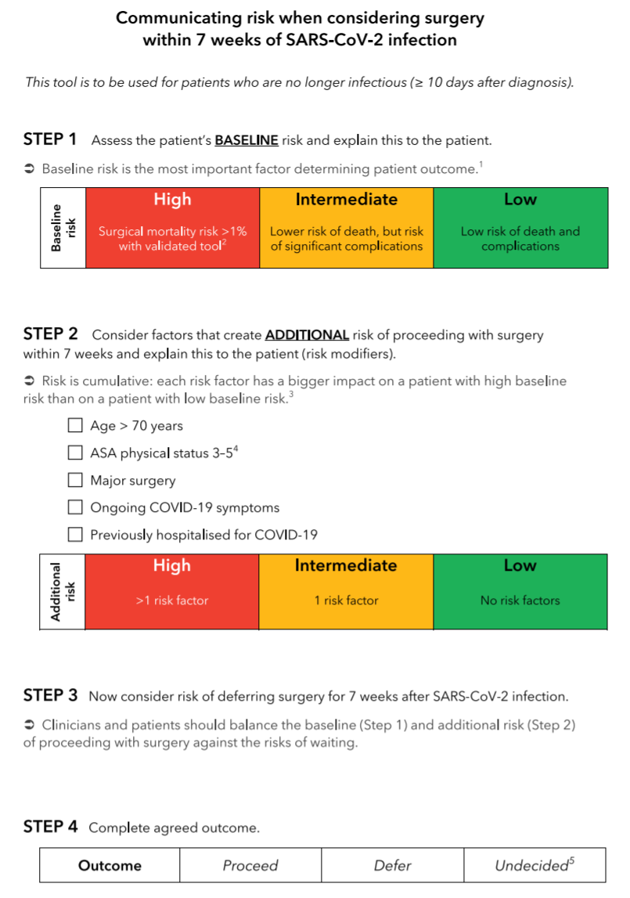

Slide 29
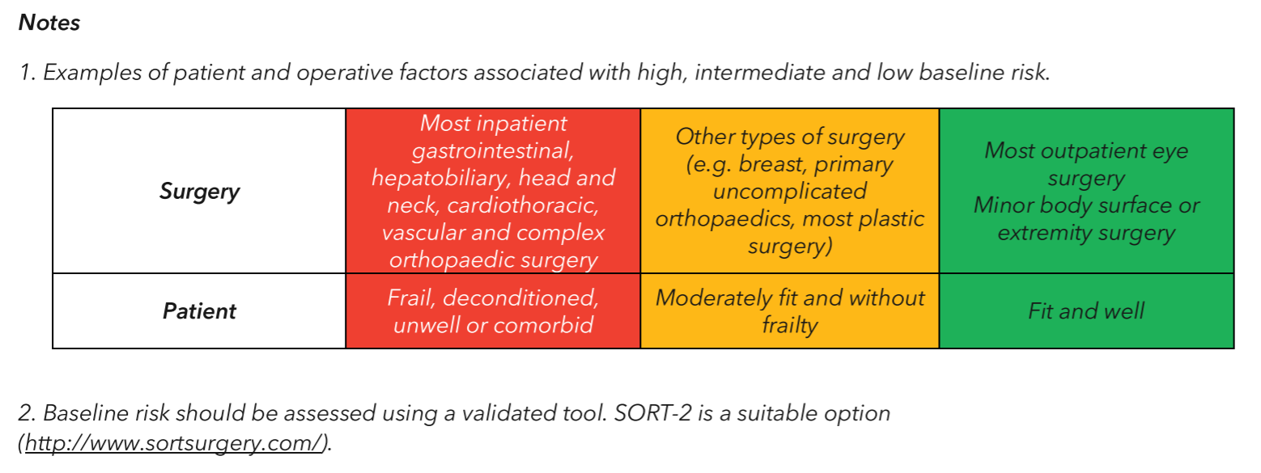

Slide 30
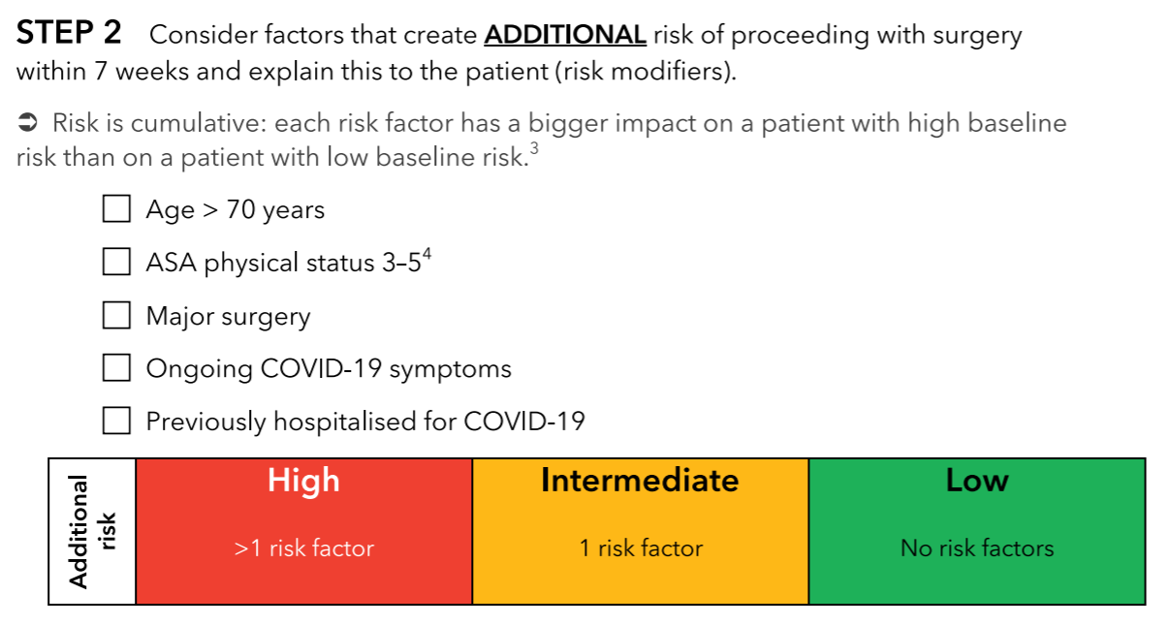

Slide 35
‘New Normal’
COVID-free
Fully vaccinated
LOWEST risk
‘Acute COVID-19’
Positive for SARS-CoV-2 via RT-PCR or antigen testing
+/- Symptoms
HIGHEST risk
‘Post-COVID-19’
Previous COVID-19 infection
+/- Symptoms
? ’Long Covid’
INTERMEDIATE risk

Slide 37
The End
Thank you for your time!

Slide 38
References
COVIDSurg Collaborative. Delaying surgery for patients with a previous SARS-CoV-2 infection. Br J Surg. 2020 Nov;107(12):e601-e602. doi: 10.1002/bjs.12050.
COVIDSurg Collaborative, GlobalSurg Collaborative. Timing of surgery following SARS-CoV-2 infection: an international prospective cohort study. Anaesthesia. 2021 Jun;76(6):748-758. doi: 10.1111/anae.15458.
DN Wijeysundera, RG Khadaroo. Surgery after a previous SARS-CoV-2 infection: data, answers and questions. Anaesthesia. 2021 Jun;76(6):731-735. doi: 10.1111/anae.15490.
Evans N. Long-COVID: the range of symptoms and how to help your patients. Nursing Standard. 2021. Available from: https://rcni.com/nursing-standard/newsroom/analysis/long-covid-range-of-symptoms-and-how-to-help-your-patients-172666 (accessed 15/08/2021)
K El-Boghdadly, T M Cook, T Goodacre, J Kua, L Blake, S Denmark, S McNally, N Mercer, S R Moonesinghe, D J Summerton. SARS-CoV-2 infection, COVID-19 and timing of elective surgery: A multidisciplinary consensus statement on behalf of the Association of Anaesthetists, the Centre for Peri-operative Care, the Federation of Surgical Specialty Associations, the Royal College. Anaesthesia. 2021 Mar 18. doi: 10.1111/anae.15464.
K El-Boghdadly, T M Cook, T Goodacre, J Kua, S Denmark, S McNally, N Mercer, S R Moonesinghe, D J Summerton. Timing of elective surgery and risk assessment after SARS-CoV-2 infection: an update: A multidisciplinary consensus statement on behalf of the Association of Anaesthetists, Centre for Perioperative Care, Federation of Surgical Specialty Associations, Royal College of Anaesthetists, Royal College of Surgeons of England. Anaesthesia. 2022 Feb 22. doi: 10.1111/anae.15699.

