Slide 1

Day Surgery Pathways
Dr Matthew Checketts
Consultant Anaesthetist, NHS Tayside
British Association of Day Surgery Council (BADS)
HCC Conference 19th May 2022
Disclosures
none

Slide 2
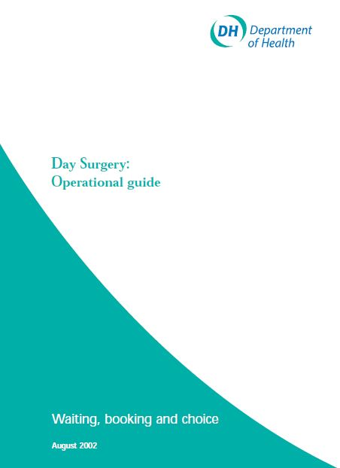
Definition of Day Surgery
Planned
Intended management of day surgery
Patient admitted / operated on / discharged on SAME calendar day
Day Surgery: Operational Guide
DoH London 2002

Slide 3
Day Surgery Pathways
GP referral for procedure
Surgical OPA
Patient selection
Booking
Pre-op assessment
Admission
Surgery
Discharge
Recovery at home
High Quality
Day Surgery
Pathway
Champions
Key Enablers

Slide 4
Day Surgery Pathways
GP referral for procedure
Surgical OPA
Patient selection
Booking
Pre-op assessment
Admission
Surgery
Discharge
Recovery at home
Ideally all undertaken by dedicated Day surgery team

Slide 5
Day Surgery Pathways
GP referral for procedure
Surgical OPA
Patient selection
Booking
Pre-op assessment
Admission
Surgery
Discharge
Recovery at home

Slide 6
GP Referral
Do our primary care colleagues know what can be done as day case?
Do they know which patients are appropriate?
Do they start the day surgery message?
Do they ensure patients are "fit" for surgery?

Slide 7
Day Surgery Pathways
GP referral for procedure
Surgical OPA
Patient selection
Booking
Pre-op assessment
Admission
Surgery
Discharge
Recovery at home

Slide 8
Surgical Outpatients
Key enablers
Start/continue the day surgery message
Promote that procedures should be done as a day case
Reassure patients about to be day case
Enable patients to be "fit" for surgery

Slide 9
Surgical Outpatients
Surgeon confirms day case management
Default suitable surgical procedures to day case
  Book as planned day case
  Intended management day case
Remember if not fit for day surgery probably not fit for elective surgery
Consider starting optimisation
Can surgery be delayed until optimised

Slide 10
Which procedures?

Slide 11
Surgical criteria
Manage oral nutrition post-operatively
Post-operative pain managed by simple oral analgesia supplemented by regional anaesthetic techniques
Low risk of significant immediate post-operative complications
  catastrophic bleeding
  airway compromise
Patient able to mobilise with / without aid post-operatively

Slide 12
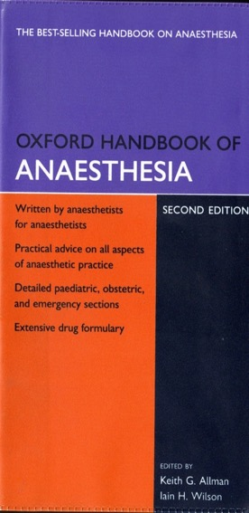
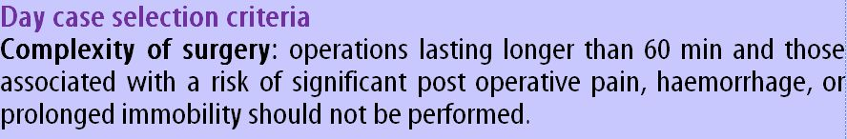
The duration of surgery in the ambulatory setting was originally limited to procedures lasting less than 90 minutes...
Notes:
In the then current Oxford Handbook of Anaesthesia... ( I would hope the author of the day surgery chapter in the new edition has updated it... [Jackson!])

Slide 13
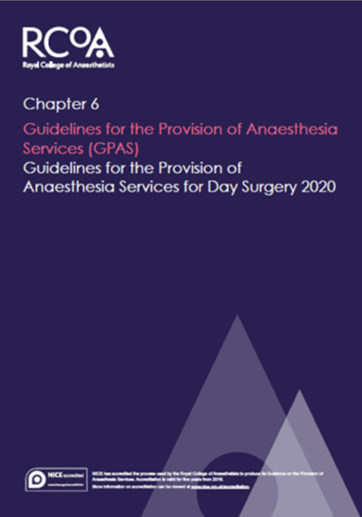
Operating times
Surgical procedures lasting 3 to 4 hours (and longer!) are now routinely performed on a day case basis

Slide 14

Basket of Procedures
2001
Cataract Extraction
Excision Breast Lump
Carpal Tunnel Decompression
Bat Ears
R/O Metalwork
Bunion Operations
Laparoscopy
Tonsillectomy
TURBT
Squint Correction
Orchidopexy
Anal Fissure
D&C / Hysteroscopy
Nasal Fractures
Myringotomy
Laparoscopic Cholecystectomy
Excision of Ganglion
Hernia Repair
Varicose Veins
Dupuytren’s Contracture
Haemorrhoidectomy
Circumcision
Arthroscopy
SMR
Termination of pregnancy
Notes:
14

Slide 15
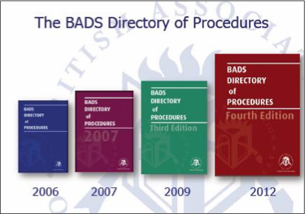
Nearly ALL surgery should be day or very short stay
2016

Slide 16
How far have we come?
Specialty | Procedures in 1990 | Procedures in 2020
Ophthalmology | Cataract Extraction | Vitrectomy
Gynaecology | Hysteroscopy | Hysterectomy
Orthopaedics | Arthroscopy | TKR /THR
Urology | Circumcision | Laparoscopic Nephrectomy
Head and Neck | Tonsillectomy | Thyroidectomy

Slide 17
Ambulatory Emergency Surgery
Should not be excluded
Unselected
Unplanned
Day or Night
Many can be considered / performed as a day case

Slide 18

Plan as a Day case
Pre- assessment
Peri-operative care
Post –operative care
Selection criteria
Pre-assessment
Admission
Operation
Day surgery unit
Same- day discharge

Slide 19
Nearly ALL surgery should be day or very short stay
Over 200 procedures listed as suitable as a day case
Mastectomy
Tonsillectomy
Hysterectomy
Hip / Knee replacement
Lap Cholecystectomy
Some emergencies
  ERPC
  Abscesses
  Lap appendix
2019

Slide 20
Day Surgery Pathways
GP referral for procedure
Surgical OPA
Patient selection
Booking
Pre-op assessment
Admission
Surgery
Discharge
Recovery at home

Slide 21
Which patients?

Slide 22
Which Patients?
Are this patient’s risks increased in any way by treatment on a day stay basis?
Would management be different if he/she were admitted as an inpatient?

Slide 23
If the answer is no
The patient is probably suitable for day case

Slide 24
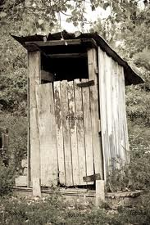
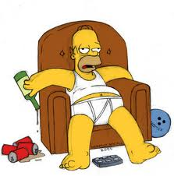
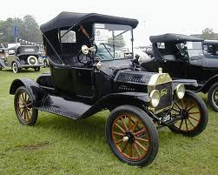
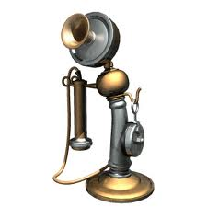
Social Factors
Responsible adult
Maximum 1 hours drive
Adequate housing
conditions
-inside toilet
-telephone access
-heating
-stairs
The vast majority of patients will meet the criteria for social factors
or
can be enabled to do so with proactive management

Slide 25
Distance from Hospital
Rarely a problem
Even in rural areas
Remember it is 1 hour from a hospital that can treat the condition and not necessarily the operating hospital

Slide 26
Potential challenge:
Patients who live alone
Do you defer surgery until an inpatient bed is available?
Options for who could provide this care?
Should you treat all procedures the same?

Slide 27
Possible Solutions
Torbay model: provide carers into patient’s home
Norwich model: allow some patients home without carers after certain procedures
Escort vs 24 hour Care
Retief J, Morris R, Stocker M. The postoperative carer: A global view and local perspectives. Journal of One Day Surgery. March 2018.

Slide 29
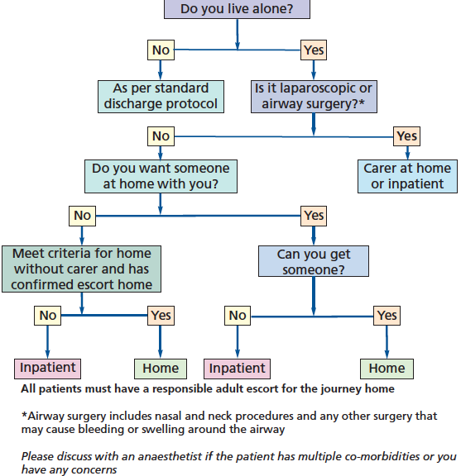
Norwich Home Alone Protocol

Slide 30
Both pathways have been in place for a number of years now
Excellent patient satisfaction
No adverse outcomes
QIP in the Day Surgery chapter Royal College of Anaesthetists
https://rcoa.ac.uk/sites/default/files/documents/2020-08/21075%20RCoA%20Audit%20Recipe%20Book_14%20Section%20B.5_p189-208_AW.pdf

Slide 31
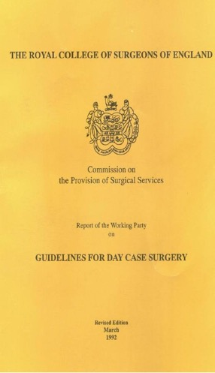

Medical Factors 1980’s
1985 & 1992
Royal College of Surgeons of England
Selection Criteria
Age limit 65-70 years
ASA I & II
BMI<30

Slide 32
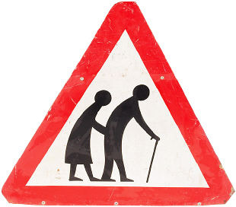
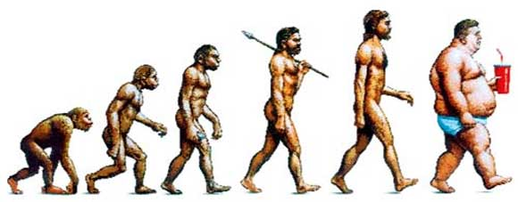
Patient Selection for
Day Case
Patient Factors:
Patient Preference
Cardio-respiratory disease
Elderly
Obesity
GORD
Reduced risk thromboembolism
Reduced PONV
Covid risk

Slide 33
Medical Exclusions
Unstable ASA 3
ASA 4 or 5
Any poorly controlled abnormality
Neonates
  Ex-prem <60/weeks post conceptual age
  Young sibling of SIDS child

Slide 34
Patient Selection
 | 1990 | 2021
ASA | 1 and 2 | No limit
Age | 70 | No Limit
BMI | 30 | No limit
IDDM | No | Yes

Slide 35

AAGBI Guidelines management peri-operative diabetes 2015
“Glycaemic control should be checked at the time of referral for surgery “
HbA1c should be < 69 mmol.mol 1 in the previous three months.
If HbA1c ≥ 69 mmol.mol 1, elective surgery should be delayed while control is improved then proceed with day surgery
Diabetics are usually better at managing their own diabetes than we are!

Slide 36
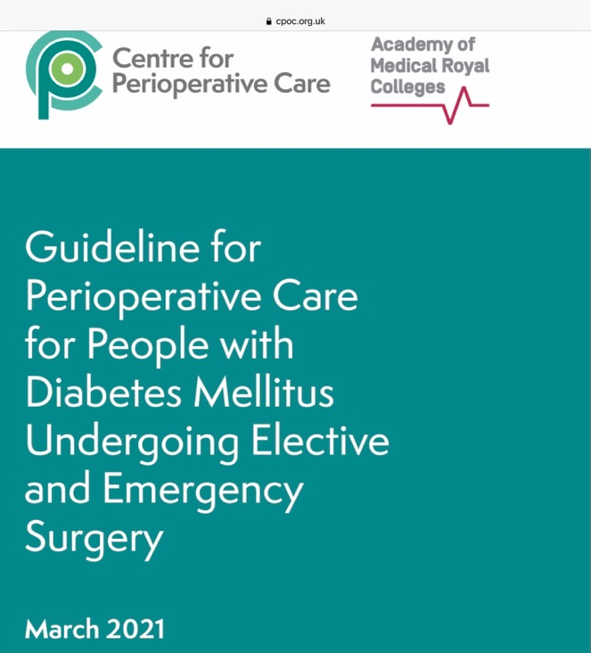
Building upon the recommendations contained within the NCEPOD report into perioperative diabetes (Highs and Lows, 2018)
CPOC has published a guideline on the care of surgical patients with diabetes that encompasses the whole perioperative pathway

Slide 37
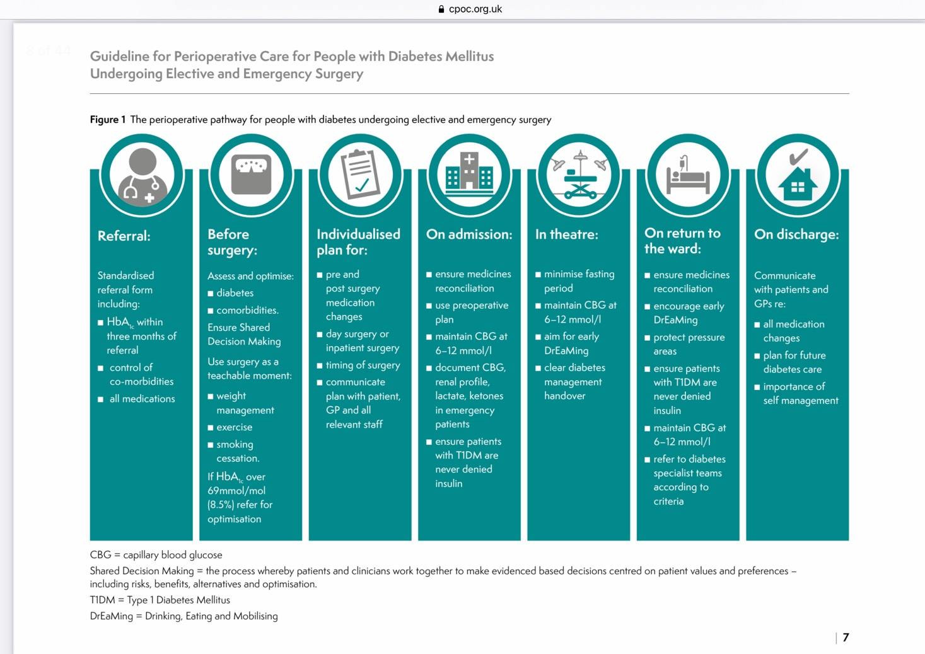

Slide 38
Elderly
Usually better managed in their own environment

Slide 39
National Audit Office 2019
The average 67 year old admitted to hospital.....
  5% loss of muscle strength per day
  After 10 days
    12% reduction in lung capacity
    14% reduction in hip/knee muscle strength
    Reduced life expectancy of 10 years

Slide 40
Obesity
“even morbidly obese patients can be safely managed in expert hands, with appropriate resources.”
“obese patients benefit from the short duration anaesthetic techniques and early
mobilisation associated with day surgery”
Day case and short stay surgery: 3
Association of Anaesthetists of Great Britain and Ireland
British Association of Day Surgery 2019

Slide 42
Obesity
Problems occur early (induction/ primary recovery)
Ensure common co-morbidities identified and address DM/ OSA
Be mindful everything can be more difficult and take longer (anaesthesia/ surgery/ positioning)
Senior staff required
Appropriate equipment (table, side extensions, instruments, oxford pillow etc)

Slide 43
Obesity
May not be appropriate for surgery in an isolated site but could still be a day case through a main hospital facility
Once they are through primary / first stage recovery no increased risk of complications from overnight stay
Day Surgery can reduce risk of DVT/HAI

Slide 44
Patient Selection
Is the procedure in the BADS Directory?
Is the patient fit for surgery?
  What would you do different if you kept them in overnight?
  If their medical condition could be optimised could they be a day case?
  If yes, can the surgery be delayed until optimised?
How can we manage them as a day case?

Slide 45
Day Surgery Pathways
GP referral for procedure
Surgical OPA
Patient selection
Booking
Pre-op assessment
Admission
Surgery
Discharge
Recovery at home

Slide 46
Booking
Agreed Booking/scheduling
Ideally booking staff in DSU
Engage with teams
Learn together
Dramatic increase in utilisation

Slide 47
Planning the List
"Smart" list order
  Consider recovery times
    Medical – Diabetes/Obesity/ Elderly
    Surgical – THR/UKR/ Tonsillectomy / Difficult lap chole
  Consider pre-surgery preparation
    Guidewire insertion
    Eg start with a mastectomy

Slide 48
Day Surgery Pathways
GP referral for procedure
Surgical OPA
Patient selection
Booking
Pre-op assessment
Admission
Surgery
Discharge
Recovery at home

Slide 49
Pre operative assessment
Well Prepared Patient
Good pre-assessment
  Nurse led
  Guidelines
  Inclusion rather than exclusion
  Make day surgery the norm
If not “fit” then optimise and make fit for day case

Slide 50
Pre operative assessment
Nurses working within the day surgery team / day surgery mindset
Plan appointment at time and place convenient and appropriate for the patient
  One-stop service immediately after surgical OPC
  Face to face with nurse
  Telephone / Virtual more common place since covid19
Anaesthetic review of notes or patient as appropriate

Slide 51
Pre operative assessment
  Patient preparation for day surgery
    Discuss arrangements from admission to discharge home
  Identification of medical concerns and address early
    Medication
    BP/Hb/AF etc
  Optimisation of patient

Slide 52
Day Surgery Pathways
GP referral for procedure
Surgical OPA
Patient selection
Booking
Pre-op assessment
Admission
Surgery
Discharge
Recovery at home

Slide 53
Admission
Dedicated day surgery facility best quality environment
Limit fasting and waiting times
  Stagger admission times
  Admission area close to theatre
Enable walking to theatre where possible
  Patients and staff prefer it
  Review need for pre-op interventions that prevent walking

Slide 54
Where?
Dedicated Facilities
For entire pathway if possible
Protected at all cost from inpatient sabotage
Staffed by nurses with day surgery expertise
Enables protected “green pathways”

Slide 55
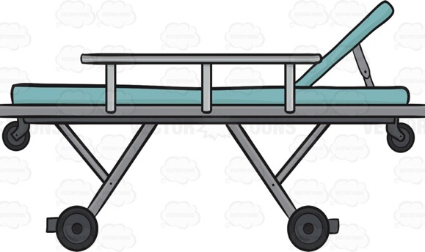
Your Day Surgery Unit
Should have....
  No beds
  No showers
  Only simple catering facilities
  No capacity to accept
  an inpatient

Slide 56
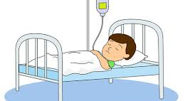
Your Day Surgery Unit
Should have....
  No beds
  No showers
  Only simple catering facilities
  No capacity to accept
  an inpatient

Slide 57
Why Dedicated facilities?
National Guidance
The ideal is a self-contained day surgery unit, with its own admission suite, wards, theatre and recovery area, together with administrative facilities. It is also the most cost effective option
Day surgery performed using inpatient wards and inpatient operating theatres is less successful and cannot be recommended. The stay-in rate (unsuccessful discharge of patients home on the day of surgery) rises from 2.4% in a free standing unit to 14% in an inpatient ward

Slide 58
Why Dedicated facilities?
National Guidance
The ideal day surgery facility is a purpose-built, self-contained day surgery unit (DSU), with its own ward, recovery areas and dedicated operating theatre(s)
Dedicated day surgery secondary recovery areas should be provided, which are not part of an inpatient ward area
Day case patients should only be managed through inpatient wards in rare circumstances, as this greatly increases their chance of an unnecessary overnight stay

Slide 59
Why Dedicated facilities?
National Guidance
Day surgery should take place within a dedicated unit or area within the main hospital site
All members of the multidisciplinary team should be trained in day surgery practice
Day case beds on wards do not provide the targeted service that is required to achieve good outcomes

Slide 60

Royal College of Surgeons
“dedicated day wards and self-contained DSUs separate from the main hospital building led to significant improvements in same day discharges for patients undergoing intended day case surgery"
“Integrated day surgery unit should have its own ward in association with the theatres serving it to form a dedicated unit”

Slide 61
Why dedicated facilities?
Patient experience
Separation from inpatient activity
  Beds, Pajamas , “the sick role”
  Everyone else is going home so I will too
Activity can continue even during times of bed pressures
  Fewer cancellations
Higher chance of successful day surgery discharge
Higher quality outcomes

Slide 62
Why dedicated facilities?
Nursing expertise
Nurses with expertise in day surgery pathway
Nurses not distracted by higher acuity patients
Whole team are committed to high quality day surgery outcomes

Slide 63
You shouldn’t rely on your day surgery patients to drive length of stay reductions in your inpatient population?
There is more risk of inpatient population increasing length of stay of day cases

Slide 64
Day Surgery Pathways
GP referral for procedure
Surgical OPA
Patient selection
Booking
Pre-op assessment
Admission
Surgery
Discharge
Recovery at home

Slide 65
Surgery and anaesthesia
Do you usual operation and do it well!
Appropriate surgical and anaesthetic technique for rapid recovery
  Short acting GAs or Day case spinals
  Multimodal analgesia
  Anti-emesis
Experienced staff
Best kit
Any specific discharge criteria specified
Documentation completed in Theatre

Slide 66
Recovery
Agreed protocols for pain and PONV management
Criteria led discharge to second stage
(Bypass second stage with awake anaesthesia - LAs/Blocks/Spinals)

Slide 67
Day Surgery Pathways
GP referral for procedure
Surgical OPA
Patient selection
Booking
Pre-op assessment
Admission
Surgery
Discharge
Recovery at home

Slide 68
Patient discharge
Nurse led discharge
  Specify criteria
  Not time specific (except for certain ops eg tonsillectomy)
  "When street fit"
TTOs in packs on DSU ward

Slide 69
Day Surgery Pathways
GP referral for procedure
Surgical OPA
Patient selection
Booking
Pre-op assessment
Admission
Surgery
Discharge
Recovery at home

Slide 70
Patient support after surgery
Need for transport home
Need carer afterwards
Not all patients will need a carer for 24hours
  Depends on surgery and risk of complications
  Patient circumstances
  Virtual wards
24hour access to skilled advice
  Not ED or GP
Post-op phone call the next day
  Provides support
  Collects audit data to enable pathway refinement

Slide 71
Measuring Outcomes
Day case rates
Cancellations on the day
Unplanned admissions
Postoperative symptoms
Patient satisfaction

Slide 72
Day Case rates
Know your data
Identify areas to improve
Identify centres performing well
Push boundaries

Slide 73
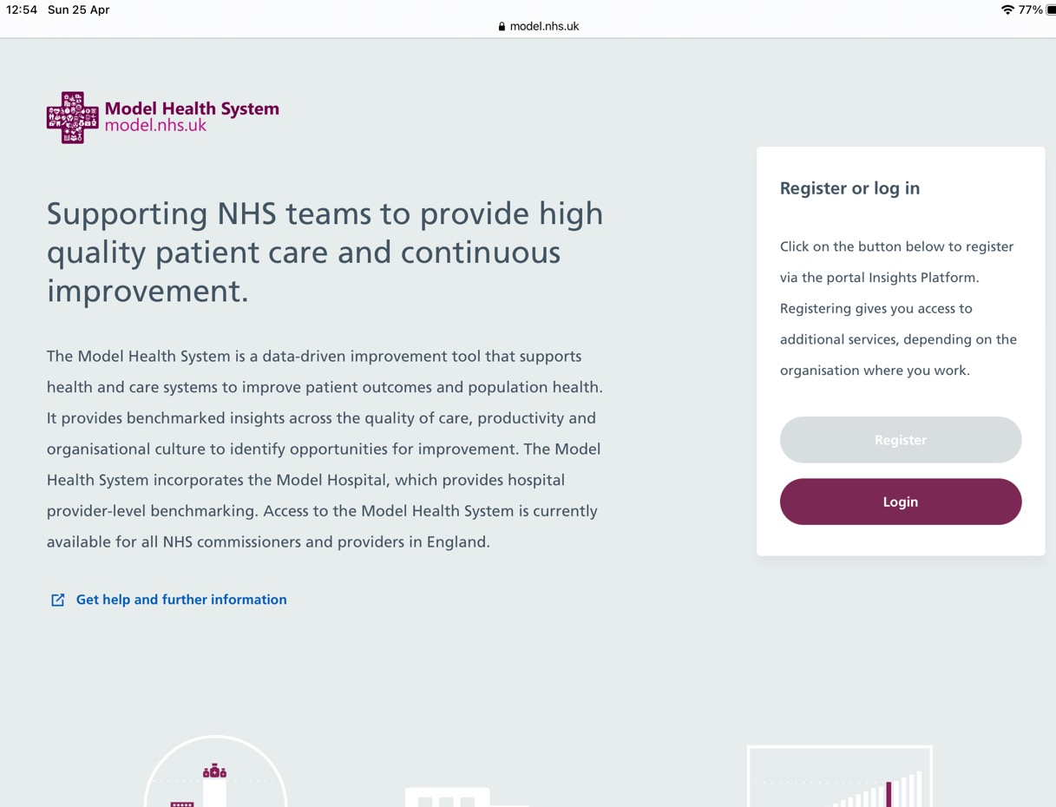

Slide 74
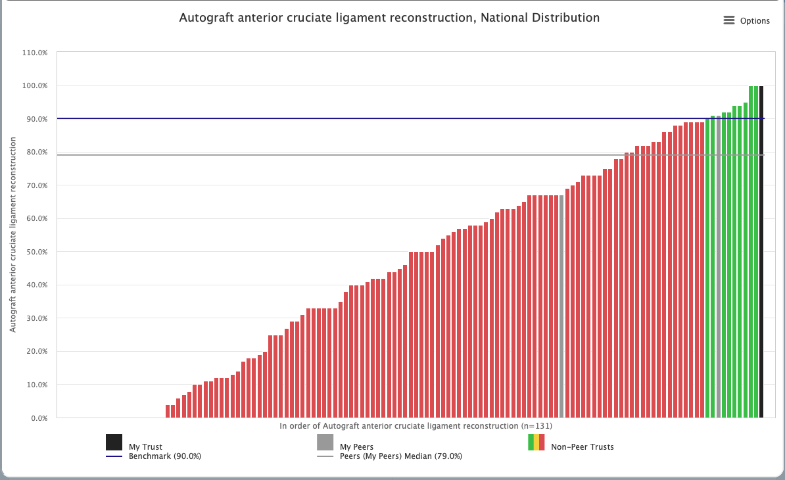
Model Health System
(Model Hospital)

Slide 75
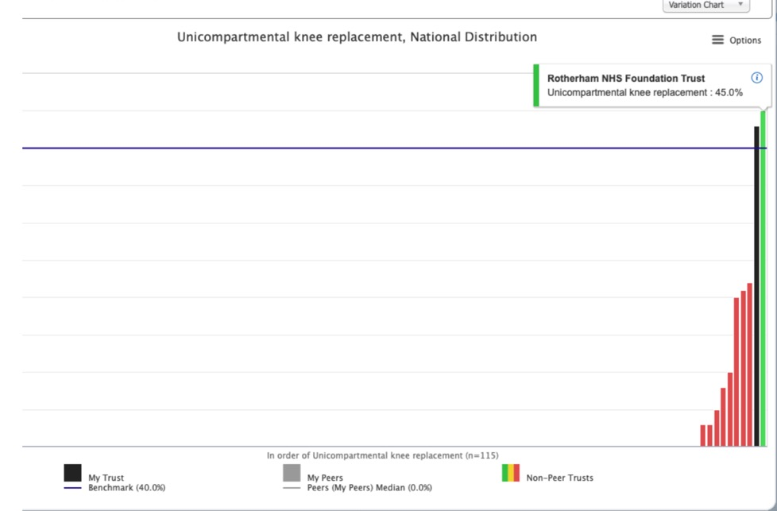
Model Hospital
BADS Benchmark 40%
Peer median0%
67% (Q4 2019 /20)
We are still working on getting our coding correct
(A year ago it showed as zero on Model Hospital)

Slide 76
Improving your day case rates
Identify all patients having procedure that did not achieve day surgery but the procedure SHOULD be day case
What were the reasons?
What would need to change in the pathway to address this?
High volume procedures

Slide 77
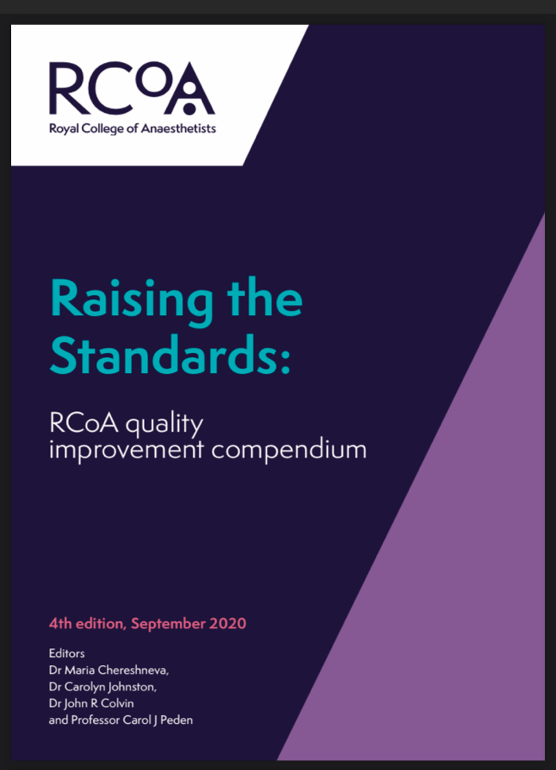
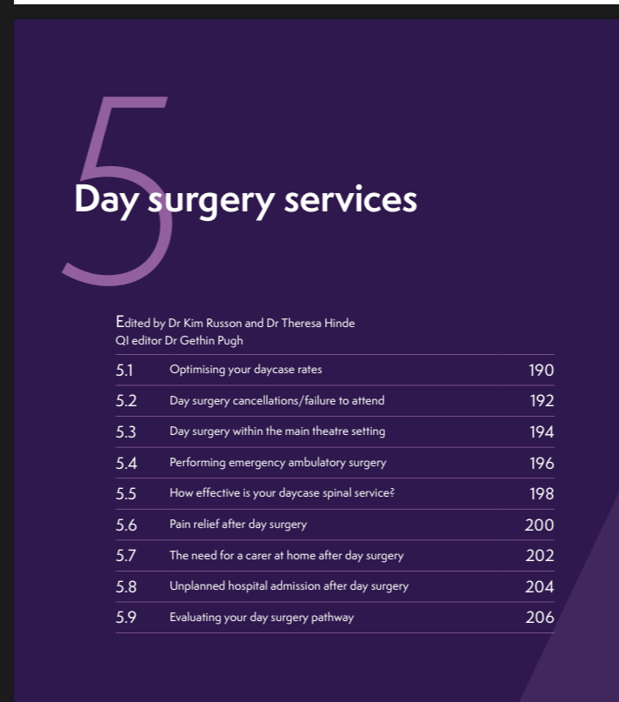

Slide 78
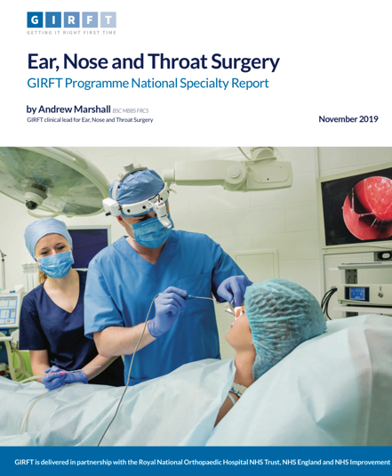
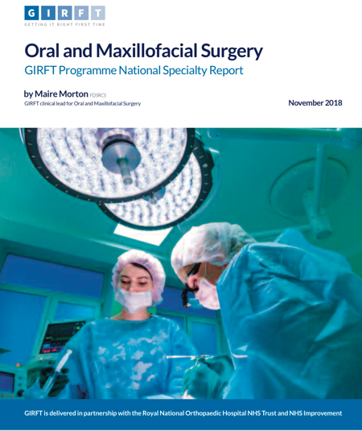
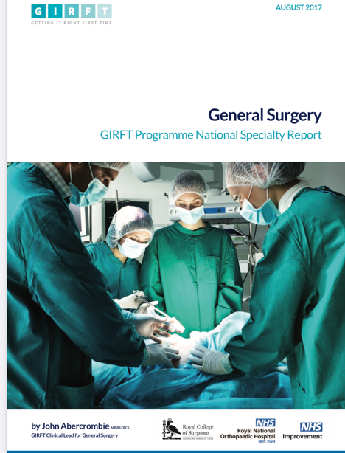

Slide 79

Reduce variation
More and more day surgery focus
Looking at index cases
Anaesthesia and Peri-operative medicine report 2021

Slide 80
Introduction of a High Quality Day Surgery Process
Engagement of clinicians
Identify day case procedures
Mapped out pathway
Default to day surgery
Agreed surgical / anaesthetic processes
Standardise pre-operative preparation
Standardise admission process
Streamline discharge process
Expect nurse led discharge as per BADS guidance

Slide 81
29 surgical procedures “High volume, low complexity” across 6 surgical specialities
A suggestion of which cases should be day case as default and their suitability for regional anaesthetic
Specialty | Procedure | Day case probable | BADS expected DC rate | Likely anaesthetic | Spinal anaesthesia opportunity | Possibility of non-airway management | Comments
General surgery | Inguinal Hernia | Yes | 75% | GA | No | No | Those rates will go up over 80%
 | Paraumbilical Hernia | Yes | 90% | GA | No/Yes | Yes | Can be undertaken under spinal
Gynaecology | Diagnostic laparoscopy | Yes | 100% | GA/Spinal | No/Yes | No/Yes
 | Endometrial ablation | Yes/OPC | 95% | GA/LA | Yes | Yes | >50% done under LA in OPC
 | Hysteroscopy | Yes/OPC | 100% | GA/LA | Yes | Yes | 90% done under LA in OPC
 | Vaginal hysterectomy | Yes | 60% | GA/Regional | Yes | Yes | Day case rates will rise to 80%
Orthopaedics | Anterior Cruciate Ligament Reconstruction | Yes | 90% | GA/Spinal | Yes | Yes/No
 | Total Hip Replacement | Yes 10-20% | 20% | Neuroaxial | Yes | Yes
 | Total Knee Replacement | Yes 10-20% | 20% | Neuroaxial | Yes | Yes
 | Uni knee replacement | Yes 40% | 40% | Neuroaxial | Yes | Yes
 | Bunions | Yes | 95% | Regional | Yes | Yes
Urology | Bladder outflow obstruction | Yes | 50-100% | GA/Neuroaxial | Yes | Yes
 | Bladder tumour resection pathway | Yes | 60% | GA/Neuroaxial | Yes | Yes
 | Cystoscopy plus | Yes | 80% | GA | Yes | Yes
 | Minor peno-scrotal surgery | Yes | 100% | GA/LA | Yes | Yes
 | Ureteroscopy and stent management | Yes | 80-90% | GA/Spinal | Yes | Yes
Acknowledgment: Dr Chris Snowden & Dr Mike Swart & GIRFT London Elective Recovery & Transformation Programme

Slide 82
Elective Surgery Recovery & Transformation Programme
Engagement of clinicians
Identify day case procedures
Mapped out pathway
Default to day surgery
Agreed surgical / anaesthetic processes
Standardise pre-operative preparation
Standardise admission process
Streamline discharge process
Expect nurse led discharge as per BADS guidance

Slide 83
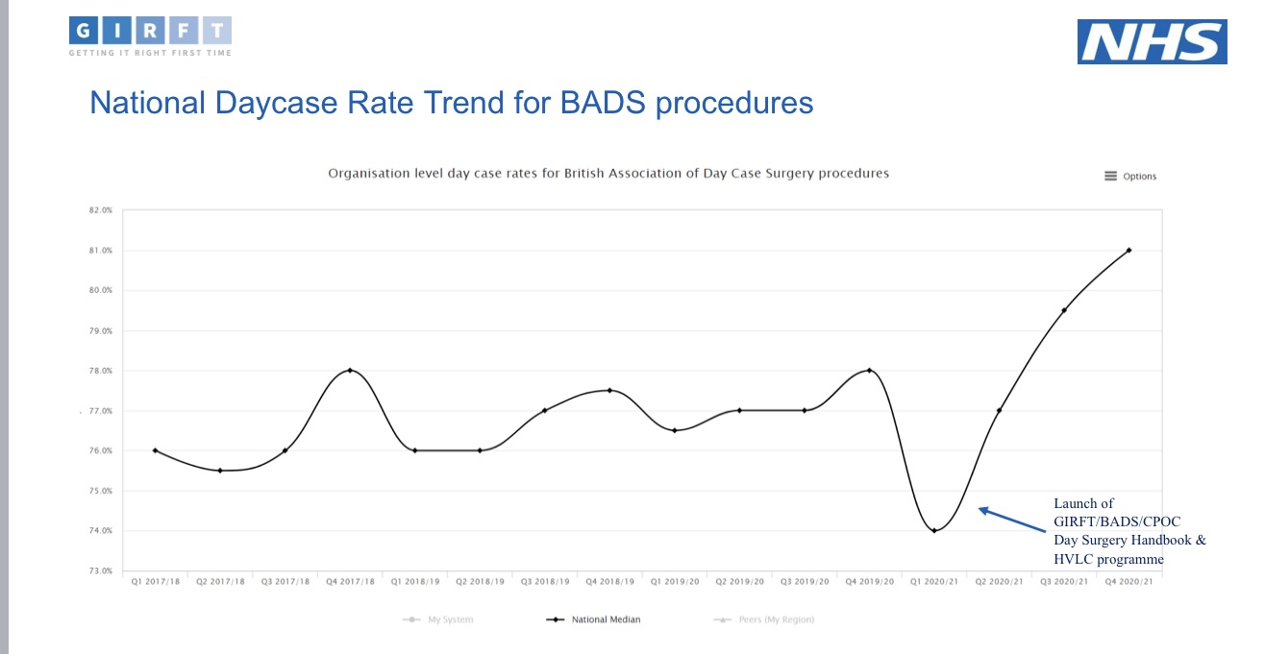

Slide 84
Developing new pathways
What changes are needed in your pathway for you to move this procedure to day case?
Who are the key players?
How can you implement this?

Slide 85
Summary of Patient pathway
Plan pathway at every stage to ensure intended day surgery management
Ensure all appropriate patients are managed as day cases
  Social care rarely an issue
  Optimised medical issues rarely an issue
  Procedures – embrace the BADS directory

Slide 86
Summary of Patient pathway
Use dedicated day surgery facilities whenever possible
Evaluate process to ensure high quality
Measure day case rates by procedure against national targets
Monitor day case rates against peers

Slide 87
Key to Successful Day Surgery
  Make Day Surgery the priority
  Support at Trust Board level
  High quality pathway
  Treat day surgery as the “norm”
  Consistent day surgery message
  Appropriate resource
    Equipment
    Senior experienced staff /Clinical expertise
Benchmark, Review service, Drive change

Slide 88
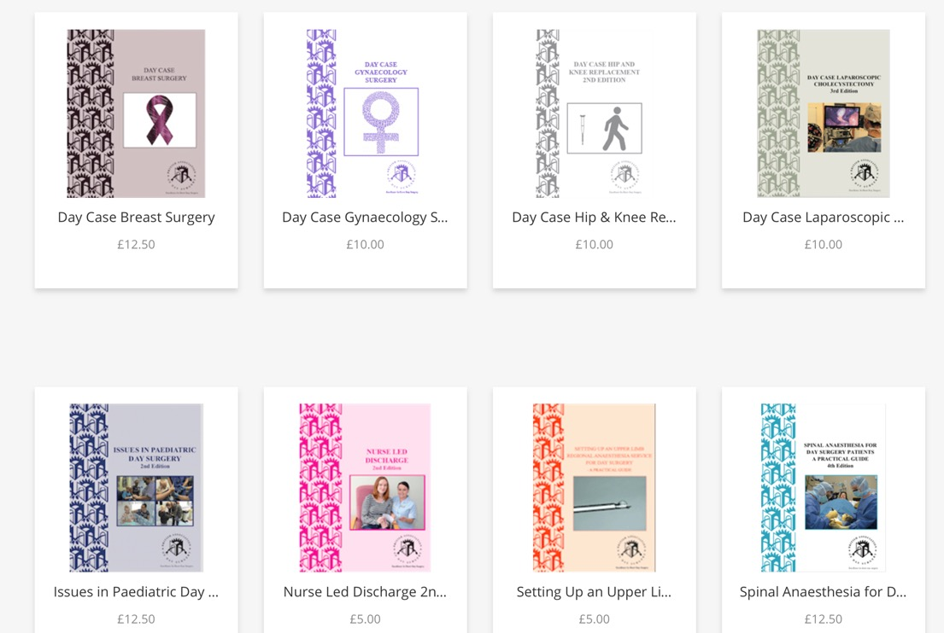
BADS Website
Links to events
Day Surgery Unit Directory

Slide 89
National Day Surgery Delivery Pack
VISION
How to deliver Day Surgery
Best practice guidance
Avoid reinventing the wheel
CONTENTS
General Principles of Day Surgery
The Day Case Pathway
Procedure specific best practice pathways and guidelines

Slide 90
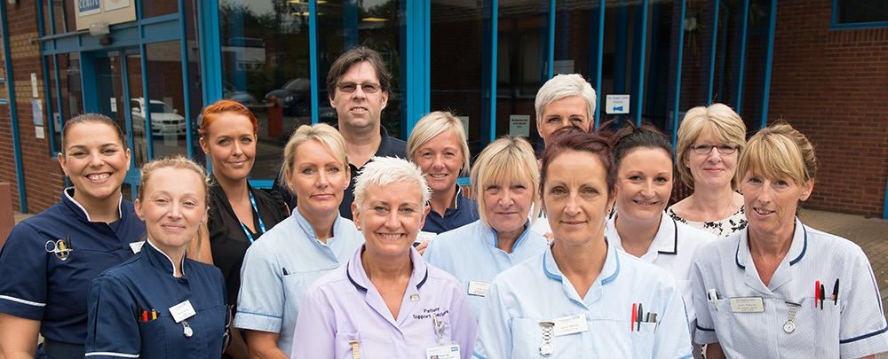
  High quality pathway
  Treat day surgery as the “norm”
  Appropriate resource
  Teamwork

Slide 91
Thank you

Slide 92


