Slide 1
Clinical negligence overview
Christina Bateman
12 May 2022

Slide 2
Agenda
The clinical negligence process – pre-action
The clinical negligence process - proceedings
Current issues and challenges
Legal tests for clinical negligence claims
Review of recent clinical negligence cases
How the Courts may view clinical negligence claims brought by families who have lost loved ones during the pandemic

Slide 3
The clinical negligence process – pre-action
    Possibly following a complaint or investigation
    Pre action protocol for the resolution of clinical disputes
      Letter of Notification/Letter of Claim
      Investigation – by NHS Resolution or one of their panel firms- factual (witness) evidence and independent expert evidence
      Letter of Response
        Admissions
        Denial
      Can attempt settlement without admissions
    In 2020/2021 74.67% of claims within NHS Resolution’s Clinical Negligence Scheme for Trusts (CNST) resolved at the pre-action stage

Slide 4
The clinical negligence process - proceedings
    Issue and service of proceedings
      Particulars of Claim
      Defence
      Witness statements
      Reports from independent experts
      Schedule of Loss and Counter Schedule (to deal with value of claim)
      Joint discussions of experts
      Trial – In 2020/2021 0.35% of claims within the CNST scheme proceeded to trial
    Alternative Dispute Resolution (ADR) at any time – pre and post proceedings

Slide 5
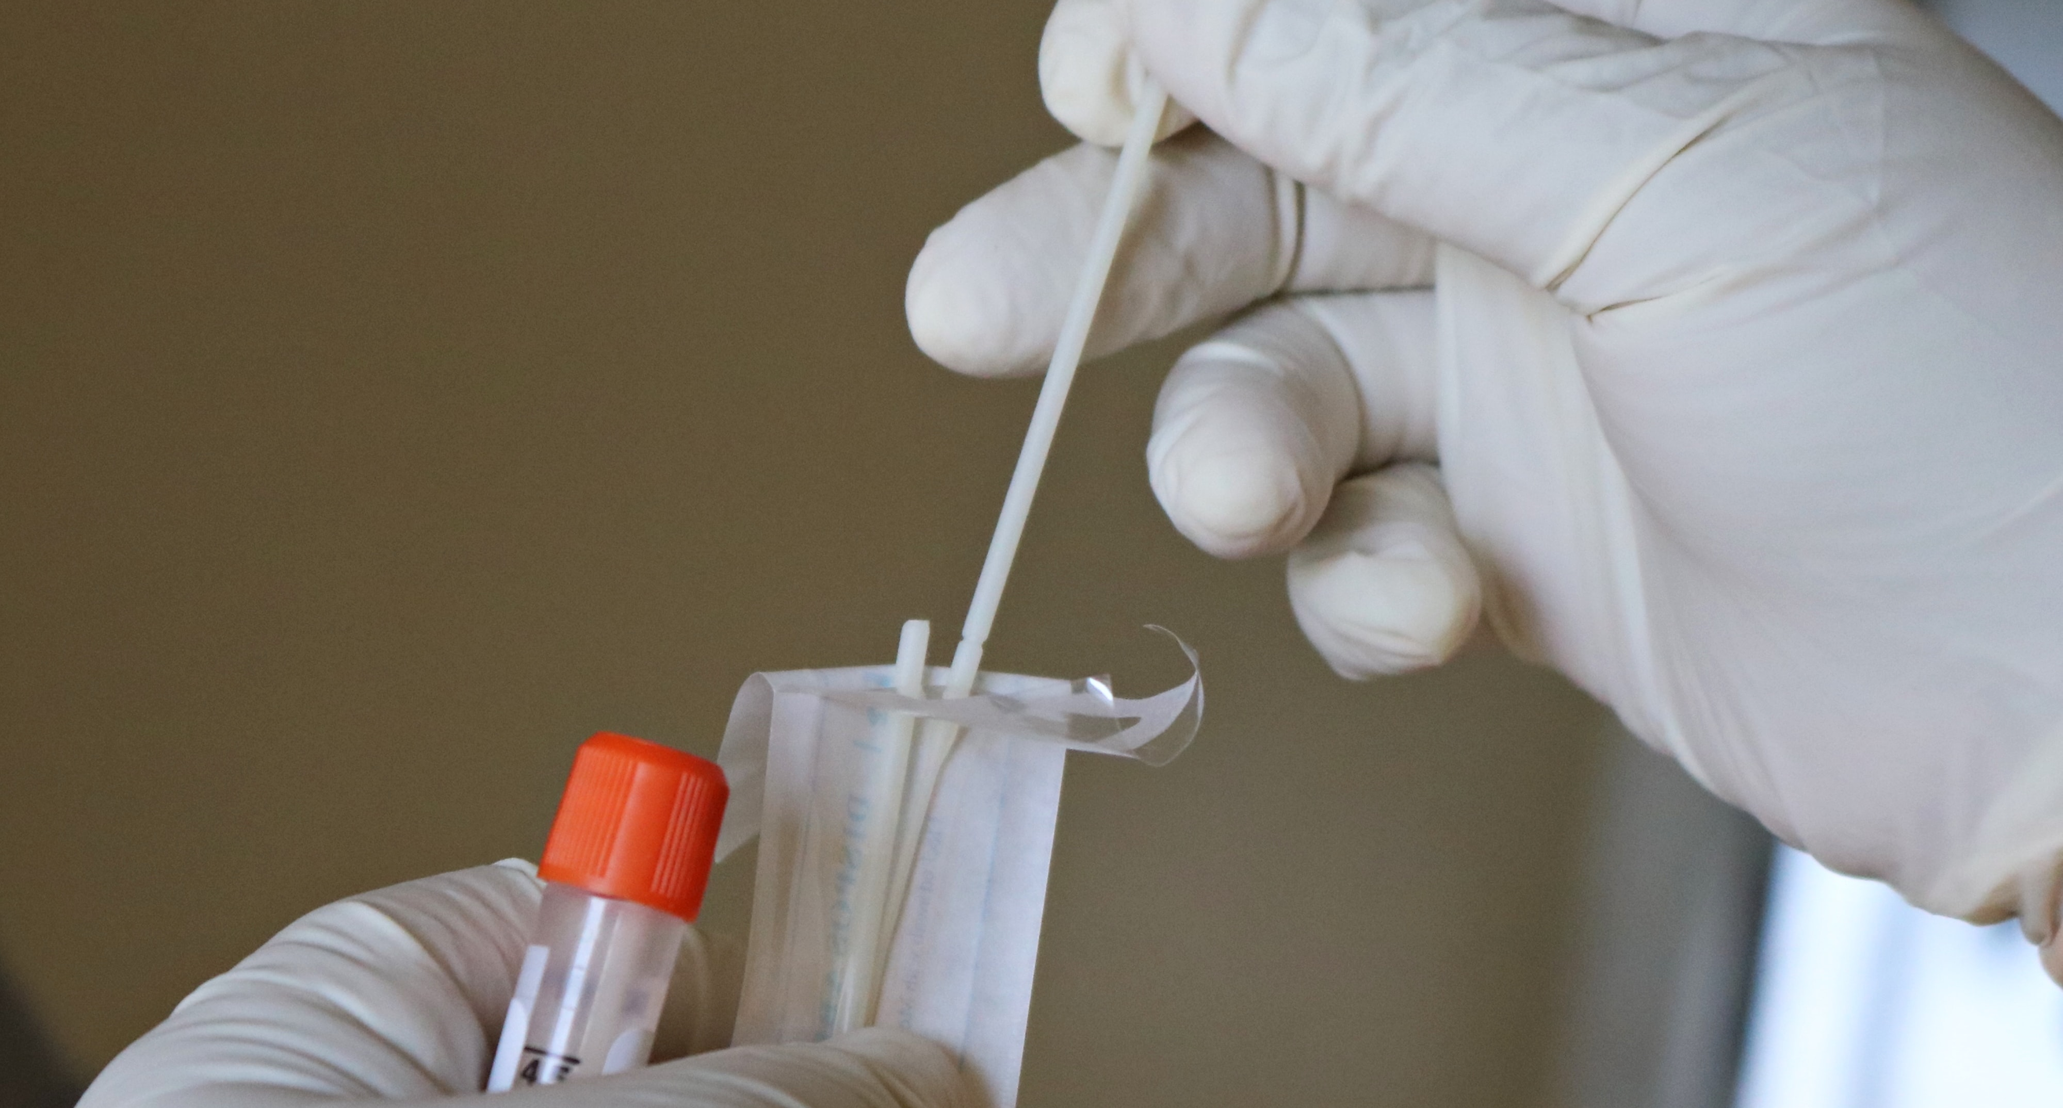
Current issues and challenges
    Court backlogs due to COVID-19 – virtual hearings and trials
    Impact of pandemic on availability of medical expert witnesses and factual witnesses
    Increasing need for co-operation between opposing parties – use of ADR

Slide 6
Legal tests for clinical negligence claims
    Duty of care
    Breach of duty of care – Bolam/Bolitho test
      Was the treatment/care in accordance with, and capable of being supported by, a reasonable and responsible body of clinical opinion, acting logically, at the relevant time?
    Consent and the Montgomery case
    Causation – breach of duty must cause a reasonably foreseeable injury
    Damages
    Claimant has the burden of proof – on the balance of probabilities

Slide 7

Review of recent clinical negligence cases
    Thorley v Sandwell & West Birmingham NHS Trust (2021)
    Khan v Meadows (2021)

Slide 8
How the Courts may view clinical negligence claims brought by families who have lost loved ones during the pandemic
    ‘
    Courts will not hold clinicians liable for national policy decisions e.g. the suspension or reduction of cancer screening programmes
    Will still need to justify own policy/clinical decisions – same legal tests apply
    Hospital acquired infection of COVID-19 – evidential difficulties for Claimants
    Indirect consequences:
      Clinician fatigue
      Staff shortages
      Waiting lists
      Equipment/supply issues
      Allocation and limitation of resources
    ‘Battle conditions’ considered – but not a licence to be negligent
    Importance of documentation

Slide 9
Thank you. Any questions
Christina Bateman, Legal Director
Christina.bateman@clydeco.com
+44 161 240 8507

