Slide 1
Decisions about Cardiopulmonary Resuscitation (CPR): Ensuring Effective & Person Centred Practice
Dr Rosie Benneyworth, Chief Inspector of Primary Medical Services and Integrated Care
13 May 2022

Slide 2
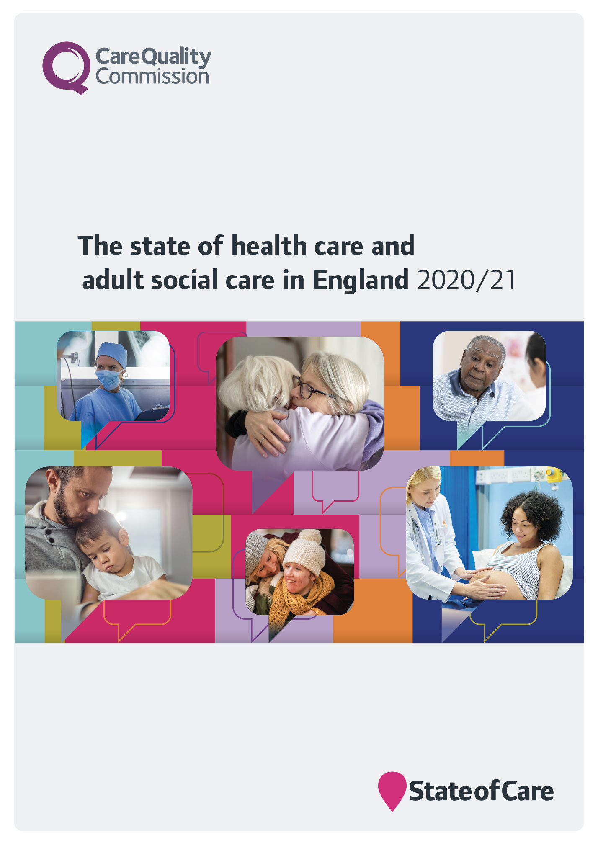
Our role and purpose
The Care Quality Commission is the independent regulator of health and adult social care in England.
We make sure health and social care services provide people with safe, effective, compassionate, high-quality care and we encourage care services to improve

Slide 3
Unique oversight of care
23,215 adult social care services
138 NHS acute hospital trusts
294 independent acute hospitals
83 community health providers or locations
10 NHS ambulance trusts
129 Independent ambulance services
199 hospices
49 NHS mental health trusts
227 independent mental health locations
10,944 dental practices
6,430 GP practices
165 Urgent care and out of hours
Is it safe?
Is it effective?
Is it caring?
Is it responsive?
Is it well-led?

Slide 4
Our review of DNACPR decisions during the pandemic
In October 2020, the Department of Health and Social Care (DHSC) asked CQC to review how Do Not Attempt Cardiopulmonary Resuscitation (DNACPR) decisions were used during COVID-19
We made our position clear on how DNACPR decisions should be made at the beginning of the pandemic
We published an interim report in Dec 2020 based on intelligence received from people sharing their experience, stakeholder groups and reviewing existing guidance
This is the final report

Slide 5
Jim’s story
About Jim
Jim was in his 80s
Jim still worked
Jim had normally been fit, well and active
Jim had a daughter called Melanie
Jim went out most weeks in his car to visit friends or go to the cinema.
Jim was taken to hospital at the beginning of the pandemic after becoming unwell with a chest infection
About 12 hours after being admitted to hospital Jim called Melanie. He was upset and confused, and told her he had signed away his life and was going to die. He told her that a doctor had put an order in place that they wouldn’t restart his heart if it stopped. He was upset that he had agreed to it because he didn’t want to die.

Slide 6
Jim’s story
Melanie told us that she tried to speak to the medical and nursing staff about this decision.
She felt that:
The conversations were all one way
No one asked about her dad, about what he was like and what his life was like at home
Because Jim was able to make decisions about his care, no one had discussed the decision with her
However, she was concerned that her dad was vulnerable because he was ill, likely to be confused as he had a bad infection, and he was all alone.
She felt he would have just gone with what they told him.
Jim died while in hospital. Not being allowed to visit because of the pandemic, and the way in which the DNACPR was applied, made his death even more distressing for Melanie and her family.

Slide 7
Themes
Information, training and support
Concerns raised as part of our scoping exercise were confirmed through fieldwork
A mixed picture around blanket and/or inappropriate use of DNACPRs
Poor record keeping means that it has not been possible to verify the extent of the problem
Consistent national approach
Improved oversight and assurance

Slide 8
Summary of findings
Increased pressure on staff time and resource
People were involved in decision making but evidence that:
people were not always supported
there had been ‘blanket’ DNACPR decisions in place
people were not supported in advance care planning conversations, or given the information they needed in an accessible way
There was a lack of awareness and confidence among people, families and care workers about what a DNACPR decision meant, and how to challenge this

Slide 9
It is vital we get this right and ensure better end of life care as a whole health and social care system, with health and social care providers, local government and the voluntary sector working together.

Slide 10
Recommendations
People must always be at the centre of their care
Everyone needs to have access to
equal and non-discriminatory personalised support
Clinicians, professionals and workers must
have knowledge,
skills and confidence
to speak with people and families
DNACPR decisions need to be recognised as part of wider conversations about advance care planning and end of life care. These decisions need to be made in a safe way that protects people’s human rights
Responsible: Department of Health and Social Care
Professionals and patients need support so they all share the same understanding and expectations for DNACPR decisions
People need to have more positive and seamless experiences of care
Support is needed for people to understand what good practice looks like for DNACPR decisions
CQC must continue to seek assurance that people are at the centre of personalised, high-quality and safe experiences of DNACPR decisions
Responsible: Care Quality Commission
There must be comprehensive records of conversations and agreed decisions
Integrated care systems need to be able to monitor and assure themselves of the quality and safety of DNACPR decisions
Health and social care providers must ensure that all workers understand how to speak up

Slide 11
Provider Bulletin
https://www.cqc.org.uk/news/newsletters-alerts/email-newsletters-cqc or Search: CQC bulletin
Publications
https://www.cqc.org.uk/publications
Social
@CQCProf @CQCProf
youtube.com/user/cqcdigitalcomms
facebook.com/CareQualityCommission
Digital platform
https://cqc.citizenlab.co/en-GB/ or Search: Citizenlab CQC
Podcasts
Wherever you listen to podcasts Search: CQC Connect
Blogs
https://medium.com/@CareQualityComm
or Search: Medium CQC

Slide 12
Dr Rosie Benneyworth
Chief Inspector, Primary Medical Services and Integrated Care
www.cqc.org.uk
enquiries@cqc.org.uk
@CQCProf
youtube.com/user/cqcdigitalcomms
facebook.com/CareQualityCommission

