Slide 1
ePrescribing: How we introduced electronic prescribing with empathy during the COVID-19 pandemic
Amanpreet K Sidhu
Lead Pharmacist Informatics
Reena Lal
Deputy Lead ePMA Pharmacist

Slide 2
We will be covering
Delivering EPMA with empathy
How we introduced electronic prescribing during the COVID-19 pandemic
Generating clinical data that allow prescribing trends to be analysed and create new pathways for auditing medication use

Slide 3
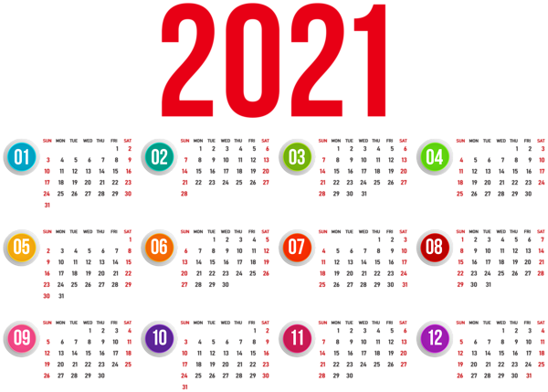
EPMA Roll-out Dates
Staff engagement
Covid-19
Clinical Data
RLH – 28th August 2021
Clinical documentation Saturday 28th August - whole site
EPMA Monday 30th August
4 week roll-out
Whipps Cross – 4th October 2021
3 week roll-out
Newham – 1st November 2021
3 week roll-out
SBH – 22nd November 2021
3 week roll-out
Notes:
Pausing it in 2020 and then we decided that we would continue once started and the second wave was just behind our implementation. Restart march 2021 we were able to able to reap the benefits of epma during the second wave.

Slide 4
Staff engagement
Covid-19
Clinical Data
Staff engagement
User Acceptance Testing
Full Dress Rehearsal
Knowledge transfer to the support teams
Training and engagement sessions
ePMA Team Support

Slide 5
Staff engagement
Covid-19
Clinical Data
User Acceptance Testing
Comms for invitations via WeConnect, Outlook Invites
Full Dress Rehearsal
Opportunity to do early engagement with transcribing team
Mid June 2021
Testing workflows for all HCP
Feedback to staff groups
Involve nursing staff to do scanning process
Plan for lesson learnt: what is critical to change in system and what's nice to have
Feedback to relevant teams/staff groups- you said/ we did posters
Involvement of Change Team and Testing Team
Notes:
UAT
mid June easing of lockdown delayed until July, affected the numbers face to face and high numbers
Really difficult to get engagement as we felt we didn’t get the right people in the room.
One of the major problems we found was site variations amongst specialities
FDR
Mimic go live so that FDR is Close to reality and think about the environment.
Transcribing, photocopy use a variety, time it and make u check skill mix. 30 mins per chart 15min check 45 min per chart. One hour itu and 30 mins check.
Timings were critical to the ward orders for go live and how many ward in a day.
Do test the proforma and make sure it work
test smart card issues, had big problems with the smartcards.
Scanning few bar codes to test good to get a big sample. Equipment is very important
Lessons learnt: Make sure it as a mdt approach to agree deadlines, not just pharmacy

Slide 6
Staff engagement
Covid-19
Clinical Data
Knowledge Transfer
Pharmacy specific knowledge transfer sessions
Training and engagement sessions
WeConnect Weeks- for all HCP prior to go- live.
ePMA Team Support
Bitesize sessions prior to each site go-live.
QRGS and User guide links in signature
TRAIN domain available in training rooms for 3rd site go-live onwards.
eLearning packages via Premier IT
Onsite engagement 2nd go-live site onwards
Post go-live walk arounds
Larger supportive team 2nd Site onwards
Notes:
Empowering people to use the system and training other users.
Training and engagement sessions
WeConnect Weeks- two weeks worth of training for all HCP prior to go- live.
Presentations and videos uploaded to Trust intranet page
Quick Reference Guides and User guide saved centrally and whole team had links in signature

Slide 7
Covid-19 Preparations
Staff engagement
Covid-19
Clinical Data
Go-live Planning
Plan to go from green area wards to red area wards
Mixed economy management
Transcribing Team
Checked vulnerable staff and devised teams accordingly
PPE available to all
Ward Management
‘Runners’ introduced to handle ‘dirty charts’
Good communication when filing away ‘live’ charts and extra transcribing checks for photocopies
Being flexible with implementation rota
Limited transcribers on these wards
Transcribers sat in separate ‘clean’ areas on ward
Photocopying of charts
Checked who was FIT TESTED
Staff LFTs on some green surgical elective wards
Notes:
Ward Management:
Staff testing lateral flow and ward management. Especially for the green surgical elective wards

Slide 8
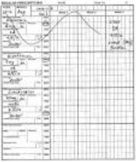
Pre go-live
Staff engagement
Covid-19
Clinical Data
Sites
Comms around dates of transcribing to sites
Transcribing checklist
Skill mix- pharmacists Vs doctors
Drug chart preparation
Weights, heights, endorsements up to date, legible, numbers of drug charts etc
Drug histories pre-done on ePMA
Roll out plan – rota
Covid-19 measures
Location of command centre
Printing of material; proformas, ward planners and guides
Setting up of MS Teams chat
Notes:
Transcribing checklist
Lots of comms between transcribing between reena and project manager
covid measure, link in with the CIL and NIO
MS teams chosen as comms method between command centre > reena/project manager> co-ordinators of transcribing team
Use platform to check progress of transcribing and have transcribing material uploaded as files.

Slide 9
Pre go-live
Staff engagement
Covid-19
Clinical Data
Transcribing Induction
1 hour induction session before each site
E-Training for transcribers
Rotas/teams for each site
Site floor plans
Transcribing proforma
Induction video
Notes:
Transcribing proforma
Roll and responsibility within the team – Transc, checker and the co-Ordinator and Reena between everyone.
Team co-ordinator role was v important.
Specifics on how to transcribe each element of the drug chart electronically e.g. start stop dates, ABX, reducing doses, PRN, care plans, placeholders etc.
Cancellation stickers
Ward planners
Screenshot of all care plans
utilising DHX as inpatient orders
Rotas:
Team who the transcriber and checker.
The clinical co-ordintoror after the team to do pharmacy clinical screening
Ward location, speciality and covid areas

Slide 10
Staff engagement
Covid-19
Clinical Data
Twice a day briefing in the command centre
Twice a day briefing to transcribing team
Go through rota plan each day
Covid-19 Measures- linking with NIO/CIL
Communication via MS Teams
Deputy Lead ePMA pharmacist co-ordination role
Be flexible with team and plans
Red shirts post transcribing
Lessons learnt of day and overnight shared
Notes:
Communication mop up the non-epma to live area etc.
One team supported the other or merged the teams as needed. Flexibility if needed.

Slide 11
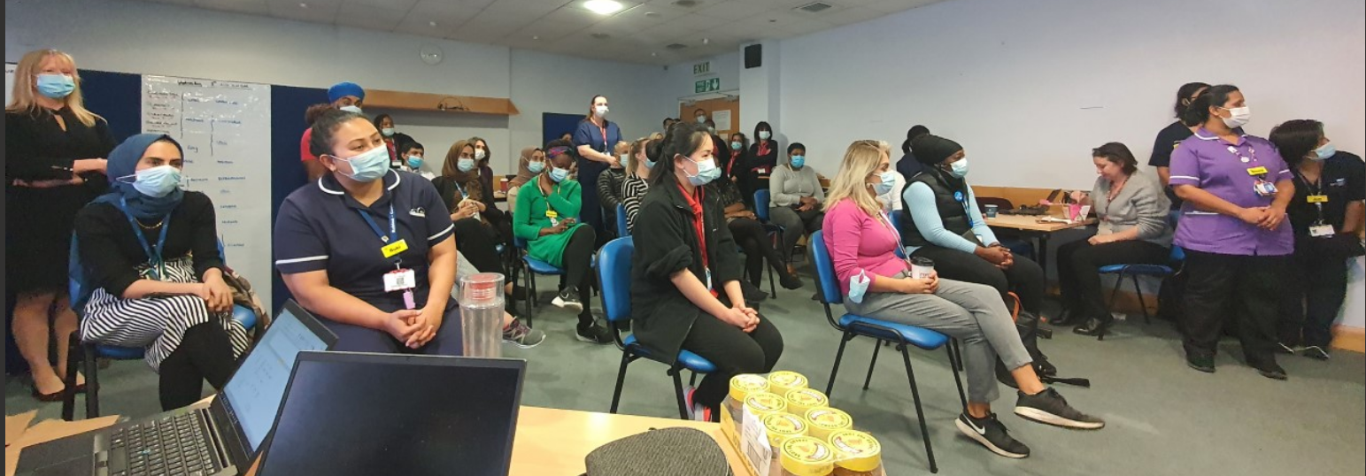
Staff engagement
Covid-19
Clinical Data
Make sure to celebrate along the way

Slide 12
How we can extract data
Staff engagement
Covid-19
Clinical Data
Lights on data
Provides Trust level data and is good for identifying trends and patterns
Cerner reports
Qlik sense
Cerner reports that are available at go live!
Internal team that build bespoke dashboards
Notes:
So as we have discussed we have a lot of data at our finger tips. Barts health has over 1800 beds although this number is always subject to change.
We have different ways in which we can extract data and use it to our advantage to ensure safe and effective use of medicines.
LON: looks at patterns and trends within the organisation and allows you compare with other cerner sites. It allows you to be proactive and identify bottlenecks across the system. The data recognise gaps and helps to transform, and address areas/individuals that may need assistance and identify opportunities for advancement through monitoring operational work. However it does not give you patient level data.

Slide 13
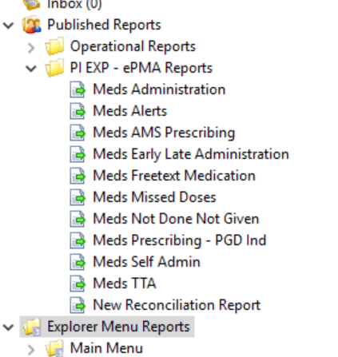
Staff engagement
Covid-19
Clinical Data
Cerner Reports
Notes:
Explain the differences between the reports that can be accessed through business objects.
Meds administration: Details of meds administered for a user defined period of time.
Meds alerts: Details of alerts associated with meds PHA and Multum alerts.
Prescribing: The prescribing report displays in-office medications and prescriptions within a given location in order to track in-office medications for ordering purposes and to understand which medications are being prescribed. This includes details of pharmacy medication orders broken down by facility and ward.
Early/late administrations: Medicine administrations either given two hours ahead or after the scheduled administration time.
Free text medications: Meds orders places as free text broken down by facility and nurse unit.
Missed doses: Details of scheduled meds administrations that are on the MAR and marked as overdue or missed doses.
Meds not done/given: Details of scheduled meds administrations that are marked as not done or not given by clinical staff.
Self-administration: Details of scheduled meds administrations that are marked as self-administrations.
Medication history and reconciliation – current inpatients: This report displays a list of current inpatients and each patient's medication history and admission medication reconciliation status.

Slide 14
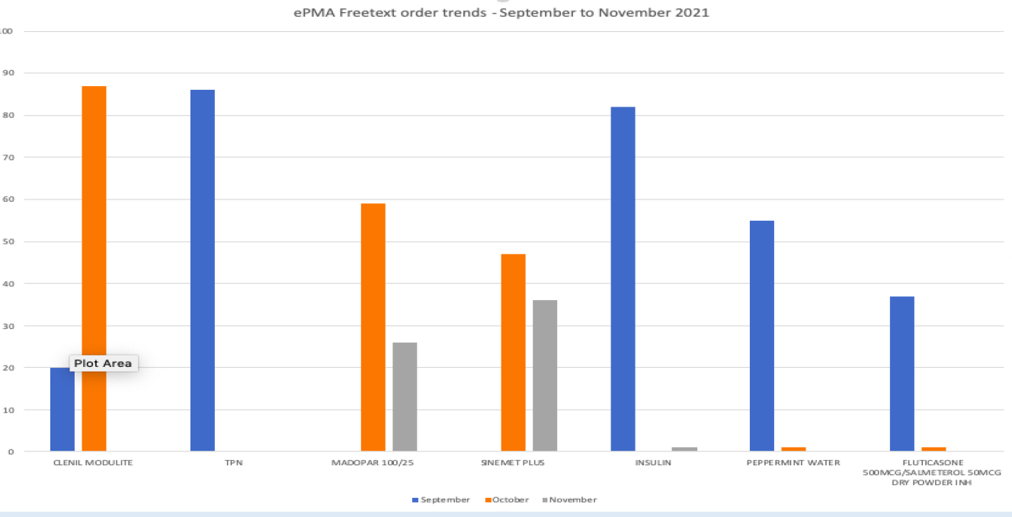
Staff engagement
Covid-19
Clinical Data
Freetext Medication Report
Notes:
Explain what a freetext order is
The first of these reports that we used during go live was the Freetext orders helped us to identify prescribing trends:
The graph shows
Explain how items are hidden within care plan which lead to free text orders
The actions we took after the meeting:
Did the medication not exist in the system, if not then it had to be added
Was the brand being added and the user should be prescribing generically
Was the medication being prescribed outside of the care plan in which case some comms and training was needed. Search criteria
Spelling mistakes

Slide 15
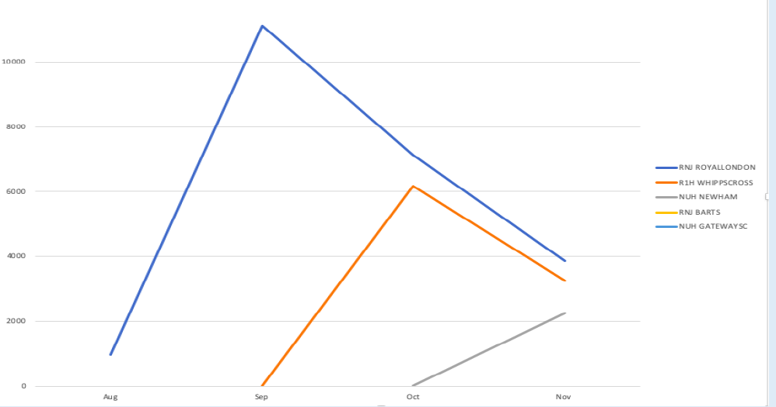
Staff engagement
Covid-19
Clinical Data
Freetext Medication Report
Notes:
Trend show the number of orders and how these reduced over time.
The number are very high as the order is counted every day as new order rather than a one off.

Slide 16
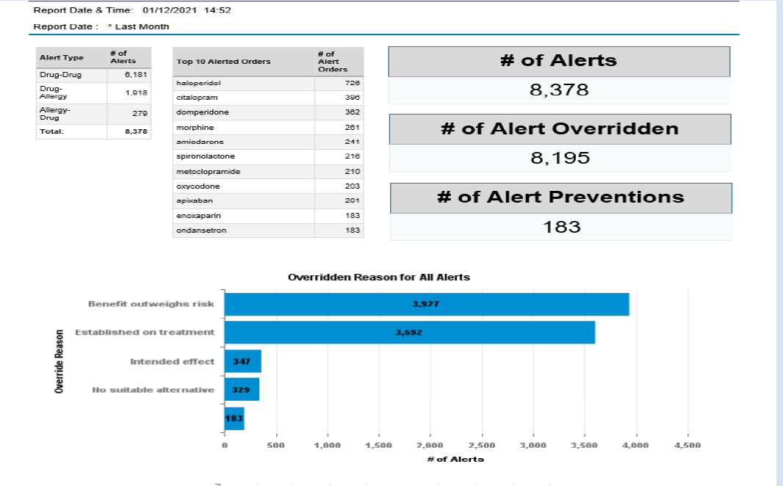
Staff engagement
Covid-19
Clinical Data
Multum Alerts
Notes:
The report data generated can be used to ensure that the amount of alerting is appropriate moving forward and works to prevent clinical issues and reduce prescribing risk
Alert can be filtered to ensure that only severe alerts fire to reduce the number of alerts
The trends can be used to Identify individuals/ groups who have overridden alerts and the override reason documented, and make changes accordingly, stop inappropriate alerts from firing e.g aspirin and warfarin for cardiac patients. Benefit v risk
Identify the number of alerts accepted – that we considered useful
Data can be used for individual DATIX investigations and serious incidents
Work to optimise the system so that unnecessary alerts are removed to reduce alert fatigue
This is an ongoing action and we are not there yet

Slide 17
Staff engagement
Covid-19
Clinical Data
Qlik Sense dashboard
How do we decide what is important?
What are the Trust priorities?
What dashboard are current built at Barts health?
What are the priorities for the coming year?
Notes:
We have a process to ensure it is fair and equitable, we make sure we align this with the trust agenda.
We are looking at the medication safety quality objectives and these are reported externally. epma has allowed us to set a standard and deliver and improve quality through reporting
Medicines safety quality indicators we will be reporting on % of missed doses and number of patients that receive medication in spite of an allergy. Talk about freetext allergies

Slide 18
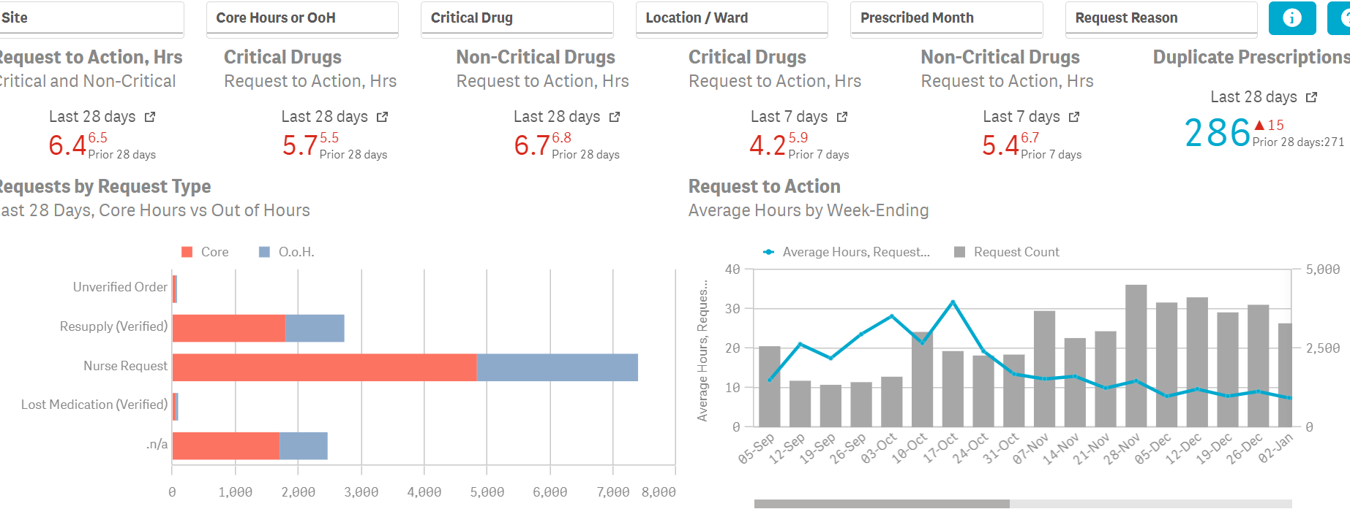
Staff engagement
Covid-19
Clinical Data
Medication requests KPI
Notes:
This is one of our clinical KPI
Duplicate within 48 hours

Slide 19
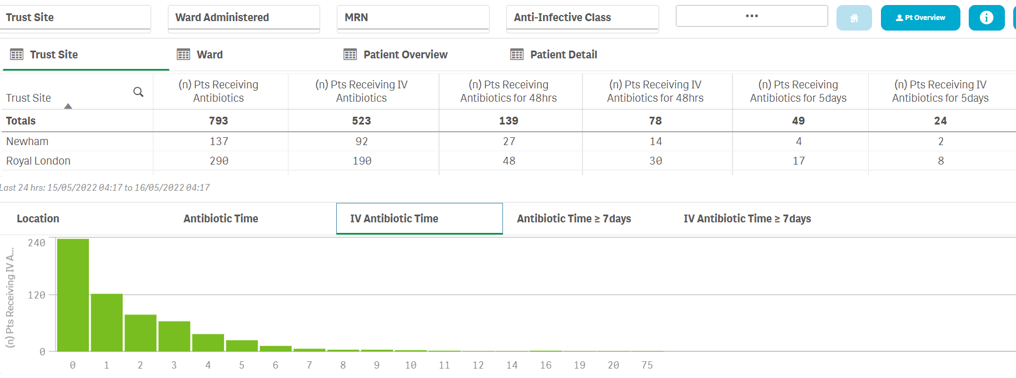
Staff engagement
Covid-19
Clinical Data
Clinical dashboard
Notes:
In the future we hope to link it with vital signs
Prescribing trends and focus training
Improve treatment and demonstrate how it interacts with the health record
You can see the order details the drug, duration, indication, when it was started, who prescribed it and who screened it
75 days and can see it for splenectomy

Slide 20
ANY QUESTIONS? Amanpreet K Sidhu Lead Pharmacist Informatics amanpreet.sidhu1@nhs.net @asidhu12 Reena Lal Deputy Lead ePMA Pharmacist reena.lal1@nhs.net @reenzlal

