Slide 1
NATIONAL DEVELOPMENTS IN EVIDENCE-BASED FALLS PREVENTION
Falls Prevention in Older People
Friday 6th May, 2022
Cameron Swift, King’s College School of Medicine, London

Slide 2
KEYS TO AN EFFECTIVE FALLS SERVICE
1. Concept – an age associated syndrome
2. Evidence – positive and negative
3. Structure - crossing all boundaries
4. Audit - measuring process and outcome

Slide 3
(1) CONCEPT: FALLS IN LATER LIFE – A THREAT
30% >65: 50%>80 fall at least once yearly
Injury, disability, dependency, mortality
NHS annual cost >£2.3bn

Slide 4
(1) CONCEPT: FALLS IN LATER LIFE: A SIGNAL
Commonly detectable (Intrinsic / Extrinsic):
Ageing processes (diminished physiological reserve)
Suboptimal physical fitness
Stable specific impairment (e.g. sensory, motor, visual, CNS)
Unstable systemic illness (diagnosed or undiagnosed)
Environmental risk factors

Slide 5
(2) EVIDENCE - POSITIVE: FALLS IN LATER LIFE – PREVENTABLE (Close et al, Lancet 1999)

Slide 6
(2) EVIDENCE - POSITIVE :- EXAMPLES OF ATTRIBUTABLE MEDICAL PROBLEMS IDENTIFIED - (80% +) (Close et al, Lancet 1999)
Cardiovascular/circulatory – (e.g. postural hypotension , arrhythmias, carotid sinus syndrome, pacemaker failure) (17%)
Visual impairment (59%), poor stereoscopic vision (62%), cataract (35%)
Decreased lower limb power (28%)
Peripheral neuropathy (20%)
Measured strength/balance impairment (72%)
Measured cognitive impairment (34%), depression (18%)
Undiagnosed malignancy (2%)

Slide 7
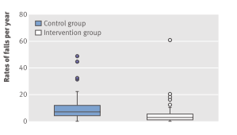
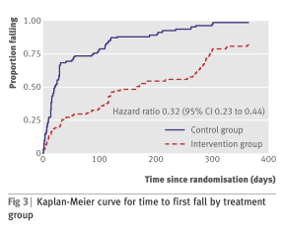
(2) EVIDENCE - POSITIVE:
FALLS IN LATER LIFE – PREVENTABLE (LOGAN et al, BMJ 2010)
(7.68 vs 3.46 control vs intervention)

Slide 8
(2) EVIDENCE - POSITIVE: FALLS IN LATER LIFE – PREVENTABLE (DAVISON et al, 2005)

Slide 9
(2) EVIDENCE: BROADER OUTCOMES - EFFECT OF AN A&E-BASED MULTIFACTORIAL INTERVENTION ON BARTHEL ADL INDEX
(from data of Close et al, 1999)
Notes:
This slide illustrates the change in Barthel scores over the one year follow up period. Repeated analysis of covariance using baseline Barthel as the covariate shows a statistically significant difference between the groups and a significant change in scores over time

Slide 10
(2) EVIDENCE - Exercise in older people living in the community (Cochrane Review 2019) (Sherrington et al)
108 RCTs with 23,407 participants living in the community in 25 countries.
Most trials had unclear or high risk of bias
81 trials (19,684 participants) compared exercise (all types) with control
Exercise reduces the rate of falls by 23% and number of people experiencing one or more falls by 15%
Findings for other outcomes are less certain

Slide 11
GtACH MULTICENTRE CLUSTER RCT from Logan et al BMJ Dec 2021
Fall Rate per participant [mean(sd)] | GtACH | Usual Care | Adjusted Ratio ** | p
0 – 3 months | 0.55 (1.36) (n=708) | 0.88 (2.37) (n=826) | 0.74 | <0.01
3 – 6 months* | 0.49 (1.13) (n=630) | 0.89 (2.60) (n=712) | 0.63 | <0.001
6 – 9 months | 0.60 (1.29) (n=547) | 0.73 (1.85) (n=633) | 0.91 | n.s.
9 – 12 months | 0.55 (1.14) (n=502) | 0.79 (2.37) (n=573) | 0.93 | n.s.
Fall Rate per 1000 resid. Days (m+sd) | GtACH | Usual Care
0 – 3 months | 6.93 (20.56) | 10.24 (27.26)
3 – 6 months* | 6.04 (14.02) | 10.38 (29.52)
6 – 9 months | 7.28 (16.67) | 9.21 (28.77)
9 – 12 months | 6.22 (12.88) | 9.22 (27.36)
* Primary outcome ** Includes both outcome variables

Slide 12
(2) EVIDENCE: FALLS IN INPATIENTS
Highest risk category
Heterogeneous studies and settings (e.g. acute. non-acute, mixed)
Inconsistent or negative findings with single factor or non-tailored interventions
Risk factor prediction tools insufficiently sensitive or specific
More research needed
Some moderate/low evidence for multifactorial assessment and intervention strategies

Slide 13
(2) EVIDENCE - POSITIVE: Effect of targeted risk factor reduction programme on inpatient falls (per thousand occupied bed days) (Healey et al, 2004)

Slide 14
“Fallsafe” care bundle key elements [RCP 2015]
Cognitive assessment*
Delirium screen*
Bed-rail/Ultra-low bed strategy*
Basic visual check*
Lying & standing blood pressure & pulse*
Medical & medication review*
Tailored on-ward (v 2-hr) observation regimen

Slide 15
(2) EVIDENCE:“NEGATIVE” , UNCERTAIN OR ATTENUATED INTERVENTION FINDINGS
Single interventions – untargeted group exercise, cognitive/behavioural, vision correction alone, Vit D (?)
Focus on cognitive impairment (A&E /Care home) (e.g. Shaw et al, 2003, Whitney et al, 2017)
Unidisciplinary assessment with non-linked referral (Lightbody et al, 2002; Spice et al 2009)
Risk factor prediction tools in inpatients [e.g. Barker et all (6-Pack), 2015]
Risk factor prospective postal screening intervention in primary care (Bruce et al, 2021)(PreFIT)
Assistive technology

Slide 16
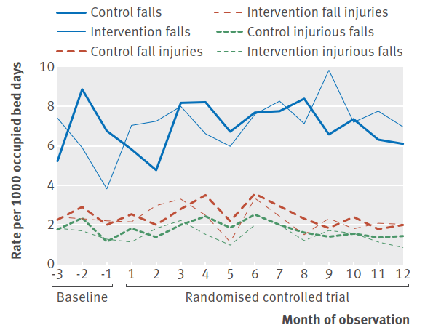
The “6-pack” (risk prediction tool based) study [Barker et al; bmj (2016) 352;h6781]

Slide 17
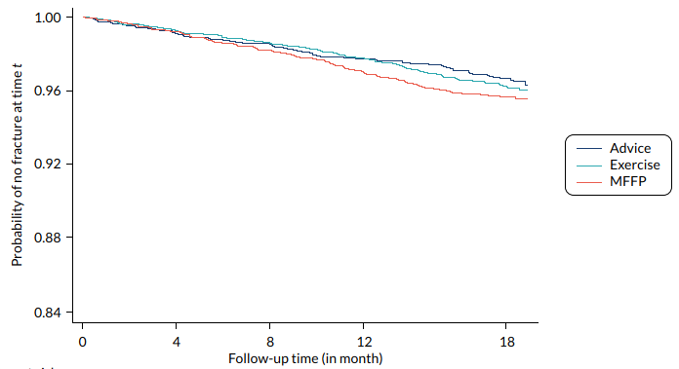
Prefit Cluster RCT (Bruce et al, 2021)

Slide 18
(3) STRUCTURE: CG 161 GENERIC FALLS ASSESSMENT AND INTERVENTION ACTIVITY (UK evidence & focus)
CASE/RISK
IDENTIFICATION
NETWORKED
FALLS SERVICE
Case / risk identified at routine health screen
MULTI-FACTORIAL
ASSESS-MENT
INDIVIDUAL-ISED SINGLE OR MULTI-FACTORIAL INTERVEN-TION & FOLLOW-UP
PRIMARY & COMMUNITY
CARE
Case / risk identified at presentation with fall / other problem
Case / risk identified at presentation with fall / other problem
SECONDARY
CARE
Presentation at A&E with fall injury/ Inpatient >65 / or Inpatient >50 with known clinical risk
BONE HEALTH
SERVICE

Slide 19
(3) STRUCTURE - COORDINATING ACROSS BOUNDARIES: GENERIC FALLS SERVICE NETWORK – AN OPPORTUNITY TO LEAD
PRIMARY & COMMUNITY
CARE
MAINSTREAM SECONDARY CARE
NETWORKED FALLS SERVICE (LINKED TO MEDICAL GERONTOLOGY)
ACCIDENT & EMERGENCY MEDICINE
POPULA
TION-BASED/
OPPORTUN-ISTIC SCREENING
ACUTE INPATIENT MEDICAL GERONTOLOGY
TRAUMA, & ORTHO-PAEDICS
OTHER MEDICAL & SURGICAL SPECIALITIES
HOME-BASED EXERCISE
PROGRAMMES
DAY HOSPITAL, OUTPATIENT CLINICS & REHABILITATION
BONE HEALTH SERVICE

Slide 20
(3) STRUCTURE - IMPROVING IMPLEMENTATION
(RCP 2017)
MANAGEMENT LEVEL
Organisation-wide Patient Safety Group
Structured rapid assessment procedures (including standardised delirium tools)
Robust data and reporting on falls & fractures
CLINICAL
Multi-D Falls Working Group auditing v QS 86
Audit of Postural BP, Visual, Medication and Walking-aid use review and provision

Slide 21
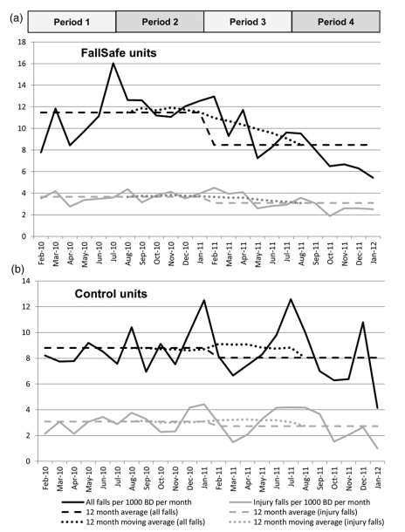
(4) AUDIT - INPATIENT IMPLEMENTATION & OUTCOME MEASUREMENT “Fallsafe” QI evaluation [Healey et al 2014]

Slide 22
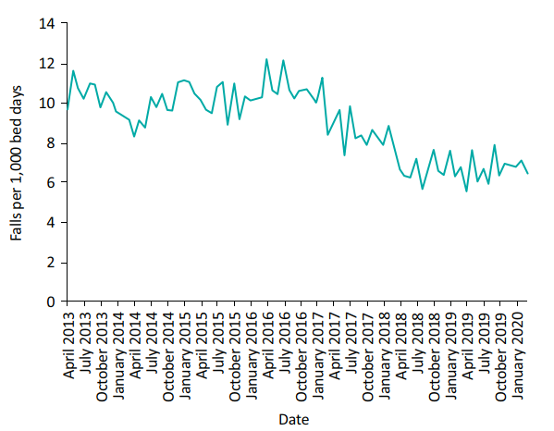
4: LOCAL AUDIT/QI: Inpatient falls per 1,000 bed days AT Northumbria Healthcare NHS Foundation Trust 2013–2020. (Richardson et al., 2020)

Slide 23
(4) LOCAL AND NATIONAL AUDIT - Some specific implementation elements
Clear lines of accountability
Seamless specialist referral access & criteria
Falls co-ordinator
FALL identification/documentation (esp in A&E and ambulance call-outs) as distinct entity
Data collection (inc. falls recurrence, hospital admission/re-admission) to RCP FFFA as indicators of cost-effectiveness
Broader health outcome data if possible
Related pathways (e.g. frailty, pro-active care) a possible trigger, but NOT a substitute for specific Falls service.

Slide 24
(4): NATIONAL AUDIT - NICE guideline on falls (CG161)
Case/risk identification
Multifactorial falls risk assessment/diagnosis
  Falls history
  Assessment of:
    gait, balance and mobility, and muscle weakness
    osteoporosis risk
    perceived functional ability and fear relating to falling
    visual impairment
    cognitive impairment and neurological examination
    urinary continence
    environmental hazards
  Cardiovascular examination and medication review
Individualised multifactorial interventions

Slide 25
(4) NATIONAL AUDIT - QS 86 2017 UPDATE STATEMENTS
1 Older people are asked about falls when they have routine assessments and reviews with health and social care practitioners, and if they present at hospital.
2. Older people at risk of falling are offered a multifactorial falls risk assessment.
3. Older people assessed as being at increased risk of falling have an individualised multifactorial intervention.
4.Older people who fall during a hospital stay are checked for signs or symptoms of fracture and potential for spinal injury before they are moved.
5. Older people who fall during a hospital stay and have signs or symptoms of fracture or potential for spinal injury are moved using safe manual handling methods.
6. Older people who fall during a hospital stay have a medical examination.
7. Older people who present for medical attention because of a fall have a multifactorial falls risk assessment.
8. Older people living in the community who have a known history of recurrent falls are referred for strength and balance training.
9. Older people who are admitted to hospital after having a fall are offered a home hazard assessment and safety interventions.

Slide 26
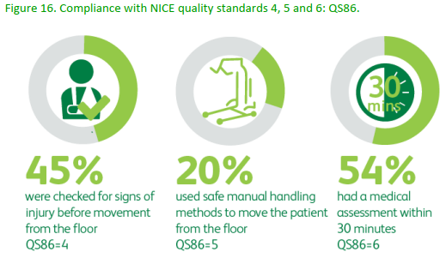
(4) NICE QS 86 ADHERENCE (naif audit) (RCP 2020)

Slide 27
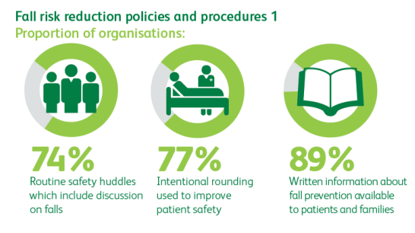
(4) PROCEDURE USE NEEDING FURTHER EVIDENCE (naif Facilities audit 2019) (RCP 2020)

Slide 28
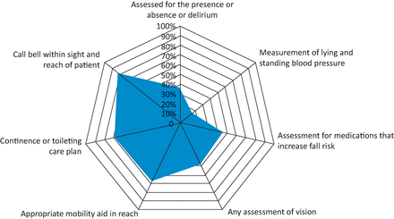
(4) NATIONAL AUDIT – SNAPSHOT DATA -INPATIENT FALLS 2017 (v 2015) (RCP 2019)

Slide 29
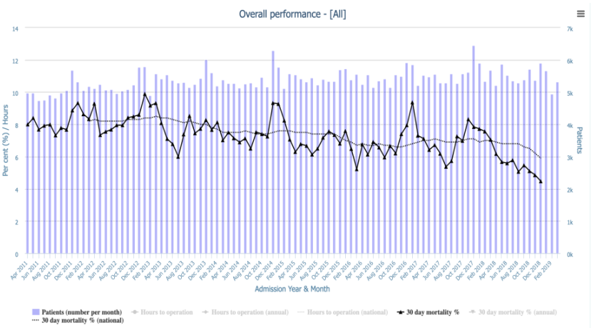
(4) 30-DAY HIP FRACTURE mortality, 2011-2018 (NHFD 2019)

Slide 30
(4) NATIONAL AUDIT OF INPATIENT FALLS (naif) 2018-21 (RCP 2020)
Focus on inpatient hip fracture (IHF).
  Rational sensitive audit outcome measure
  Continuous year-round national data collection (NHFD)
  Increased incentive for trust level participation
Fall prevention management audited for IHF only
All inpatient settings eligible to participate (inc. community, specialist, mental health trusts)
Data collection to include immediate post fall management (QS 86)
Data entered onto the NHFD as IHF
Once yearly facilities audit

Slide 31
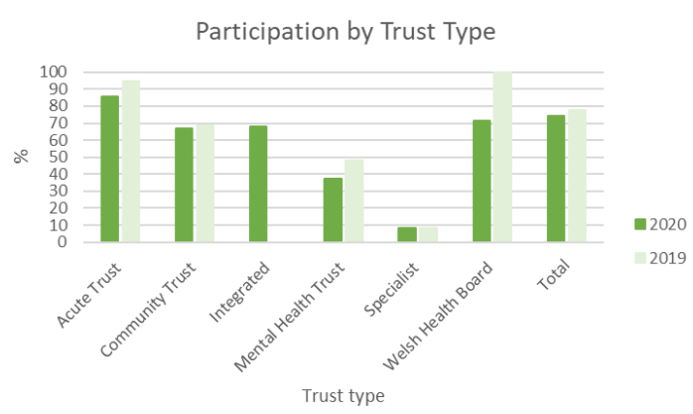
(4) Naif FACILITIES AUDIT Participation
2020 v 2019 (NAIF 2021)

Slide 32
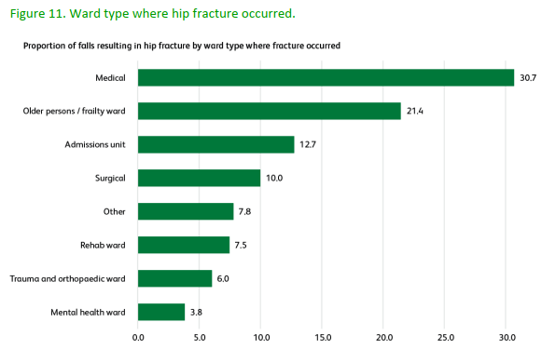
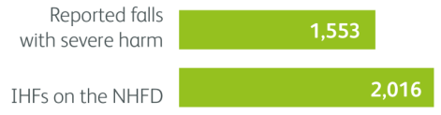
(4) IHF LOCATION (NAIF 2019) (RCP 2020)

Slide 33
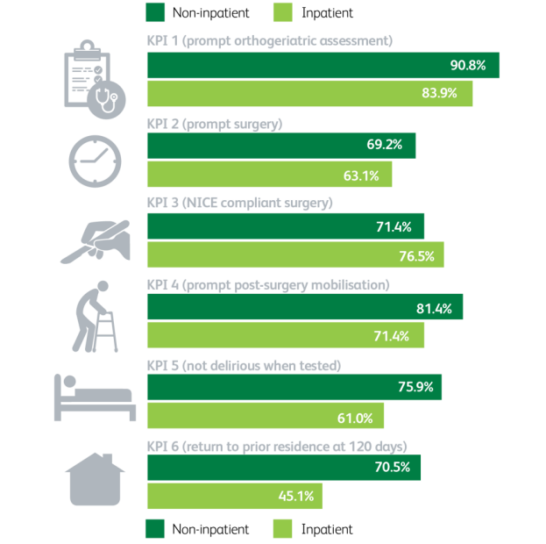
(4) NHFD 6 KPI’s FOR INPATIENT &
NON-INPATIENT HIP FRACTURE [NHFD 2021]

Slide 34
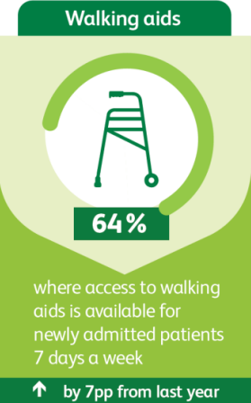
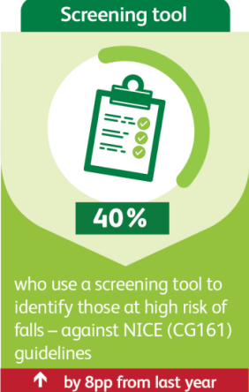
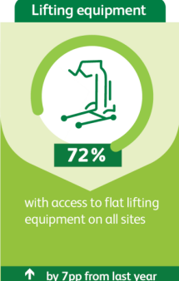
(4) CONCORDANCE WITH GUIDANCE RECOMMENDATIONS (naif Facilities audit 2019 & 20) (RCP 2021)

Slide 35
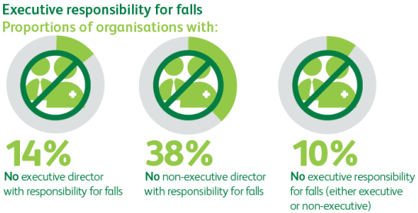
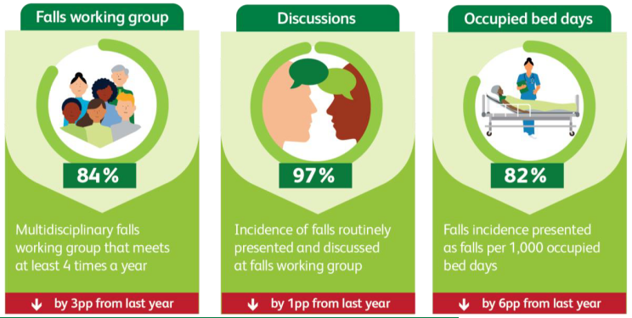
(4) Implementation management
(naif Facilities audit 2019 & 20) (RCP 2021)

Slide 36
(4) NATIONAL AUDIT OF INPATIENT FALLS (naif) 2018-21 (RCP 2021)
DATA – regularly updated, openly accessible
GUIDANCE – e.g.
  Vision assessment
  Postural blood pressure measurement
  Post-fall management*
  Gaining insight (v. incident review only)*
    Hot debrief (immediate info collection)
    After action review (MDT learning)
            *In development

Slide 37
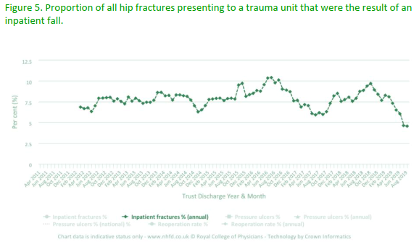
(4) Nhfd Data 2018 (naif audit) (RCP 2020)

Slide 38
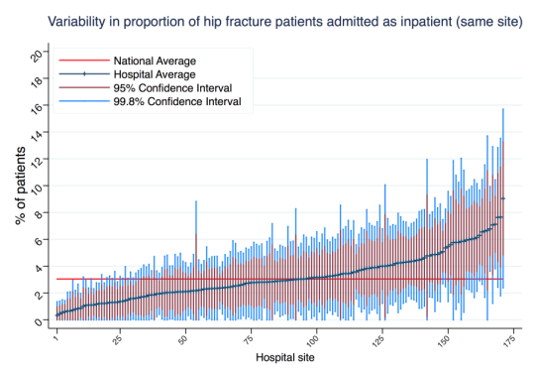
(4) Nhfd Data 2018 (naif audit) (RCP 2020)

Slide 39
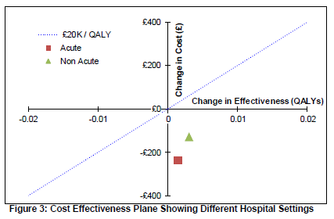
NICE CG 161: COST-EFFECTIVENESS OF INPATIENT FALLS PREVENTION

Slide 40
KEYS TO AN EFFECTIVE FALLS SERVICE
1. Concept – an age associated syndrome
2. Evidence – positive and negative
3. Structure - crossing all boundaries
4. Audit - measuring process and outcome

