Slide 1
The role of the nursing associate: the NMC perspective
Healthcare Conferences
May 2022
Wendy Fowler, Nursing Education Adviser, NMC

Slide 2
Wendy Fowler, Education Adviser, NMC

Slide 3
The story so far…
The Shape of Caring review by Health Education England (HEE) identified a skills gap between the roles of health care assistants and registered nurses.
Nursing associates support the delivery of nursing care across a wide range of health and care settings.
A profession in its own right and will provide a progression route into graduate level nursing degree programmes.
The role is being introduced in England and so the regulation applies to England only
In January 2017, the NMC agreed to regulate nursing associates, requiring a change our legislation by the Government
We became the legal regulator for nursing associates in England in July 2018.
The nursing associate part of our register opened on 28 January 2019.
First nursing associates revalidated in January 2022
Notes:
Nursing associates to work as members of interdisciplinary teams supporting the delivery of nursing care across a wide range of health and care settings.
The role will be generic within the field of nursing
In January 2017, the NMC agreed to the Government’s request to regulate nursing associates. We agreed to this because we decided it was the right thing to do in order to protect the public
Agreeing to the Government’s request doesn’t mean we are automatically the regulator for nursing associates. We need the Government to change our legislation, so that we have the legal power to regulate nursing associates. This process takes 18 months to two years and so we started early in 2017.
By January 2019, we expect that we will be ready to welcome the first group of nursing associates onto our register

Slide 4
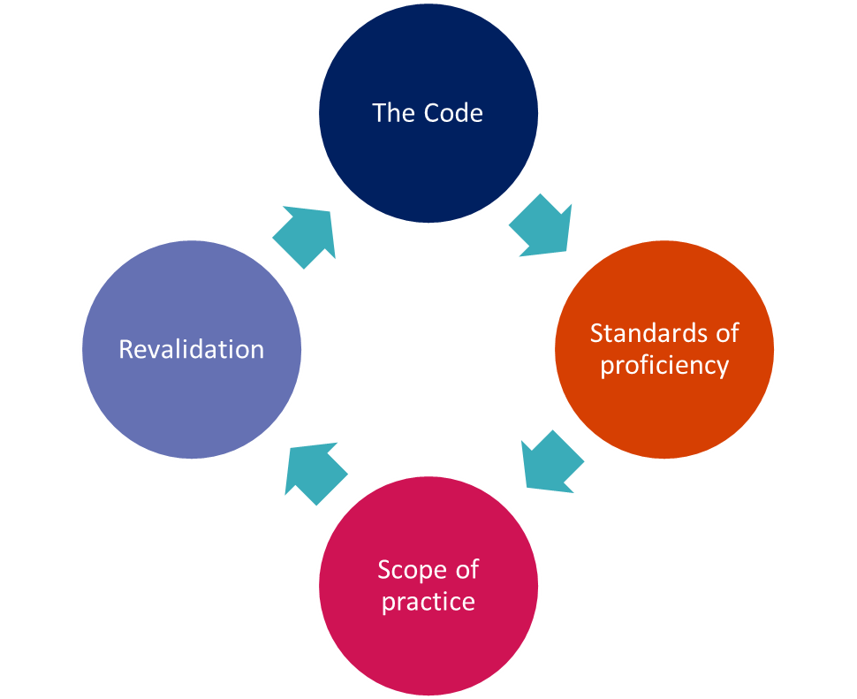
Regulation of Nursing Associates
Better, safer care
14

Slide 5
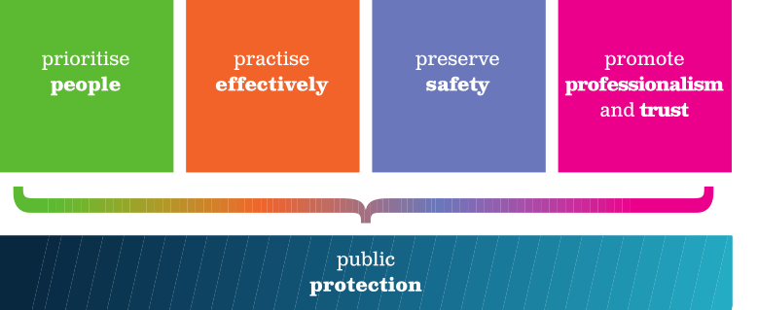
Four themes brought together in one Code
Together they signify good nursing, midwifery and nursing associate practice
Notes:
Think about what this means in terms of your scope of practice – how does the code mean to you in your day to day work life?

Slide 6
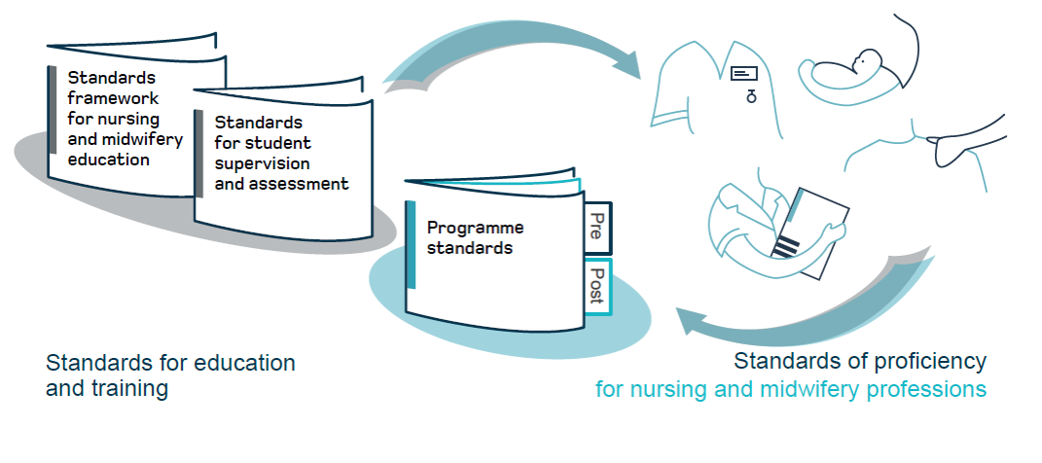
Our standards

Slide 7
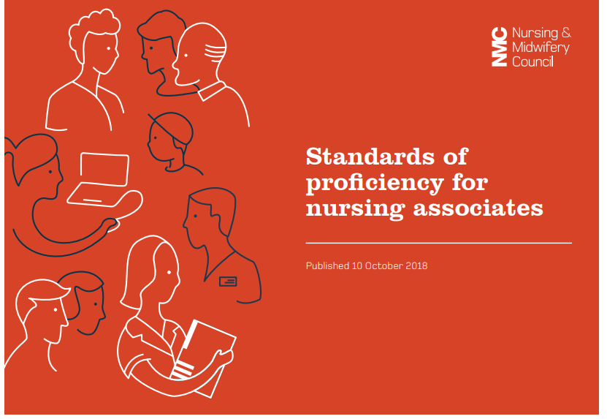
We developed the standards of proficiency for nursing associates to apply across all health and care settings to:
Help nursing associates by providing clarity about their role.
Providing clarity on what knowledge and skills other health and care professionals can reasonably expect from nursing associates.
Allow education institutions to develop and deliver programmes that give students the skills, knowledge and behaviours to meet these standards when they qualify

Slide 8
The six platforms
Being an accountable professional
Promoting health and preventing ill health
Provide and monitor care
Working in teams
Improving safety and quality of care
Contributing to integrated care

Slide 9
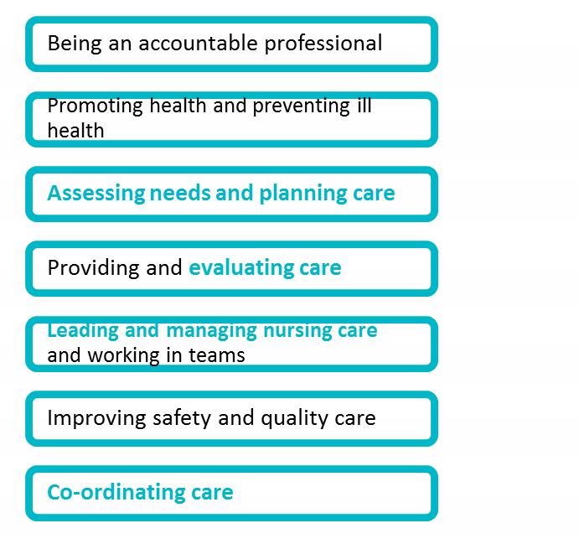
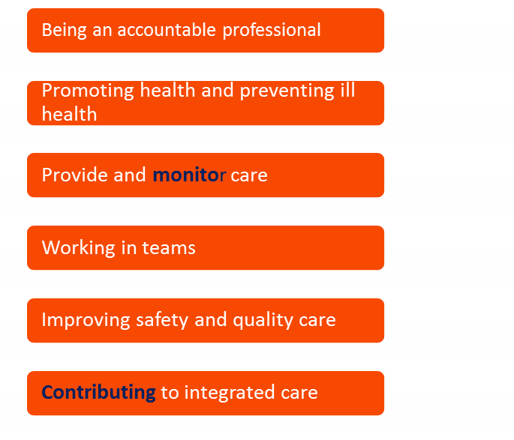
Comparison of proficiencies
Future nurse
Nursing associate
6
PLATFORMS
7
PLATFORMS
Notes:
The standards of proficiency set out what ALL nursing associates need to know and be able to do in order to join the register
Like nurses and midwives, nursing associates can develop further knowledge and skills and enhance their scope
The standards are derived from the new nursing standards, to show synergies and differences
Skills annexes are included and refer to communication and relationship skills and procedures to be achieved at the point of registration.

Slide 10
Like with nurses and other healthcare professionals, nursing associates can expand their knowledge and skills with the right training and governance. The intention is for nursing associates to support, not replace, registered nurses
Scope of practice will develop over time through further education and competence in keeping with the Code
The role of the Nursing Associate is employer led.
Expectation of employers to consider skill mix and risk assessment for nursing associates to work within the Code
Notes:
Nursing associates are members of the nursing team in England that help bridge the gap between health and care assistants and registered nurses.
Nursing associates work with people of all ages, in a variety of settings in health and social care. The role contributes to the core work of nursing, freeing up registered nurses to focus on more complex clinical care.
Like with nurses and other healthcare professionals, nursing associates can expand their knowledge and skills with the right training and governance. The intention is for nursing associates to support, not substitute, registered nurses. It's a stand-alone role that also provides a progression route into graduate level nursing.
Scope of practice will develop over time through further education and competence in keeping with the Code.

Slide 11
Practise effectively
11 Be accountable for your decisions to delegate tasks and duties to other people. To achieve this, you must:
11.1 only delegate tasks and duties that are within the other person’s scope of competence, making sure that they fully understand your instructions
11.2 make sure that everyone you delegate tasks to is adequately supervised and supported so they can provide safe and compassionate care
11.3 confirm that the outcome of any task you have delegated to someone else meets the required standard
Preserve safety
13 Recognise and work within the limits of your competence. To achieve this, you must, as appropriate:
13.5 complete the necessary training before carrying out a new role

Slide 12
Thank you
wendy.fowler@nmc-uk.org
educationandstandards@nmc-uk.org

