Slide 1
Implementation - The Journey Julie Mulinga May 2022

Slide 2
Our Story
Partnership working
Developments across health and social care sector
Support through COVID pandemic and ongoing – what have we learnt?

Slide 3
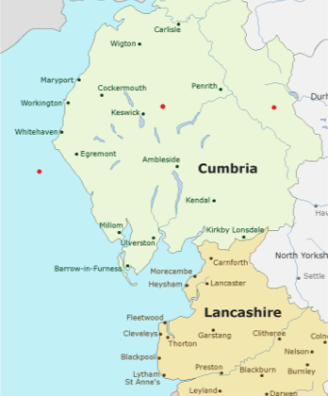
Context
Nursing history
Validation/NMC approval -1st cohort
Pandemic
Geographical location
Widening access - academic and pastoral support
Notes:
Subsequently have had subsequent 5 x cohorts
1st qualified and on NMC register Feb and April 2022
Straddle Cumbria and Lancashire sitting with HEE Northwest and Northeast. Many in areas of deprivation where lower % population go from school into HE. Very reliant on growing own. Widening access. Passionate about supporting addressing inequalities and enabling to have access .everyone to develop and fulfil their potential
Long history of delivering 4 fields of nursing with staffing in all 4 areas

Slide 4
Partnership Working
Notes:
Widest sense of word - internally to ensure university processes and procedures fit with the requirements of apprenticeships
Externally with local stakeholders – wider health and social care provision - hospices. Nursing homes, GPs as well as local NHS Trusts. Small cohorts but form a range of clinical backgrounds means apprentices come with a breadth of experience in a range of settings adding to a rich learning experience for all.
Employer needs/requirements of the role
Placements - reciprocal arrangements where possible, invites to study days for all nursing students within a health economy.
Flexibility in built into our programme with placements and academic blocks, bespoke to needs of employers - crucial during lockdowns

Slide 5
Communication
Notes:
Promotion of role- myth busting, Communication with all stakeholders key - apprentices, employers – strategic and operational level, practice assessors, PEFs, apprentice/nursing leads; academic and wider support teams within university, HEE, NMC, other HEIs/employers - sharing experiences

Slide 6
Notes:
Academic – SPLD, general academic writing
Placement/practice
Pastoral - health and wellbeing, safeguarding
Through pandemic and continuing

Slide 7
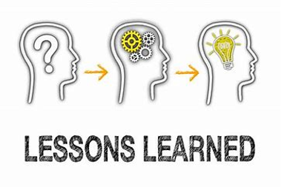
What have we learnt?
Notes:
Communication and partnership working is key - internally and externally
Flexibility - changing health and social care landscape

Slide 8
This Photo by Unknown Author is licensed under CC BY-SA

Slide 9
