Slide 1
The Parliamentary and Health Service Ombudsman
The new NHS Complaint Standards
Jo Power – Liaison Officer 08 June 2022

Slide 2
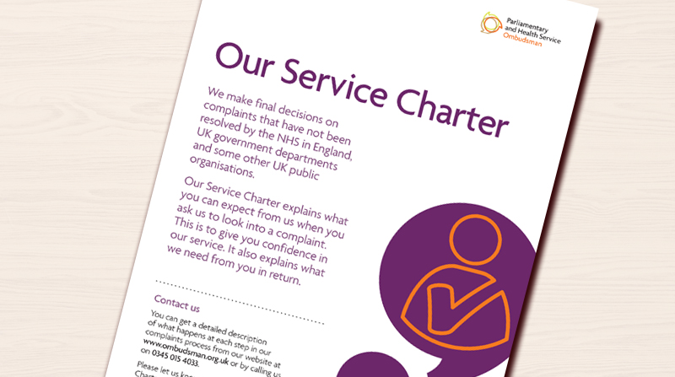
Overview
              The Ombudsman – a reminder
              Supporting and improving frontline complaint handling
              The new NHS Complaint Standards, model procedure and guidance
              Implementing the Standards

Slide 3



Our role
Parliamentary Commissioner Act 1967
Health Service Commissioners Act 1993
18%
82%
Complaints about UK government departments and public organisations
Complaints about the NHS in England

Slide 4

NHS complaints second and final stage - Ombudsman
Under Regulation 14(2)(c) and Regulation 14(2)(d), the local response must tell the complainant of their right to take the complaint to the Ombudsman
The Local Authority Social Services and National Health Service Complaints (England) Regulations 2009

Slide 5

The numbers – 2020-21
79,249 enquiries received
18,689 enquiries resolved through advice or re- direction
24,842 complaints seen by caseworkers
17,103 complaints were not ready for us
23,124 decisions were made, including:
  18,689 decided after initial checks
  14 cases resolved through mediation
  3,864 decided after primary investigation
  557 decided after detailed investigation

Slide 6
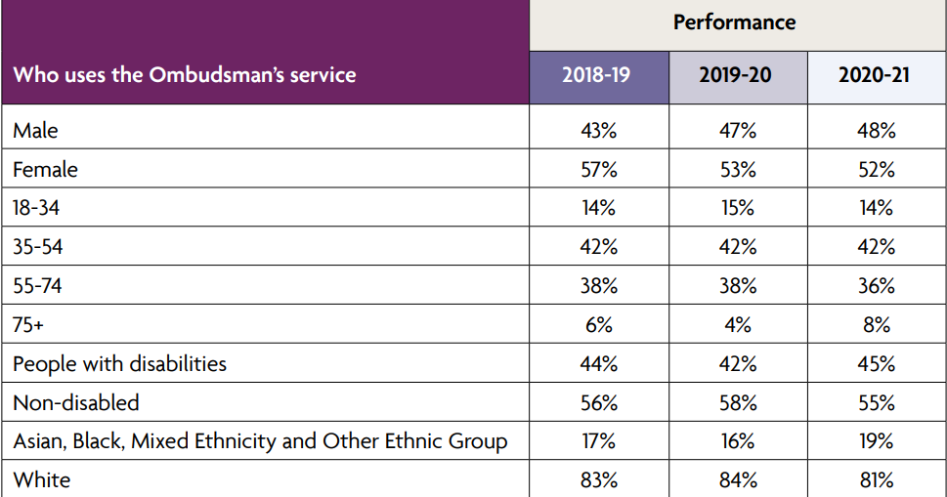
Our customers

Slide 7
Recommendations in 2020-21
We recommended 267 apologies | We made 226 service improvement recommendations
We recommended 82 other actions to put things right | We made 170 recommendations for financial remedy

Slide 8

Our casework process
Investigation
Our approach
We look to see if what happened was in keeping with relevant regulations, standards, policies and published guidance.
Our decision
If it wasn’t, we look to see how significant the shortfall is and what impact it has had and, if it has caused hardship or injustice, has that already been remedied by the organisation.

Slide 9

The NHS
Complaint Standards

Slide 10

The background
Working in partnership to strengthen and support frontline complaint handling.
Developing new Complaint Standards for the NHS in England
Developing supporting guidance, training and professional accreditation for complaint handlers

Slide 11

Research found three core issues:
No consistency
No core training/support
Complaints not valued

Slide 12

Good practice but no consistency
We need a single vision of what good complaints handling looks like

Slide 13

We need centralised, standardised training

Slide 14

We want to be supported and recognised for the professionals we are

Slide 15

Do not reinvent the wheel
Based on existing guidance and good practice and draw this together into a single vision for all
Ensure you meet the requirements of the NHS Complaint Regulations

Slide 16
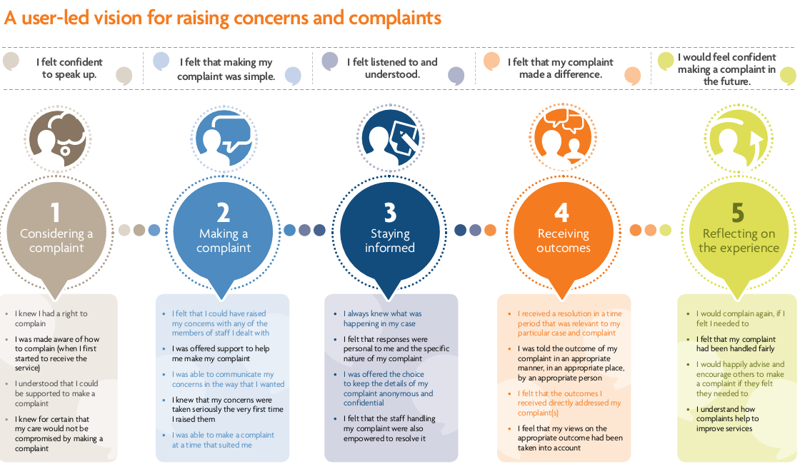
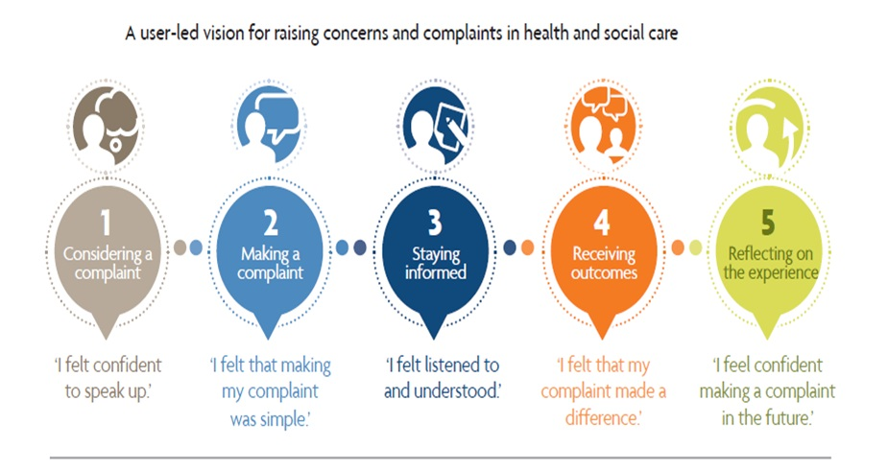
My Expectations

Slide 17
The Complaint Standards:
Set out a single set of expectations for NHS staff to follow when they handle a complaint
Support staff to deliver what people expect when they raise a complaint
Describe how NHS organisations can be ‘just and learning’ cultures by:
- taking responsibility when things go wrong
- celebrating positive feedback

Slide 18

The Complaint Standards

Slide 19


The launch – 30 March 2021

Slide 20

Pilot and Early Adopter phase
…. leading the way

Slide 21


Early Adopters - it’s not too late!!!
Liaisonmanagers@ombudsman.org.uk

Slide 22

What’s in it for you?
Early adopters are trailblazers, leading the way
You will be able to make sure that final versions really work in practice and make things better for you and your service users
Help us develop something that will truly help and support colleagues right across the NHS

Slide 23
Community of practice
Share experiences with other early adopter organisations
To join, email Liaisonmanagers@ombudsman.org.uk

Slide 24

www.ombudsman.org.uk/complaint-standards

Slide 25
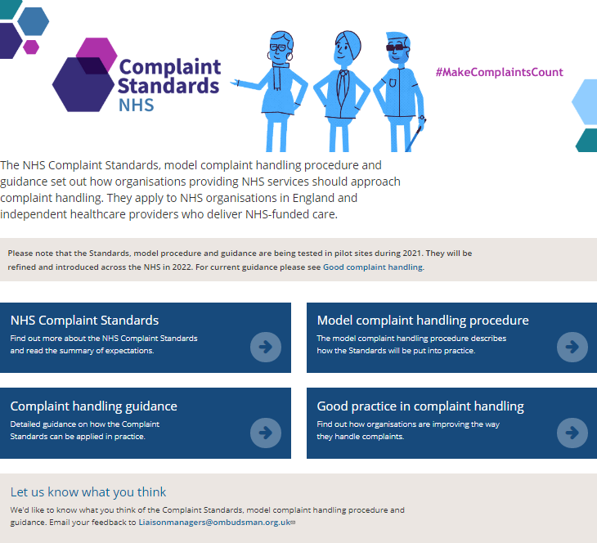
The Complaint Procedure and the Guidance is available on our website
www.ombudsman.org.uk/complaint-standards

Slide 26

Three Steps
How to work with your team and resolve complaints early where you can
If needed, how to carry out a full and fair investigation
If something has gone wrong, how to put things right and ensure learning is captured, embedded and services improve

Slide 27
There is a focus on early resolution of complaints and supporting people to do this

Slide 28
Quality responses and realistic timescales are important to build trust.
Keeping people updated and involved throughout may make the initial process longer but will reduce ‘comebacks’.

Slide 29

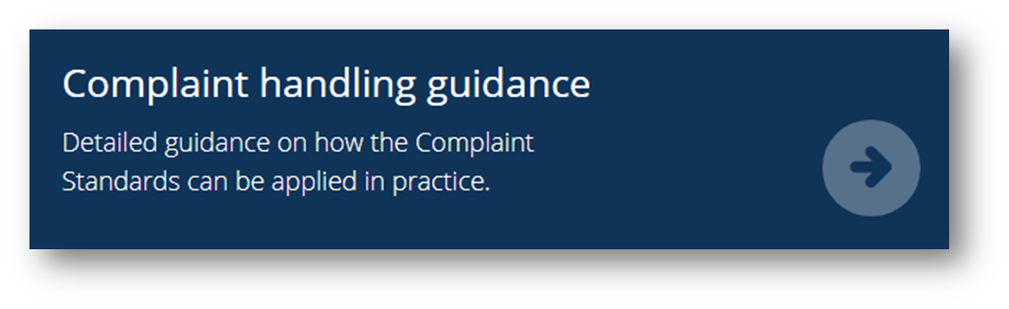
Make sure you share your feedback and suggestions on the model Complaint Handling Procedure and Guidance Modules
liaisonmanagers@ombudsman.org.uk

Slide 30
Next Steps
Refine & tailor materials
NHS Standards
Finalise end 2022
Consult & design
Engage, Refine, Tailor
UKCG Standards
Launch Sep 22
Finalise end 2022
Design, engage & begin using
Embed in casework
From Q1 23-24
Engage, training
Advanced training
Continue to embed
Jan 2023
23-24
24-25
Report on Progress

Slide 31
2023 – Launch to the wider NHS
PHSO will start to use the Complaint Standards to assess complaint handling at NHS organisations from spring 2023
PHSO worked with regulators from across the health sector when we developed the Complaint Standards and they will also use them in their complaint handling assessments.

Slide 32




Thank you
Website
www.ombudsman.org.uk
@PHSOmbudsman
Helpline
0345 015 4033
8.30 - 5.00 Monday to Thursday
8:30 –12:00 Friday
Parliamentary and Health Service Ombudsman
Email
liaisonmanagers@ombudsman.org.uk
Radio Ombudsman Podcast

