Slide 1



Complaints Resolution & Learning from Claims
Lorraine Cardill
Acting Deputy Director of Safety and Learning
NHS Complaints Summit
8th June 2022
@NHSresolution

Slide 2
By the end of session
What does resolution mean to a complainant?
The work of NHS resolution
Learning from complaints that turn into claims

Slide 3
The genesis NHS Resolution
Formerly called the NHS Litigation Authority (NHS LA) –joined by the National Clinical Assessment Service and the Family Health Services Appeal Unit, functions brought together by successive arm’s length body reviews
Established in 1995 to bring expertise and economies of scale to the management of compensation claims against the NHS in England and to pool the risk of such claims
Changed our name in 2017 to better reflect all core functions under a shared purpose and our five-year strategy.

Slide 4
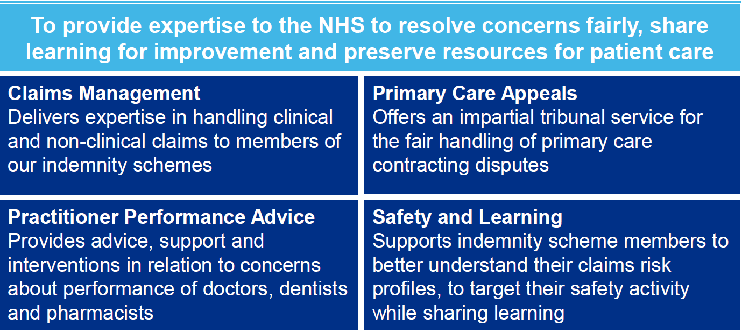
Our Vision

Slide 5
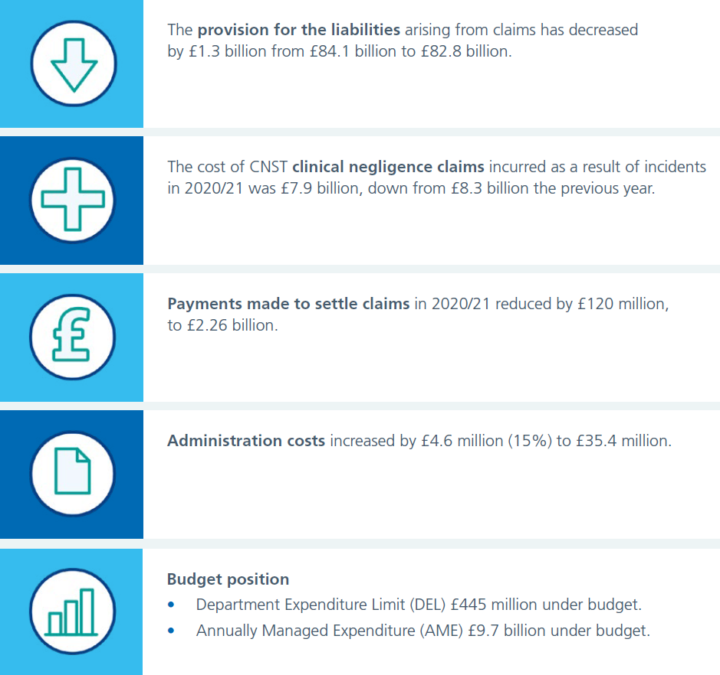
Financial headlines

Slide 6
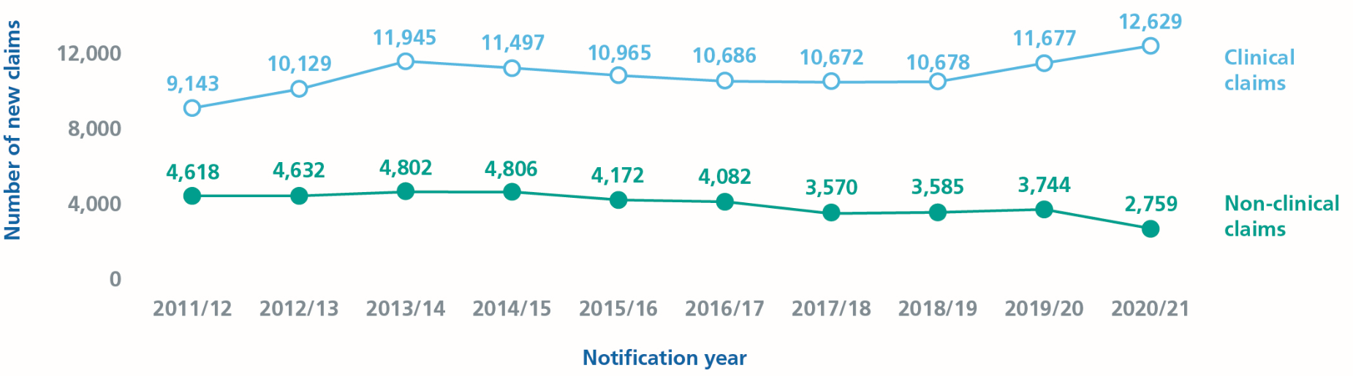
New claims in 2020/21

Slide 7
New claims in 2020/21
The following contribute to the increase of 951 clinical claims and incidents received to 12,629 in 2020/21:
840 relate to historical liabilities covered by our ELSGP.
572 claims and incidents were reported to CNSGP.
139 claims were from the Early Notification Scheme
7 were CNSC incidents.

Slide 8
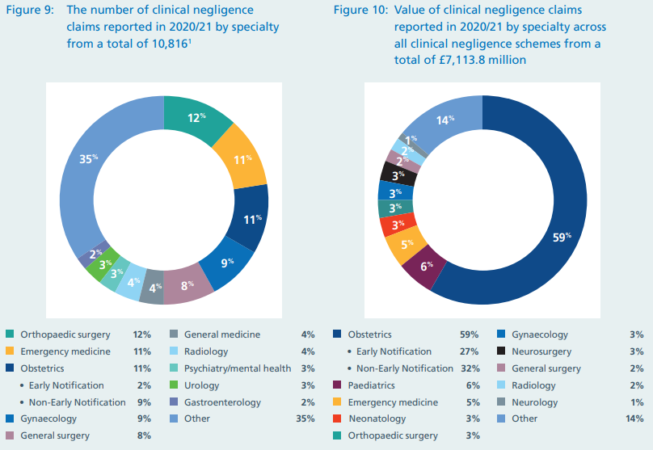
The number of clinical negligence claims reported in 2020/21 by specialty from a total of 10,816

Slide 9
Value of clinical negligence claims reported in 2020/21 by specialty across all clinical negligence schemes

Slide 10
Why learn from claims?
Harm
Financial cost
Human Cost
Clinical Governance
Reduce harm & claims

Slide 11

Why we need to learn from harm
“To err is human, to cover up is unforgivable, and to fail to learn is inexcusable”
Sir Liam Donaldson
“It requires insight into personal and organisational deficiencies and the welcoming of constructive criticism. Above all, it requires a determination to put right what has gone wrong, not only for any who have suffered as a result, but to protect future patients from a repetition of wrong-doing. It requires a willingness to learn and be challenged.”
Francis (2013) Vol 3, p1488

Slide 12
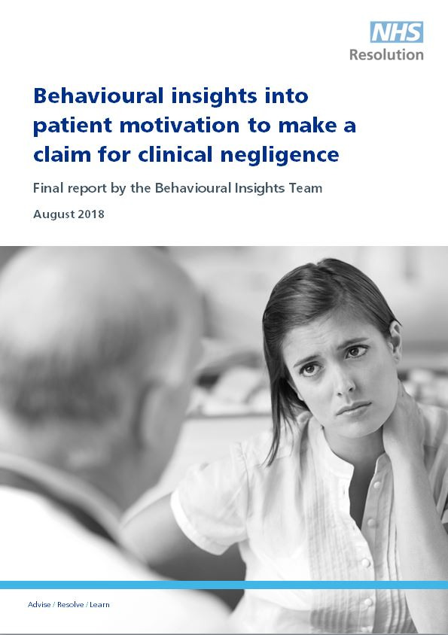
How far upstream?
Why do people claim?
NHS Resolution’s research into behavioural insights August 2018
10,000 former claimants approached. 728 responded and in depth interviews undertaken with a sample
Key conclusions:
NHS staff reactions generally considered inadequate
Majority not satisfied with the NHS complaints handling process
Suggestion from NHS staff major motivation to claim

Slide 13
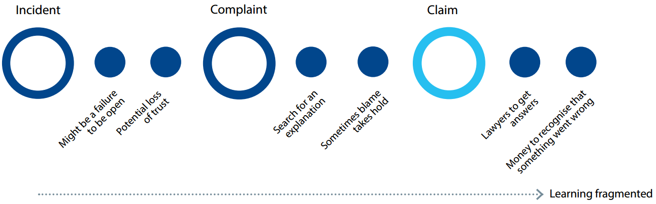
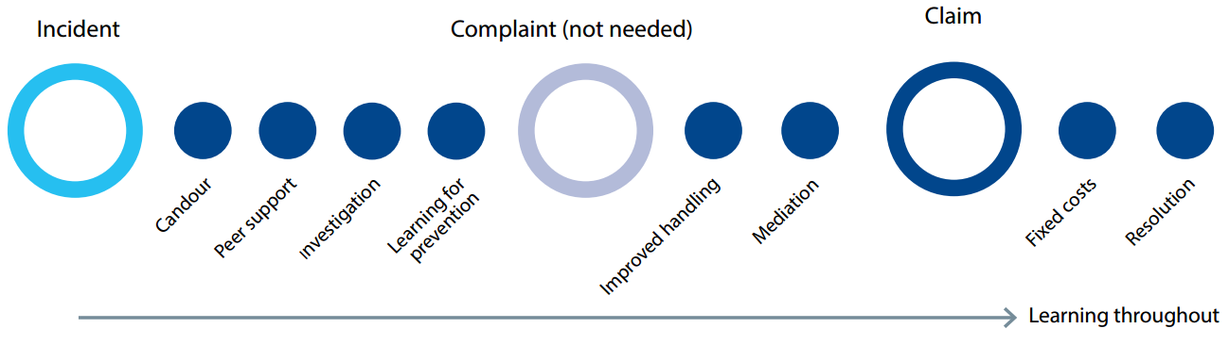
Our role – moving upstream
Current (worst case scenario)
Future (best case scenario)

Slide 14
Supporting patients and their family following an incident
After an incident the following actions are not only statutory, regulatory and professional requirements, but also the right and fair way to support staff, patients and their families
  Making a meaningful apology as soon possible
  Communicating openly and clearly with patients and their families
  Keeping patients, families and staff informed throughout an incident and investigation

Slide 15

Saying sorry
Saying sorry meaningfully when things go wrong is vital for everyone involved in an incident, including the patient, their family, carers, and the staff that care for them.
Saying sorry is:
  always the right thing to do
  not an admission of liability
  acknowledges something could have gone better
  the first step to learning from what happened and preventing it recurring

Slide 16
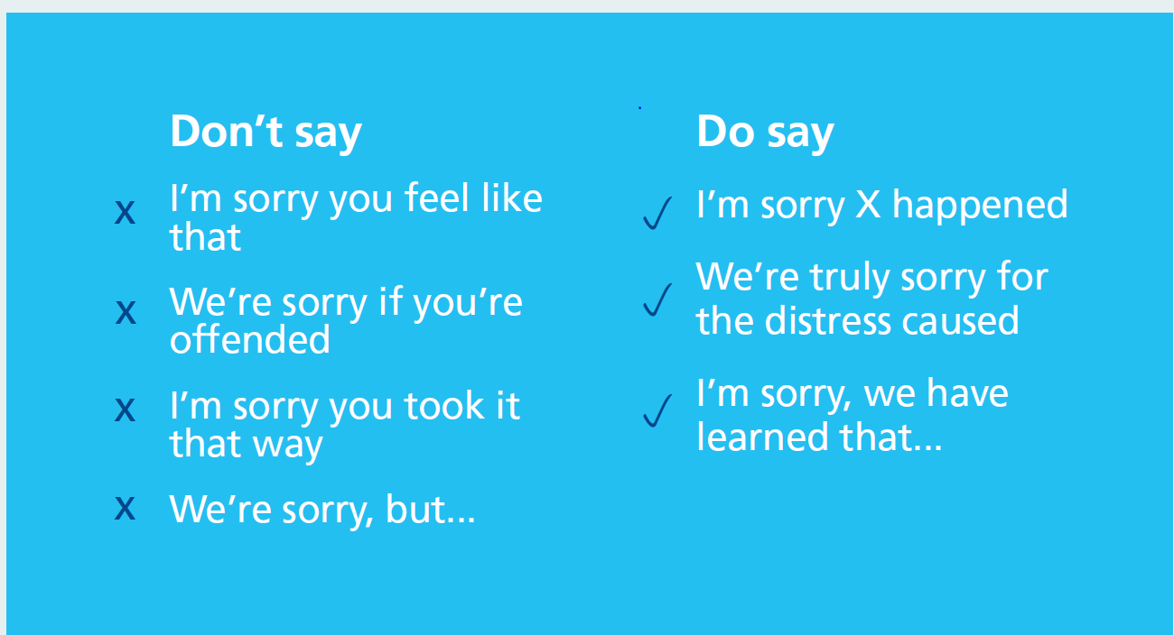
Saying Sorry

Slide 17

Example of Saying Sorry
You may also need to say sorry in writing where significant harm has been caused or in response to a written complaint. An example of this could be:
“I wish to assure you that I am deeply sorry for the poor care you have been given and that we are all truly committed to learning from what happened. I apologise unreservedly for the distress this has caused you and your family”

Slide 18

Saying Sorry

Slide 19
What do people expect?
What do patients and families want?
  An apology
  To prevent it happening to someone else
  To understand what went wrong
  To have answers and be heard
  Compassion, understanding and support
  Signposting to support where appropriate
What do staff want?
  Help to say sorry
  To prevent it happening to someone else
  To understand what went wrong
  To have answers and be heard
  Compassion, understanding and support
  Signposting to support where appropriate

Slide 20

Being fair: supporting a just and learning culture for staff and patients following incidents in the NHS
A just and learning culture is the balance of fairness, justice, learning – and taking responsibility for actions. It is not about seeking to blame the individuals involved when care in the NHS goes wrong. It is also not about an absence of responsibility and accountability.
All actions should be understood
Staff should be supported to learn from their actions
Chaffer, D., Kline, R. and Woodward, S.

Slide 21
Three aims of Being Fair
To help the NHS prioritise learning about how to minimise the conditions and behaviours that can underpin or lead to things not going as planned rather than apportion individual blame
Help the NHS build a consistent approach for all staff, no matter what profession or background
Help the NHS to avoid, wherever possible, suspension, exclusion and disciplinary action unless there is wilful intent

Slide 22


Conclusions
A just and learning culture is for all: staff, patients and organisations. It is not only about safety; it is about how we treat each other, every day
When things do not go as planned, patients’ physical and mental health, and wellbeing will always be of paramount concern to healthcare staff
At the heart of this are the rights of patients and their families to an apology, an explanation and to be involved in any subsequent reviews or investigations
They also have the right to seek assurances and / or financial compensation where appropriate
Full report and leaflet available online

Slide 23

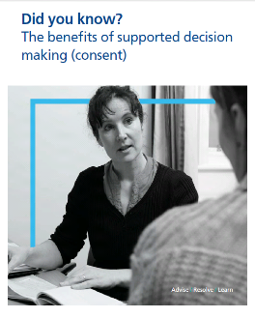
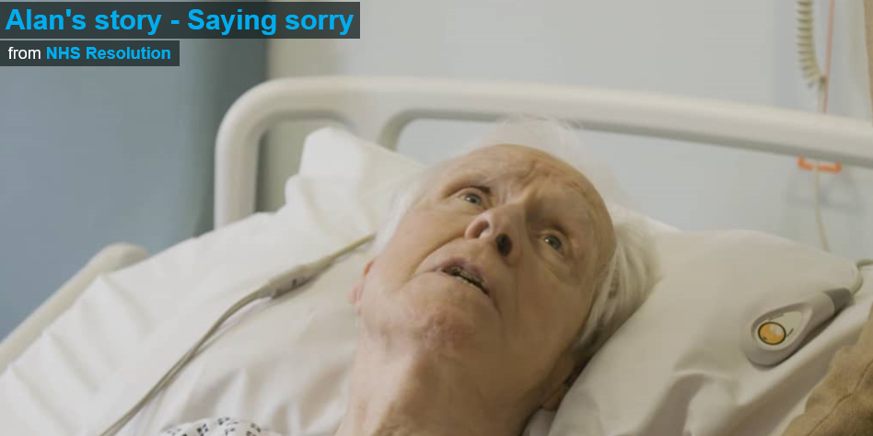
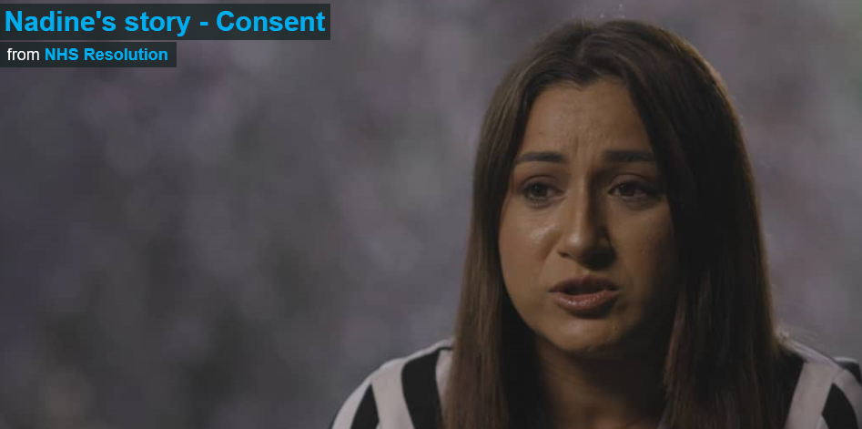
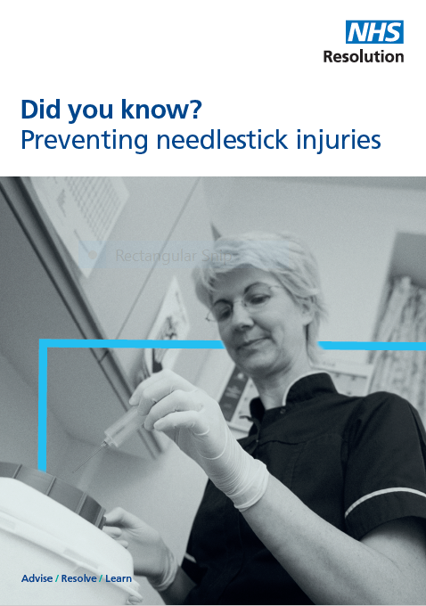

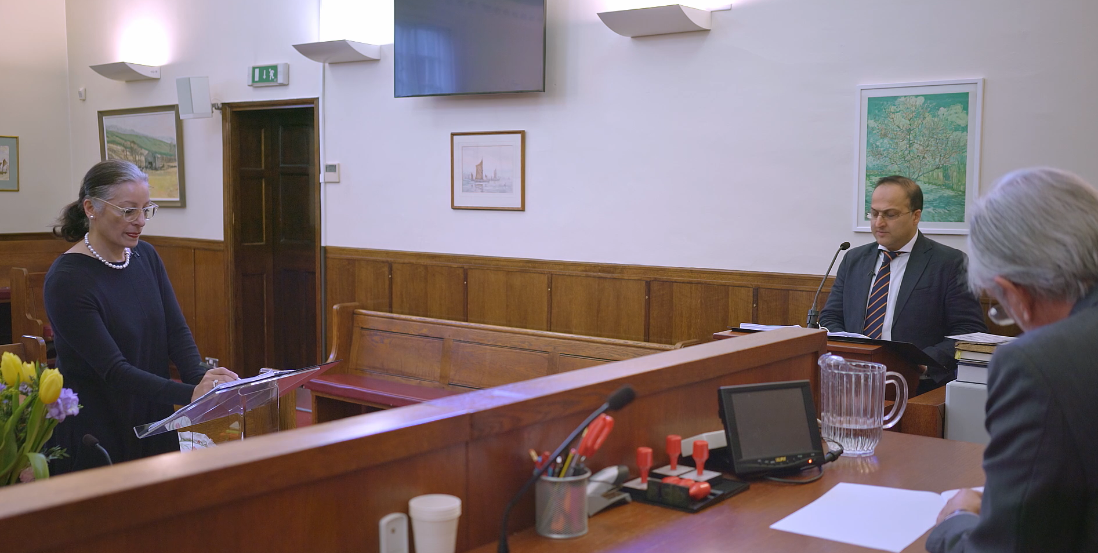



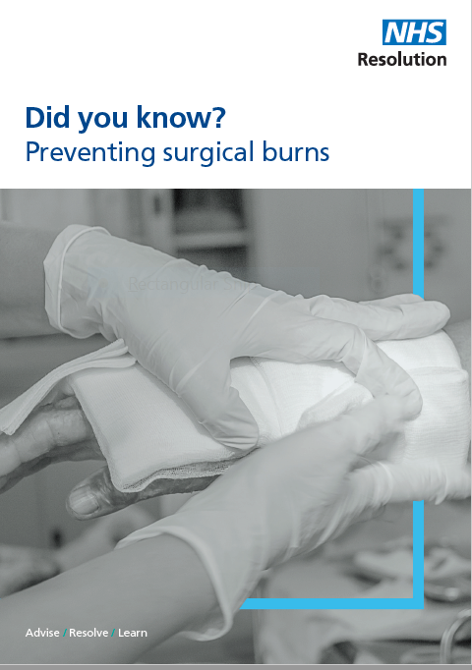

Resources
https://resolution.nhs.uk/resources/

Slide 24

Thank you

Slide 25
Contact NHS Resolution
NHS Resolution
8th Floor,
10 South Colonnade,
Canary Wharf,
London, E14 4PU
or
Arena Point, Merrion Way, Leeds, LS2 8PA
London 020 7811 2700
Leeds 0203 928 2000
generalenquiries@resolution.nhs.uk
Safety and Learning team:
@NHSResolution
020 7811 2700
Safety@resolution.nhs.uk
https://resolution.nhs.uk

