Slide 1
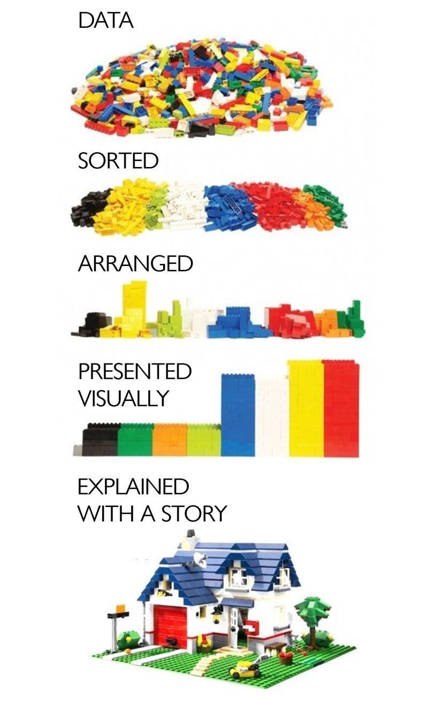
“My experience of end of life
support and care
in advanced heart failure……”
A “borrowed” illustration, but simply too good to avoid using; full credit and thanks to the originator!

Slide 2

From the cardiomyopathy Change Agenda 2021:
Advanced/advancing heart failure patients with cardiomyopathy to be carefully monitored and supported, to enable referral to a Transplant Centre for assessment and on-going care at the earliest opportunity. This support to include:
  Assistance with frailty, including support to access disabled parking badge, occupational therapist support within the home and “pre-hab exercise programmes”, where available
  Palliative care with an advanced care package to run ahead of and in parallel with route into transplant.
  Referral for end-of-life provision for those patients judged unsuitable for transplant or LVAD.

Slide 3
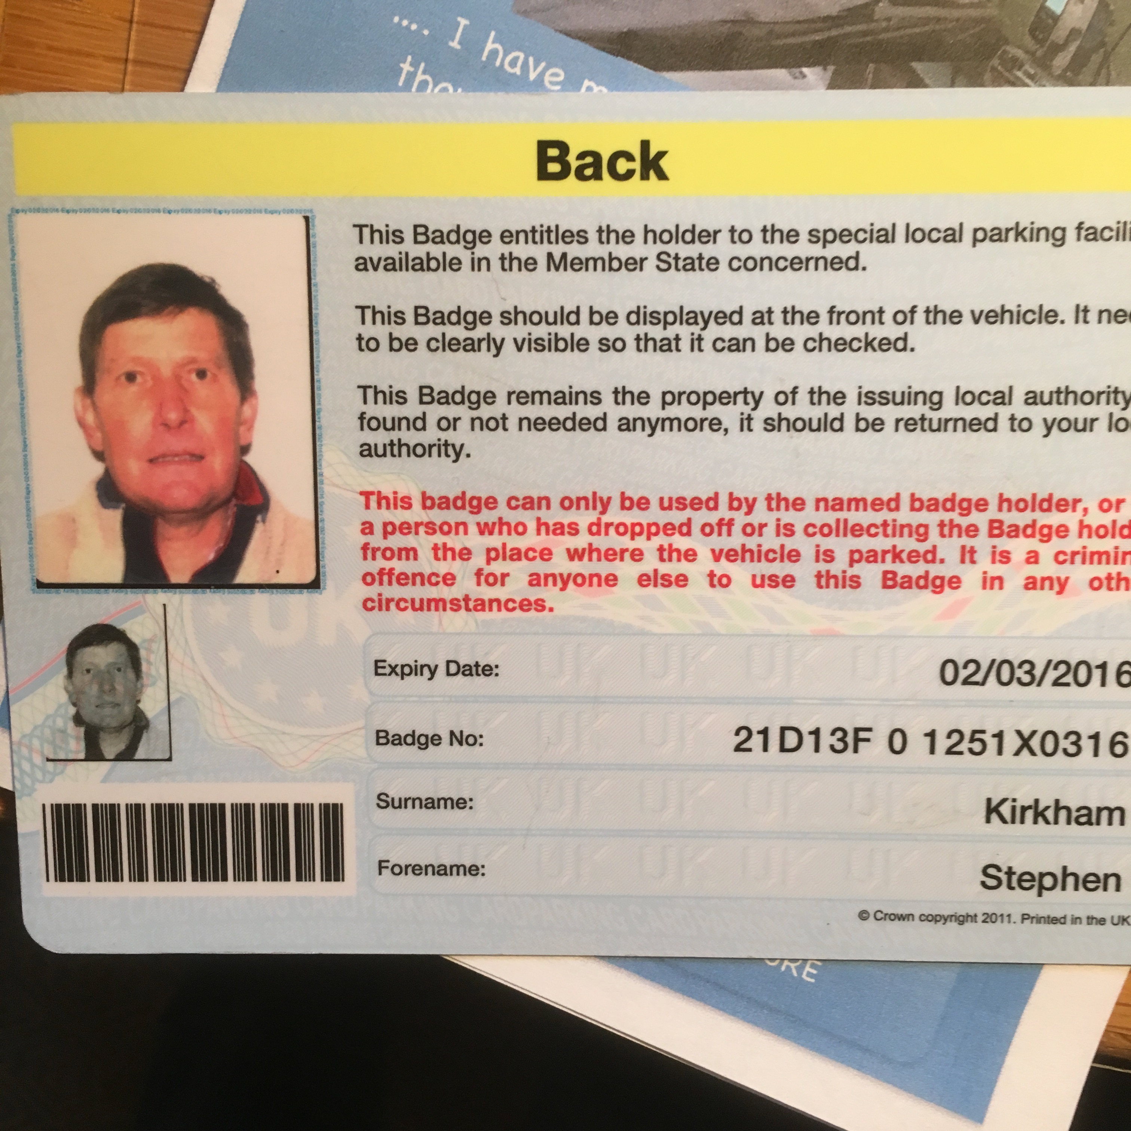
Finally obtained in early 2015

Slide 4
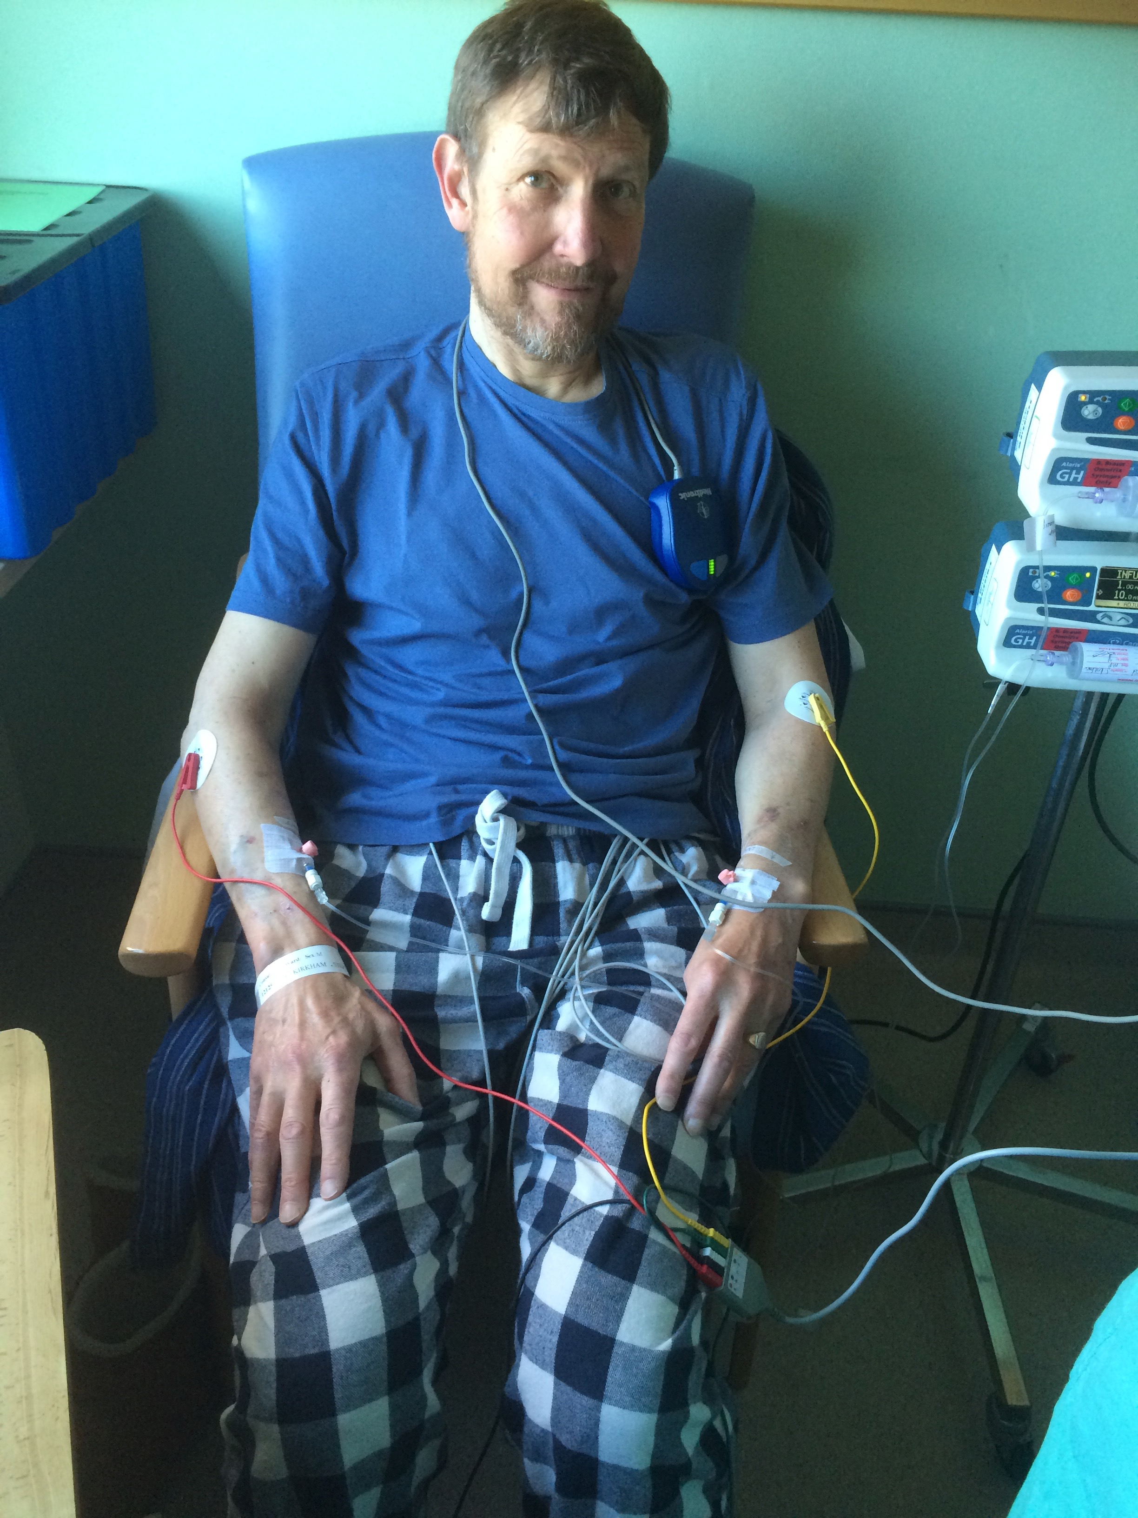


Slide 5
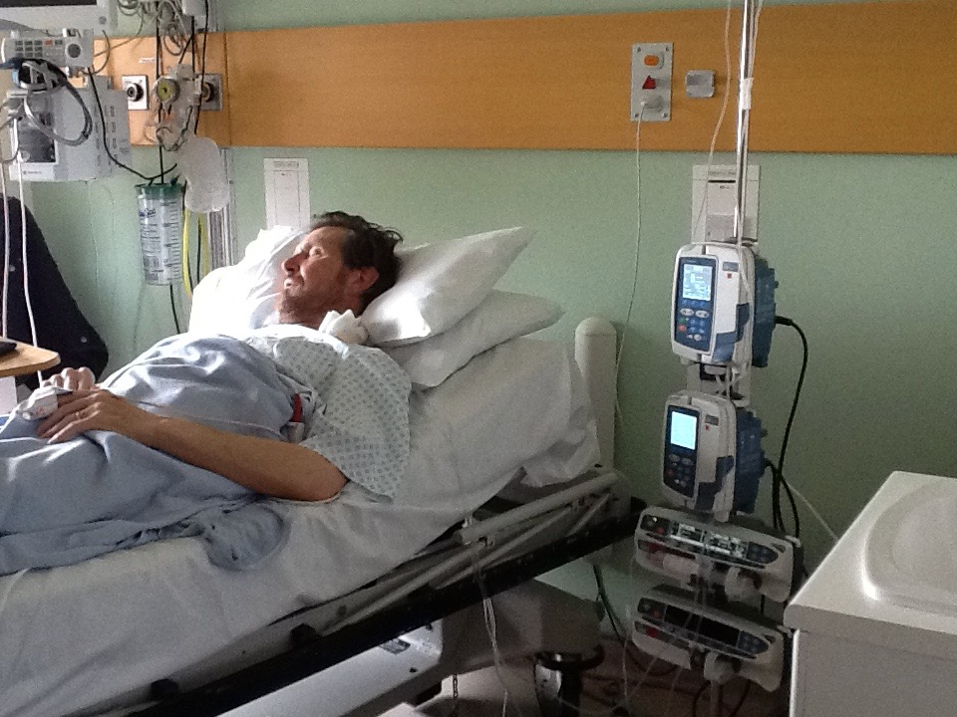
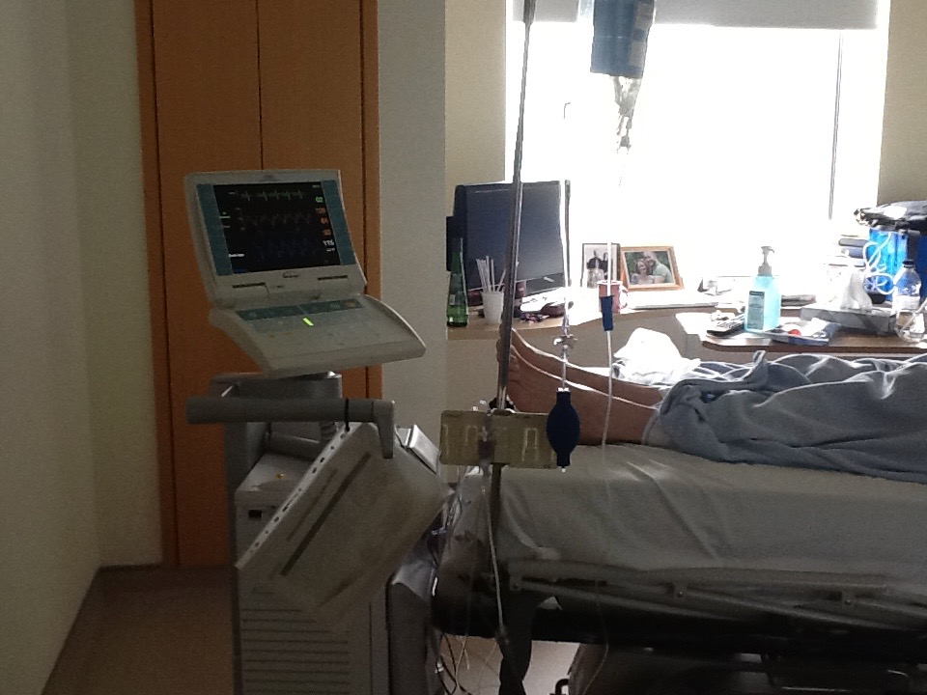
Whilst on the urgent transplant list

Slide 6
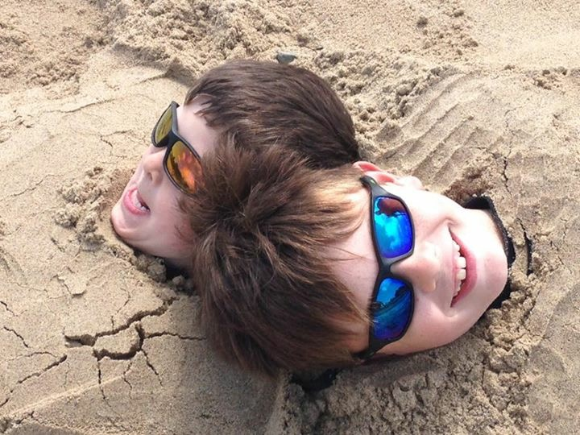
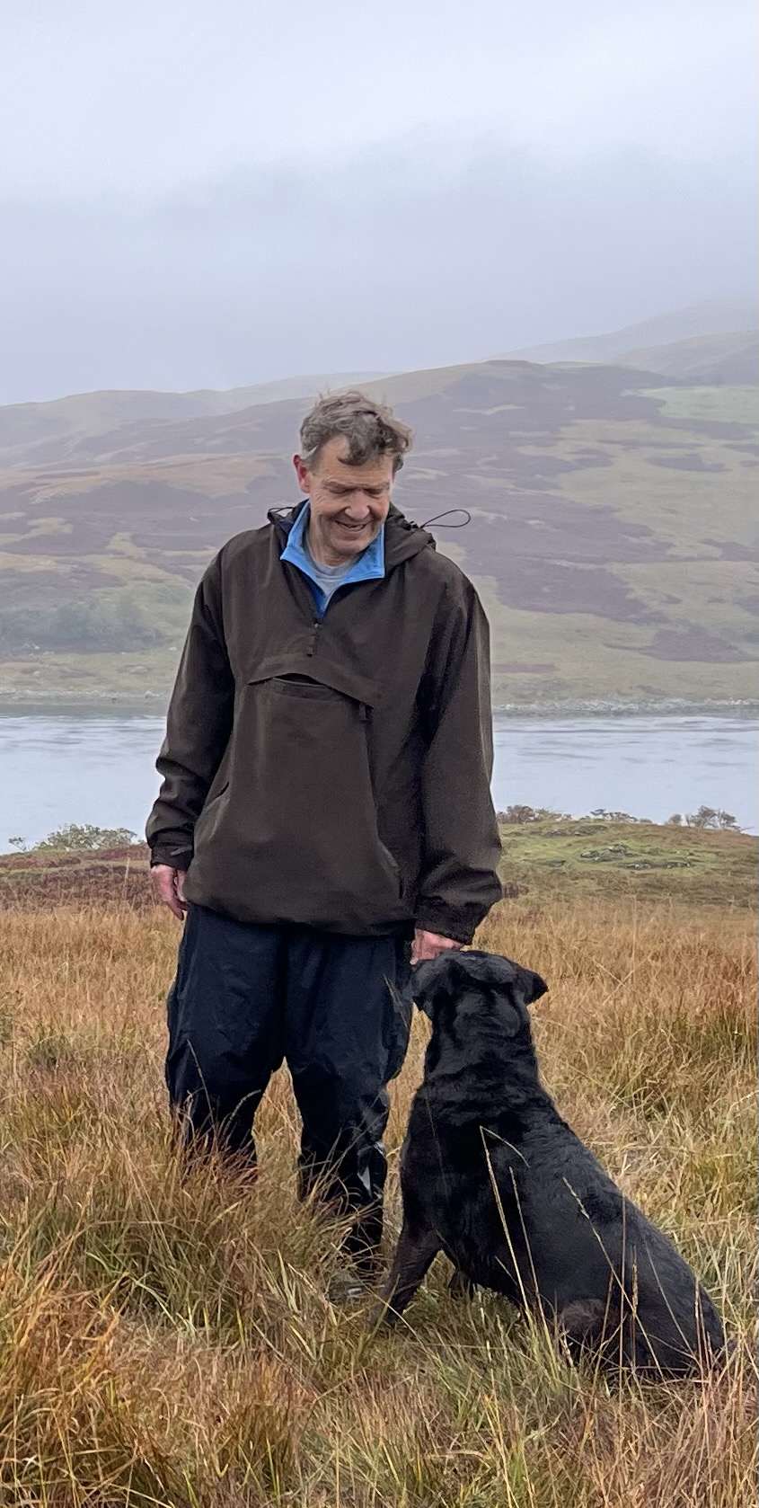
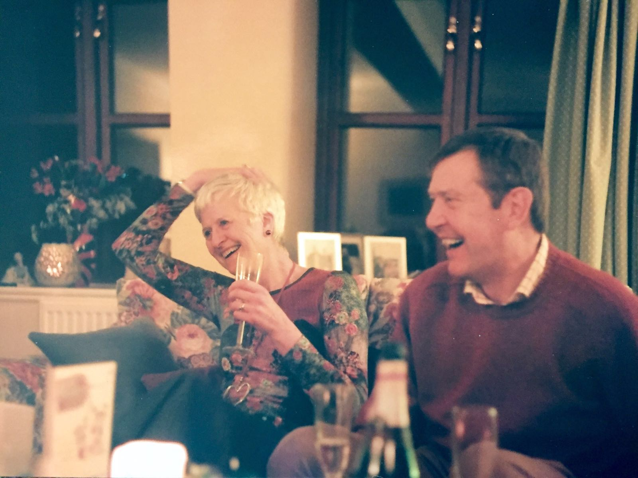
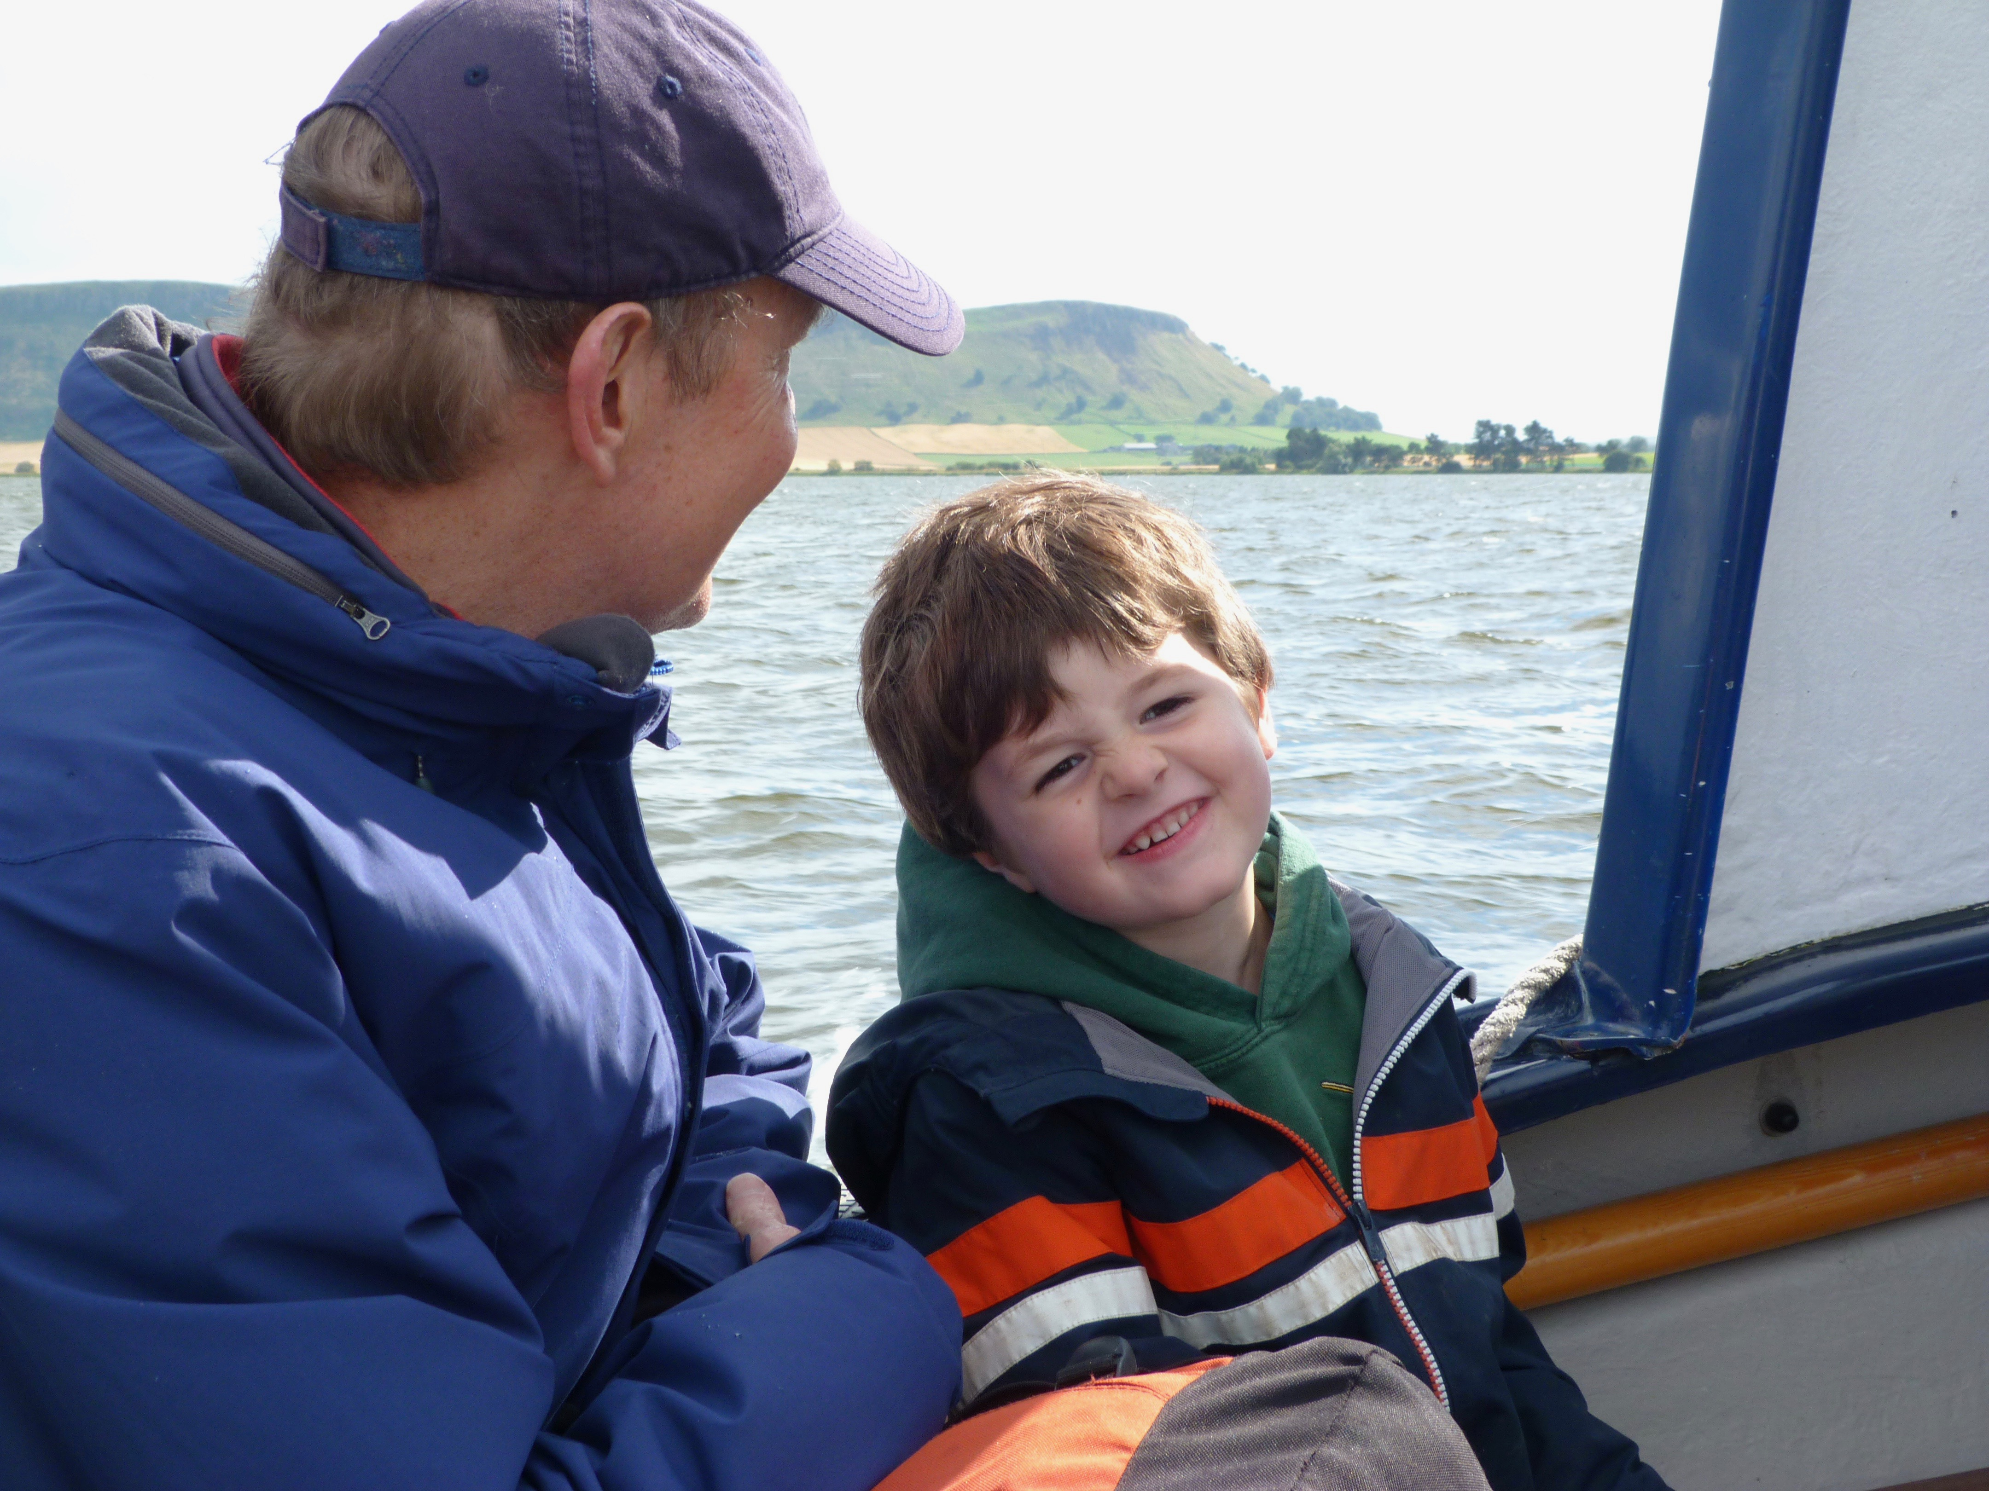
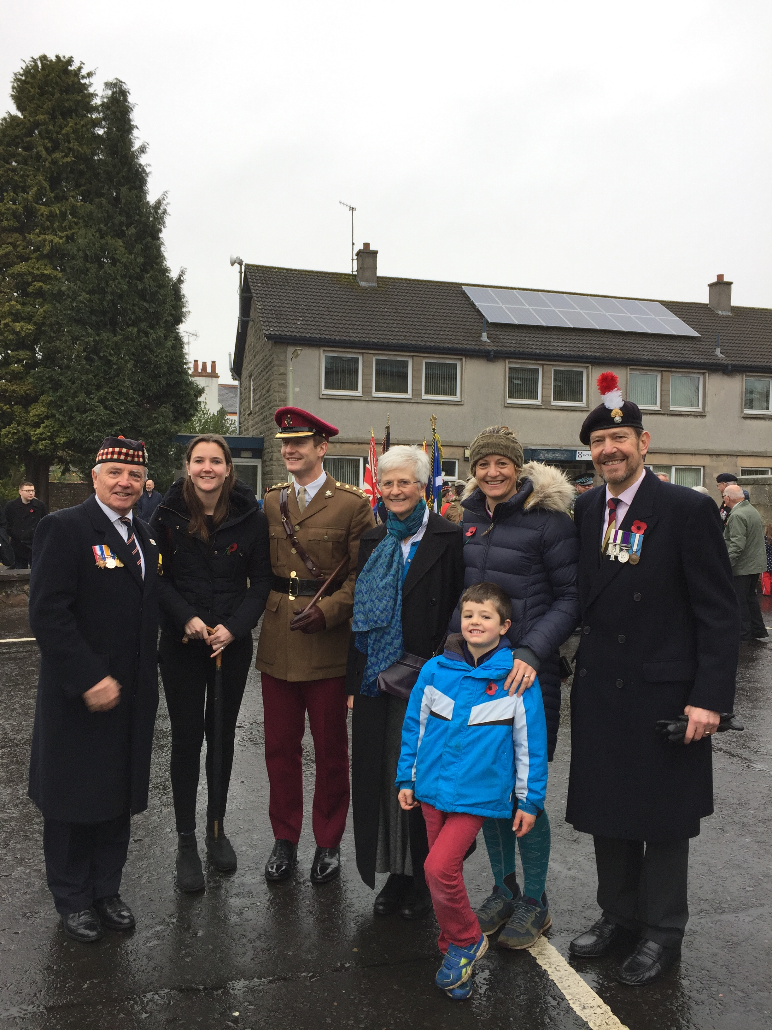
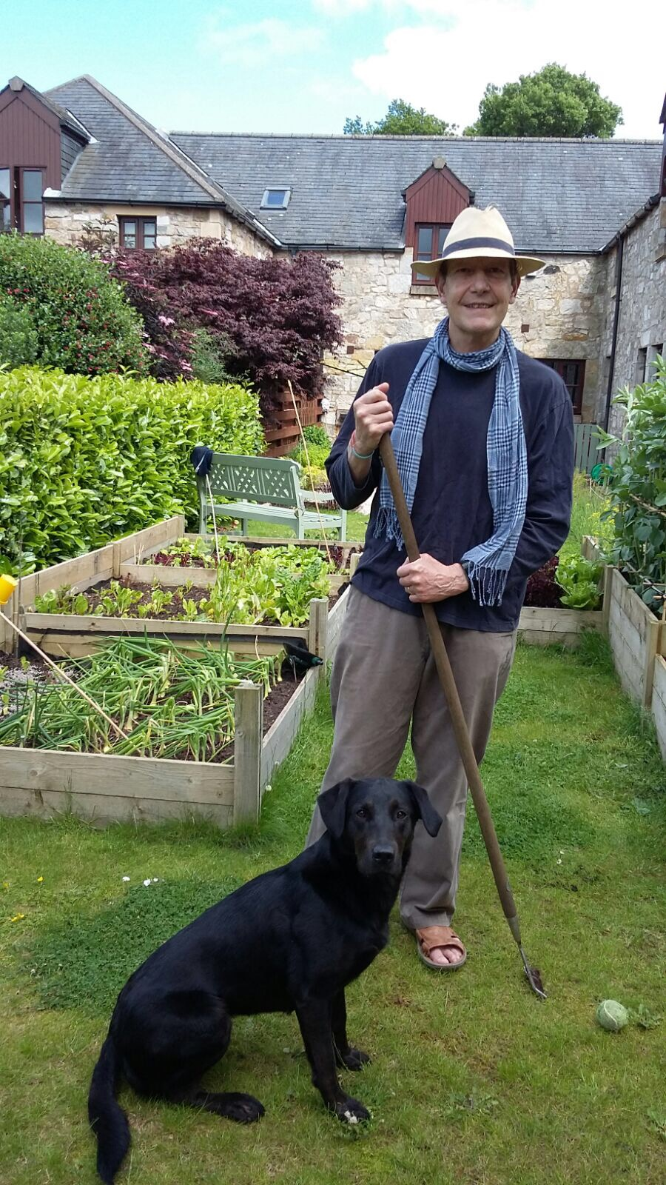
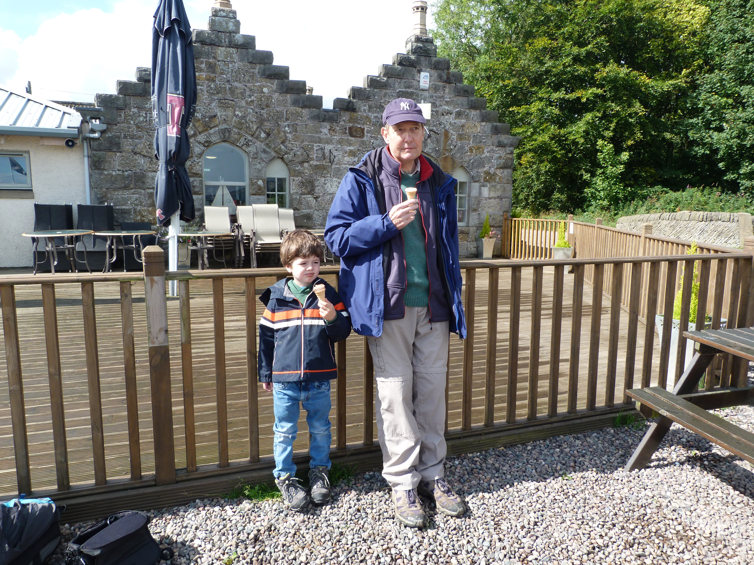


Slide 7
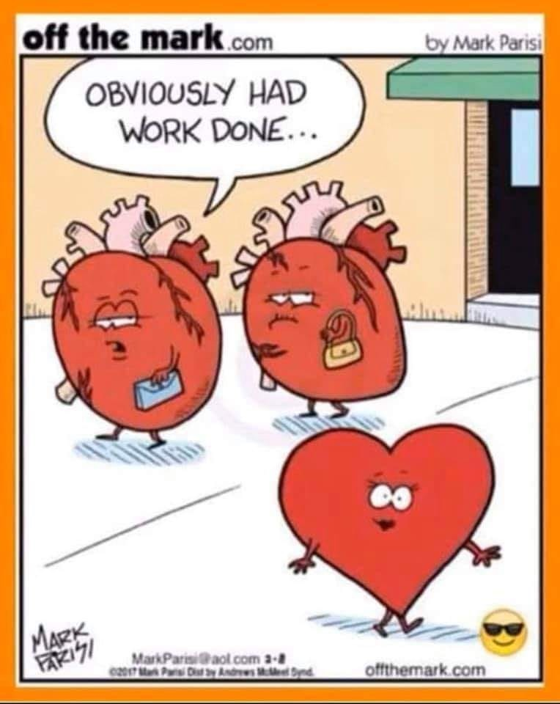

Welcome!
We’re here to offer practical and emotional support to each other; oh, and we’re very aware of the need to be real and hopeful!
Advanced Heart Failure towards Transplant Support Group.

Slide 8
“” just a lovely group….”
“Thanks to all for helping me
when the chips were down””
…..the group really helped get me through transplant….. there is always someone who knows how it feels, and can give support and advice
“Thank you CM UK”
“Thanks to the group I have made some real friends, who 'get it' in a way that not even my family or closest friends do”.
…provides support, experience, wisdom, but above all care and friendship.
” Loneliness before AHF Group, friendship after it”.
Advanced Heart Failure towards Transplant Support Group.

Slide 9
This patient’s closing reflections…
Early identification of advanced heart failure, and potential for Tx
Honesty, honesty, confirmation
Advanced Care Planning. NB statistics from NHSBT
Advice and support to get affairs in order
OT, disabled badge and Palliative Care

Slide 10
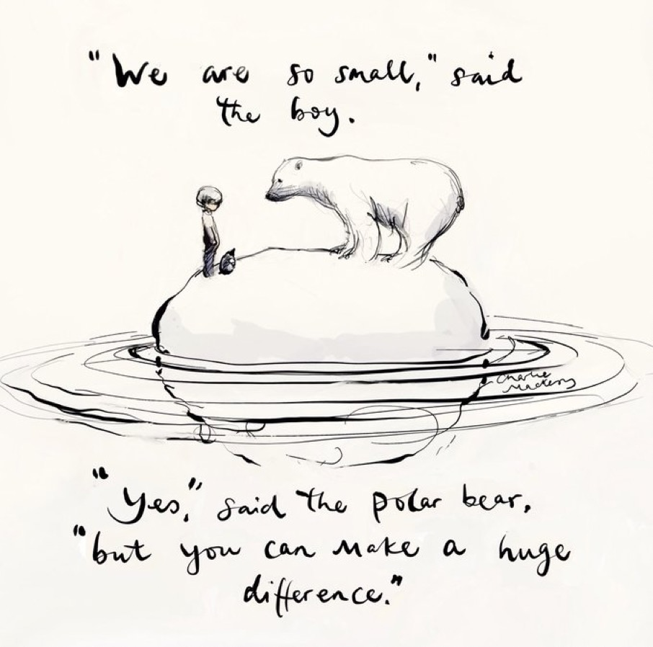
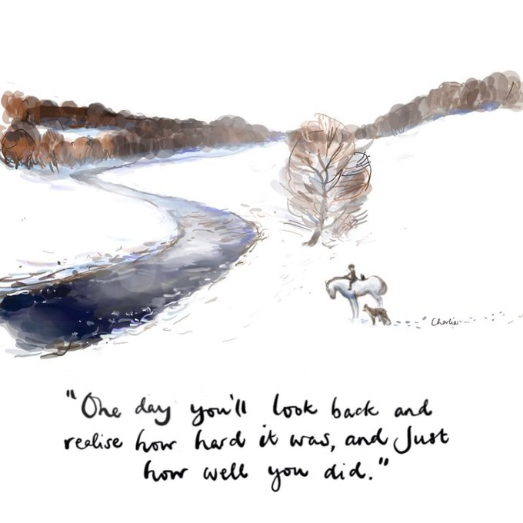
So having survived my “journey towards the end of life”…..
Credit, Charlie Mackesy
………any questions?
Credit, Charlie Mackesy

