Slide 1
Integrating Human Factors and Ergonomics into Health and Social Care
Laura Askins- Postgraduate Clinical Lecturer- HF & Civility
Dr Crisanto Espa$ñ$a- OMFS Trust Doctor
June 2022

Slide 2
Aims and objectives
Share the experiences of South Tees NHS Foundation Trust in regards to integrating Human Factors principles to improve patient safety
Discuss the application of Human Factors and civility within our trust to improve quality of care
Demonstrate the impact of Covid-19 on safety at South Tees NHS Foundation Trust
Share a case study that demonstrates the application of the PESTO model (South Tees adapted SIEPS)

Slide 3
Background

Slide 4
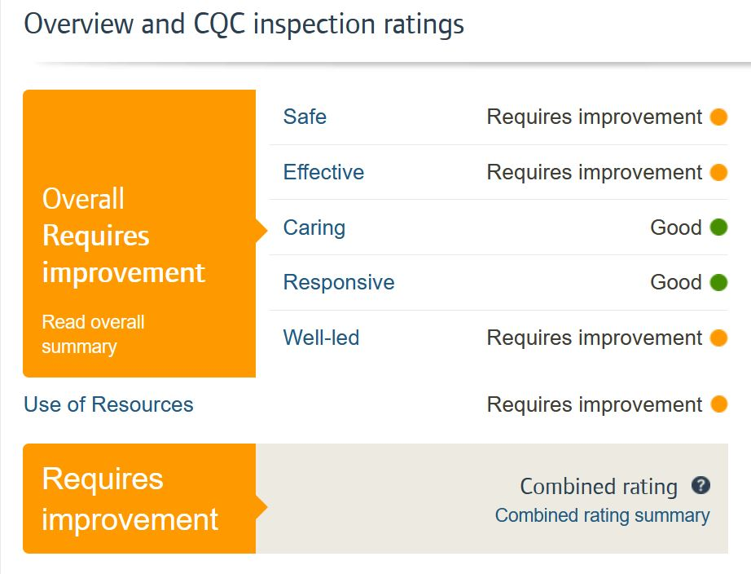
2019

Slide 5
2019
Quite simply – STRIVE made a pledge to support full Trust learning in patient safety
We did this because we believe that leadership and safety are 2 sides of a coin and if we can come together and learn from each other we will lead a safer culture of care for our patients
Compassionate leadership enables shared learning

Slide 6
LISA
Objective: Safety and Quality First
Strategy: Provide Leadership and Safety Development to support our clinical leaders of today and tomorrow to shape the safe care - and the teams delivering safe care – for the now and the future.
Tactics: To provide a range of evidence-based development opportunities to enable clinical leaders to have the core skills and leadership training to support the delivery of safe, quality care.

Slide 7
PEOPLE ARE INSPIRED & ENERGISED WHEN THINGS WORK BETTER

Slide 8
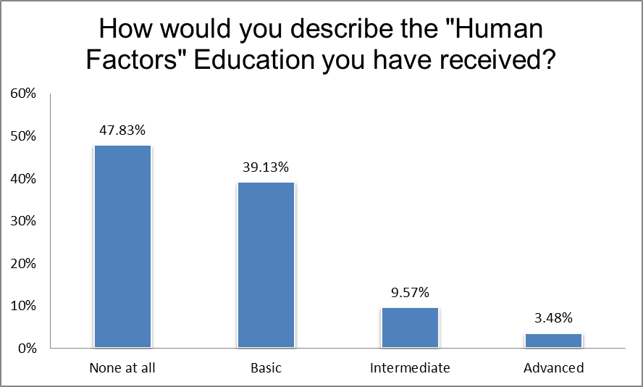
Notes:
CWEE edit

Slide 9
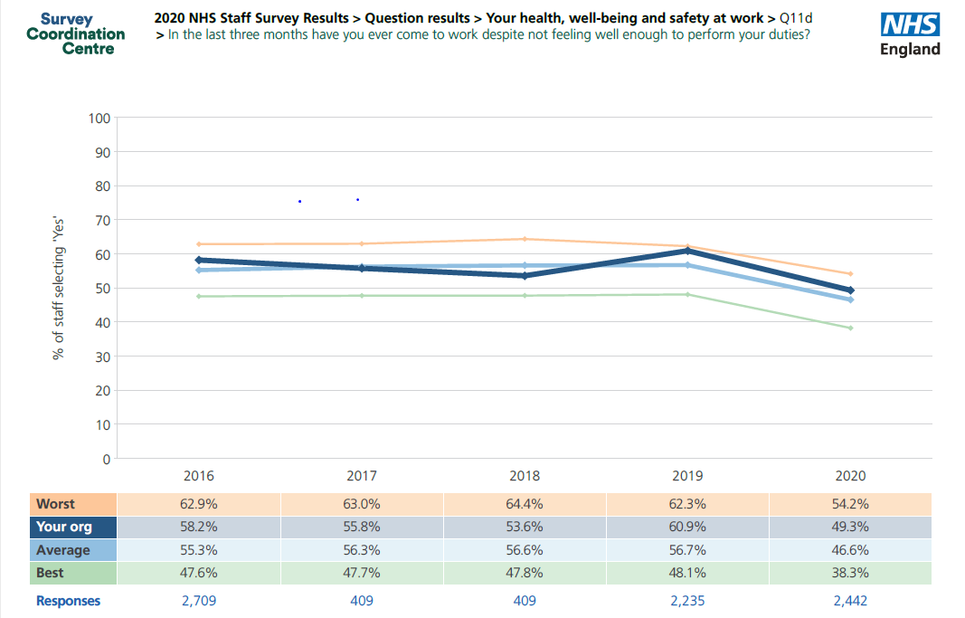
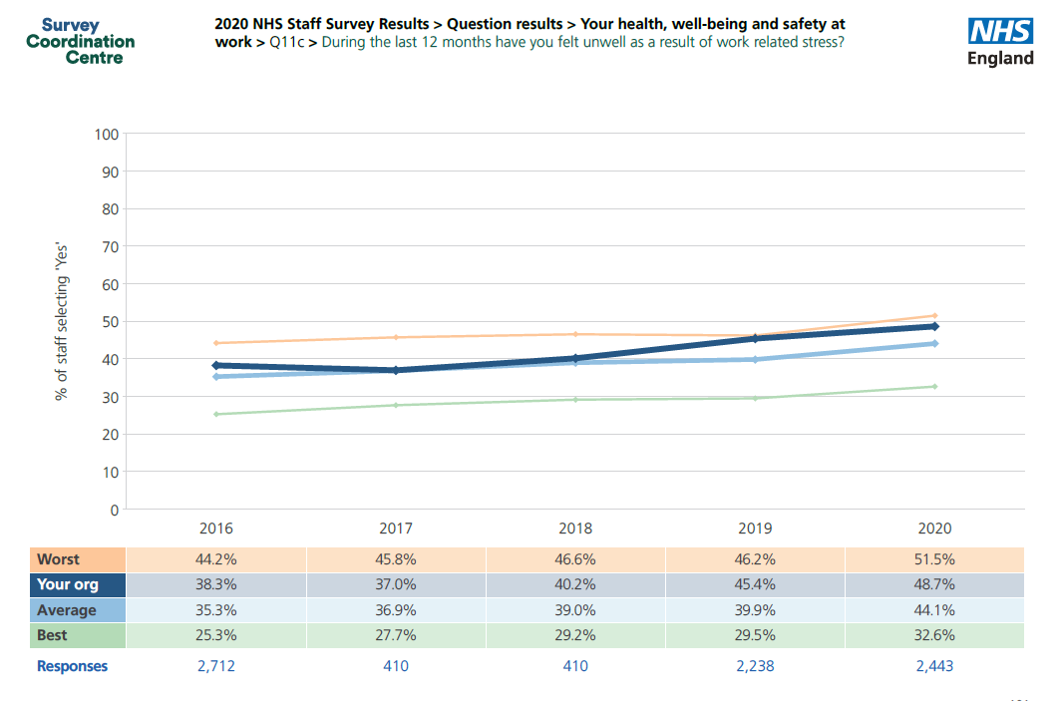
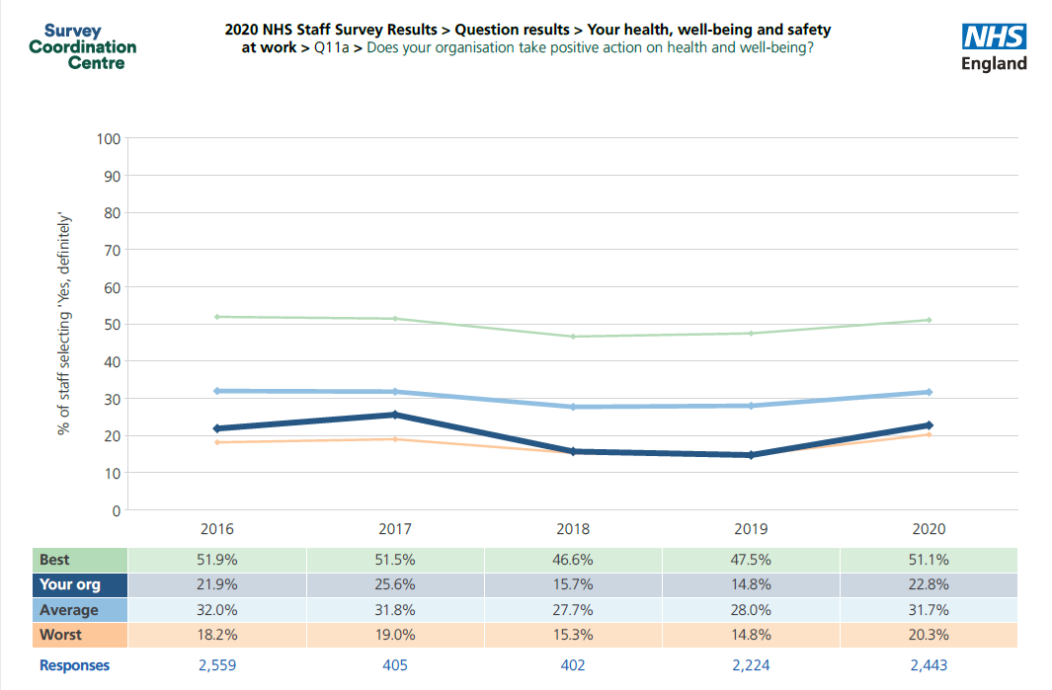
How does our workforce feel
Notes:
Must keep in perspective (only 25% of employees filled it in)
Click 1: Health and wellbeing
Click 2 Have you felt unwell as a result of work related stress
Click 3 Have you still come to work despite this (presenteeism)
ALL trend along the worst national lines despite improvements; shows just how bad we were 18 months/2 years ago
On top of this we have a workforce with only a minimal idea of what HF sciences are
The emphasis of this training is on raising awareness of the importance of non technical skills in the workplace, but also acknowledging that unless we invest in each other personally and professionally, we do not have an invigorated workforce and things are more likely to go wrong

Slide 10
Where did we start?

Slide 11
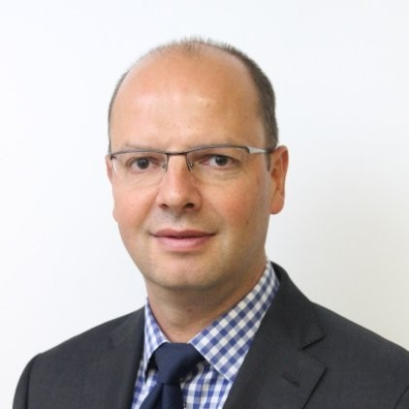
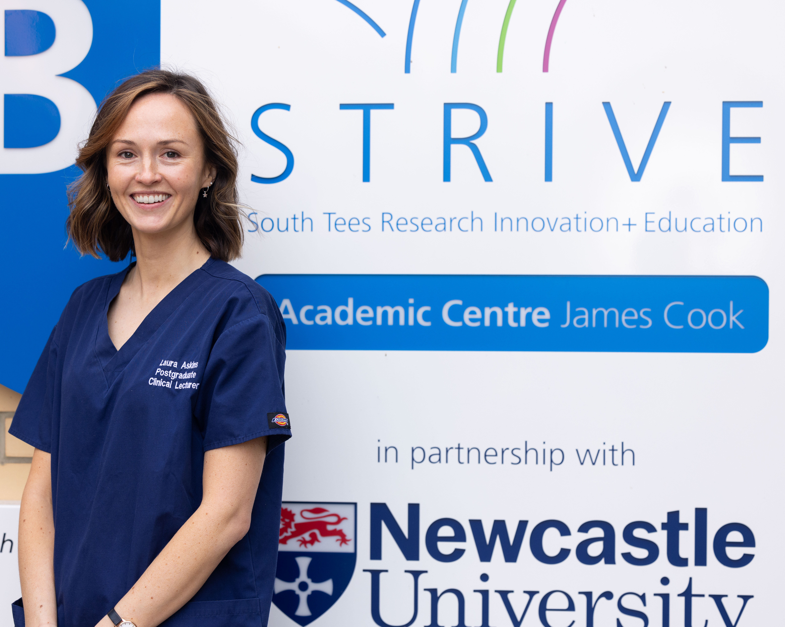
Faculty- difficult, initially targeted senior members of staff, spoke with SLT, CEO
Compiled a strategy
Recognised the link with leadership, OD and QI
Notes:
CWEE edit

Slide 12
Patient Safety Day
Patient Safety Day 2
Nov 2020
Compassionate Leadership
Learning from incidents – medication safety, ng tubes, iv oromorph
LocSSIPS
LISA – what safety training means in STRIVE
Civility Saves Lives
Patient Safety Day 3
July 2021
Civility and Human Factors
Culture – how we each make a difference
Patient Safety Day 1
Safer Surgery Audits 2019 and 2020
2 half day safety education sessions
Shared learning across all surgical specialities with theatres leading to changes within theatre setting
Facilitated learning around safety incidents and what would make us safer
Patient Safety Day 4
Oct 2021
Civility saves lives
Learning from excellence – where can we go with Safety 2 learning?
Learning from incidents – nasogatric tubes
Culture for learning
Simulation and human factors
Maternity safety
Notes:
Thign to focus on is that inline with LISA mission, ¾ safety days included facilitated sessions around HF and civilty

Slide 13
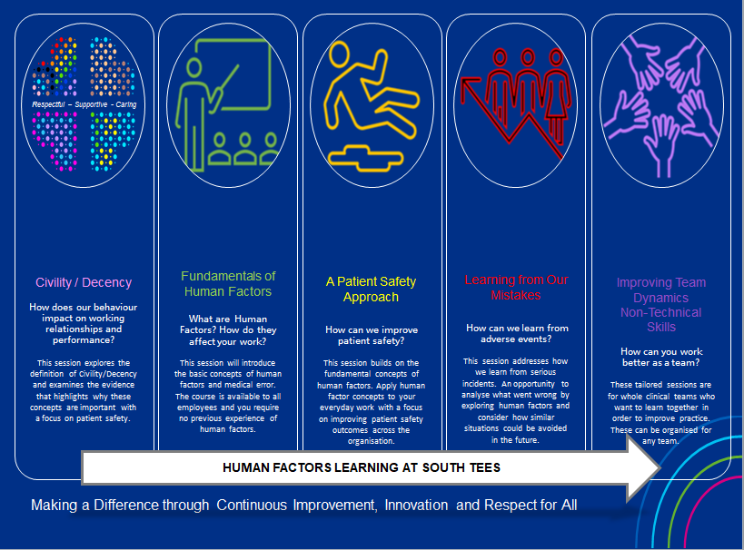

Slide 14
Educational resources
Videos
Targeted introductions
Induction
Online resources
Consulting

Slide 15
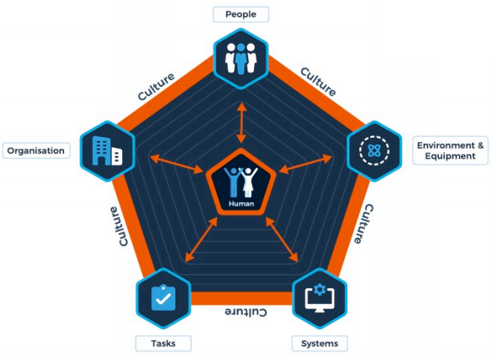
Risk arises when we interact with
People
Environment & Equipment
Systems
Tasks
Organisation
Notes:
One of the resources we developed was PESTO based on SIEPS

Slide 16
Notes:
How did the impact of COVID affected the way we work, report and respond to incidents.

Slide 18
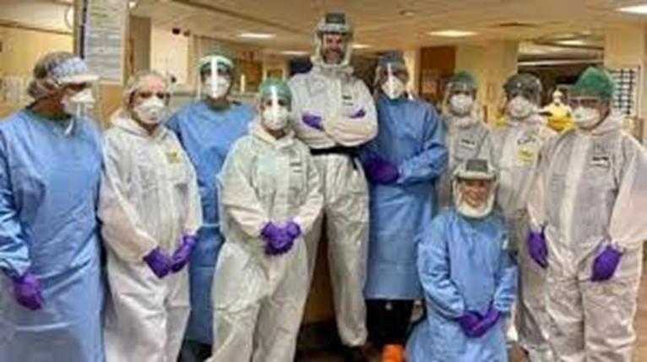

Slide 19
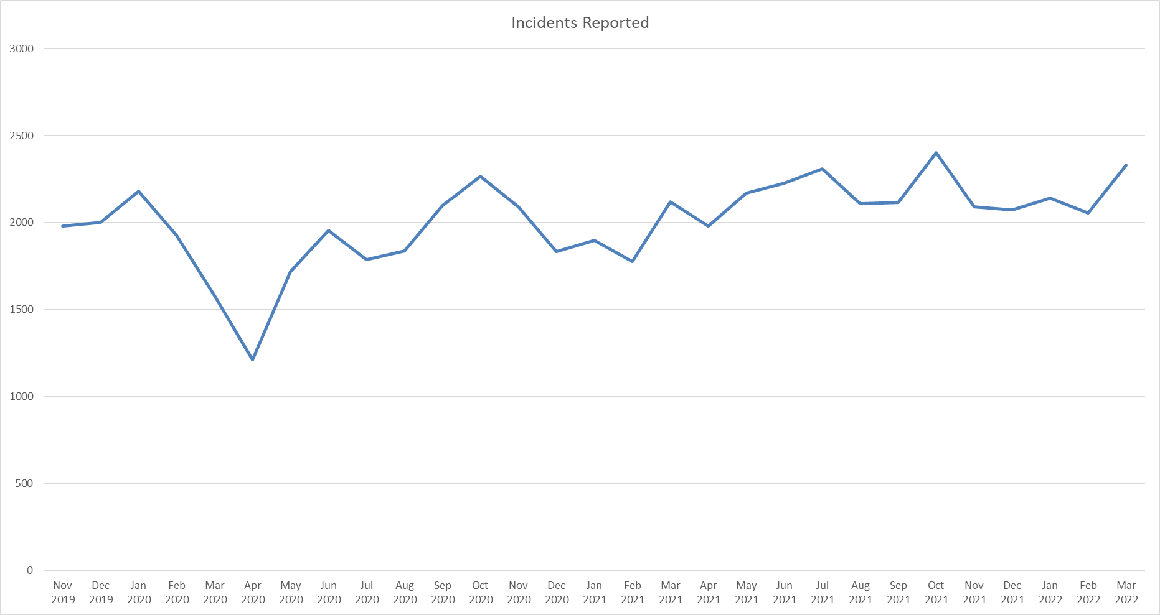
Incident levels during COVID

Slide 20
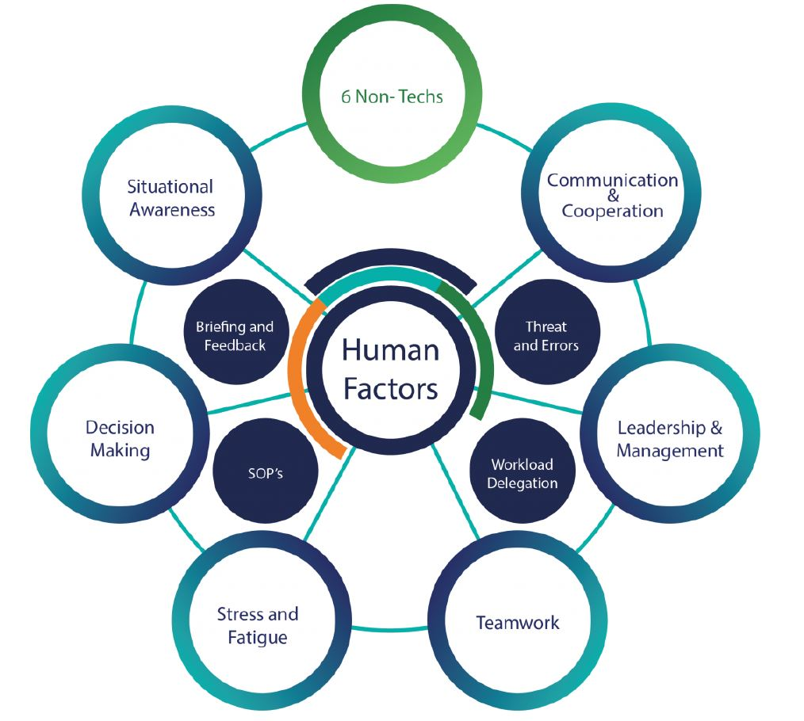

Slide 21
How did we deliver this?
45 minute session at induction
Online and Face to face teaching
Hospital based intelligence on teams that needed support
Worked with HR and safety team
Notes:
Hospital based intelligence: Freedom to speak up, DATIX and CQC. E.g. crit care had a surge of SI’s and never events so programe of learning and support was offered to them

Slide 22
A case study
human factors: the impact of Covid-19

Slide 24
Task: Consider the content of the video and apply PESTO to understand why it may have happened?
People
Environment & Equipment
Systems
Tasks
Organisation
Notes:
5 mins

Slide 25
What’s next?

Slide 26
Results
Staff survey has improved- 2 years in a row
Incidence reporting initially increased, then levelled out however levels of harm have decreased significantly
Feedback is unanimously positive, tangible increase of awareness across the trust

Slide 27
What's next?
Build on HF and civility with psychological safety and joy at work
Restorative Just Culture integration
Discovery interviews and stronger links with OD
Measuring the impact

