Slide 1
Pain management Prescribing: Case Studies
Inge Bateman
Lead Clinical Nurse Specialist Inpatient Pain Service
University Sussex Hospitals NHS Foundation Trust
Worthing, St. Richards & Southlands Hospitals

Slide 2
Session content
Definition of pain
Why do we treat pain?
Pain assessment
Case study presentation – management of pain is easy or is it?

Slide 3
Definition of pain
The International Association for the Study of Pain (IASP) now define pain as “An unpleasant sensory and emotional experience associated with, or resembling that associated with, actual or potential tissue damage,”
Six key notes and etymology:
Pain is always a personal experience that is influenced to varying degrees by biological, psychological, and social factors.
Pain and nociception are different phenomena. Pain cannot be inferred solely from activity in sensory neurons.
Through their life experiences, individuals learn the concept of pain.
A person’s report of an experience as pain should be respected.
Although pain usually serves an adaptive role, it may have adverse effects on function and social and psychological well-being.
Verbal description is only one of several behaviors to express pain; inability to communicate does not negate the possibility that a human or a nonhuman animal experiences pain.
IASP 2202020
Notes:
The inability to communicate verbally does not negate the possibility that an individual is experiencing pain and is in need of appropriate pain-relieving treatment.
Pain is always subjective. Each individual learns the application of the word through experiences related to injury in early life. Biologists recognize that those stimuli which cause pain are liable to damage tissue. Accordingly, pain is that experience we associate with actual or potential tissue damage. It is unquestionably a sensation in a part or parts of the body, but it is also always unpleasant and therefore also an emotional experience. Experiences which resemble pain but are not unpleasant, e.g., pricking, should not be called pain. Unpleasant abnormal experiences (dysaesthesias) may also be pain but are not necessarily so because, subjectively, they may not have the usual sensory qualities of pain.
Many people report pain in the absence of tissue damage or any likely pathophysiological cause; usually this happens for psychological reasons. There is usually no way to distinguish their experience from that due to tissue damage if we take the subjective report. If they regard their experience as pain and if they report it in the same ways as pain caused by tissue damage, it should be accepted as pain. This definition avoids tying pain to the stimulus. Activity induced in the nociceptor and nociceptive pathways by a noxious stimulus is not pain, which is always a psychological state, even though we may well appreciate that pain most often has a proximate physical cause.

Slide 4
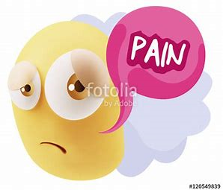
Why treat acute pain?
Humanitarian reasons
Reduce complications
Speed up Recovery
Promote early discharge
Quality of life improved

Slide 5
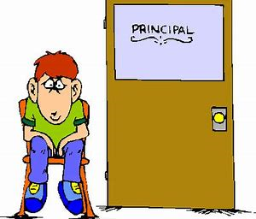
Consequences if pain not well controlled
General (reduced mobility – increased risk of thrombo embolic event)
Respiratory (Severe pain (especially upper abdomen & thoracic - may cause inability to cough ⇓ FRC ⇒ atelectasis, V/Q abnormalities, hypoxaemia)
Cardiovascular (activates sympathetic efferent nerves causing ⇑ HR, Inotropy, ⇑ BP which ⇑ myocardial O2 demand and ⇓ myocardial O2 supply so ⇑ risk of cardiac ischaemia)
GI (Sympathetic activity ⇒ ⇓ GI motility contributes to ileus)
Endocrine (may enhance pain and reduce healing)
Psychological (anxiety, fatigue, disorientation & depression)
Chronicity (Poorly controlled acute pain can lead to debilitating chronic pain syndromes)

Slide 6
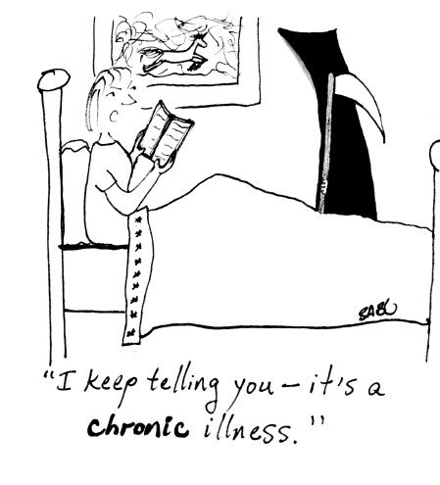
Chronicity
Poorly controlled acute pain can lead to debilitating chronic pain syndromes.
McCaffery and Pasero 1999

Slide 7
Chronic pain
Severe chronic pain is a considerable physical and psychological burden to the patient & society
Breivik H et al. EurJ Pain 2006;10:287–333
Becker N et al. Pain 1997;73:393–400
Gore M et al. J Pain 2006;7:892–900
McDermott AM et al. EurJ Pain 2006;10:127–135

Slide 8
Effective pain management
In order to treat pain effectively it is necessary to assess it.
Pain is most effectively assessed by means of self-reporting.
Stannard, C 1998.

Slide 9
Pain assessment
Frequency
Pain scoring tool
Location of pain
Description of pain
Has the pain changed
Side effects
Review drug chart
What analgesia has pt. used at home
Patient’s/Parent’s knowledge
Diagnosis/surgery
Always assess pain on activity

Slide 10
Assessment tools
SCALE | EXAMPLES
Verbal | Pain intensity: None, mild, moderate, severe, excruciating Global rating scale: Effectiveness of treatment 0-4 (poor - excellent) McGill pain questionnaire
Numerical | 0, 1, 2, 3,4 0,1,2,3,4,5,6,7,8,9,10
Visual | J L No pain-----------------------------Worst pain
Behaviour | Bolton PAINAD Critical Care Pain Observation Tool (CPOT) Non Verbal Pain Scale (NVPS) Strong Memorial Hospital USA

Slide 11
Pain scores
No pain = 0
Mild pain = 1
Moderate pain = 2
Severe pain = 3
Excruciating pain = 4

Slide 12
Bolton pain assessment tool
 | ABSENT 0 | MILD PAIN 1 | MODERATE PAIN 2 | SEVERE TO EXCRUCIATING PAIN 3
VOCALISATION | None | Occasional moan or groan | Low level speech with a negative or disapproving quality | Repeatedly crying out Loud moaning or crying
FACIAL EXPRESSION | Smiling Relaxed | Looking tense | Sad Frowning | Grimacing Looks frightened
CHANGE IN BODY LANGUAGE | None | Tense Fidgeting | Guarding part of the body | Withdrawn Rigid Fists clenched Knees pulled up
BEHAVIOURAL CHANGE | None | Increased confusion | Refusing to eat Alterations in usual behavioural pattern | Pulling or pushing away Striking out
PHYSIOLOGICAL CHANGE | Normal | Occasional laboured breath Increased heart rate | Hyperventilation Increased heart rate and blood pressure (use EWAS scoring) | Temperature, pulse or blood pressure outside normal limits (use EWAS scoring) Perspiring Flushing Pallor
PHYSICAL CHANGES | None | Skin tears | Pressure ulcers Arthritis | Post-surgery Trauma
BOLTON SCORE | 0-3 | 4-8 | 9-13 | 14-18
PAIN SCORE 0-4 | 0 | 1 | 2 | 3-4
ACTIONS | No action Monitor | Give Paracetamol if appropriate Monitor | If regular analgesia prescribed has it been given & offer PRN analgesia Repeat assessment in one hour | If regular analgesia prescribed has it been given & offer PRN analgesia Refer to ward team immediately

Slide 13
Aging population & increased fragility
Pain is common problem for elderly patients
50% of older people have chronic pain (in hospital this may be as high as 80%)
High prevalence of coexisting diseases
Poly pharmacy
Difference in absorption and clearance
Increased risk of adverse effects
Complex drug interactions
Increased risk of sedation, constipation & urinary retention
Sensory impairment
Social isolation

Slide 14
Assessment
Patient history
Pain assessment
Review current medication
Concordance
Impression/diagnosis
Make treatment decision
Review

Slide 15
Summery
Pain management is easy when treating acute pain in patients without
comorbidities (physical and mental health) and/or psychosocial issues who
takes no medicines, as long as we assess pain and apply multi modal approach
to the treatment of acute pain. Unfortunately, this is not the majority of our
case load, which does make management of pain more complex.
Patients still require opioids but we must make sure they are time limited and
use must be monitored and adjusted appropriately. This includes a
management plan on discharge and follow up by GP if needed.
If neuropathic agents have been started we should make recommendation for
its treatment length and follow up by GP.
Pain is never just about treating symptoms of physical pain.

Slide 16
Thank you

