Slide 1
The Revised (Sept 2021) National Competency Framework for All Practitioners
Angela Alexander, Professor Emerita, University of Reading
20 January 2022

Slide 2
My task (and yours)…
the revised framework: what has changed?
deadlines for implementation
what does good prescribing look like? Competency dimensions
how the national framework can be used in practice
levels of prescribing competence
the competency framework for designated prescribing practitioners
moving forward and current issues

Slide 3
So why did we need a revised framework?
Since the 2016 framework, there have been various changes which needed to be included in the update of the framework these include:
Legislation changes introducing paramedic prescribers in April 2018
Current prescribing topics such as remote prescribing, social prescribing, psychosocial assessment and eco-directed sustainable prescribing. Further key themes can be found in the table below
Publication of the RPS Competency Framework for Designated Prescribing Practitioners in December 2019

Slide 4
The revised framework: what has changed?
New key themes were added e.g. consultation setting, health literacy, social prescribing, sustainable prescribing, reducing waste, and supporting others prescribing (DPP)
Now 76 supporting statements – 12 new ones
New further information sections added to provide clarity and give examples
The professionalism section is now integrated into the framework with more focus on scope of practice

Slide 5
Endorsed by:
Association For Prescribers
British Dental Association
British Dietetic Association
British Pharmacological Society
Chartered Society of Physiotherapy
College of Optometrists
College of Paramedics
Joint Council For Cosmetic Practitioners
Pharmaceutical Society of Northern Ireland
Royal College Of Midwives
Royal College of Nursing
Royal College of Podiatry
Society of Radiographers
Royal College of General Practitioners
And not forgetting… Patients!

Slide 6
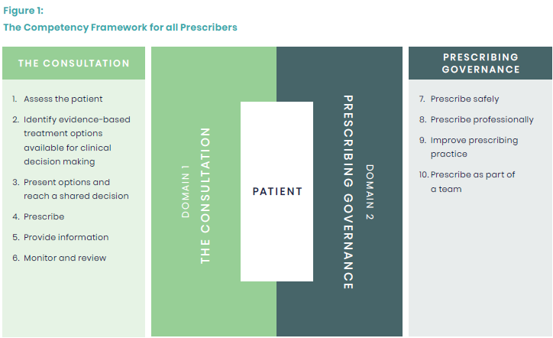
Structure of the framework
TWO DOMAINS
COMPETENCY AND SUPPORTING STATEMENTS
FURTHER INFORMATION
Notes:
Structure of the framework
2 domains
Domain 1 - the consultation: competencies that the prescriber should demonstrate during the consultation
Domain 2 - prescribing governance: competencies that the prescriber should demonstrate with respect to prescribing governance
10 competencies (updated 2 titles for clarity)
Now 75 supporting statements under the competencies - Each of these competencies contains several supporting statements related to the prescriber role which describe the activity or outcome that the prescriber should actively and routinely demonstrate.
Updated diagram design– figure 1 design updated, concept same e.g. patient at centre and domains surround it
Interactive links to glossary and further information sections
New Further information sections - The further information sections under each competency provide prescribers with information and examples (list not exhaustive or definitive), which provide clarity and meaning to the supporting statements. The recommendation for this competency framework is to use it alongside any relevant further information sections to support implementation into practice.
Please note:
The framework competencies and supporting statements are not in any particular order. The numbering is mainly to support mapping purposes and does not reflect the level of importance of the statement. They are not designed to be used as a script or in isolation as they may overlap with others.
Due to the generic nature of the framework, it may be that not every competency or supporting statement is relevant to your practice or setting. However, you should still be able to consider how you could demonstrate the supporting statement.

Slide 7
9. Improve prescribing practice
9.1 Improves by reflecting on own and others’ prescribing practice, and by acting upon feedback and discussion.
9.2 Acts upon inappropriate or unsafe prescribing practice using appropriate processes.ª
9.3 Understands and uses available tools^{b} to improve prescribing practice.
9.4 Takes responsibility for own learning and continuing professional development relevant to the prescribing role.^{c}
9.5 Makes use of networks for support and learning.
9.6 Encourages and supports others with their prescribing practice and continuing professional development.^{d}
9.7 Considers the impact of prescribing on sustainability, as well as methods of reducing the carbon footprint and environmental impact of any medicine.^{e}
Notes:
Light teal sections = new additions/changes.

Slide 8
9. Further information on the supporting statements
a Processes include whistleblowing, regulatory and professional guidance, and employer procedures.
b Tools include supervision, observation of practice and clinical assessment skills, portfolios, workplace competency-based assessments, questionnaires, prescribing data analysis, audits, case-based discussions, personal formularies and actively seeking regular patient and peer feedback
c By continuously reviewing, reflecting, identifying gaps, planning, acting, applying and evidencing learning or competencies.
d By considering mentoring, leadership and workforce development (for example, becoming a Designated Prescribing Practitioner).
e Methods of reducing a medicine’s carbon footprint and environmental impact include proper disposal of medicine/device/equipment waste, recycling schemes, avoiding overprescribing and waste through regular reviews, deprescribing, dose and device optimisation.
Notes:
Light teal sections = new additions/changes.

Slide 9
Deadlines for implementation
Publication date: September 2021
Effective date: by September 2022
Next review date: September 2026

Slide 10
What does good prescribing look like? (and who is best to ask?)

Slide 11
How the national framework can be used in practice
Attending networking/learning events
Audits
Case studies
Case-based discussions
CPD records
Looking at prescribing data analysis
Observation of practice and clinical assessment skills
Peer discussions & feedback
Personal formularies
Portfolios mapped to competencies
Questionnaires and patient feedback.
Reading – articles, SOPs, guidelines, processes in practice
Real life practice examples
Reflective accounts - identifying gaps
Setting SMART objectives
Supervision
Video recordings (consent)
Workplace competency-based assessments

Slide 12
Levels of prescribing competence
Where is your confidence in all of this too?
The framework should help to boost your confidence in prescribing too.

Slide 13
The competency framework for Designated Prescribing Practitioners
regulatory changes in 2018/19 enabled some non-medical prescribers (NMPs) to take on role of supervising and confirming competence during the period of learning in practice in addition to Designated Medical Practitioners (DMPs)
there was a need to ensure that those who took on the role were suitable
framework was developed with representatives from all prescribers, regulators, education providers and patients.

Slide 14
Structure of the DPP competence framework

Slide 15
Moving forward and current issues
Go to https://www.rpharms.com/resources/frameworks/prescribers-competency-framework and https://www.rpharms.com/resources/frameworks/designated-prescribing-practitioner-competency-framework
Identify your gaps in relation to your own practice and current and future issues e.g. different consultation models, extending scope of practice
Find the resources to help you to move your competence to level 3 and 4 for all the statements

Slide 16
Any
questions

Slide 17
Small group breakout sessions
From what you’ve heard so far what competencies do you need to develop for the future?
What resources do you have to support your learning for those competencies?

