Slide 1
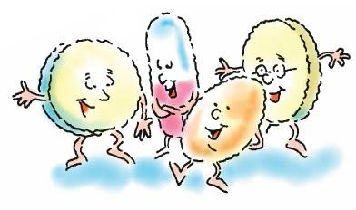
Understanding clinical pharmacology to improve prescribing competence
Aleksandra Howell
Senior Clinical Pharmacist
Oxford University Hospitals NHS Foundation Trust

Slide 2
Objectives
Clinical pharmacology - issues in prescribing practice
Understanding drug interactions
Physiological changes and drug interactions in older people
Case studies in practice

Slide 3
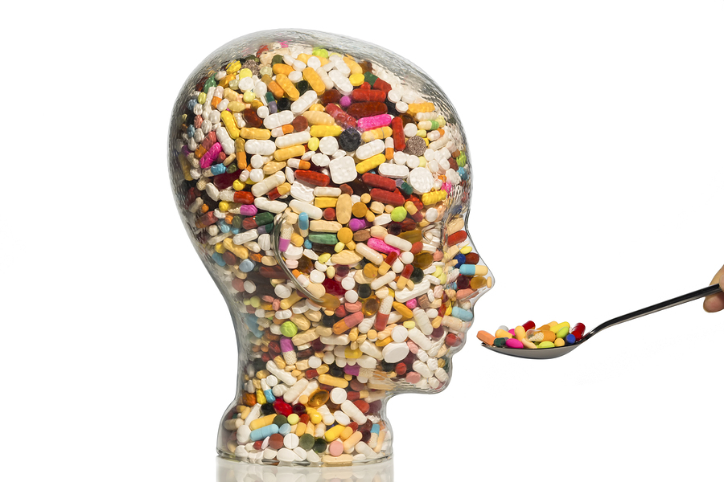
Clinical pharmacology
Arose in the 1960s
Relationship between drugs and humans
Focuses on the safe, effective and economic use of medicines¹
Clinical pharmacologists assess risk vs. benefit of medications and optimise treatments
What a drug does to the body
What the body does to a drug
How a drug treats a disease
Is it the best available choice
Notes:
1. https://www.bps.ac.uk/about/about-pharmacology/what-is-clinical-pharmacology

Slide 4
Clinical Pharmacology in prescribing practice
Polypharmacy – common consequence of aging
Multimorbidity = more medicines
50% of people >65 live with co-morbidities
Over 1 million of people in the UK take ≥ 8 meds/day
Risk of side effects and ADRs:
Patients on ≥10meds 3x more likely to be admitted to hospital
Inappropriate polypharmacy leads to:
↑ hospital admissions
In 2016, 66% of hospital bed-days were occupied by people >65 years of age
↑ mortality
physical and cognitive decline
Notes:
https://www.kingsfund.org.uk/projects/time-think-differently/trends-disease-and-disability-long-term-conditions-multi-morbidity
Patterson, S. M. et al.in Cochrane Database of Systematic Reviews(John Wiley & Sons, Ltd, 2014).
Johansson, T. et al.Impact of strategies to reduce polypharmacy on clinically relevant endpoints: a systematic review and meta-analysis. Br. J. Clin. Pharmacol.82,532–548 (2016)
https://www.ncbi.nlm.nih.gov/pmc/articles/PMC443443/

Slide 5
Clinical Pharmacology issues in prescribing practice
Relative ease of starting a medication and difficulty in stopping
Single disease guidelines
Little evidence in paediatric and frail/older population
Medications started for short course and never stopped
Medications started for new complaints and never reviewed
Prescribing cascades
Limited time/skill for structured medication reviews
Pharmacokinetics and pharmacodynamics variations in children and elderly
Unclear guidelines regarding deprescribing
Problematic stopping medications prescribed in secondary care
Unclear indications
Multimorbidities

Slide 6
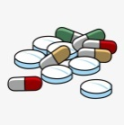
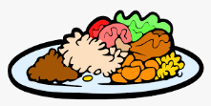
Drug interactions
When some medications taken together or with particular substances cause a different effect than they would individually
Pharmacodynamic
Drugs with similar or opposite effects and side-effects
Compete for receptors
Affect the same body system
Usually predictable (based on the mechanism of action)
Often can be extrapolated to the whole group
Pharmacokinetic
One drug affecting the journey of another through the body
Increasing/decreasing the amount of the other drug
Should not be extrapolated to the whole group of related drugs

Slide 7
Case study
86 year old man presenting with a fall, bg confusion
PMHx: acid reflux, moderate frailty, depression, HTN, AF, leg pain
Medications:
Sertraline 50mg OD
Amitriptyline 10mg ON
Apixaban 5mg BD
Lansoprazole 15mg OD while on Naproxen
Indapamide 2.5mg OD
Bisoprolol 5mg OD
Ramipril 10mg OD
Bloods: low Na+

Slide 8
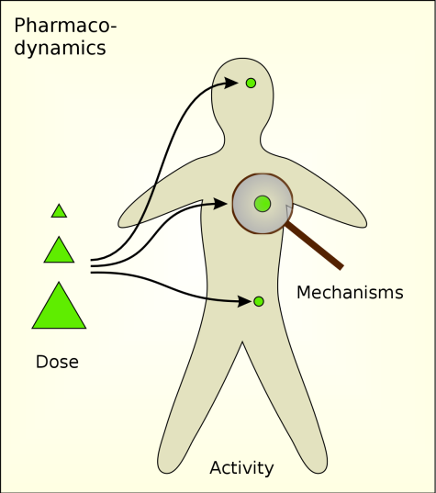
Drug interactions - examples
Pharmacodynamic – what a drug does to the body
NSAIDs with anticoagulants/antiplatelets - ↑ risk of bleeding/gastrotoxicity
Warfarin + vit. K ↓ anticoagulation (risk of clots) - food
Salbutamol + ß-blockers – respiratory depression
Z-drugs and Benzos ↑ sedative effect
CCB with ACEI - ↓ BP
BP meds + NSAIDs - ↑ BP
A/depressants + opioids - serotonin syndrome
Prednisolone + NSAIDs - gastrotoxicity

Slide 9
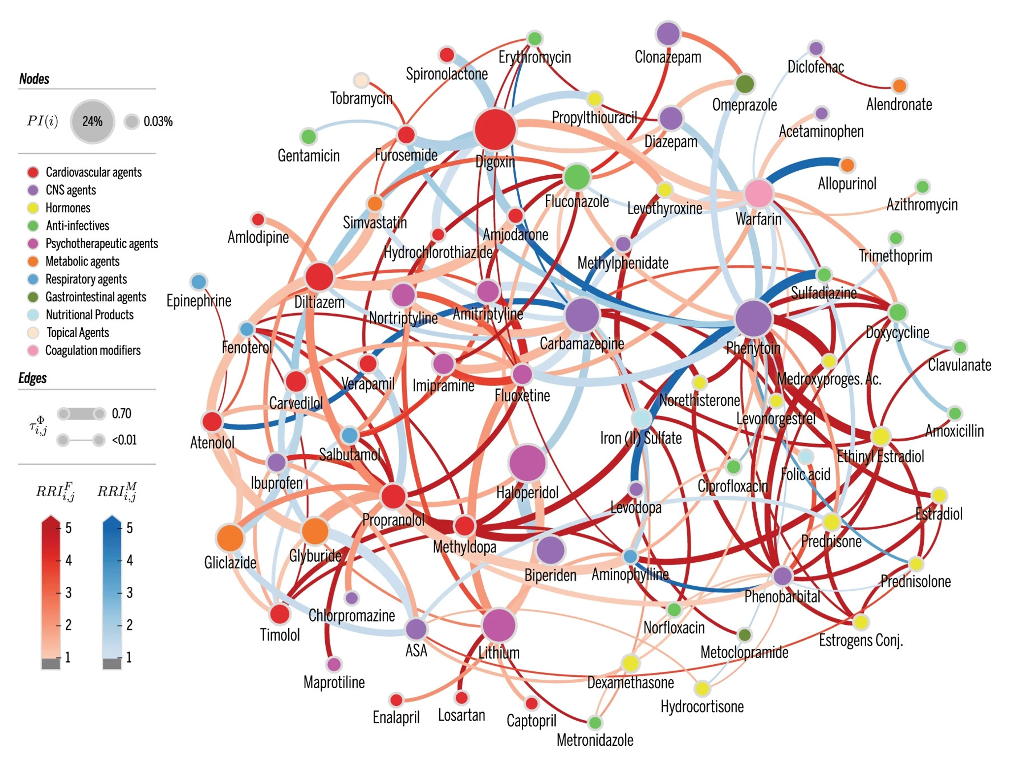
Notes:
https://www.nature.com/articles/s41746-019-0141-x – drug-drug interactions (blues higher risk for female, reds for male)

Slide 10
Case study
A 54 year old woman presented to ED with general weakness, severe muscle pain (myalgia), dark urine (reddish-brown)
PMHx: hypercholesterolaemia, recent URTI
No recent trauma, no alcohol/substance abuse
Medications:
Simvastatin 40mg
Recently completed course of Clarithromycin 500mg BD prescribed by Out of Hours Dr
OTC Fluconazole 150mg for vaginal thrush
Bloods: high creatinine, CK and ALT
Diagnosis: rhabdomyolysis and AKI

Slide 11
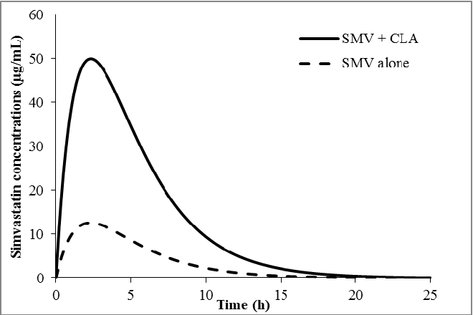
Notes:
Methaneethorn, Janthima et al. “A pharmacokinetic drug-drug interaction model of simvastatin and clarithromycin in humans.” 2014 36th Annual International Conference of the IEEE Engineering in Medicine and Biology Society (2014): 5703-5706.

Slide 12
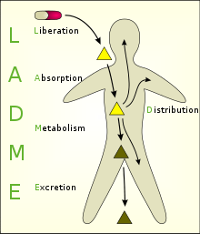
Pharmacokinetic – what the body does to a drug
PPI with Calcium
Iron/calcium with Levothyroxine
Cytochrome P450
Increased effect (Simvastatin + Clarithromycin, grapefruit juice + CCB)
Decreased effect (↑Carbamazepine ↔ ↓Fluconazole)
Notes:
The bisphosphonates, used in osteoporosis such as alendronate, have a very low bioavailability of only 0.5% to 2%. Calcium ions in mineral water or milk sharply reduce this still further.

Slide 13
Physiological changes and drug interactions in older people
ABSORPTION | DISTRIBUTION
↑ gastric pH Delayed gastric emptying ↓intestinal mobility | Body water/fat content changes Total body water ↓ Total body fat ↑ by ~50% ↓ serum albumin
METABOLISM | ELIMINATION
↓ liver mass ↓ hepatic blood flow | ↓ kidney mass ↓ renal function
Orthostatic responses and postural control ↑risk of postural hypotension (due to ↓ reflex of tachycardia)
Cognitive function ↑risk of medication-related confusion (↓ cholinergic transmission)
Visceral muscle function ↑risk of constipation Bladder instability (incontinence and urinary retention)
PHARMACODYNAMICS
Notes:
A – appropriate environment for A (acidic for Calcium)
D – water-soluble (Digoxin) has lower D, so higher peaks and shorter half-loves; fat/water ratio – risk of sarcopenia
M – choose drugs less reliant on hepatic M (Lorazepam rather than Diazepam)
E – adjust doses or/and intervals for renal function (DOACs, Digoxin)

Slide 14
When is a medication inappropriate?
Unnecessary
(no indication or benefit)
Unwanted
(by the patient)
Unjustifiable
(risks versus benefits)

Slide 15
“WHO estimates that more than half of all medicines are prescribed, dispensed or sold inappropriately, and that half of all patients fail to take them correctly.“
Notes:
http://www.polypharmacy.scot.nhs.uk/polypharmacy-guidance-medicines-review/for-healthcare-professionals/principles/what-is-polypharmacy-and-why-is-it-important/
https://www.who.int/activities/promoting-rational-use-of-medicines

Slide 16
10 principles of good prescribing
Be clear about the reasons for prescribing
Take into account the patient’s medication history before prescribing
Take into account other factors that might alter the benefits and risks of treatment
Take into account the patient’s ideas, concerns, and expectations
Select effective, safe, and cost effective medicines individualised for the patient
Adhere to national guidelines and local formularies where appropriate
Write unambiguous legal prescriptions using the correct documentation
Monitor the beneficial and adverse effects of medicines
Communicate and document prescribing decisions and the reasons for them
Prescribe within the limitations of your knowledge, skills and experience
By British Pharmacological Society
Notes:
https://www.bps.ac.uk/education-engagement/teaching-pharmacology/ten-principles-of-good-prescribing

Slide 17
Any questions?

